Slide 1
Unit-II
Software Project Management

Slide 2
Syllabus
Project Planning- Sliding window planning, The SPMP Document of Project Planning
Metrics for Project size Estimation- Lines of code- Function Point
COCOMO- Basic- Intermediate- Complete
Scheduling - work breakdown structure- Critical path method- PERT charts.

Slide 3
Project Planning
Once a project has been found to be feasible, software project managers undertake project planning.
Project planning is undertaken and completed before any development activity starts.
During project planning, the project manager performs the following activities.
Estimation: The following project attributes are estimated.
• Cost: How much is it going to cost to develop the software product?
• Duration: How long is it going to take to develop the product?
• Effort: How much effort would be necessary to develop the product?

Slide 4
Project Planning
Scheduling: After all the necessary project parameters have been estimated, the schedules for manpower and other resources are developed.
Staffing: Staff organisation and staffing plans are made.
Risk management : This includes risk identification, analysis.
Miscellaneous plans: This includes other plans such as quality assurance plan and configuration management plan, etc.
Size estimation is the first activity that a project manager undertakes during project planning.

Slide 5
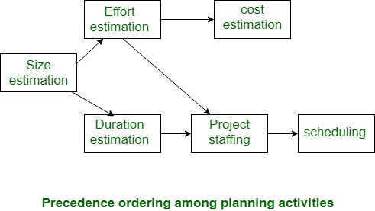

Slide 6
Project Planning
Size is the most fundamental parameter based on which all other estimations and project plans are made.
Based on the size estimation, the effort required to complete a project and the duration over which the development is to be carried out are estimated.
Based on the effort estimation, the cost of the project is computed.
Other planning activities such as staffing, scheduling etc. are undertaken based on the effort and duration estimates made.

Slide 7
Sliding Window Planning
It is usually very difficult to make accurate plans for large projects at project initiation.
In order to overcome this problem, sometimes project managers undertake project planning over several stages.
Planning a project over a number of stages protects managers from making big commitments at the start of the project.
This technique of staggered planning is known as sliding window planning.
In the sliding window planning technique, starting with an initial plan, the project is planned more accurately over a number of stages.

Slide 8
The SPMP Document of Project Planning
Once project planning is complete, project managers document their plans in a software project management plan (SPMP) document.
Organisation of the software project management plan (SPMP) document
1. Introduction
(a) Objectives
(b) Major Functions
(c) Performance Issues
(d) Management and Technical Constraints
2. Project estimates
(a) Historical Data Used
(b) Estimation Techniques Used
(c) Effort, Resource, Cost, and Project Duration Estimates

Slide 9
The SPMP Document of Project Planning
3. Schedule
(a) Work Breakdown Structure
(b) Task Network Representation
(c) Gantt Chart Representation
(d) PERT Chart Representation
4. Project resources
People
(b) Hardware and Software
(c) Special Resources
5. Staff organisation
(a) Team Structure
(b) Management Reporting

Slide 10
The SPMP Document of Project Planning
6. Risk management plan
Risk Analysis
(b) Risk Identification
(c) Risk Estimation
(d) Risk Abatement Procedures
7. Project tracking and control plan
Metrics to be tracked
(b) Tracking plan
(c) Control plan

Slide 11
The SPMP Document of Project Planning
8. Miscellaneous plans
Process Tailoring
(b) Quality Assurance Plan
(c) Configuration Management Plan
(d) Validation and Verification
(e) System Testing Plan
(f ) Delivery, Installation, and Maintenance Plan

Slide 12
METRICS FOR PROJECT SIZE ESTIMATION
The size of a project is obviously not the number of bytes that the source code occupies, neither is it the size of the executable code.
The project size is a measure of the problem complexity in terms of the effort and time required to develop the product.
Currently, two metrics are popularly being used to measure size
Lines of code (LOC) and
function point (FP)
Each of these metrics has its own advantages and disadvantages.

Slide 13
Lines of code (LOC)
LOC is possibly the simplest among all metrics available to measure project size.
This metric measures the size of a project by counting the number of source instructions in the developed program.
While counting the number of source instructions, comment lines, and header lines are ignored.
Determining the LOC count at the end of a project is very simple. However , accurate estimation of LOC count at the beginning of a project is a very difficult task.

Slide 14
Lines of code (LOC)
LOC metric has several shortcomings when used to measure problem size
LOC is a measure of coding activity alone.
LOC count depends on the choice of specific instructions.
LOC measure correlates poorly with the quality and efficiency of the code.
LOC metric penalises use of higher-level programming languages and code reuse.
LOC metric measures the lexical complexity of a program and does not address the more important issues of logical and structural complexities.
It is very difficult to accurately estimate LOC of the final program from problem specification.

Slide 15
Lines of code (LOC)
From the project managers perspective, the biggest shortcoming of the LOC metric is that the LOC count is very difficult to estimate during project planning stage, and can only be accurately computed after the software development is complete.

Slide 16
Function Point (FP) Metric
Function point metric was proposed by Albrecht in 1983.
A function point is a "unit of measurement" to express the amount of business functionality of a product.
Function points are used to compute a functional
size measurement (FSM) of software.

Slide 17
Function Point (FP) Metric
The cost (in dollars or hours) of a single unit is
calculated from past projects
The size of the project is estimated on the basis of
functions or services requested by the customer.
It does not deal with the size of the LOC.
It relies on the product features.

Slide 18
Function Point (FP) Metric
Function point (FP) metric computation
The size of a software product (in units of function points or FPs) is computed using different characteristics of the product identified in its requirements specification. It is computed using the following three steps:
Step 1: Compute the unadjusted function point (UFP)
Step 2: Refine UFP
Step 3: Compute FP by further refining UFP

Slide 19
Function Point (FP) Metric
Step 1: UFP computation
The unadjusted function points (UFP) is computed as the weighted sum of five characteristics of a product

Slide 20
Function Point (FP) Metric
Number of inputs: Each data item input by the user is counted.
Number of outputs: The outputs considered include reports printed, screen outputs, error messages produced, etc.
Number of inquiries: An inquiry is a user command (without any data input) and only requires some actions to be performed by the system.
Number of files: The files are logical files.
Number of interfaces: The interfaces denote the different mechanisms that are used to exchange information with other systems. Examples of such interfaces are data files on tapes, disks, communication links with other systems, etc.

Slide 21
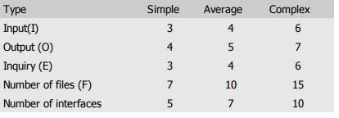
Function Point (FP) Metric
Step 2: Refine parameters
UFP computed at the end of step 1 is a gross indicator of the problem size. This UFP needs to be refined.
For example, some input values may be extremely complex, some very simple, etc.
The complexity of each parameter is graded into three broad categories—simple, average, or complex.
The weights for the different parameters are determined based on the numerical values .

Slide 22
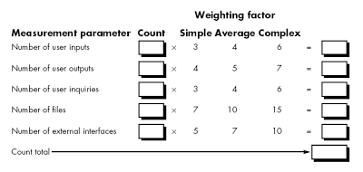

Slide 23
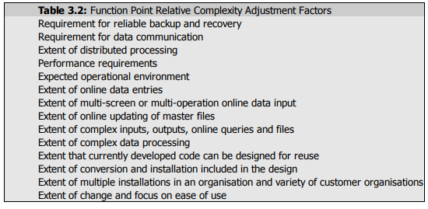
Function Point (FP) Metric
Step 3: Refine UFP based on complexity of the overall project
In the final step, several factors that can impact the overall project size are considered to refine the UFP computed in step 2.
Albrecht identified 14 parameters that can influence the development effort.

Slide 24
Function Point (FP) Metric
Each of these 14 parameters is assigned a value from 0 (not present or no influence) to 6 (strong influence).
0 ( not present)
1 (incidental)
2 (moderate)
3 (average)
4 (significant)
5 (highly essential)
6 (strong influence)

Slide 25
Function Point (FP) Metric
The resulting numbers are summed, yielding the total degree of influence (DI).
A Technical Complexity Factor (TCF) for the project is computed and the TCF is multiplied with UFP to yield FP.
The TCF expresses the overall impact of the corresponding project parameters on the development effort.
TCF is computed as (0.65+0.01*DI).
As DI can vary from 0 to 84, TCF can vary from 0.65 to 1.49.
Finally, FP is given as the product of UFP and TCF.
FP=UFP*TCF

Slide 26
Compute the FP value for the grade calculation of students. Assume that it is an average complexity size project. The information domain values are as follows:
Number of user inputs = 13
Number of user outputs = 4
Number of user inquiries = 2
Number of files = 5
Number of external interfaces = 2
The total value of complexity adjustment attribute is 13.

Slide 27
Domain Characteristics | Count |  | Weighting factor |  |  | Count
 |  |  | Simple | Average | Complex
No of user Input | 13 | * | 3 | 4 | 6 | 52
No of user output | 4 | * | 4 | 5 | 7 | 20
No of user enquiries | 2 | * | 3 | 4 | 6 | 8
No of files | 5 | * | 7 | 10 | 15 | 50
No of external interfaces | 2 | * | 5 | 7 | 10 | 14
UFP value : |  |  |  |  |  | 144

Slide 28
Compute TCF , which has the CAA value = 13
DI=13*3=39
TCF=0.65+0.01*(DI) = 0.65+0.01*39 = 1.04
compute FP = UFP * TCF
=144*1.04
= 149.76

Slide 29
Example: Compute the FP value for an average complexity size project. The information domain values are as follows:
Number of user inputs = 50
Number of user outputs = 40
Number of user inquiries = 35
Number of files = 6
Number of external interfaces = 4
The total value of complexity adjustment attribute is 14.

Slide 30
Domain Characteristics | Count |  | Weighting factor |  |  | Count
 |  |  | Simple | Average | Complex
No of user Input | 50 | * | 3 | 4 | 6 | 200
No of user output | 40 | * | 4 | 5 | 7 | 200
No of user enquiries | 35 | * | 3 | 4 | 6 | 140
No of files | 6 | * | 7 | 10 | 15 | 60
No of external interfaces | 4 | * | 5 | 7 | 10 | 28
UFP value : |  |  |  |  |  | 628

Slide 31
Compute TCF , which has the CAA value = 14
DI=14*3=42
TCF=0.65+0.01*(DI) = 0.65+0.01*42 = 1.07
compute FP = UFP * TCF
=628*1.07
= 671.96

Slide 32
Advantages
Accurately estimates the project cost, project duration, staffing size.
Disadvantages
This method is only suitable for Business systems.
Many aspects of this method are not validated.
The functional point has no significant meaning, it’s just a numerical value.

Slide 33
COCOMO
COnstructive COst estimation MOdel (COCOMO) was proposed by Boehm [1981].
It is a regression model based on LOC, i.e number of Lines of Code.
Software cost estimation should be done through 3 stages:
Basic COCOMO
Intermediate COCOMO and
Complete (detailed)COCOMO.
It is multivariable size estimation model

Slide 34
Basic COCOMO Model
Boehm postulated that any software development project can be classified into one of the following three categories based on the development complexity—
Organic
semidetached
embedded.
Based on the category of a software development project, he gave different sets of formulas to estimate the effort and duration from the size estimate.

Slide 35
Basic COCOMO Model
Three basic classes of software development projects.
Organic: We can classify a development project to be of organic type, if the project deals with developing a well-understood application program, the size of the development team is reasonably small, and the team members are experienced in developing similar types of projects.
Semidetached: A development project can be classify to be of semidetached type, if the development team consists of a mixture of experienced and inexperienced staff. Team members may have limited experience on related systems but may be unfamiliar with some aspects of the system being developed. Embedded: A development project is considered to be of embedded type, if the software being developed is strongly coupled to hardware, or if stringent regulations on the operational procedures exist. Team members may have limited experience on related systems but may be unfamiliar with some aspects of the system being developed.

Slide 36
Basic COCOMO Model
For the three product categories, Boehm provides different sets of expressions to predict the effort (in units of person-months) and development time from the size estimation given in kilo lines of source code (KLSC) or (KLOC).
Person-month (PM) is a popular unit for effort measurement.
Person-month (PM) is considered to be an appropriate unit for measuring effort, because developers are typically assigned to a project for a certain number of months.

Slide 37
Basic COCOMO Model
The basic COCOMO estimation model is given by following expressions
Effort = a1 × (KLOC)^{a2} PM
Tdev = b1 × (Effort)^{b2} months
where,KLOC is the estimated size of the software product expressed in Kilo Lines Of Code.
a1, a2, b1, b2 are constants for each category of software product.
Effort is the total effort required to develop the software product, expressed in person- months (PMs).
Tdev is the estimated time to develop the software, expressed in months.

Slide 38
Basic COCOMO Model
 | a1 | a2 | b1 | b2
Organic | 2.4 | 1.05 | 2.5 | 0.38
Semi-detached | 3.0 | 1.12 | 2.5 | 0.35
Embedded | 3.6 | 1.20 | 2.5 | 0.32

Slide 39
Basic COCOMO Model
Estimation of effort:
Organic : Effort = 2.4(KLOC)^{1.05} PM
Semi-detached : Effort = 3.0(KLOC)^{1.12} PM
Embedded : Effort = 3.6(KLOC)^{1.20} PM

Slide 40
Basic COCOMO Model
Estimation of development time
Organic : Tdev = 2.5(Effort)^{0.38} Months
Semi-detached : Tdev = 2.5(Effort)^{0.35} Months
Embedded : Tdev = 2.5(Effort)^{0.32} Months

Slide 41
Problem
Assume that a system for simple student registration in a course is planned to be developed and its estimated size is approximately 10,000 LOC. The organization proposed to pay 25,000 per month to s/w engineers. Compute the development effort, development time, and the total cost for product development.

Slide 42
The project can be considered an organic project.
From basic COCOMO Model
Development effort (E)=2.4*(10)^{1.05}=26.93PM
Development effort (T)=2.5*(26.93)^{0.38}=8.74months
Total product development cost=
Development time *salaries of engineers
=8.74*25000
=2,18500

Slide 43
Problem
Assume that the size of an organic type software product has been estimated to be 32,000 lines of source code. Assume that the average salary of software engineers be Rs. 15,000/- per month. Determine the effort required to develop the software product and the nominal development time.

Slide 44
Intermediate COCOMO
The basic COCOMO model determines the effort and time based on the project size.
There are certain other factors that can affect the project size and hence the development effort and time.
Therefore, Boehm has introduced 15 cost drivers, considering the various aspects of product development environment.
These cost drivers are used to adjust the project complexity and are termed as effort adjustment factors (EAF).
These cost drivers are classified as Computer Attributes, Product Attributes, Project Attributes, and Personnel Attributes.
The Intermediate COCOMO model computes software development effort as a function of the program size and a set of cost drivers. The cost drivers and their ratings are shown in Table

Slide 45
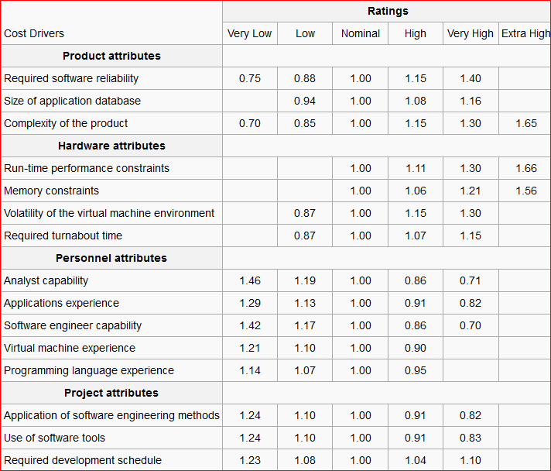

Slide 46
The intermediate COCOMO model estimates the initial effort using the basic COCOMO model
Then the EAF is calculated as the product of 15 cost drivers.
Total effort is determined by multiplying the initial effort with the total value of EAF.
The computation steps are summarized below

Slide 47
Intermediate COCOMO Model
 | a1 | a2 | b1 | b2
Organic | 3.2 | 1.05 | 2.5 | 0.38
Semi-detached | 3.0 | 1.12 | 2.5 | 0.35
Embedded | 3.6 | 1.20 | 2.5 | 0.32

Slide 48
Intermediate COCOMO Model
Development effort (E):
Initial effort (E_{i}) = a1 × (KLOC) ^{a2}
Effort Adjustment Factor (EAF) = EAF1× EAF2×... × EAF_{n}
Total development effort (E) = E_{i}× EAF
Development time (T) = b1 × (E)^{b2}

Slide 49
PROBLEM:
Suppose a lib management system (LMS) is to be designed for an academic institution. From the project proposal, the following five major components are identified:
online data entry - 1.0 kloc
data update - 2.0 kloc
file input and output - 1.5 kloc
library reports - 2.0 kloc
query and search - 0.5 kloc

Slide 50
The database size and application experience are very important in this project. The use of the software tool and the main storage is highly considerable. The virtual machine experience and its volatility can be kept low. All other cost drivers have nominal requirements. Use the COCOMO model to estimate the development effort and the development time

Slide 51
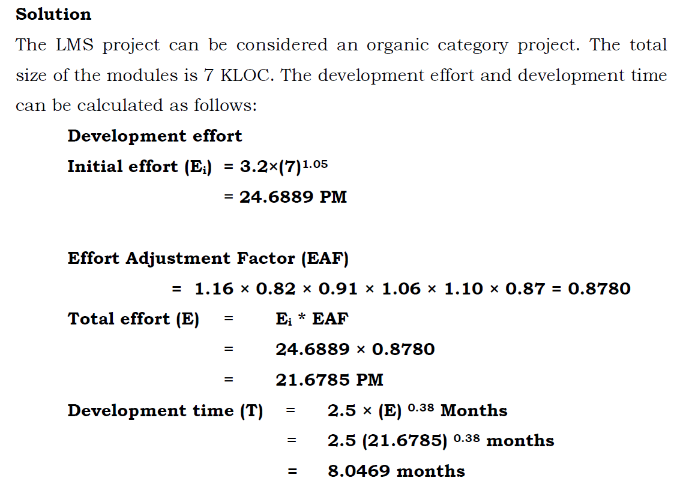

Slide 52
Detailed COCOMO Model
The detailed COCOMO inherits all the features of the intermediate COCOMO model for the overall estimation of the project cost.
For detailed planning and scheduling, it is necessary to assess the impact of the cost drivers in a phased manner.
The detailed COCOMO model uses different cost drivers for each phase of the project. Phase-wise effort multipliers provide better estimates than the intermediate model.
The detailed COCOMO model defines five life cycle phases for effort distribution:
Plan and Requirement,
System Design,
Detailed Design,
Code and Unit Test, and
Integration Test.

Slide 53
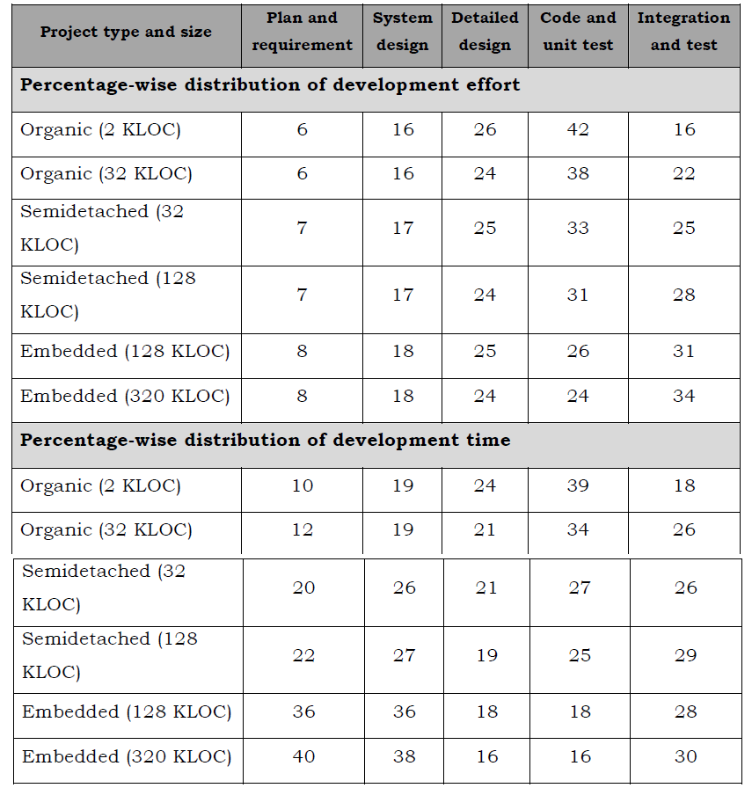
Table 3.2: Phase-wise Effort Distribution for Detailed COCOMO
Model

Slide 54
The percentage of effort in a phase varies with the project size and the project nature. The phase-wise percentage of effort distribution for some KLOC values is shown in table 3.2.
In the detailed COCOMO model, effort is calculated as a function of size (in terms of KLOC) and the value of a set of cost drivers according to each phase of the software life cycle.

Slide 55
Example
Compute the phase-wise development effort for the problem discussed in
Example 3.2 above
Solution
There are five components in the organic project discussed in Example above:
Online Data Entry,
Data Update,
File Input and Output,
Library Reports,
Query and Search.
The estimated effort (E) is 21.6785 PM. The total size is 7 KLOC, which is between 2 KLOC and 32 KLOC. Thus, the actual percentage of effort can be calculated as follows:
H.KLOC DV + [(L.KLOC DV - H.KLOC DV) / (H.KLOC - L.KLOC)]*Size

Slide 56
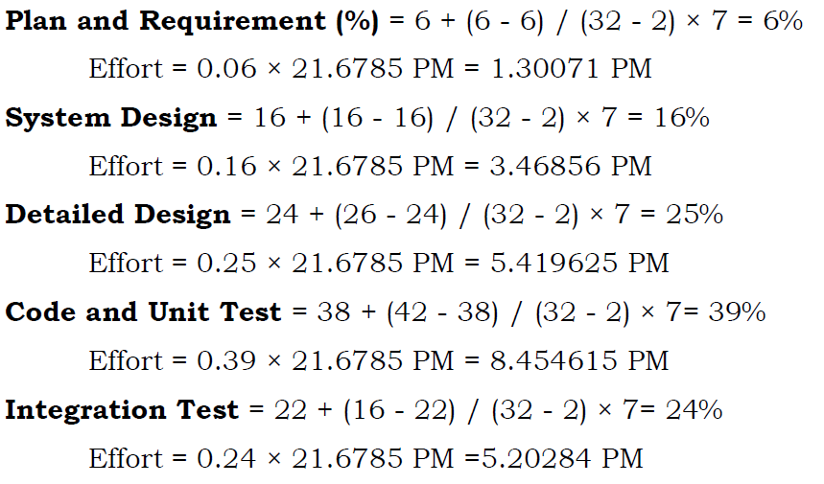

Slide 57
Scheduling
Scheduling the project tasks is an important project planning activity.
To schedule the project activities, a software project manager needs to do the following:
Identify all the major activities that need to be carried out to complete the project.
2. Break down each activity into tasks.
3. Determine the dependency among different tasks.
4. Establish the estimates for the time durations necessary to complete the tasks.
5. Represent the information in the form of an activity network.
6. Determine task starting and ending dates from the information represented in the activity network.
7. Determine the critical path. A critical path is a chain of tasks that determines the duration of the project.
8. Allocate resources to tasks.

Slide 58
Work Breakdown Structure
Work breakdown structure (WBS) is used to recursively decompose a given set of activities into smaller activities.
Once project activities have been decomposed into a set of tasks using WBS, the time frame when each activity is to be performed is to be determined.
The end of each important activity is called a milestone.
WBS provides a notation for representing the activities, sub-activities, and tasks needed to be carried out in order to solve a problem.
Each of the activity is represented using a rectangle.
The root of the tree is labelled by the project name.
Each node of the tree is broken down into smaller activities that are made the children of the node.
The project is decomposed until a leaf-level subactivity (a task) requires approximately two weeks to develop.

Slide 59
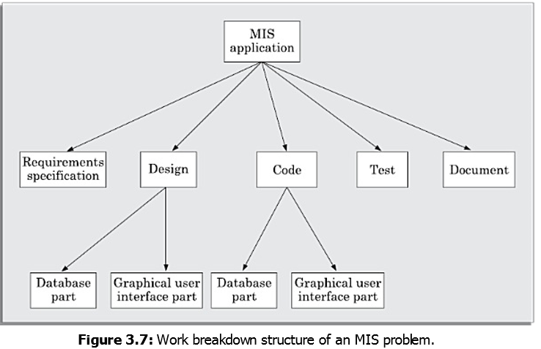
WBS of Management Information System Software

Slide 60
Activity Network
An activity network shows the different activities making up a project, their estimated durations, and their interdependencies.
Activity on Node (AoN): In this representation, each activity is represented by a rectangular (some use circular) node and the duration of the activity is shown alongside each task in the node.
Activity on Edge (AoE): In this representation tasks are associated with the edges. The edges are also annotated with the task duration.
Activity networks were originally represented using activity on edge (AoE) representation. However, activity on node (AoN) has become popular since this representation is easier to understand.

Slide 61
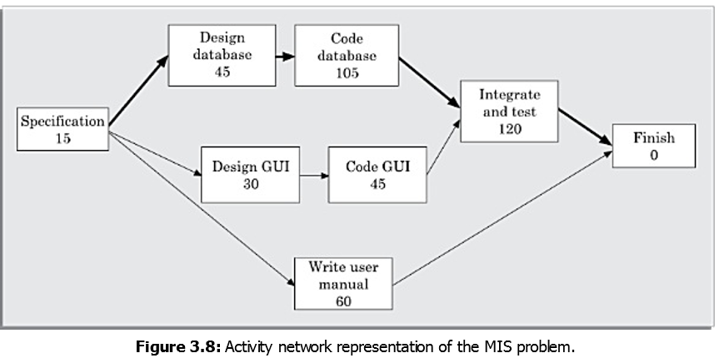
Activity Network

Slide 62
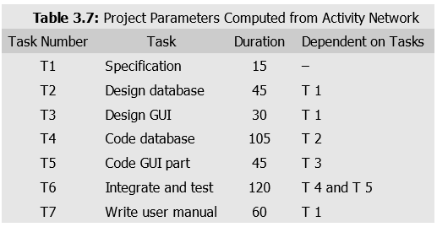
Activity Network

Slide 63
Critical Path Method (CPM)
A critical path consists of a set of dependent tasks that need to be performed in a sequence and which together take the longest time to complete.
A path from the start node to the finish node containing only critical tasks is called a critical path.
CPM is an algorithmic approach to determine the critical paths and slack times.
Critical path is the path through the network in which the slack time is zero.
The following quantities are used to calculate the critical path
Minimum time (MT): It is the minimum time required to complete the project. It is computed by determining the maximum of all paths from start to finish.
ES and EF are calculated in the forward pass through the network diagram.
Earliest start (ES): It is the time of a task is the maximum of all paths from the start to this task.
ES=EF value of predecessor activity

Slide 64
Critical Path Method (CPM)
Earliest finish time (EF): The EF for a task is the sum of the earliest start time of the task and the duration of the task.
EF= ES+activity duration
LS and LF are calculated in the backward pass through the network diagram.
Latest start time (LST): It is the difference between MT and the maximum of all paths from this task to the finish.
LS= LF-activity duration
Latest finish (LF): LF indicates the latest time by which a task can finish without affecting the final completion time of the project. A task completing beyond its LF would cause project delay. LF of a task can be obtained by subtracting maximum of all paths from this task to finish from MT.
LF= LS value of Immediate successor activity
Slack time (ST): The slack time (or float time) is the total time that a task may be delayed before it will affect the end time of the project. The slack time indicates the ”flexibility” in starting and completion of tasks. ST for a task is LS-ES and can equivalently be written as LF-EF.

Slide 65
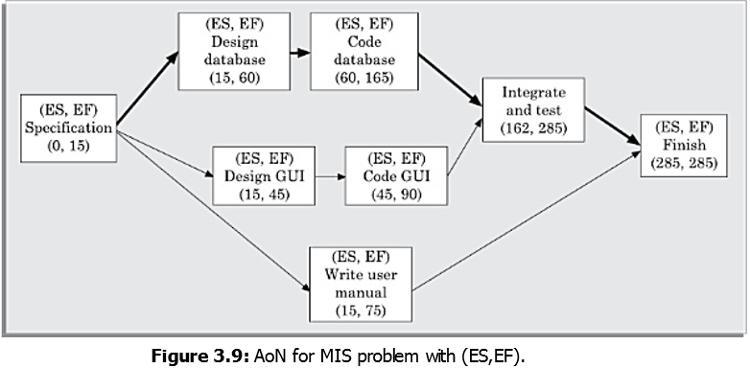

Slide 66
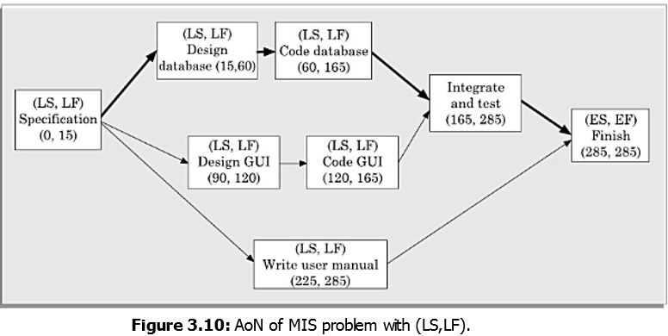

Slide 67
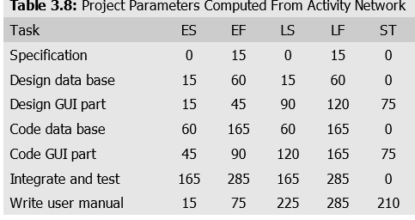

Slide 68
PERT Charts
Project Evaluation and Review Technique (PERT) charts are a more sophisticated form of activity chart.
PERT charts like activity networks consist of a network of boxes and arrows.
The activity durations computed using an activity network are only estimated duration.
It is therefore not possible to estimate the worst case (pessimistic) and best case (optimistic) estimations using an activity diagram.
The CPM can be used to determine the duration of a project.

Slide 69
PERT Charts
In PERT chart, each task is annotated with three estimates:
Optimistic (O): The best possible case task completion time.
Most likely estimate (M): Most likely task completion time.
Worst case (W): The worst possible case task completion time.
The optimistic (O) and worst case (W) estimates represent the all possible scenarios of task completion.
The most likely estimate (M) is the completion time that has the highest probability.
The three estimates are used to compute the mean estimated time. It is calculated as ET = (O + 4M + W )/6.

Slide 70
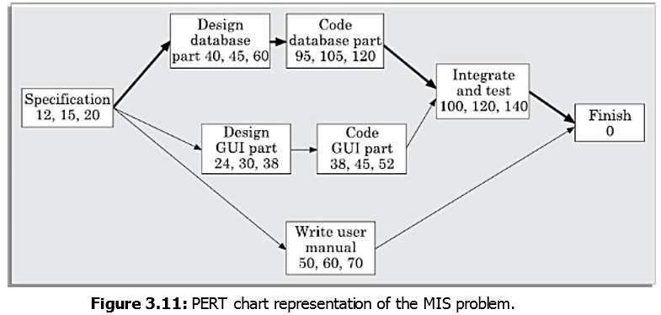

Slide 71
Estimated time calculation for Pert chart
Activity | O | M | W | Estimated time=(O+4M+W)/6
Specification | 12 | 15 | 20 | 15.3
Design Database | 40 | 45 | 60 | 46.66
Code database | 95 | 105 | 120 | 105.83
Design GUI | 24 | 30 | 38 | 30.33
Code GUI | 38 | 45 | 52 | 45
Integrate and Test | 100 | 120 | 140 | 120
Write User Manual | 50 | 60 | 70 | 60

Slide 72
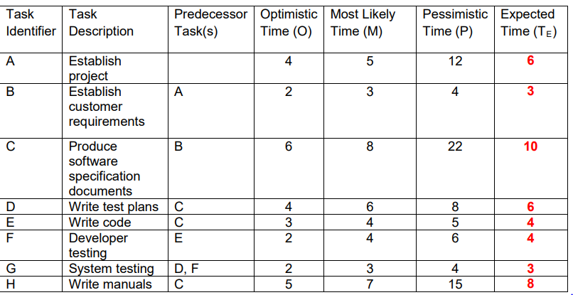
PERT example

Slide 73
Gantt Charts
Gantt chart has been named after its developer Henry Gantt.
A Gantt chart is a form of bar chart.
The vertical axis lists all the tasks to be performed.
The bars are drawn along the y-axis, one for each task.
Gantt charts used in software project management are actually an enhanced version of the standard Gantt charts.
In the Gantt charts used for software project management, each bar consists of a unshaded part and a shaded part.
The shaded part of the bar shows the length of time each task is estimated to take.
The unshaded part shows the slack time.
Gantt chart representation of a project schedule is helpful in planning the utilisation of resources, while PERT chart is useful for monitoring the timely progress of activities.

Slide 74
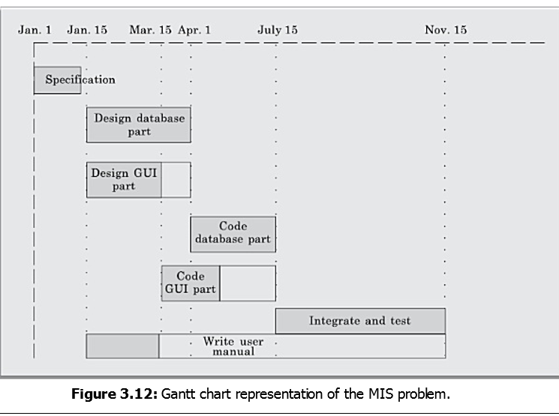

Slide 75
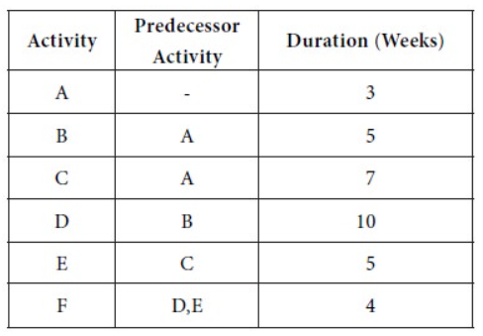
Examples for CPM

Slide 76
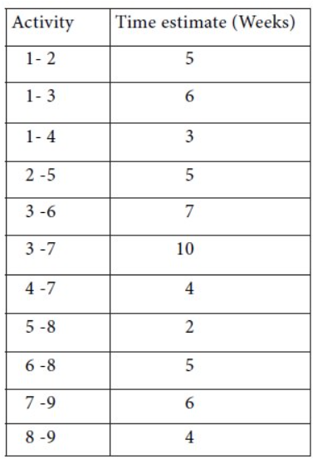

Slide 77
Previous Question paper Problems
Suppose a project was estimated to be 400 KLOC. Calculate the effort , development time and average staff size for each of the three model i.e., organic, semi-detached & embedded.
Solution: The basic COCOMO equation takes the form:
Effort=a₁*(KLOC) ^{a2} PM Tdev=b₁*(efforts)^{b2} Months
Average staff size=Effort/Tdev Estimated Size of project= 400 KLOC
(i)Organic Mode
Effort = 2.4 * (400)^{1.05} = 1295.31 PM Tdev = 2.5 * (1295.31)^{0.38}=38.07 Months
Average staff size=Effort/Tdev= 1295.31/38.07=34.03 Persons
(ii)Semidetached Mode
Effort = 3.0 * (400)^{1.12}=2462.79 PM Tdev = 2.5 * (2462.79)^{0.35}=38.45 Months
Average staff size=Effort/Tdev= 2462.79/38.45=64.05 Persons
(iii) Embedded Mode
Effort = 3.6 * (400)^{1.20} = 4772.81 PM Tdev = 2.5 * (4772.8)^{0.32} = 38 Months
Average staff size=Effort/Tdev= 4772.81 /38=125.60 Persons

Slide 78
Previous Question paper Problems
A project size of 200 KLOC is to be developed. Software development team has average experience on similar type of projects. The project schedule is not very tight. Calculate the Effort, development time, average staff size, and productivity of the project.
Solution: Software development team has average experience on similar type of projects. The project schedule is not very tight. So this is semidetached type of project.
Effort=a₁*(KLOC) ^{a2} PM Tdev=b₁*(efforts)^{b2} Months
Average staff size=Effort/Tdev
Productivity=KLOC/Effort
Effort=3.0(200)^{1.12}=1133.12PM Tdev=2.5(1133.12)^{0.35}=29.3 Months
Productivity=KLOC/Effort
=200/1133.12
=0.176 KLOC/PM
=176 LOC/PM

