Slide 1
Unit-IV
Software Design and Modelling

Slide 2
Syllabus
Software Design: Approaches to software design- function oriented design- object oriented design.
Object Modelling Using UML: Object Modeling Using UML:- Basic object orientation Concepts-Basic Concepts-
Class relationships, Usecase Model-Representation of usecases-why develop the use case diagram-How to identify the use case of a system?-Essential use case versus real use case, Class diagram, Interaction diagrams, Activity Diagram, state chart Diagram,Component and Deployment diagrams.

Slide 3
Approaches to software design
There are two fundamental approaches to software design
function-oriented design
object-oriented design
Function-oriented Design
Features of the function-oriented design approach:
Top-down decomposition:
A system, to start with, is viewed as a black box that provides certain services (also known as high-level functions) to the users of the system.
In top-down decomposition, starting at a high-level view of the system, each high-level function is successively refined into more detailed functions.

Slide 4
Function-oriented Design
For example, consider a function create-new-library member which essentially creates the record for a new member, assigns a unique membership number to him, and prints a bill towards his membership charge.
This high-level function may be refined into the following subfunctions:
• assign-membership-number
• create-member-record
• print-bill
Each of these subfunctions may be split into more detailed subfunctions and so on.
Centralised system state:
The system state can be defined as the values of certain data items that determine the response of the system to a user action or external event.
For example, the set of books (i.e. whether borrowed by different users or available for issue) determines the state of a library automation system.
Such data in procedural programs usually have global scope and are shared by many modules.

Slide 5
Function-oriented Design
The system state is centralised and shared among different functions.
For example, in the library management system, several functions such as the following share data such as member-records for reference and updation:
• create-new-member
• delete-member
• update-member-record
A few of the well-established function-oriented design approaches are as following:
• Structured design by Constantine and Yourdon, [1979]
• Jackson’s structured design by Jackson [1975]
• Warnier-Orr methodology [1977, 1981]
• Step-wise refinement by Wirth [1971]
• Hatley and Pirbhai’s Methodology [1987]

Slide 6
Object-oriented Design
In the object-oriented design (OOD) approach, a system is viewed as being made up of a collection of objects (i.e. entities).
Each object is associated with a set of functions that are called its methods.
Each object contains its own data and is responsible for managing it.
The data internal to an object cannot be accessed directly by other objects and only through invocation of the methods of the object.
The system state is decentralised since there is no globally shared data in the system and data is stored in each object.
For example, in a library automation software, each library member may be a separate object with its own data and functions to operate on the stored data.
The methods defined for one object cannot directly refer to or change the data of other objects.

Slide 7
Function-oriented Design VS Object- oriented Design
Function-oriented Design | Object- oriented Design
The basic abstractions, which are given to the user, are real world functions. | The basic abstractions are not the real world functions but are the data abstraction where the real world entities are represented.
Functions are grouped together by which a higher level function is obtained. | Function are grouped together on the basis of the data they operate since the classes are associated with their methods.
It is carried out using structured analysis and structured design i.e, data flow diagram | It is carried out using UML
In this approach the state information is often represented in a centralized shared memory. | In this approach the state information is not represented in a centralized memory but is implemented or distributed among the objects of the system.

Slide 8
Function-oriented Design VS Object- oriented Design
Function-oriented Design | Object- oriented Design
It is a top down approach. | It is a bottom up approach.
It begins by considering the use case diagrams | It begins by identifying objects and classes.
In function oriented design we decompose in function/procedure level. | We decompose in class level.

Slide 9
Object Modelling Using UML
UML stands for Unified Modeling Language.
UML is different from the other common programming languages such as C++, Java, COBOL, etc.
UML is a pictorial language used to make software blueprints.
UML can be described as a general purpose visual modeling language to visualize, specify, construct, and document software system.
UML is not a programming language but tools can be used to generate code in various languages using UML diagrams. UML has a direct relation with object oriented analysis and design.
UML diagrams are not only made for developers but also for business users, common people, and anybody interested to understand the system.

Slide 10
Object Orientation Concepts
Class – A class defines the blue print i.e. structure and functions of an object.
Objects – Objects help us to decompose large systems and help us to modularize our system. Modularity helps to divide our system into understandable components so that we can build our system piece by piece. An object is the fundamental unit (building block) of a system which is used to depict an entity.
Inheritance – Inheritance is a mechanism by which child classes inherit the properties of their parent classes.
Abstraction – Mechanism by which implementation details are hidden from user.
Encapsulation – Binding data together and protecting it from the outer world is referred to as encapsulation.
Polymorphism – Mechanism by which functions or entities are able to exist in different forms.

Slide 11
UML Building Blocks
The building blocks of UML can be defined as
Things
Relationships
Diagrams

Slide 12
Class Relationships
Classes in a programming solution can be related to each other in the following four ways:
• Inheritance
• Association and link
• Aggregation and composition
• Dependency

Slide 13
Class Relationships
Inheritance
• The inheritance feature allows one to define a new class by incrementally extending the features of an existing class.
The original class is called the base class (also called superclass or parent class ) and the new class obtained through inheritance is called the derived class (also called a subclass or a child class ).
The derived class inherit the features of the base class.

Slide 14
Class Relationships
Inheritance
The inheritance feature allows one to define a new class by incrementally extending the features of an existing class.
The original class is called the base class (also called superclass or parent class ) and the new class obtained through inheritance is called the derived class (also called a subclass or a child class ).
The derived class inherit the features of the base class.
Each derived class can be considered as a specialisation of its base class because it modifies or extends the basic properties of the base class .
The inheritance relationship can be viewed as a generalisation-specialisation relationship.
When a new definition of a method that existed in the base class is provided in a derived class, the method is said to be overridden in the derived class.

Slide 15
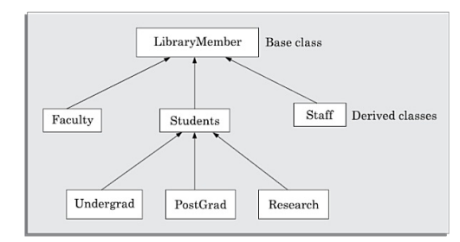
Class Relationships
Library Information system

Slide 16
Class Relationships
Inheritance
• Two important advantages of using the inheritance mechanism in programming include code reuse and simplicity of program design.
Multiple inheritance
Multiple inheritance is a mechanism by which a subclass can inherit attributes and methods from more than one base class.
However, some features of a class are similar to one class and a few other features of the class are similar to those of another class.
In this case, it would be useful if the class could be allowed to inherit features from both the classes. Using the multiple inheritance feature, a class can inherit features from multiple base classes.

Slide 17
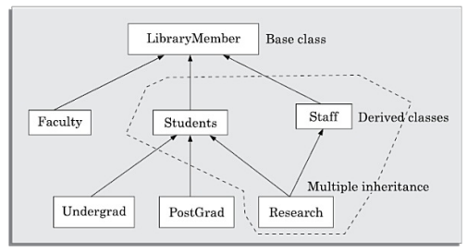
Class Relationships
Multiple Inheritance

Slide 18
Class Relationships
Association and link
Association is a common type of relation among classes.
When two classes are associated, they can take each others help (i.e. invoke each others methods) to serve user requests.
If one class is associated with another bidirectionally, then the corresponding objects of the two classes know each others ids (identities).
As a result, it becomes possible for the object of one class to invoke the methods of the corresponding object of the other class.
n-ary association
Binary association between classes is very commonly encountered in design problems. However, there can be situations where three or more different classes can be involved in an association. As an example of a ternary association, consider the following—A person books a ticket for a certain show. Here, an association exists among the classes Person, Ticket, and Show.

Slide 19
Class Relationships
n-ary association
Binary association between classes is very commonly encountered in design problems.
However, there can be situations where three or more different classes can be involved in an association.
As an example of a ternary association, consider the following—A person books a ticket for a certain show.
Here, an association exists among the classes Person, Ticket, and Show.
A class can have an association relationship with itself. This is called recursive association or unary association.
Link
When two classes are associated, the relationship between two objects of the corresponding classes is called a link.
An association describes a group of similar links. A link can be considered as an instance of an association relation.

Slide 20
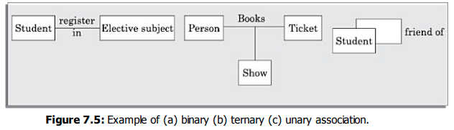
Class Relationships
Association

Slide 21

Class Relationships
Composition and aggregation
Composition and aggregation represent part/whole relationships among objects.
Objects which contain other objects are called composite objects.
As an example----A Book object can have upto ten Chapters. In this case, a Book object is said to be composed of upto ten Chapter objects.
The composition/aggregation relationship is also known a s has a relationship.

Slide 22
Class Relationships
Dependency
A class is said to be dependent on another class, if any changes to the latter class necessitates a change to be made to the dependent class.
A dependency relation between two classes shows that any change made to the independent class would require the corresponding change to be made to the dependent class.
Dependencies among classes may arise due to various causes.
Two important reasons for dependency to exist between two classes are the following:
1. A method of a class takes an object of another class as an argument.
2. A class implements an interface class.

Slide 23
How to Identify Class Relationships?
Composition
B is a permanent part of A
A is made up of Bs
A is a permanent collection of Bs
Aggregation
B is a part of A
A contains B
A is a collection of Bs
Inheritance
A is a kind of B
A is a specialisation of B
A behaves like B
Association
A delegates to B
A needs help from B
A collaborates with B.

Slide 24
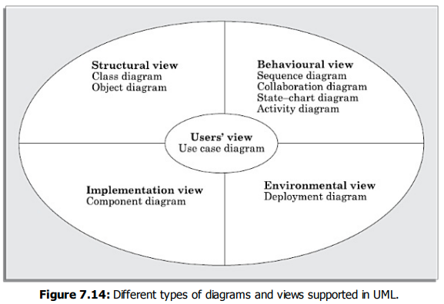
UML DIAGRAMS
UML diagrams can capture the following views (models) of a system:
User’s view
Structural view
Behaviourial view
Implementation view
Environmental view

Slide 25
USE CASE MODEL
The use case model for any system consists of a set of use cases
A simple way to find all the use cases of a system is to ask the question —“What all can the different categories of users do by using the system?”
For the library information system (LIS), the use cases could be:
• issue-book
• query-book
• return-book
• create-member
• add-book, etc
A use case typically involves a sequence of interactions between the user and the system.
Even for the same use case, there can be several different sequences of interactions.
A use case consists of one main line sequence and several alternate sequences.
The main line sequence represents the interactions between a user and the system that normally take place.

Slide 26
Representation of Use Cases
A use case model can be documented by drawing a use case diagram and writing an accompanying text elaborating the drawing.
In the use case diagram, each use case is represented by an ellipse with the name of the use case written inside the ellipse.
All the ellipses (i.e. use cases) of a system are enclosed within a rectangle which represents the system boundary.
The name of the system being modeled (e.g., library information system ) appears inside the rectangle.
The different users of the system are represented by using stick person icons.
Each stick person icon is referred to as an actor.
An actor is a role played by a user with respect to the system use.
It is possible that the same user may play the role of multiple actors.
An actor can participate in one or more use cases.
The line connecting an actor and the use case is called the communication relationship.
Both human users and external systems can be represented by stick person icons. When a stick person icon represents an external system, it is annotated by the stereotype <>.

Slide 27
Why Develop the Use Case Diagram?
The use case model forms the core model to which all other models must conform
Identifying the different types of users (actors) in implementing a security mechanism through a login system, so that each actor can invoke only those functionalities to which he is entitled to.
Another important use is in designing the user interface in the implementation of the use case targetted for each specific category of users who would use the use case.
Another possible use is in preparing the documentation (e.g. users’ manual) targeted at each category of user.
Further, actors help in identifying the use cases and understanding the exact functioning of the system.

Slide 28
How to Identify the Use Cases of a System?
The high-level requirements specified in the SRS document correspond to the use cases.
In the absence of a well formulated SRS document, a popular method of identifying the use cases is actor-based.
This involves first identifying the different types of actors and their usage of the system.
For each actor the different functions are identified.
For example, for a Library Automation System, the categories of users can be members, librarian, and the accountant.
Each user typically focuses on a set of functionalities.
The member typically concerns himself with book issue, return, and renewal aspects.
The librarian concerns himself with creation and deletion of the member and book records.
The accountant concerns itself with the amount collected from membership fees and the expenses aspects.

Slide 29
Essential Use Case versus Real Use Case
Essential use cases are created during early requirements elicitation.
These are also early problem analysis artifacts.
They are independent of the design decisions and tend to be correct over long periods of time.
Real use cases describe the functionality of the system in terms of its actual current design committed to specific input/output technologies.
The real use cases can be developed only after the design decisions have been made.
Real use cases are a design artifact.
Sometimes organisations commit to development contracts that include the detailed user interface specifications.
In such cases, there is no distinction between the essential use case and the real use case.

Slide 30
Class Diagram
The classes represent entities with common features, i.e., attributes and operations.
Classes are represented as solid outline rectangles with compartments.
The class name is usually written using mixed case convention and begins with an uppercase (e.g. LibraryMember).
Classes have optional attributes and operations compartments.
Association between two classes is represented by drawing a straight line between the concerned classes.
The multiplicity indicates how many instances of one class are associated with the other.
Aggregation is a special type of association relation where the involved classes are not only associated to each other, but a whole-part relationship exists between them.
The inheritance relationship is represented by means of an empty arrow pointing from the subclass to the superclass.
A dependency relationship is shown as a dotted arrow (see Figure 7.28) that is drawn from the dependent class to the independent class.

Slide 31
INTERACTION DIAGRAMS
There are two kinds of interaction diagrams—sequence diagrams and collaboration diagrams.
These two diagrams are equivalent in the sense that any one diagram can be derived automatically from the other
Sequence diagram
A sequence diagram shows interaction among objects.
The diagram deals with some sequences, which are the sequence of messages flowing from one object to another.
The vertical dashed line is called the object’s lifeline.
Each message is labelled with the message name.

Slide 32
INTERACTION DIAGRAMS
Collaboration diagram
A collaboration diagram shows both structural and behavioural aspects explicitly.
A sequence diagram shows only the behavioural aspects.
The structural aspect of a collaboration diagram consists of objects and links among them indicating association.
In this diagram, each object is also called a collaborator.
The behavioural aspect is described by the set of messages exchanged among the different collaborators.
The link between objects is shown as a solid line and can be used to send messages between two objects.
The message is shown as a labelled arrow placed near the link.
Messages are prefixed with sequence numbers because they are the only way to describe the relative sequencing of the messages in this diagram.

Slide 33
ACTIVITY DIAGRAM
The activity diagram focuses on representing various activities and their sequence of actions.
Activity diagrams are normally employed in business process modelling.
This is carried out during the initial stages of requirements analysis and specification.
Activity diagram describes the flow of control in a system.
The flow can be sequential, concurrent, or branched.
Activities are nothing but the functions of a system.

Slide 34
STATE CHART DIAGRAM
A state chart diagram is normally used to model how the state of an object changes in its life time.
The basic elements of the state chart diagram are as follows:
Initial state: This represented as a filled circle.
Final state: This is represented by a filled circle inside a larger circle.
State: These are represented by rectangles with rounded corners.
Transition: A transition is shown as an arrow between two states

Slide 35
COMPONENT DIAGRAM
Component diagrams represent a set of components and their relationships.
These components consist of classes, interfaces, or collaborations.
A component diagram can be used to represent the physical structure of an implementation in terms of the various components of the system.

Slide 36
DEPLOYMENT DIAGRAM
The deployment diagram shows the environmental view of a system.
It captures the environment in which the software solution is implemented.
A deployment diagram shows how a software system will be physically deployed in the hardware environment.

