Slide 1
Unit-V
Testing

Slide 2
Syllabus
Testing:- Basic concepts and Terminologies, Testing Activities, why design test cases?
Black-Box Testing:- Equivalence class partitioning, Boundary value analysis
White-Box Testing:- Basic concepts, statement coverage, branch coverage, multiple condition coverage, path coverage, McCabe’s cyclomatic complexity metric
Integration testing:- Phased versus Incremental Integration Testing
System Testing

Slide 3
TESTING
The aim of program testing is to identify all defects in a program.
However, in practice, even after satisfactory completion of the testing phase, it is not possible to guarantee that a program is error free.
This is because the input data domain of most programs is very large, and it is not practical to test the program exhaustively with respect to each value that the input can assume.
We must remember that careful testing can expose a large percentage of the defects existing in a program, and therefore provides a practical way of reducing defects in a system.

Slide 4
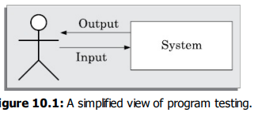
Basic Concepts and Terminologies
How to test a program?
Testing a program involves executing the program with a set of test inputs and observing if the program behaves as expected.
If the program fails to behave as expected, then the input data and the conditions under which it fails are noted for later debugging and error correction.

Slide 5
TERMINOLOGIES
MISTAKE
A mistake is essentially any programmer action that later shows up as an incorrect result during program execution.
A programmer may commit a mistake in almost any development activity.
For example, during coding a programmer might commit the mistake of not initializing a certain variable, or might overlook the errors that might arise in some exceptional situations such as division by zero in an arithmetic operation. Both these mistakes can lead to an incorrect result.
ERROR
An error is the result of a mistake committed by a developer in any of the development activities.
One example of an error is a call made to a wrong function.
The terms error, fault, bug, and defect are considered to be synonyms in the area of program testing

Slide 6
TERMINOLOGIES
FAILURE
A failure of a program essentially denotes an incorrect behaviour exhibited by the program during its execution.
An incorrect behaviour is observed either as an incorrect result produced or as an inappropriate activity carried out by the program.
Every failure is caused by some bugs present in the program.
The number of possible ways in which a program can fail is extremely large. Out of the large number of ways three randomly selected examples:
The result computed by a program is 0, when the correct result is 10.
A program crashes on an input.
A robot fails to avoid an obstacle and collides with it.
It may be noted that mere presence of an error in a program code may not necessarily lead to a failure during its execution.

Slide 7
TERMINOLOGIES
TEST CASE
A test case is a triplet [I , S, R], where I is the data input to the program under test, S is the state of the program at which the data is to be input, and R is the result expected to be produced by the program.
The state of a program is also called its execution mode.
Execution modes—edit, view, create, and display.
A test case is a set of test inputs, the mode in which the input is to be applied, and the results that are expected during and after the execution of the test case.
TEST SCENARIO
A test scenario is an abstract test case in the sense that it only identifies the aspects of the program that are to be tested without identifying the input, state, or output.
A test case can be said to be an implementation of a test scenario.
An important automatic test case design strategy is to first design test scenarios through an analysis of some program abstraction (model) and then implement the test scenarios as test cases

Slide 8
TERMINOLOGIES
TEST SCRIPT
A test script is an encoding of a test case as a short program.
Test scripts are developed for automated execution of the test cases.
A test case is said to be a positive test case if it is designed to test whether the software correctly performs a required functionality.
A test case is said to be negative test case, if it is designed to test whether the software carries out something, that is not required of the system.
consider an example as a program to manage user login. A positive test case can be designed to check if a login system validates a user with the correct user name and password.
A negative test case can be a test case that checks whether the login functionality validates and admits a user with wrong login user name or password.

Slide 9
TERMINOLOGIES
TEST SUITE
A test suite is the set of all test cases that have been designed by a tester to test a given program.
TESTABILITY
Testability of a requirement denotes the extent to which it is possible to determine whether an implementation of the requirement conforms to it in both functionality and performance.
A failure mode of a software denotes an observable way in which it can fail.
As an example of the failure modes of a software, consider a railway ticket booking software that has three failure modes—failing to book an available seat, incorrect seat booking (e.g., booking an already booked seat), and system crash.
Equivalent faults denote two or more bugs that result in the system failing in the same failure mode.
Consider the following two faults in C language—division by zero and illegal memory access errors. These two are equivalent faults, since each of these leads to a program crash.

Slide 10
Verification vs Validation
The objectives of both verification and validation techniques are very similar since both these techniques are designed to help remove errors in a software.
Verification is concerned with phase containment of errors, Validation is to check whether the deliverable software is error free.
Error detection techniques = Verification techniques + Validation techniques

Slide 11
Verification vs Validation
Verification | Validation
Verification is the process of determining whether the output of one phase of software development conforms to that of its previous phase | Validation is the process of determining whether a fully developed software conforms to its requirements specification
Verification is to check if the work products produced after a phase conform to that which was input to the phase | Validation is applied to the fully developed and integrated software to check if it satisfies the customer’s requirements.
Verification usually involves use of theorem proving techniques or use of automated tools such as a model checker. | Validation techniques are primarily based on product testing.
Unit and Integration testing can be considered as verification steps where it is verified whether the code is a s per the module and module interface specifications | System testing can be considered as a validation step where it is determined whether the fully developed code is as per its requirements specification.
Verification does not require execution of the software | Validation requires execution of the software.
Verification steps are to determine whether the steps in product development are being carried out alright | Validation is carried out towards the end of the development process to determine whether the right product has been developed.

Slide 12
Testing Activities
Testing involves performing the following main activities
Test suite design: The set of test cases using which a program is to be tested is designed by using several test case design techniques
Running test cases and checking the results to detect failures: Each test case is run and the results are compared with the expected results.
A mismatch between the actual result and expected results indicates a failure.
The test cases for which the system fails are noted down for later debugging.
Locate error: In this activity, the failure symptoms are analysed to locate the errors.
For each failure observed during the previous activity, the statements that are in error are identified.
Error correction: After the error is located during debugging, the code is appropriately changed to correct the error.

Slide 13
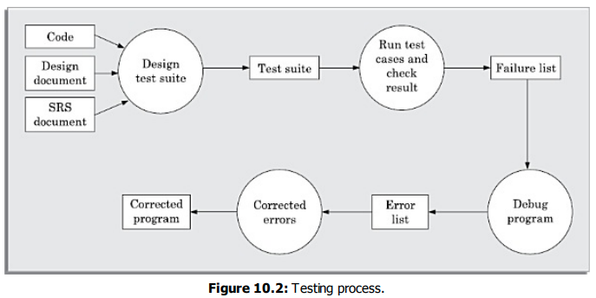
Testing Activities

Slide 14
Why design Testcase
Testing a software using a large collection of randomly selected test cases does not guarantee that all (or even most) of the errors in the system will be uncovered.
Consider the following example code segment which determines the greater of two integer values x and y. This code segment has a simple programming error:
if (x>y) max = x;
else max = x;
For the given code segment, the test suite {(x=3,y=2);(x=2,y=3)} can detect the error, whereas a larger test suite {(x=3,y=2);(x=4,y=3); (x=5,y=1)} does not detect the error.
For effective testing, the test suite should be carefully designed rather than picked randomly.
A minimal test suite is a carefully designed set of test cases such that each test case helps detect different errors.

Slide 15
Why design Testcase
There are essentially two main approaches to systematically design test cases
Black-box approach
White-box (or glass-box) approach
These two approaches to test case design are complementary.
That is, a program has to be tested using the test cases designed by both the approaches, and one testing using one approach does not substitute testing using the other.

Slide 16
Black-box Testing
In the black-box approach, test cases are designed using only the functional specification of the software.
Test cases are designed based on an analysis of the input/out behaviour (functional behaviour) and does not require any knowledge of the internal structure of a program.
For this reason, black-box testing is also known as functional testing.
The two main approaches available to design black box test cases:
Equivalence class partitioning
Boundary value analysis

Slide 17
Equivalence class partitioning
In the equivalence class partitioning approach, the domain of input values to the program under test is partitioned into a set of equivalence classes.
The partitioning is done such that for every input data belonging to the same equivalence class, the program behaves similarly.
Equivalence classes for a unit under test can be designed by examining the input data and output data.
The following are two general guidelines for designing the equivalence classes:
If the input data values to a system can be specified by a range of values, then one valid and two invalid equivalence classes need to be defined. For example, if the equivalence class is the set of integers in the range 1 to 10 (i.e., [1,10]), then the invalid equivalence classes are [−∞,0], [11,+∞].
If the input data assumes values from a set of discrete members of some domain, then one equivalence class for the valid input values and another equivalence class for the invalid input values should be defined. For example, if the valid equivalence classes are {A,B,C}, then the invalid equivalence class is {A,B,C}, where

Slide 18
Equivalence class partitioning
2. If the input data assumes values from a set of discrete members of some domain, then one equivalence class for the valid input values and another equivalence class for the invalid input values should be defined. For example, if the valid equivalence classes are {A,B,C}, then the invalid equivalence class is - {A,B,C}, where is the universe of possible input values.

Slide 19
Equivalence class partitioning
Example
For a software that computes the square root of an input integer that can assume values in the range of 0 and 5000.Determine the equivalence classes and the black box test suite.
There are three equivalence classes—The set of negative integers, the set of integers in the range of 0 and 5000, and the set of integers larger than 5000.
Therefore, the test cases must include representatives for each of the three equivalence classes.
A possible test suite can be: {–5,500,6000}.

Slide 20
Equivalence class partitioning
Example
Design equivalence class partitioning test suite for a function that reads a character string of size less than five characters and displays whether it is a palindrome.
The equivalence classes are palindromes, non-palindromes, and invalid inputs. Now, selecting one representative value from each equivalence class, we have the required test suite: {abc,aba,abcdef}.

Slide 21
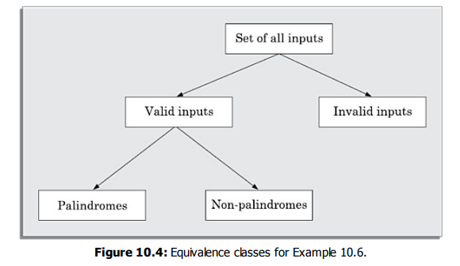
Equivalence class partitioning

Slide 22
Boundary Value Analysis
Boundary value analysis-based test suite design involves designing test cases using the values at the boundaries of different equivalence classes.
To design boundary value test cases, it is required to examine the equivalence classes to check if any of the equivalence classes contains a range of values.
Programmers often fail to properly address the special processing required by the input values that lie at the boundary of the different equivalence classes.
For example, programmers may improperly use < instead of <=, or conversely <= for <.
For an equivalence class that is a range of values, the boundary values need to be included in the test suite.
For example, if an equivalence class contains the integers in the range 1 to 10, then the boundary value test suite is {0,1,10,11}.

Slide 23
Boundary Value Analysis
Example
For a function that computes the square root of the integer values in the range of 0 and 5000, determine the boundary value test suite.
There are three equivalence classes—The set of negative integers, the set of integers in the range of 0 and 5000, and the set of integers larger than 5000.
The boundary value-based test suite is: {-1,0,5000,5001}.

Slide 24
BLACK BOX TESTING
The important steps in the black-box test suite design approach:
Examine the input and output values of the program.
Identify the equivalence classes.
Design equivalence class test cases by picking one representative value from each equivalence class.
Design the boundary value test cases by examine if any equivalence class is a range of values. Include the values at the boundaries of such equivalence classes in the test suite.

Slide 25
White-box Testing
In designing white-box test cases requires a thorough knowledge of the internal structure of a program.
Therefore white-box testing is also called structural testing.
White-box test cases are based on an analysis of the code.
White-box testing is an important type of unit testing.
A large number of white-box testing strategies exist. Each testing strategy essentially designs test cases based on analysis of source code.

Slide 26
White-box Testing
Basic Concepts
A white-box testing strategy can either be coverage-based or fault based.
Fault-based testing
A fault-based testing strategy targets to detect certain types of faults.
Mutation testing is a fault-based testing technique in the sense that mutation test cases are designed to help detect specific types of faults in a program.
In mutation testing, a program is first tested by using an initial test suite designed by using various white box testing strategies .
The idea behind mutation testing is to make a few arbitrary changes to a program at a time.
Each time the program is changed, it is called a mutated program and the change effected is called a mutant.

Slide 27
White-box Testing
Coverage-based testing/ Control flow based Testing
A coverage-based testing strategy attempts to execute certain elements of a program.
Popular examples of coverage-based testing strategies are
Statement coverage
Branch coverage
Multiple condition coverage and
Path coverage-based testing.

Slide 28
White-box Testing
Statement Coverage
The statement coverage strategy aims to design test cases to execute every statement in a program at least once.
The principal idea of the statement coverage strategy is that unless a statement is executed, there is no way to determine whether an error exists in that statement.
Example: Design statement coverage-based test suite for the following Euclid’s GCD computation program:
int computeGCD(x,y)
int x,y;
{ 1 while (x != y)
{ 2 if (x>y) then
3 x=x-y;
4 else y=y-x;
5 }
6 return x; }

Slide 29
White-box Testing
To design the test cases for the statement coverage, the conditional expression of the while statement needs to be made true and the conditional expression of the if statement needs to be made both true and false.
By choosing the test set {(x = 3, y = 3), (x = 4, y = 3), (x = 3, y = 4)}, all statements of the program would be executed at least once.

Slide 30
White-box Testing
Branch Coverage
A test suite satisfies branch coverage, if it makes each branch condition in the program to assume true and false values in turn.
For branch coverage each branch in the Control Flow Graph representation of the program must be taken at least once, when the test suite is executed.
Branch testing is also known as edge testing, since in this testing scheme, each edge of a program’s control flow graph is traversed at least once.
Example: Determine a test suite to achieve branch coverage for previous example.
The test suite {(x = 3, y = 3), (x = 3, y = 2), (x = 4, y = 3), (x = 3, y = 4)} achieves branch coverage.
It is easy to show that branch coverage-based testing is a stronger testing than statement coverage-based testing.

Slide 31
White-box Testing
Multiple Condition Coverage
In the multiple condition (MC) coverage-based testing, test cases are designed to make each component of a composite conditional expression to assume both true and false values.
For example, consider the composite conditional expression ((c1 .and.c2 ).or.c3).
A test suite would achieve MC coverage, if all the component conditions c1, c2 and c3 are each made to assume both true and false values.
It is easy to prove that condition testing is a stronger testing strategy than branch testing.
For a composite conditional expression of n components, 2n test cases are required for multiple condition coverage.
Thus, for multiple condition coverage, the number of test cases increases exponentially with the number of component conditions.
Therefore, multiple condition coverage-based testing technique is practical only if n (the number of conditions) is small.

Slide 32
White-box Testing
Multiple Condition Coverage
Consider the following C program segment:
if(temperature>150 || temperature>50)
setWarningLightOn();
The program segment has a bug in the second component condition, it should have been temperature<50.
The test suite {temperature=160, temperature=40} achieves branch coverage.
But, it is not able to check that setWarningLightOn(); because this statement should not be called for temperature values within 150 and 50.

Slide 33
White-box Testing
Path Coverage
A test suite achieves path coverage if it executes each linearly independent paths
atleast once.
A linearly independent path can be defined in terms of the control flow graph (CFG) of a program.
Therefore, to understand path coverage-based testing strategy, we need to first understand how the CFG of a program can be drawn.
Control flow graph (CFG)
A control flow graph describes the sequence in which the different instructions of a program get executed.
In order to draw the control flow graph of a program, we need to first number all the statements of a program.
The different numbered statements serve as nodes of the control flow graph.

Slide 34
White-box Testing
A CFG is a directed graph consisting of a set of nodes and edges (N, E), such that each node N corresponds to a unique program statement and an edge exists between two nodes if control can transfer from one node to the other.
We can easily draw the CFG for any program, if we know how to represent the sequence, selection, and iteration types of statements in the CFG.
Every program is constructed by using these three types of constructs only.

Slide 35
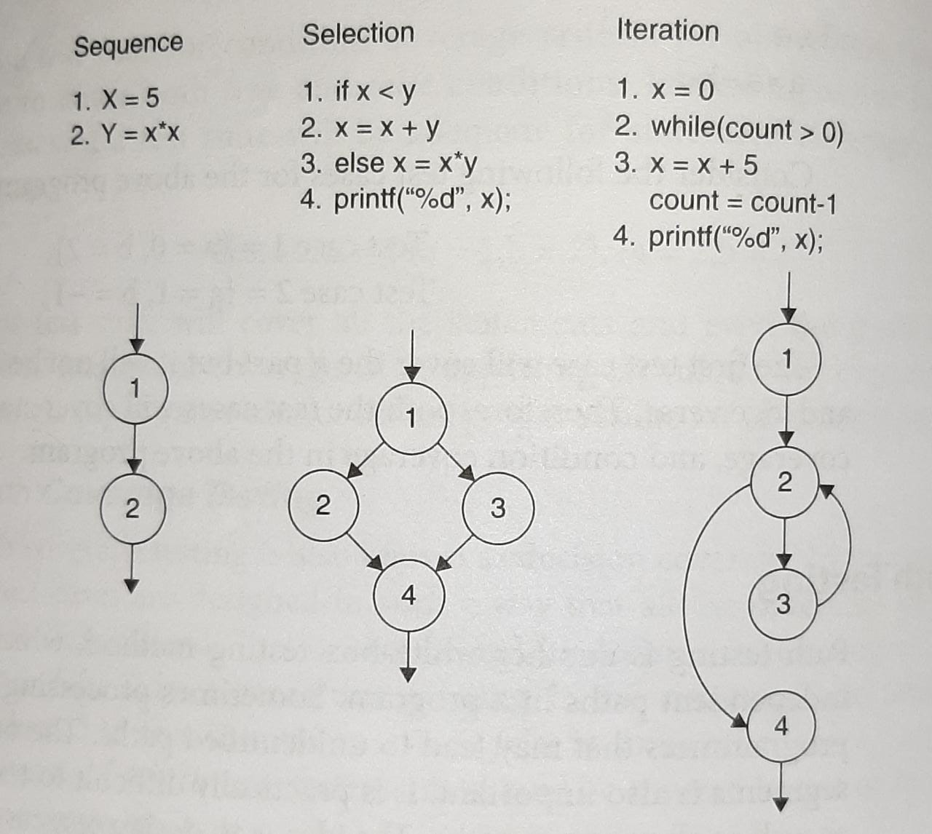

Slide 36
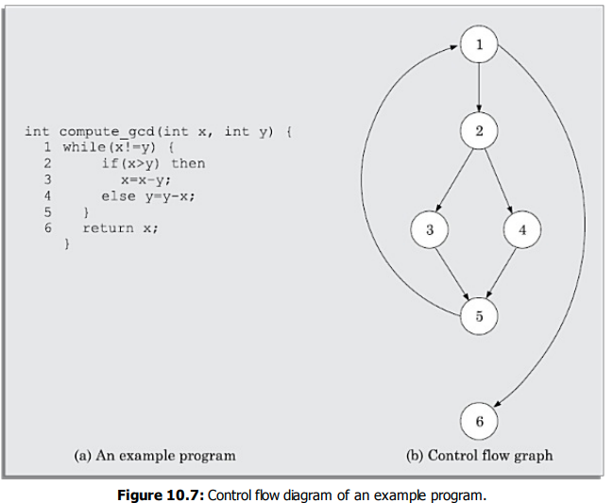

Slide 37
White-box Testing
McCabe’s Cyclomatic Complexity Metric
McCabe obtained his results by applying graph-theoretic techniques to the control flow graph of a program.
McCabe’s cyclomatic complexity defines an upper bound on the number of independent paths in a program.
We discuss three different ways to compute the cyclomatic complexity
Method 1:
Given a control flow graph G of a program, the cyclomatic complexity V(G) can be computed as:
V(G) = E – N + 2
where, N is the number of nodes of the control flow graph and E is the number of edges in the control flow graph.
For the CFG of previous example ,E = 7 and N = 6.
Therefore, the value of the Cyclomatic complexity = 7 – 6 + 2 = 3.

Slide 38
White-box Testing
Method 2:
An alternate way of computing the cyclomatic complexity of a program is based on a visual inspection of the control flow graph.
In this method, the cyclomatic complexity V (G) for a graph G is given by the following expression:
V(G) = Total number of non-overlapping bounded areas + 1
In the program’s control flow graph G, any region enclosed by nodes and edges can be called as a bounded area.
From a visual examination of the above CFG the number of bounded areas is 2.
Therefore the cyclomatic complexity, computed with this method is also 2+1=3.
Method 3:
The cyclomatic complexity of a program can also be easily computed by computing the number of decision and loop statements of the program.
If N is the number of decision and loop statements of a program, then the McCabe’s metric is equal to N + 1.
In above CFG one decision and one loop statements are there so N=2,then McCabe’s metric is 2+1=3

Slide 39
White-box Testing
Steps to carry out path coverage-based testing
1. Draw control flow graph for the program.
2. Determine the McCabe’s metric V(G).
3. Determine the cyclomatic complexity. This gives the minimum number of test cases required to achieve path coverage.
4. repeat
Uses of McCabe’s cyclomatic complexity metric
Estimation of structural complexity of code
Estimation of testing effort
Estimation of program reliability

Slide 40
Integration Testing
Integration testing is carried out after all the modules have been unit tested.
The objective of integration testing is to detect the errors at the module interfaces
The objective of integration testing is to check whether the different modules of a program interface with each other properly.
The integration plan specifies the steps and the order in which modules are combined to realise the full system.
After each integration step, the partially integrated system is tested.
The following approaches can be used to develop the test plan:
Big-bang approach to integration testing
Top-down approach to integration testing
Bottom-up approach to integration testing
Mixed (also called sandwiched ) approach to integration testing

Slide 41
Integration Testing
Big-bang approach to integration testing
Big-bang testing is the most obvious approach to integration testing.
In this approach all the unit tested modules of the system are simply linked together and tested.
This technique can be used only for very small systems.
If there is any defect found , it becomes difficult to identify where the defect has occured.

Slide 42
Integration Testing
Top-down approach to integration testing
In Top-down integration testing, first the main module is tested and then move down to integrate and test its lower level modules.
This testing is continued until all modules at last level have been integrated and tested
The main advantage is that it can take decisions early before testing the lower level modules.
The disadvantage is the testing of a module may be delayed if its lower level modules are not available.

Slide 43
Integration Testing
Bottom-up approach to integration testing
In bottom-up integration testing, first the modules for the each subsystem are integrated.
Thus, the subsystems can be integrated separately and independently.

Slide 44
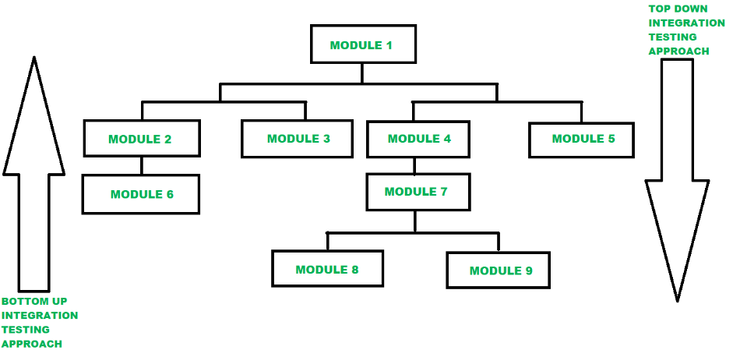

Slide 45
Integration Testing
Mixed (also called sandwiched ) approach to integration testing
The mixed (also called sandwiched ) integration testing follows a combination of top-down and bottom-up testing approaches.
In top-down approach, testing can start only after the top-level modules have been coded and unit tested.
Similarly, bottom-up testing can start only after the bottom level modules are ready.
The mixed approach overcomes this shortcoming of the top-down and bottom-up approaches.
In the mixed testing approach, testing can start as and when modules become available after unit testing.
Therefore, this is one of the most commonly used integration testing approaches.

Slide 46
Phased versus Incremental Integration Testing
Big-bang integration testing is carried out in a single step of integration.
In contrast, in the other strategies, integration is carried out over several steps.
In these later strategies, modules can be integrated either in a phased or incremental manner.
A comparison of these two strategies is as follows:
In incremental integration testing, only one new module is added to the partially integrated system each time.
In phased integration, a group of related modules are added to the partial system each time.
Phased integration requires less number of integration steps compared to the incremental integration approach.
But in the incremental testing approach the errors can easily be traced .
The phased integration testing approach is similar to big-bang testing.

Slide 47
System Testing
After all the units of a program have been integrated together and tested, system testing is taken up.
System tests are designed to validate a fully developed system to assure that it meets its requirements.
The test cases are designed based on the SRS document.
The system testing procedures are the same for both object-oriented and procedural programs.
There are essentially three main kinds of system testing depending on who carries out testing:
1. Alpha Testing: Alpha testing refers to the system testing carried out by the test team within the developing organisation.
2. Beta Testing: Beta testing is the system testing performed by a select group of friendly customers.
3. Acceptance Testing: Acceptance testing is the system testing performed by the customer to determine whether to accept the delivery of the system.

