Slide 1

Smart Energy Metering and Real-Time Electricity Consumption Monitoring System Using IoT Technology
An IoT-based solution for continuously measuring, monitoring, and managing electricity consumption — delivering real-time insights to improve energy efficiency and reduce costs.
BOTCHA JASWANTH KUMAR
323129520040

Slide 2
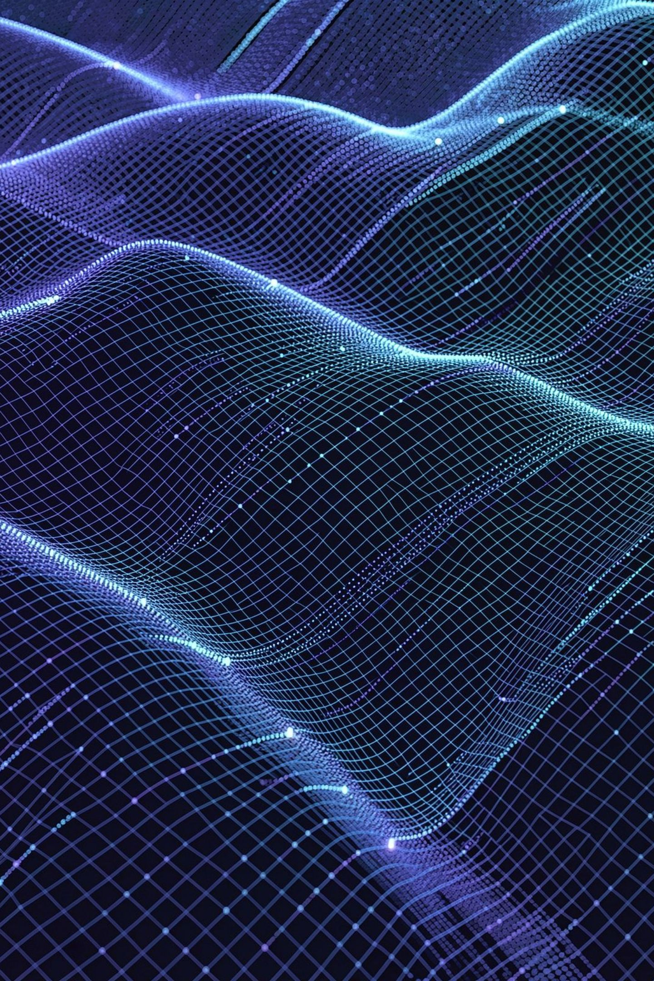

Problem Statement
The Challenge
What Is Needed
Efficient electricity management is critical for reducing energy costs and promoting sustainable energy usage. Yet most consumers and utility providers still rely on outdated metering infrastructure.
Intelligent systems for continuous electricity monitoring
Actionable insights for effective energy management
Tools to identify consumption patterns
Capability to optimize electricity usage proactively
Traditional electricity meters provide limited information and do not allow users to monitor power usage in real time.

Slide 3
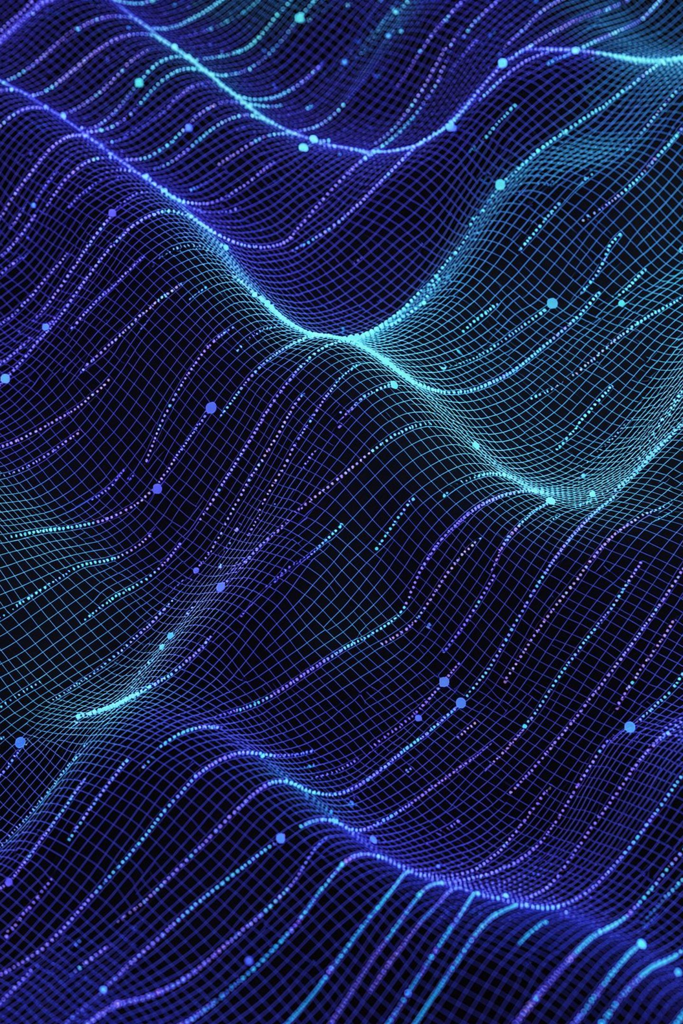
Proposed Solution
The Smart Energy Metering and Real-Time Electricity Consumption Monitoring System leverages IoT technology to continuously measure, collect, and transmit electricity consumption data to a central server.
Continuous Measurement
Centralized Platform
All energy data is transmitted to and stored on a central server for unified monitoring.
Electricity usage is measured and collected automatically without manual intervention.
User-Friendly Interface
Energy information is presented through a secure, intuitive interface for informed decision-making.

Slide 4
Project Objectives
1
Monitor & Measure
1
Analyze & Report
Continuously monitor electricity consumption and measure real-time power usage.
Generate analytical reports to support data-driven energy management decisions.
2
Collect & Record
2
Optimize & Reduce
Automatically collect consumption data and maintain historical electricity records.
Help users optimize energy utilization and reduce electricity and operational costs.
3
Inform & Alert
3
Promote Sustainability
Provide real-time energy information, estimated bills, and detect abnormal electricity usage.
Promote efficient and sustainable power consumption practices.

Slide 5
System Components
These components work together to enable continuous, accurate electricity monitoring across the entire system.
Smart Energy Meter
Current Sensors
Measures electricity consumption at the source.
Monitor electrical current for consumption measurement.
Voltage Sensors
IoT Communication Modules
Monitor voltage information used for electricity monitoring.
Transmit electricity consumption data to the central system.
Cloud-Based Monitoring
Interactive Dashboard
Stores and provides centralized access to collected energy data.
Displays real-time energy info, historical data, alerts, and reports.

Slide 6
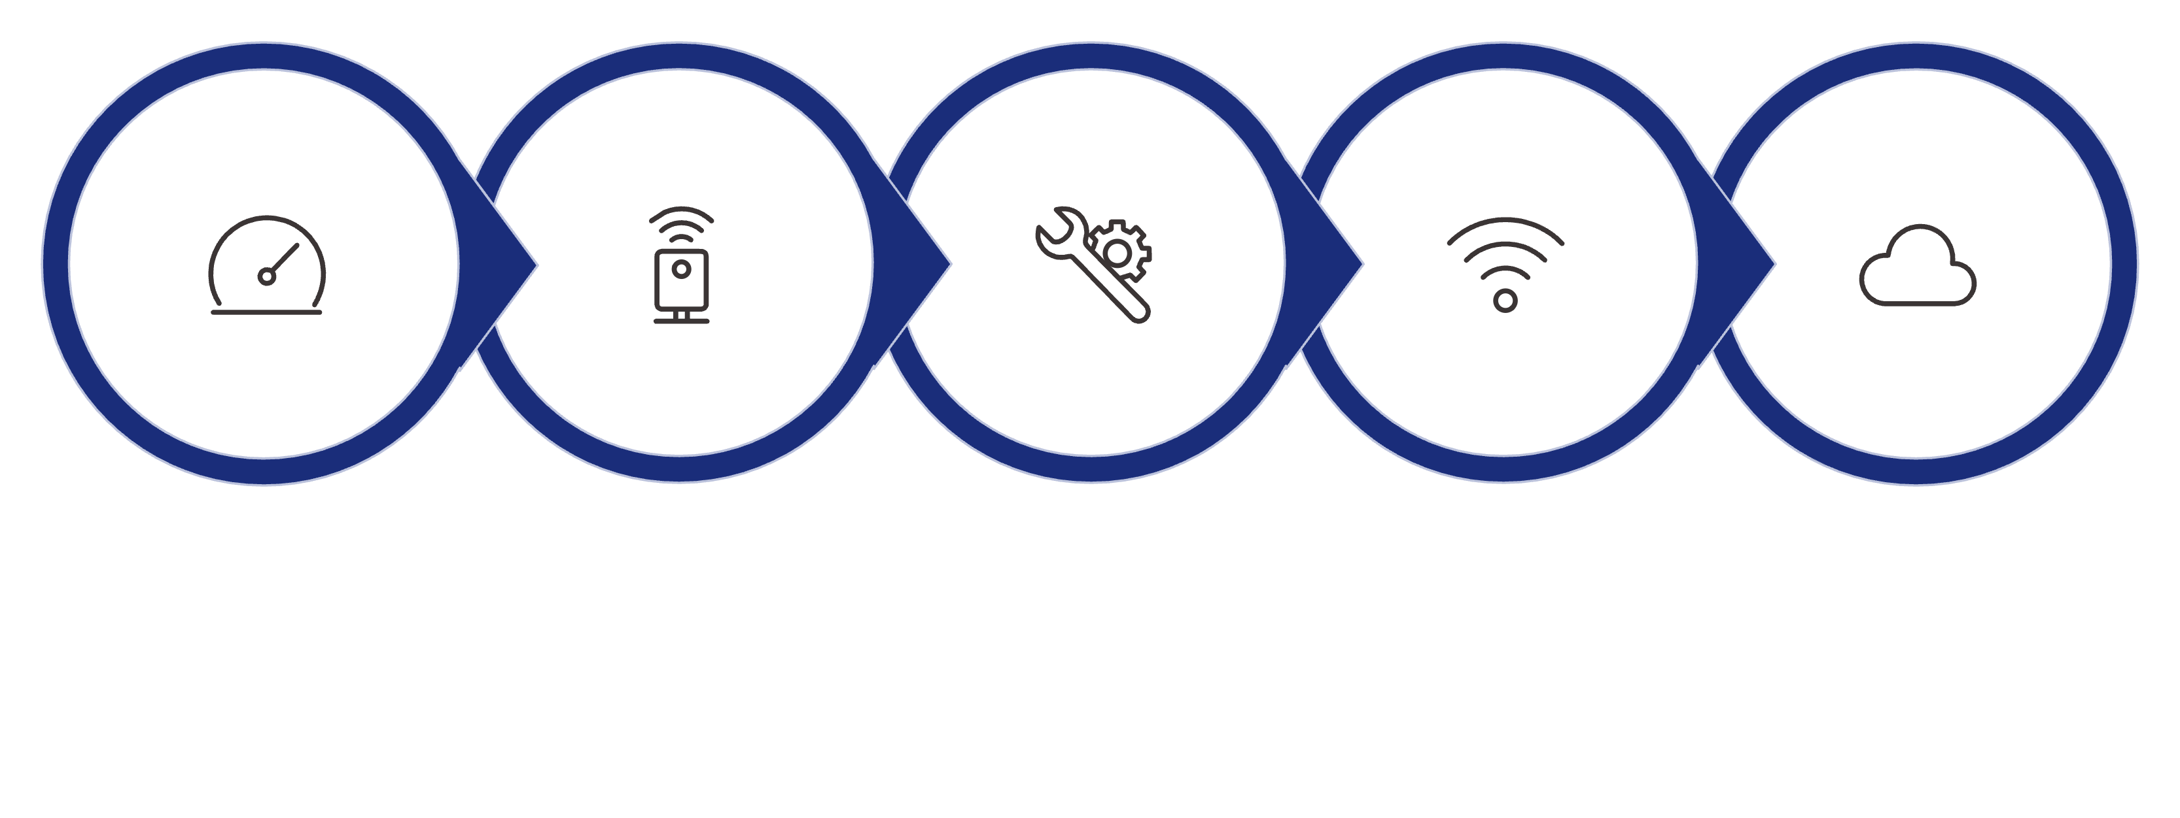
System Working Process
Measure
Collect
Process
Transmit
Cloud
The system operates as a seamless end-to-end pipeline — from physical measurement at the meter, through IoT transmission and cloud processing, to actionable insights displayed on the monitoring dashboard.

Slide 7

Real-Time Monitoring Dashboard
What the Dashboard Displays
How It Helps Users
Understand current electricity consumption
Review historical usage patterns
Identify abnormal energy usage
Estimate electricity costs
Make informed energy-management decisions
Optimize electricity utilization
Live power usage
Real-time electricity consumption
Energy consumption history
Estimated electricity bills
Abnormal usage alerts
Analytical reports
Energy monitoring information

Slide 8
Benefits and Energy Management
Real-Time Visibility
Anomaly Detection
Provides real-time visibility into electricity consumption, improving electricity management and helping users understand energy patterns.
Enables identification of abnormal electricity usage, supporting better energy utilization and more proactive management.
Cost Reduction
Sustainability
Helps reduce electricity and operational costs by providing actionable energy-consumption insights that drive smarter decisions.
Enhances energy efficiency and supports sustainable power consumption through continuous, data-driven monitoring.
Real-time monitoring empowers users to make better, more informed decisions about their electricity usage — reducing waste and improving overall energy performance.

Slide 9
Applications and Scope
Where the System Can Be Applied
System Scope
The system supports continuous monitoring of electricity consumption across different types of facilities. It is designed to be:
Residential
Commercial
Secure — protecting energy data and user access
Scalable — adaptable to facilities of varying sizes
Centralized — suitable for unified energy monitoring
Analytical — useful for real-time consumption analysis
Practical — suitable for improving energy-management practices
Industrial
Educational
Smart City

Slide 10

Conclusion
The Smart Energy Metering and Real-Time Electricity Consumption Monitoring System provides an intelligent approach to electricity management. Smart energy meters, current sensors, and voltage sensors continuously collect electricity usage information. IoT communication modules transmit consumption data to a central server, while cloud-based monitoring enables centralized access to energy information.
Interactive dashboards provide live power usage, consumption history, estimated bills, abnormal usage alerts, and analytical reports — helping users optimize energy utilization, reduce costs, and improve efficiency across residential, commercial, industrial, educational, and smart-city environments.
"Real-time IoT-based energy monitoring enables smarter electricity management, improved energy efficiency, and more sustainable power consumption."

