Slide 1

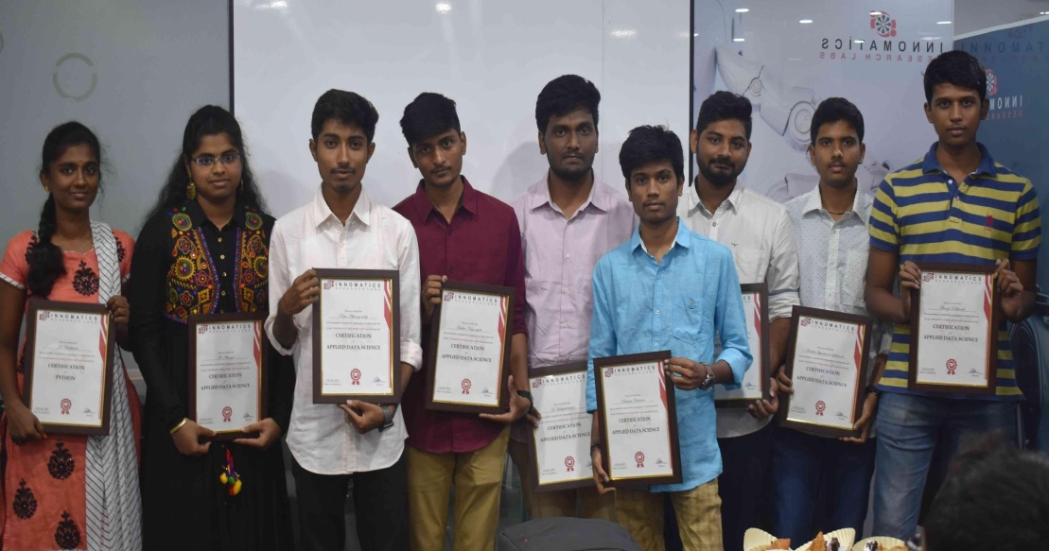
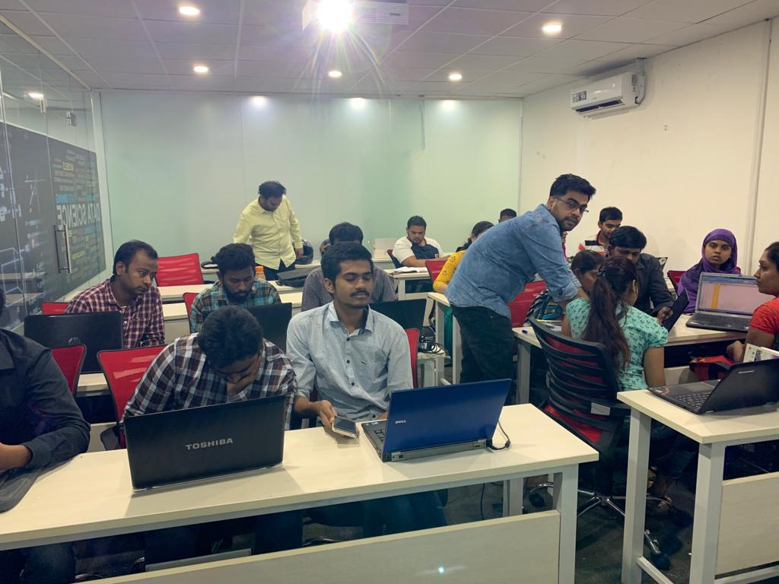


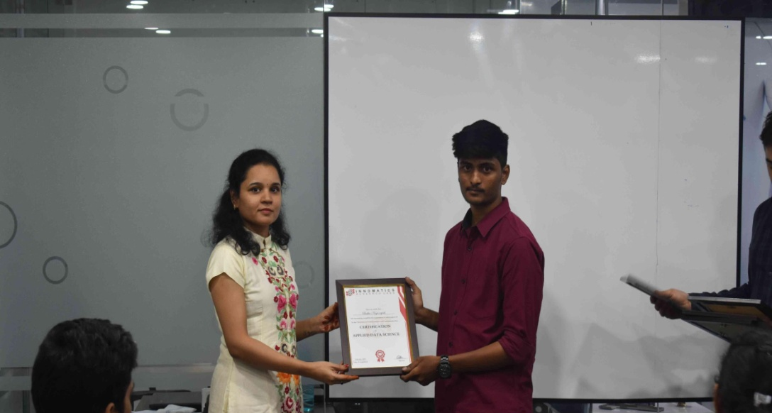
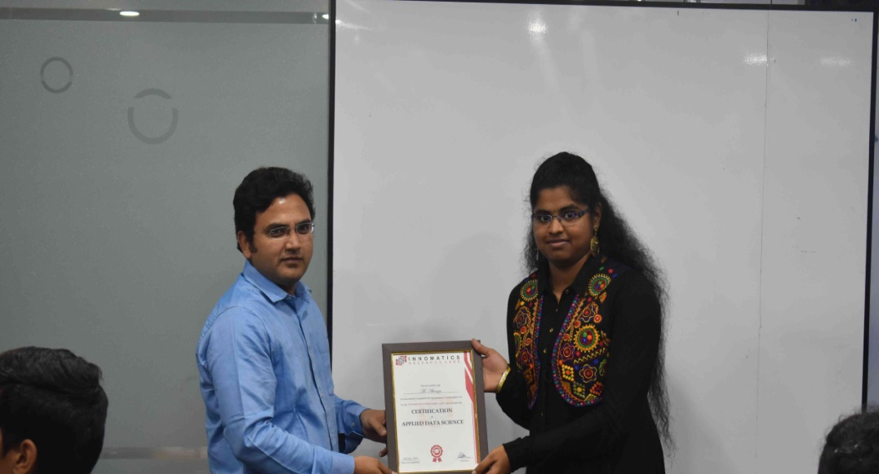

Slide 2
SWIGGY EDA
Performing Analysis on the data scraped from the Swiggy website and to obtain useful Insights out of it

Slide 3
About me
JASWANTH REDDY
B.Tech(Electronics and Communication Engineering)
I wanted to learn Data Science because of the fact that I enjoy solving real world problems using analytical approach
No Prior Working experience
Innomatics Research lab has Experienced Faculties to train and they also have Mentoring session to clarify doubts and improve our skills

Slide 4
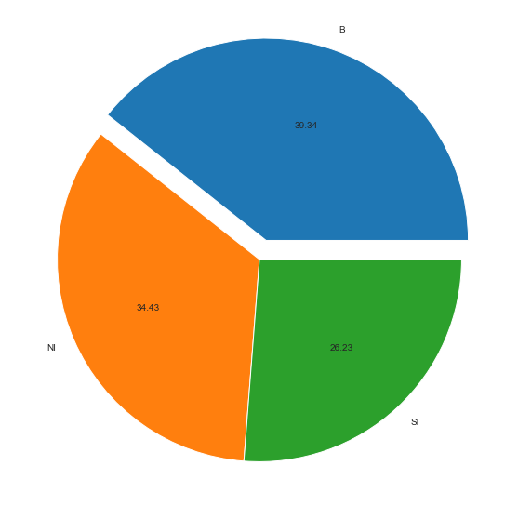
Types of Food Items
In Hyderabad most of the restaurants are popular for serving Biryani

Slide 5
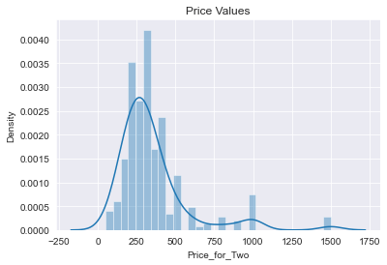
Price Values
Majority of Restaurants are having their Prices ranging between 200 and 400

Slide 6
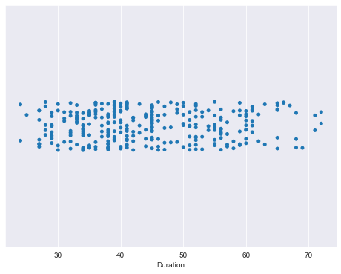
Delivery Time
Average Delivery time is in between 35 to 45 minutes

Slide 7
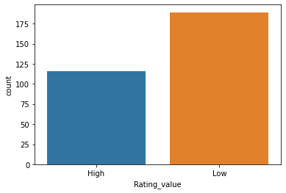
Ratings count
Restaurants with less number of user Ratings are higher

Slide 8
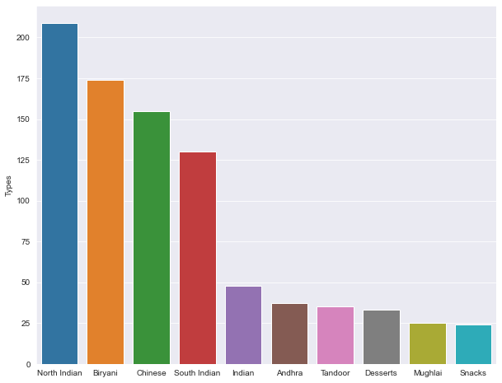
Food Types
North Indian is the Highest served Food type in Hyderabad followed by Biryani and Chinese

Slide 9
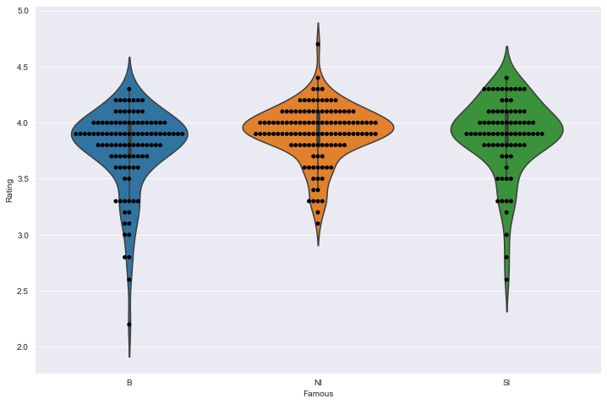
Rating and Famous Food type
Most of the rating lie between 3.8 and 4
North Indian has less variations when compared to Biryani and South Indian

Slide 10
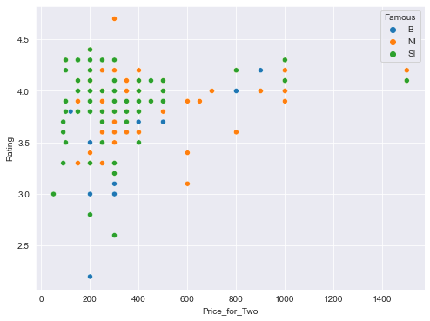
Rating and Price
South Indian has more variations in its Price values when compared to Biryani and North Indian

Slide 11
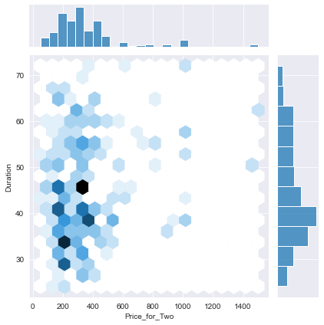
Duration and Price
The color density is more at Price values ranging between 200 & 400 and Delivery time between 35 & 45

Slide 12
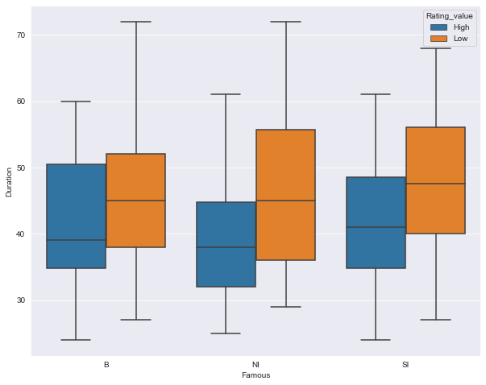
Delivery time and Famous Food type
Restaurants having more user Rating count are taking less time to Deliver their food

Slide 13
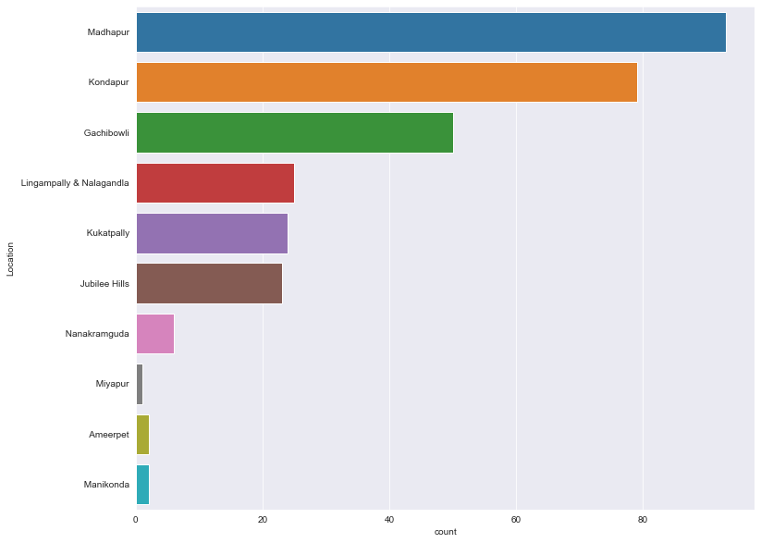
Location
Madhapur have more number of Restaurants followed by Kondapur and Gachibowli

Slide 14
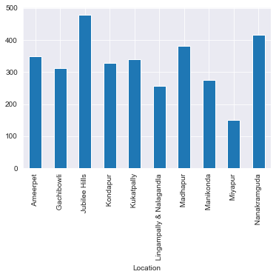
Location and Price
Jubilee Hills is having Expensive Restaurants in Hyderabad

Slide 15
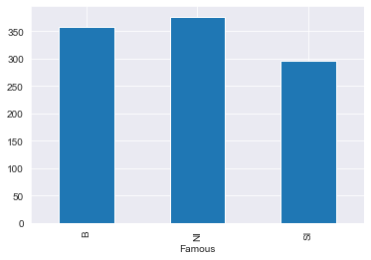
Price and Famous Food type
Price values of North Indian are higher than Biryani and South Indian

Slide 16
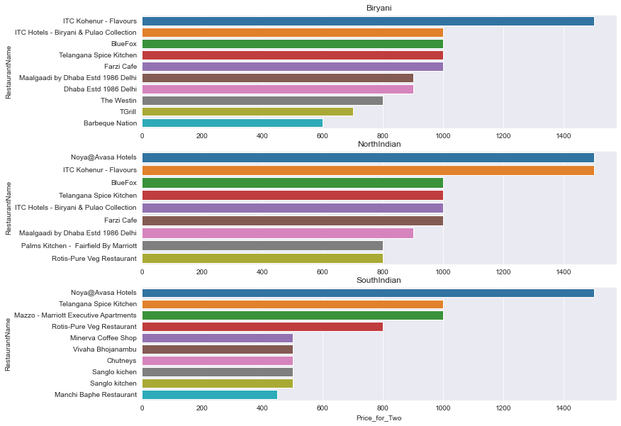
Top Restaurants and Price

Slide 17
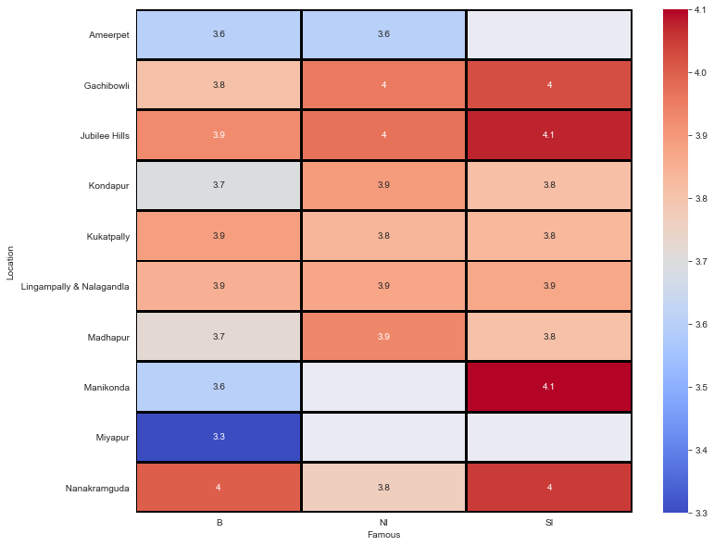
Location and Rating
Jubilee Hills, Madhapur and Nanakramguda are having restaurants with high rating
Miyapur and Ameerpet are having restaurants with low rating

Slide 18
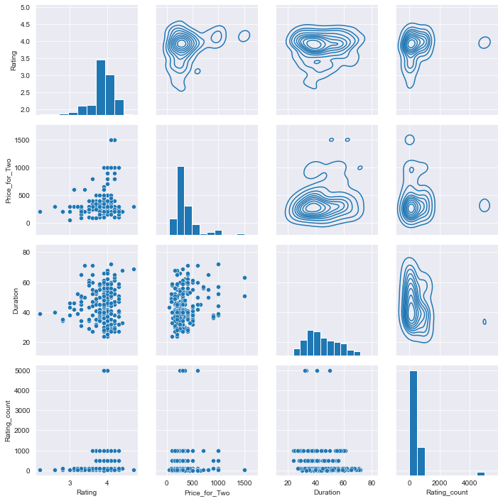
Pair Grid

Slide 19

THANK YOU

