Slide 1


OPERATING SYSTEMS
MINI PROJECT
ALARM CLOCK
SYSTEM
Linux-Based Alarm Management System | Processes, Signals and System Calls
Time Control
System Calls
Signals & Processes
Set, manage, and trigger alarms through a simple Linux interface.
Built around core operating system interactions for process control.
Uses process handling and signal-driven behavior for alarm execution.
Academic viva project focused on practical OS concepts with a clean Linux-based implementation.
Team Members
Roll No. | Name
2520030284 | T. JASWANTH REDDY
2520030239
2520030234
NEXT:
PROCESS FLOW
→
SIGNALS
→
SYSTEM CALLS

Slide 2
ABSTRACT
Project Overview
Alarm Clock System
Main Objective: Provide a reliable and automated time-management solution that reduces the possibility of missing important activities, appointments, classes, or wake-up times.
A simple and efficient system designed to help users manage their time and receive alerts at specified times.
Users can set, modify, and cancel alarms as required. When the current time matches the set alarm time, the system generates an alert through a buzzer, sound, or notification.
Designed to combine practicality with clear terminal-based interaction for everyday time management.
Real-Time Monitoring
Displays the current time and alarm status through a terminal interface.
Terminal Control
Automated Alerts
Simple Linux-based interaction
Timely reminders when alarms match
Core Concepts
Demonstrates conditional statements, loops, functions, and data structures.
Flexible Management
Set, modify, and cancel with ease
Advanced Features
Supports multiple alarms, snooze, labels, 12/24-hour formats, and custom sounds.
NEXT:
SYSTEM DESIGN
→
IMPLEMENTATION DETAILS

Slide 3

PROBLEM STATEMENT
Problem Statement
In today's busy lifestyle, people need to manage wake-up times, classes, appointments, meetings, and other important activities. Depending on memory or basic timekeeping methods can lead to missed or delayed tasks.
Timely Alerts
Multiple Alarms
Generates alerts using buzzer, sound, or notification when scheduled time is reached
Supports multiple alarms and snooze functionality for flexible scheduling
Reminder Management
Better Productivity
Addresses the difficulty of efficiently managing multiple time-based reminders
Helps users avoid missing important activities and improves overall time management
Solution: The Alarm Clock System provides a simple, reliable, and user-friendly solution — allowing users to view the current time and set, modify, or delete alarms through a Linux terminal interface.
NEXT:
SYSTEM OVERVIEW
→
PROBLEM SOLVED THROUGH AUTOMATED ALERTS

Slide 4

INTRODUCTION
Introduction
System Implementation: Linux-based C/C++ application demonstrating core OS concepts
User Input
Process Creation
User enters alarm time through Linux terminal
Child process created using fork(); parent and child communicate via signals
User Input
Process Creation
Time Monitoring
Alarm Trigger
Synchronization
Time Monitoring
Synchronization
Application continuously monitors system time for alarm match
wait() used for process synchronization; alarm can be stopped, cancelled, or controlled
Next: Follow the flow from implementation to system behavior as the alarm logic moves into runtime execution.
Terminal-Based Control
Multi-Process Design
Signal Communication
Real-Time Alerting
Stardust-style visual flow: bright step colors, clear process separation, and stronger emphasis on the Linux OS implementation.

Slide 5

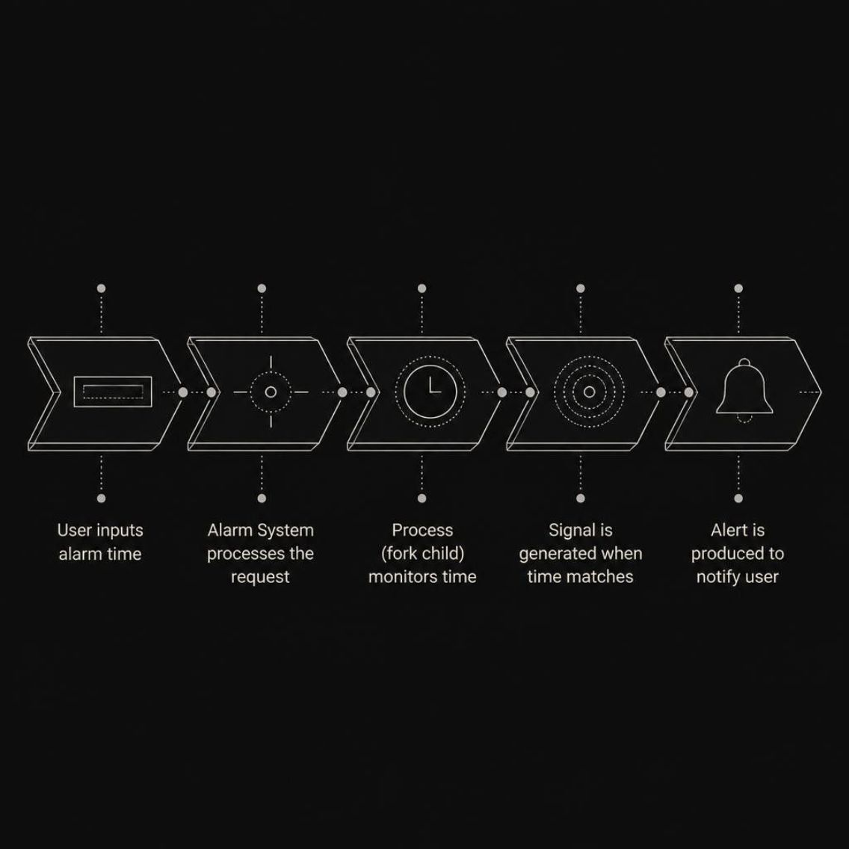
Expected Outcome
Alarm Management
DATA FLOW
Successfully set and manage alarms through Linux terminal; allow user to stop or cancel alarm
From input to alert
OS Concepts Demonstrated
The alarm workflow moves through a clear sequence, from terminal entry to the final user notification.
Process creation using fork(), signal handling, inter-process communication, and process synchronization using wait()
Practical Learning
Provide practical understanding of Linux OS concepts; reduce missed reminders and improve time management
NEXT:
IMPLEMENTATION DETAILS
Terminal-Based Control
Multi-Process Design
Signal Communication
Real-Time Alerting
Stardust-style visual flow: bright step colors, clear process separation, and stronger emphasis on the Linux OS implementation.

Slide 6


Components & System Calls Used
NEXT:
SYSTEM WORKFLOW
HARDWARE STACK
OS CONCEPTS / SYSTEM CALLS
HARDWARE / DEV ENVIRONMENT
fork()
Development Stack
1
Creates a child process
getpid() / getppid()
Hardware
2
Gets the process ID and parent process ID
Computer / Laptop
3
signal() / sigaction()
OS
Handles signals between processes
Linux / Ubuntu Operating System
4
kill()
Sends signals between processes
Tools
GCC Compiler & Terminal
5
wait()
Synchronizes parent and child processes
Alert
6
SIGSTOP / SIGCONT / SIGTERM
Buzzer / Speaker (optional physical alert)
Pauses, resumes, and safely terminates a process
Note: Core project is primarily a Linux software implementation.
Vibrant signal flow powers the alarm logic.
FLOW
BUILD
TEST
ALERT
→ System calls connect process control to the final alarm response, creating a clear bridge into the next topic.

Slide 7
VIVA PRESENTATION
OPERATING SYSTEMS
CLOSING SLIDE
Thank You
Alarm Clock System | Operating Systems Mini Project | Linux-Based C/C++ Implementation
Project Focus
Thank you for listening
Questions?
Process creation, signals, synchronization, and timed alerts
We welcome your questions and feedback.
We're happy to discuss design choices, implementation details, and results.
Platform
PROCESS CONTROL
SIGNALS
LINUX
Linux-based development with GCC and terminal tools
Core Idea
Simple, interactive system behavior with clear process control
Designed for a confident academic viva and a clear project wrap-up.
Next: Q&A
Next: Review
Next: Wrap-up
Open discussion on implementation and outcomes.
Key design choices and system call flow.
Final thoughts and project takeaways.
→ Progressive flow to the next topic →
Thank you. Looking forward to your questions.

