Slide 1
Car Rental Fleet Management
Vadlapatla Jaswin 2620030148
Viswa Aditya 2620040108

Slide 2
Abstract
This project is a simple Car Rental Fleet Manager program that helps a rental business keep track of its cars, bookings, and returns without the usual paperwork hassle. It lets the admin add new cars to the fleet, rent them out to customers, process returns, and keep an eye on which vehicles need maintenance.
To make all this work smoothly, the program relies on some basic but powerful programming logic. Whenever someone wants to rent a car, an if-else check makes sure that car is actually free before confirming the booking, so two people can't accidentally book the same vehicle. A switch statement is used to sort cars by type—like hatchback, sedan, or SUV—so each one can be rented at the right price. To help the admin see the entire fleet at a glance, a for loop goes through the list of cars and displays them all, showing what's available and what's already rented out. And to keep the whole system running smoothly, a while loop keeps the program active in a loop, letting the user rent, return, or check on cars again and again until they decide to exit.

Slide 3
Understanding Problem Statement
Manual tracking is error-prone: keeping track of cars, bookings and returns on paper is slow and leads to mistakes.
Double booking risk: two customers can accidentally book the same vehicle if availability is not checked.
Charges vary: the total depends on days rented, the rate for each vehicle type, and late fees.
Maintenance gaps: cars that need service must be flagged and kept out of circulation until cleared.
Goal: a Java program that handles the fleet, rentals, returns and maintenance using control statements.

Slide 4
Module 1: From Problem to Program
Problem solving: computational thinking, algorithm and flowchart
Java basics: Java environment, program structure, primitive data types, variables, constants, literals
Operators: arithmetic, relational, logical, assignment, ternary, unary, special, bitwise
Expressions: typecasting, precedence and associativity
Console I/O: formatted printing, reading input with Scanner

Slide 5
Module 2: Control Flow
Selection: if, if-else, nested-if, if-else-if ladder
Switch: default, break, compound statements
Loops: while, do-while, for
Loop control: continue, infinite loops, nested loops

Slide 6
Module 3: Methods & Arrays
Methods: definition, invocation, parameter passing, return values, overloading
Recursion: base case and recursive case
Loops: enhanced for-each loop
1D arrays: traversal, searching, summation, average, counting
2D arrays: matrix arithmetic

Slide 7
Module 4: OOP & Exceptions
Classes and objects: fields, methods, new, null, constructors (default, parameterized, overloading), this
Encapsulation: private fields, accessors/mutators, static members, toString()
Inheritance: is-a relationships, method overriding, interfaces, programming to interfaces
Exceptions: checked vs unchecked, try-catch-finally, multi-catch, throw, throws

Slide 8
Module 5: Strings & File I/O
Strings: immutability, length, substring, comparison (equals vs ==), StringBuilder and StringBuffer
Text handling: split(), join(), trimming, validation, tokenization
Library algorithms: Arrays.sort(), Collections.sort(), binarySearch(), Comparable and Comparator
File I/O: Files and Path, buffered readers/writers, try-with-resources

Slide 9
Module 6: Collections & Streams
Collections: List, Set, Map using ArrayList, HashMap, HashSet; generics and autoboxing
Functional style: lambda expressions, method references, Predicate, Function, Consumer, Supplier
Streams: filter, map, sorted, distinct, limit; forEach, collect, count, reduce
Collectors: toList, groupingBy, counting, joining

Slide 10
Conclusion
Complete solution: the Car Rental Fleet Manager covers 4 features: add vehicles, rent car, return car and maintenance tracking.
4 control statements: if-else checks availability, switch handles vehicle type, for loop displays the fleet, while loop runs the rental menu.
Takeaway: a few simple programming tools, used the right way, can solve a real everyday business problem.

Slide 11
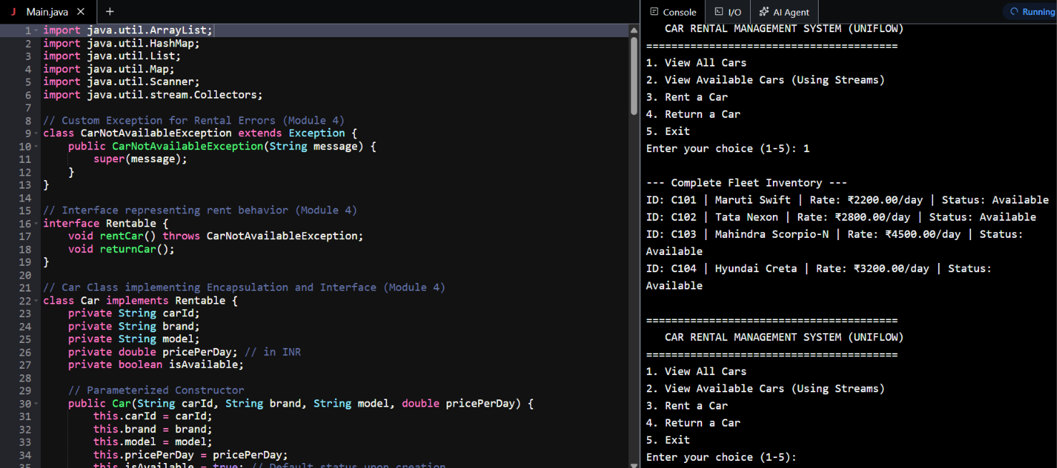
Screen Shots

Slide 12
Geo Tag Photo and git hub link

