Slide 1
STATSGEEKS · COORDINATE-RF
Building-age transfer with scarce labels
Madrid → Amsterdam
0.749299
We classify four building-construction eras from 30 m Landsat pixels. Coordinate-RF combines a Madrid-learned prior with a target-support random forest, whitened spectral features and spatial context. On the frozen Amsterdam random-pixel protocol it reaches 0.749299 macro-F1 at 200 labels per class. The method uses the full unlabelled target pool and an additional development label bank; spatial extrapolation remains a limitation.
Locked macro-F1
200 labels/class
200 paired episodes
Frozen evidence: FINAL_SUBMISSION/results_summary/learning_curve.csv
01 / 10
Notes:
Speaker 1. First-slide abstract, under 150 words. Introduce the problem and the exact scope, not just the score.

Slide 2
01 · PROBLEM & MOTIVATION
A useful urban signal, with imperfect labels
Why age?
What data?
What task?
Retrofit planning
Energy-policy evidence
Incomplete records
Six spectral bands
1984–2025 imagery
30 m mixed pixels
Four construction eras
Madrid source city
Amsterdam target city
76,263 source pixels · 25,992 target pixels · 60 spectral features
Data: organizer notebooks; docs/MASTER_PLAN.md dataset summary
02 / 10
Notes:
Speaker 1. Age supports retrofit and energy planning. Explain mixed-pixel labels and different oldest-era boundaries.

Slide 3
02 · CHALLENGE UNDERSTANDING
Transfer must work when labels are scarce
Cross-city shift
Few-label adaptation
Spectral and spatial patterns differ.
Source knowledge needs adaptation.
5 / 25 / 50 / 100 / 200 labels per class.
Only designated support labels fit the local RF.
25 labels/class = 100 target support labels
The additional 800-label development bank is separate research supervision.
Protocol: candidate/reports/METHODS.md; locked learning-curve CSV
03 / 10
Notes:
Speaker 1 → Speaker 2. The 25-shot result is important to the rubric. Macro-F1 gives each class equal weight.

Slide 4
03 · PIPELINE
One source prior, one local adaptation branch
Madrid source branch
Amsterdam local branch
Contextual spectral features
Covariance alignment + refinement
Frozen source probability prior
Full-pool adaptive whitening
Two standardized coordinates
Support-only 200-tree RF
↓
↓
Blend probabilities → nine-neighbour smoothing → classes
Method: candidate/reports/METHODS.md; frozen model configuration
04 / 10
Notes:
Speaker 2. Historical learning pipeline, not executed during release. Two source RFs produce the cached prior. Only support labels fit the target RF.

Slide 5
04 · DESIGN RATIONALE & CREATIVITY
The contribution is the combination
Source reuse
Local geometry
Spatial context
Source probability weight:
20 / (20 + 4b)
Less weight as support grows.
Adaptive whitening
Spectral + coordinate inputs
Balanced random forest
Label-free smoothing
Nine spatial neighbours
Full-pool access required
b = labels/class. Components interact; ablation bars are not additive causal effects.
Mechanism evidence: candidate/reports/RESULTS.md and METHODS.md
05 / 10
Notes:
Speaker 2. Explain rationale without presenting entangled ablations as additive causal effects. No novelty claim for RF itself.

Slide 6
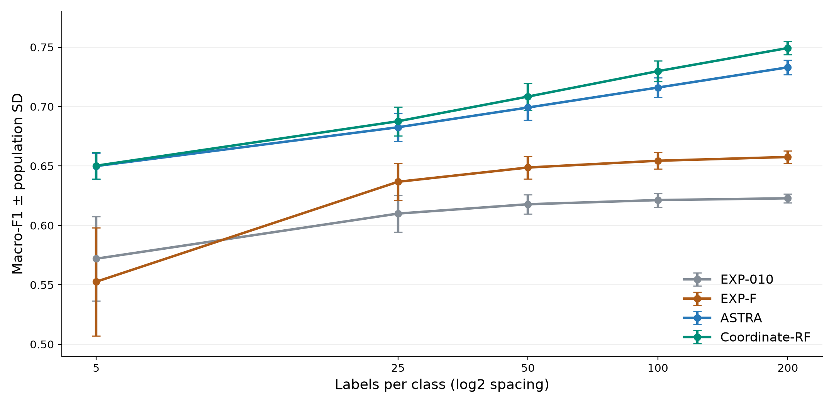
05 · LOCKED LEARNING CURVE
Performance improves as target support grows
25 / class
0.687664
200 / class
0.749299
SD is episode spread, not a confidence interval.
Source: FINAL_SUBMISSION/results_summary/learning_curve.csv · no new predictions
06 / 10
Notes:
Speaker 3. Explain every budget and population SD. These are 200 paired episodes per budget on one fixed city. ASTRA, EXP-F and EXP-010 are historical comparison methods.

Slide 7
06 · RESULT INTERPRETATION
A strong fixed-city result—not universal superiority
200 labels/class
What the evidence says
Coordinate-RF: 0.749299 ± 0.005716
Matched ASTRA: 0.733037
Mean gain: +0.016262
200/200 paired wins at 200/class
Five-shot superiority is inconclusive
One shared target-city population
The 800-label development bank and current support are excluded from final queries.
Paired evidence: candidate/reports/RESULTS.md and STATISTICAL_ANALYSIS.md
07 / 10
Notes:
Speaker 3. At 200/class, compare Coordinate-RF with ASTRA on matched episodes. Do not infer independent-city significance from the paired tests.

Slide 8
07 · ANALYSIS & LIMITATIONS
Spatial extrapolation reveals the trade-off
Four-direction mean
Worst-direction mean
Coordinate-RF: 0.694216
Matched ASTRA: 0.696672
Coordinate-RF: 0.644816
Matched ASTRA: 0.658183
Coordinates help within this pool; they do not establish transfer to new geography.
Frozen spatial evidence: candidate/reports/SPATIAL_ANALYSIS.md
08 / 10
Notes:
Speaker 3 → Speaker 4. Lower spatial means are material negative evidence. Different query geography prevents equating spatial and random-pixel scores.

Slide 9
08 · ENGINEERING & INTEGRITY
Frozen evidence, explicit reproducibility boundaries
What is preserved
What is not claimed
Model + configuration + ordered inputs
Notebook outputs + result tables
Manifest and SHA-256 checksums
Fresh training or runtime replay here
A self-contained raw-data rebuild
Organizer-held-out validation
Safe audit: python -B scripts/validate_release.py
Verification: scripts/validate_release.py; FINAL_SUBMISSION/manifest.json
09 / 10
Notes:
Speaker 4. Hash checks are safe; --verify is not just a checksum command and fits support RFs. Explain the pool-bound artifact and distinguish static checks from runtime reproduction.

Slide 10
09 · CONCLUSION & FUTURE WORK
A clear result—and a clear next test
Coordinate-RF · macro-F1 0.749299
200 labels/class · fixed-city random-pixel evaluation
Before competition upload
Next research—not run
Confirm full-pool, coordinate and
additional-supervision eligibility.
Independent-city / spatial validation
Portable inference for new target pools
Start here: docs/judge/START_HERE.md · results remain locked
10 / 10
Notes:
Speaker 4. Close with exact score and scope. Future work is proposed, not performed. All four speakers should rehearse handoffs. Take questions on source transfer, the 25-shot regime, extra supervision and spatial limitations.

