Slide 1
STATSGEEKS · BUILDING-AGE TRANSFER LEARNING
Transfer that actually transfers
Building age drives urban retrofit and energy policy, but records are incomplete. We classify the construction era of buildings within 30-metre Landsat pixels into four classes, training on Madrid and adapting to Amsterdam with as few as five labelled examples per class. The organiser's starter pipeline appears to perform transfer learning but does not: its Madrid-trained Random Forest is discarded, and Amsterdam prototypes are computed from Amsterdam data alone. We reproduced that baseline exactly, then built a method that genuinely reuses Madrid-learned state. Our contribution is prototype shrinkage. An Amsterdam class mean estimated from five pixels is nearly unbiased but very noisy, so we shrink it toward Madrid's class geometry, with the weight falling as target data grows. Five-shot macro F1 rises by 0.0487 over the starter, winning 47 of 50 paired episodes. The optimal shrinkage declines monotonically with budget, exactly as shrinkage theory predicts.
Abstract · 145 words

Slide 2
THE PROBLEM
How old are these buildings?
Four construction eras, per 30 m Landsat pixel
Train on Madrid → adapt to Amsterdam
As few as five labelled examples per class
Metric: four-class macro F1
76k
26k
42
5
Madrid pixels
Amsterdam pixels
years of imagery
labels, worst case
M1

Slide 3
THE DATA
Construction leaves a spectral fingerprint
Six spectral bands · once a year · 1984–2025
A field becomes a roof. Concrete weathers.
42-year trajectory → 60 summary features
Labels are area-weighted averages — noisy by construction
One pixel can hold a 1950s block and a 2010s block — and gets a label describing neither.
There is a ceiling below 1.0. Nobody knows where it is.
M2

Slide 4
WHAT WE FOUND
The starter's transfer learning transfers nothing
1. Train a Random Forest on Madrid
2. Throw it away
3. Build Amsterdam prototypes from
Amsterdam data alone
Madrid contributes only a scaler
More labels ≠ more transfer
It just measures Amsterdam-only learning
The rubric can disqualify for this.
And that flaw became our best instrument.
It touches no tree code — so it proved our data pipeline was identical, and isolated a scikit-learn version difference in the baseline.
M2 → M3

Slide 5
OUR METHOD
We transfer a metric, not a classifier
1. Learn
2. Freeze
3. Project
4. Prototype
a transform on Madrid only
never refit on Amsterdam
push Amsterdam through it
class means from support labels
Madrid teaches which measurements matter
Amsterdam supplies the examples
Query labels never touched — evaluation only
3 KB
244 MB
what we ship
the forest behind it
M3

Slide 6
RESULTS
Better at every budget
shots/class
starter
ours
gain
won
+9.7%
5
0.5038
0.5524
+0.0487
8/10
25
0.6037
0.6122
+0.0085
9/10
50
0.6090
0.6173
+0.0083
at five shots
10/10
100
0.6087
0.6195
+0.0108
10/10
200
0.6135
0.6240
+0.0105
10/10
47/50
episodes won
Same pixels. Same episodes. Same environment. The only thing that differs is the method.
M3

Slide 7
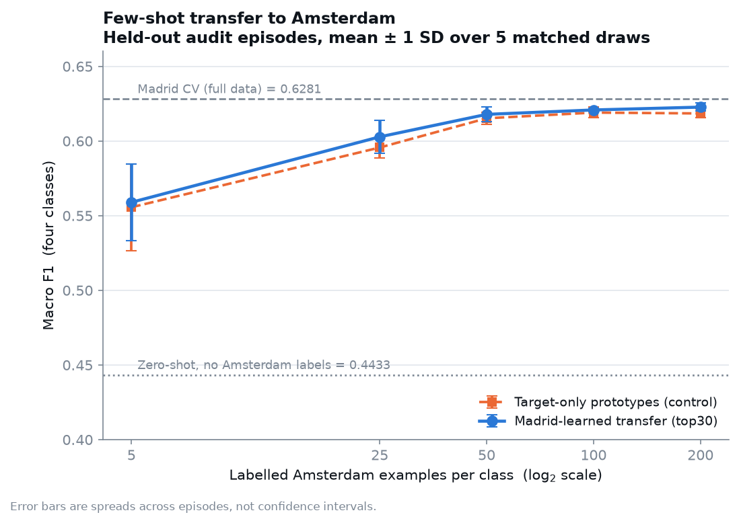
LEARNING CURVE
The gain is where the data is scarcest
Five shots is the hard case
That is where transfer should matter
And that is where it does
Beyond 25 shots, Amsterdam has
enough data of its own
M3

Slide 8
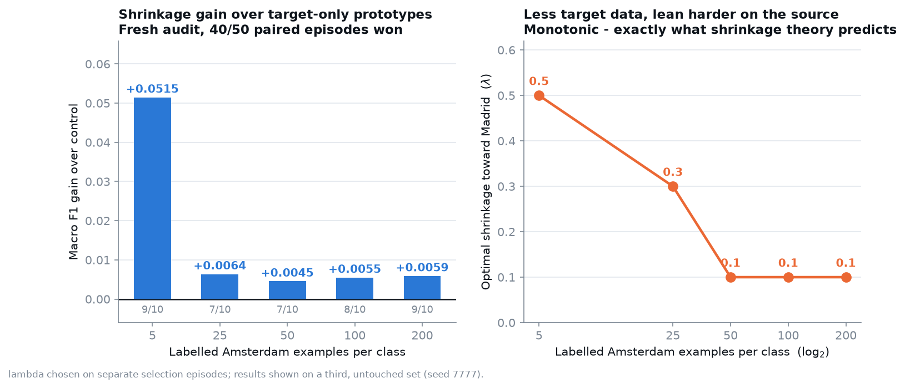
THE FINDING
Two knobs. Both depend on how much data you have.
λ — how much we trust Madrid over Amsterdam
k — how many features we keep
Less data → lean on Madrid, use fewer features
More data → trust Amsterdam, afford more features
shots
features (k)
shrinkage (λ)
We did not impose this. It is what shrinkage
5
30
0.6
theory predicts, recovered from the data.
25
45
0.0
50
45
0.0
100
45
0.0
200
45
0.0
M4

Slide 9
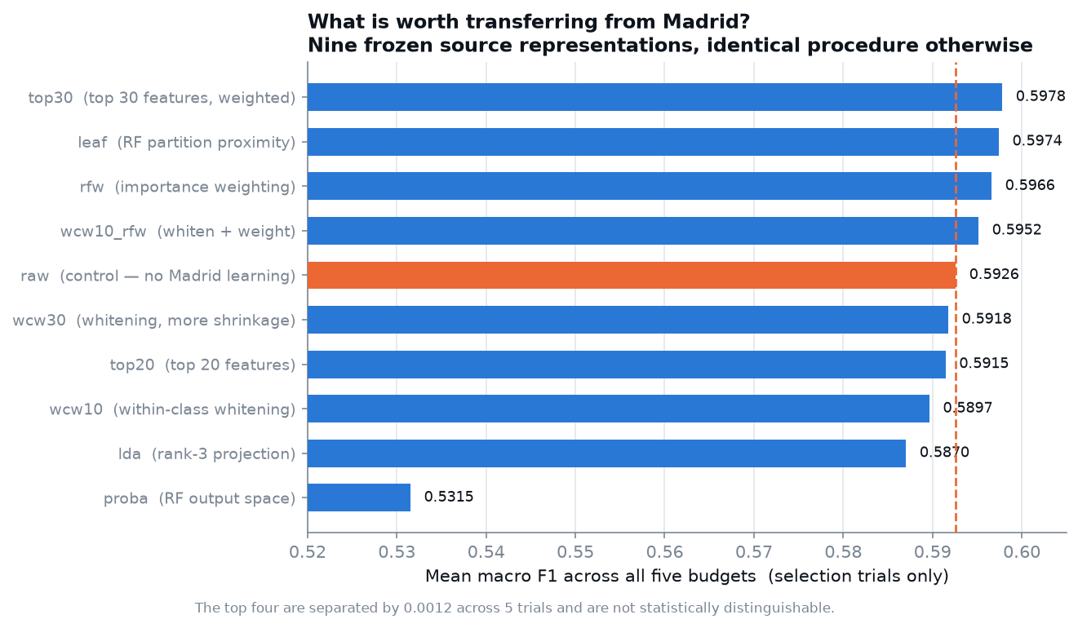
ABLATIONS
Three things we tried that did not work
Rank-3 LDA
compresses 60 dims to 3 — loses too much
RF probability space
worst of nine — 4 dims is not enough
94 season-aware features
informative but dilutive — noisier prototypes
All three: too few dimensions, or too many.
M4

Slide 10
HONESTY
What we are not claiming
Gains beyond five shots are ~1.5% — small
Error bars are spreads, not confidence intervals
Confusion diagonals are recall, not F1
Accuracy would have flattered us — we report macro F1
We do not compare to the organiser's published numbers
Why not?
Different episodes and a different scikit-learn. Our own reproduction of their method scores 0.5038 at five shots against their published 0.5437 — same code, different draws. Comparing across them would invent an improvement.
M4

Slide 11
STATED, NOT HIDDEN
Limitations
1. Features still built label-dependently — no hidden-test path yet
2. Scaling fitted before cross-validation — not fold-safe
3. λ schedule: five values from five selection trials — overfit risk
4. Optimal k moves once (30→45) — weak evidence for a trend
5. Near a label-noise ceiling — three independent lines of evidence
No claims of worldwide portability. No claims of calibrated confidence.
M4

Slide 12
CONCLUSION
The starter's transfer transferred nothing. We proved it.
We built one that does, and measured it honestly.
Better at every budget. +9.7% where data is scarcest.
A number without a mechanism is not a finding.

Slide 13
BACKUP
Reproducibility
requirements.txt pins the exact stack
Raw data + feature cache SHA256 recorded
Episode indices stored, not regenerated from a seed
Stage 1 artifact 3 KB · reload test 17/17 in a clean session
Seeds fixed throughout · 12 commits · tagged
Cold-start reproduction: ~35 minutes

Slide 14
BACKUP
Why our baseline differs from the organiser's
All six prototype budgets match them to 4 decimal places
Both Random-Forest results differ: +0.0102 and +0.1006
The prototype path never uses the forest — it isolates the cause
Determinism: 0 of 25,992 predictions differ across two refits
Still inferred, not measured — we did not install their version

Slide 15
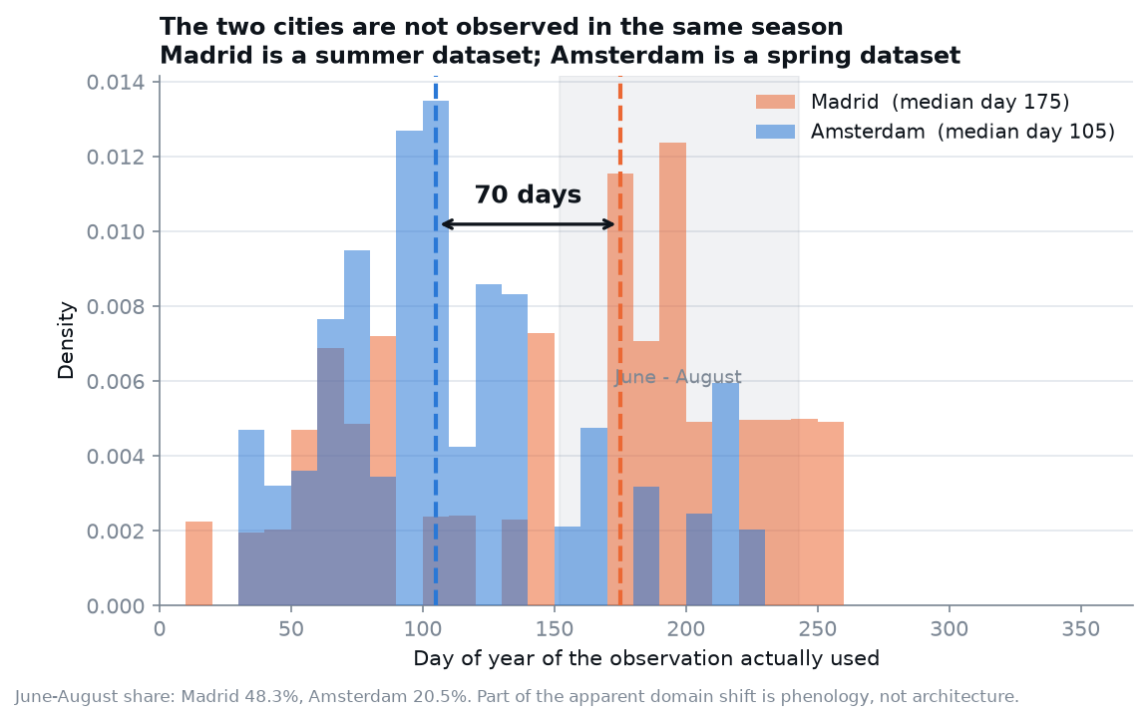
BACKUP
A 70-day seasonal offset between the cities
Madrid median day 175 · Amsterdam day 105
June–August: 48.3% vs 20.5%
Part of the domain shift is phenology, not architecture
We rebuilt features to control for it
It did not help — dilution outweighed the correction
Reported as a measured finding with a negative test

Slide 16
BACKUP
The episode protocol
One permutation per class per trial; budgets read prefixes
So budgets are nested: support(5) ⊂ support(25) ⊂ …
Support and query disjoint, verified in code every episode
Selection and audit sets never overlap
Four independent seeds used across the project
Query set shrinks unevenly as budget grows — a stated limitation

