Slide 1
StatsGeeks | Coordinate-RF
Building-age classification: Madrid → Amsterdam
Final selected incumbent; reproducible full-pool few-shot inference.
200-shot macro-F1: 0.749299 ± 0.005716.
Existing locked audit, not a new independent test.
Notes:
Evidence: existing locked final_complete.json and spatial_complete.json. No independent organizer validation. Building-age classification: Madrid → Amsterdam
Final selected incumbent; reproducible full-pool few-shot inference.
200-shot macro-F1: 0.749299 ± 0.005716.
Existing locked audit, not a new independent test.

Slide 2
Problem and task
Four building-age classes; 60 ordered spectral features.
Labelled Madrid source; small balanced Amsterdam support.
Budgets: 5 / 25 / 50 / 100 / 200 labels per class.
Macro-F1 gives equal weight to each class.
Organizer data needed for raw training; pool-bound inference artifact supplied.
Notes:
Evidence: existing locked final_complete.json and spatial_complete.json. No independent organizer validation. Four building-age classes; 60 ordered spectral features.
Labelled Madrid source; small balanced Amsterdam support.
Budgets: 5 / 25 / 50 / 100 / 200 labels per class.
Macro-F1 gives equal weight to each class.
Organizer data needed for raw training; pool-bound inference artifact supplied.

Slide 3
Starting point and experimental journey
EXP-010: source-selected weighted prototypes.
EXP-F: covariance-aware metric adaptation.
ASTRA: source prior, adaptive whitening, forest, graph.
Coordinate-RF: append standardized coordinates to local inputs.
Overnight discovery uses development support only; no query-driven selection.
Notes:
Evidence: existing locked final_complete.json and spatial_complete.json. No independent organizer validation. EXP-010: source-selected weighted prototypes.
EXP-F: covariance-aware metric adaptation.
ASTRA: source prior, adaptive whitening, forest, graph.
Coordinate-RF: append standardized coordinates to local inputs.
Overnight discovery uses development support only; no query-driven selection.

Slide 4
Challenges and failed approaches
Domain shift, scarce labels, noisy mixed-pixel age classes.
Historical support-only alternatives: ExtraTrees, boosted trees, covariance blends, wider graphs and ensembles.
They did not replace the development-locked Coordinate-RF under the documented gates.
Overnight results are exploratory, not new headline evidence.
Notes:
Evidence: existing locked final_complete.json and spatial_complete.json. No independent organizer validation. Domain shift, scarce labels, noisy mixed-pixel age classes.
Historical support-only alternatives: ExtraTrees, boosted trees, covariance blends, wider graphs and ensembles.
They did not replace the development-locked Coordinate-RF under the documented gates.
Overnight results are exploratory, not new headline evidence.

Slide 5
Transfer-learning insight
Source information survives as an aligned probability prior.
120 contextual source features; covariance transport.
One pseudo-class refinement uses predictions, never target truth.
Two source RF200/leaf2 models; blend decreases as support grows.
Notes:
Evidence: existing locked final_complete.json and spatial_complete.json. No independent organizer validation. Source information survives as an aligned probability prior.
120 contextual source features; covariance transport.
One pseudo-class refinement uses predictions, never target truth.
Two source RF200/leaf2 models; blend decreases as support grows.

Slide 6
Final method
Unlabelled-pool covariance → budget-adaptive diagonal shrinkage.
Whiten 60 inputs; append standardized lattice x/y.
Fit balanced RF200, leaf1, sqrt features, seed42 on support only.
Blend source prior: alpha=20/(20+4b).
Gaussian smoothing: 9 neighbours, sigma1, one step.
Notes:
Evidence: existing locked final_complete.json and spatial_complete.json. No independent organizer validation. Unlabelled-pool covariance → budget-adaptive diagonal shrinkage.
Whiten 60 inputs; append standardized lattice x/y.
Fit balanced RF200, leaf1, sqrt features, seed42 on support only.
Blend source prior: alpha=20/(20+4b).
Gaussian smoothing: 9 neighbours, sigma1, one step.

Slide 7
Why it works — and assumptions
Spectral covariance adapts to target distribution.
Coordinates help interpolate local geography.
Source prior matters most when labels are scarce.
This is transductive/full-unlabelled-target inference.
Coordinates, pool membership and extra development supervision require organizer eligibility confirmation.
Notes:
Evidence: existing locked final_complete.json and spatial_complete.json. No independent organizer validation. Spectral covariance adapts to target distribution.
Coordinates help interpolate local geography.
Source prior matters most when labels are scarce.
This is transductive/full-unlabelled-target inference.
Coordinates, pool membership and extra development supervision require organizer eligibility confirmation.

Slide 8
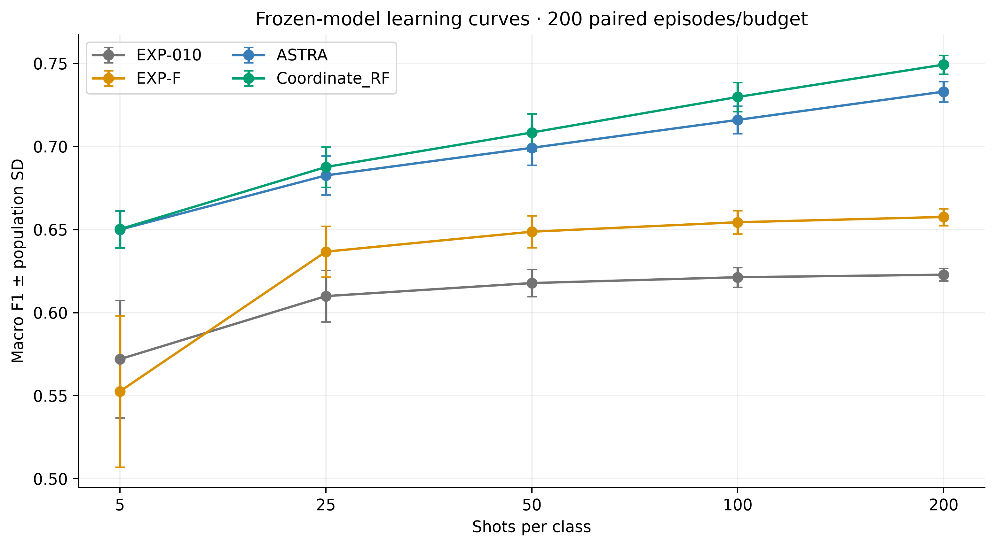
Locked learning curve
5: 0.650253 ± 0.011246
25: 0.687664 ± 0.012145
50: 0.708436 ± 0.011277
100: 0.729839 ± 0.008802
200: 0.749299 ± 0.005716
Notes:
Evidence: existing locked final_complete.json and spatial_complete.json. No independent organizer validation. 5: 0.650253 ± 0.011246
25: 0.687664 ± 0.012145
50: 0.708436 ± 0.011277
100: 0.729839 ± 0.008802
200: 0.749299 ± 0.005716

Slide 9
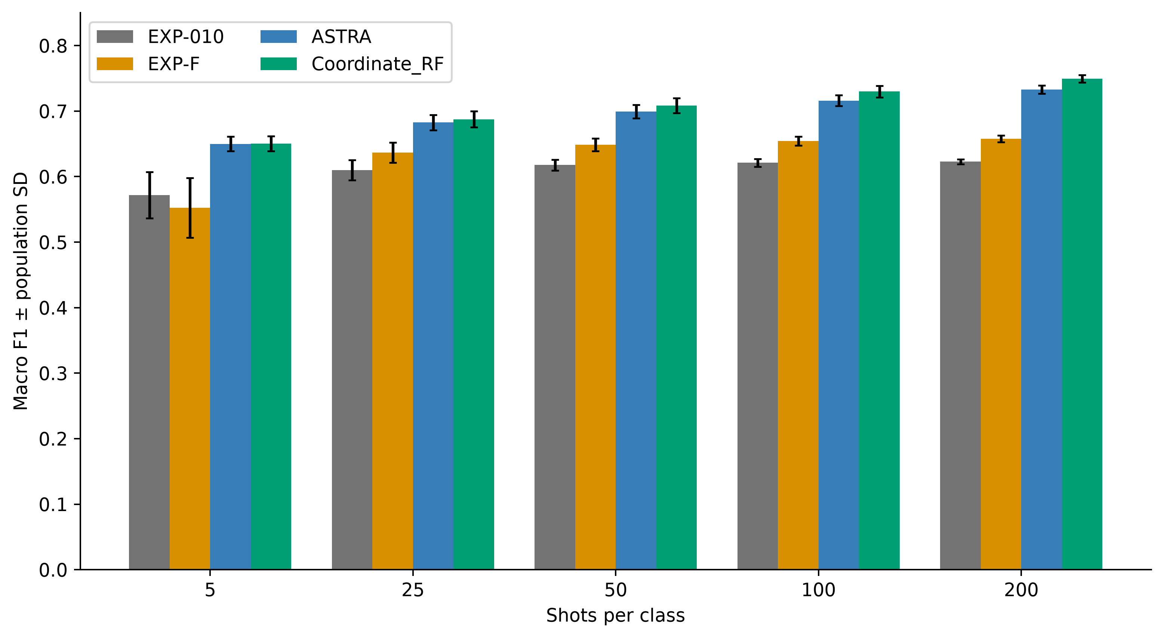
Matched comparisons at 200 shots
Coordinate-RF 0.749299; 200 episodes.
Gain vs ASTRA +0.016262; 200/200 wins.
Gain vs EXP-F +0.091697.
Gain vs EXP-010 +0.126459.
Inductive controls have different information access.
Five-shot advantage over ASTRA is negligible.
Notes:
Evidence: existing locked final_complete.json and spatial_complete.json. No independent organizer validation. Coordinate-RF 0.749299; 200 episodes.
Gain vs ASTRA +0.016262; 200/200 wins.
Gain vs EXP-F +0.091697.
Gain vs EXP-010 +0.126459.
Inductive controls have different information access.
Five-shot advantage over ASTRA is negligible.

Slide 10
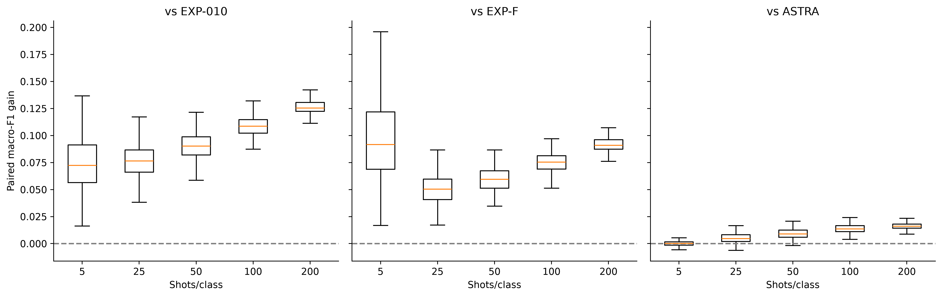
Paired gains and uncertainty
Matched support episodes on one fixed city.
Error bars/intervals quantify support sampling only.
Repeated query pixels imply correlated episodes.
No independent-city or organizer-test claim.
Notes:
Evidence: existing locked final_complete.json and spatial_complete.json. No independent organizer validation. Matched support episodes on one fixed city.
Error bars/intervals quantify support sampling only.
Repeated query pixels imply correlated episodes.
No independent-city or organizer-test claim.

Slide 11
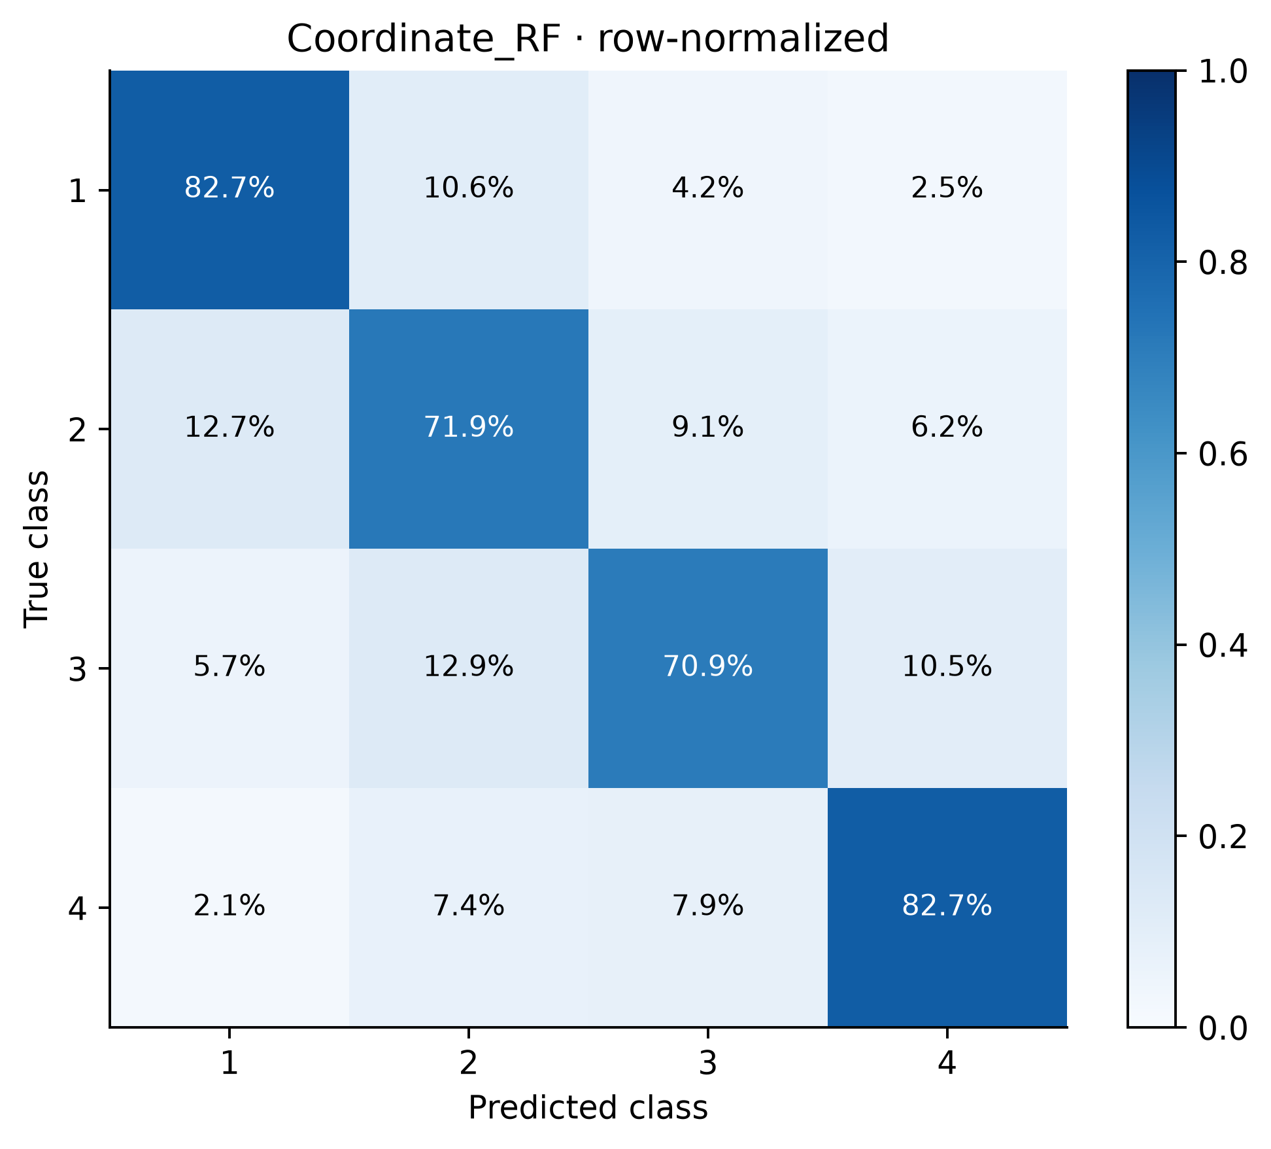
Class-level performance
Saved locked predictions/confusion matrices.
Macro-F1 is the mean of four class F1 values.
Pooled confusion is descriptive; not mean episode F1.
Notes:
Evidence: existing locked final_complete.json and spatial_complete.json. No independent organizer validation. Saved locked predictions/confusion matrices.
Macro-F1 is the mean of four class F1 values.
Pooled confusion is descriptive; not mean episode F1.

Slide 12
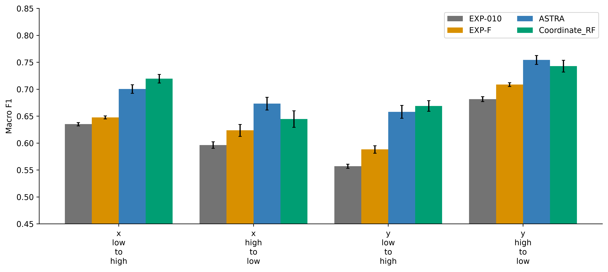
Spatial stress: all directions
200/class; opposite half; 10-key-unit buffer.
x-low .719836; x-high .644816.
y-low .669160; y-high .743052.
Mean .694216; worst .644816.
ASTRA mean .696672; worst .658183.
Coordinates improve interpolation, not all extrapolation.
Notes:
Evidence: existing locked final_complete.json and spatial_complete.json. No independent organizer validation. 200/class; opposite half; 10-key-unit buffer.
x-low .719836; x-high .644816.
y-low .669160; y-high .743052.
Mean .694216; worst .644816.
ASTRA mean .696672; worst .658183.
Coordinates improve interpolation, not all extrapolation.

Slide 13
Reproducibility
Existing clean source refit: 4000 exact prediction arrays / 1000 episodes.
Overnight fresh source refit: eight exact state arrays and five-budget replay.
Current package: clean-process five-budget cached replay.
Notebook executed sequentially in a fresh Python process.
Hashes, feature order, config, seeds and provenance included.
Query truth is absent from inference inputs.
Notes:
Evidence: existing locked final_complete.json and spatial_complete.json. No independent organizer validation. Existing clean source refit: 4000 exact prediction arrays / 1000 episodes.
Overnight fresh source refit: eight exact state arrays and five-budget replay.
Current package: clean-process five-budget cached replay.
Notebook executed sequentially in a fresh Python process.
Hashes, feature order, config, seeds and provenance included.
Query truth is absent from inference inputs.

Slide 14
Limitations and conclusion
0.80 not achieved on the locked audit.
No fresh untouched population exists locally for promotion.
Historical ASTRA audit exposure is disclosed.
Extra 800 research-development labels are beyond episode budgets.
Retain Coordinate-RF; do not force an unverified winner.
Competition eligibility remains conditional on organizer rules.
Notes:
Evidence: existing locked final_complete.json and spatial_complete.json. No independent organizer validation. 0.80 not achieved on the locked audit.
No fresh untouched population exists locally for promotion.
Historical ASTRA audit exposure is disclosed.
Extra 800 research-development labels are beyond episode budgets.
Retain Coordinate-RF; do not force an unverified winner.
Competition eligibility remains conditional on organizer rules.

Slide 15
Written explanation (1/2)
Coordinate-RF predicts four building-age classes for Amsterdam using labelled Madrid source data and a small class-balanced Amsterdam support set. The target is macro-F1, which weights each class equally. We evaluate 5, 25, 50, 100 and 200 support pixels per class.
Our source branch augments 60 spectral inputs with local 3-by-3 lattice averages, aligns source and unlabelled target covariance, and refines class-conditional alignment using source-model pseudo-labels, never query truth. Two source Random Forests produce a target probability prior. The local branch adaptively whitens 60 inputs using full unlabelled target covariance with budget-dependent diagonal shrinkage, appends two standardized lattice coordinates, and fits a 200-tree, balanced Random Forest to support labels only. Its probabilities are blended with the source prior using weight 20/(20+4b), then smoothed over nine spatial neighbours with Gaussian weights.
The locked random-pixel results, each from 200 paired episodes, are 0.650253, 0.687664, 0.708436, 0.729839 and 0.749299 macro-F1 across the five budgets. At 200 shots the population SD is 0.005716. Matched gains are 0.016262 over ASTRA, 0.091697 over EXP-F and 0.126459 over EXP-010. All 200 paired episodes beat ASTRA at that budget. The five-shot advantage is negligible.
Notes:
Evidence: existing locked final_complete.json and spatial_complete.json. No independent organizer validation. Coordinate-RF predicts four building-age classes for Amsterdam using labelled Madrid source data and a small class-balanced Amsterdam support set. The target is macro-F1, which weights each class equally. We evaluate 5, 25, 50, 100 and 200 support pixels per class.
Our source branch augments 60 spectral inputs with local 3-by-3 lattice averages, aligns source and unlabelled target covariance, and refines class-conditional alignment using source-model pseudo-labels, never query truth. Two source Random Forests produce a target probability prior. The local branch adaptively whitens 60 inputs using full unlabelled target covariance with budget-dependent diagonal shrinkage, appends two standardized lattice coordinates, and fits a 200-tree, balanced Random Forest to support labels only. Its probabilities are blended with the source prior using weight 20/(20+4b), then smoothed over nine spatial neighbours with Gaussian weights.
The locked random-pixel results, each from 200 paired episodes, are 0.650253, 0.687664, 0.708436, 0.729839 and 0.749299 macro-F1 across the five budgets. At 200 shots the population SD is 0.005716. Matched gains are 0.016262 over ASTRA, 0.091697 over EXP-F and 0.126459 over EXP-010. All 200 paired episodes beat ASTRA at that budget. The five-shot advantage is negligible.

Slide 16
Written explanation (2/2)
This is transductive, full-pool, coordinate-aware inference, not an inductive unseen-city claim. The packaged artifact is bound to the supplied ordered Amsterdam pool. Rebuilding for another pool requires organizer feature data, feature order, source-fitted scaling and matching lattice coordinates. The final query population excludes the designated 800-label development bank and current support. Development labels are additional research supervision beyond each episode budget; repeated episodes are correlated. The inherited ASTRA recipe has historical audit exposure. No independent organizer-held-out validation is claimed, and protocol eligibility must be confirmed against organizer rules.
Geographic extrapolation remains a limitation: the four-direction spatial mean is 0.694216 and the worst direction is 0.644816, versus ASTRA's 0.696672 and 0.658183. Coordinate-RF is therefore selected for the stated random-pixel/full-pool use case, not universal superiority. Frozen configurations, hashes, label-free prediction replay, support/query separation and saved confusion matrices support reproducibility. No competitor code, data or predictions are included. No overnight exploratory candidate replaces the incumbent without fresh-population validation.
Notes:
Evidence: existing locked final_complete.json and spatial_complete.json. No independent organizer validation. This is transductive, full-pool, coordinate-aware inference, not an inductive unseen-city claim. The packaged artifact is bound to the supplied ordered Amsterdam pool. Rebuilding for another pool requires organizer feature data, feature order, source-fitted scaling and matching lattice coordinates. The final query population excludes the designated 800-label development bank and current support. Development labels are additional research supervision beyond each episode budget; repeated episodes are correlated. The inherited ASTRA recipe has historical audit exposure. No independent organizer-held-out validation is claimed, and protocol eligibility must be confirmed against organizer rules.
Geographic extrapolation remains a limitation: the four-direction spatial mean is 0.694216 and the worst direction is 0.644816, versus ASTRA's 0.696672 and 0.658183. Coordinate-RF is therefore selected for the stated random-pixel/full-pool use case, not universal superiority. Frozen configurations, hashes, label-free prediction replay, support/query separation and saved confusion matrices support reproducibility. No competitor code, data or predictions are included. No overnight exploratory candidate replaces the incumbent without fresh-population validation.

