Slide 1
STATSGEEKS · BUILDING-AGE TRANSFER LEARNING
Transfer that actually transfers
Building age drives urban retrofit and energy policy, but records are incomplete. We classify the construction era of buildings within 30-metre Landsat pixels into four classes, training on Madrid and adapting to Amsterdam with as few as five labelled examples per class.
The organiser baseline showed substantial source-target mismatch, motivating a representation-based transfer strategy. Madrid learns feature ranking and class geometry; Amsterdam support labels estimate target prototypes. At five shots we shrink noisy prototypes toward re-centred Madrid geometry. At larger budgets shrinkage switches off while dimensionality reduction remains useful. In frozen EXP-010 audit episodes, tuned macro F1 improves over the matched full-feature, target-only control at every budget, with 45 of 50 paired wins. The largest mean gain occurs at five shots per class—only 20 labelled Amsterdam samples total—where prototype estimation is hardest.
Abstract · ≤150 words

Slide 2
THE PROBLEM
How old are these buildings?
Four construction eras, per 30 m Landsat pixel
Train on Madrid → adapt to Amsterdam
As few as five labelled examples per class
Metric: four-class macro F1
76k
26k
42
5
Madrid pixels
Amsterdam pixels
years of imagery
labels, worst case

Slide 3
THE DATA
Construction leaves a spectral fingerprint
Six spectral bands · once a year · 1984–2025
A field becomes a roof. Concrete weathers.
42-year trajectory → 60 summary features
Labels are area-weighted averages — noisy by construction
One pixel can hold a 1950s block and a 2010s block — and gets a label describing neither.
There is a ceiling below 1.0. Nobody knows where it is.

Slide 4
BASELINE CONTEXT
Source-target mismatch motivates transfer
Organiser reference path
Madrid-fitted scaling
Amsterdam-only prototypes
The reference path establishes a matched target-only control
It motivated reuse of supervised Madrid state
Our comparison holds episodes and classifier form fixed
Provenance limitation: local RF outputs differ from organiser-saved outputs. Incomplete package/input provenance means the cause remains unidentified.

Slide 5
OUR METHOD
Freeze Madrid knowledge; adapt prototypes
Madrid
Frozen RF
Top-k
Amsterdam
Adapt
Predict
→
→
→
→
→
labelled data
ranking + geometry
feature selection
support set
prototypes
query labels
5 shots/class → k=30, λ=0.6
Shrink toward Madrid geometry
25–200 shots/class → k=45, λ=0.0
Shrinkage switches off
Query labels are evaluation-only.

Slide 6
FROZEN EXP-010 AUDIT
Five shots is the practical anchor
shots/class
EXP-010
control
gain
wins
+0.0372
5
0.552 ± 0.060
0.515 ± 0.070
+0.037
7/10
25
0.612 ± 0.013
0.609 ± 0.015
+0.003
8/10
5-shot macro F1 gain
50
0.617 ± 0.008
0.614 ± 0.008
+0.004
10/10
100
0.620 ± 0.005
0.615 ± 0.005
+0.005
10/10
45 / 50
200
0.624 ± 0.004
0.619 ± 0.004
+0.005
10/10
± population SD across 10 audit episodes — not confidence intervals
paired audit wins
SCIENTIFIC HEADLINE · 5/class = 20 labels total
0.552 ± 0.060 vs 0.515 ± 0.070 · 7/10 wins
OFFICIAL 25-SHOT RESULT
+0.0033 macro F1 · 8/10 paired wins

Slide 7
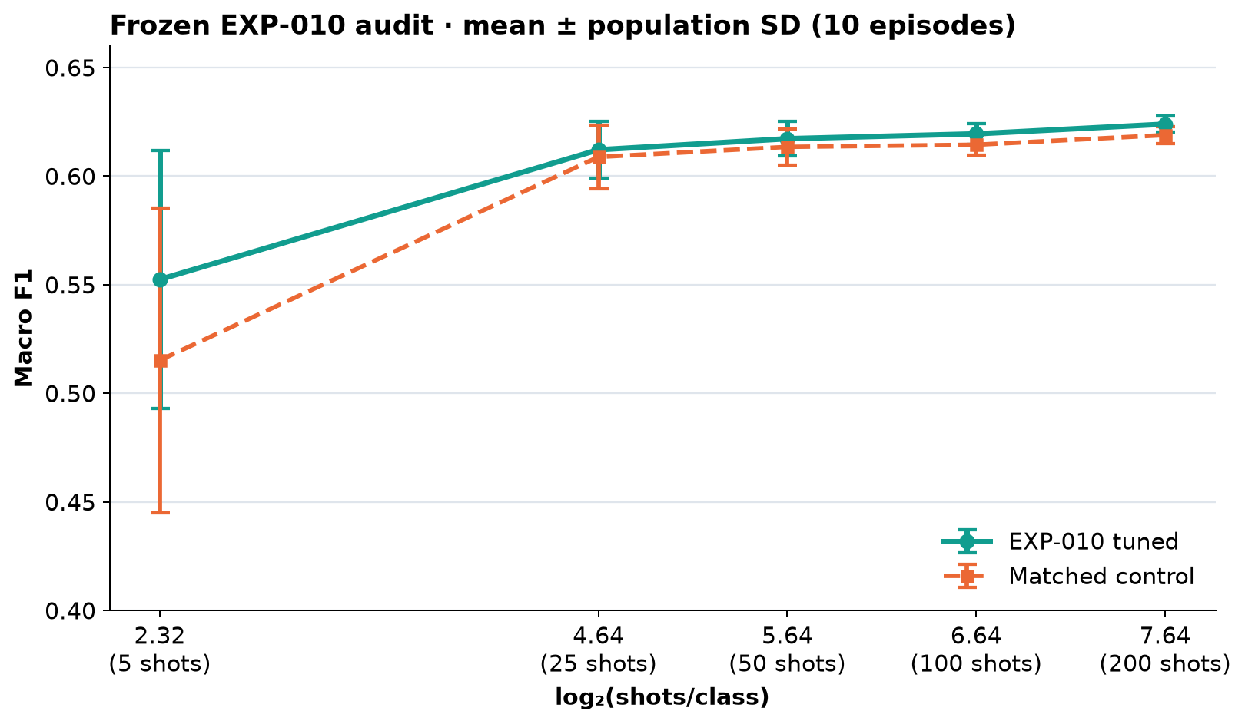
REQUIRED LEARNING CURVE
Transfer helps most in the lowest-data regime
5 shots/class
High episode spread
25+ shots/class
Prototypes stabilise
Empirical takeaway:
Transfer helps most when target prototypes are hardest to estimate.
Source-domain CV (documented local protocol):
Madrid 0.6281 ± 0.0043 macro F1

Slide 8
EMPIRICAL INTERPRETATION
More labels reduce prototype estimation error
shots
features (k)
shrinkage (λ)
λ — how much we trust Madrid over Amsterdam
k — how many features we keep
5
30
0.6
25
45
0.0
Less data → lean on Madrid, use fewer features
50
45
0.0
More data → trust Amsterdam, afford more features
100
45
0.0
In these experiments, the selected schedule
200
45
0.0
switches shrinkage off once labels increase.

Slide 9
WHAT WE LEARNED
Negative results clarify the mechanism
EXP-004 · WHITENING REVERSAL
EXP-007 · MORE FEATURES DID NOT HELP
Within-class whitening changed from harmful at low shot count to beneficial at high shot count. The same transform gave opposite outcomes as support grew.
The expanded 94-feature seasonal/coverage representation did not outperform the original 60 features. Extra dimensions can dilute few-shot prototype estimates.
Together, these outcomes support—without proving—the prototype estimation-error interpretation.

Slide 10
HONESTY
What we are not claiming
Gains beyond five shots are small in absolute macro F1
Error bars are spreads, not confidence intervals
Confusion diagonals are recall, not F1
Accuracy would have flattered us — we report macro F1
We do not claim exact reproduction of organiser RF outputs
Why not?
Source-domain Madrid CV is 0.6281 ± 0.0043 under the documented local protocol; local zero-shot is 0.4433, versus organiser-saved 0.6179 and 0.3427. Package/input provenance is incomplete, so the cause remains unidentified and exact reproduction is not claimed.

Slide 11
STATED, NOT HIDDEN
Limitations
1. Features still built label-dependently — no hidden-test path yet
2. Scaling fitted before cross-validation — not fold-safe
3. λ schedule: five values from five selection trials — overfit risk
4. Optimal k moves once (30→45) — weak evidence for a trend
5. EXP-010 has not been independently replicated
No claims of worldwide portability. No claims of calibrated confidence.

Slide 12
CONTROLS AND PROVENANCE
Reproducible by design, limited by evidence
EVALUATION CONTROLS
EVIDENCE BOUNDARY
Exact episode manifests + RNG binding
Madrid → Amsterdam only
Support/query isolation
No hidden-test claim
Frozen EXP-010 state
No independent EXP-010 replication
Matched episodes for tuned and control
Local baseline provenance is incomplete
Population SD over 10 audit episodes
Controls support validity, not superiority

Slide 13
CONCLUSION
Madrid learns feature ranking and class geometry.
Amsterdam support labels estimate target prototypes.
EXP-010: positive mean gains, 45/50 paired wins.
A number without a mechanism is not a finding.

Slide 14
BACKUP
Reproducibility
requirements.txt pins the exact stack
Raw data + feature cache SHA256 recorded
Episode indices stored, not regenerated from a seed
EXP-010 package stores weights, k=30/45 offsets and schedule
Frozen artifacts include recorded SHA256 checksums
Cold-start reproduction: ~35 minutes

Slide 15
BACKUP
Why our baseline differs from the organiser's
All six prototype budgets match them to 4 decimal places
Both Random-Forest results differ: +0.0102 and +0.1006
The prototype path does not consume fitted forest predictions
Determinism check: 0 of 25,992 predictions differed across two refits
Exact cause remains unidentified; no causal explanation is claimed

Slide 16
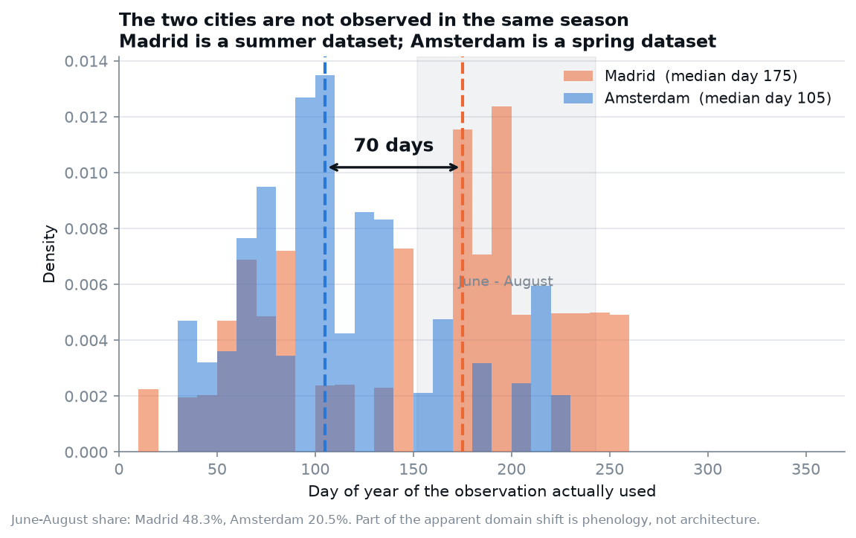
BACKUP
A 70-day seasonal offset between the cities
Madrid median day 175 · Amsterdam day 105
June–August: 48.3% vs 20.5%
Part of the domain shift is phenology, not architecture
We rebuilt features to control for it
It did not help — dilution outweighed the correction
Reported as a measured finding with a negative test

Slide 17
BACKUP
The episode protocol
One permutation per class per trial; budgets read prefixes
So budgets are nested: support(5) ⊂ support(25) ⊂ …
Support and query disjoint, verified in code every episode
Selection and audit sets never overlap
Four independent seeds used across the project
Query set shrinks unevenly as budget grows — a stated limitation

