Slide 1
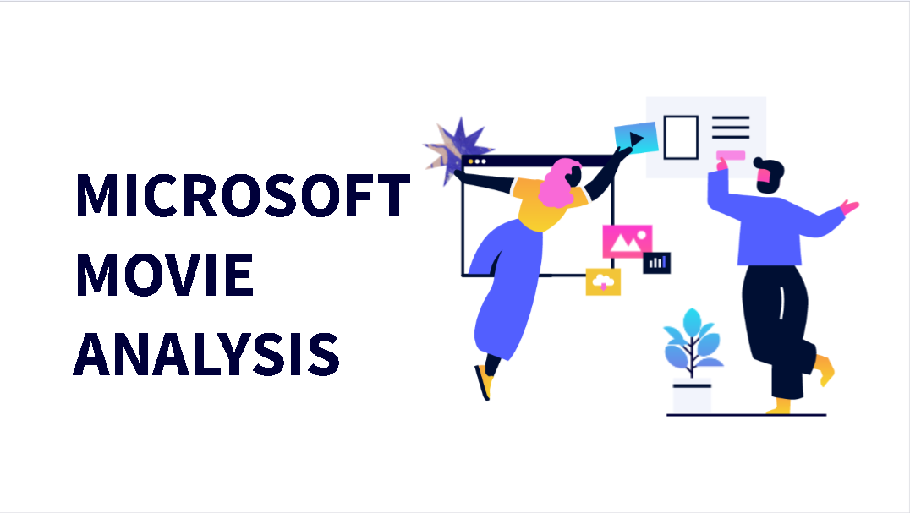

Slide 2
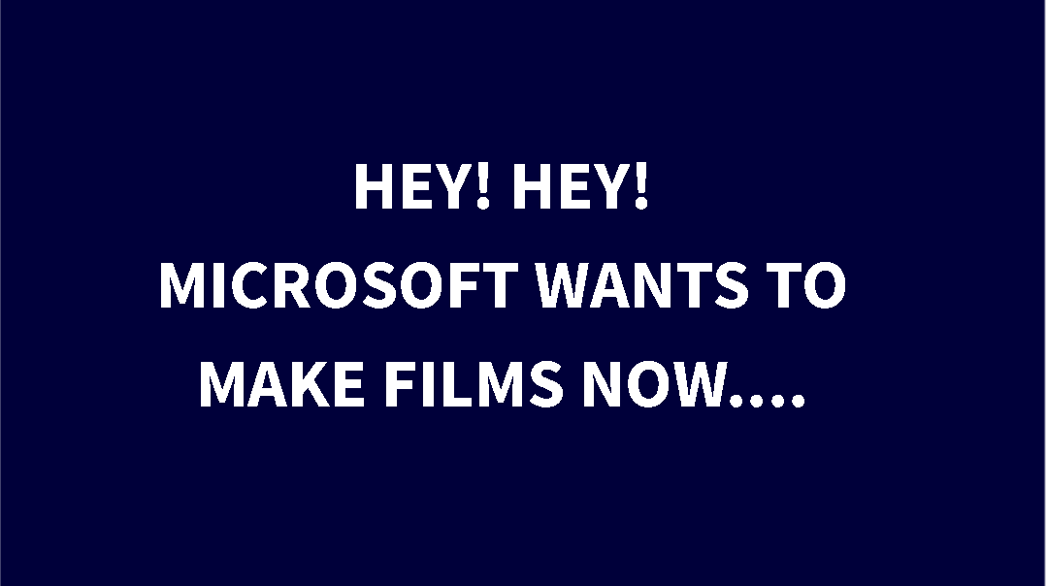

Slide 3
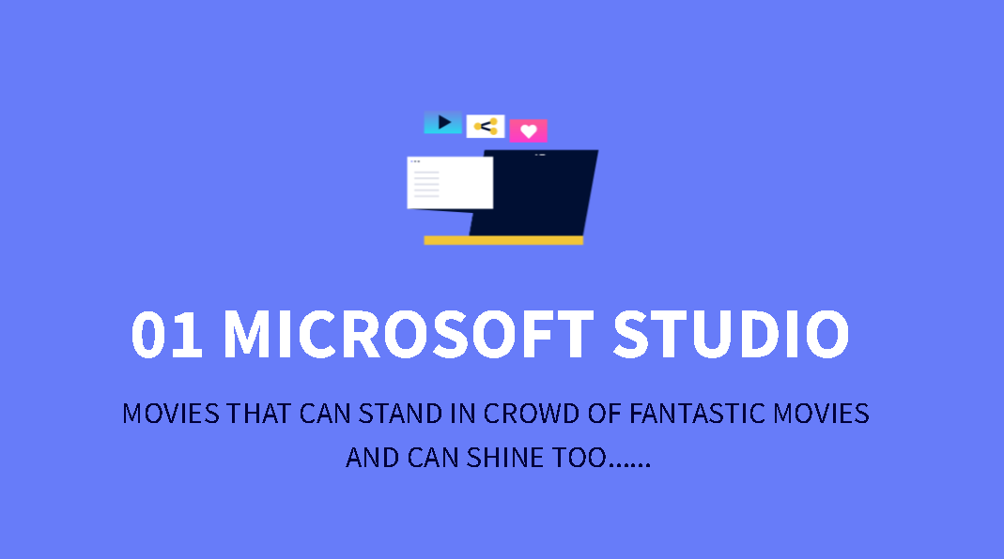

Slide 4
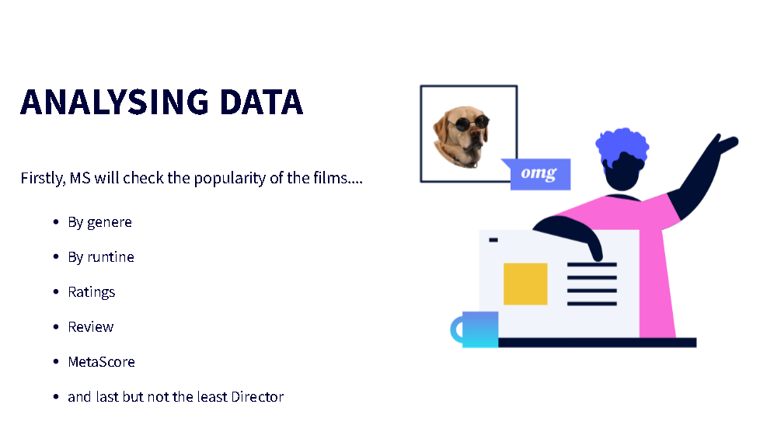

Slide 5


Slide 6
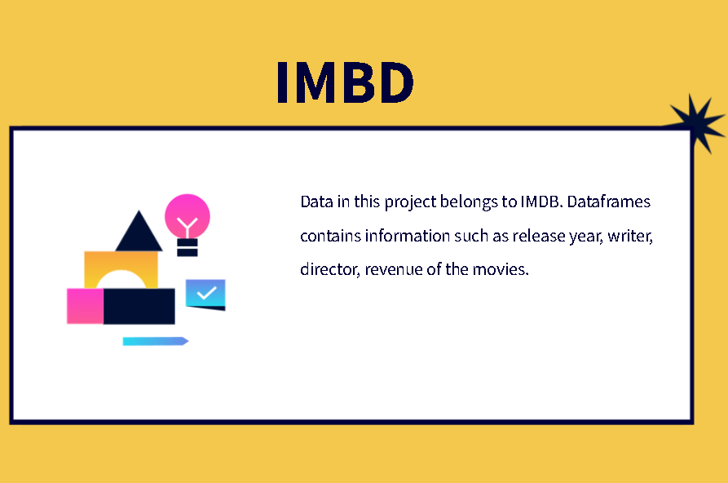

Slide 7
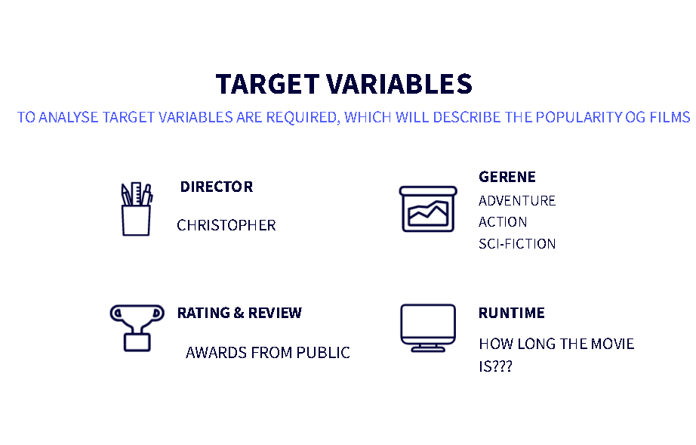

Slide 8
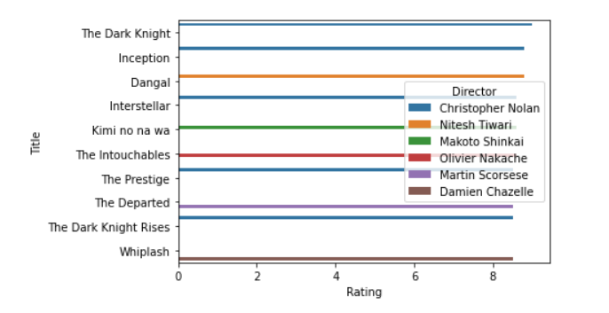
Let’s start with DIRECTOR
CHRISTOPHER NOLAN
Directed some most talked movies
Global recognition
Success rate

Slide 9
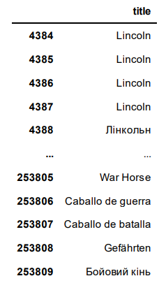
WRITER(optional)
WROTE MAJORITY OF MOVIES WITH 8 OR 8.5 RATING
CONSISTENCY IS NOTICABLE

Slide 10
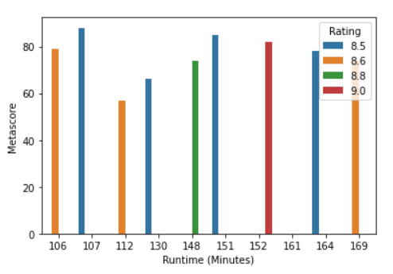
RUNTIME…
Runtime is inversely proportional to
rating and meta-score.
OPTIMUM runtime is
100 to 110 minutes.

Slide 11
GENRE
ADVENTURE/SCI-FI/ACTION(MUTATION)
All above listed categories are related to this genre.
Most cinematic universe revolves around this.
Kids are an easy target audience.
Better to introduce new super human character.

Slide 12
FINAL SAY…
MICROSOFT should approach:
CHRISTOPHER NOLAN as director
STEVEN SPILBERG as writer
RUNTIME: 100-110 minutes
GENRE: ACTION/SCI-FI/ADVENTURE
NEXT STEP:
LOOK FOR EMERGING TECHNOLOGY TO DISCUSS IN MOVIE
CONSULT WITH MAJOR MOVIE STUDIOS
PERFORM SURVEYS AMONG AUDIENCE TO MAKE SPECIFIC DECISION
INTRODUCE CHARACTER WITH BACK STORIES

Slide 13
THANK YOU
&
ALL THE BEST

