Slide 1
Project
GoAuto3830 data understanding challenge
Group 6
Parminder Singh
Rajveer Singh
Jaswinder Singh
FARHAN MOHAMMED
Manoj Bhatta

Slide 2

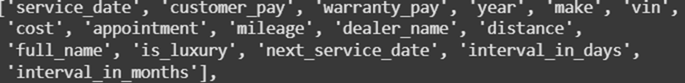
Reviewing given data
Available numerical features- mileage, customer_pay, warranty_pay, cost, distance, year
Dates- sale_date and service_date
Categorical features- dealer_name, appointment, loyalty_card, make
Newly added- full_name, is_luxury, interval_in_months

Slide 3
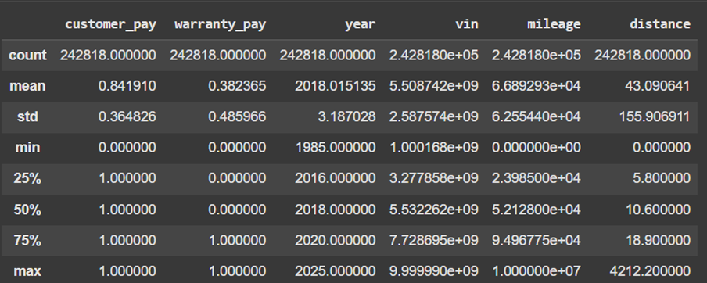
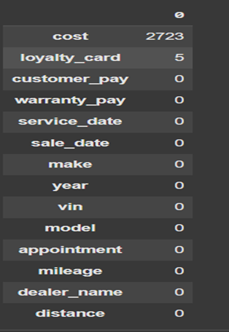
What missing values or errors exist?

Slide 4
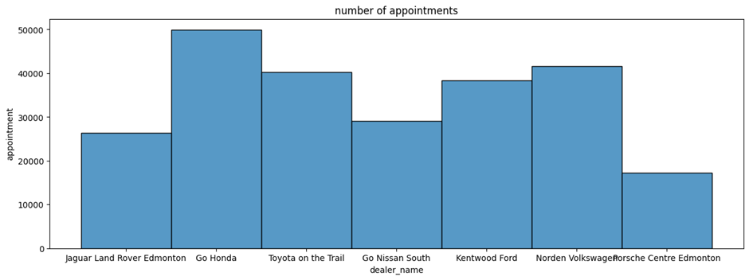
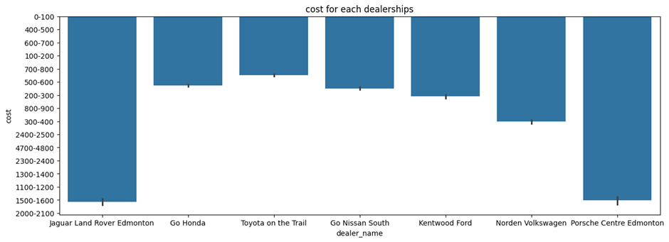
visualizations

Slide 5
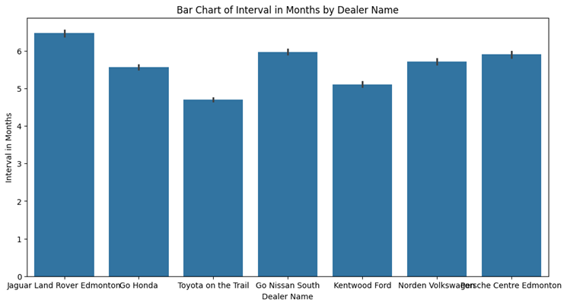
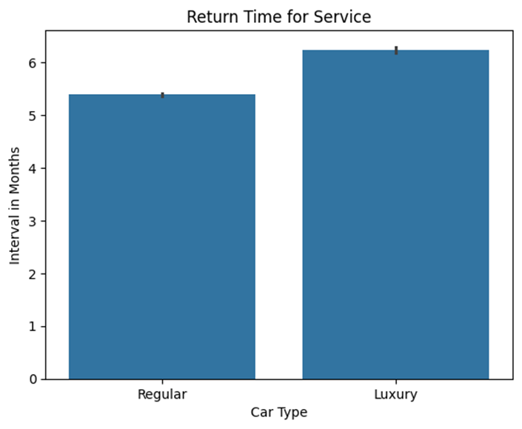
Visuals for interval months for dealers and for regular vs luxury vehicles.

Slide 6
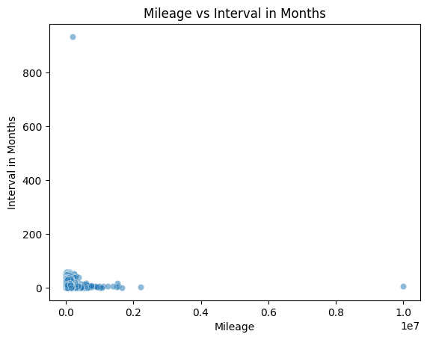
Scatterplot for milage and return time(months)

Slide 7
How data connects to business goals
Based on service data- patters of return can be used to predict future interval time
Number of returns can help measure given dealerships performance
It can be used to predict timing and at what milage does a regular vehicle or luxury vehicle comes in for service
Thank you

