Slide 1
Agenda
Fire and Smoke Detector ML Prototype
Florence2 + SAM2
Yolo’s and SAM’s

Slide 2
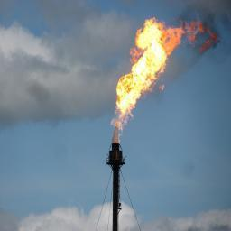
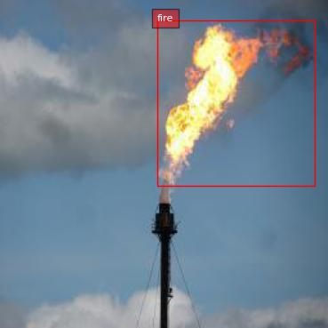
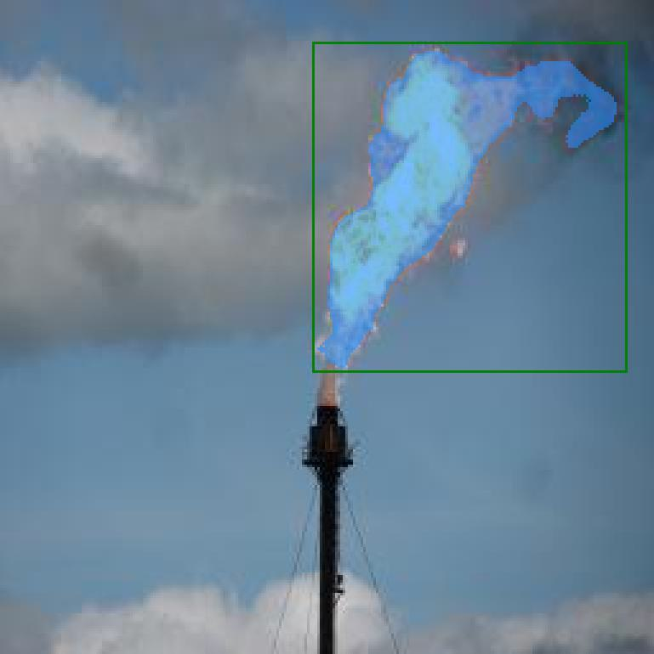
Fire and Smoke Detector ML Prototype
Model-1
Model-2
Two-stage ML Pipeline
Model-1: Caption and Bounding box
Model-2: Segment Area-of-Interest

Slide 3
Florence2 + SAM2
Florence2
SAM2
Florence2 inference time = 0.1 to 0.2 sec.
SAM2 inference time = 0.12 to 0.14 sec.
Inference code: https://github.com/jaswindersingh2/fire-and-smoke-detectors

Slide 4
Yolo’s and SAM’s
Florence2,
Yolo v6-11,
Grounding Dino
SAMv1,
SAMv2,
Florence2
Optimize these models (TensorRT, 4-bit quantization, LayerSkip)
Finetune these models
Run on edge devices (Nvidia nano Jetson)

Slide 5
References
Dataset from: universe.roboflow.com/roboflow-universe-projects/fire-and-smoke-segmentation/dataset/4
Florence2: https://www.microsoft.com/en-us/research/publication/florence-2-advancing-a-unified-representation-for-a-variety-of-vision-tasks/
SAM2: https://github.com/facebookresearch/sam2
Pipeline Inference code: https://github.com/jaswindersingh2/fire-and-smoke-detectors/tree/main

