Slide 1

Final Project Review-2
ONLINE QUIZ APPLICATION
TEAM NUMBER:4
Presented by:
24B11AI175 – K. Jaswitha
24B11AI268 - M Pujitha
- AIML
- AIML
24B11AI149
24B11AI343
J Mounika - AIML
P Sri Vaishnavi - AIML
Under esteemed guidance of:

Slide 2
Outline
Abstract
Introduction
System Overview
Technologies Used
Database Design
System Modules
Implementation
Output Screens
Conclusion
References
Appendix
Login Screen (if implemented)
Add Record Screen
Search Screen
Update Screen
Display Records

Slide 3
Abstract:
The advancement of digital technologies has significantly transformed the education system, especially in the way assessments and evaluations are conducted. Traditional quiz systems are often manual, time-consuming, and prone to human errors, making them inefficient in today’s fast-paced learning environment. These systems also lack proper data management and do not provide instant feedback to students, which is essential for effective learning. To overcome these limitations, this project focuses on the design and development of an Online Quiz Application, a web-based platform that automates the process of conducting quizzes and evaluating results.
The Online Quiz Application provides a user-friendly interface that allows users to register, log in, and participate in quizzes from any location with internet access. The system ensures flexibility and accessibility, enabling students to attempt quizzes at their convenience. On the other hand, the administrator module allows authorized users to create, update, and manage quiz questions efficiently. This dual functionality ensures smooth operation and effective management of quiz-related activities.
The application is developed using modern web technologies such as HTML, CSS, and JavaScript for frontend design, Node.js for backend processing, and MongoDB for database management. These technologies provide a robust and scalable framework for building the application. In addition, AI-based development tools were utilized to speed up the development process; however, the core logic, system design, and implementation were completely developed and understood by the team.

Slide 4
CHAPTER 1: INTRODUCTION
Introduction:
In today’s digital era, technology plays a crucial role in transforming traditional methods into more efficient and accessible systems. One such advancement is the development of online platforms for conducting quizzes and assessments. The Online Quiz Application is designed to replace the conventional paper-based examination system with a more flexible and automated solution.
This application provides a platform where users can easily register, log in, and participate in quizzes from anywhere at any time. It eliminates the need for manual evaluation by automatically calculating scores and displaying results instantly. The system ensures accuracy, saves time, and reduces the chances of errors that are common in traditional methods.
The application consists of two main components: the user module and the admin module. The user module allows participants to take quizzes and view their results, while the admin module enables administrators to manage questions, users, and quiz data efficiently. The system is built using web technologies, making it user-friendly and responsive.
The primary aim of this project is to enhance the learning and assessment experience by providing a fast, reliable, and secure platform for conducting quizzes. It is widely applicable in schools, colleges, and online learning environments, helping both educators and learners achieve better outcomes.

Slide 5
Problem Statement:
In the current education system, quizzes and examinations are often conducted using traditional methods that require manual effort for both conducting the test and evaluating the answers. These methods are time-consuming, less efficient, and prone to human errors. Evaluating a large number of answer sheets manually can lead to mistakes, delays in result declaration, and inconsistency in assessment.
Another major issue with the existing system is the lack of automation and proper data management. Quiz data, including questions, answers, and student results, is often not stored in a structured manner. This makes it difficult to retrieve, analyze, and maintain records effectively. Additionally, students do not have easy access to practice quizzes, which limits their ability to improve their knowledge and performance.
Traditional quiz systems also lack flexibility and accessibility. Students are required to be physically present at a specific location and time to take the test. This creates inconvenience, especially in situations where remote access is necessary. Furthermore, there is no provision for instant feedback, which is essential for helping students understand their mistakes and improve their learning outcomes.
Moreover, the absence of a centralized system makes it difficult for administrators to create, update, and manage quizzes efficiently. Managing large amounts of quiz data manually increases the chances of errors and reduces overall productivity.

Slide 6
Objectives of the Project
The main objective of this project is to develop an efficient and user-friendly Online Quiz Application that automates the process of conducting quizzes and evaluating results. The system is designed to simplify quiz management, improve accessibility, and provide accurate and instant feedback to users.
The specific objectives of the project are as follows:
To design and develop a web-based platform that allows users to register and log in securely
To provide an interactive interface for users to attempt quizzes anytime and from any location
To enable administrators to create, update, and manage quiz questions easily
To automate the evaluation process and generate results instantly after quiz submission
To store and manage user data, quiz questions, and results efficiently using a database
To reduce manual effort and minimize errors in quiz evaluation
To improve the speed and accuracy of the assessment process
To provide a flexible and scalable system that can handle multiple users simultaneously
To enhance the learning experience by providing immediate feedback to users
To ensure proper data management and easy retrieval of information
The project also aims to demonstrate the effective use of modern web technologies in developing real-time applications. AI-based development tools were used to speed up the development process, while the system’s logic, structure, and implementation were fully designed and executed by the developers.

Slide 7
Scope of Project:
The scope of this project is to develop a web-based Online Quiz Application that provides an efficient platform for conducting quizzes and managing assessments digitally. The system is designed to be simple, user-friendly, and accessible, making it suitable for a wide range of users including students, teachers, and training organizations.
The application allows users to register, log in, and attempt quizzes from any location with internet access. This improves flexibility and eliminates the need for physical presence during assessments. The system also provides instant evaluation and result generation, which helps users understand their performance immediately.
The project includes an administrator module that enables authorized users to create, update, and manage quiz questions effectively. Admins can organize quizzes based on different topics and control the overall functionality of the system. This ensures proper management of quiz data and smooth operation of the application.
The system uses a database to store user information, quiz questions, answers, and results. This ensures efficient data management, easy retrieval of information, and better record maintenance. The application is developed using modern web technologies, making it scalable and capable of handling multiple users. .

Slide 8
CHAPTER 2: SYSTEM OVERVIEW
System Overview:
In the current scenario, quiz and examination systems are mostly conducted using traditional or semi-digital methods. These methods include paper-based tests, manual evaluation, or basic computer-based systems that lack automation and advanced features. Such systems are widely used in schools and colleges but have several drawbacks that affect efficiency and accuracy.
In traditional quiz systems, teachers or instructors prepare question papers manually and distribute them to students. After completion, answer sheets are collected and evaluated manually. This process requires a significant amount of time and effort, especially when dealing with a large number of students. The evaluation process is also prone to human errors, which may lead to incorrect results.
Even in some digital systems, the functionality is limited. These systems may allow basic quiz attempts but often lack features such as automated result generation, proper data storage, and efficient quiz management. In many cases, data is not stored in a structured format, making it difficult to retrieve and analyze information later.
Another major issue with the existing system is the lack of accessibility and flexibility. Students are required to be physically present at a specific location to attend the quiz. This creates inconvenience and limits the ability to conduct remote assessments. Additionally, these systems do not provide instant feedback, which is important for improving learning outcomes.

Slide 9
Main Agenda (core idea):
The main agenda of the Online Quiz Application is to develop an efficient and user-friendly platform for conducting quizzes digitally. The project focuses on simplifying the traditional examination process by automating quiz creation, participation, and evaluation.
It aims to provide a secure system where users can easily register, log in, and attempt quizzes from anywhere at any time. Another key agenda is to deliver instant results and feedback, helping users quickly understand their performance.
The system also focuses on enabling administrators to manage quiz content effectively, including adding, updating, and deleting questions. Additionally, it ensures proper data management, accuracy in evaluation, and a smooth user experience.
Overall, the agenda is to create a reliable, scalable, and time-saving solution that enhances learning and assessment through technology.

Slide 10
System Architecture: The Online Quiz Application follows a three-tier architecture, which separates the system into different layers for better performance, scalability, and maintenance. 1. Presentation Layer (Frontend) This is the user interface of the application where users and admins interact with the system. It is developed using technologies like HTML, CSS, and JavaScript. Users can register, log in, attempt quizzes, and view results through this layer. 2. Application Layer (Backend) This layer handles the core logic of the system. It processes user requests, validates inputs, manages quiz flow, and calculates results. Backend technologies like Python / Java / Node.js can be used to implement this layer. 3. Data Layer (Database) This layer stores all the data required for the system, such as user details, quiz questions, answers, and results. Databases like MySQL / MongoDB are used to manage and retrieve data efficiently.

Slide 11
Features of the System
User Registration & Login: Allows users to create accounts and securely log in to the system.
User-Friendly Interface: Simple and interactive design for easy navigation and better user experience.
Multiple Choice Questions (MCQs): Supports quizzes with objective-type questions for quick answering and evaluation.
Instant Result Generation: Automatically calculates and displays results immediately after quiz submission.
Admin Control Panel: Admin can add, update, delete questions, and manage user data efficiently.
Secure Data Management: Stores user details, quiz data, and results safely in the database.
Time Efficiency: Reduces manual effort in conducting and evaluating quizzes.
Accessibility: Users can take quizzes anytime and from anywhere using internet access.
Performance Tracking: Keeps records of user scores for future reference and analysis.
Scalability: System can be expanded with additional features like timers, leaderboards, and advanced question types.

Slide 12
CHAPTER 3: TECHNOLOGIES USED
Technologies Used
Frontend Technologies
HTML: Used to design the structure of web pages.
CSS: Used for styling and layout of the application.
JavaScript: Adds interactivity and handles client-side logic.
Backend Technologies
Python / Java / Node.js: Used to implement server-side logic, handle requests, and process quiz data.
Database
MySQL / MongoDB: Used to store user information, quiz questions, answers, and results.
Development Tools
Visual Studio Code: Code editor used for writing and managing code.
Git & GitHub: Used for version control and project management.
Web Technologies
HTTP/HTTPS Protocol: Used for communication between client and server.
Browser: Used to run and access the application.

Slide 13
Tools Used –
Visual Studio Code (VS Code): Used as the main code editor for writing and managing frontend and backend code.
Google Chrome (Web Browser): Used to run, test, and debug the application.
Git: Used for version control to track changes in the project.
GitHub: Used to store and manage the project repository online.
XAMPP / WAMP: Used to create a local server environment for running backend applications (especially for PHP & MySQL).
MySQL Workbench / phpMyAdmin: Used for designing and managing the database.
Postman (Optional): Used for testing APIs and backend services.

Slide 14
CHAPTER 4: DATABASE DESIGN
Database Overview
The database is a core component of the Online Quiz Application, responsible for storing, managing, and retrieving all the data required for the system. It maintains user details, quiz questions, and results in a well-structured format. A relational database like MySQL is used to organize the data into tables for better efficiency and reliability.
The system mainly consists of three tables: Users, Questions, and Results. The Users table stores information such as user name, email, password, and role (admin/user). The Questions table contains quiz questions along with multiple-choice options and the correct answer. The Results table stores the scores obtained by users, total questions, and the date of the quiz.
These tables are connected using primary keys and foreign keys to maintain relationships and ensure data consistency. The database supports smooth data flow, where user data is stored during registration, questions are retrieved during the quiz, and results are saved after completion.
Overall, the database ensures secure data storage, fast retrieval, reduced redundancy, and efficient management of the entire quiz system.

Slide 15
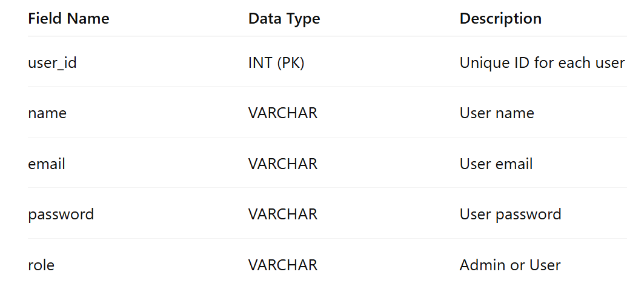
Tables In Database:
User Table:

Slide 16
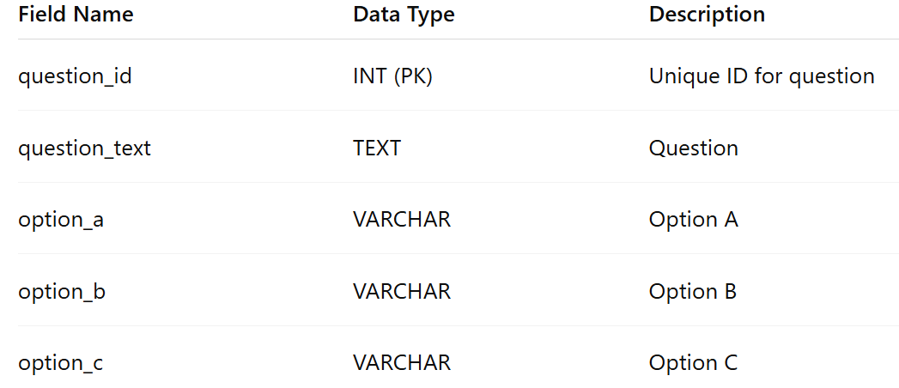
Questions Table:

Slide 17
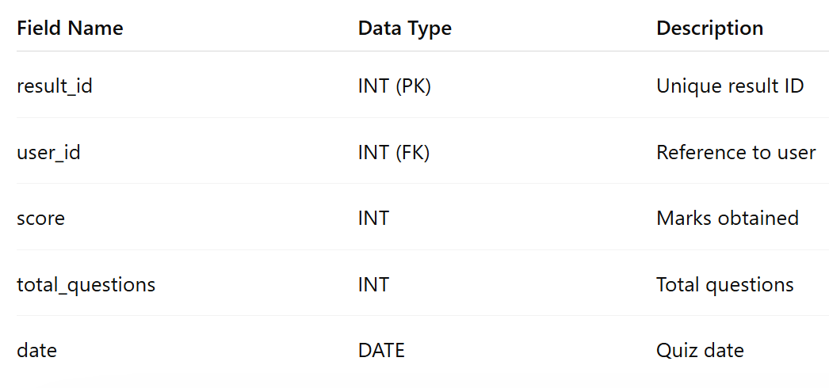
Result Table:

Slide 18
Data Flow:
The data flow in the Online Quiz Application shows how information moves between the user, system, and database.
The user first registers and logs into the system. The entered details are stored in the Users table.
The admin adds quiz questions, which are saved in the Questions table.
When the user starts the quiz, questions are retrieved from the database and displayed on the screen.
The user selects answers and submits the quiz.
The system processes the answers, calculates the score, and generates the result.
The final score is stored in the Results table and displayed to the user instantly.
This flow ensures smooth communication between the frontend, backend, and database, making the system efficient and reliable.

Slide 19
CHAPTER 5: SYSTEM MODULES
🔹 System Modules
The Online Quiz Application is divided into different modules to manage the system efficiently. Each module performs a specific function.
🔸 Login Module
This module handles user authentication. Users and admins must enter their credentials to log in. It ensures secure access and prevents unauthorized users.
🔸 Registration Module
This module allows new users to create an account by entering details like name, email, and password. After registration, users can log in to the system.
🔸 Quiz Module
This module displays quiz questions to users. It allows users to select answers, navigate between questions, and submit the quiz. It manages the entire quiz process.
🔸 Result Module
This module calculates the score after quiz submission. It displays the result instantly along with performance details.
🔸 Admin Module
This module is used by the administrator to manage the system. The admin can add, update, delete questions, and view user details and results.

Slide 20
CHAPTER 6: IMPLEMENTATION
The Online Quiz Application is implemented using a combination of frontend, backend, and database technologies to ensure smooth functionality and user interaction.
1. Frontend Implementation
The user interface is developed using HTML, CSS, and JavaScript.
HTML is used to structure the web pages.
CSS is used for styling and layout design.
JavaScript is used to handle user interactions like form validation, quiz navigation, and dynamic content updates.
This layer provides pages such as login, registration, quiz interface, and result display.
2. Backend Implementation
The backend is developed using technologies like Python / Java / Node.js.
It handles user authentication (login & registration).
Processes quiz logic and manages question flow.
Evaluates answers submitted by users.
Generates and sends results to the frontend
3. Database Implementation
A database like MySQL is used to store and manage data.
Tables are created for users, quizzes, questions, and results.
SQL queries are used for inserting, updating, retrieving, and deleting data.
Relationships are maintained using primary and foreign keys.
4. Integration Process
Frontend communicates with backend using HTTP requests.
Backend interacts with the database to fetch and store data.
Data flows smoothly between all components to ensure real-time quiz functionality.
5. Testing & Deployment
The application is tested using browsers like Chrome.
Debugging tools are used to fix errors.
The system can be deployed on a local server or online hosting platform.

Slide 21
User Interaction Based Learning
The Online Quiz Application is designed to support interaction-based learning, where users actively engage with the system to improve their knowledge and understanding. Instead of passive learning, this approach encourages users to participate in quizzes, think critically, and receive immediate feedback.
The system provides an interactive environment where users answer questions, navigate between quiz sections, and view results instantly. This continuous interaction helps users identify their strengths and weaknesses in different topics.
One of the key features supporting interaction-based learning is instant feedback, which allows users to understand correct and incorrect answers immediately after completing the quiz. This helps in better retention of concepts and improves learning efficiency.
Additionally, the system can include features like timers, score tracking, and performance analysis, which motivate users to perform better and stay engaged. The user-friendly interface further enhances interaction by making the system easy to use and accessible.
Overall, the application promotes active learning, improves user engagement, and makes the assessment process more effective and enjoyable.

Slide 22
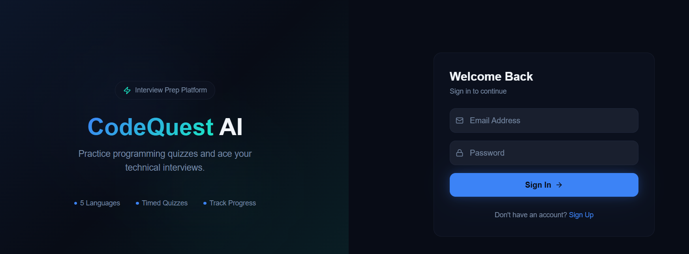
CHAPTER 7: OUTPUT SCREENS
Login Screen
Users enter credentials to login into the system.

Slide 23
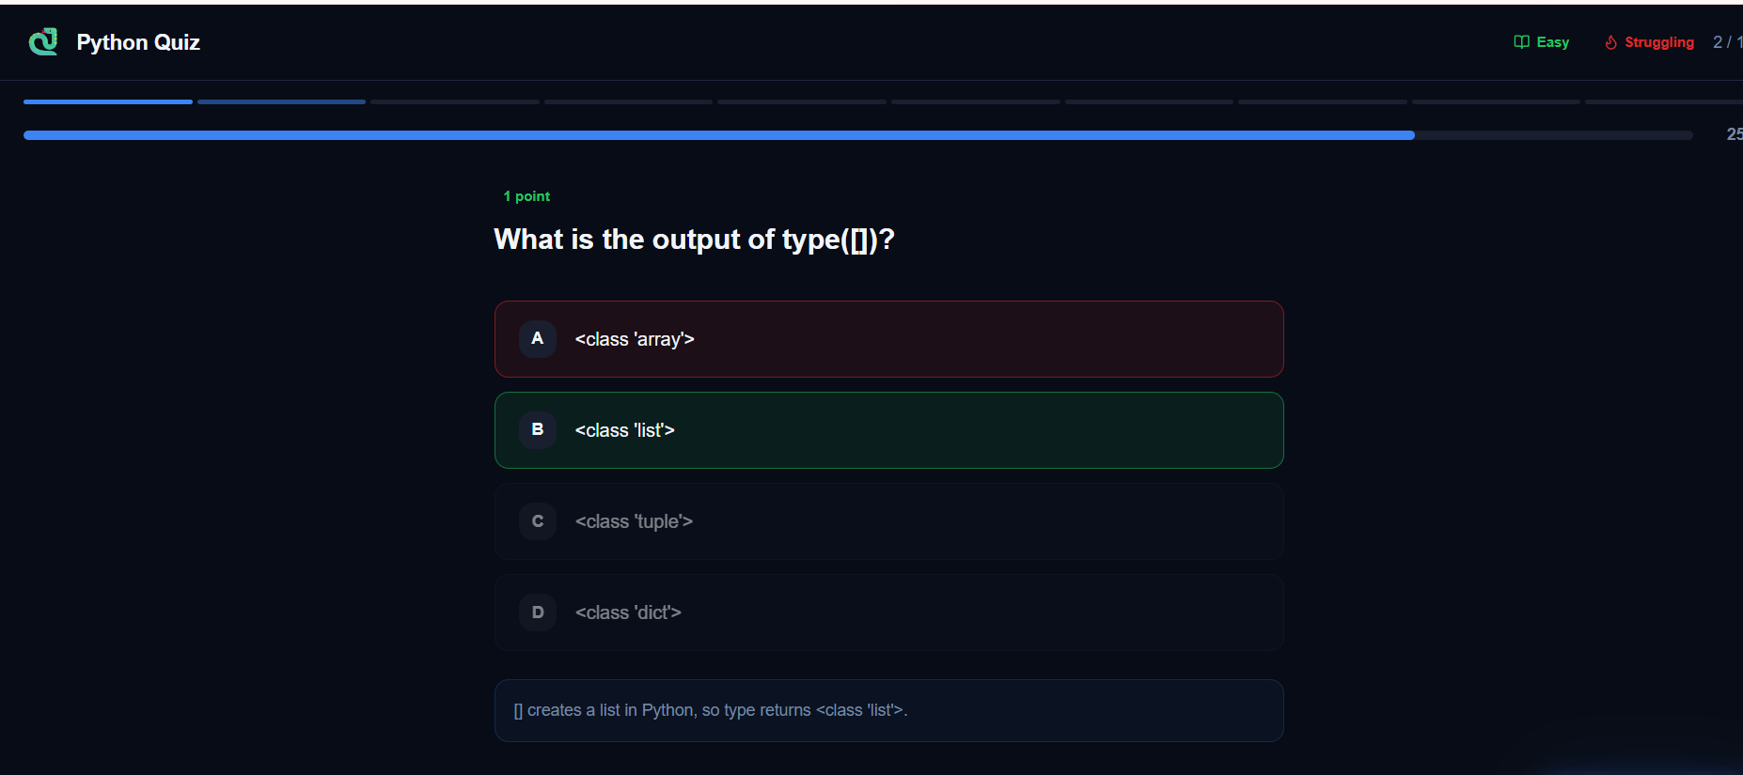
Quiz Screen:
Users attempt questions in this screen.

Slide 24
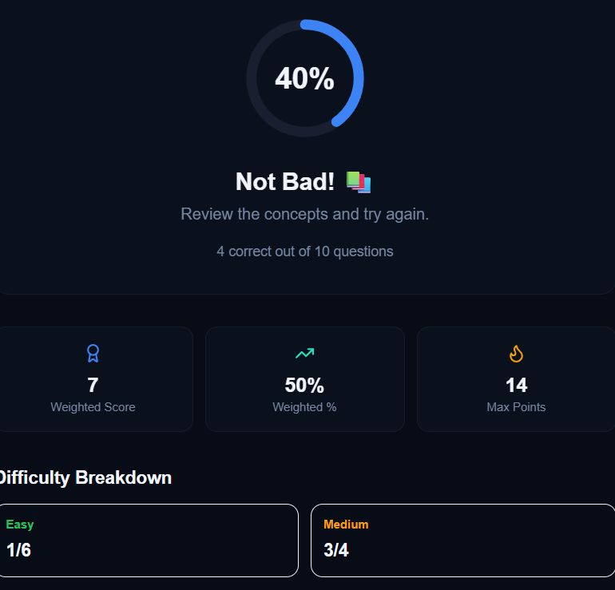
Result Screen
Displays score and performance.

Slide 25
CHAPTER 8: ADVANTAGES & LIMITATIONS
Advantages
Time Saving: Reduces the time required for conducting exams and evaluating answers.
Instant Results: Provides immediate feedback and scores after quiz completion.
Accuracy: Eliminates human errors in evaluation and result calculation.
User-Friendly: Easy to use interface for both users and administrators.
Accessibility: Users can take quizzes anytime and from anywhere with internet access.
Paperless System: Reduces the use of paper, making it eco-friendly.
Efficient Management: Admin can easily manage questions, users, and quiz data.
Secure Data Storage: Stores all information safely in a structured database.
Scalability: Can handle a large number of users and quizzes simultaneously.
Improved Learning Experience: Helps users learn through interactive and engaging quizzes.

Slide 26
Limitations
Internet Dependency: Requires a stable internet connection to access and attempt quizzes.
Technical Issues: System errors, server downtime, or bugs may affect performance.
Limited Question Types: Mostly supports objective questions (MCQs), less suitable for descriptive answers.
Security Risks: Possibility of cheating or unauthorized access if proper security measures are not implemented.
Device Requirement: Users must have access to a computer or smartphone to use the system.
Initial Setup Effort: Requires time and effort to design, develop, and maintain the system.
Lack of Personal Interaction: No direct communication between instructor and student during the quiz.
Data Privacy Concerns: User data must be properly protected to avoid misuse or leaks.

Slide 27
CHAPTER 9: FUTURE ENHANCEMENTS
Future Enhancements
Timer-Based Quizzes: Add time limits for each quiz to increase difficulty and improve time management.
Advanced Question Types: Include descriptive, image-based, and video-based questions.
Leaderboard System: Display top performers to encourage healthy competition among users.
Performance Analytics: Provide detailed reports and graphs showing user performance and progress.
Mobile Application: Develop an Android/iOS app for better accessibility and user experience.
AI-Based Recommendations: Suggest quizzes based on user performance and interests.
Multi-Language Support: Allow users to take quizzes in different languages.
User Feedback System: Enable users to give feedback on quizzes for improvement.
Secure Proctoring System: Implement features like webcam monitoring to prevent cheating.
Cloud Integration: Host the application on cloud platforms for better scalability and availability.

Slide 28
CHAPTER 10: CONCLUSION
Conclusion
The Online Quiz Application successfully provides a modern and efficient solution for conducting quizzes and assessments. It replaces the traditional paper-based system with a digital platform that is faster, more accurate, and easy to manage. The system allows users to participate in quizzes from anywhere and receive instant results, improving both convenience and learning efficiency.
With features like automated evaluation, secure data management, and user-friendly interface, the application reduces manual effort and minimizes errors. It also enables administrators to manage quiz content effectively, making the entire process more organized and reliable.
Overall, the project demonstrates how technology can enhance the learning and assessment experience. The Online Quiz Application is a scalable and flexible system that can be further improved with advanced features in the future, making it highly useful for educational institutions and online learning platforms.

Slide 29
References & Appendix
References:
W3Schools – https://www.w3schools.com/ (for HTML, CSS, JavaScript learning)
MDN Web Docs – https://developer.mozilla.org/ (for web development concepts)
GeeksforGeeks – https://www.geeksforgeeks.org/ (for programming and database concepts)
Official MySQL Documentation – https://dev.mysql.com/doc/
Stack Overflow – https://stackoverflow.com/ (for troubleshooting and coding help)
YouTube Tutorials (various channels for project guidance)
Appendix:
The appendix contains additional supporting information related to the project:
Sample Screens:
Login Page
Registration Page
Quiz Interface
Result Page
Sample Code Snippets:
User Login & Authentication Code
Database Connection Code
Quiz Evaluation Logic
Database Schema:
Table structures for Users, Questions, Quiz, and Results
Test Cases:
Input and expected output for different scenarios
User Manual:
Steps to use the application (Register → Login → Attempt Quiz → View Result)

Slide 30
THANK YOU

