Slide 1
Experiments
Experiment 1- EXPIMG
Publication 1
Experiment 2- EXPSIM
Publication 2
Experiment 3- Small-N
Experiment 4- Orthographic/Semantic
Chapter 3

Slide 2
Experiments
Thesis Chapters
Introduction
Experiment 1- EXPIMG
Publication 1
Experiment 2- EXPSIM
Thesis with Publication
Publication 2
Experiment 3- Small-N
Experiment 4- Orthographic/Semantic
Chapter 3
Discussion

Slide 3
Experiments
Thesis Chapters
Introduction
Experiment 1- EXPIMG
Publication 1
Experiment 2- EXPSIM
Thesis with Publication
Publication 2
Experiment 3- Small-N
Experiment 4- Orthographic/Semantic
Chapter 3
Discussion

Slide 4
Experiments
Thesis Chapters
Introduction
Experiment 1- EXPIMG
Publication 1
Experiment 2- EXPSIM
Thesis with Publication
Publication 2
Experiment 3- Small-N
Experiment 4- Orthographic/Semantic
Chapter 3
Discussion

Slide 5
Experiments
Thesis Chapters
Introduction
Experiment 1- EXPIMG
Publication 1
Experiment 2- EXPSIM
Thesis with Publication
Publication 2
Experiment 3- Small-N
Experiment 4- Orthographic/Semantic
Chapter 3
Discussion

Slide 6

Study
Test
Source Error
WORD
WORD
X

Slide 7
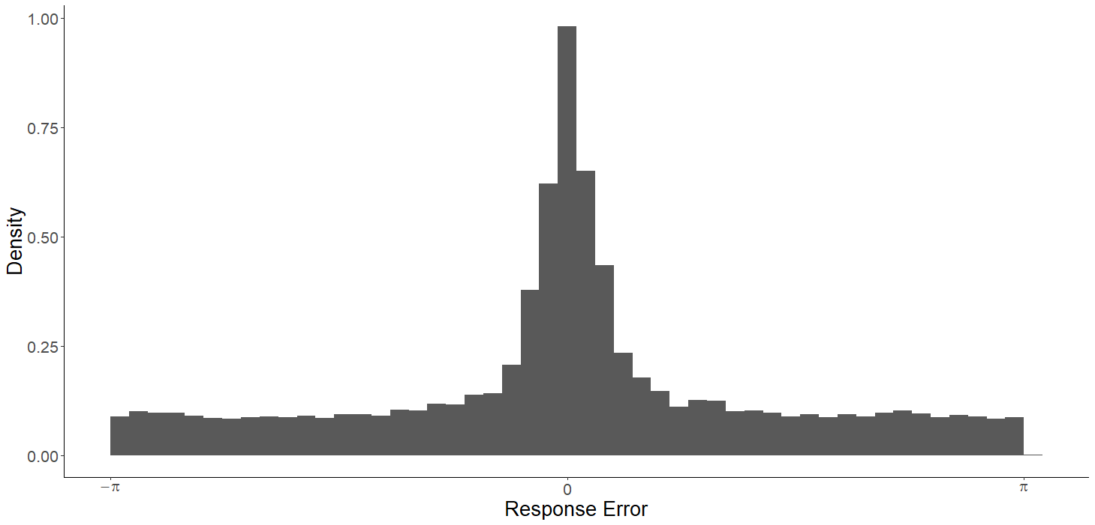
Publication 2
Memory for Target
Guesses

Slide 8
TIER
TIED
CORD

Slide 9
Where was
“CORD” Located?

Slide 10
Guessing
Intrusions
Notes:
Is the evidence that, to this point, been used to support threshold model of source memory actually explainable by intrusions? Note this is only for one trial, because intrusions are uniformly distributed across trials, the overall distribution of errors across trials will look like a flat tail. The key difference is that one any one trial, the errors from intrusions are systematic, and linked to the locations of possible intrusions. The driving rationale here is inspired by Paul Bays work- if we account for intrusions, does the amount of uniform guessing (in a no-information state) go down? In his work, it did substantially 62% down to 14%.

Slide 11
PLUG
CALM
PLUM
Response Error
FLAG
DREG
Notes:
Before we even get to the modelling, there’s some evidence that intrusions are happening by just looking at the data

Slide 12
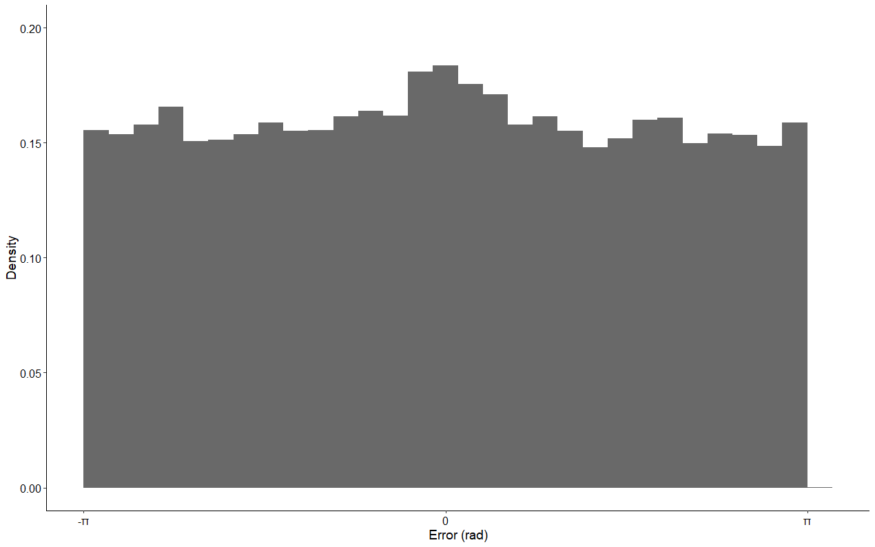
Distances between Response and Nontarget Angles

Slide 13
Are “guesses” due to intrusions?
Pure Guess
Pure Intrusion
Intrusion + Guess

Slide 14
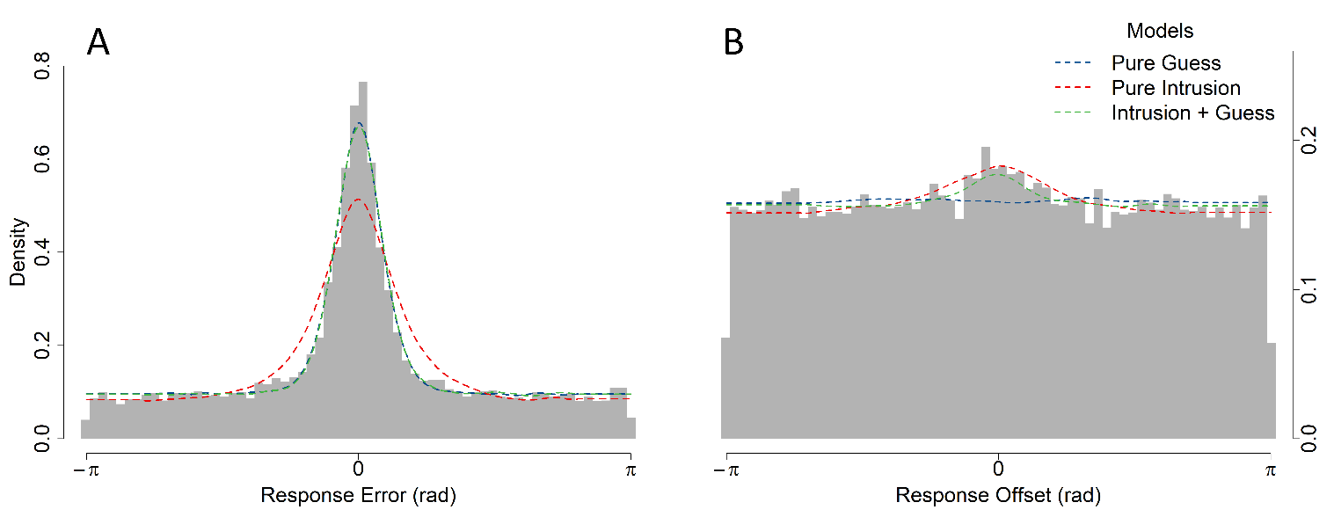
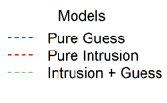

Slide 15
Weighting Intrusions
CUBS
COVE
PUPS
CORE
backwards
forwards
Temporal Similarity
Orthographic Similarity
Spatial Similarity
Semantic Similarity

Slide 16
Temporal Similarity
ALOE GRAB ROOT CUBS COVE PUPS CORE CARD MUGS
-6
-5
-4
-3
-2
-1
0
+1
+2
Lag
Notes:
Assumption that the strength of association between items is an exponentially decreasing function of distance

Slide 17
Temporal Similarity
ALOE GRAB ROOT CUBS COVE PUPS CORE CARD MUGS
-4
-3
-2
-1
0
1
2
3
4
Lag
Notes:
Assumption that the strength of association between items is an exponentially decreasing function of distance

Slide 18
Intrusions + Guess: all intrusions equal
Likelihood of Intrusion
-4
-3
-2
-1
1
2
3
4
Lag
Notes:
Assumption that the strength of association between items is an exponentially decreasing function of distance

Slide 19
Temporal Gradient
Likelihood of Intrusion
-4
-3
-2
-1
1
2
3
4
Lag
Notes:
Assumption that the strength of association between items is an exponentially decreasing function of distance

Slide 20
Temporal Gradient
Likelihood of Intrusion
-4
-3
-2
-1
1
2
3
4
Lag
Notes:
Assumption that the strength of association between items is an exponentially decreasing function of distance

Slide 21
Temporal Gradient
Likelihood of Intrusion
-4
-3
-2
-1
1
2
3
4
Lag
Notes:
Assumption that the strength of association between items is an exponentially decreasing function of distance

Slide 22
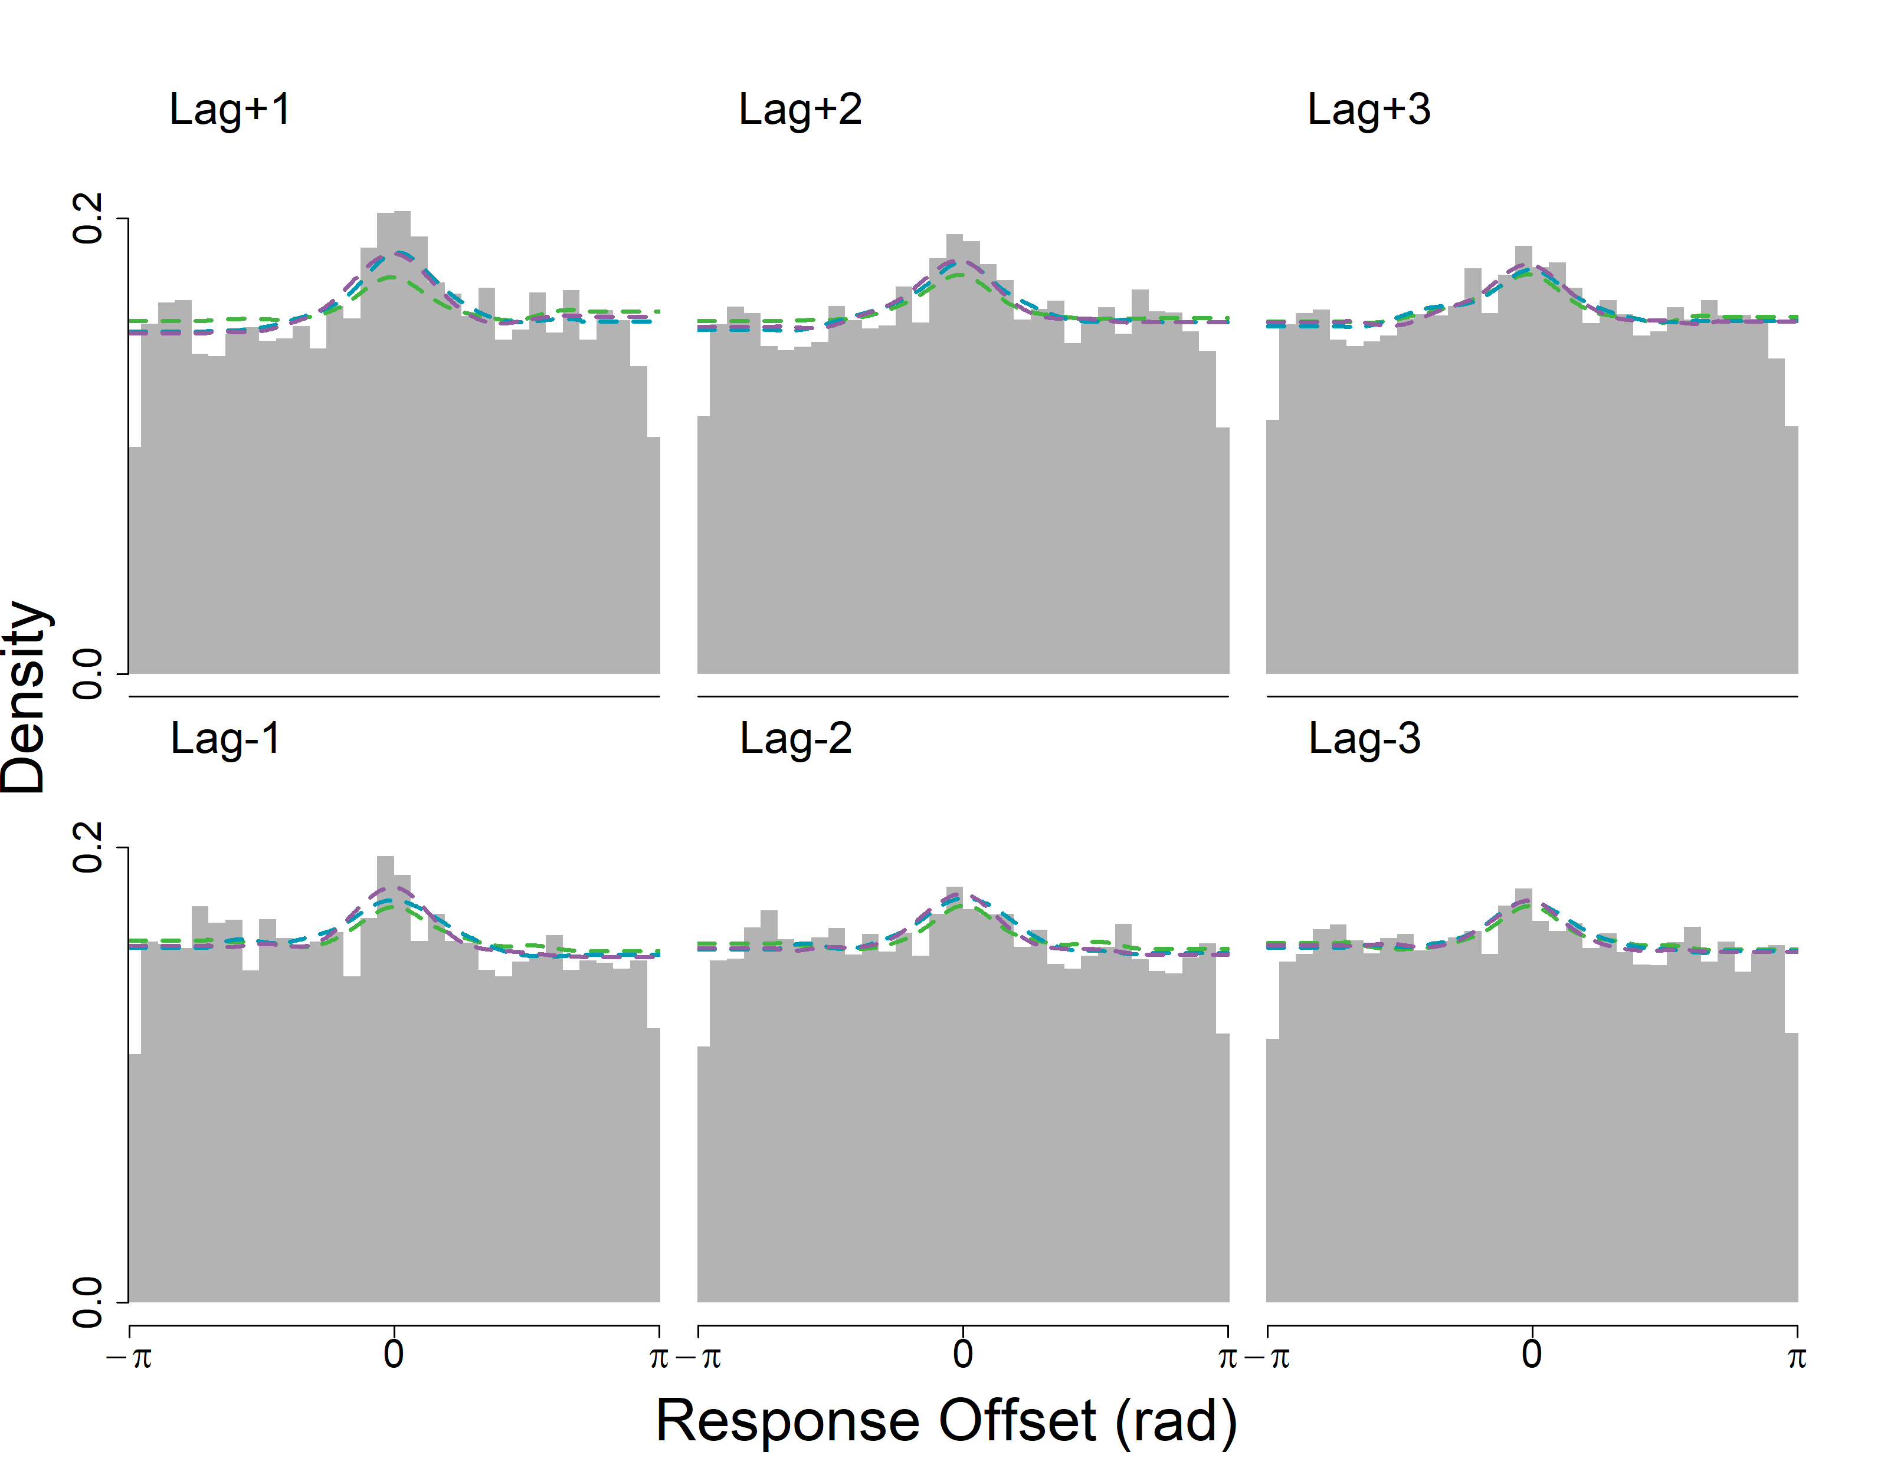
R

Slide 23
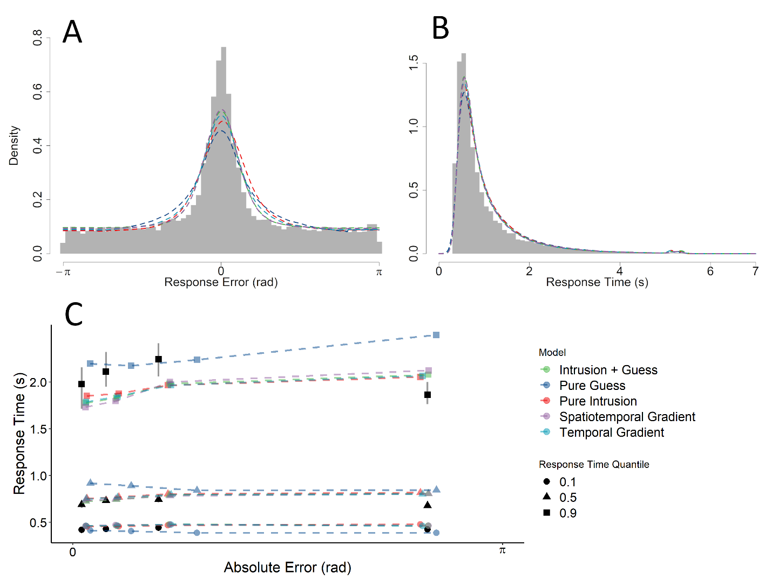
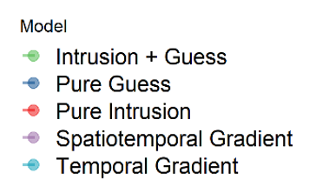

Slide 24
Experiments
Thesis Chapters
Introduction
Experiment 1- EXPIMG
Publication 1
Experiment 2- EXPSIM
Thesis with Publication
Publication 2
Experiment 3- Small-N
Experiment 4- Orthographic/Semantic
Chapter 3
Discussion

Slide 25
Experiments
Thesis Chapters
Introduction
Experiment 1- EXPIMG
Publication 1
Experiment 2- EXPSIM
Thesis with Publication
Publication 2
Experiment 3- Small-N
Experiment 4- Orthographic/Semantic
Chapter 3
Discussion

Slide 26
Semantic | Orthographic | Unrelated
classy | cooked | heroic
snappy | choked | rusted
swanky | copied | biased
mellow | cooped | allied
groovy | conned | grubby
trendy | cooled | incite

Slide 27
Experiments
Thesis Chapters
Introduction
Experiment 1- EXPIMG
Publication 1
Experiment 2- EXPSIM
Thesis with Publication
Publication 2
Experiment 3- Small-N
Experiment 4
Chapter 3
Orthographic/Semantic
Discussion

Slide 28
Experiment 4
Introduction
Underway
Data collection to finish 2 weeks from today
Started late 2021, paused
Six-page outline, need to sit down and write it out
9-10 weeks
Chapter 3
Discussion
Writing not started
Same model comparison
Regular thesis chapter, not paper
7-8 weeks from now
Writing not started
Done by ~Mid-August

Slide 29
