Slide 1


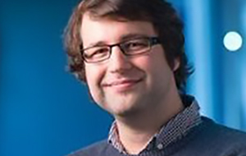
Continuous and Thresholded Models of Source Memory:
A Diffusion Model Approach
Jason Zhou
Adam Osth
Philip Smith
Simon Lilburn

Slide 2
Source Memory
Memory for the context in which an item was previously encountered.

Slide 3
Existing Models
  Continuous
    Banks (2000)
  Thresholded
    Batchelder and Riefer (1990)
    Klauer and Kellen (2010)

Slide 4
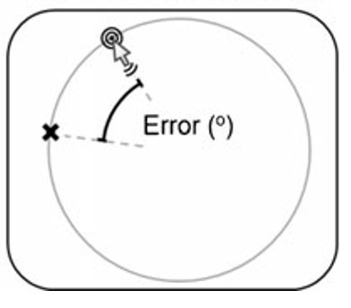
Continuous Report
Harlow, I. M., & Donaldson, D. I. (2013). Source accuracy data reveal the thresholded nature of human episodic memory. Psychonomic bulletin & review, 20(2), 318-325.

Slide 5
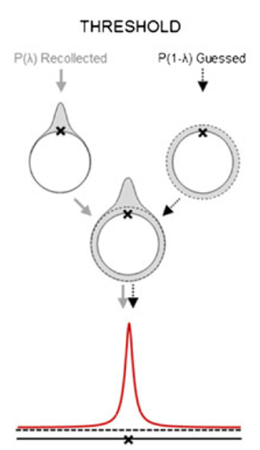
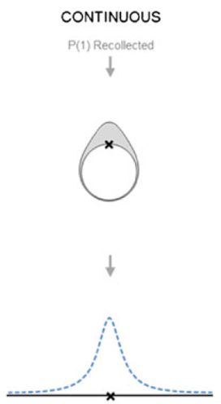
Harlow, I. M., & Donaldson, D. I. (2013). Source accuracy data reveal the thresholded nature of human episodic memory. Psychonomic bulletin & review, 20(2), 318-325.

Slide 6
Unrecognised Items
Source Memory does not exist for Unrecognised Items.
    Hautus et al., 2008
    Malejka and Broder, 2015

Slide 7
Encoding Phase
600ms
HAVOC
1500ms

Slide 8
Recognition Phase
HAVOC
1500ms
Confidence?

Slide 9

Source Response
HAVOC
1500ms

Slide 10
Block Design
Encode
Distractor
Recognition Rating
Source Response

Slide 11
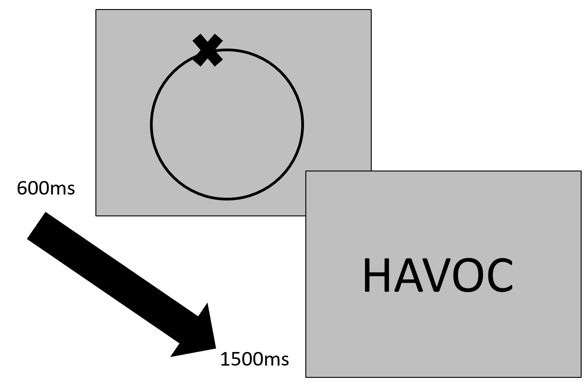
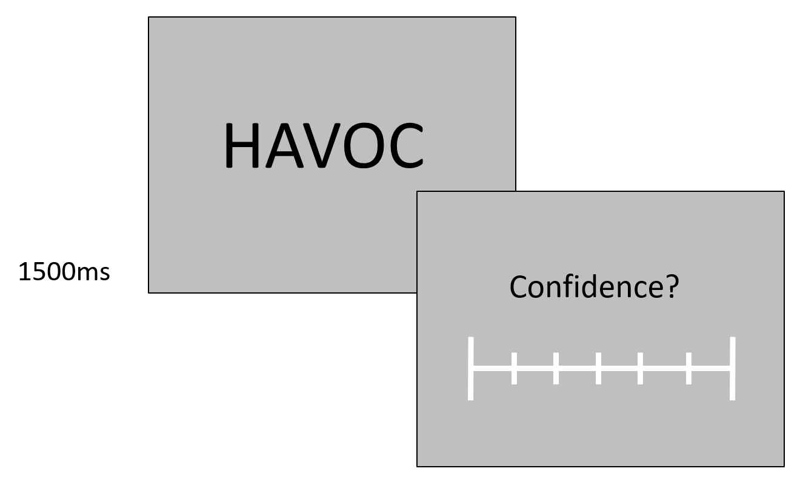
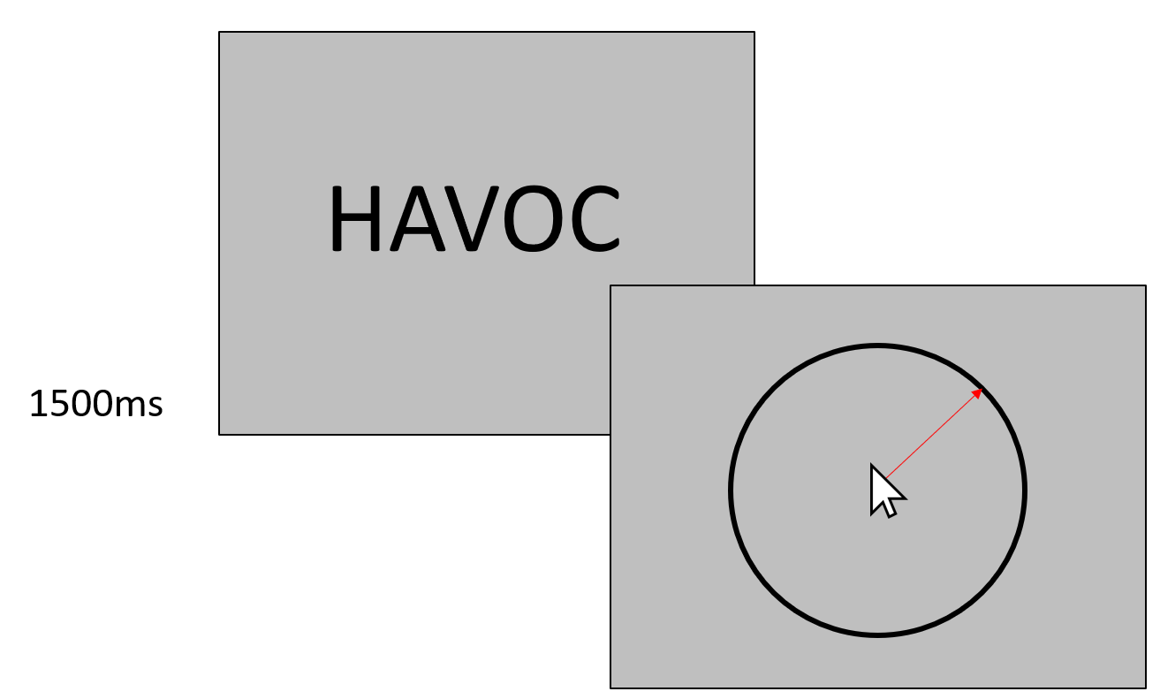
Encoding
Recognition Task
Source Task

Slide 12
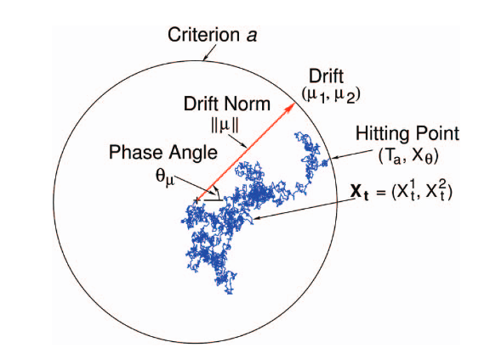
Smith (2016) Circular Diffusion Model
Notes:
As Phil said on Thursday, the diffusion model is able to capture heavy tailed

Slide 13
Model Variants
Continuous model
  Single Process
  Drift rate variability in decision-making.
Threshold model
  Two processes for decision making in information-driven (positive drift) and guessing states (zero drift).

Slide 14
Individual Fit Statistics (BICs)
 | Model
Participant | Threshold | Continuous
1 | 1185 | 1237
2 | 2042 | 2245
3 | 2275 | 2215
4 | 1783 | 1990
5 | 2190 | 2222
6 | 1712 | 1735
7 | 1847 | 1797
8 | 1137 | 1285
9 | 3075 | 3234
10 | 2108 | 2081
11 | 2431 | 2452
12 | 1105 | 1606
13 | 3176 | 3361
15 | 2456 | 2477
16 | 1968 | 2082
17 | 2197 | 2199
18 | 1939 | 2130
19 | 2988 | 3094
20 | 2853 | 2955

Slide 15
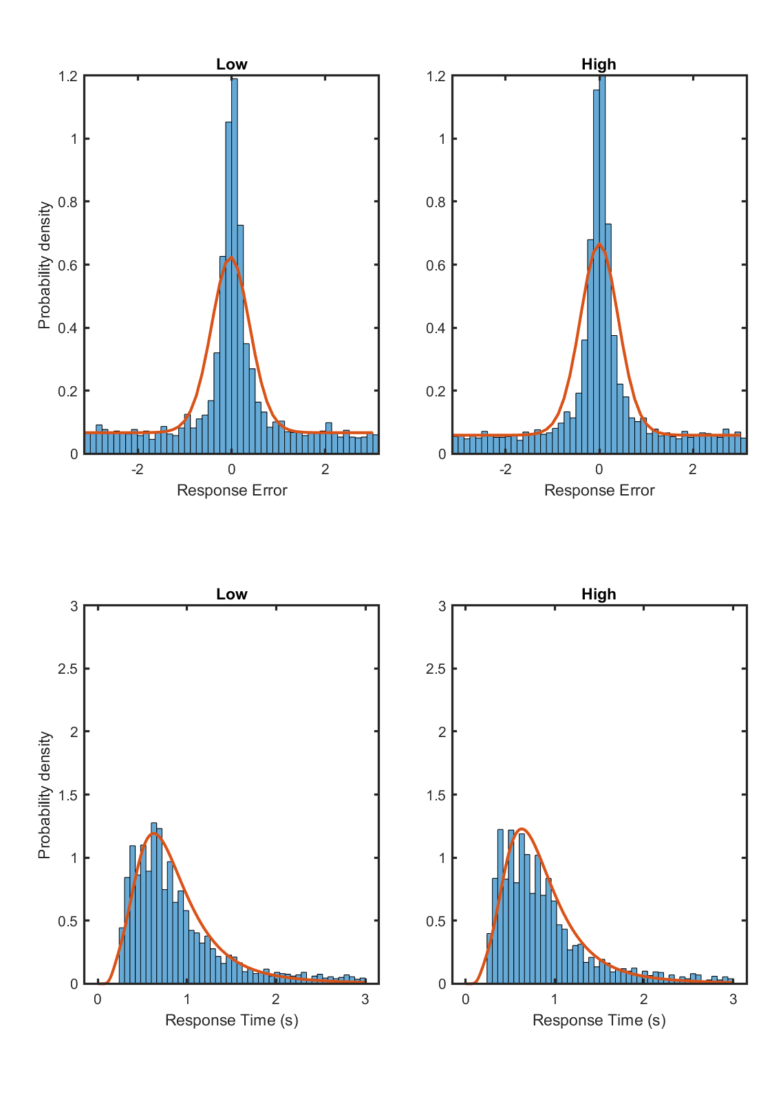
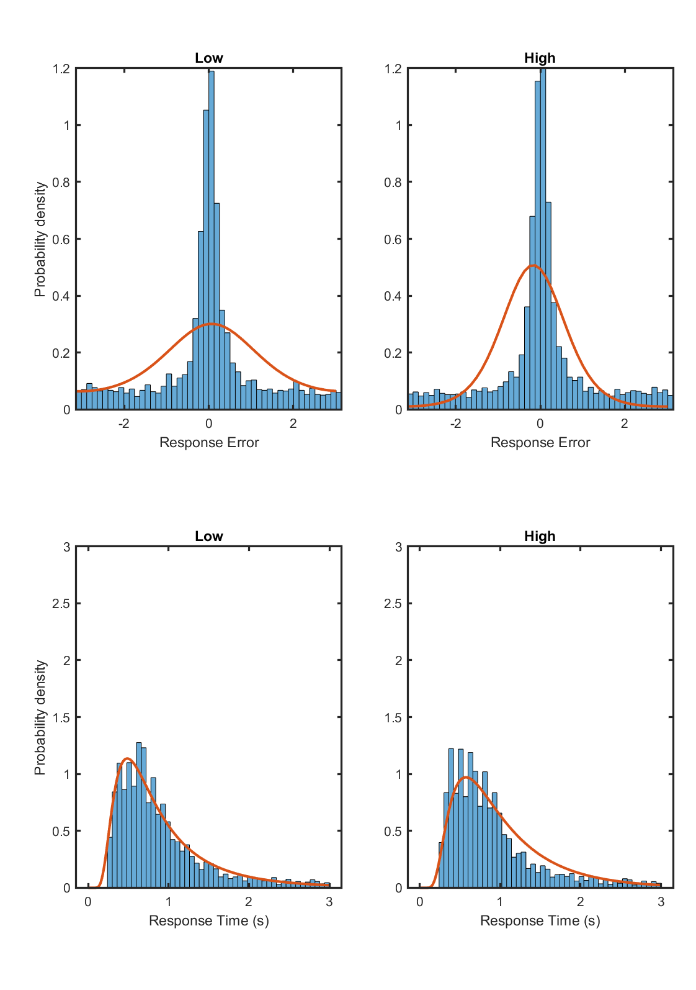
Group Fits
Threshold
Continuous

Slide 16
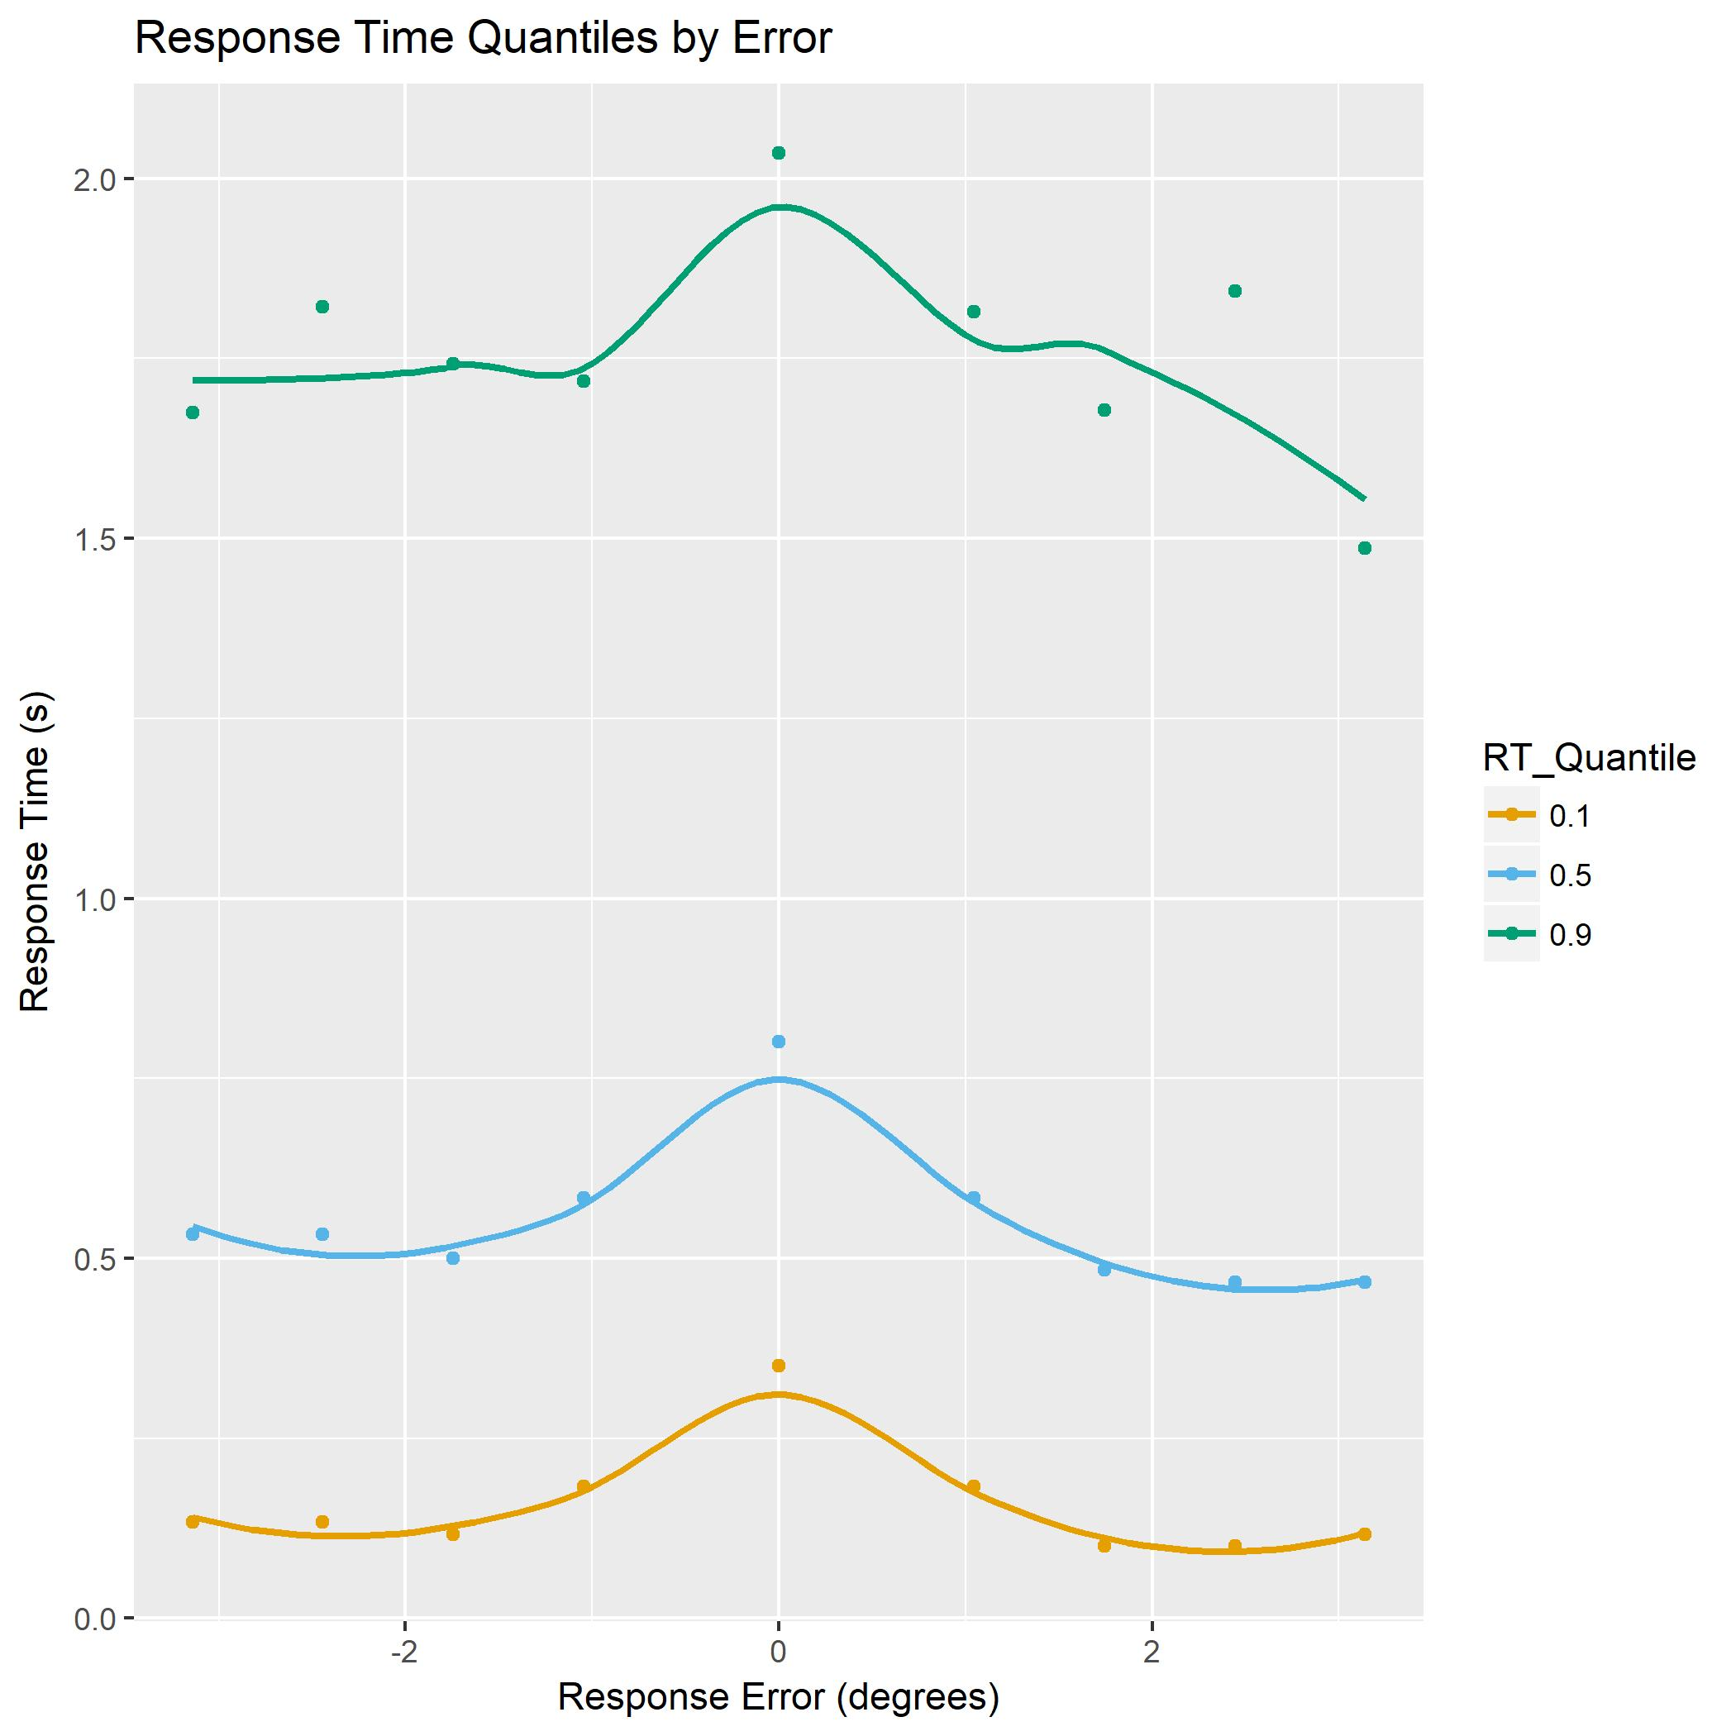
Response Time Quantiles

Slide 17
Individual Fits (Criterion Variability)
 | Model
Participant | Threshold | Continuous
1 | 1344 | 1554
2 | 2231 | 2319
3 | 1952 | 2059
4 | 1755 | 2058
5 | 2162 | 2315
6 | 1715 | 1867
7 | 3538 | 3388
8 | 2072 | 1454
9 | 1771 | 3160
10 | 2023 | 2181
11 | 2283 | 2033
12 | 1247 | 1712
13 | 3492 | 3438
15 | 3620 | 3521
16 | 1964 | 2698
17 | 2487 | 2284
18 | 1932 | 2211
19 | 3185 | 3208
20 | 3712 | 2975

Slide 18
jasonz1@student.unimelb.edu.au

Slide 19
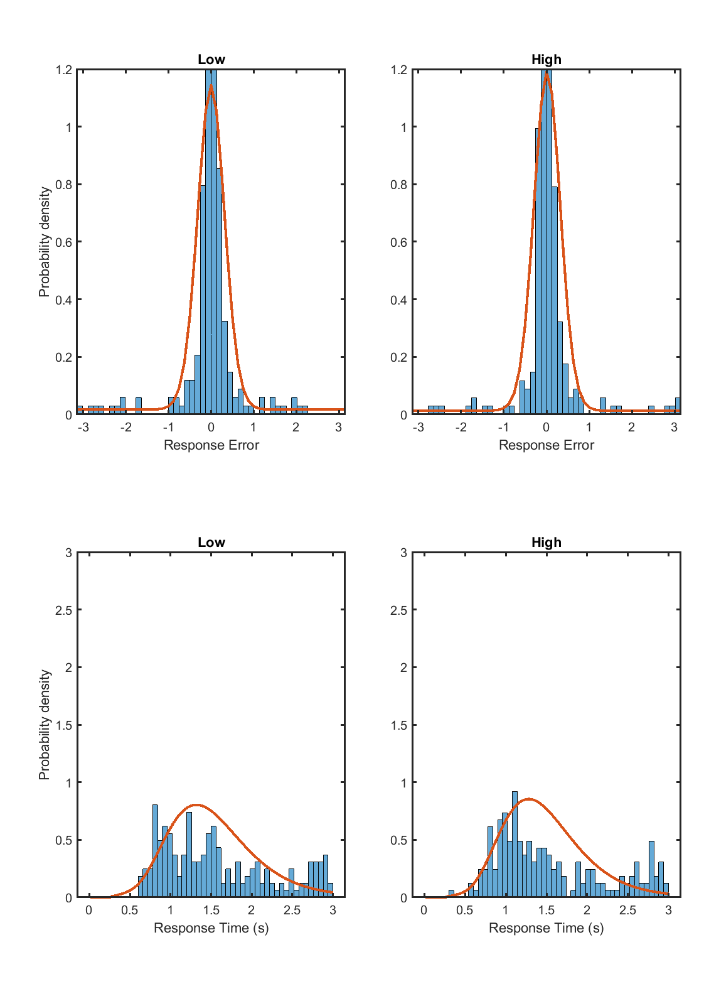
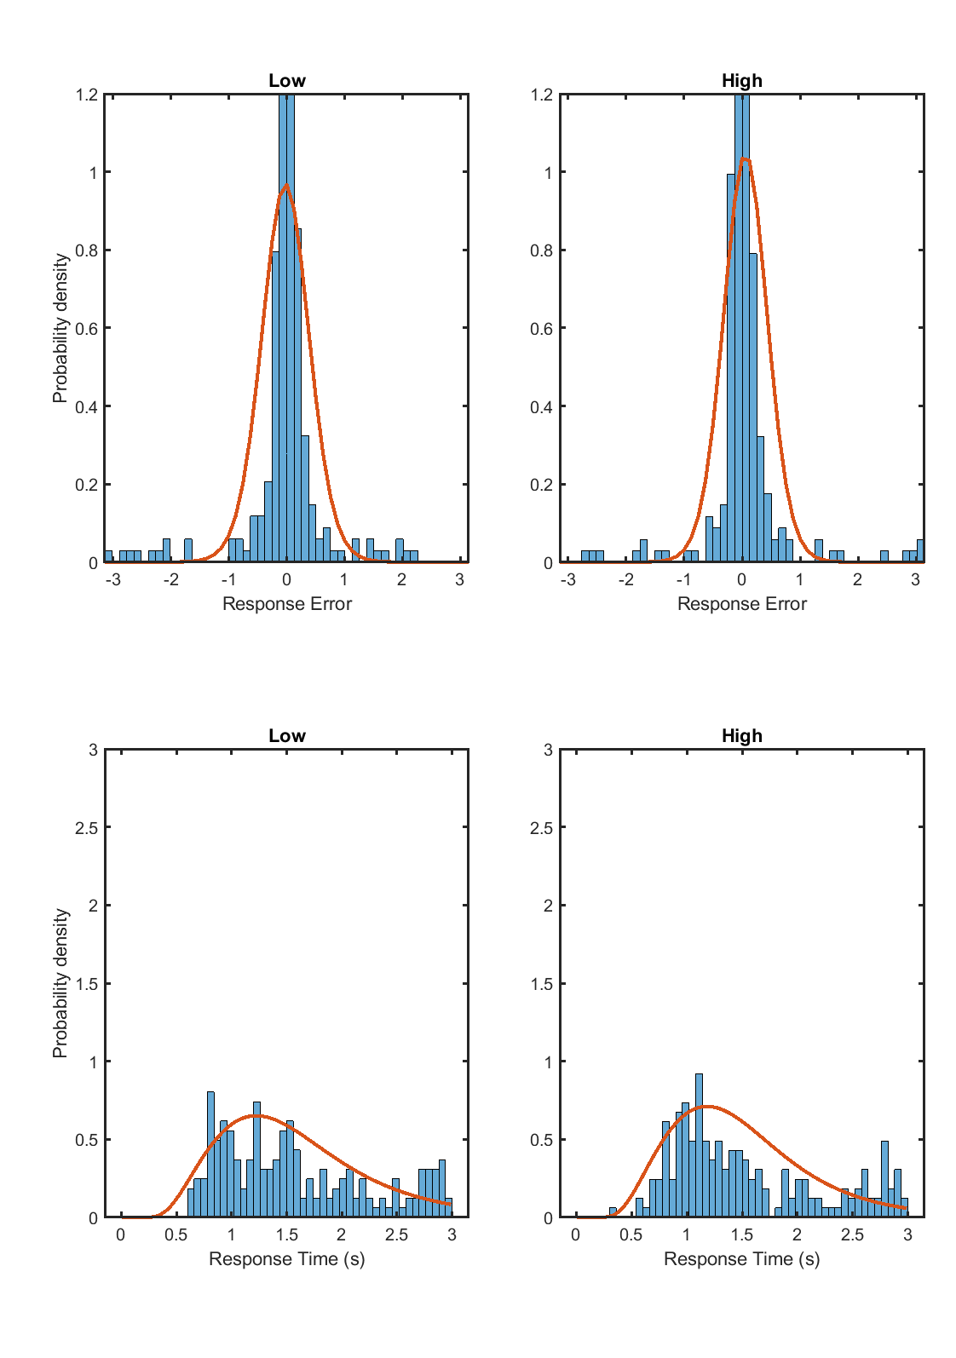
Participant 10
Threshold
Continuous

Slide 20
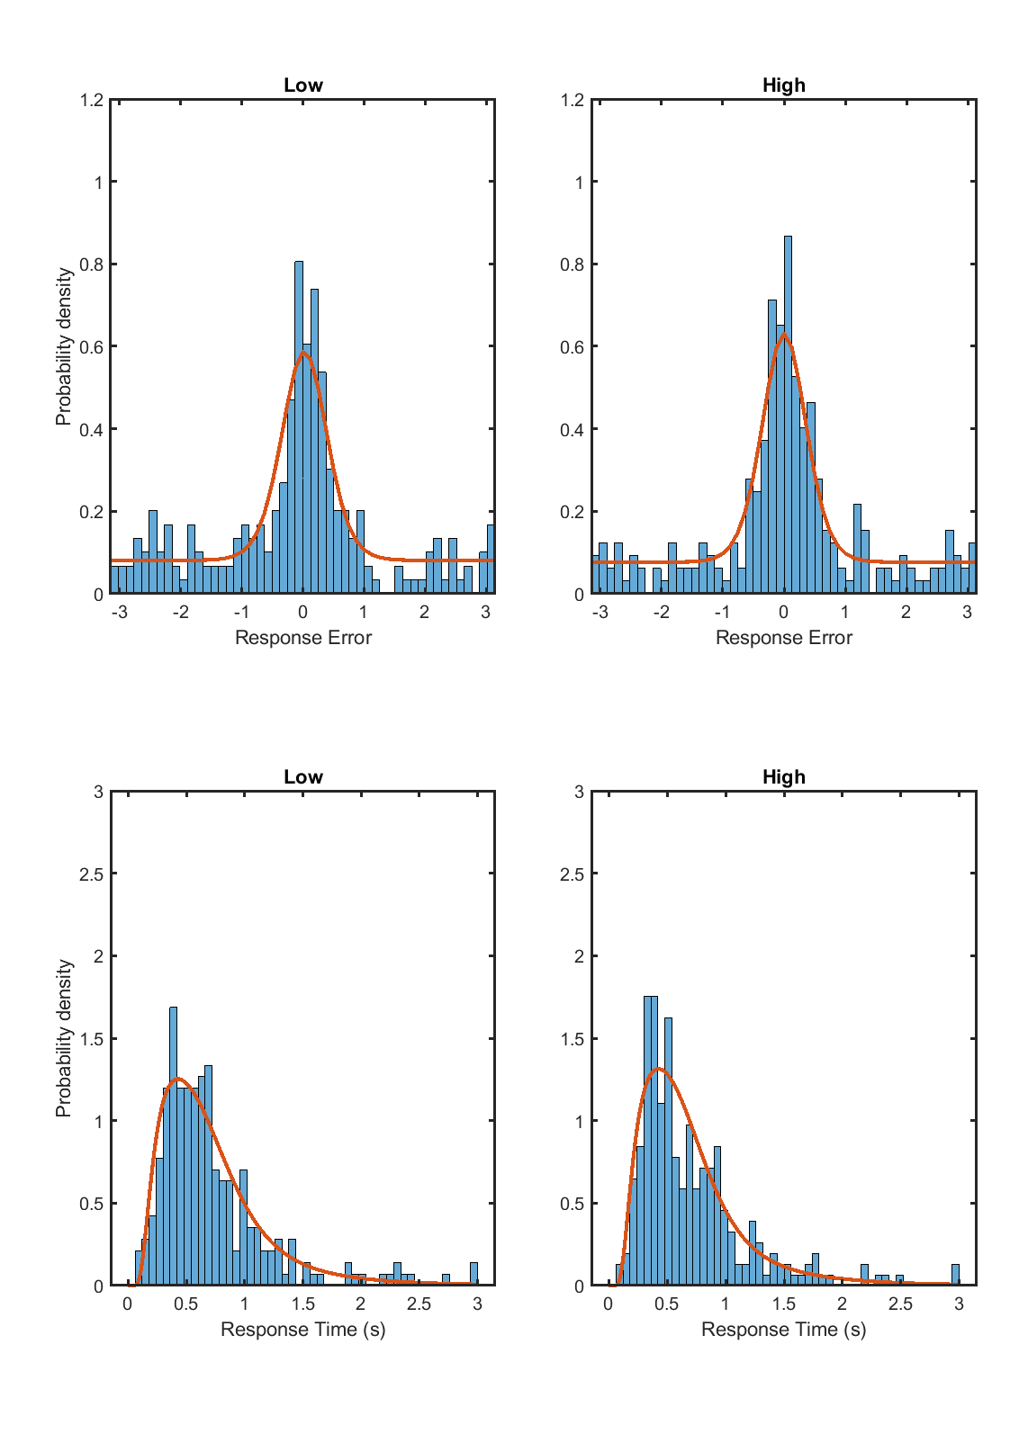

Participant 3
Threshold
Continuous

