Slide 1
Source Memory Retrieval is Thresholded: Evidence from Diffusion Modelling of Continuous-Outcome Tasks
Complex Human Data Hub 2022 Seminar Series
…also a “precompletion” seminar

Slide 2
Source Memory
Information about the conditions in which a memory was formed.
How do items in memory become associated with contexts?
Notes:
Source of a “fact”
Not being able to remember whether the person you’re about to tell a joke to is the person you heard it from in the first place
Amnesia Context matters a lot in how people encode, organize, and retrieve information from memory

Slide 3
Recognition and Source Memory Tasks
Recognition: was this item previously studied?
Source: which source was this item studied in?
Notes:
Source memory is one of the tools that have been used to study episodic memory. Another prominent tool is the recognition task. In recognition, people study a set of items, and then need to discriminate between old studied items and new unstudied items (lures). In source, people are shown a set of items in different sources (font colour of words, side of a screen, gender of a speaker, sensory modality) and then report the source of an item. From Osth et al. 2018: “The relationship between memory for content and context is studied in the laboratory using the item recognition and source memory paradigms. In the item recognition paradigm, participants study a list of items and at test are asked to discriminate between studied items (targets) and unstudied items (lures). The source memory paradigm presents participants with a set of items in different sources, such as different font colors, studied locations, or sensory modalities. At test, participants judge which source studied items were presented in.”

Slide 4
The Nature of Episodic Memory
Memory strength varies continuously, retrieval precision increases with strength (Signal Detection Theory: Banks, 2000)
Memory strength must reach a threshold in order to be retrieved (Batchelder & Riefer, 1990; Klauer & Kellen, 2010)
Different retrieval mechanisms are used in different kinds of memory tasks.
Notes:
Elaborating on why source memory is interesting to researchers: From Osth et al. 2018: “The relationship between memory for content and context is studied in the laboratory using the item recognition and source memory paradigms. In the item recognition paradigm, participants study a list of items and at test are asked to discriminate between studied items (targets) and unstudied items (lures). The source memory paradigm presents participants with a set of items in different sources, such as different font colors, studied locations, or sensory modalities. At test, participants judge which source studied items were presented in.”

Slide 5
The Yonelinas (1999) Dual-Process Model
Familiarity
Recollection
Continuous
Discrete
Notes:
Familiarity is a continuous measure of the strength of an item in memory, its like a rough sense of whether you’ve encountered something before
Recollection is the full richness of the encounter. Crucially, recollection sometimes just doesn’t work, it fails absolutely, and so there is a threshold on it.

Slide 6
The Yonelinas (1999) Dual-Process Model
Familiarity
Recognition
Recollection
Source
Notes:
When performing a recognition task, one can respond by directly retrieve an item from memory through recollection, or by simply making a judgement about whether the item is memory or not without retrieving it, based on a feeling of familiarity.
In this way, both recollection and familiarity can contribute to successful recognition.
On the other hand, in a source memory task, familiarity cannot distinguish between two studied items from different sources, as both items are present in memory and should therefore be equally familiar.
Thus, the Yonelinas (1999) dual-process model predicts that source judgements should rely purely on a high threshold recollection process.

Slide 7
So, is Source Memory Thresholded?
Notes:
So where or not source memory is actually thresholded is pretty consequential question for how we understand the nature of episodic memory retrieval

Slide 8


Continuous-Outcome Tasks
Responses made on a continuous (often circular) domain
Response precision instead of proportion correct
Color
Wilken and Ma (2004)
Bays et al. (2009)
Smith et al. (2020)
Location
Harlow and Donaldson (2013)
Error°
WORD
Adapted from Smith et al. (2020). “Modeling Continuous Outcome Color Decisions With the Circular Diffusion Model: Matric and Categorical Properties” Psychological review, 127, 562-590. Figure 1. Copyright American Psychological Association.
Notes:
Two-Choice Tasks are Inconclusive Historically, the continuous-outcome task has its origins in the method of adjustment of classical psychophysics (Woodworth & Schlossberg, 1954), in which sensory thresholds were measured by asking participants to adjust the intensity of a variable stimulus to match a standard. It was reintroduced to modern cognitive psychology by Prinzmetal, Amiri, Allen, and Edwards (1998), who used it to study the effects of attention on perceptual variability. It was first applied to the study of memory by Wilken and Ma (2004), who used it to investigate how the representations of items in visual working memory change with the number of items that stored.

Slide 9
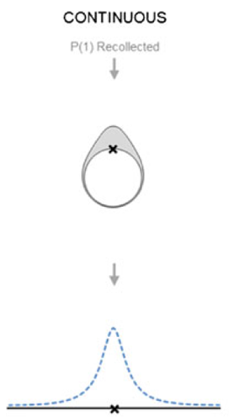
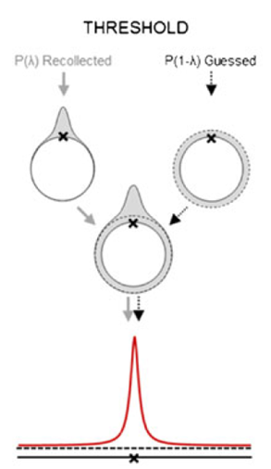
Harlow & Donaldson (2013)
Continuous
Threshold
Harlow, I. M., & Donaldson, D. I. (2013). Source accuracy data reveal the thresholded nature of human episodic memory. Psychonomic bulletin & review, 20(2), 318-325.

Slide 10
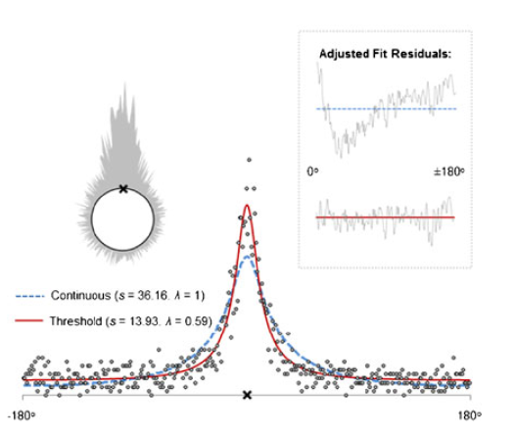
Harlow & Donaldson (2013)
Harlow, I. M., & Donaldson, D. I. (2013). Source accuracy data reveal the thresholded nature of human episodic memory. Psychonomic bulletin & review, 20(2), 318-325.

Slide 11
Study 1
Q: Could source “guesses” be due to recognition failure?
A: No, people still seem to guess when we look only at items recognised with high confidence.
Q: Could heavy-tailed error distribution be a decision (rather than a memory) phenomenon?
A: No, diffusion models which assume a mixture with guesses are preferred over those that do not.
Notes:
A lack of source discriminability for unrecognized items has been replicated numerous times (Bell, Mieth, & Buchner, 2017; Malejka & Broder, 2016; Onyper, Zhang, & Howard, 2010; but see Fox & Osth, 2020 for exceptions), although these studies often employed a procedure where item and source ratings were obtained in the same test trials. When item recognition and source memory tests were in separate blocks, Osth, Fox, McKague, Heathcote, and Dennis (2018) observed reliable source memory for unrecognized items, but discriminability was still close to chance-level accuracy (d’ ~ 0.1).
If the lack of source memory for unrecognized items generalizes to continuous report tasks, then the contribution of guesses from the unrecognized items would result in a heavy-tailed error distribution, which would not necessarily reflect a threshold in memory retrieval but might simply reflect a state in which source retrieval was not attempted. In the context of the findings of Harlow and Donaldson (2013), this account of apparent guessing behavior predicts that if unrecognized items are excluded, the heavy tails in the error distribution will disappear, and that a continuous model will be preferred in account for source performance.

Slide 12
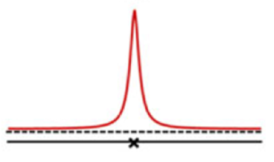
Recognition
No source discriminability in discrete choice tasks for unrecognised items¹
Are these unrecognised items?
¹ Fox and Osth (2022) blocked vs unblocked designs

Slide 13
Decision-Making and Response Times
When people respond to a memory task, they are making decisions based on the information retrieved
To analyse only response outcomes is to overlook response time (RT) data (Ratcliff & Starns, 2019)
Notes:
Decision making is this whole intervening step between whats happening with memory and what we can observe from the response data. There is a very rich literature about properties of the decision-making process. This makes it somewhat fraught to draw conclusions about the nature of memory on the basis of responses, since anything that’s happening at the level of decision making might change what we can infer about memory.
In the recognition memory literature we have examples of conclusions changing after modelling decision process and constraining models with RT data

Slide 14
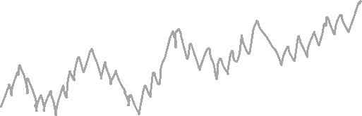
The Diffusion Model
R
Mean Drift Rate
Response A
μ
TIME
a
Accumulator
Decision Criterion
Response B
Notes:
The diffusion model describes decision-making as a noisy evidence accumulation process, the rate of which is defined as the drift rate, that accumulates until a response boundary or criterion that represents the amount of evidence required for a given response to be output (Ratcliff & McKoon, 2008).
Drift rate reflects the quality of evidence driving the decision process and draws an explicit link between response accuracy and RT: higher drift rates result in higher accuracy and faster RTs, while lower drift rates result in lower accuracy and slower RTs (Ratcliff et al., 2015).
In applications of the model to memory, the drift rate reflects the quality of the information retrieved from memory, estimates of drift rate from the model and the way in which they varying across experimental conditions are important theoretically in testing between alternative models of the memory system.
The diffusion decision model is a particularly influential account of decision making, which successfully explains well-documented phenomena like the speed-accuracy trade-off, and slow and fast error patterns under different decision conditions (Ratcliff et al., 2016).

Slide 15

The Diffusion Model
R
Mean Drift Rate
Response A
μ
η Drift Rate Variability
a
Decision Criterion
Response B
Notes:
The diffusion model describes decision-making as a noisy evidence accumulation process, the rate of which is defined as the drift rate, that accumulates until a response boundary or criterion that represents the amount of evidence required for a given response to be output (Ratcliff & McKoon, 2008).
Drift rate reflects the quality of evidence driving the decision process and draws an explicit link between response accuracy and RT: higher drift rates result in higher accuracy and faster RTs, while lower drift rates result in lower accuracy and slower RTs (Ratcliff et al., 2015).
In applications of the model to memory, the drift rate reflects the quality of the information retrieved from memory, estimates of drift rate from the model and the way in which they varying across experimental conditions are important theoretically in testing between alternative models of the memory system.
The diffusion decision model is a particularly influential account of decision making, which successfully explains well-documented phenomena like the speed-accuracy trade-off, and slow and fast error patterns under different decision conditions (Ratcliff et al., 2016).

Slide 16
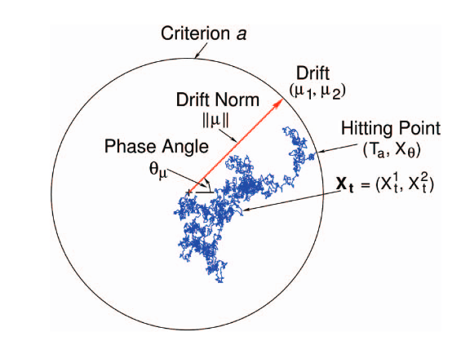


The Circular Diffusion Model
R
$$\left\|μ\right\|$$
From P. L. Smith (2016). “Diffusion theory of decision making in continuous report’ Psychological review, 123, 425-451. Figure 2. Copyright American Psychological Association.
Notes:
The drift rate is vector-valued and consists of two components, (μ_{1,} μ₂), which jointly specify its magnitude and direction. In polar coordinates the magnitude is represented by the drift norm ||μ|| and direction is represented by the phase angle θ_{μ}

Slide 17
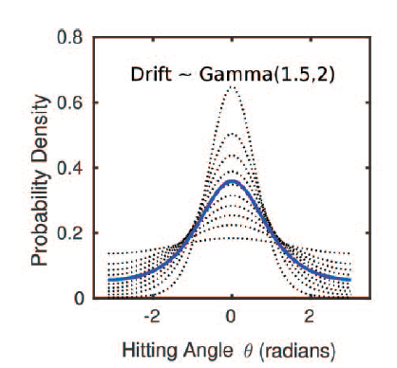
Drift Rate Variability
R
High Drift (fast RT)
Overall
Low Drift (slow RT)
Variable Precision
Threshold
Notes:
In difficult two-choice decisions in which accuracy is stressed, error RTs are typically slower than correct RTs (Luce, 1986, p. 233), especially in memoy tasks (e.g.; Osth, Bora, Dennis, & Heathcote, 2017; Ratcliff & Smith, 2004).
when drift rate varies across trials: The fastest responses are those made with the smallest error and RTs systematically increase with increasing error.

Slide 18
Model Comparison
R
Variable Precision
Threshold
?
+

Slide 19
Study 1
Q: Could source “guesses” be due to recognition failure?
A: No, people still seem to guess when we look only at items recognised with high confidence.
Q: Could heavy-tailed error distribution be a decision (rather than a memory) phenomenon?
A: No, diffusion models which assume a mixture with guesses are preferred over those that do not.
Notes:
A lack of source discriminability for unrecognized items has been replicated numerous times (Bell, Mieth, & Buchner, 2017; Malejka & Broder, 2016; Onyper, Zhang, & Howard, 2010; but see Fox & Osth, 2020 for exceptions), although these studies often employed a procedure where item and source ratings were obtained in the same test trials. When item recognition and source memory tests were in separate blocks, Osth, Fox, McKague, Heathcote, and Dennis (2018) observed reliable source memory for unrecognized items, but discriminability was still close to chance-level accuracy (d’ ~ 0.1).
If the lack of source memory for unrecognized items generalizes to continuous report tasks, then the contribution of guesses from the unrecognized items would result in a heavy-tailed error distribution, which would not necessarily reflect a threshold in memory retrieval but might simply reflect a state in which source retrieval was not attempted. In the context of the findings of Harlow and Donaldson (2013), this account of apparent guessing behavior predicts that if unrecognized items are excluded, the heavy tails in the error distribution will disappear, and that a continuous model will be preferred in account for source performance.

Slide 20
Experimental Paradigm
Encode
Distractor
Recognition
Source

Slide 21

Experimental Paradigm
Encode
Distractor
Recognition
Source
x 10
DRAG
TRY AGAIN
2000 ms

Slide 22
Experimental Paradigm
Encode
Distractor
Recognition
Source
3 + 6 + 2 = 10
1 = TRUE
0 = FALSE
30000 ms

Slide 23
Experimental Paradigm
Encode
Distractor
Recognition
Source
Is this word OLD or NEW?
CART
Sure New
Sure Old

Slide 24
Experimental Paradigm
Encode
Distractor
Recognition
Source
DRAG
1000 ms

Slide 25
Study 1: Results
Q: Could source “guesses” be due to recognition failure?

Slide 26
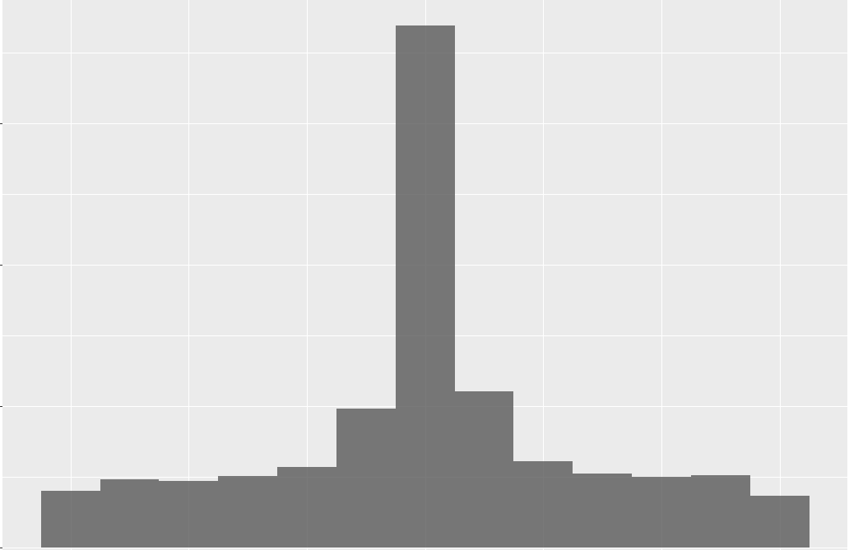
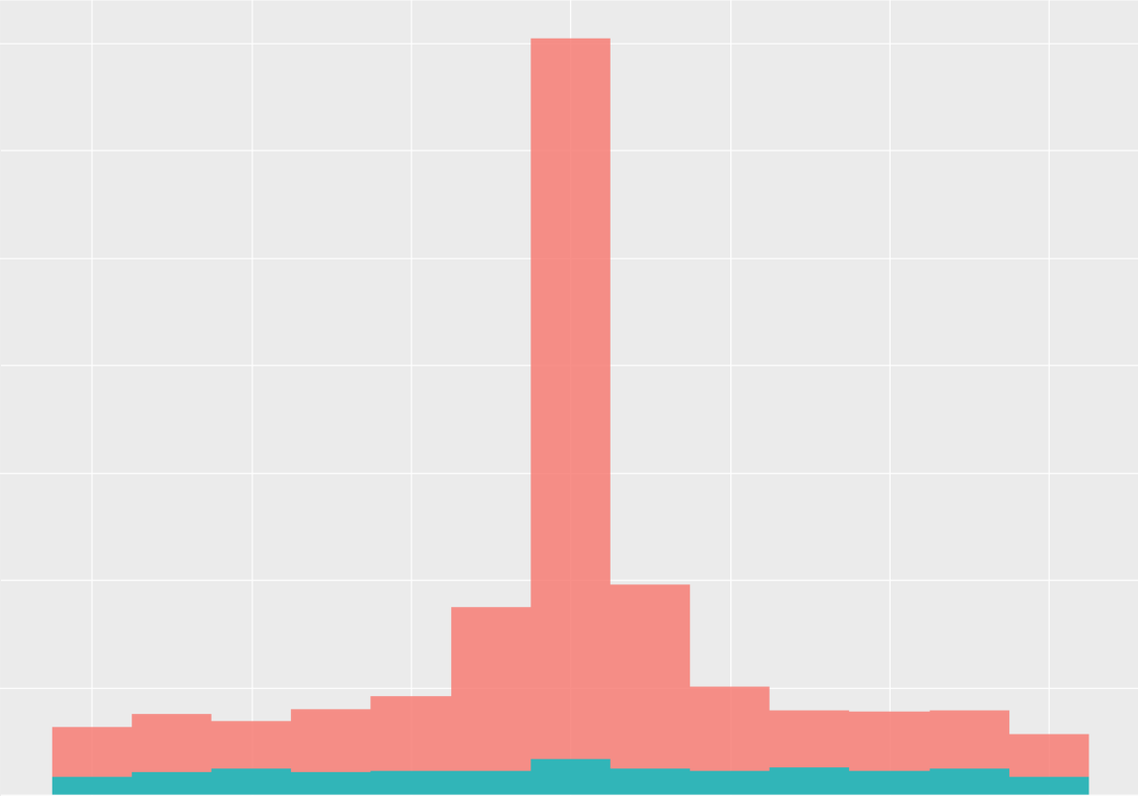

Slide 27
>3 Recognised
≤3 Unrecognised

Slide 28
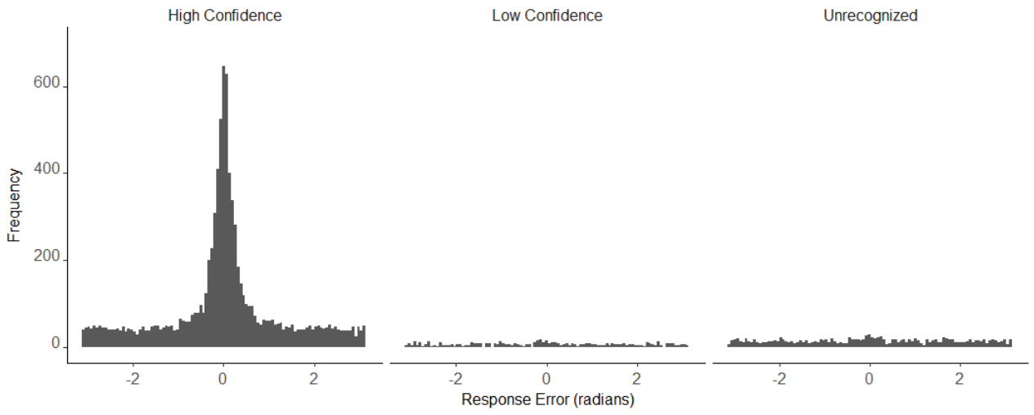
6
4-5
1-3

Slide 29
Study 1
Q: Could source “guesses” be due to recognition failure?
A: No, people still seem to guess when we look only at items recognised with high confidence.
Q: Could heavy-tailed error distribution be a decision (rather than a memory) phenomenon?
A: No, diffusion models which assume a mixture with guesses are preferred over those that do not.
Notes:
model would allow us to distinguish between the predictions of SDT-like variable precision models and thresholded models of memory in the RT and accuracy data from a continuous outcome retrieval task

Slide 30
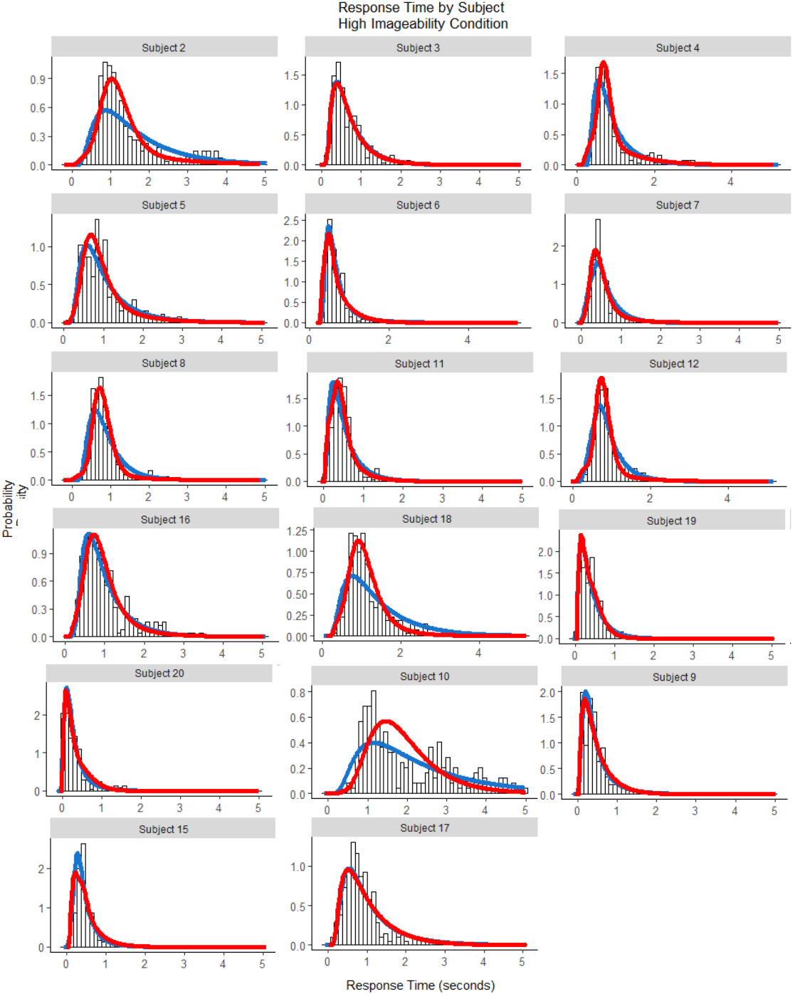
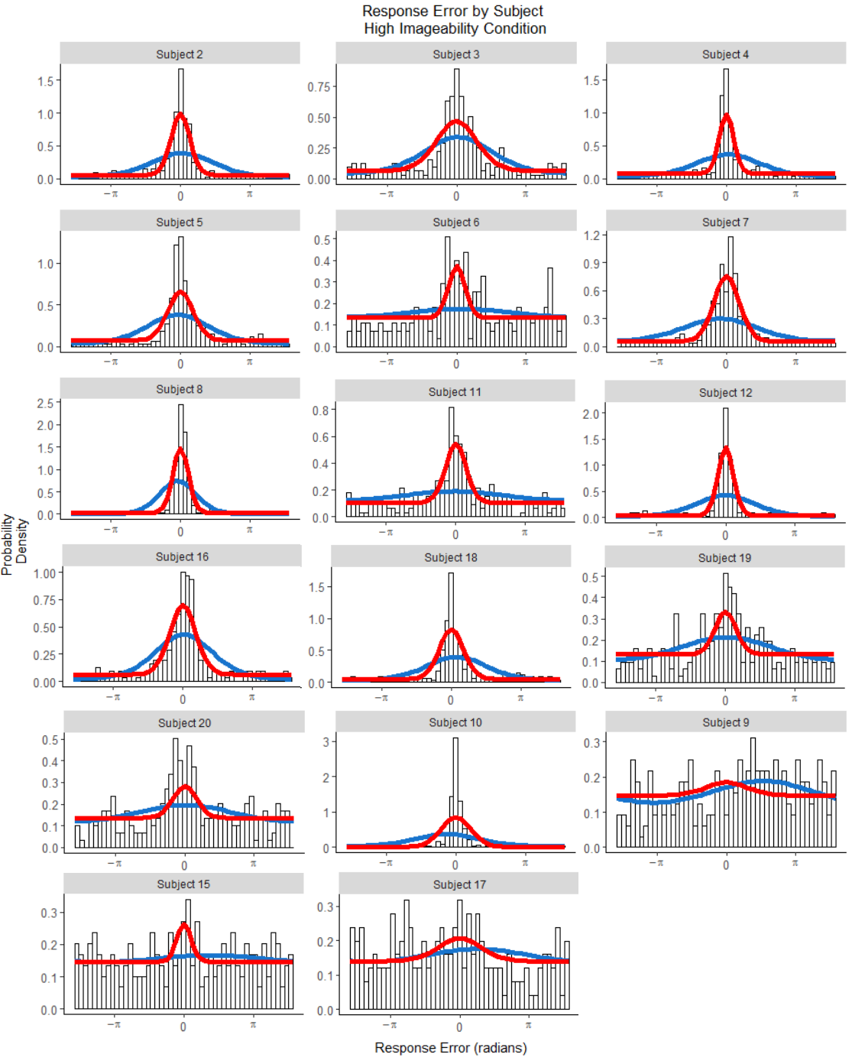
Response Error
Response Time
Density
Probability Density
Models
Variable-Precision Threshold
Response Time (seconds)

Slide 31
Response Error
Response Time
Density
Probability Density
Models
Variable-Precision Threshold
Response Time (seconds)

Slide 32
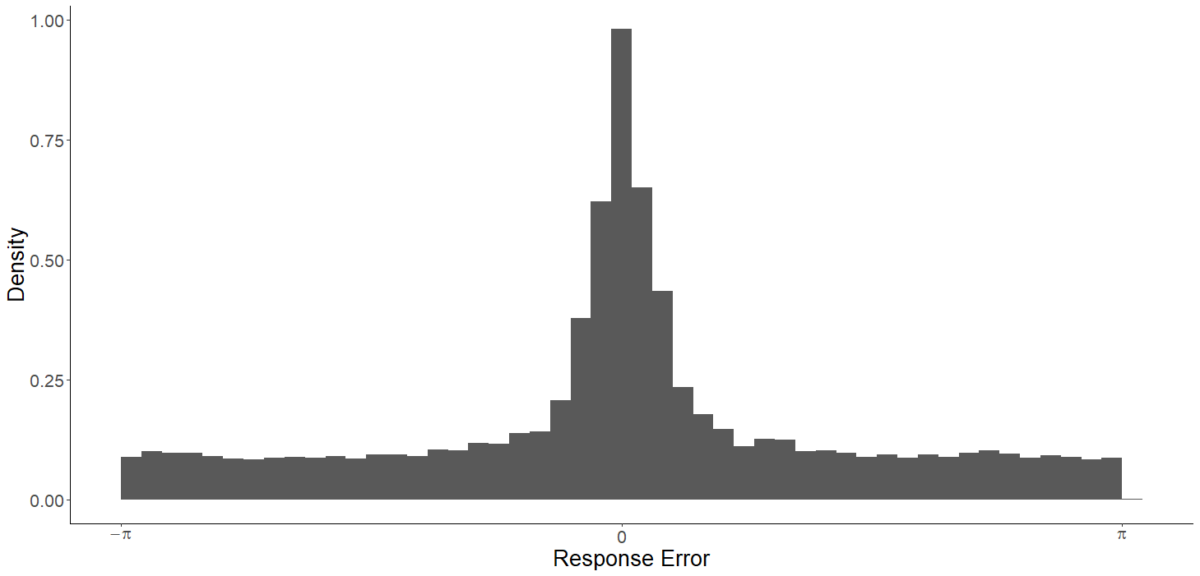
Relationships between Error and RT

Slide 33
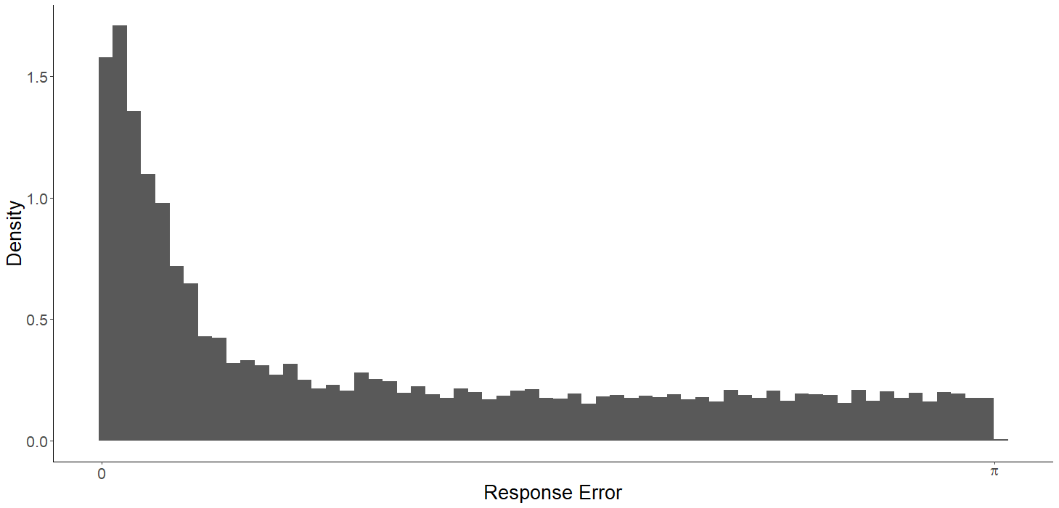
Error Quantiles
0.1
0.3
0.5
0.9

Slide 34
Error Quantiles
0.9
0.1
0.3
0.5
0.9
0.5
0.1
Response Time

Slide 35
Error Quantiles
0.9
0.5
0.1
Response Time
Notes:
when drift rate varies across trials: The fastest responses are those made with the smallest error and RTs systematically increase with increasing error.

Slide 36
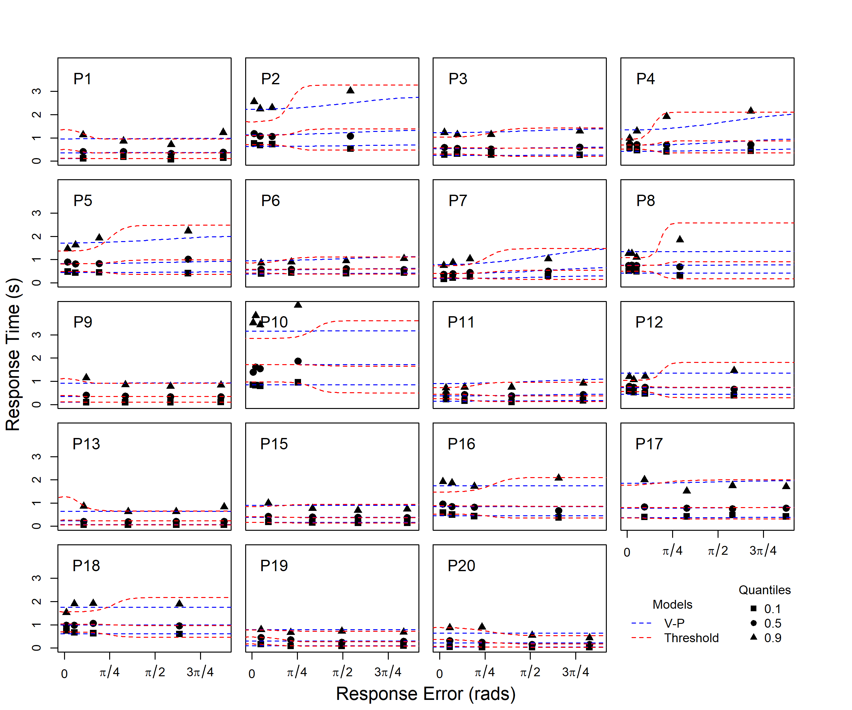
Threshold
Variable Precision

Slide 38
Study 1
Q: Could source “guesses” be due to recognition failure?
A: No, people still seem to guess when we look only at items recognised with high confidence.
Q: Could heavy-tailed error distribution be a decision (rather than a memory) phenomenon?
A: No, diffusion models which assume a mixture with guesses are preferred over those that do not.
Notes:
Guesses are not due to unrecognised items
Heavy-tailed distribution is a memory phenomenon, not a decision one
Source memory retrieval appears to be thresholded

Slide 39
Study 2: Intrusions from Non Target Items
Q: Are our findings robust to changes in presentation format?
A: Yes.
Sequential
Simultaneous
WORD
WORD
Notes:
Our primary aim is to understand whether there really are discrete failures to retrieve source information *or* whether some of these apparent failures are due to non-target confusions.

Slide 40
Study 2: Intrusions from Non Target Items
Q: Are our findings robust to changes in presentation format?
A: Yes.
Q: Are “guesses” actually due to confusions between targets?
A: No, intrusions happen, but there are still guesses.
Notes:
Our primary aim is to understand whether there really are discrete failures to retrieve source information *or* whether some of these apparent failures are due to non-target confusions.

Slide 41
TIER
TIED
CORD

Slide 42
Intrusions
Where was
“CORD” Located?
Target
Notes:
Is the evidence that, to this point, been used to support threshold model of source memory actually explainable by intrusions? Note this is only for one trial, because intrusions are uniformly distributed across trials, the overall distribution of errors across trials will look like a flat tail. The key difference is that one any one trial, the errors from intrusions are systematic, and linked to the locations of possible intrusions. The driving rationale here is inspired by Paul Bays work- if we account for intrusions, does the amount of uniform guessing (in a no-information state) go down? In his work, it did substantially 62% down to 14%.

Slide 43
=
Guessing
Intrusions
Target
Notes:
Is the evidence that, to this point, been used to support threshold model of source memory actually explainable by intrusions? Note this is only for one trial, because intrusions are uniformly distributed across trials, the overall distribution of errors across trials will look like a flat tail. The key difference is that one any one trial, the errors from intrusions are systematic, and linked to the locations of possible intrusions. The driving rationale here is inspired by Paul Bays work- if we account for intrusions, does the amount of uniform guessing (in a no-information state) go down? In his work, it did substantially 62% down to 14%.

Slide 44
Evidence of Intrusions
PLUG
CALM
PLUM
Response Error
FLAG
DREG
Notes:
Before we even get to the modelling, there’s some evidence that intrusions are happening by just looking at the data

Slide 45
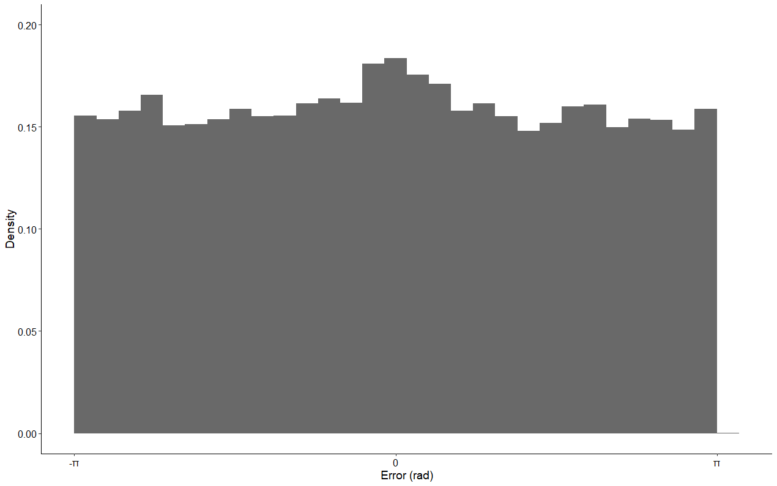
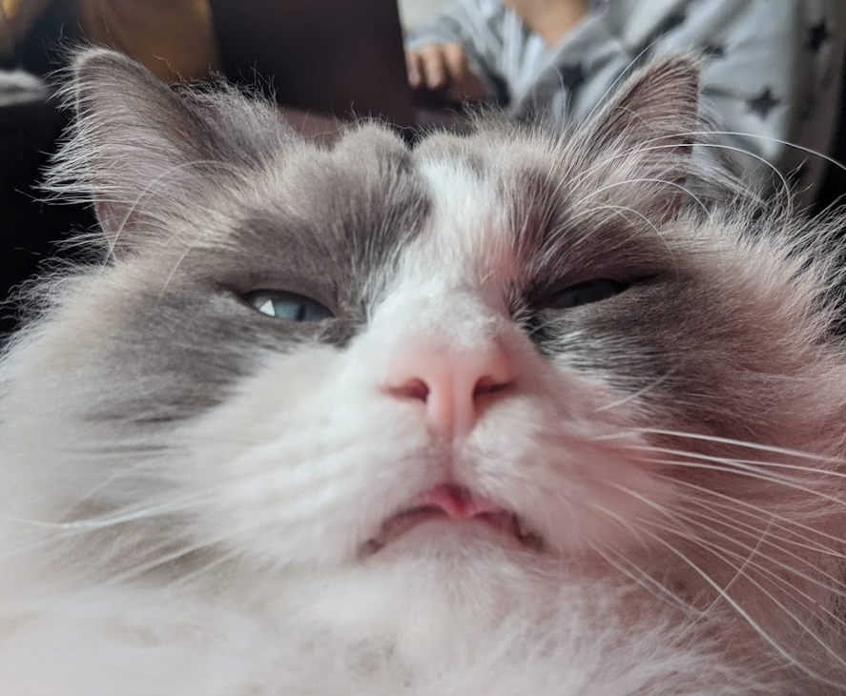
Evidence of Intrusions: Recentered Errors
R
Notes:
Before we even get to the modelling, there’s some evidence that intrusions are happening by just looking at the data

Slide 46
Are “guesses” due to intrusions?
Pure Guess
Pure Intrusion
Intrusion + Guess

Slide 47
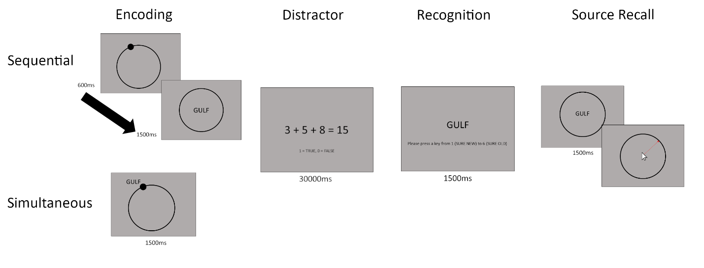
Experimental Paradigm

Slide 48
Experiment 1:
More participants, fewer sessions
Experiment 2:
Fewer participants, more sessions

Slide 49
Study 2: Intrusions from Non Target Items
Q: Are our findings robust to changes in presentation format?
A: Yes.
Q: Are “guesses” actually due to confusions between targets?
A: No, intrusions happen, but there are still guesses.
Notes:
Our primary aim is to understand whether there really are discrete failures to retrieve source information *or* whether some of these apparent failures are due to non-target confusions.

Slide 50
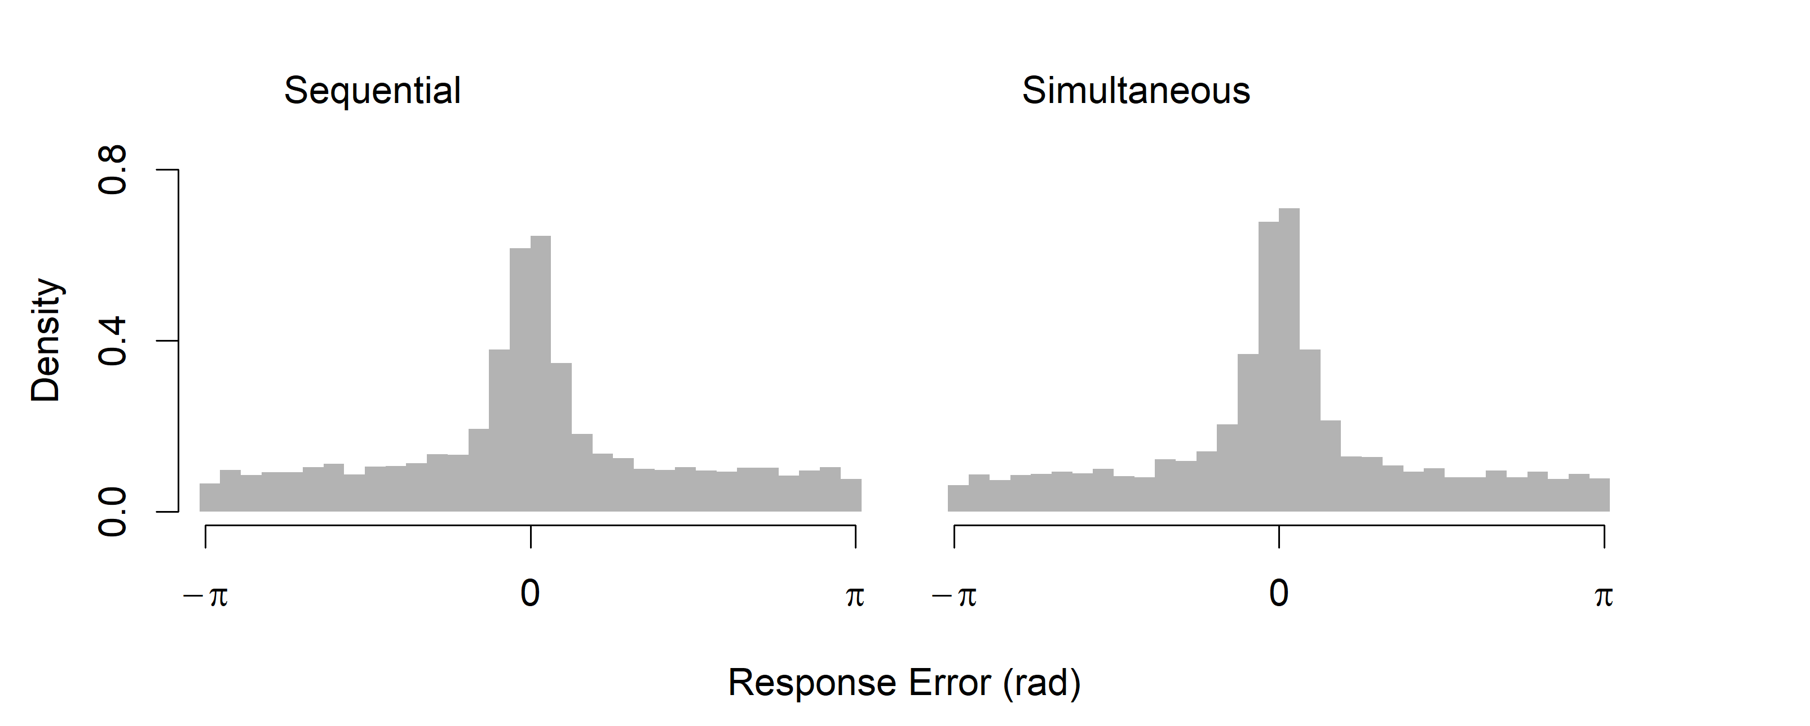
Simultaneous vs. Sequential Presentation
R

Slide 51
Study 2: Intrusions from Non Target Items
Q: Are our findings robust to changes in presentation format?
A: It doesn’t matter how the stimuli are presented
Q: Are “guesses” actually due to confusions between targets?
A: No, intrusions happen, but there are still guesses.
Notes:
Our primary aim is to understand whether there really are discrete failures to retrieve source information *or* whether some of these apparent failures are due to non-target confusions.

Slide 52
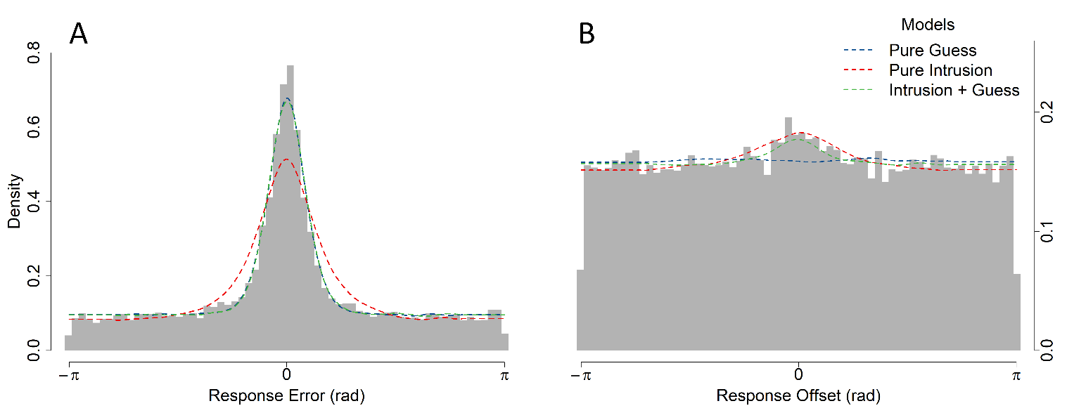
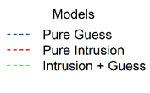
Response Outcomes
PLUG
CALM
PLUM
Response Error
FLAG
DREG

Slide 53
So, intrusions do happen,
but seemingly, so do guesses.
Are all intrusions equally likely?
Notes:
A purely continuous with intrusions model is ruled out

Slide 54
Weighting Intrusions
CUBS
COVE
PUPS
CORE
backwards
forwards
Temporal Similarity
Orthographic Similarity
Spatial Similarity
Semantic Similarity

Slide 55
Temporal Similarity
ALOE GRAB ROOT CUBS COVE PUPS CORE CARD MUGS
-6
-5
-4
-3
-2
-1
0
+1
+2
Lag
Notes:
Assumption that the strength of association between items is an exponentially decreasing function of distance

Slide 56
Temporal Similarity
ALOE GRAB ROOT CUBS COVE PUPS CORE CARD MUGS
-4
-3
-2
-1
0
1
2
3
4
Lag
Notes:
Assumption that the strength of association between items is an exponentially decreasing function of distance

Slide 57
Intrusions + Guess: all intrusions equal
Likelihood of Intrusion
-4
-3
-2
-1
1
2
3
4
Lag
Notes:
Assumption that the strength of association between items is an exponentially decreasing function of distance

Slide 58
Temporal Gradient
Likelihood of Intrusion
-4
-3
-2
-1
1
2
3
4
Lag
Notes:
Assumption that the strength of association between items is an exponentially decreasing function of distance

Slide 59
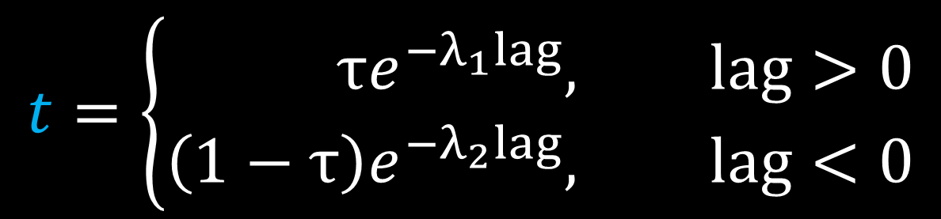
Temporal Gradient
$$t=\left\{\begin{aligned}τe^{−λ_{1}lag}, &lag>0 \\ \left(1−τ\right)e^{{−λ}_{2}lag}, &lag<0\end{aligned}\right.$$
Likelihood
- lag
+ lag
Lag
Notes:
Assumption that the strength of association between items is an exponentially decreasing function of distance

Slide 60
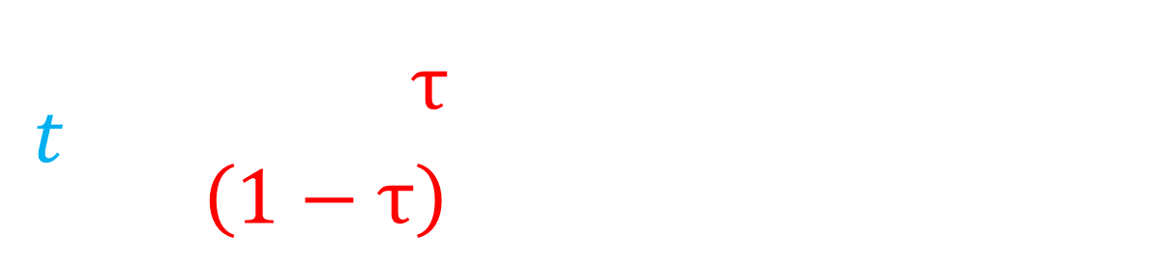
Temporal Gradient
$$t=\left\{\begin{aligned}τe^{−λ_{1}lag}, &lag>0 \\ \left(1−τ\right)e^{{−λ}_{2}lag}, &lag<0\end{aligned}\right.$$
Likelihood
- lag
+ lag
Lag
Notes:
Assumption that the strength of association between items is an exponentially decreasing function of distance

Slide 61
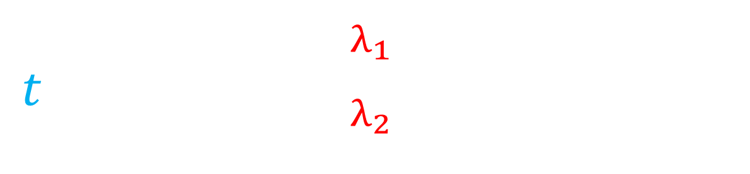
Temporal Gradient
$$t=\left\{\begin{aligned}τe^{−λ_{1}lag}, &lag>0 \\ \left(1−τ\right)e^{{−λ}_{2}lag}, &lag<0\end{aligned}\right.$$
Likelihood
- lag
+ lag
Lag
Notes:
Assumption that the strength of association between items is an exponentially decreasing function of distance

Slide 62
Spatiotemporal Gradient
Spatial Similarity
* Temporal Similarity
Likelihood
Distance between items
Notes:
Weighted product

Slide 63
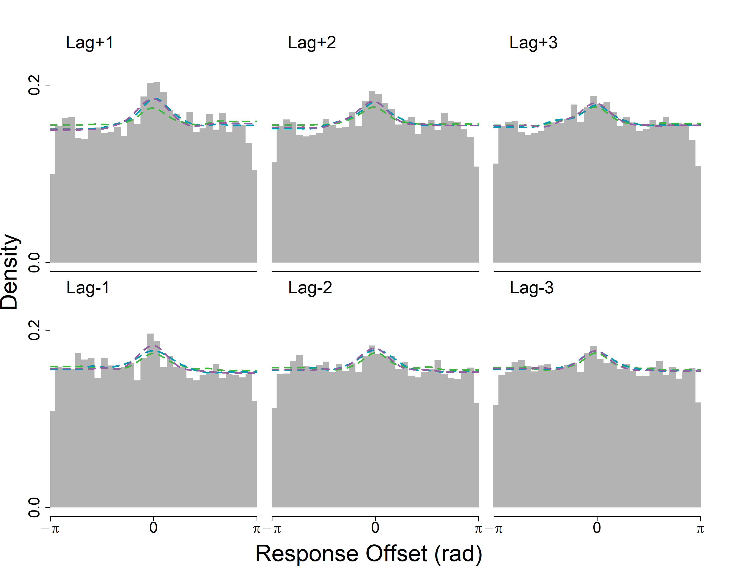
R

Slide 64
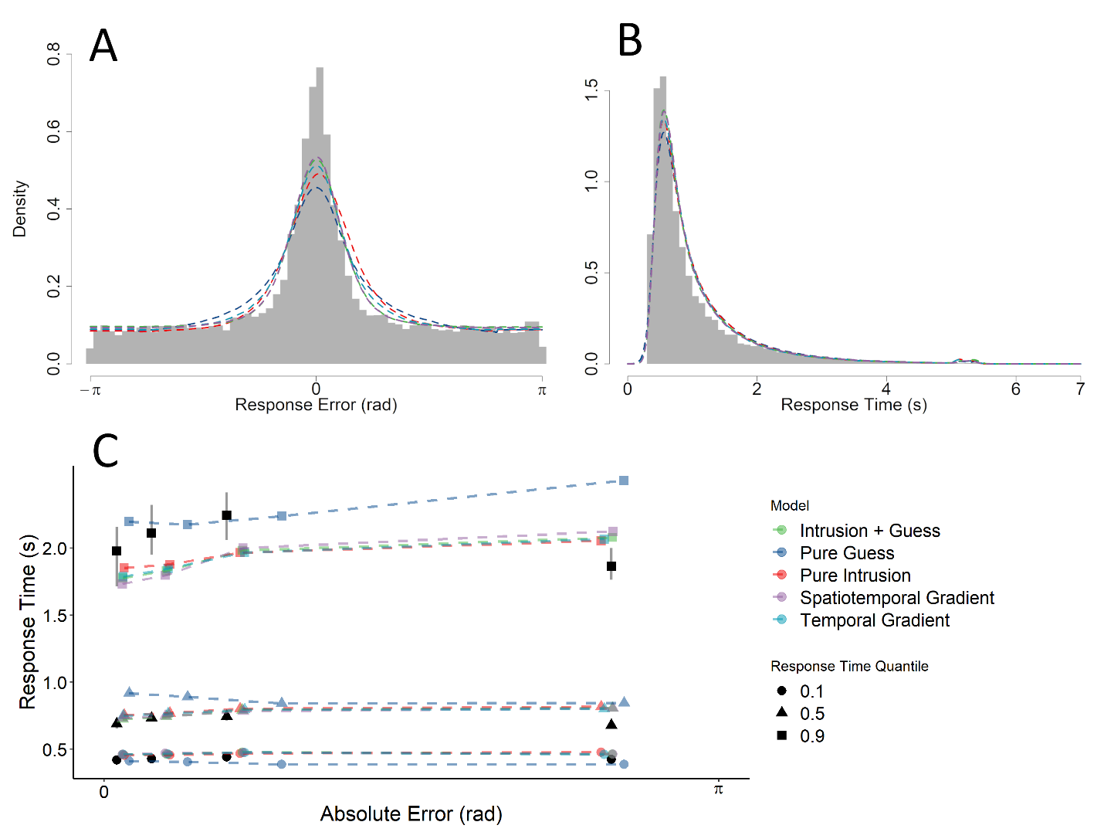
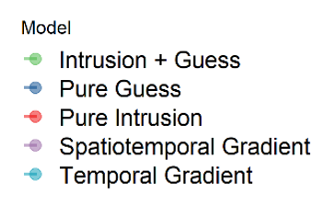

Slide 67
Experiment 1:
More participants, fewer sessions
Experiment 2:
Fewer participants, more sessions

Slide 68
Spatiotemporal-Orthographic Gradient
Spatiotemporal-Semantic Gradient
Four-Factor Gradient

Slide 69
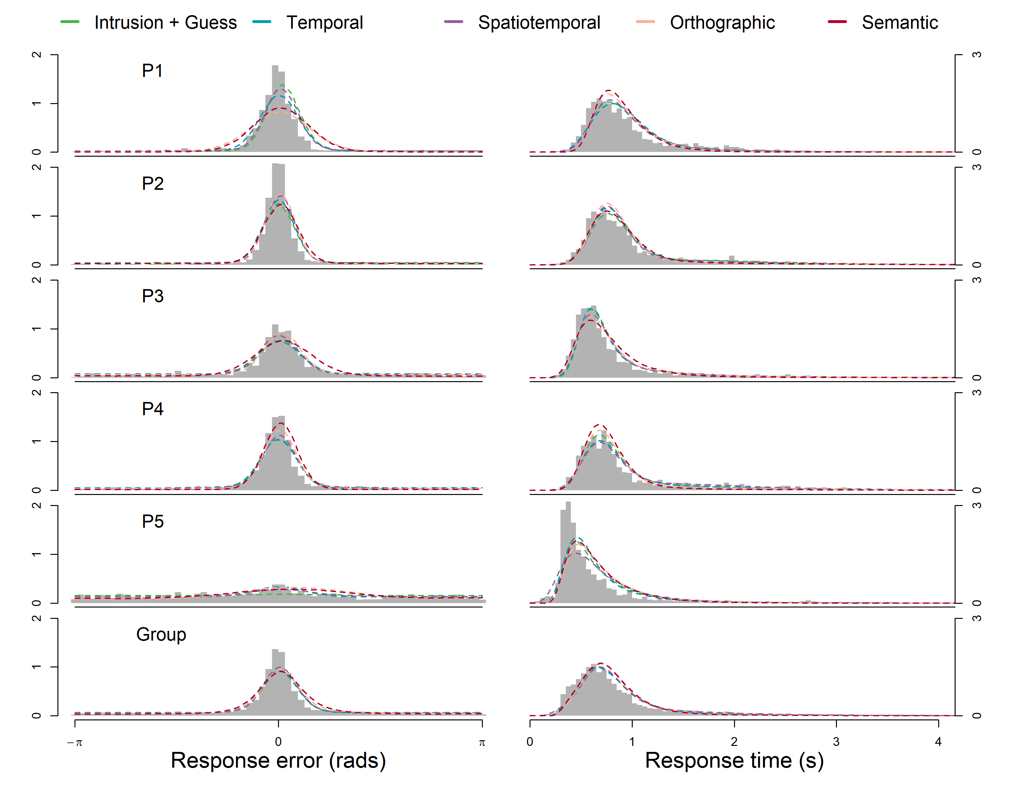

Slide 70
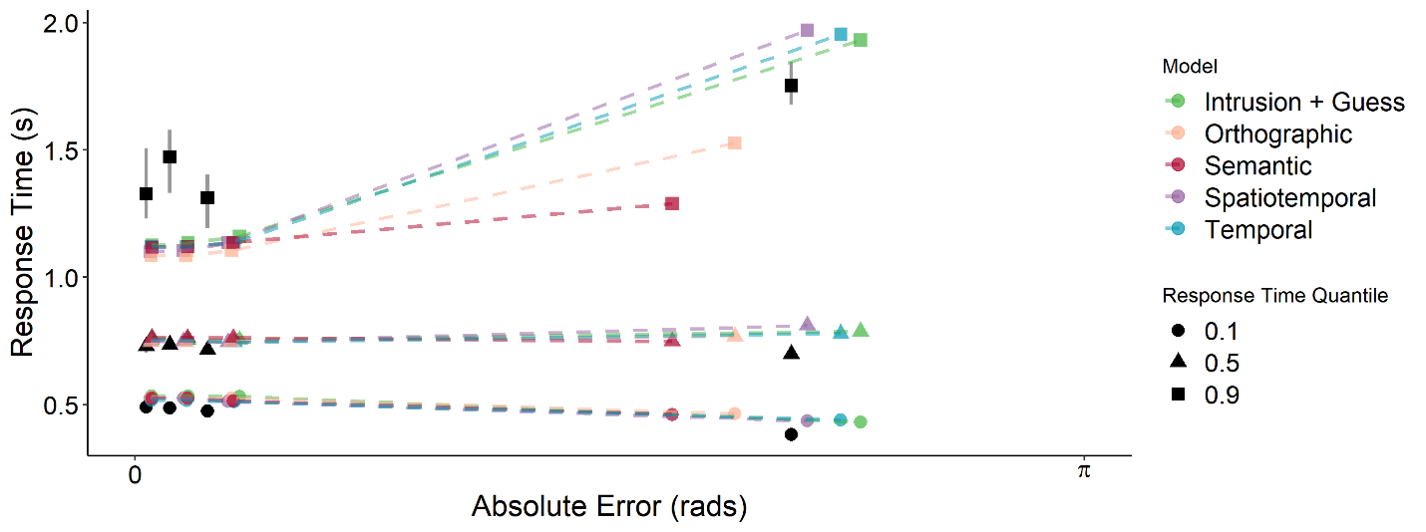
Notes:
The main reason for the spatiotemporal model’s advantage over the alternative models was its ability to predict the RT and the proportion of guessed responses with high error compared to the temporal and flat gradient models which overpredicted high error responses. Other than uniform guesses, intrusions in the spatiotemporal model are also more likely to come from near non targets, which reduces the contribution of further intrusions which yield high error responses.

Slide 71
Study 2: Intrusions from Non Target Items
Q: Are our findings robust to changes in presentation format?
A: It doesn’t matter how the stimuli are presented
Q: Are “guesses” actually due to confusions between targets?
A: Intrusions do happen, but there are still guesses.
Notes:
Our primary aim is to understand whether there really are discrete failures to retrieve source information *or* whether some of these apparent failures are due to non-target confusions.

Slide 72
Study 2: Intrusions from Non Target Items
Previous models overestimated the proportion of guesses
Evidence that spatiotemporal similarity influences intrusions
No evidence for semantic or orthographic similarity effect
Notes:
Last point pretty surprising.
DRM false memory related semantic, but semantic similarity can exert effects even in lists of unrelated words, including transitions between list words in a free recall task and predicting false alarms in recognition memory
Semantic links facilitate free recall. Semantic can increase familiarity of words, leading to false alarms in recognition.
In source, associations aren’t formed between items. You use an item and list context to cue a source location, so semantic similarity may exert less of an influence in source than free recall
It’s possible that semantic and orthographic do exert and effect, but the between-words similarities are too low to exert a noticeable influence. Spatiotemporal dominates. Most of the literature would suggest we should see an effect of both item and context similarity

Slide 73
Study 3 : Manipulating Similarity of Items
SEMANTIC | ORTHOGRAPHIC | UNRELATED
bottle | starts | stingy
drinks | states | quarry
scotch | stands | caveat
liquid | stairs | weakly
refill | status | pixies
whisky | stakes | bowing
squirt | stains | prince
carton | stages | wonder

Slide 74
What does it all mean?
Source memory retrieval is a thresholded process
Purely continuous models are incompatible with our data
Directions
Drift rate distributions in source judgement determined by predictions of memory model
Racing circular diffusion models
Notes:
Not due to unrecognised items
Not attributable to drift rate variability
Doesn’t matter how source is presented (sequentially/simultaneously)
Even when intrusions are accounted for (although previous estimates of guess rate were too high)

Slide 75

Precision in the Circular Diffusion Model
$$κ=\frac{a\left\|μ\right\|}{σ^{2}}$$

Slide 76

Precision in the Circular Diffusion Model
$$κ=\frac{a\left\|μ\right\|}{σ^{2}}$$
Precision
Notes:
precision is equal to the quality of the information in the stimulus, represented by the drift norm, multiplied by the amount of evidence required for a response, represented by the decision criterion, divided by the noisiness of the evidence accumulation process.
This relationship between precision, strength of evidence and the decision criterion is a key feature of the circular diffusion model which motivates our application of the model to the source memory task. As previously discussed, the analytic decomposition of precision in the preceding equation allows to distinguish the effects of evidence quality and decision criterion on precision in fits of the model to data.

Slide 77

Precision in the Circular Diffusion Model
Quality of Information
$$κ=\frac{a\left\|μ\right\|}{σ^{2}}$$
Precision
Notes:
precision is equal to the quality of the information in the stimulus, represented by the drift norm, multiplied by the amount of evidence required for a response, represented by the decision criterion, divided by the noisiness of the evidence accumulation process.
This relationship between precision, strength of evidence and the decision criterion is a key feature of the circular diffusion model which motivates our application of the model to the source memory task. As previously discussed, the analytic decomposition of precision in the preceding equation allows to distinguish the effects of evidence quality and decision criterion on precision in fits of the model to data.

Slide 78

Precision in the Circular Diffusion Model
Amount of Evidence Required
Quality of Information
$$κ=\frac{a\left\|μ\right\|}{σ^{2}}$$
Precision
Notes:
precision is equal to the quality of the information in the stimulus, represented by the drift norm, multiplied by the amount of evidence required for a response, represented by the decision criterion, divided by the noisiness of the evidence accumulation process.
This relationship between precision, strength of evidence and the decision criterion is a key feature of the circular diffusion model which motivates our application of the model to the source memory task. As previously discussed, the analytic decomposition of precision in the preceding equation allows to distinguish the effects of evidence quality and decision criterion on precision in fits of the model to data.

Slide 79

Precision in the Circular Diffusion Model
Amount of Evidence Required
Quality of Information
$$κ=\frac{a\left\|μ\right\|}{σ^{2}}$$
Precision
Noise in Evidence Accumulation
Notes:
precision is equal to the quality of the information in the stimulus, represented by the drift norm, multiplied by the amount of evidence required for a response, represented by the decision criterion, divided by the noisiness of the evidence accumulation process.
This relationship between precision, strength of evidence and the decision criterion is a key feature of the circular diffusion model which motivates our application of the model to the source memory task. As previously discussed, the analytic decomposition of precision in the preceding equation allows to distinguish the effects of evidence quality and decision criterion on precision in fits of the model to data.

Slide 80
Two-Choice Tasks are Inconclusive

Slide 81
Comparing Model Parameters
Uniform Guessing
Precision (prec)
Proportion of uniform guesses (γ)
Zhang, W., & Luck, S. J. (2008). Discrete fixed-resolution representations in visual working memory. Nature, 453(7192), 233-235.

Slide 82
Model Parameters
Uniform Guessing
Precision (prec)
Proportion of uniform guesses (γ)
Zhang, W., & Luck, S. J. (2008). Discrete fixed-resolution representations in visual working memory. Nature, 453(7192), 233-235.

Slide 83
Model 1
Uniform Guessing
Precision (prec)
Proportion of uniform guesses (γ)
Zhang, W., & Luck, S. J. (2008). Discrete fixed-resolution representations in visual working memory. Nature, 453(7192), 233-235.

Slide 84
Model 2
Intrusions
Precision (prec)
Proportion of intrusions (β)
Bays, P. M., Catalao, R. F., & Husain, M. (2009). The precision of visual working memory is set by allocation of a shared resource. Journal of vision, 9(10), 7-7.

Slide 85
Model 3
Intrusions + Uniform Guessing
Precision (prec)
Proportion of uniform guesses (γ)
Proportion of intrusions (β)

Slide 86

Temporal Similarity
Implemented an asymmetric temporal gradient in our model
Determines probability of particular non-target intruding based on lag
$$t=\left\{\begin{aligned}τe^{−λ_{1}lag}, &lag>0 \\ \left(1−τ\right)e^{{−λ}_{2}lag}, &lag<0\end{aligned}\right.$$
Notes:
Assumption that the strength of association between items is an exponentially decreasing function of distance

Slide 87
Temporal Similarity
$$t=\left\{\begin{aligned}τe^{−λ_{1}lag}, &lag>0 \\ \left(1−τ\right)e^{{−λ}_{2}lag}, &lag<0\end{aligned}\right.$$
-4
-3
-2
-1
1
2
3
4
Lag
Notes:
Assumption that the strength of association between items is an exponentially decreasing function of distance

Slide 88
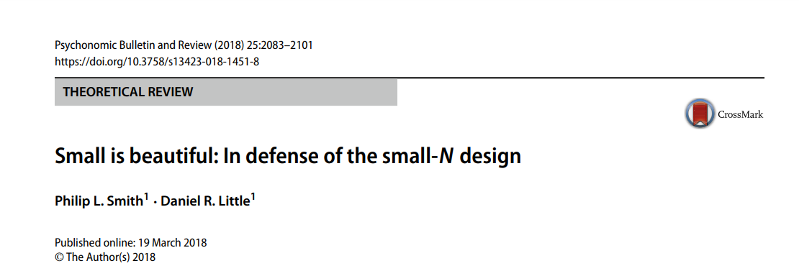
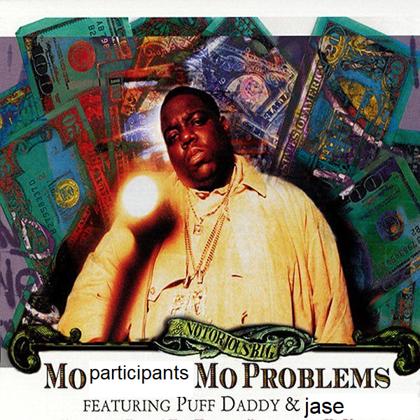
Experiment 1:
More participants, fewer sessions
Experiment 2:
Fewer participants, more sessions

Slide 89
Estimated Proportion of Guesses
Model Name | ΔΣAIC | Intrusions | Guesses
Model Name | BIC | γ | β
Pure Guess | 276.86 |  | .60
Pure Intrusion | 1116.16 | .46
Intrusion + Guess | 0 | .24 | .36
Temporal Gradient | 114.91 | .28 | .39
Spatiotemporal Gradient | 175.77 | .22 | .39

Slide 90
Estimated Proportion of Guesses
Model Name | ΔΣAIC | Intrusions | Guesses
Model Name | BIC | γ | β
Intrusion + Guess | 445 | .12 | .30
Temporal | 586 | .14 | .32
Spatiotemporal | 0 | .17 | .27
Orthographic | 1095 | .15 | .15
Semantic | 1042 | .12 | .15

Slide 91
Estimated Proportion of Guesses
Model Name | ΔΣAIC | Intrusions | Guesses
Model Name | BIC | γ | β
Pure Guess | 276.86 |  | .60
Pure Intrusion | 1116.16 | .46
Intrusion + Guess | 0 | .24 | .36
Temporal Gradient | 114.91 | .28 | .39
Spatiotemporal Gradient | 175.77 | .22 | .39

