Slide 1

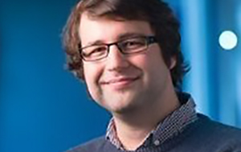

Source Memory for Recognised Items
Jason Zhou
Adam Osth
Simon Lilburn
Philip Smith

Slide 2
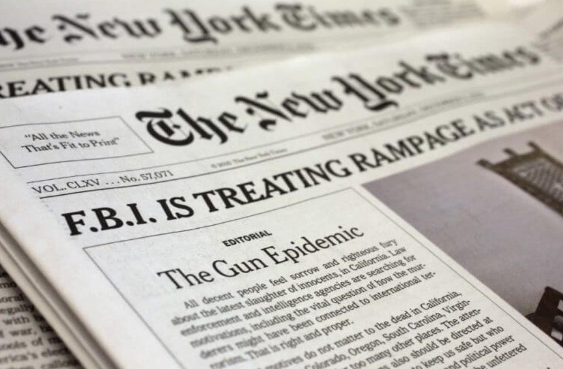
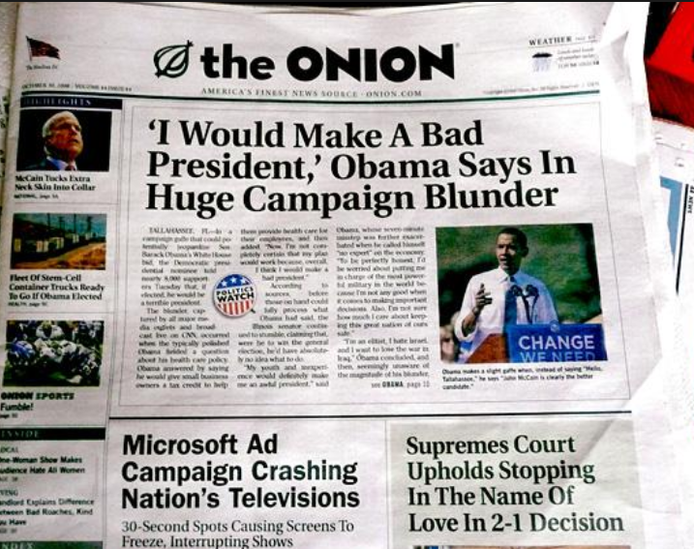
Source Memory

Slide 3
Source Memory
Recognition and Source Memory in Aging Populations
    Howard, Bessette-Symons, Zhang and Hoyer (2006)
Mapping Neural Activation for Source Retrieval
    Rugg, Fletcher, Chua and Dolan (1999)

Slide 4
Two Components in Response
Overall response in continuous source memory task appears to be comprised of two components.

