Slide 1
Characterising Source Memory using the Circular Diffusion Model
Source Memory
Jason Zhou
Adam Osth, Simon Lilburn, Philip Smith
Melbourne School of Psychological Sciences, The University of Melbourne

Slide 2



Location
Source Memory
Memory for the context in which an item was previously encountered
Time
Thoughts
Emotion
Notes:
Memory is associative and it is episodic (linked to a context) two very basic properties of memory. Source memory becomes a little laboratory to study memory
Episodic and associative nature of memory, this gets at both

Slide 3
Location
X
WORD

Slide 4
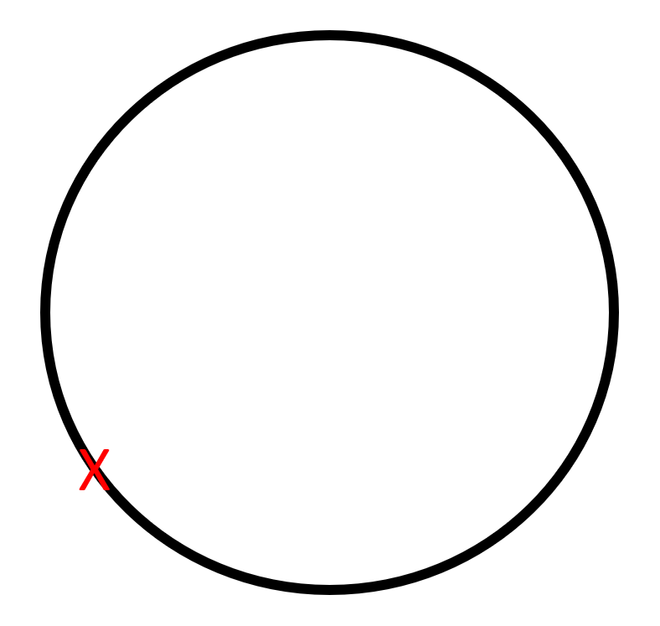
Location
WORD

Slide 5
Item
Source
WORD

Slide 6
Models of Source Memory Retrieval
Retrieved information may be inaccurate but not absent
Gradual decline in the quality of information retrieved
Continuous
Threshold
Retrieval fails discretely
Performance is made up of either:
Precise responses
Guesses

Slide 7
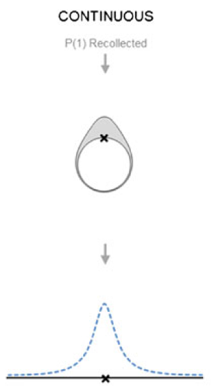
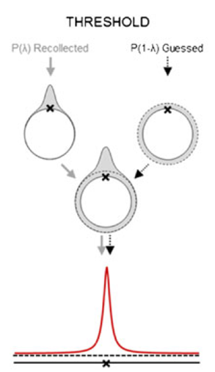
Models of Source Memory Retrieval
Continuous
Threshold
Harlow, I. M., & Donaldson, D. I. (2013). Source accuracy data reveal the thresholded nature of human episodic memory. Psychonomic bulletin & review, 20(2), 318-325.

Slide 8
Models of Source Memory Retrieval
Continuous
Threshold
Harlow, I. M., & Donaldson, D. I. (2013). Source accuracy data reveal the thresholded nature of human episodic memory. Psychonomic bulletin & review, 20(2), 318-325.

Slide 9
Models of Source Memory Retrieval
Continuous
Threshold
Harlow, I. M., & Donaldson, D. I. (2013). Source accuracy data reveal the thresholded nature of human episodic memory. Psychonomic bulletin & review, 20(2), 318-325.

Slide 10
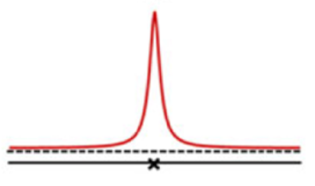
Source Memory for Unrecognised Items
No source memory for unrecognised Items
Hautus et al., 2008
Malejka and Broder, 2016
Source memory trials for unrecognised items?

Slide 11
Participants
20 participants
4 x 60-minute sessions
180 trials per session
720 observations per participant

Slide 12
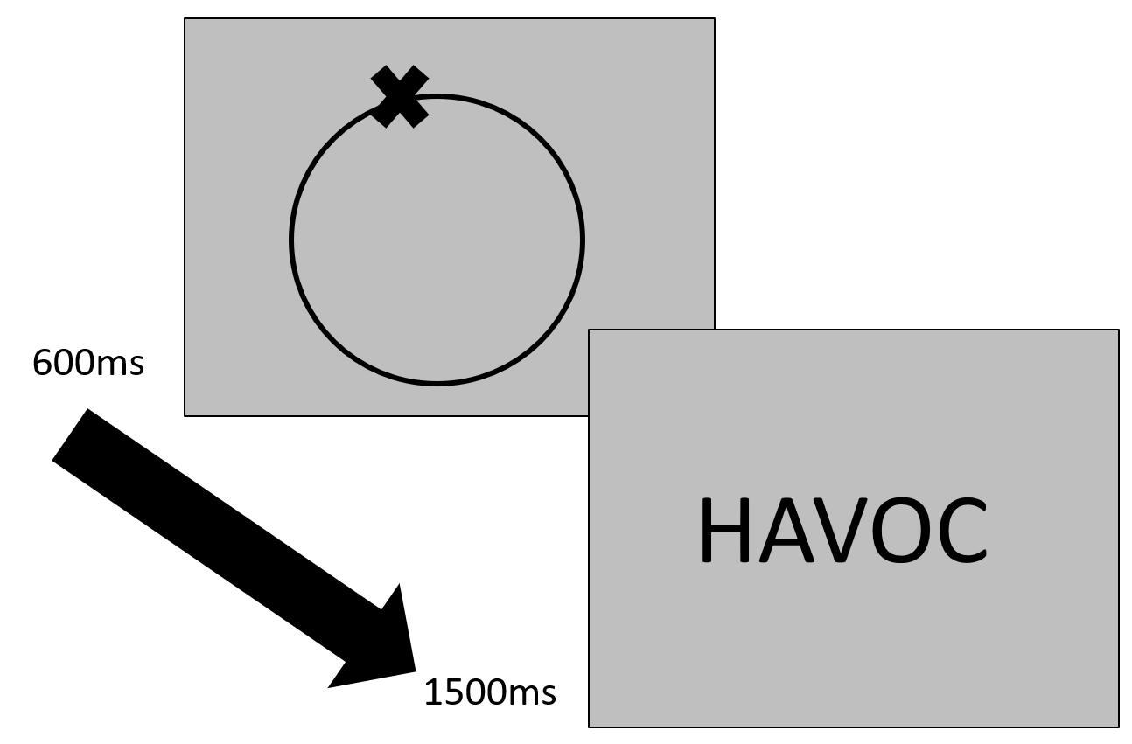
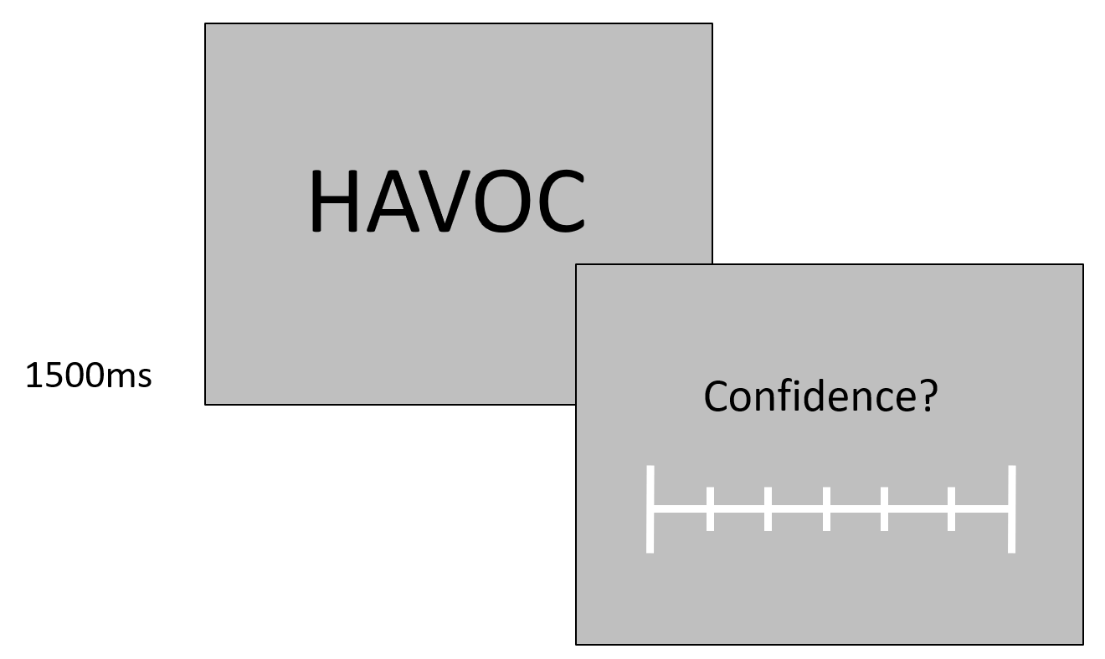
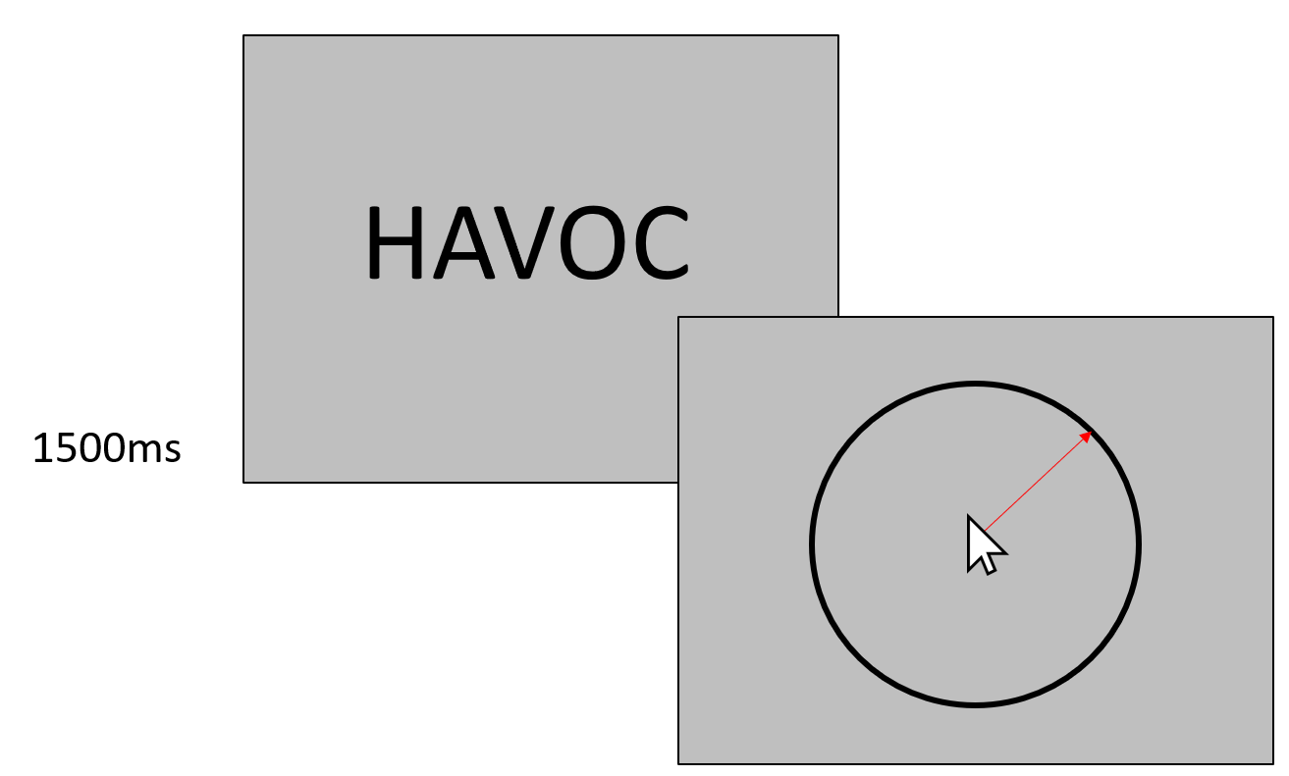
Procedure
Encoding
Recognition Task
Source Task
>3 Recognised
≤3 Unrecognised

Slide 13
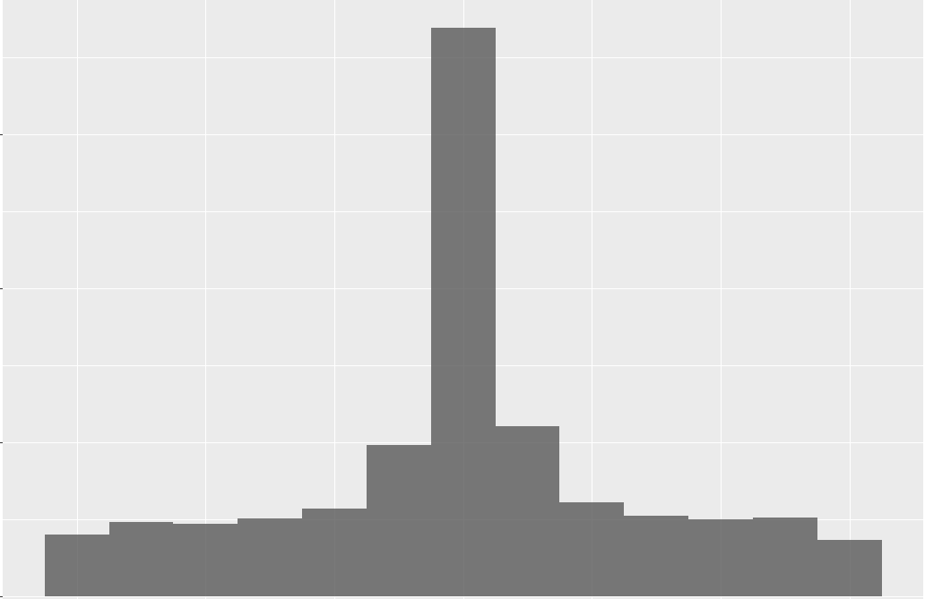
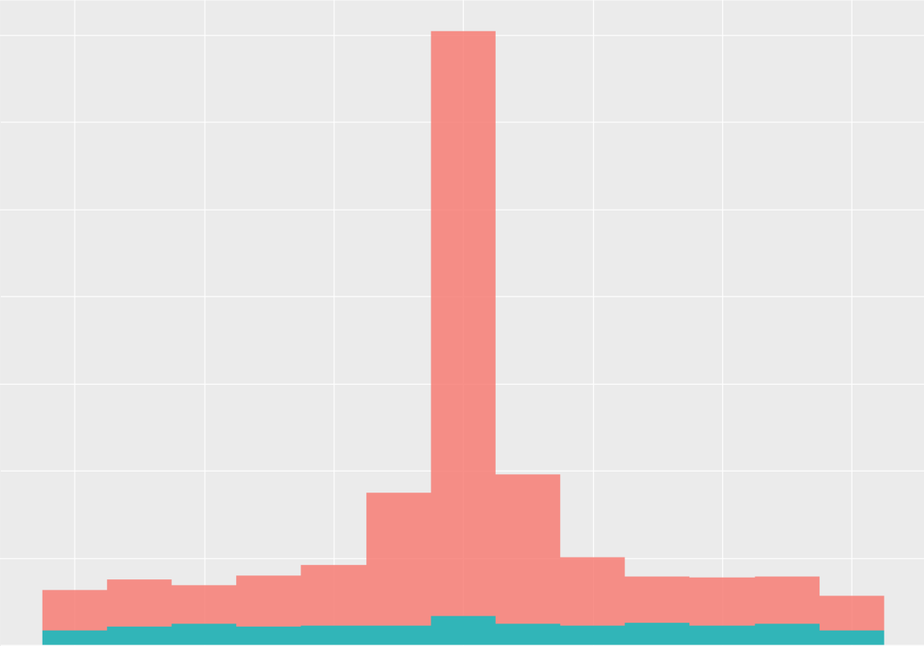
>3 Recognised
≤3 Unrecognised

Slide 14
>3 Recognised
≤3 Unrecognised

Slide 15
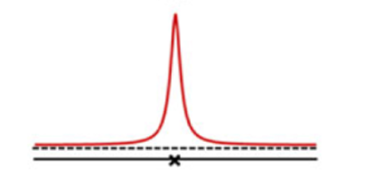
A More Sophisticated Model
Continuous
Threshold
Harlow, I. M., & Donaldson, D. I. (2013). Source accuracy data reveal the thresholded nature of human episodic memory. Psychonomic bulletin & review, 20(2), 318-325.

Slide 16
A More Sophisticated Model
Continuous
Threshold

Slide 17
Decision Making in Memory
Presentation
Representation
Output
Encoding
Retrieval

Slide 18
Decision Making in Memory
Presentation
Representation
Output
Decision

Slide 19
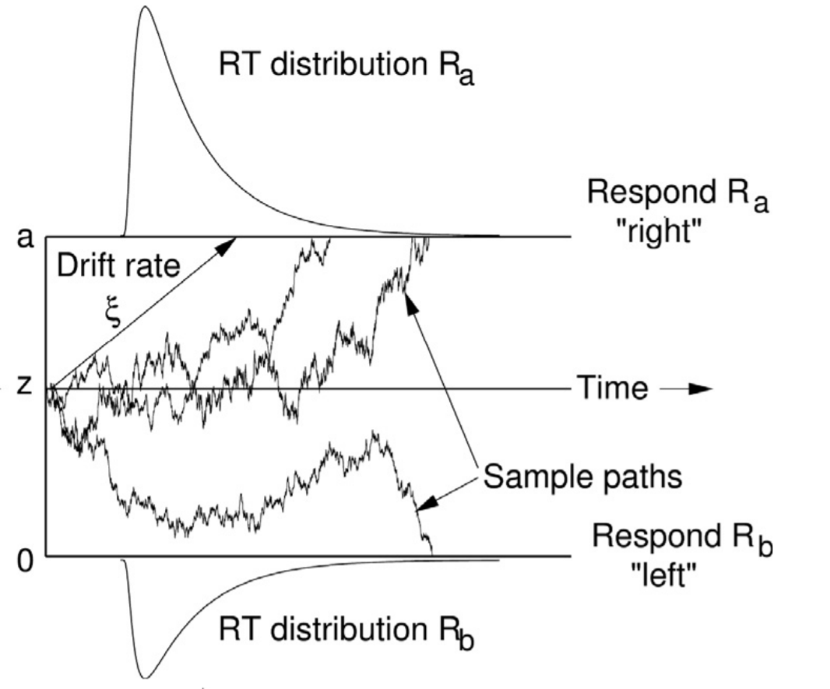

Diffusion Model
a Decision Criterion
μ Mean Drift Rate
Accumulator
η Trial-to-trial
Drift Variability

Slide 20
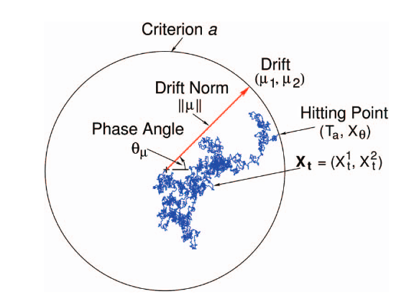
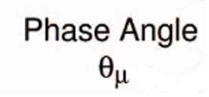
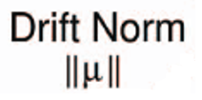
Circular Diffusion Model
a Decision Criterion
μ Mean Drift Rate
η Trial-to-trial
Drift Variability
~ Precision
~ Rate

Slide 21
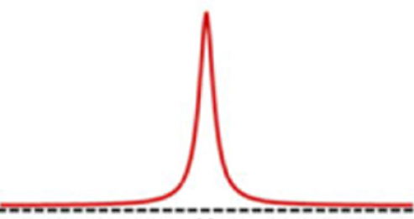
Circular Diffusion Model
η Trial-to-trial
Drift Variability
Low Precision
High Precision
Van den Berg, R., Awh, E., & Ma, W. J. (2014). Factorial comparison of working memory models. Psychological review, 121(1), 124.

Slide 22
Circular Diffusion Model Variants
Continuous
Threshold
~
+
?
η
Variable Drift
Positive Drift
+
Zero Drift

Slide 23
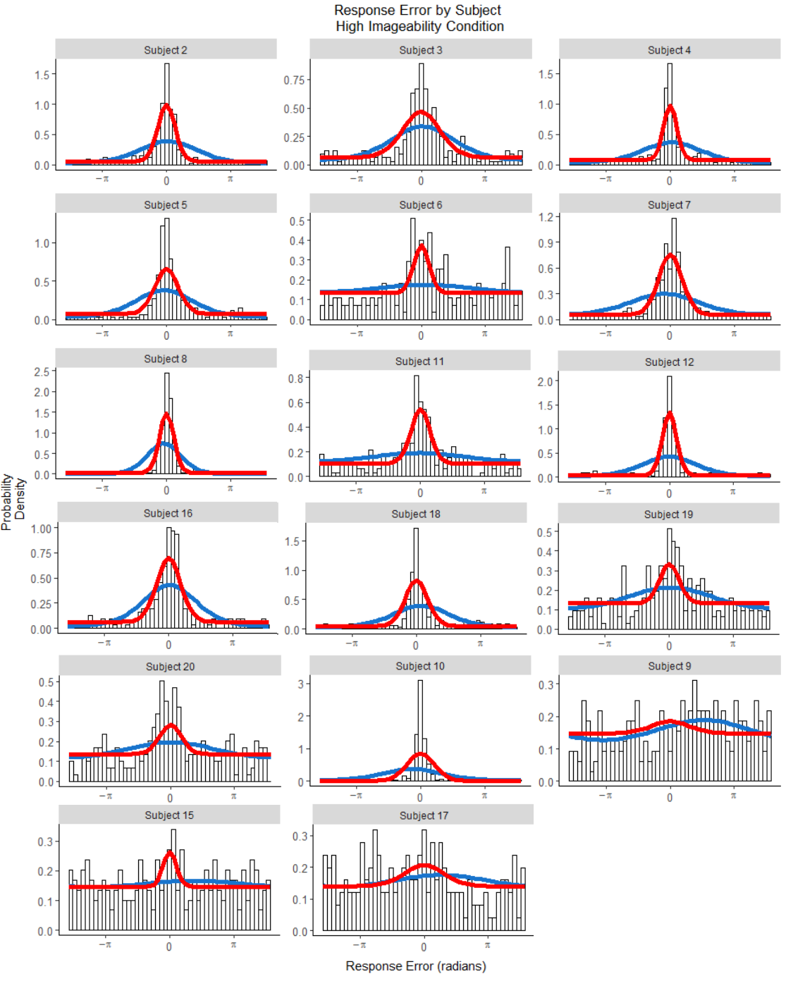
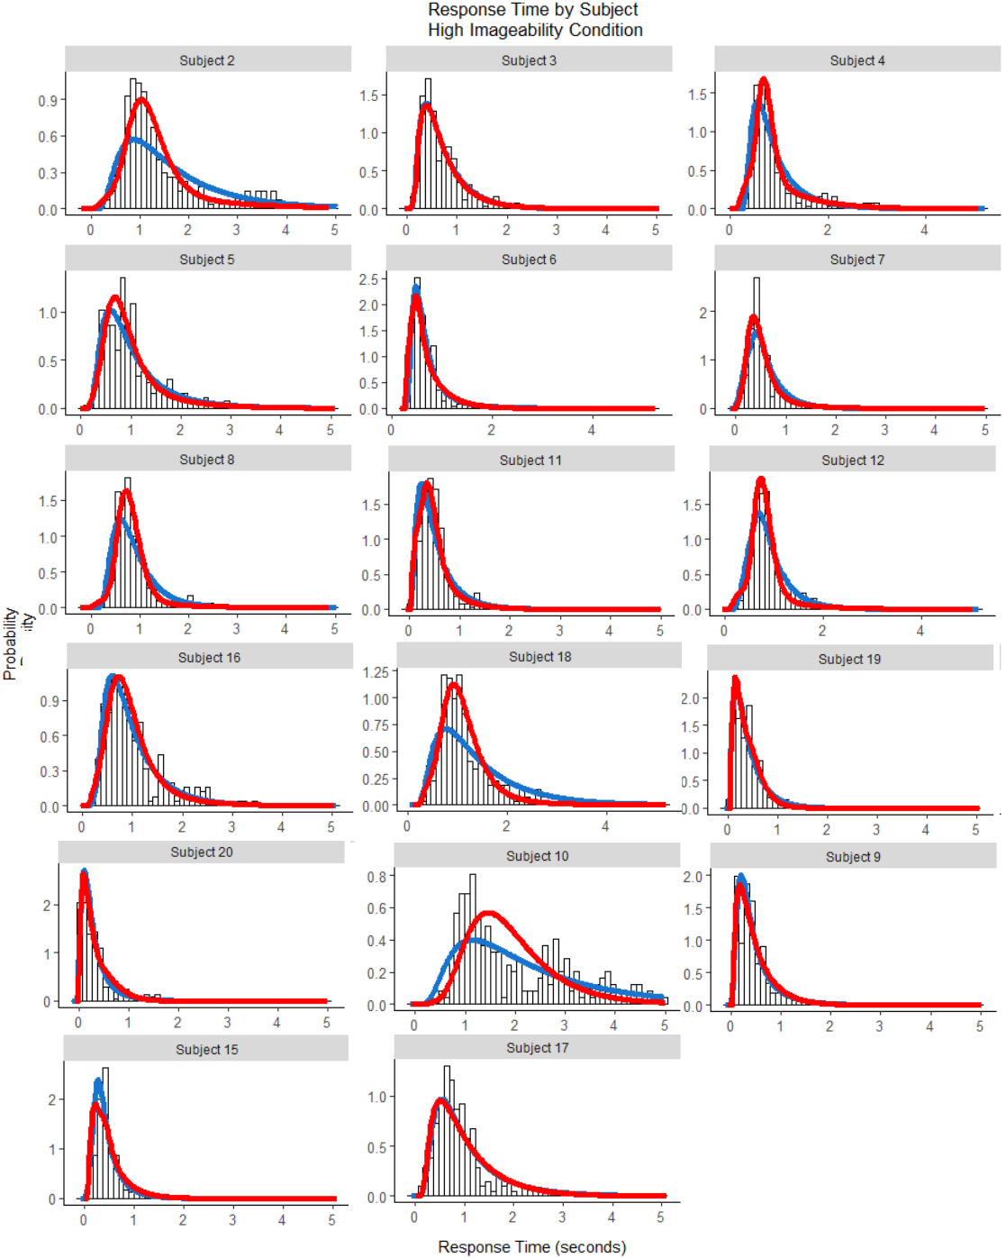
Probability Density
Continuous
Threshold
Response Error (radians)
Response Time (seconds)

Slide 24
Probability Density
Continuous
Threshold
Response Error (radians)
Response Time (seconds)

Slide 25
Probability Density
Continuous
Threshold
Response Error (radians)
Response Time (seconds)

Slide 26
Probability Density
Continuous
Threshold
Response Error (radians)
Response Time (seconds)

Slide 27
Probability Density
Continuous
Threshold
Response Error (radians)
Response Time (seconds)

Slide 28
Probability Density
Continuous
Threshold
Response Error (radians)
Response Time (seconds)

Slide 29
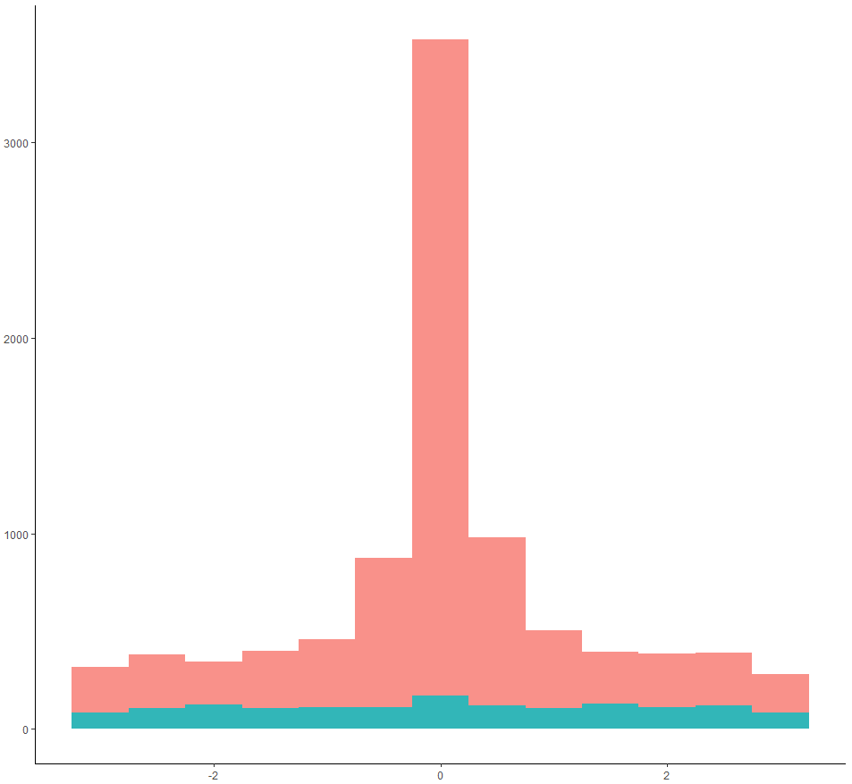
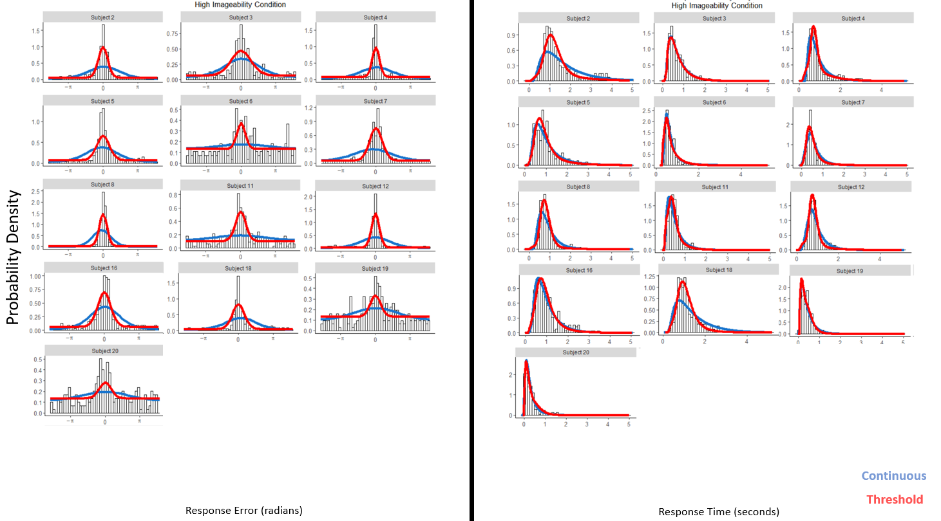
Conclusion

Slide 30
Characterising Source Memory using the Circular Diffusion Model
Source Memory
Jason Zhou
jasonz1@student.unimelb.edu.au
Adam Osth, Simon Lilburn, Philip Smith
Notes:
Difficulty distinguishing cont and thresh on the level of response error
Emphasise we are doing RT and
Emphasise the strength of the the model
Best participant
Large variability in participant pool. There are crappy participants that aren’t really diagnostic on the level of
Threshold model for participant 8.
Get participants for which the models are both credible
Threshold isn’t quite getting the peakiness but its trying to get the RT. Many models can get just response error
Make mention of fitting other models that are elaboration.

Slide 31
Participant
2 | 2250 | 1989
3 | 1893 | 1768
4 | 3818 | 3111
5 | 2228 | 2028
6 | 1598 | 1574
7 | 1613 | 1306
8 | 1821 | 687
11 | 1821 | 1675
12 | 1734 | 1009
16 | 2239 | 1839
18 | 2094 | 1881
19 | 1669 | 1577
20 | 1663 | 1585
10 | 2005 | 1874
9 | 2097 | 2090
15 | 1916 | 1924
17 | 2043 | 2064
Continuous
Threshold

Slide 32
Participant
2 | 2250 | 1989
3 | 1893 | 1768
4 | 3818 | 3111
5 | 2228 | 2028
6 | 1598 | 1574
7 | 1613 | 1306
8 | 1821 | 687
11 | 1821 | 1675
12 | 1734 | 1009
16 | 2239 | 1839
18 | 2094 | 1881
19 | 1669 | 1577
20 | 1663 | 1585
10 | 2005 | 1874
9 | 2097 | 2090
15 | 1916 | 1924
17 | 2043 | 2064
Continuous
Threshold

Slide 33
Participant
2 | 2250 | 1989
3 | 1893 | 1768
4 | 3818 | 3111
5 | 2228 | 2028
6 | 1598 | 1574
7 | 1613 | 1306
8 | 1821 | 687
11 | 1821 | 1675
12 | 1734 | 1009
16 | 2239 | 1839
18 | 2094 | 1881
19 | 1669 | 1577
20 | 1663 | 1585
10 | 2005 | 1874
9 | 2097 | 2090
15 | 1916 | 1924
17 | 2043 | 2064
Continuous
Threshold

Slide 34
Participant
2 | 2250 | 1989
3 | 1893 | 1768
4 | 3818 | 3111
5 | 2228 | 2028
6 | 1598 | 1574
7 | 1613 | 1306
8 | 1821 | 687
11 | 1821 | 1675
12 | 1734 | 1009
16 | 2239 | 1839
18 | 2094 | 1881
19 | 1669 | 1577
20 | 1663 | 1585
10 | 2005 | 1874
9 | 2097 | 2090
15 | 1916 | 1924
17 | 2043 | 2064
Continuous
Threshold

Slide 35
