Slide 1
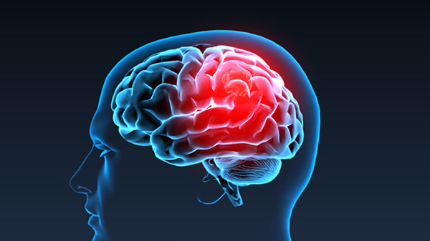

DIFFUSION MODELLING OF INTRUSIONS IN CONTINUOUS-OUTCOME SOURCE MEMORY
JASON ZHOU
AUSTRALASIAN EXPERIMENTAL PSYCHOLOGY SOCIETY (EPC - 2021)

Slide 2
Source Memory
Memory for the source (or origin) of the material stored in memory.
WORD

Slide 3
Source Memory
Memory for the source (or origin) of the material stored in memory.
On which side of the screen was
WORD
originally presented?

Slide 4
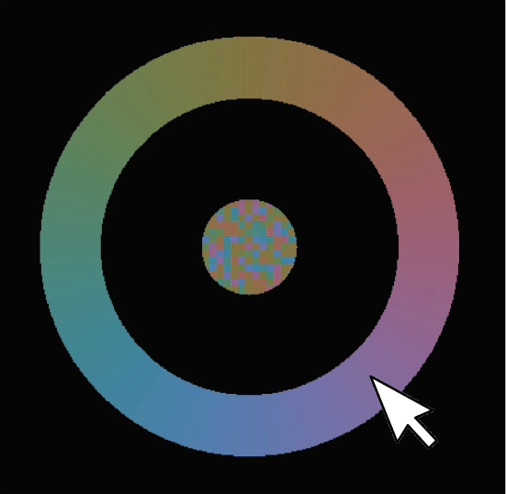

Continuous-Outcome Tasks
Responses made on a continuous (often circular) domain
Response precision instead of proportion correct
  Color
    Wilken and Ma (2004)
    Bays et al. (2009)
    Smith et al. (2020)
  Location
    Harlow and Donaldson (2013)
WORD
Adapted from Smith et al. (2020). “Modeling Continuous Outcome Color Decisions With the Circular Diffusion Model: Matric and Categorical Properties” Psychological review, 127, 562-590. Figure 1. Copyright American Psychological Association.

Slide 5


Models of Source Memory Retrieval
EPC - 2021
Continuous
Threshold
X
X
Gradual Decline
All or None
Notes:
A number of models have been developed to explain the source memory task, which make distinct assumptions about source memory retrieval. Based on Signal Detection Theory (SDT), continuous models of source memory claim that memory relies on continuous evidence. In signal detection models, retrieved information may be inaccurate but not absent, allowing for a gradual decline in the quality of information retrieved (Banks, 2000; Mickes, Wais & Wixted, 2009).
In contrast, threshold or discrete-state models hold that retrieval fails discretely, and so performance is made up of either precise responses driven by memory, or guesses when the memory is below the retrieval threshold (Batchelder & Riefer, 1990; Klauer & Kellen, 2010).

Slide 6
Why does this matter?
Is there a threshold in source memory retrieval?
  Dual-Process Model (Yonelinas, 1999) assumes so
Does memory exist in discrete states?
  Parallel in Visual Working Memory literature: slots vs resource

Slide 7
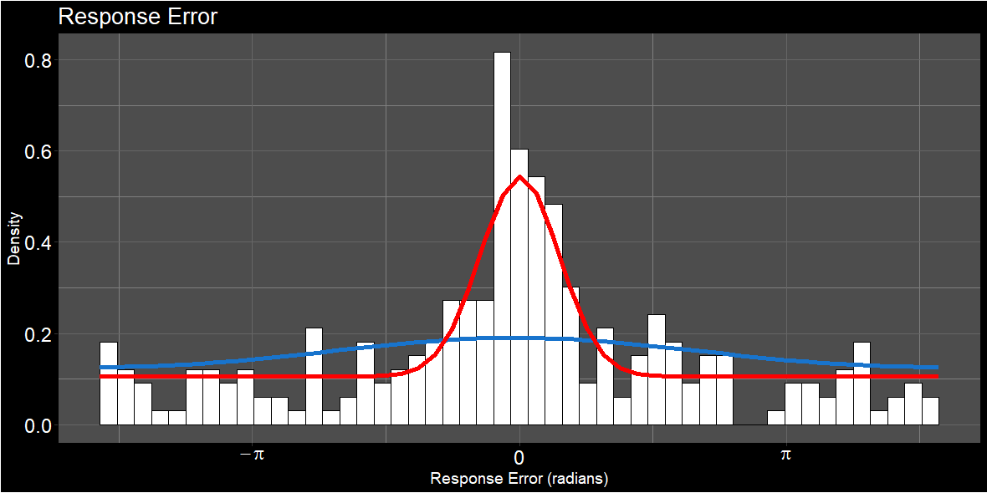
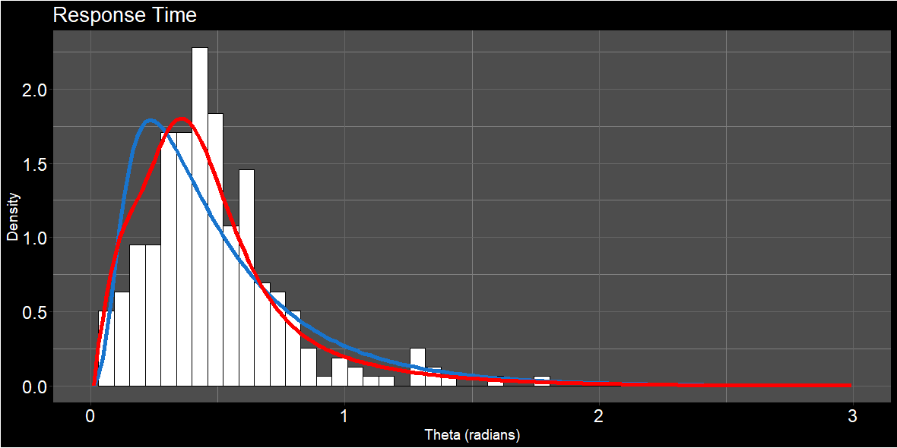
Support for a Threshold Model
Harlow and Donaldson (2013)
Zhou et al. (2021)
Continuous
Threshold

Slide 8
Intrusions in Memory
EPC - 2021
When attempting to retrieve one item, information for another item is retrieved instead.

Slide 9
TIER
TIED
CORD

Slide 10
Where was
“CORD”
Located?

Slide 11
Guessing
Intrusions
Notes:
Is the evidence that, to this point, been used to support threshold model of source memory actually explainable by intrusions?
Note this is only for one trial, because intrusions are uniformly distributed across trials, the overall distribution of errors across trials will look like a flat tail. The key difference is that one any one trial, the errors from intrusions are systematic, and linked to the locations of possible intrusions.
The driving rationale here is inspired by Paul Bays work- if we account for intrusions, does the amount of uniform guessing (in a no-information state) go down? In his work, it did substantially 62% down to 14%.

Slide 12
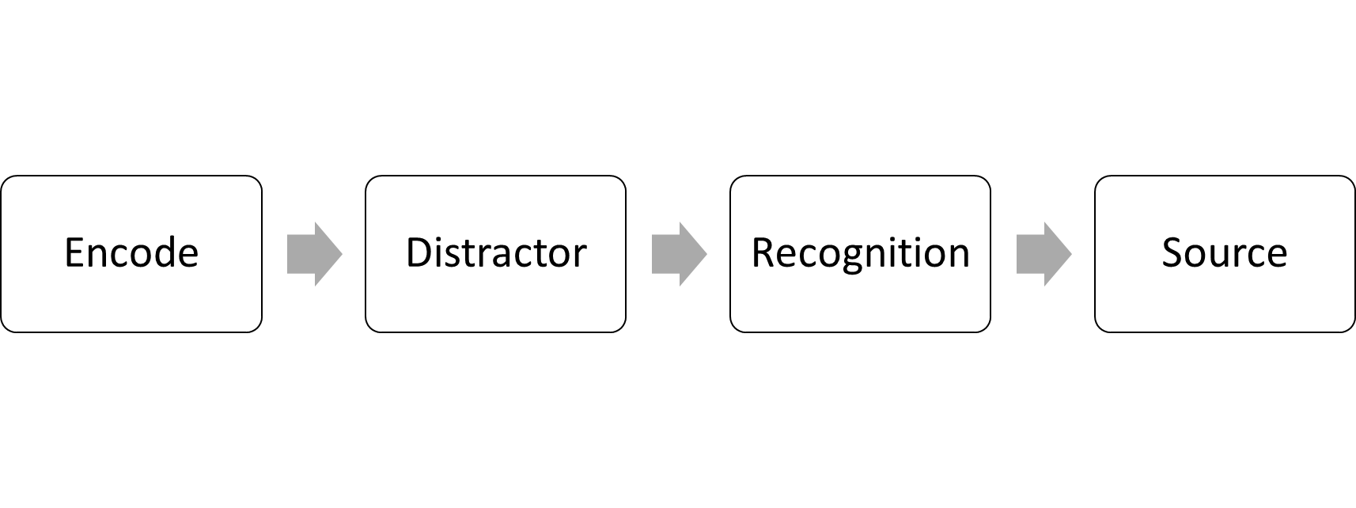
Experimental Paradigm
EPC - 2021

Slide 13
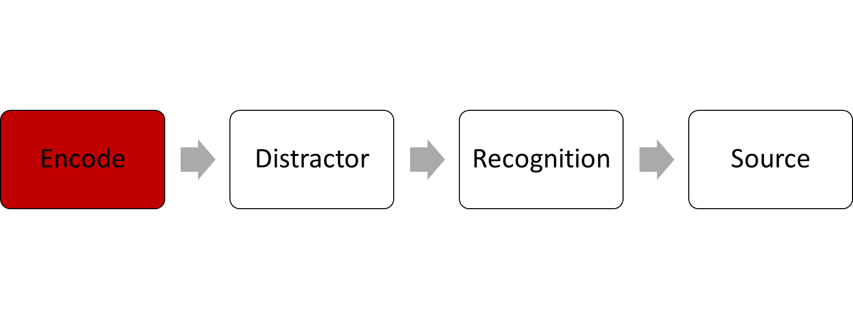
Experimental Paradigm
EPC - 2021
x 10
CART
TRY AGAIN
DRAG
2000 ms

Slide 14
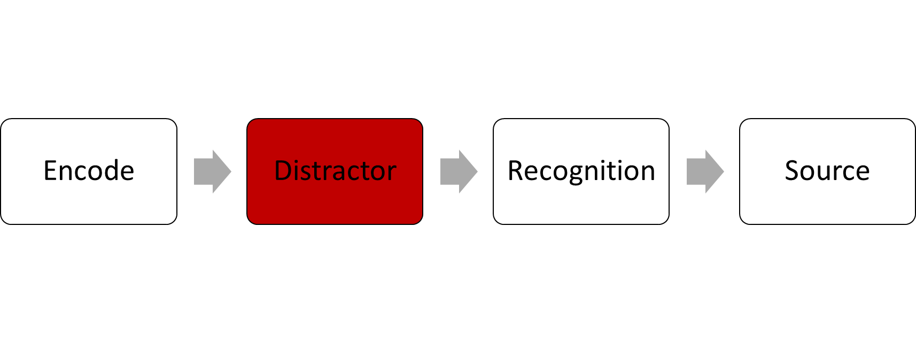
Experimental Paradigm
EPC - 2021
3 + 6 + 2 = 10
1 = TRUE
0 = FALSE
30000 ms

Slide 15
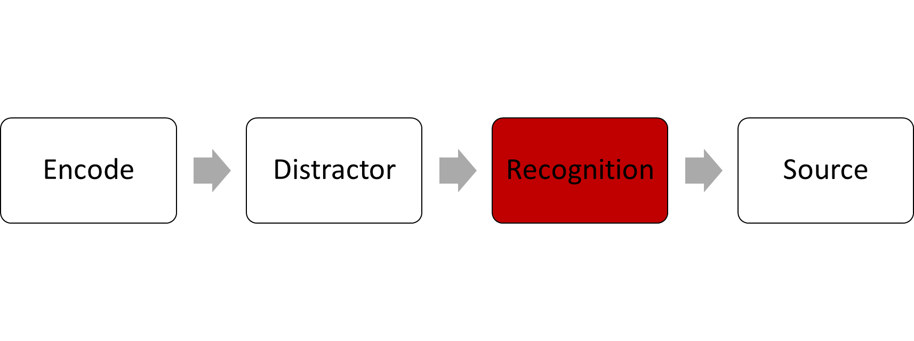
Experimental Paradigm
EPC - 2021
Is this word OLD or NEW?
CART
Sure New
Sure Old

Slide 16
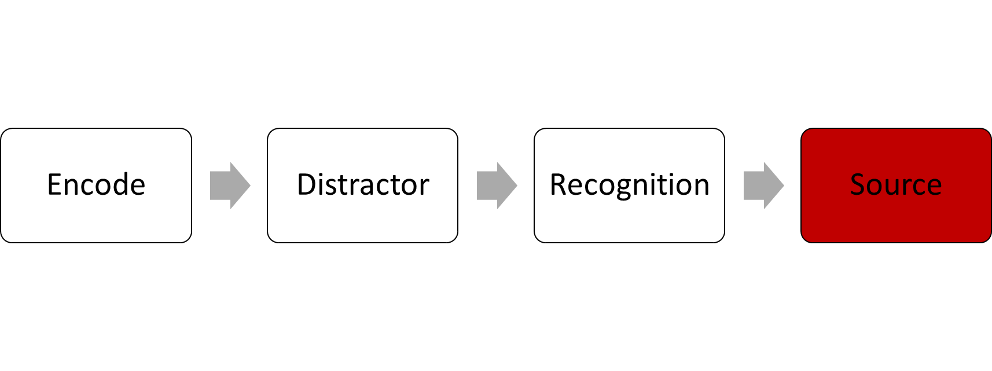
Experimental Paradigm
EPC - 2021
CART
1000 ms

Slide 17
Experimental Paradigm
EPC - 2021
x 10
30 s
x 20
x 10
x 12 Blocks
x 3 Sessions
x 28 Participants

Slide 18
Evidence for Intrusions in the Data
EPC - 2021
PLUG
CALM
PLUM
Response Error
FLAG
DREG
Notes:
Before we even get to the modelling, there’s some evidence that intrusions are happening by just looking at the data

Slide 19
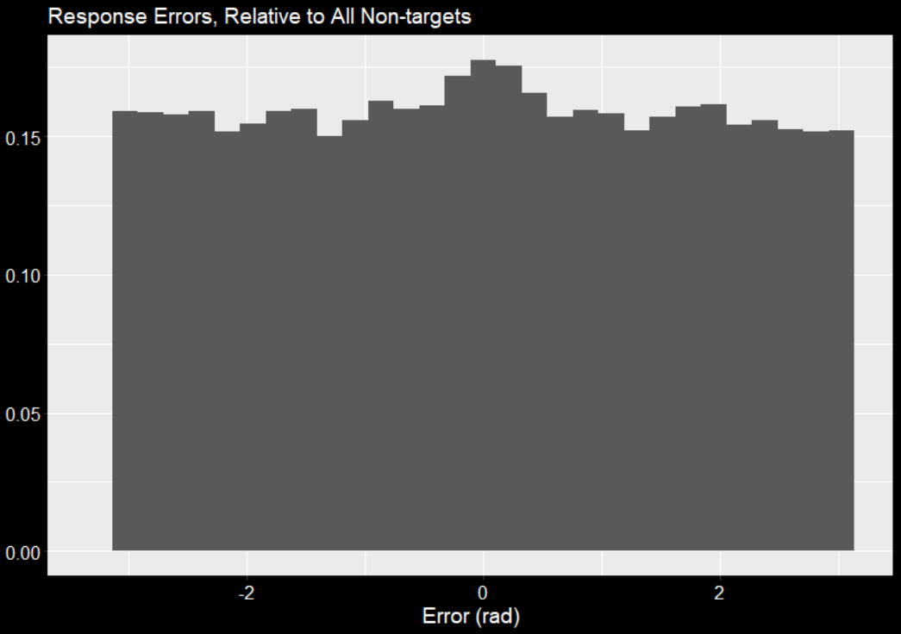
Evidence for Intrusions
EPC - 2021
Density

Slide 20
Comparing Model Parameters
Uniform Guessing
Precision (prec)
Proportion of uniform guesses (γ)
Zhang, W., & Luck, S. J. (2008). Discrete fixed-resolution representations in visual working memory. Nature, 453(7192), 233-235.

Slide 21
Model Parameters
Uniform Guessing
Precision (prec)
Proportion of uniform guesses (γ)
Zhang, W., & Luck, S. J. (2008). Discrete fixed-resolution representations in visual working memory. Nature, 453(7192), 233-235.

Slide 22
Model Parameters
Uniform Guessing
Precision (prec)
Proportion of uniform guesses (γ)
Zhang, W., & Luck, S. J. (2008). Discrete fixed-resolution representations in visual working memory. Nature, 453(7192), 233-235.

Slide 23
Model Parameters
Intrusions
Precision (prec)
Proportion of intrusions (β)
Bays, P. M., Catalao, R. F., & Husain, M. (2009). The precision of visual working memory is set by allocation of a shared resource. Journal of vision, 9(10), 7-7.

Slide 24
Model Parameters
Intrusions + Uniform Guessing
Precision (prec)
Proportion of uniform guesses (γ)
Proportion of intrusions (β)

Slide 25
Model Parameters
Intrusions with Different Precision
Precision for Target (prec1)
Precision for Intrusion(prec2)
Proportion of intrusions (β)

Slide 26
Model Fits
Model Name | ΔBIC | Parameter Estimates
 |  | prec1 | prec2 | γ | β
Uniform Guessing | 3.03 | 17.38 |  | 0.60
Intrusions | 28.57 | 5.53 |  |  | 0.44
Guessing + Intrusions | 0 | 15.88 |  | 0.46 | 0.14
Intrusions with Different Precision | 2.2 | 17.46 | 1.03 |  | 0.60
Guessing + Intrusions with Different Precision | 4.94 | 17.82 | 16.30 | 0.38 | 0.22

Slide 27
Model Fits
Model Name | ΔBIC | Parameter Estimates
 |  | prec1 | prec2 | γ | β
Uniform Guessing | 3.03 | 17.38 |  | 0.60
Intrusions | 28.57 | 5.53 |  |  | 0.44
Guessing + Intrusions | 0 | 15.88 |  | 0.46 | 0.14
Intrusions with Different Precision | 2.2 | 17.46 | 1.03 |  | 0.60
Guessing + Intrusions with Different Precision | 4.94 | 17.82 | 16.30 | 0.38 | 0.22

Slide 28
Model Fits
Model Name | ΔBIC | Parameter Estimates
 |  | prec1 | prec2 | γ | β
Uniform Guessing | 3.03 | 17.38 |  | 0.60
Intrusions | 28.57 | 5.53 |  |  | 0.44
Guessing + Intrusions | 0 | 15.88 |  | 0.46 | 0.14
Intrusions with Different Precision | 2.2 | 17.46 | 1.03 |  | 0.60
Guessing + Intrusions with Different Precision | 4.94 | 17.82 | 16.30 | 0.38 | 0.22
Notes:
They essentially agree on the proportion of off-target responses, but the guessing + intrusions decomposes it into proportion of intrusions and guessing. A drop from 60% to 46% is not the same margin as Bays observed in his vwm task, but it is a drop

Slide 29
Model Fits
Model Name | ΔBIC | Parameter Estimates
 |  | prec1 | prec2 | γ | β
Uniform Guessing | 3.03 | 17.38 |  | 0.60
Intrusions | 28.57 | 5.53 |  |  | 0.44
Guessing + Intrusions | 0 | 15.88 |  | 0.46 | 0.14
Intrusions with Different Precision | 2.2 | 17.46 | 1.03 |  | 0.60
Guessing + Intrusions with Different Precision | 4.94 | 17.82 | 16.30 | 0.38 | 0.22
Notes:
Intrusions with diff prec is actually doing *marginally* better than the pure guessing model, but it does this in a hacky way

Slide 30
Model Fits
Model Name | ΔBIC | Parameter Estimates
 |  | prec1 | prec2 | γ | β
Uniform Guessing | 3.03 | 17.38 |  | 0.60
Intrusions | 28.57 | 5.53 |  |  | 0.44
Guessing + Intrusions | 0 | 15.88 |  | 0.46 | 0.14
Intrusions with Different Precision | 2.2 | 17.46 | 1.03 |  | 0.60
Guessing + Intrusions with Different Precision | 4.94 | 17.82 | 16.30 | 0.38 | 0.22
Notes:
Intrusions with diff prec is actually doing *marginally* better than the pure guessing model, but it does this in a hacky way by just dropping precision of intrusions waaaay down, so its basically just the same as uniform guessing at that point

Slide 31
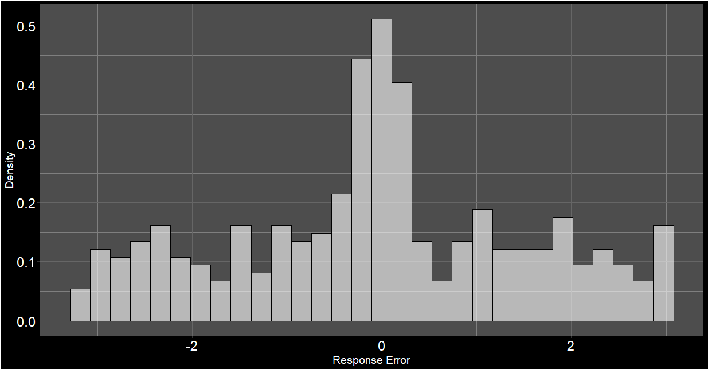
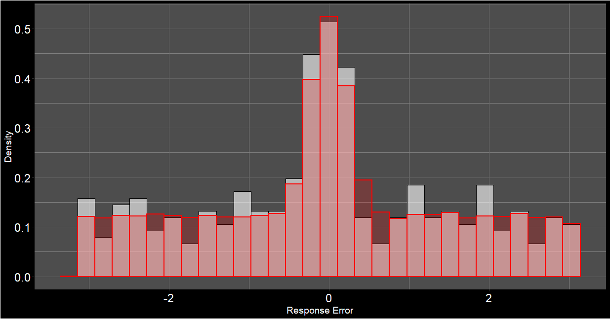
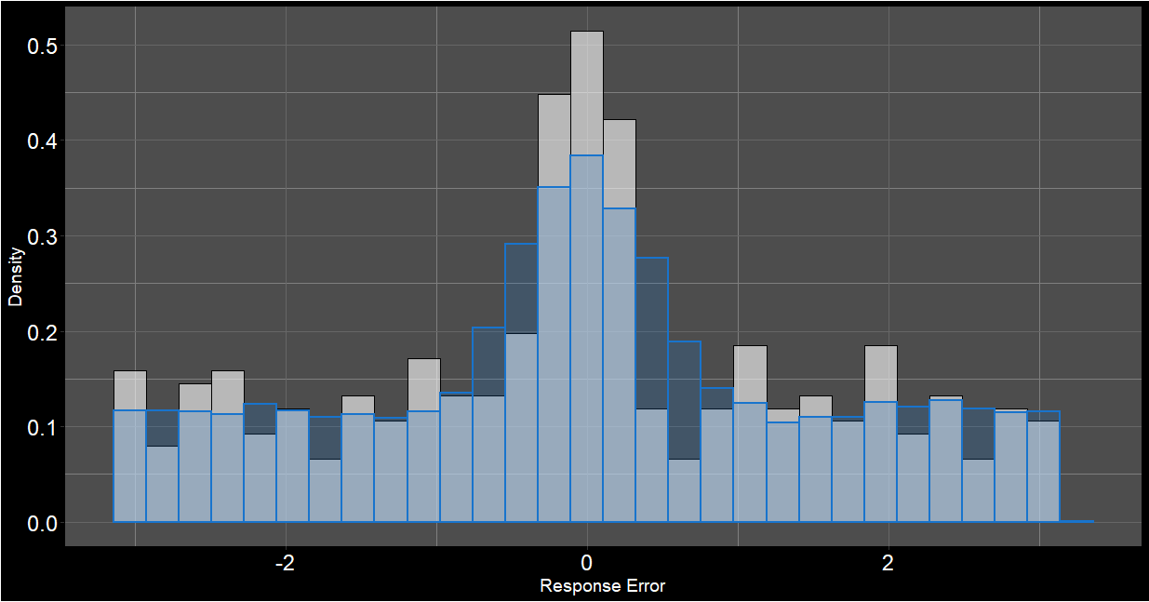
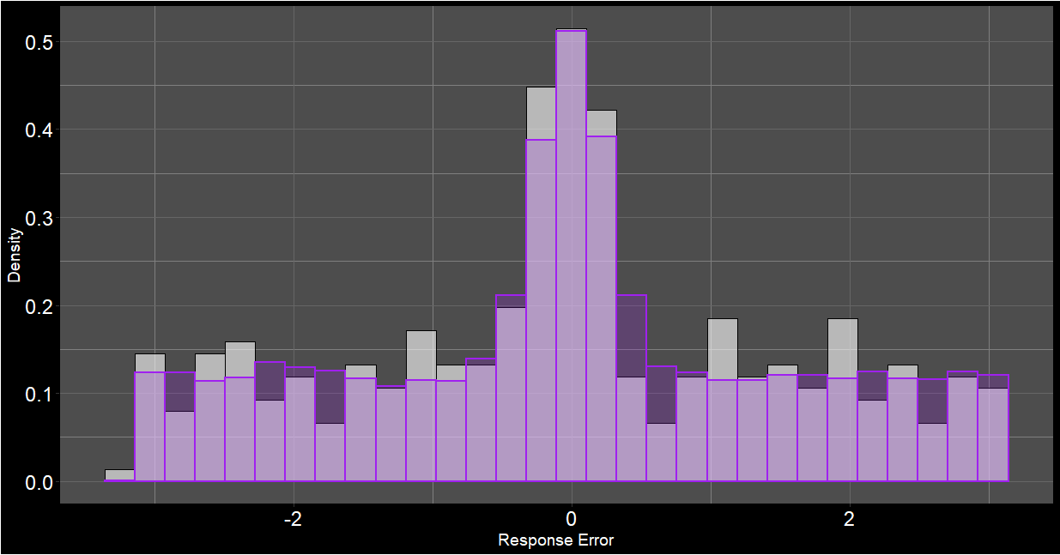
Uniform Guessing
Intrusions
Guessing + Intrusions

Slide 32
Takeaways
EPC - 2021
Continuous model with intrusions provides a better account of data than pure continuous model
Intrusions account for some, but not all, off-target responses

Slide 33
Weighting Intrusions
BOXES
MOVE
LIFT
MORE
Proximity in Time
Orthographic Similarity
Proximity in Space
Semantic Similarity

Slide 34
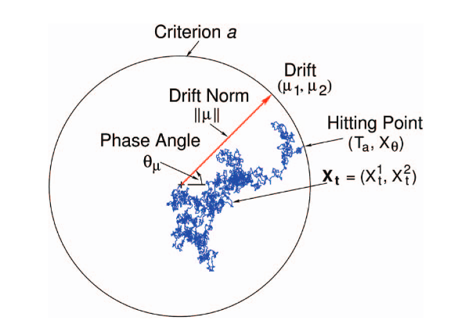
Response Times and Diffusion Modelling
EPC - 2021
Response Times (RTs) can tell you a lot about underlying processes!
Circular diffusion model (Smith, 2016) can model continuous-outcome decisions
From P. L. Smith (2016). “Diffusion theory of decision making in continuous report’ Psychological review, 123, 425-451. Figure 2. Copyright American Psychological Association.

Slide 35
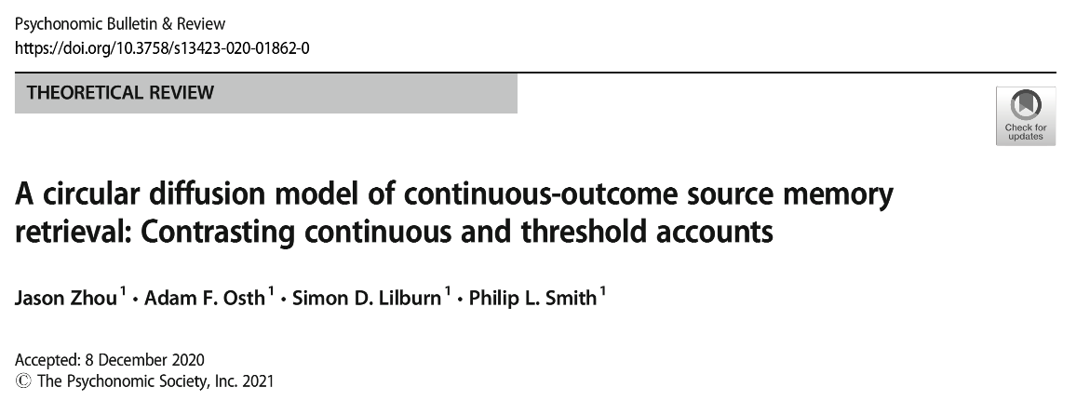

jasonz1@student.unimelb.edu.au

Slide 36
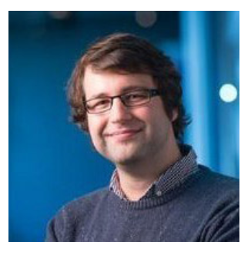
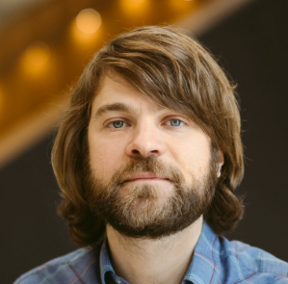
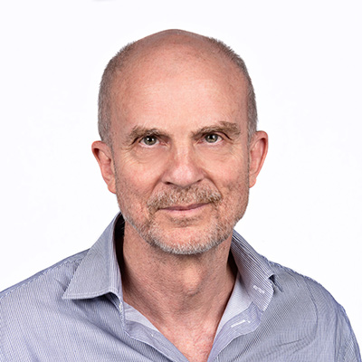
Acknowledgements
Dr. Adam F. Osth
Prof. Philip L. Smith
Dr. Simon D. Lilburn

