Slide 1

A Systematic Model of Intrusions in Source Memory
Jason Zhou
Context & Episodic Memory Symposium: International 2021

Slide 2
Source Memory
Memory for the source (or origin) of the material stored in memory.
WORD

Slide 3
Source Memory
Memory for the source (or origin) of the material stored in memory.
On which side of the screen was
WORD
originally presented?

Slide 4


Continuous-Outcome Tasks
Responses made on a continuous (often circular) domain
Response precision instead of proportion correct
Color
Wilken and Ma (2004)
Bays et al. (2009)
Smith et al. (2020)
Location
Harlow and Donaldson (2013)
WORD
Adapted from Smith et al. (2020). “Modeling Continuous Outcome Color Decisions With the Circular Diffusion Model: Matric and Categorical Properties” Psychological review, 127, 562-590. Figure 1. Copyright American Psychological Association.

Slide 5
Models of Source Memory Retrieval
Continuous
Threshold
X
X
Gradual Decline
All or None
Notes:
A number of models have been developed to explain the source memory task, which make distinct assumptions about source memory retrieval. Based on Signal Detection Theory (SDT), continuous models of source memory claim that memory relies on continuous evidence. In signal detection models, retrieved information may be inaccurate but not absent, allowing for a gradual decline in the quality of information retrieved (Banks, 2000; Mickes, Wais & Wixted, 2009).
In contrast, threshold or discrete-state models hold that retrieval fails discretely, and so performance is made up of either precise responses driven by memory, or guesses when the memory is below the retrieval threshold (Batchelder & Riefer, 1990; Klauer & Kellen, 2010).

Slide 6
Why does this matter?
Is there a threshold in source memory retrieval?
Dual-Process Model (Yonelinas, 1999) assumes so
Does memory exist in discrete states?
Parallel in Visual Working Memory literature: slots vs resource

Slide 7
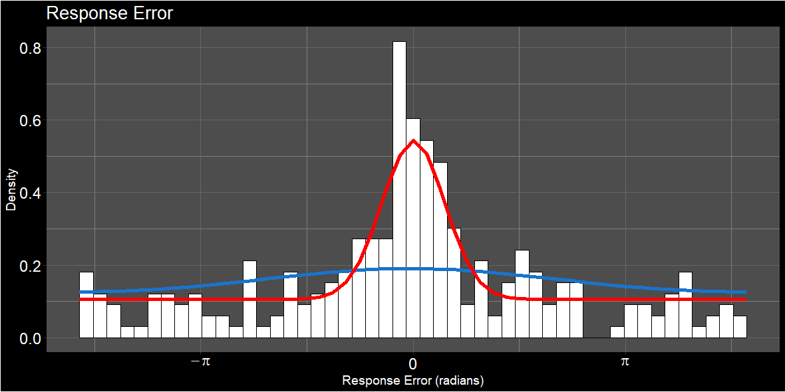
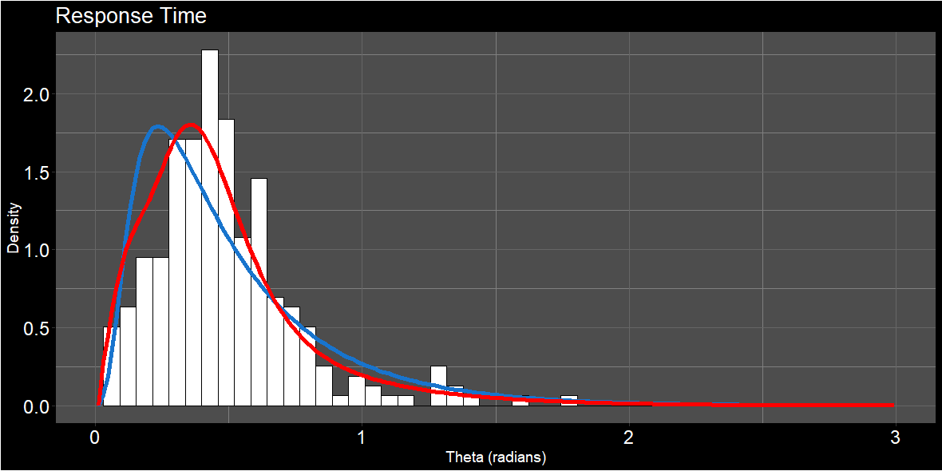
Support for a Threshold Model
Harlow and Donaldson (2013)
Zhou et al. (2021)
Continuous
Threshold

Slide 8
Intrusions in Memory
When attempting to retrieve one item, information for another item is retrieved instead.

Slide 9
TIER
TIED
CORD

Slide 10
Where was
“CORD” Located?

Slide 11
Guessing
Intrusions
Notes:
Is the evidence that, to this point, been used to support threshold model of source memory actually explainable by intrusions? Note this is only for one trial, because intrusions are uniformly distributed across trials, the overall distribution of errors across trials will look like a flat tail. The key difference is that one any one trial, the errors from intrusions are systematic, and linked to the locations of possible intrusions. The driving rationale here is inspired by Paul Bays work- if we account for intrusions, does the amount of uniform guessing (in a no-information state) go down? In his work, it did substantially 62% down to 14%.

Slide 12
Evidence for Intrusions in the Data
PLUG
CALM
PLUM
Response Error
FLAG
DREG
Notes:
Before we even get to the modelling, there’s some evidence that intrusions are happening by just looking at the data

Slide 13
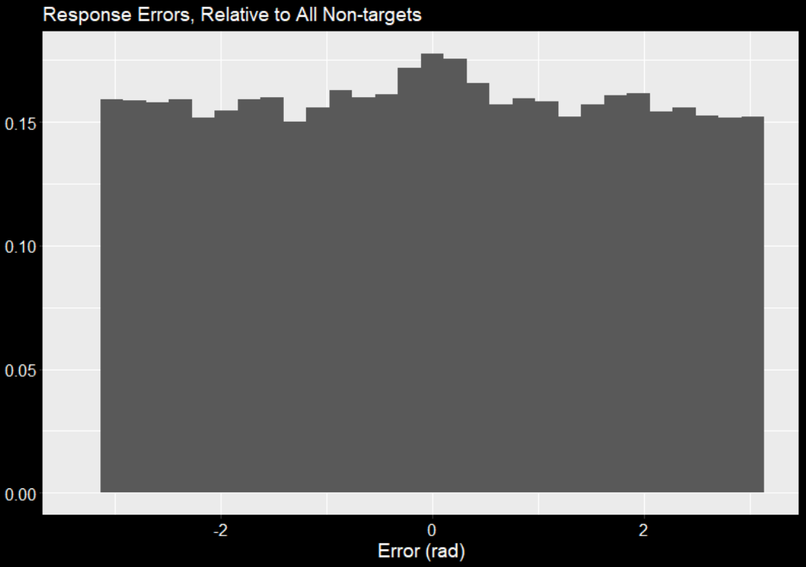
Evidence for Intrusions
Density
(See Bays et al., 2009)

Slide 14
Comparing Model Parameters
Uniform Guessing
Precision (prec)
Proportion of uniform guesses (γ)
Zhang, W., & Luck, S. J. (2008). Discrete fixed-resolution representations in visual working memory. Nature, 453(7192), 233-235.

Slide 15
Model Parameters
Uniform Guessing
Precision (prec)
Proportion of uniform guesses (γ)
Zhang, W., & Luck, S. J. (2008). Discrete fixed-resolution representations in visual working memory. Nature, 453(7192), 233-235.

Slide 16
Model 1
Uniform Guessing
Precision (prec)
Proportion of uniform guesses (γ)
Zhang, W., & Luck, S. J. (2008). Discrete fixed-resolution representations in visual working memory. Nature, 453(7192), 233-235.

Slide 17
Model 2
Intrusions
Precision (prec)
Proportion of intrusions (β)
Bays, P. M., Catalao, R. F., & Husain, M. (2009). The precision of visual working memory is set by allocation of a shared resource. Journal of vision, 9(10), 7-7.

Slide 18
Model 3
Intrusions + Uniform Guessing
Precision (prec)
Proportion of uniform guesses (γ)
Proportion of intrusions (β)

Slide 19
Model Fits
Model Name | ΔBIC | Parameter Estimates
Model Name | BIC | prec1 | prec2 | γ | β
Guessing only | 3.03 | 17.38 |  | 0.60
Intrusions only | 28.57 | 5.53 |  |  | 0.44
Guessing + Intrusions | 0 | 15.88 |  | 0.46 | 0.14
Intrusions with Different Precision | 2.2 | 17.46 | 1.03 |  | 0.60
Guessing + Intrusions with Different Precision | 4.94 | 17.82 | 16.30 | 0.38 | 0.22

Slide 20
Model Fits
Model Name | ΔBIC | Parameter Estimates
Model Name | BIC | prec1 | prec2 | γ | β
Guessing only | 3.03 | 17.38 |  | 0.60
Intrusions only | 28.57 | 5.53 |  |  | 0.44
Guessing + Intrusions | 0 | 15.88 |  | 0.46 | 0.14
Intrusions with Different Precision | 2.2 | 17.46 | 1.03 |  | 0.60
Guessing + Intrusions with Different Precision | 4.94 | 17.82 | 16.30 | 0.38 | 0.22

Slide 21
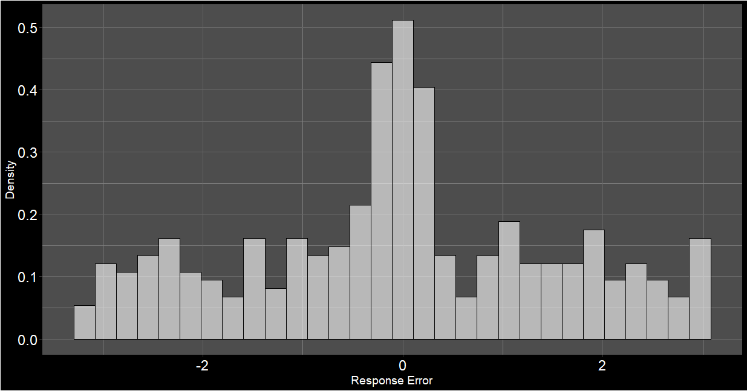
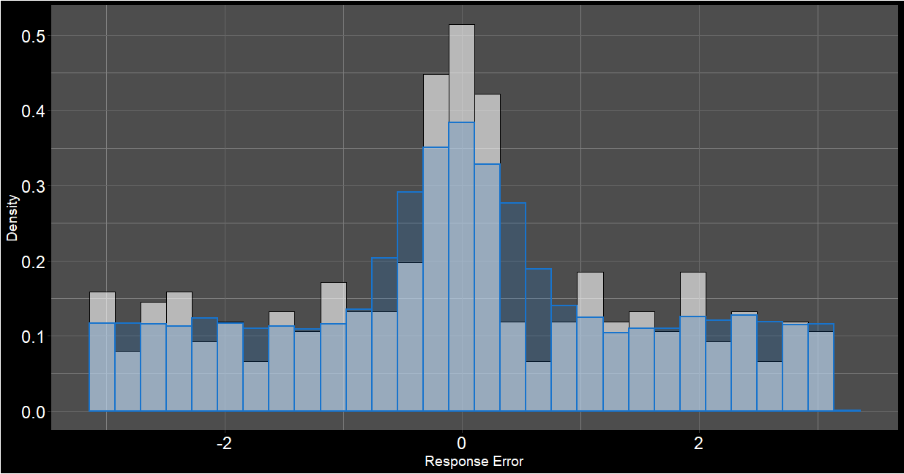
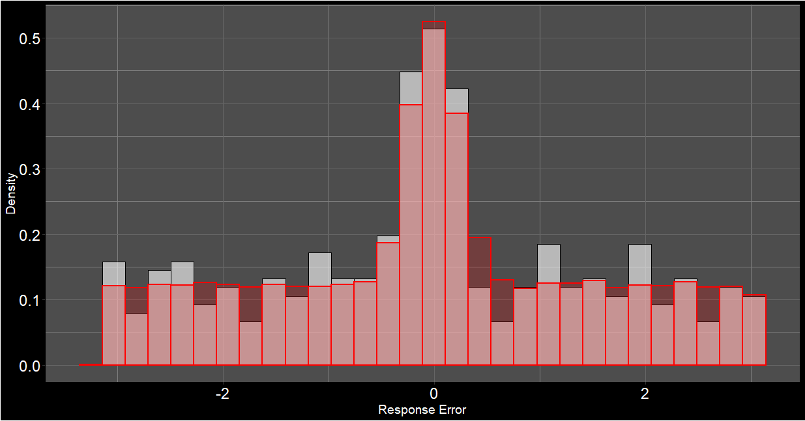
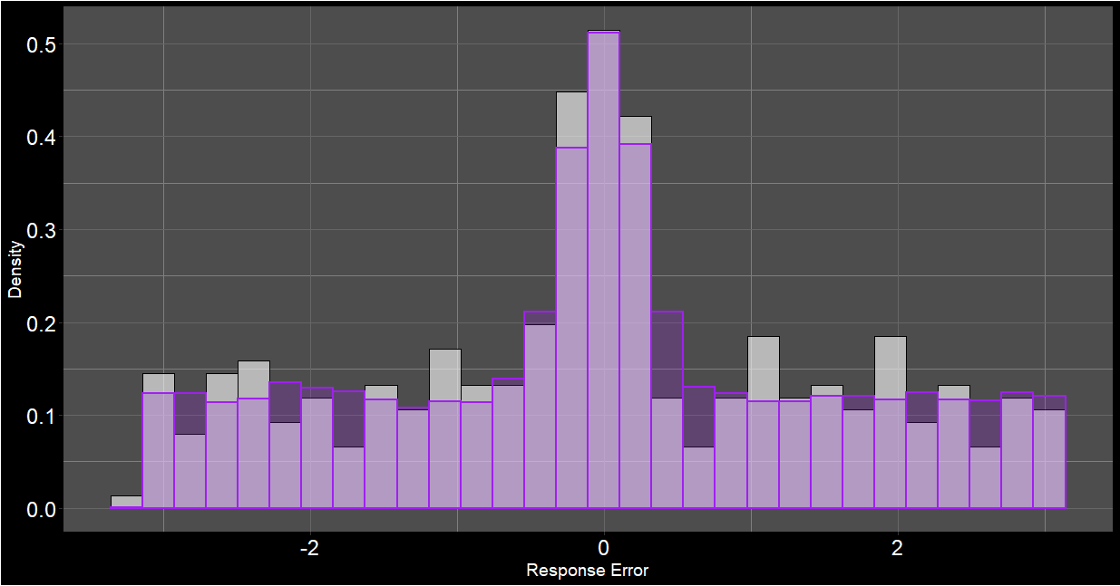
Uniform Guessing
Intrusions
Guessing + Intrusions

Slide 22
Model Fits
Model Name | ΔBIC | Parameter Estimates
Model Name | BIC | prec1 | prec2 | γ | β
Guessing only | 3.03 | 17.38 |  | 0.60
Intrusions only | 28.57 | 5.53 |  |  | 0.44
Guessing + Intrusions | 0 | 15.88 |  | 0.46 | 0.14
Intrusions with Different Precision | 2.2 | 17.46 | 1.03 |  | 0.60
Guessing + Intrusions with Different Precision | 4.94 | 17.82 | 16.30 | 0.38 | 0.22
Notes:
They essentially agree on the proportion of off-target responses, but the guessing + intrusions decomposes it into proportion of intrusions and guessing. A drop from 60% to 46% is not the same margin as Bays observed in his vwm task, but it is a drop

Slide 23
Interim Conclusion
Intrusions happen…
But so does uniform guessing
Support for some kind of retrieval threshold

Slide 24
Weighting Intrusions
BOXES
MOVE
LIFT
MORE
Temporal Similarity
Orthographic Similarity
Spatial Similarity
Semantic Similarity

Slide 25
Temporal Similarity
Law of Contiguity: Experiences close in time become associated
In serial recall, people often shift or transpose the order of items
Most transpositions happen over short distances (Hurlstone et al., 2014 is a good review)
Primacy gradient of activation (i.e. “Chaining model”; Grossberg, 1977; Page & Norris, 1998)
In free recall, people tend to recall neighbouring items in order
Contiguity with forward bias (Davis et al., 2008; Healey et al, 2019)
Popov et al. (2021)
When misbinding occurs in continuous-outcome task, error was most likely to come from locations in neighbouring serial positions

Slide 26
Temporal Similarity
Implemented an asymmetric temporal gradient in our model
Determines probability of particular non-target intruding based on lag
κe^{−λlag}
Forwards
(1-κ)e^{−λlag}
Backwards

Slide 27
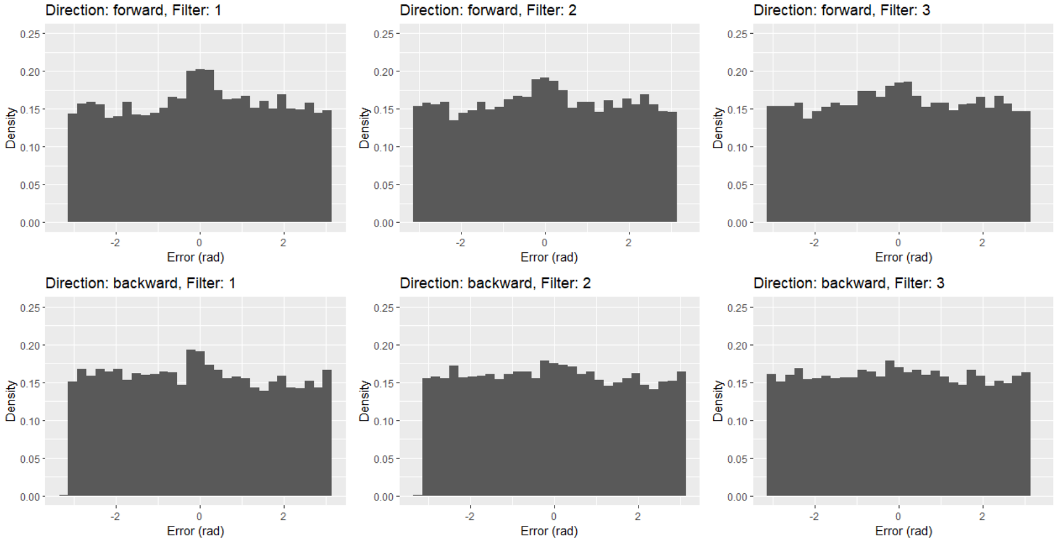
Temporal Similarity

Slide 28
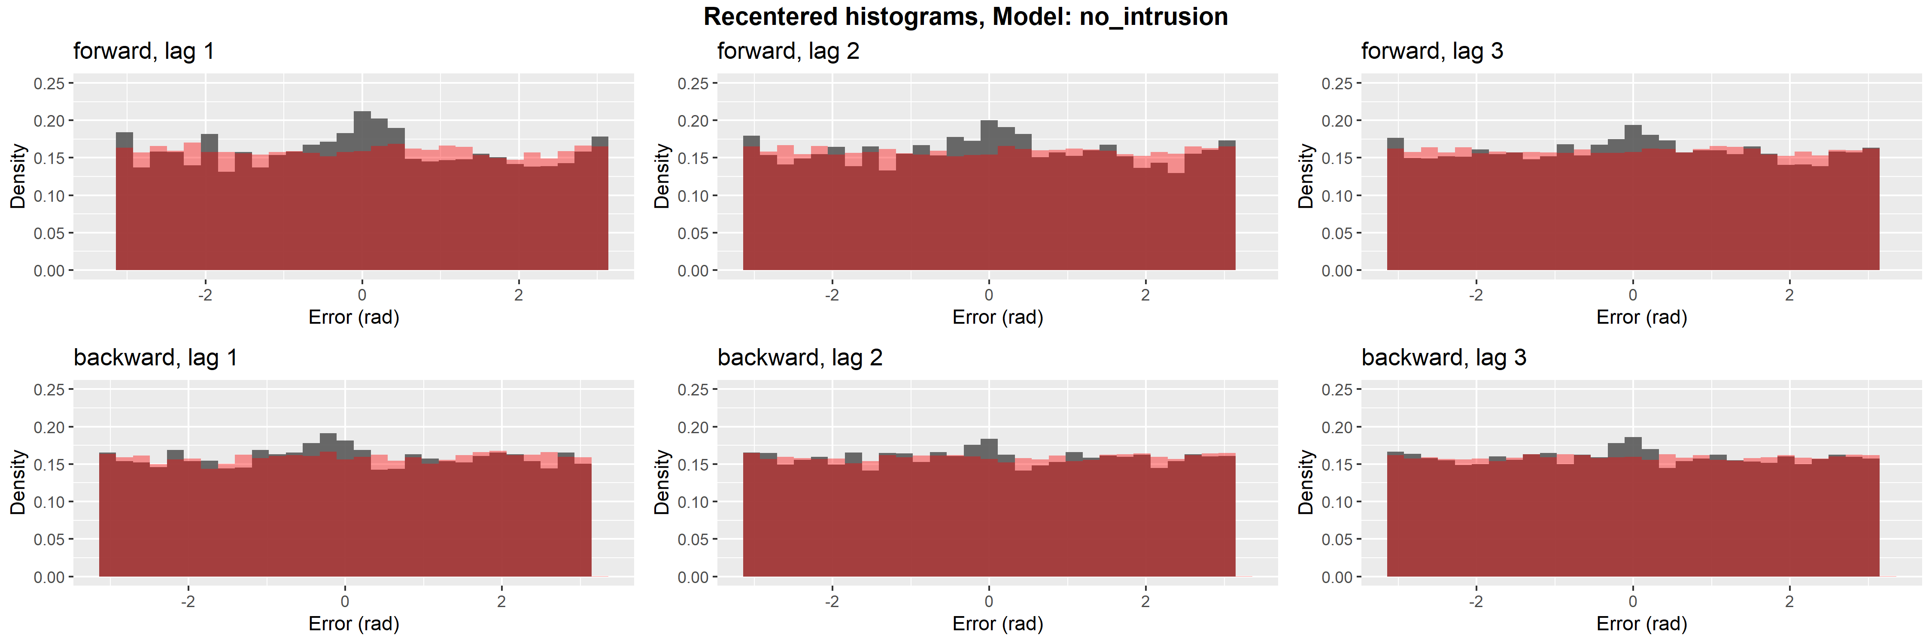
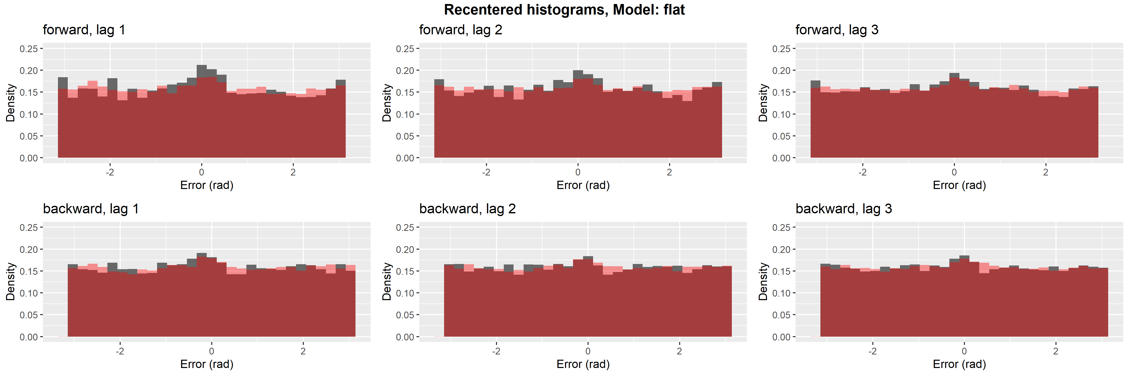

Slide 29
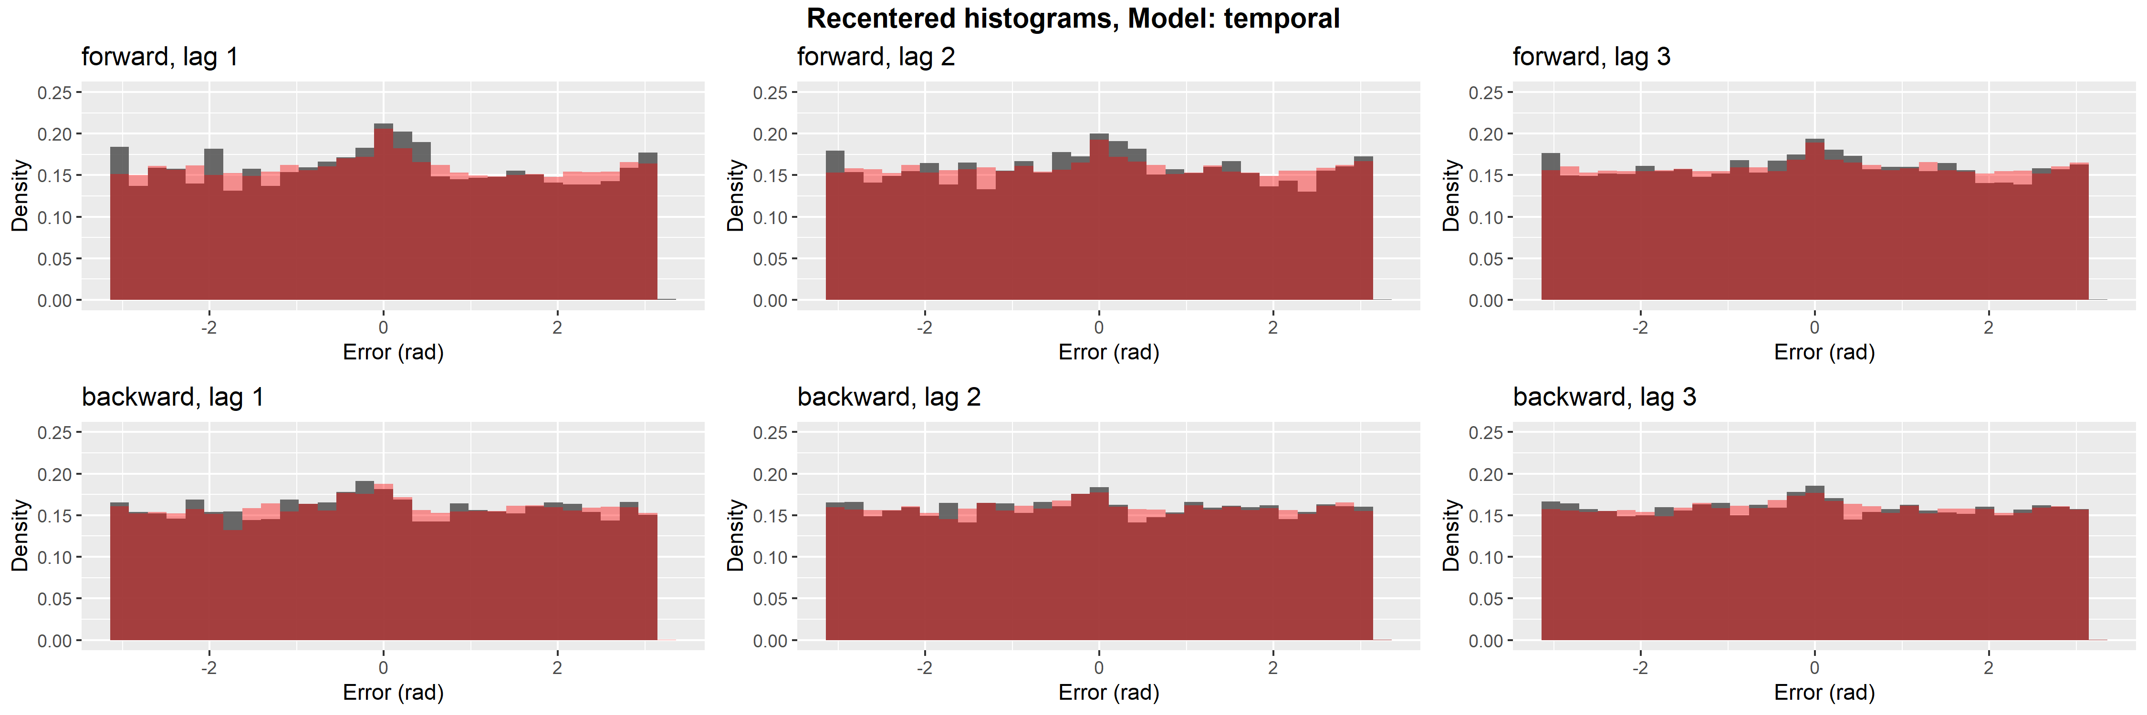

Slide 30
AIC Comparison
 | AIC | Δ AIC
No Intrusions | 9264 | 190
Flat Intrusions | 9112 | 37
Temporal Gradient | 9100 | 26

Slide 31
Temporal Similarity
Henson et al. (1996): “Sawtooth” pattern. It’s not just about temporal order.
B A P

Slide 32
Spatiotemporal Similarity
Swap errors in Visual Working Memory affected by cue-feature dimension
“Spatial transposition gradients” - Rerko et al. (2014)

Slide 33
Spatiotemporal Similarity
(e^{ζdistance}) * (κe^{−λlag})

Slide 34
AIC Comparison
 | AIC | Δ AIC | AIC Weight
No Intrusions | 9264 | 190 | 5.24E-42
Flat Intrusions | 9112 | 37 | 8.02E-09
Temporal Gradient | 9100 | 26 | 2.61E-06
Spatiotemporal Gradient | 9074 | 0 | 0.9984

Slide 35
A Wrinkle in the Story…
Limitations to using a mixture model approach
Ambiguity in how changes the weight of one component of the mixture affect changes in other components
Target
Guesses

Slide 36
A Wrinkle in the Story…
Limitations to using a mixture model approach
Ambiguity in how changes the weight of one component of the mixture affect changes in other components
Target
Guesses

Slide 37
A Wrinkle in the Story…
Limitations to using a mixture model approach
Ambiguity in how changes the weight of one component of the mixture affect changes in other components
Target
Guesses

Slide 38
A Wrinkle in the Story…
Limitations to using a mixture model approach
Ambiguity in how changes the weight of one component of the mixture affect changes in other components
Target
Intrusions
Guesses

Slide 39
A Wrinkle in the Story…
Limitations to using a mixture model approach
Ambiguity in how changes the weight of one component of the mixture affect changes in other components
Target
Intrusions
Guesses

Slide 40
A Wrinkle in the Story…
Limitations to using a mixture model approach
Ambiguity in how changes the weight of one component of the mixture affect changes in other components
Target
Intrusions
Guesses

Slide 41
A Wrinkle in the Story…
Limitations to using a mixture model approach
Ambiguity in how changes the weight of one component of the mixture affect changes in other components
Target
Intrusions
Guesses

Slide 42
A Wrinkle in the Story…
Limitations to using a mixture model approach
Ambiguity in how changes the weight of one component of the mixture affect changes in other components
Target
Intrusions
Guesses

Slide 43
…and a Path Forward
Process model (e.g. racing evidence accumulators) to disambiguate how these components interact
Racing against the clock (Hawkins et al., 2021)
Target
Intrusions
Guesses
Decision Criteria
Time

Slide 44
Conclusions
Intrusions account for some, but not all errors
Uniform guessing still appears to be present
Source memory retrieval is thresholded
Intrusion probability is influenced by a combination of temporal and spatial similarity
Lacking evidence of semantic or orthographic similarity

Slide 45
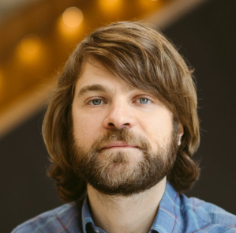

Acknowledgements
Dr. Adam F. Osth
Prof. Philip L. Smith

Slide 46
References

Slide 47
Experimental Paradigm
EPC - 2021
Encode
Distractor
Recognition
Source

Slide 48
Experimental Paradigm
EPC - 2021
Encode
Distractor
Recognition
Source
x 10
CART
TRY AGAIN
DRAG
2000 ms

Slide 49
Experimental Paradigm
EPC - 2021
Encode
Distractor
Recognition
Source
3 + 6 + 2 = 10
1 = TRUE
0 = FALSE
30000 ms

Slide 50
Experimental Paradigm
EPC - 2021
Encode
Distractor
Recognition
Source
Is this word OLD or NEW?
CART
Sure New
Sure Old

Slide 51
Experimental Paradigm
EPC - 2021
Encode
Distractor
Recognition
Source
CART
1000 ms

Slide 52
Experimental Paradigm
EPC - 2021
Encode
Distractor
Recognition
Source
x 10
30 s
x 20
x 10
x 12 Blocks
x 3 Sessions
x 28 Participants

