Slide 1
ENVIRONMENTAL WARRIORS
Cindy, Jay, Nelson, Sayali

Slide 2
OUR GOALS
Educate the Public
Increase Data Accessibility
Global Scalability
General lack of awareness of our daily exposure to environmental hazards and the associated health implications
Provide a free mobile app where users can search their zip codes to find the pollution levels in the community
Use predictive model built from US datasets to apply to data sources from any other part of the world

Slide 3
HYPOTHESIS
DATA SOURCE
There is higher level of pollutants in lower income neighborhoods.
Sourced data from US government agencies:
NYC also provides testing of water for lead and copper levels, data from 2018 - 2020
The EPA provides data across variety of locations on air pollutants, data from 2018 - 2020

Slide 4
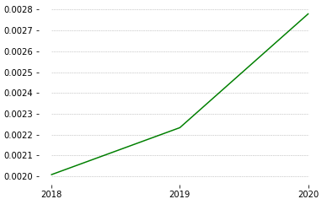
FINDINGS
Levels of lead has increased over time by 40% between 2018 and 2020 in NYC.
Challenges involved the wide disparity in available data in each year - led to insufficient data for further modeling.
While we didn’t explore the data the way we initially intended, we found a model for providing ease of access to the data for residents of the New York area through a mock application that can take in our data in a full-scale deployable environment.
LEAD VALUES
TIME

Slide 5
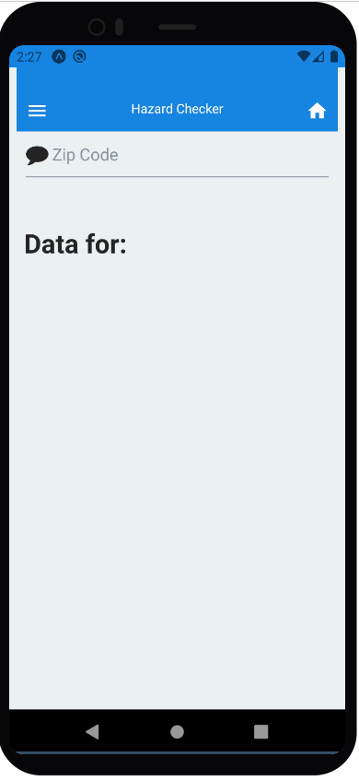
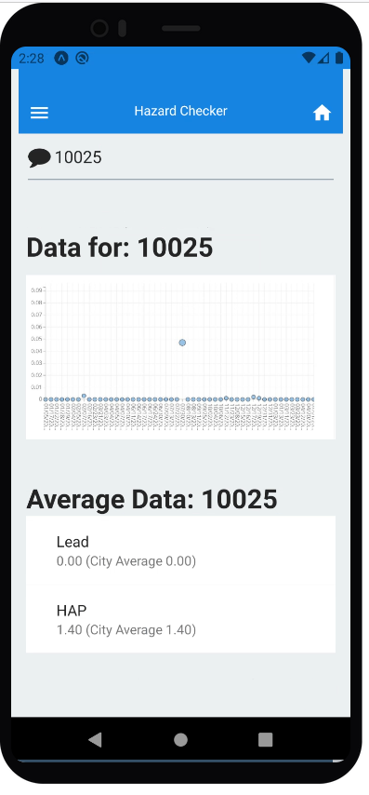
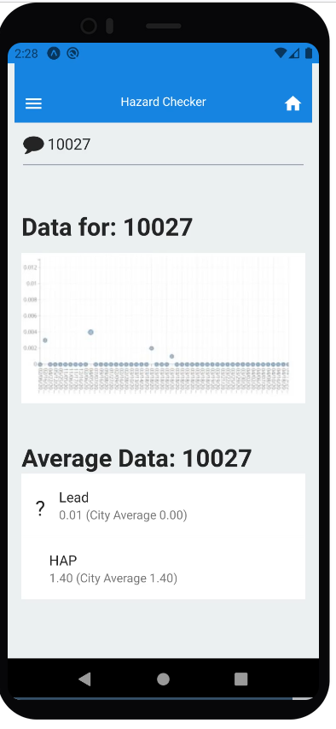
MOCK CONSUMER MOBILE APP
We developed a mobile app for New York City residents to search the average lead levels (and eventually other hazard levels) in their neighborhood through a simple search of their zip code.
Our code contains the framework for the data that can be deployed to use the application in practice.
The application itself runs and can do simple, generalized searches of the zip codes: 10025, 10027, 10031. The zip codes contain mock data.
iOS and Android binary compatible through React Native / Expo. Click the links below to try it out yourself!
Demo Code

