Slide 1



Uncovering the Ionizing Radiation Fields in Galaxies Using Detailed Photoionization Modeling
Jay A. Trevino¹, Danielle A. Berg², Karla Z. Arellano-Co’rdova², Grace M. Olivier³, and the CLASSY team
¹Columbia University, ²Department of Astronomy, College of Natural Sciences, The University of Texas, ³Ohio State University

Slide 2
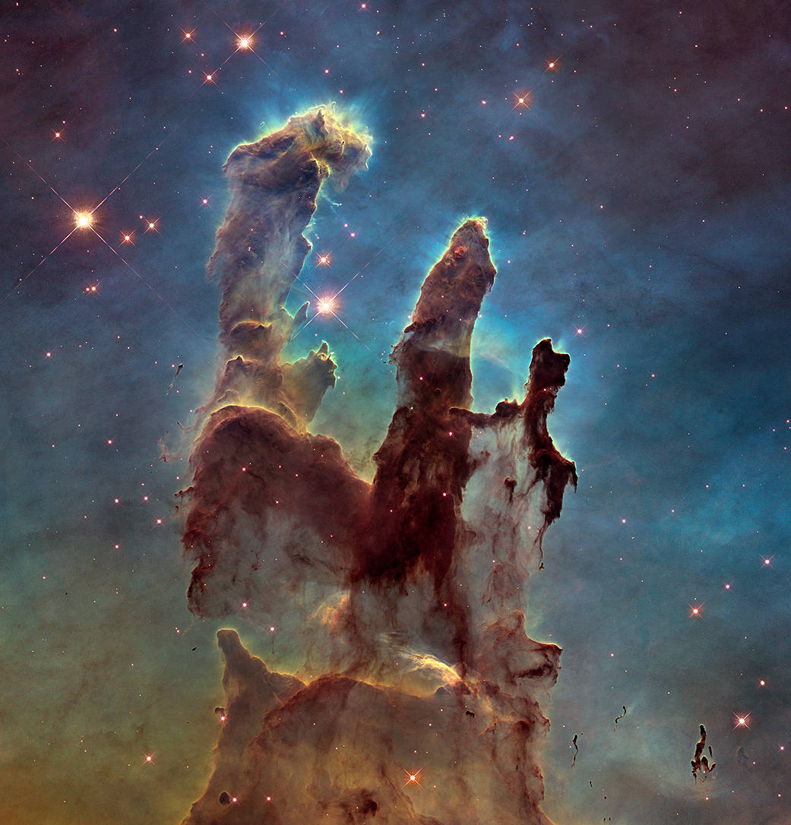

Slide 3
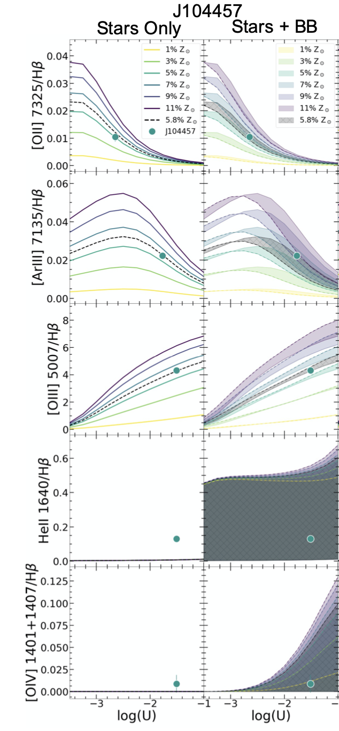
J104457
The highest ionizing emission lines cannot be reproduced
Stars Stars + BB
J104457
Stars Stars + BB
[He II]
[O IV]

Slide 4
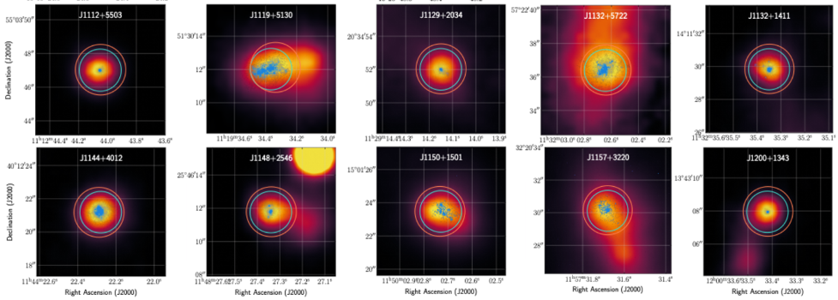
CLASSY galaxies

