Slide 1
Keyword extraction from e-portfolios
Jana Tafferner & Verena Günther

Slide 2
Topics
Process & Programs (1-10)
Final result (11)
Limitations, barriers and difficulties
Outlook

Slide 3
1. Process & Programs (1)
Install and use the (default-)Pipeline of spacy (de_core_news_sm)
First program: Deutsche Pipeline mit Ausgabe in Datei
Assignment of words to categories by spacy
Output of the resulting words in a file: additionally there are category explanations and the result count
Result:
The default-Pipeline found and assigned just a very low number of entities
The classification is partly not satisfactory
Solution attempts:
Compare different Pipelines from spacy
prepare words from the portfolio beforehand

Slide 4
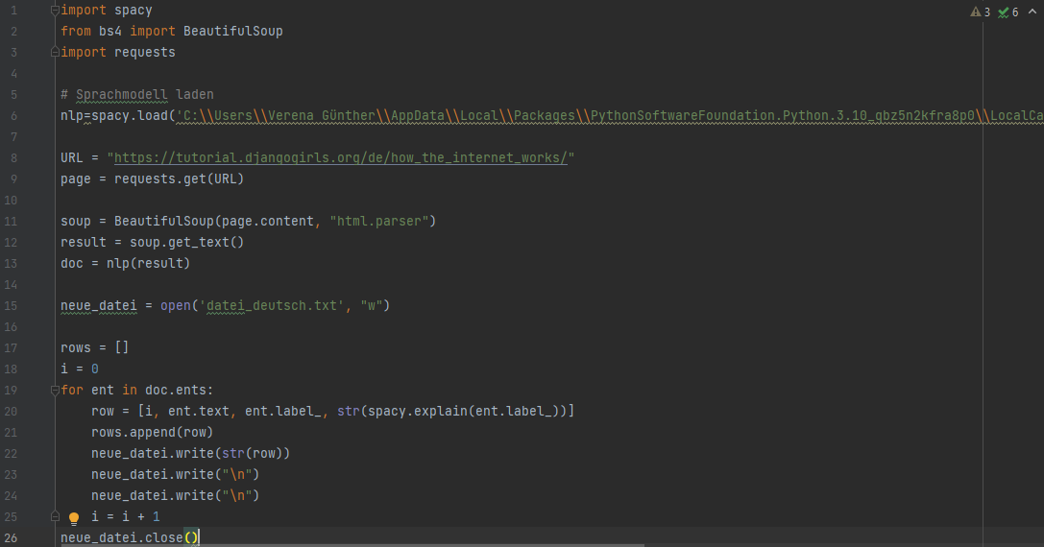
First Program

Slide 5
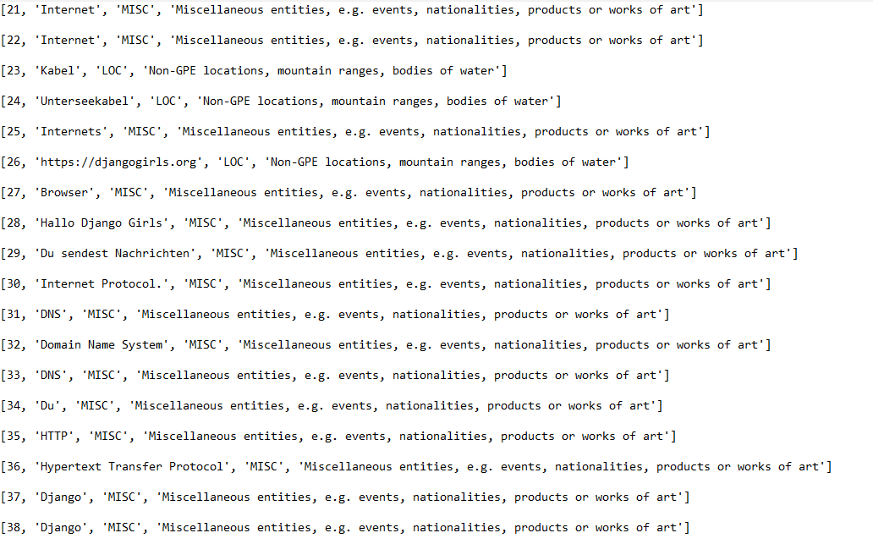

Slide 6
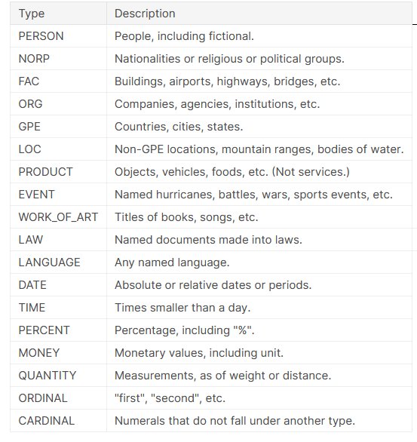
1. Process & Programs
German categories by spacy:
English categories by spacy:
Type | Description
MISC | Miscellaneous entities, e.g. events, nationalities, products or works of art
LOC | Non-GPE locations, mountain ranges, bodies of water
PER | Named person or family
ORG | Companies, agencies, institutions, etc.

Slide 7
1. Process & Programs (2)
Use the large-Pipeline of spacy (de_core_news_lg)
Program: Vergleichsprogramm large Pipeline mit Ausgabe in Konsole
Result:
No better results, rather less results
Counted words large-Pipeline: 33
Counted words default-Pipeline: 38
Next Solution attempts:
Comparison of an english Pipeline of spacy with an english e-portfolio and a german pipeline with the same e-portfolio just in the german language (we used a portfolio that is available in both english and german language)

Slide 8
1. Process & Programs (3 + 4)
Use an english-Pipeline of spacy (en_core_web_sm)
Program: Vergleichsprogramm englische Pipeline mit Ausgabe in Datei
Result:
German Pipeline provides better results
Counted words english-Pipeline: 20
Counted words german-Pipeline: 38
Next step:
Using a previously locally saved e-Portfolio instead of an online e-Portfolio
Program: Programm lokal gespeichertes Portfolio

Slide 9
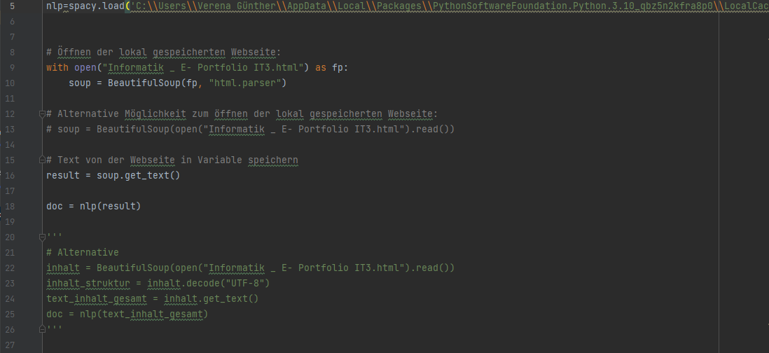

Slide 10
1. Process & Programs (5)
Next step:
Program: Ausgabe mit Displacy und Ausgabe auf lokalem Server
use the visualizer displacy by spacy
Result:
the css- formatting is not retained
results are inaccurate, the classification of the categories is not fitting in most cases
words are assigned to multiple categories
spacy sums up several words and the words therefore are not considered individually

Slide 11
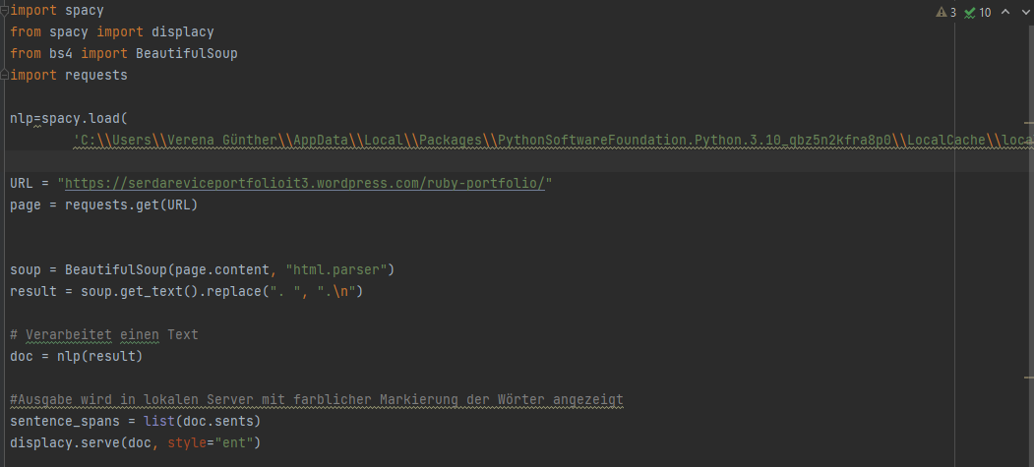

Slide 12
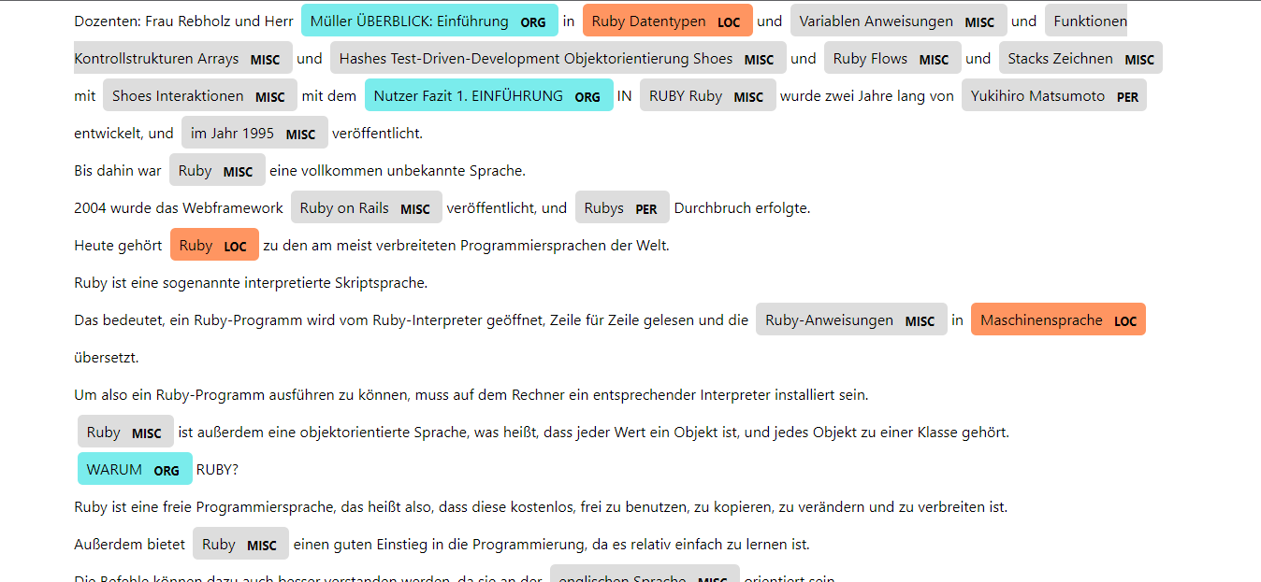

Slide 13
1. Process & Programs (6)
Next step:
Program: Annotation in HTML
Create a local copy of the portfolio so that results are not only shown in a file
So the words should remain in the right place in the portfolio and be marked -> highlighting directly in the e-Portfolio → the formatting of the e-portfolio is maintained
Result:
Words are sometimes assigned to several categories -> should be fixed so that they are only assigned to one category at a time
The formatting is maintained

Slide 14
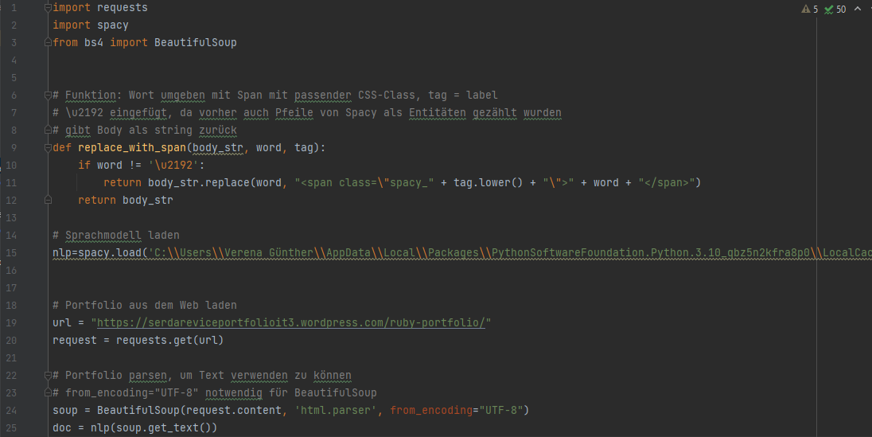

Slide 15
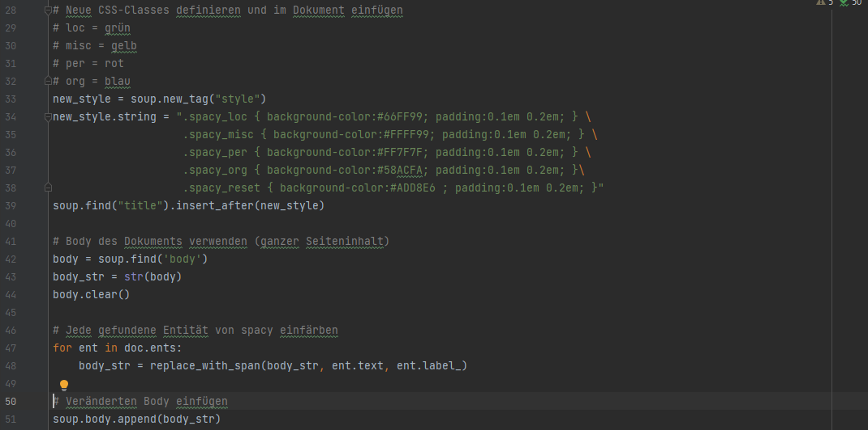

Slide 16
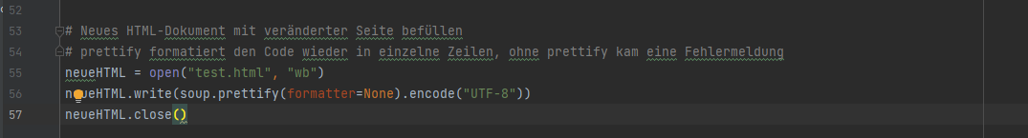

Slide 17
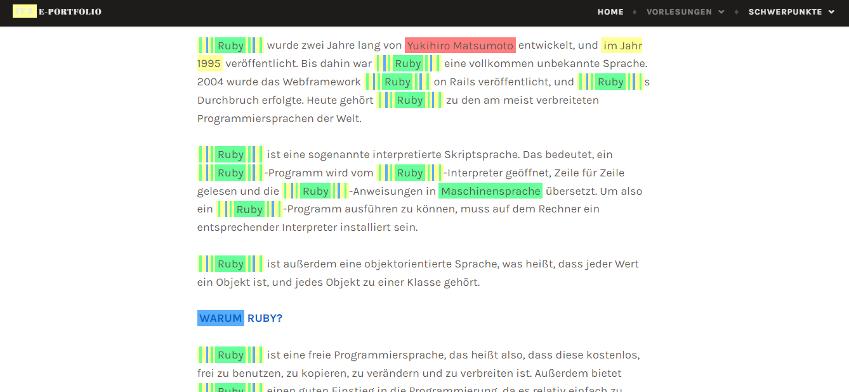

Slide 18
1. Process & Programs (7)
Next steps:
Program: Annotation mit Eingabeaufforderung
fix that words are only assigned to one category at a time
program is to be called up via the command line and input is to be possible there in order to enter any e-portfolio
Creation of a web server → now it is possible to open an edited copy of the e-portfolio with a link in the command line

Slide 19
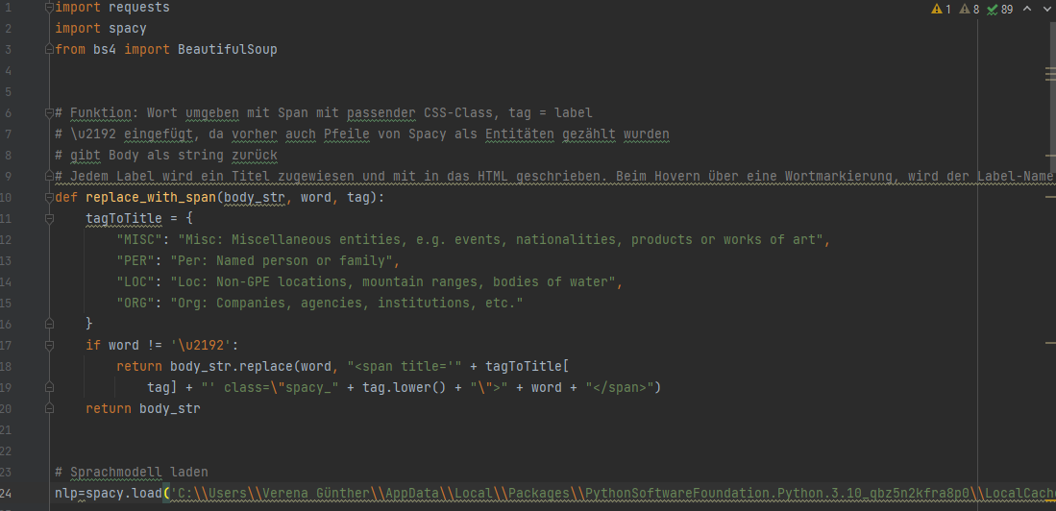

Slide 20
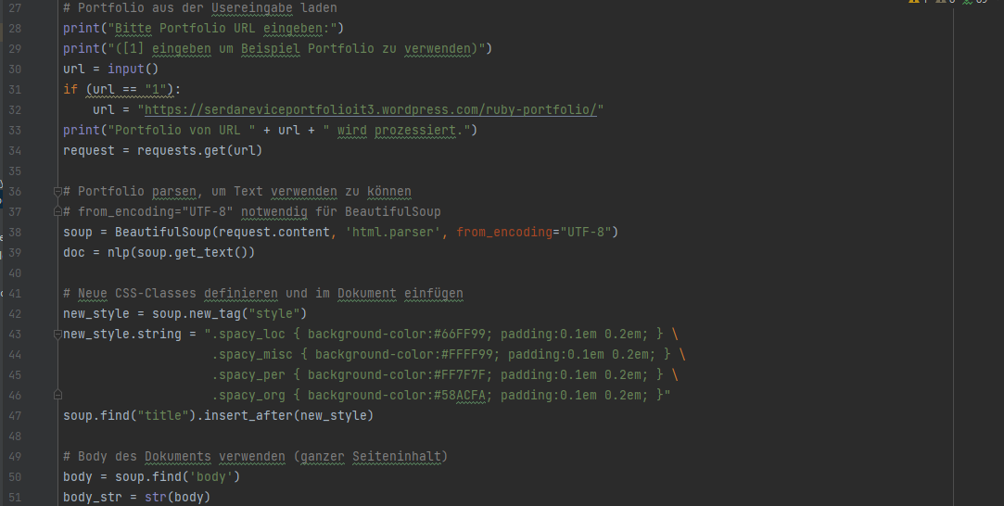

Slide 21
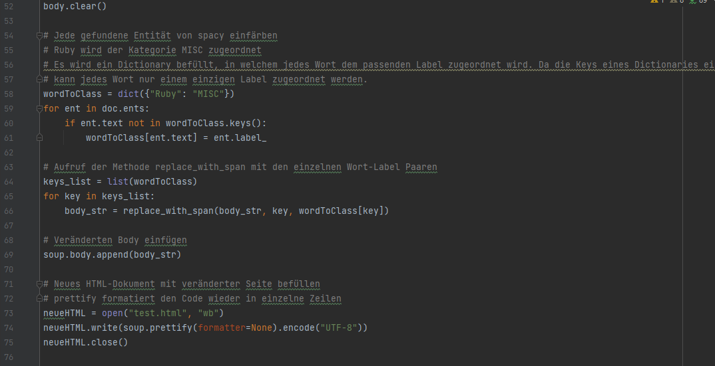

Slide 22
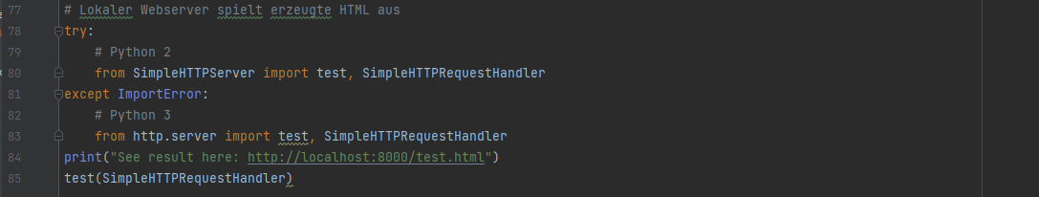

Slide 23
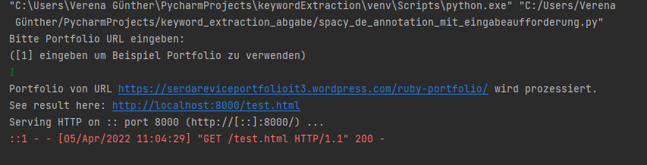
Command line

Slide 24
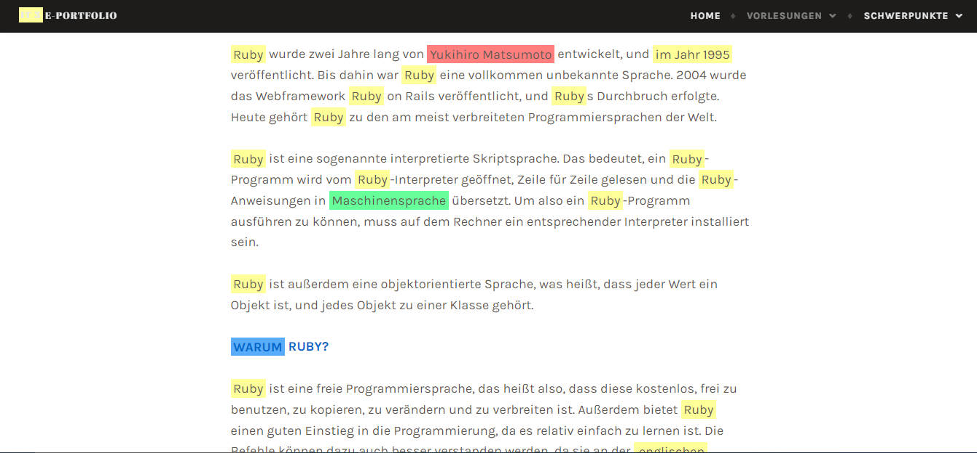

Slide 25
1. Process & Programs (8)
Next steps:
Program: Dictionary
Because the results from spacy are still not satisfying, we created a dictionary by hand
Based on concept maps from Ms. Rebholz
The categories from spacy are expanded (15 categories in total)
In the dictionary we have assigned more than 150 words to categories

Slide 26
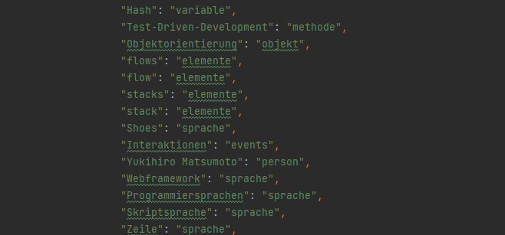
Extract of the dictionary

Slide 27
1. Process & Programs (9)
Next steps:
Program: Dictionary ohne Spacy
Creating a program by hand with best case Assignments without spacy
Hover-effect: categories are explained on hover

Slide 28
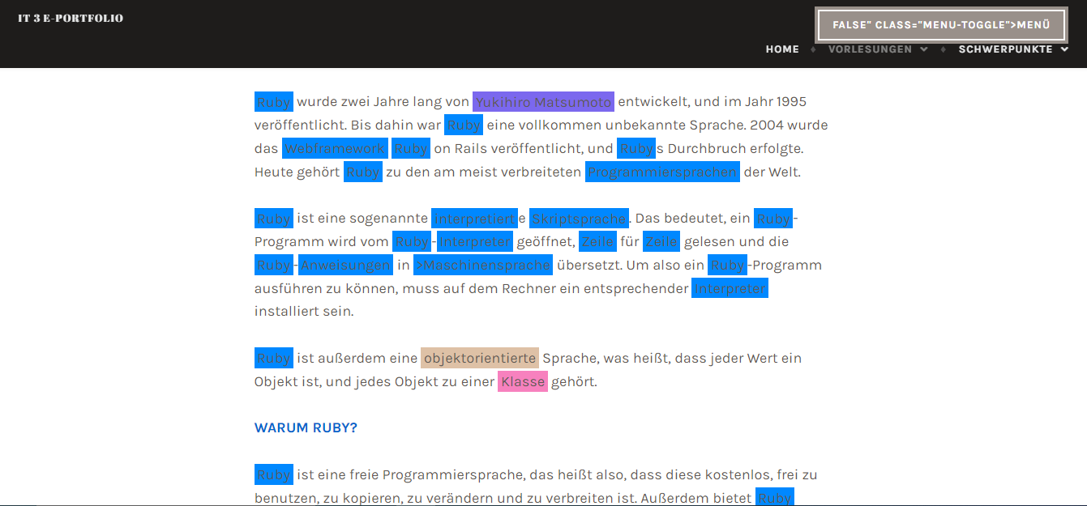

Slide 29
Process & Programs (10)
Next steps:
Program: Dictionary mit Ergänzungen von Spacy
combine the dictionary and the results of spacy
Result:
HTML code is broken when specific words e.g. “style”, “center” or “Objekt” occur in the dictionary

Slide 30
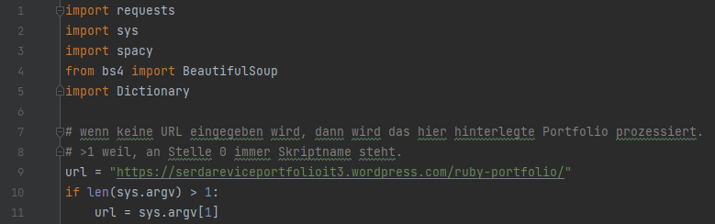

Slide 31
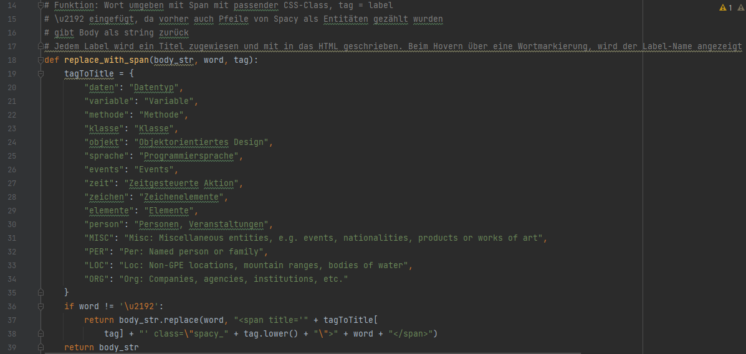
The Code

Slide 32
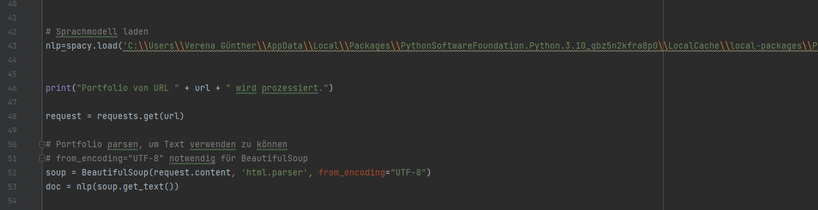

Slide 33
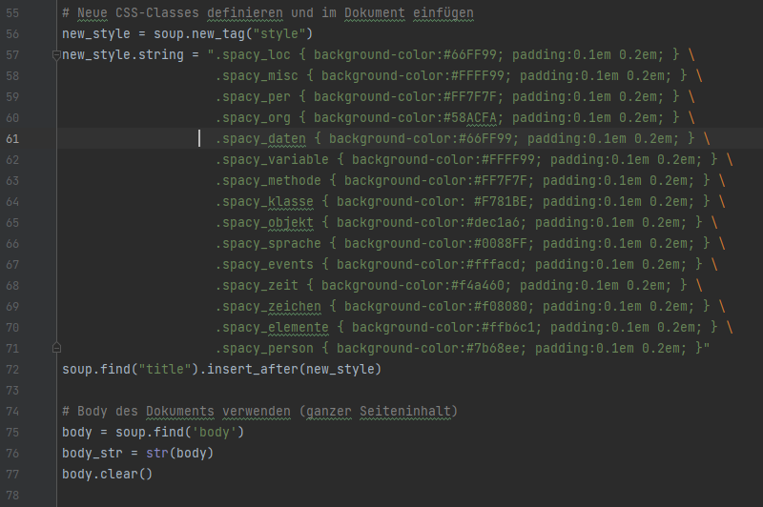

Slide 34
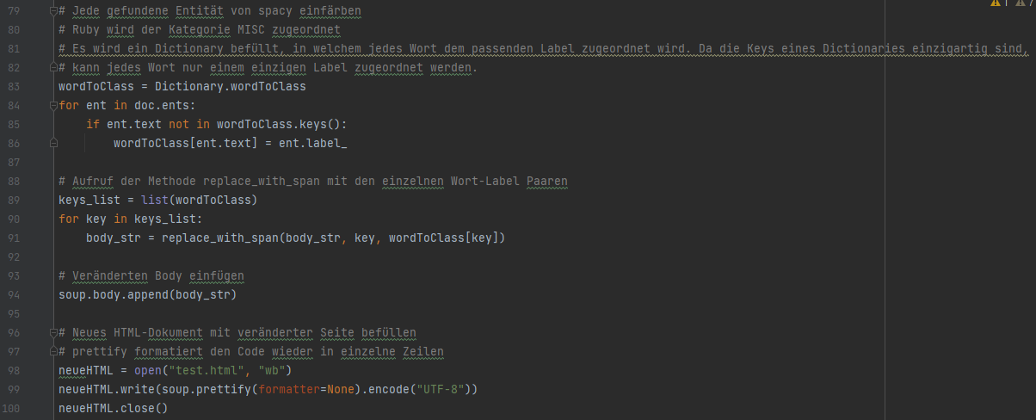

Slide 35
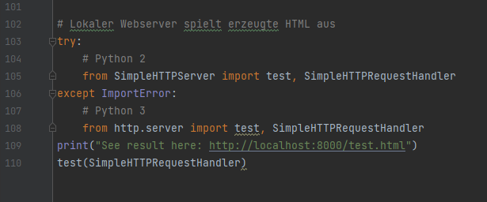

Slide 36
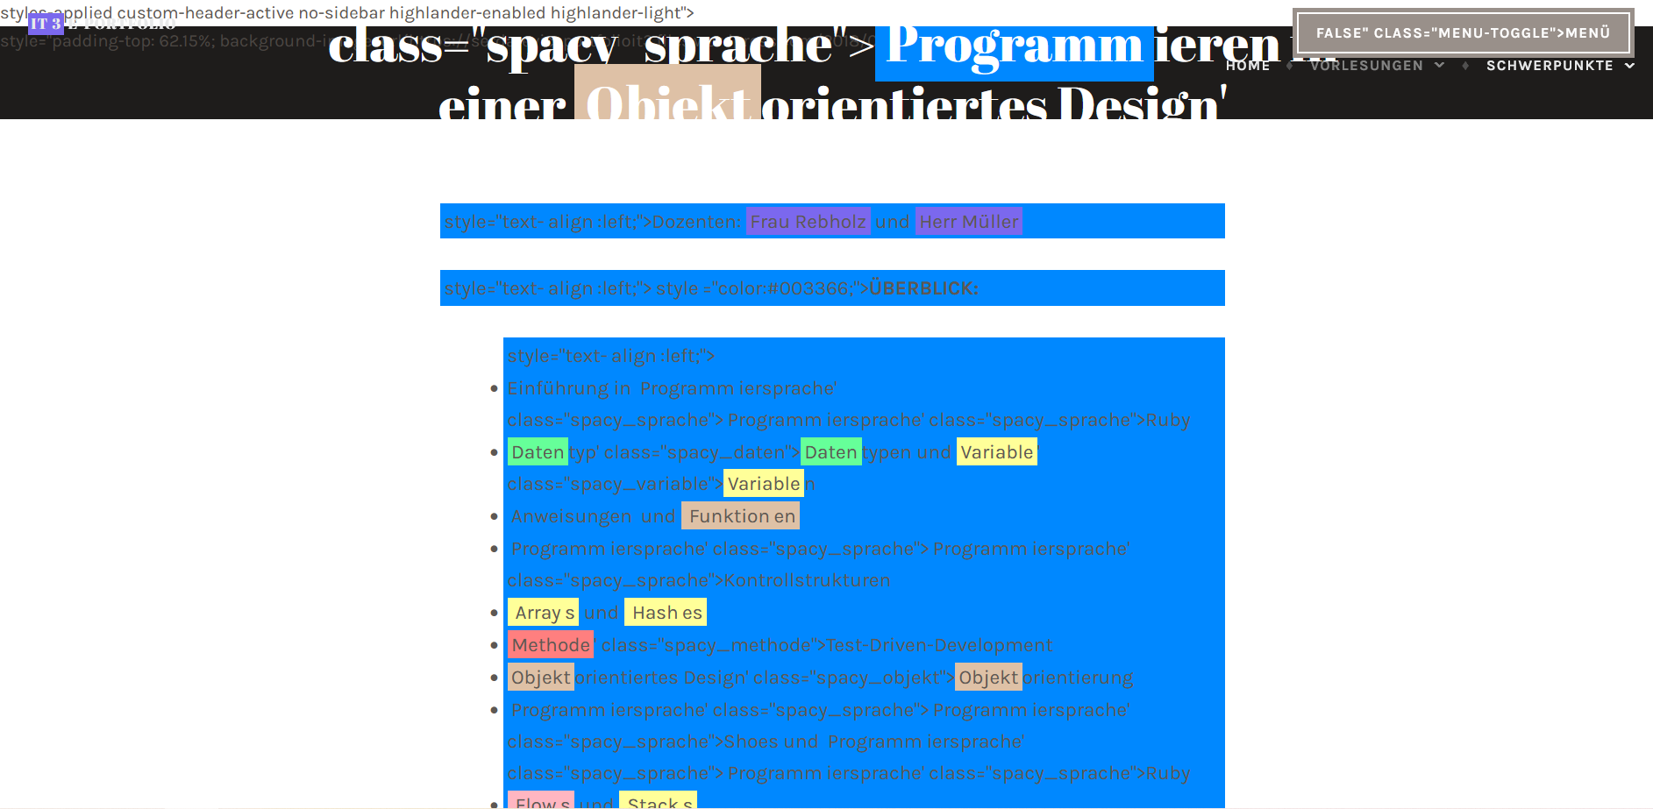

Slide 37
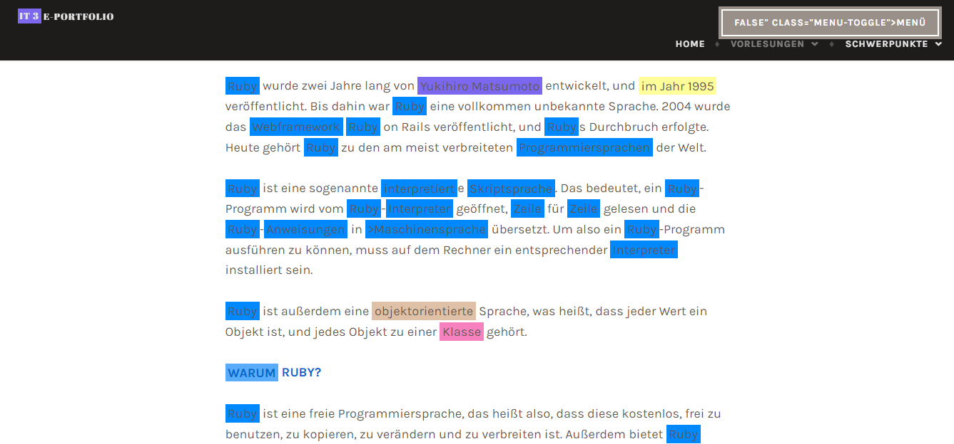

Slide 38
2. Final result (11)
Program: Keyword Extraction (Endergebnis)
Description:
words from a german e-portfolio are assigned to labels
the words are highlighted in a copy of the e-portfolio
every label has a different color
the labels are predefined by spacy and enriched with additional categories
the labels/colors are explained on mouse-over
the assignment of words to certain categories takes place through pre-trained pipelines of the software spacy and through a manually created dictionary, which is oriented towards the concept maps by Ms. Rebholz
the program can be used via the command line

Slide 39
2. Final result
Type | Description
MISC | Miscellaneous entities, e.g. events, nationalities, products or works of art
LOC | Non-GPE locations, mountain ranges, bodies of water
PER | Named person or family
ORG | Companies, agencies, institutions, etc.
Daten | Datentyp
Variable | Variable
Methode | Methode
Klasse | Klasse
Objekt | objektorientiertes Design
Sprache | Programmiersprache
Events | Events
Zeit | Zeitgesteuerte Aktion
Zeichen | Zeichenelemente
Elemente | Elemente
Person | Personen, Veranstaltungen
15 Categories

Slide 40
2. Final result
The sequences of the program:
When calling up the program, the user can enter a web address
Either the user enters an URL or a predefined URL is processed
The spacy result is added to the previously created dictionary
A local web server then serves a copy of the portfolio displaying the results
The words are highlighted depending on the categories.
To prevent words from being assigned twice, the words found are stored in a dictionary. Each word can only occur once

Slide 41
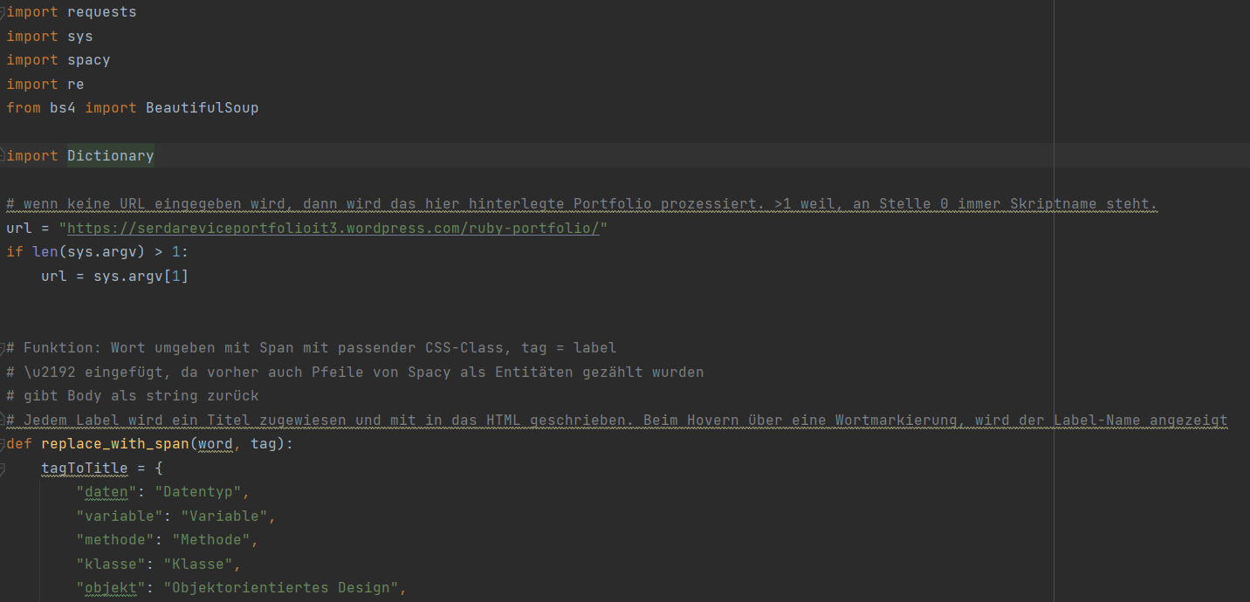
2. Final result

Slide 42
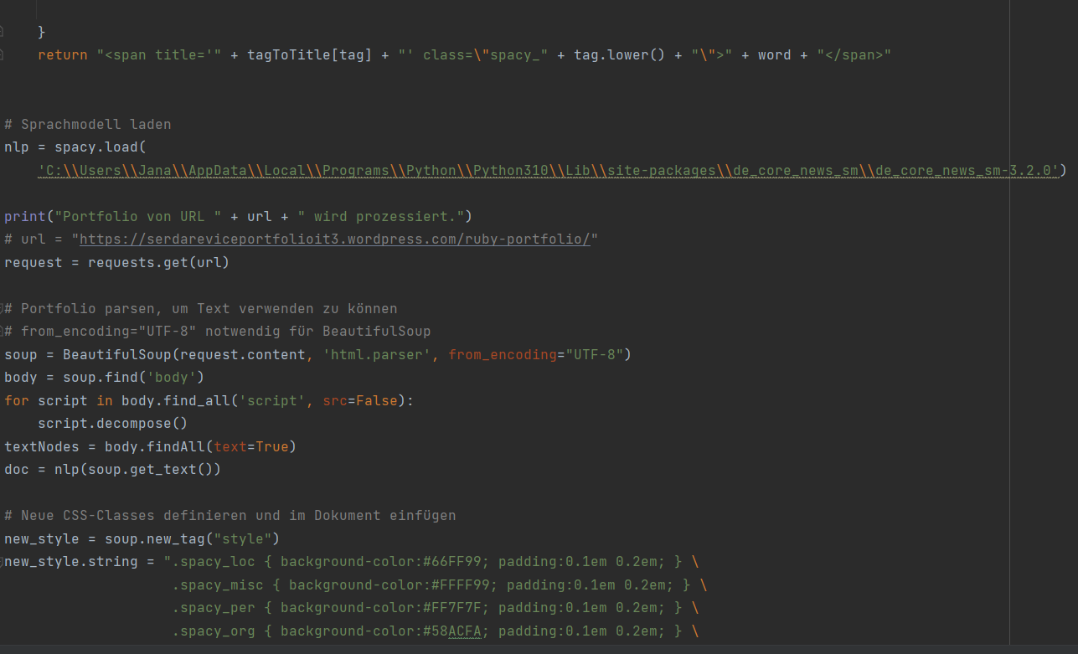
2. Final result

Slide 43
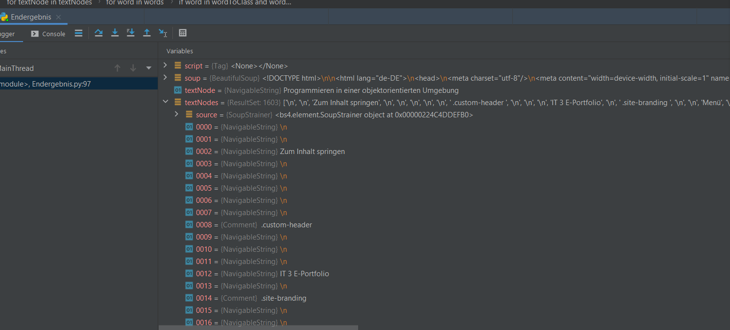
2. Final result
Problem from previous program was solved by working with TextNodes.

Slide 44
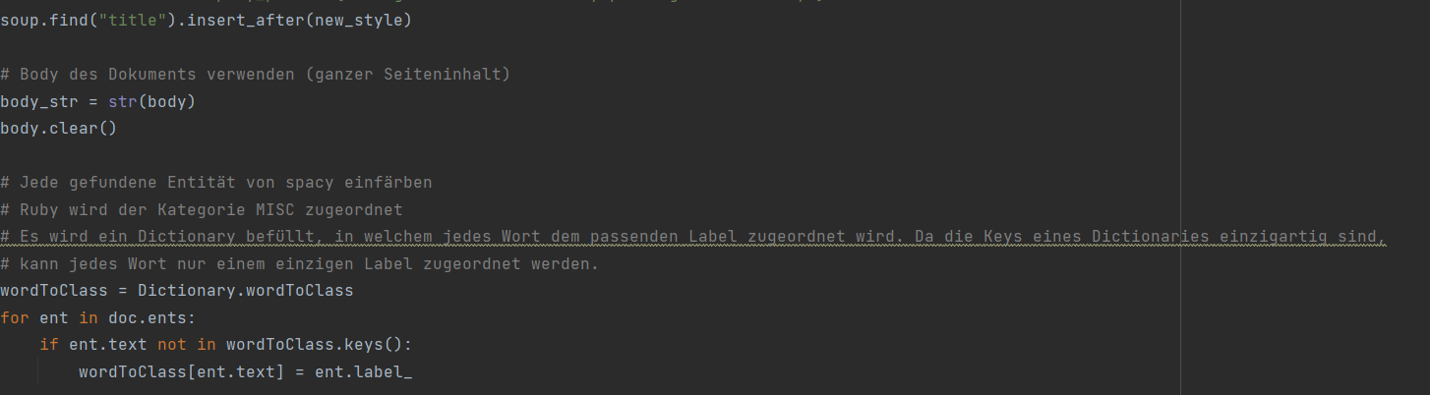
2. Final result

Slide 45
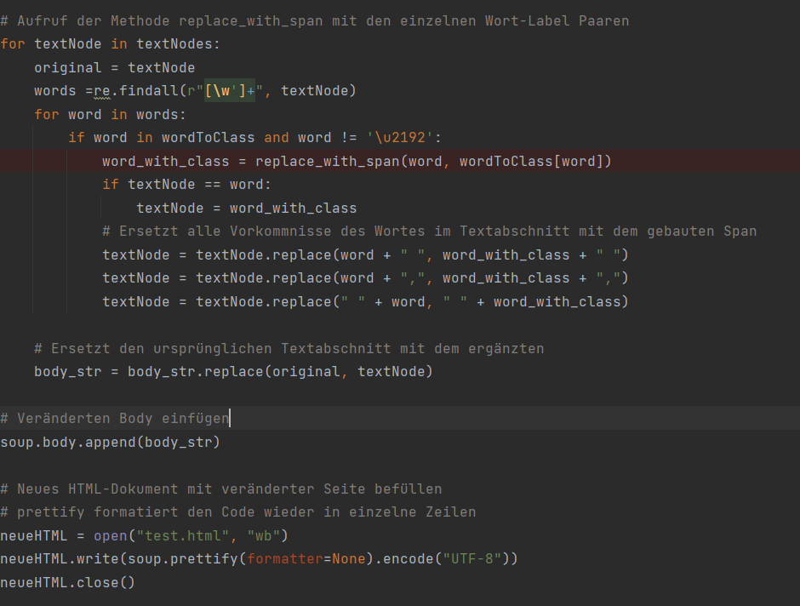
2. Final result

Slide 46
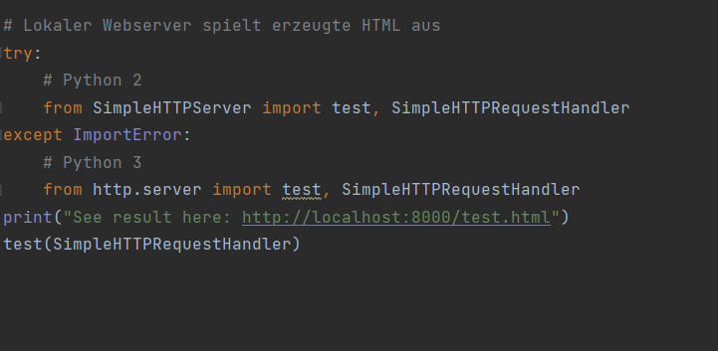
2. Final result

Slide 47
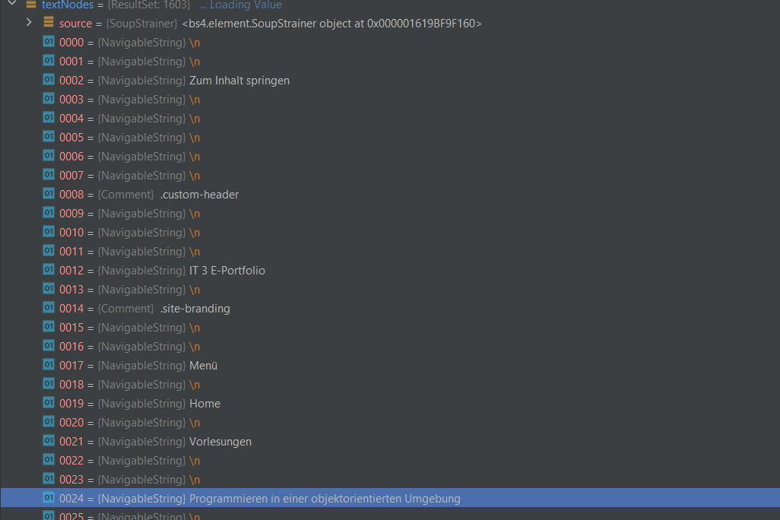
2. Final result

Slide 48
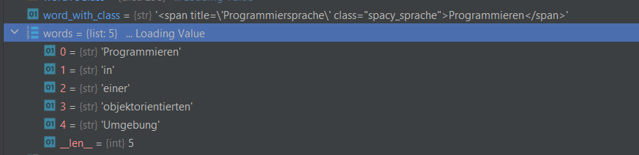
2. Final result

Slide 49
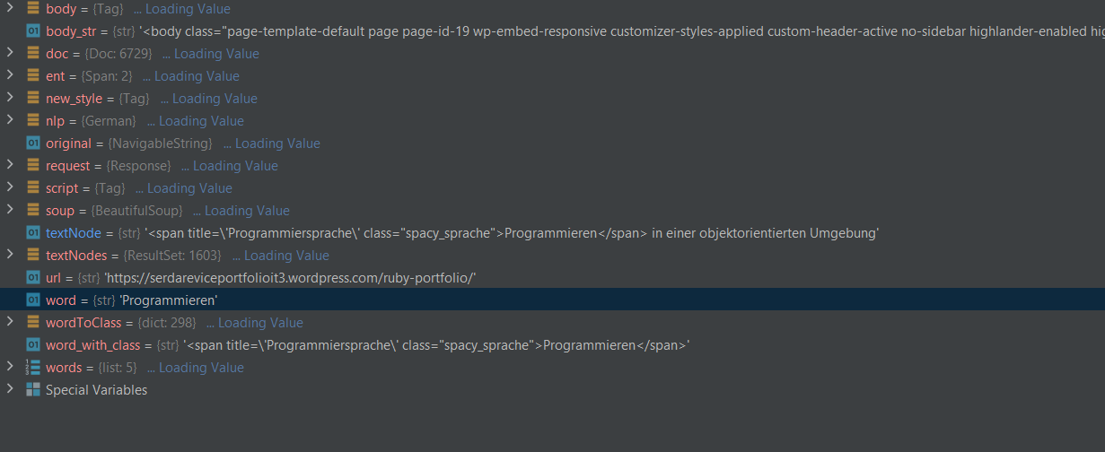
2. Final result

Slide 50
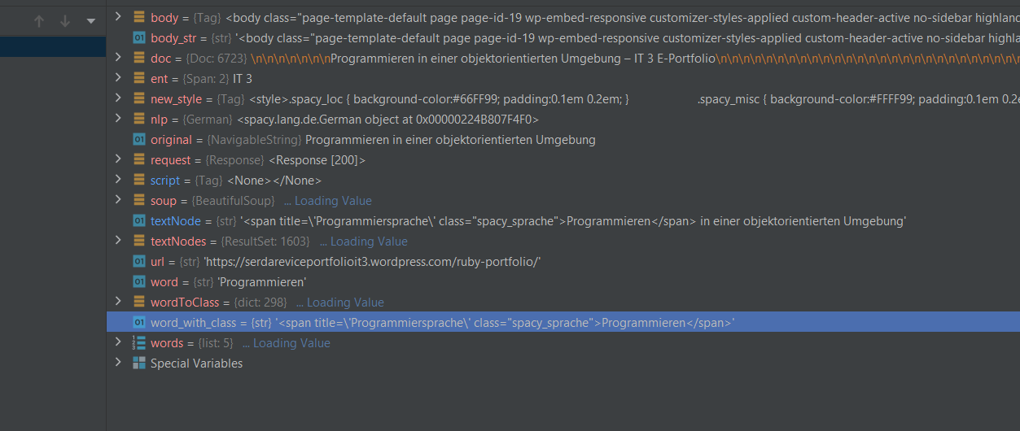
2. Final result

Slide 51
2. Final result
Required software, libraries & pipelines:
Python
request
spacy
bs4 from BeautifulSoup
de_core_news_sm from Spacy
sys
re
(More information in our README)

Slide 52
2. Final result
— Live demonstration —

Slide 53
3. Limitations, barriers and difficulties
spacy:
the assignment of the words to categories by spacy aren’t satisfying
only a small number of words are assigned to categories by spacy
results are inaccurate, the classification of the categories is not fitting in most cases
words are assigned to multiple categories
spacy sums up several words and the words therefore are not considered individually
just four categories in the german version
topic modelling/recognition is not possible with spacy
pipeline from spacy couldn't be trained by us → better possible with the purchasable version of spacy (prodigy)
dictionary:
specific words are interpreted as code e.g. “style”, “center” → formatting of the e-portfolio is damaged because of errors in html code (spans are not closing).

Slide 54
4. Outlook
Compare the results of spacy with results of other software (e.g. NLTK or gensim)
Topic modelling e.g. with Gensim
Test the purchasable version prodigy of spacy
Training a Pipeline based on the concept maps

Slide 55
Vielen Dank für Eure Aufmerksamkeit!

