Slide 1
Elder care management System
TS- WEB/CC/AI TRACK CAPSTONE PROJECT
Presented By:
1. J.S.Thanuja
Guided By:
Poova Ragavan

Slide 2
OUTLINE
Abstract
Problem Statement (Should not include solution)
Aims , Objective & Proposed System/Solution
System Design
System Development Approach(Technology Used)
Algorithm & Deployment
Conclusion
References
Future Scope

Slide 3
Abstract
An old age home is a shelter that is home to the older and needy people who the family has abandoned.
Now a days homeless old age people are increasing rapidly, even though we have a lot of old age homes, many of us does not know about their address, location, strength,its activities etc. And there are many individual websites for a particular old age home, but there is no website which gives data about all the old age homes and which can handle every old age home through a single website. Our project is about the website which gives data about every old age home and we manage every old age home through a single website.

Slide 4
Problem Statement
Here is the problem we observed that it is difficult to visit the all elder care home’s physically and it is difficult to know about the vacancies and facilities etc…..

Slide 5
Proposed Solution
we came with solution ,we developed a website which include all old age homes which are located in AP. Here they can see all old age home’s which are in AP,they can know about vacancies,facilities and they can join the old agers through online etc..

Slide 6
System Architecture
Volunteer
data
Data management
media
admin
Contact details
About us
Donation details
user

Slide 7
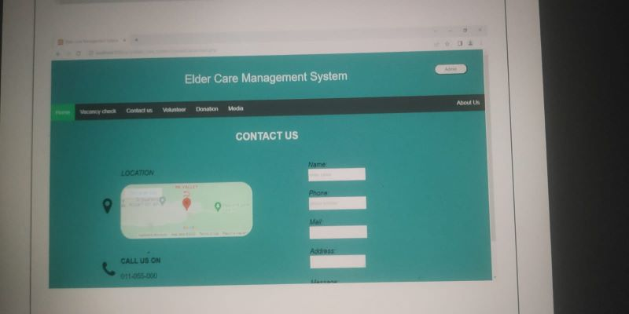
Algorithm & Deployment

Slide 8
THANK YOU

