Slide 1
ACCORD check-in
1 October 2026

Slide 2
Agenda
1. AFRIMET on acmadDL
ACMAD's climate data catalogue moved onto the ACCORD data layer. Catalogue growth, verification, on-demand layers, status.
2. Weather agent benchmark
Do reusable skills help an agent complete a forecasting workflow? Current experiment, interim results, failure modes, next test.
Agenda · 1 Oct 2026 · 2

Slide 3
AFRIMET on acmadDL

Slide 4
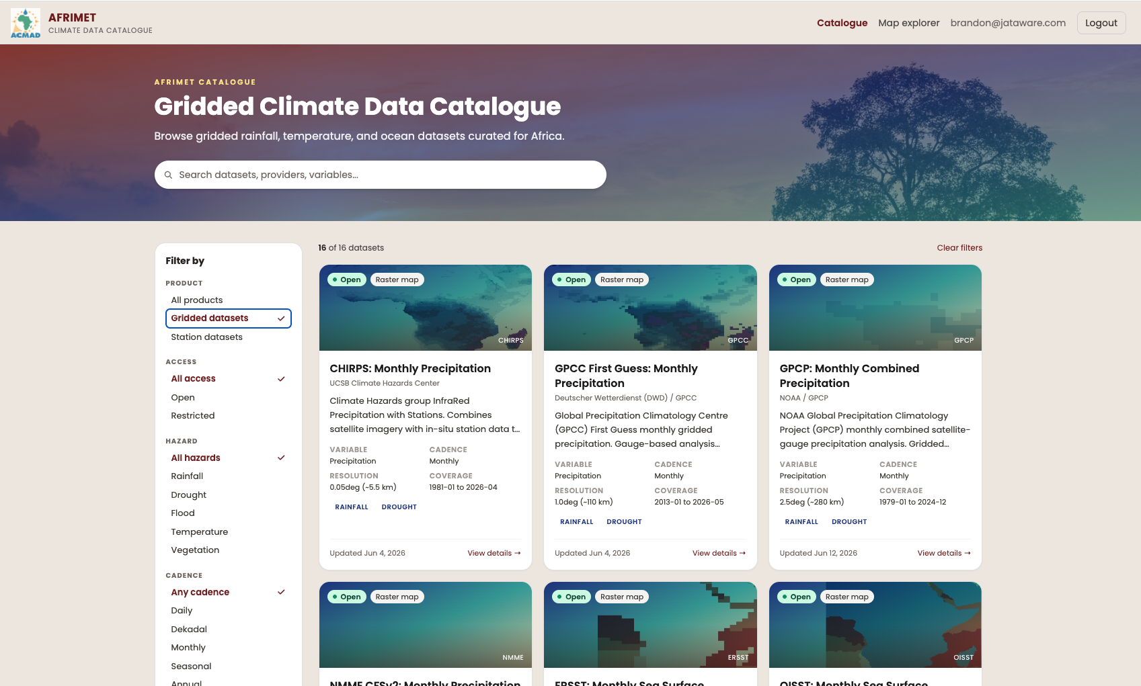
AFRIMET today
ACMAD's climate data catalogue and map explorer.
FastAPI, Celery, GeoServer, TiTiler, PostGIS
19 datasets in the portal
One adapter per source, maintained in afrimet
Download, parse, units, crop: rewritten for each new source
AFRIMET on acmadDL · 1 Oct 2026 · 4
Notes:
ACMAD's own product and team. The issue is the one every tool in this space has: acquisition code is written again inside each application.

Slide 5
acmadDL as the data layer
Sources
acmadDL
afrimet
Users
Copernicus CDS
ECMWF ECDS
IRI / CCSR OPeNDAP
NOAA, UCSB, DWD HTTP
Rhiza Sheerwater
S3 / Icechunk
source → canonical
canonical → published
Portal
Map explorer
GeoTIFF
API
fetch(product, variable, time, region)
URL and filename patterns
variable resolution
unit conversion
fill value → NaN
longitude convention
Africa crop
cache
rate → monthly total
north-up COG per band
GeoServer publish
layer metadata
TiTiler cache
auth, quotas, collections
Also on acmadDL: africas2s, Forecast Hub, acmaddl-mcp, Beaker
afrimet no longer stages raw files. The adapter returns a (time, lat, lon) array in final units.
New dataset: one entry in acmadDL's catalog, one in afrimet's. No adapter code.
acmadDL pinned to a commit. Bumps are re-verified.
AFRIMET on acmadDL · 1 Oct 2026 · 5
Notes:
acmadDL owns remote source to clean xarray. afrimet keeps what is specific to a web catalogue. ACCORD's forecast tools and AFRIMET now share one acquisition layer.

Slide 6
Catalogue: 23 → 53 datasets, 42 served by acmadDL
Migrated | CHIRPS v2 monthly, dekad, pentad · GPCC monitoring, first guess · GPCP · TAMSAT · ERSST · OISST · ERA5-Land t2m, precip, PEV | 12
New: CHIRPS v3 | monthly, monthly prelim, dekad, dekad prelim, dekad TIF, pentad, annual, daily, daily 0.25°, rolling dekad | 10
New: reanalysis, merged obs | ERA5 t2m, precip, SST · CMAP · CAMS-OPI · CHIRPS v2 annual, daily | 6
New: NMME | CFSv2 · CCSM4 · CESM1 · GEOS-S2S · SPEAR · CanSIPS-IC4 | 6
New: C3S | ECMWF SEAS5 · UKMO · Météo-France · DWD · DWD GCFS2.1 · CMCC SPS4 · JMA · ECCC CanSIPSv3 | 8
Unchanged, afrimet adapters | ARC2 · CRU TS · ISD-Lite · CFSv2 CPC hindcast · WIS2 stations · GHA stations · SPI 1, 3, 6, 12 | 11
The 12 migrated datasets produce the same rasters as before. Same layers, same styles, verified.
The 14 forecast systems are the models in ICPAC's and ACMAD's objective forecasts. AFRIMET had none.
acmadDL has 59 products. Each remaining one is a YAML entry away.
AFRIMET on acmadDL · 1 Oct 2026 · 6
Notes:
Counts are catalogue entries on the acmadDL branch of ACMAD-Niamey/afrimet vs develop. Portal shows 19 today because WIS2 and derived SPI are not cards.

Slide 7
Verification and on-demand layers
Verification
On-demand layers
Each migrated dataset published twice: legacy adapter, then acmadDL.
COGs compared cell by cell: CRS, cell centres, nodata mask, values.
Centre tolerance 1% of grid spacing. Not byte equality; row order differs by source.
GPCP, ERSST, OISST now include cells west of 0°. The old clip stopped at the meridian.
scripts/verify_acmaddl.py run, compare
request
month
quota
acmadDL
fetch
COG cache
TiTiler
core collection: scheduled monthly, published to GeoServer.
extended collection: fetched per dataset, year, month on request. Cached, tiled, not archived.
500 MB per user per day. 5 GB global. 20 GB cache with eviction.
Requests are logged. Usage decides what gets promoted to core.
Separate Celery queue. A slow CDS pull does not block the refresh.
AFRIMET on acmadDL · 1 Oct 2026 · 7
Notes:
On-demand is how 59 products get exposed without ACMAD archiving all of them. The log tells ACMAD what to promote.

Slide 8
Status
Where it is
Next
Branch acmadDL on ACMAD-Niamey/afrimet. David Kelly, 9 commits, 8 to 30 Sep.
Not merged. Not deployed. Pending ACMAD review.
Tests cover the adapter, COG comparison, pipeline, on-demand API, cache, quotas.
ACMAD (Collins Asega) landed CI/CD and Docker on develop in parallel.
ACMAD review, merge, deploy: core scheduled, extended on demand.
Forecast systems in Map explorer.
Migrate ARC2, CRU TS, CFSv2 hindcast.
africas2s layers: anomalies, terciles, seasonal aggregates.
Same library under ACMAD's NDJF run and s2s-mcp.
AFRIMET on acmadDL · 1 Oct 2026 · 8
Notes:
No ask. Offer to walk through the branch if they want.

Slide 9
Weather agent benchmark

Slide 10
What are we testing?
Can a coding agent build a working forecast from scratch, and how does that depend on the model?
Does adding Rhiza weather skills or ACCORD libraries improve completion, time or cost?
When the next forecast is needed, does retained code and fitted state reduce the work?
Report completion, forecast error, tokens, time and cost separately. Treat the expected advantages as hypotheses.
ACCORD · 1 October 2026 · 10
Notes:
This is the motivation for the actual three-arm seasonal pilot. No claim that Rhiza cannot produce reusable code, that ACCORD already improves accuracy, or that an extra ACCORD skills condition was tested.

Slide 11
Archived benchmark: execution conditions
Python only
Skills only
Python + skills
The agent writes, runs, and revises its own code using standard scientific Python packages.
The agent reads guides and invokes weather-skills operations; custom Python is disabled.
The agent can combine catalog operations with its own Python. Skill use is measured, not assumed.
Ten models, one task, three conditions: 30 planned attempts. The small-model tier includes 1B, 3B, 7B, 8B, and 9B models.
Astra is excluded because it helped develop the benchmark. Earlier runs remain archived.
Archived Kenya heat benchmark · different task and protocol · 11
Notes:
Historical content imported from the original check-in deck. Different task, conditions, model matrix and execution limits from the seasonal rainfall pilot. Hidden from the slideshow to avoid mixing claims; retained for reference. Its figures are not included in the current comparison.

Slide 12
Archived task: two-week Kenya heat outlook
cosine-latitude spatial mean
for each member and day
weekly peak
per member
ensemble median, spread,
minimum, and maximum
Use a real, archived ECMWF S2S forecast to calculate the hottest daily regional-mean temperature in each week.
Pass requires a structured answer matching an independent numeric reference, correct units and source citation, and a valid, nonblank figure.
Every attempt gets the same cached raw data and an empty workspace. Intermediate results stay within that attempt; no outputs or history cross runs.
Equal ceilings: 24 model calls, 40 executions, 200k tokens, 600 seconds.
Download and setup are excluded so solve time measures analysis, not data transfer.
Archived Kenya heat benchmark · different task and protocol · 12
Notes:
Historical content imported from the original check-in deck. Different task, conditions, model matrix and execution limits from the seasonal rainfall pilot. Hidden from the slideshow to avoid mixing claims; retained for reference. Its figures are not included in the current comparison.

Slide 13
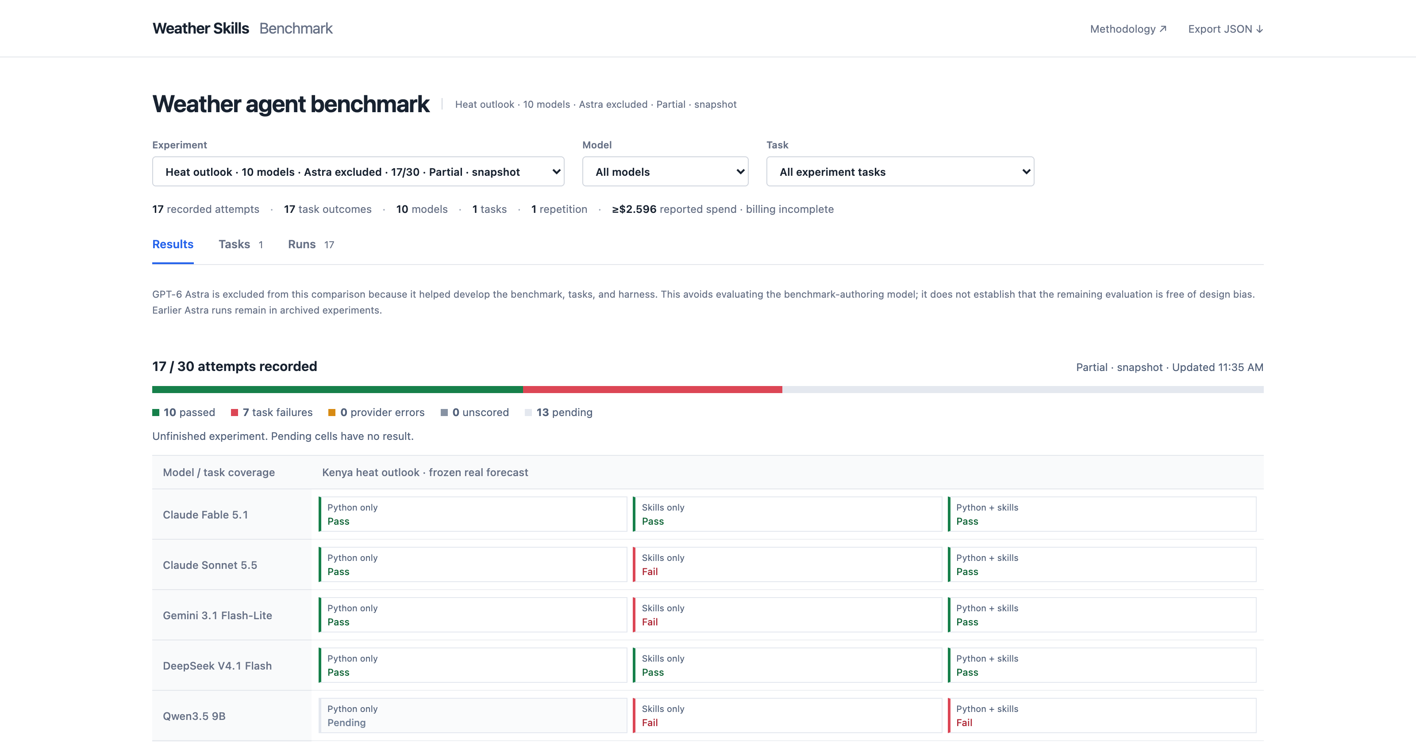
Archived benchmark: interim snapshot
Landing page of the benchmark dashboard. Select a result to inspect its trace. Not a ranking.
Archived Kenya heat benchmark · different task and protocol · 13
Notes:
Historical content imported from the original check-in deck. Different task, conditions, model matrix and execution limits from the seasonal rainfall pilot. Hidden from the slideshow to avoid mixing claims; retained for reference. Its figures are not included in the current comparison.

Slide 14
Archived benchmark: failure modes
Skills bypassed: 0 of 6 Python + skills attempts invoked a skill. The prompt makes skills optional; this condition tests availability, not actual reuse.
Interface friction: wrong action names, XML tool-call wrappers, guide-read requirements, and invalid CLI arguments consumed turns.
Recovery and delivery: Python indexing and unit errors required retries. Sonnet produced a figure but failed the strict artifact-submission contract.
Budget exhaustion: 6 of 7 failures hit the token limit; Qwen's hybrid run hit the time limit. Repeated context and unusable responses contributed.
Initial six-model batch: 18 attempts, 7 failures. One attempt per model and condition.
Archived Kenya heat benchmark · different task and protocol · 14
Notes:
Historical content imported from the original check-in deck. Different task, conditions, model matrix and execution limits from the seasonal rainfall pilot. Hidden from the slideshow to avoid mixing claims; retained for reference. Its figures are not included in the current comparison.

Slide 15
The three arms we actually tested
Scratch
Standard scientific Python; the agent builds the workflow.
Rhiza skills
The same Python environment + Rhiza weather skills catalog and scripts.
ACCORD
The same Python environment + africas2s (DeepScale) and Rosetta/acmadDL, with API documentation.
Identical supplied data and budgets. Every arm can retain its own code, inputs and fitted models.
Observed use: Rhiza catalog context, no script calls; ACCORD agents called africas2s. Data retrieval was not tested.
ACCORD · 1 October 2026 · 15
Notes:
Supersedes the unexecuted libraries-versus-libraries-plus-guides proposal in the original deck. There is no fourth arm or bespoke ACCORD skill-guide experiment. Generic Python is allowed everywhere. The configured Rhiza arm gets the actual catalog and scripts, but these attempts did not read individual SKILL.md files or invoke scripts. The ACCORD arm gets installed packages, package docs and a generic navigation pointer to the persistent ensemble-regression API. All tested data were supplied; Rosetta acquisition and download caching are available but their benefits were not measured here. Model IDs, configurations, artifacts and actual toolkit imports are logged.

Slide 16
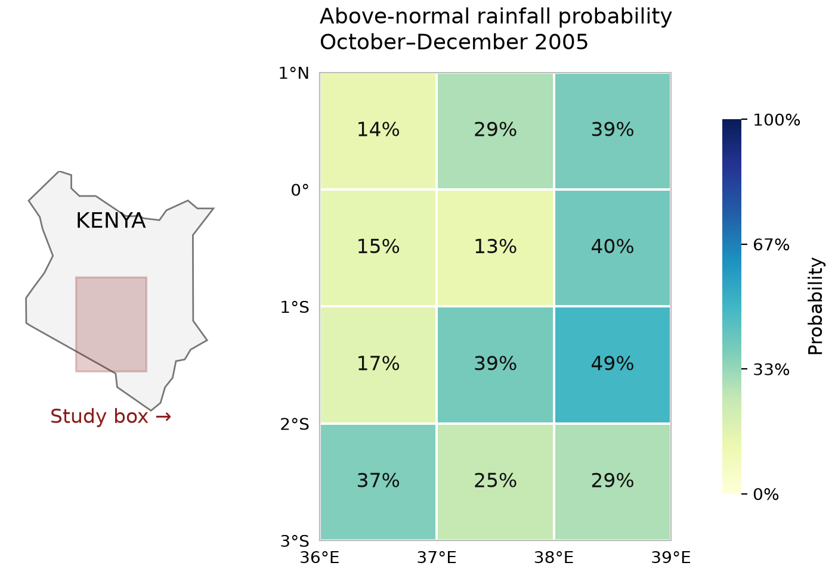
The task: a reusable seasonal rainfall forecast
Same data and budgets; scratch, Rhiza skills, or ACCORD libraries (DeepScale / Rosetta).
Turn September-issued ECMWF forecasts and CHIRPS observations into Oct–Dec rainfall probabilities for a 12-cell Kenyan study box.
Train on 1993–2004; predict 2005–06. Save the code and fitted model, then forecast 2007–08 in a fresh conversation.
Check completion and replay, scientific quality with an LLM judge, forecast error, tokens, time and cost.
Can stronger agents finish? Do tools save effort? Does saved work help next time?
Example: Fable + ACCORD, historical 2005 forecast; 33% is climatology.
ACCORD · 1 October 2026 · 16
Notes:
The Kenya locator places the shaded study box beside its probability grid. Natural Earth generalized boundary, source/hash in slides/assets/kenya-study-area.json. Forecast map source and hash: slides/assets/tercile-example.json. Above-normal rainfall is above the observed 1993–2004 upper-tercile threshold; this is one of three probabilities, not a map of skill. The 12 cells cover south=-3, north=1, west=36, east=39, not a national forecast. Monthly rates are converted to seasonal totals; CHIRPS observations are spatially aggregated with cosine-latitude weights. Leave-one-year-out validation fits both thresholds and calibration within each fold. Forecast-only frozen inference receives no verification observations. Twelve independent artifact, calculation and replay checks plus five LLM-judge criteria; accuracy uses RPS/RMSE separately from completion and cost. These are previously inspected development years, two per batch, so general skill and calibration are not established. Same per-attempt caps: $5.50, 900 seconds, 800k tokens, 60 turns, 16,384 output tokens. Data are supplied; acquisition is not tested.

Slide 17
Model capability and tools
Nine initial attempts: three models × three tool environments, with the same task, data and limits.
Scratch
Rhiza
ACCORD
Model / tools
Checks / 12
Agent API cost ($)
Tokens
Minutes
Haiku / scratch
3/12
$0.92
776,678
4.5
Haiku / Rhiza
7/12
$0.86
748,020
3.8
Haiku / ACCORD
5/12
$0.88
764,137
4.1
Sonnet / scratch
9/12
$0.26
86,410
1.6
Sonnet / Rhiza
12/12
$0.36
132,946
1.6
Sonnet / ACCORD
9/12
$0.55
213,754
2.6
Fable / scratch
12/12
$3.36
260,515
4.9
Fable / Rhiza
11/12
$4.42
360,047
4.9
Fable / ACCORD
12/12
$4.39
365,355
4.1
Sonnet + Rhiza matched Fable scratch’s 12/12 checks at 89% lower API cost. Haiku stayed incomplete in all arms.
One attempt per condition. Cost bars: $0–$5. Haiku 4.5 / Sonnet 5.5 / Fable 5.1. Rhiza supplied catalog context; scripts were not called.
ACCORD · 1 October 2026 · 17
Notes:
Colors are arm-specific on all comparison charts: scratch gray, Rhiza blue, ACCORD red. Rows are grouped Haiku / Sonnet / Fable, always scratch / Rhiza / ACCORD within each group. Haiku + ACCORD and Sonnet + ACCORD are separately authorized extensions with identical task, model settings, pinned sandbox image, tool guidance and inputs. No retries or alternate prompts. All attempts retained. Sonnet scratch missed three units-metadata checks despite correct array values. Fable Rhiza has a read-only replay defect. Rhiza conditions did not call scripts or read individual SKILL.md files. ACCORD agents use the installed scientific API. Checks and exact RPS/RMSE, model versions, prompts, traces, tokens and USD are in report.html and results/revision-summary.json. Sonnet + Rhiza matched Fable scratch’s 12/12 checks with 49% fewer tokens, 67% less elapsed time and 89% lower agent API cost. This does not mean skills improve every model or that libraries universally improve accuracy.

Slide 18
Follow-up task: forecast the next two years
Produce Oct–Dec rainfall probabilities for 2007–08 in the same Kenyan study area (initial: 2005–06).
Fable, fresh conversation: reuse the saved model without refitting; validate the workflow and record repairs.
Agent API cost ($0–$5)
Light: initial · dark: follow-up
Follow-up: tokens / time / checks
$3.36
Scratch
$3.77
334,053 / 3.8 min / 12/12
$4.42
Rhiza
$2.39
213,139 / 2.5 min / 11/12
$4.39
ACCORD
$1.89
165,576 / 2.6 min / 12/12
ACCORD’s follow-up: 50% fewer tokens, 50% lower cost and 31% less time than scratch.
Both passed 12/12 checks. Across both attempts, ACCORD cost 12% less.
RPS ↓: scratch 0.396; Rhiza 0.404; ACCORD 0.412. No accuracy advantage established. No fresh-workspace controls or download savings.
ACCORD · 1 October 2026 · 18
Notes:
Extension task: with the same 12 cells and training data, prepare the saved predictor for the September-issued October–December forecasts for 2007 and 2008, instead of the initial 2005 and 2006. Each Fable arm starts a fresh conversation with its own retained files. No refitting; repairs may be documented. Verification observations remain private. The locator on slide 16 marks the same study box for both phases. Follow-up uses 2007–08, two previously inspected development years. All three Fable arms retained unchanged fitted-state hashes and cached inputs. Direct predictors execute in approximately 1–2 seconds without LLM calls. Bars instead measure conversational follow-up including validation and reporting. ACCORD initial + follow-up cost $6.27595 versus scratch $7.13088. No causal reuse estimate without fresh-workspace controls. Sonnet has initial comparisons only; follow-ups remain Fable only.

Slide 19
How good were the forecasts?
Fable in all three arms, evaluated against CHIRPS observations.
Ranked Probability Score (RPS): error in below / near / above probabilities; lower is better.
Forecast | 2005–06 initial | 2007–08 follow-up
Raw ECMWF | 0.369 | 0.439
Simple model-climatology baseline | 0.296 | 0.353
Fable / scratch | 0.279 | 0.396
Fable / Rhiza | 0.281 | 0.404
Fable / ACCORD | 0.279 | 0.412
All three beat raw ECMWF; initial forecast accuracy is similar across arms.
The simple baseline wins on the follow-up. No ACCORD accuracy advantage established.
Two previously inspected years per batch; general skill and calibration remain unproven. Rhiza’s predictor scored, but workflow replay failed.
ACCORD · 1 October 2026 · 19
Notes:
Source: results/revision-summary.json, metrics.RPS for Fable scratch, Rhiza and ACCORD initial and follow-up attempts. All scores come from frozen predictors evaluated against private-to-agent CHIRPS observations on the same 12 cells. Training years 1993–2004; initial 2005–06; follow-up 2007–08. Raw baseline counts ECMWF members in observed-training terciles. The model-climatology baseline counts members against terciles from the model’s own historical ensemble distribution; it accounts for distribution differences without the agent-fitted regression. Lower RPS is better. Initial RPS: raw 0.368546598, model-climatology 0.295942372, scratch 0.279028737, Rhiza 0.281017925, ACCORD 0.279452220. Follow-up: raw 0.439242635, model-climatology 0.353362053, scratch 0.396182983, Rhiza 0.403827736, ACCORD 0.412328401. Rainfall-amount RMSE, initial/follow-up mm: raw 214.898/80.597, scratch 178.094/70.096, Rhiza 178.485/73.325, ACCORD 175.870/69.915. Those amount-error reductions do not establish an ACCORD advantage over scratch. Only two development years per batch; spatial cells are not independent years, and verification years had previously been inspected by the designer. Reliability diagnostics are descriptive, not evidence of generally calibrated probabilities. Rhiza’s frozen predictor produced scoreable outputs even though solve.py failed the separate full-workflow replay gate. No submissions were repaired, no new forecasts run, and no new model calls were made for this slide. The next scientific evaluation should apply saved predictors to more untouched years and compare against the same baselines.

Slide 20
Toward auto-science
Make each experiment leave behind something the next agent can use.
Research → Hypothesis → Experiment → Evaluate
Keep tested code, data, fitted models, findings and failed attempts.
Use that shared record to choose and run the next experiment.
Today: measure completion, cost and reuse. Next: test whether scientific improvements accumulate.
ACCORD · 1 October 2026 · 20
Notes:
Simplified from /Users/ezekielbarnett/Developer/ACCORD/docs/presentations/toward-auto-science.html and assets/slide-autoscience-loop.svg. The source describes retrieve/reason/experiment workers submitting to a shared evaluator, curating findings, dead ends, wiki pages and writeups, and using that record for the next hypothesis. This slide is the intended research direction; the weather pilot does not yet demonstrate recursive improvement, a shared scientific leaderboard, or community-contributed discoveries. No illustrative skill curve is presented as measured evidence.

