Slide 1
THE RESEARCH QUESTION
Give coding agents a substrate that lasts
The agent does the work in every arm. We test what helps that work accumulate.
Claude from scratch
Claude + Rhiza
Claude + ACCORD
Generic scientific Python and internet access. The agent discovers data and builds its own workflow.
Pinned skills, scripts and documentation. The agent composes an existing procedure into a solution.
Pinned DeepScale and Rosetta. The agent can build on data adapters, scientific methods and fitted models.
Hypothesis: maintained scientific capabilities reduce repeated work and improve results across iterations.
Expected ordering is a hypothesis. Rhiza includes reusable code; all three arms may retain their own work. One follow-up cannot establish recursive improvement or community-scale effects.
1
Notes:
Expected ordering is a hypothesis. Rhiza includes reusable code; all three arms may retain their own work. One follow-up cannot establish recursive improvement or community-scale effects.

Slide 2
A FAIR EXPERIMENT
Change the tools. Hold the opportunity constant.
Same model, task, token/spend limits, compute resources, source permissions and data credentials.
1 Initial attempt
2 Freeze and evaluate
3 Related follow-up
An isolated workspace. Scratch cannot import the other toolkits. Rhiza receives its catalog; ACCORD receives its libraries and documentation.
Save code, outputs and provenance. Check numbers independently, rerun offline, then use one evidence-citing LLM judge.
Fresh conversation, same arm’s saved code, models, data and notes. Measure correctness, cost, time and repairs again.
Controlled access first. Open-web replication is separate and requires an audit of downloaded tools.
Sandbox probes passed in all three environments: approved HTTPS worked; direct egress, unapproved libraries/data and write requests were blocked. Public ECDS access is not proof of authenticated S2S retrieval.
2
Notes:
Sandbox probes passed in all three environments: approved HTTPS worked; direct egress, unapproved libraries/data and write requests were blocked. Public ECDS access is not proof of authenticated S2S retrieval.

Slide 3
THREE CASES, ONE EVALUATION PATTERN
Numerical evidence underneath. A readable scorecard on top.
No weighted leaderboard. A scientifically valid negative result can complete the task.
Case | Independent numerical checks | Scientific measurement
Seasonal rainfall | Aggregation, training separation, coverage, probabilities | RPS skill + rainfall RMSE + reliability
Forecast IOD | Climatology, weighted index, ensemble spread, dates | Error against OISST; too few windows for calibration
Kenya rainfall outlook | Six weekly maps and regional member statistics | Calculation correctness; no observed forecast verification
Judge: data/provenance · scientific processing · results/uncertainty · communication · reproduction/reuse. Each rated 0–2 with evidence.
The judge cannot override failed numerical checks. The main report shows completion, scientific quality, tokens/cost/time, and follow-up performance. Borderline judgments receive human review.
3
Notes:
The judge cannot override failed numerical checks. The main report shows completion, scientific quality, tokens/cost/time, and follow-up performance. Borderline judgments receive human review.

Slide 4
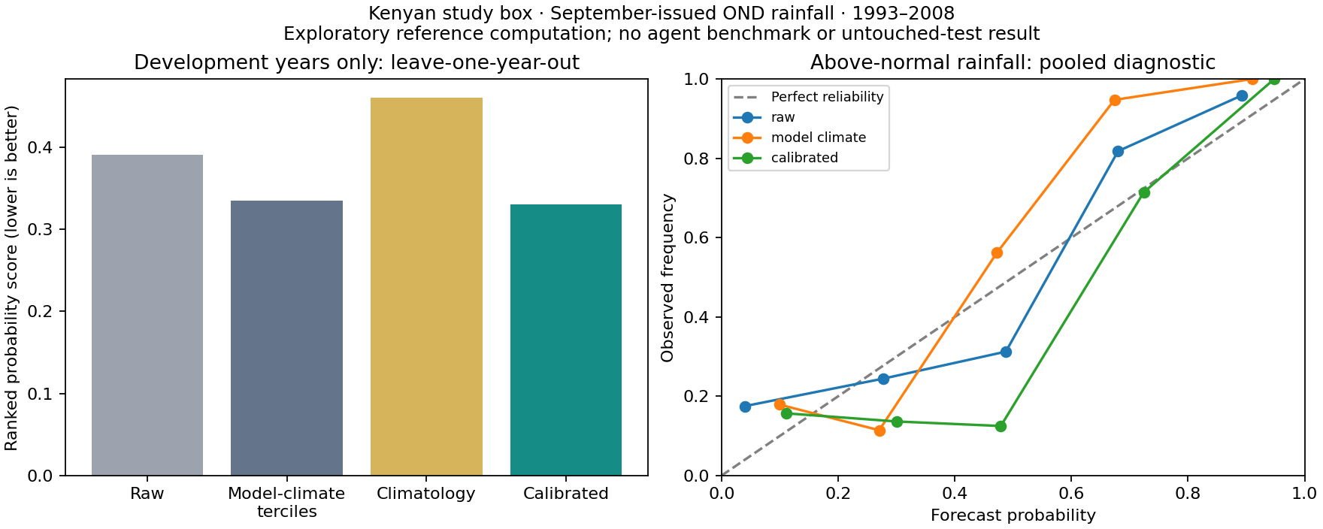
EXISTING FEASIBILITY EVIDENCE — NOT AN ARM COMPARISON
A real seasonal problem, with an honest baseline
September-issued OND rainfall · Kenyan study box · 1993–2008 development years · leave-one-year-out
What the reference calculation shows
RPS: raw 0.391; model-climate 0.335; calibrated 0.330.
15.5% better than raw, but only 1.5% better than model-climate probabilities. Calibration does not uniformly improve.
All three arms can in principle solve this task. The experiment tests how reliably and efficiently they do so.
These are expert-written feasibility calculations, not agent results. Independent Python reproduced the numerics without ACCORD. We have not measured comparative token cost, speed or reuse.
4
Notes:
Exploratory uncertainty intervals include no improvement. Private evaluation years have not been inspected. Source: results/development-scores.json and results/other-arms-feasibility.json.

Slide 5
TODAY’S DELIVERABLE AND REVIEW CHECKPOINT
One illustrative suite: three arms, two attempts each
Prefer the seasonal case to test scientific skill. Kenya is a simpler workflow-efficiency fallback.
Arm | Initial: correctness / cost / time | Follow-up: correctness / cost / time
Scratch | Not run | Not run
Rhiza | Not run | Not run
ACCORD | Not run | Not run
Ready for review: isolated environments, three task contracts, numerical checkers, shared judge rubric and this slide deck.
PAUSED before model calls. Next: choose model and budget; freeze the chosen reference/data policy; resolve case-specific scientific issues; agree to launch one six-attempt suite. The full three-case pilot is 18 attempts per access mode. No fabricated result ordering.
5
Notes:
PAUSED before model calls. Next: choose model and budget; freeze the chosen reference/data policy; resolve case-specific scientific issues; agree to launch one six-attempt suite. The full three-case pilot is 18 attempts per access mode. No fabricated result ordering.

