Slide 1
ACCORD check-in
1 October 2026

Slide 2
Agenda
1. AFRIMET on acmadDL
ACMAD's climate data catalogue moved onto the ACCORD data layer. Catalogue growth, verification, on-demand layers, status.
2. Weather agent benchmark
Do reusable skills help an agent complete a forecasting workflow? Current experiment, interim results, failure modes, next test.
Agenda · 1 Oct 2026 · 2

Slide 3
AFRIMET on acmadDL

Slide 4
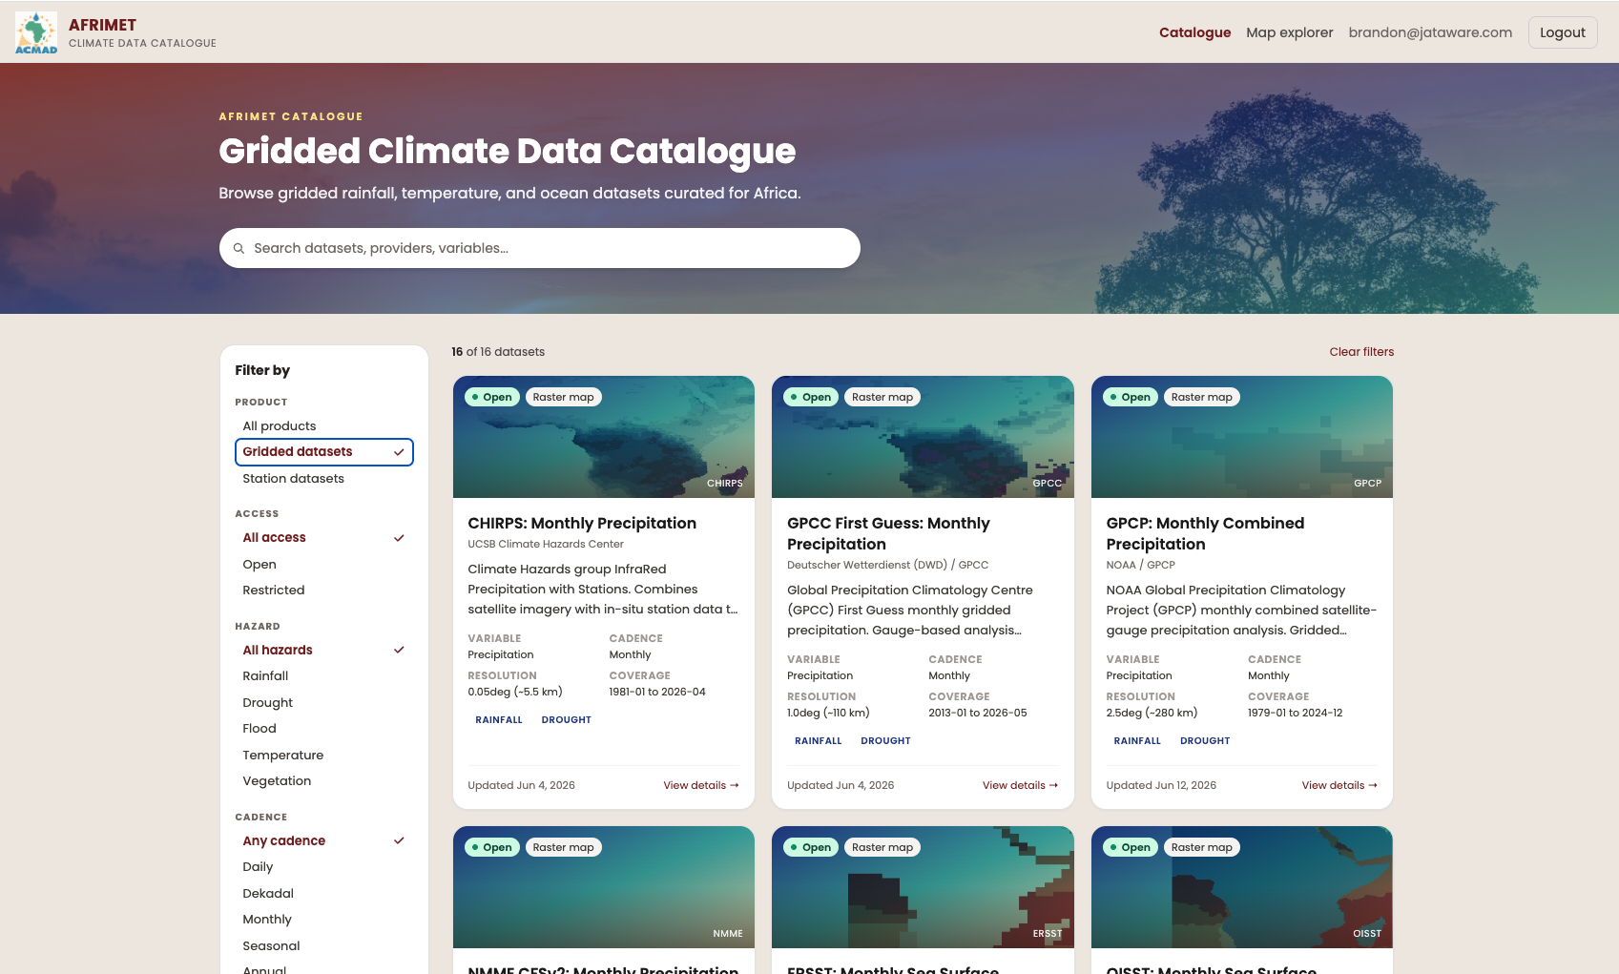
AFRIMET today
ACMAD's climate data catalogue and map explorer.
FastAPI, Celery, GeoServer, TiTiler, PostGIS
19 datasets in the portal
One adapter per source, maintained in afrimet
Download, parse, units, crop: rewritten for each new source
AFRIMET on acmadDL · 1 Oct 2026 · 4
Notes:
ACMAD's own product and team. The issue is the one every tool in this space has: acquisition code is written again inside each application.

Slide 5
acmadDL as the data layer
Sources
acmadDL
afrimet
Users
Copernicus CDS
ECMWF ECDS
IRI / CCSR OPeNDAP
NOAA, UCSB, DWD HTTP
Rhiza Sheerwater
S3 / Icechunk
source → canonical
canonical → published
Portal
Map explorer
GeoTIFF
API
fetch(product, variable, time, region)
URL and filename patterns
variable resolution
unit conversion
fill value → NaN
longitude convention
Africa crop
cache
rate → monthly total
north-up COG per band
GeoServer publish
layer metadata
TiTiler cache
auth, quotas, collections
Also on acmadDL: africas2s, Forecast Hub, acmaddl-mcp, Beaker
afrimet no longer stages raw files. The adapter returns a (time, lat, lon) array in final units.
New dataset: one entry in acmadDL's catalog, one in afrimet's. No adapter code.
acmadDL pinned to a commit. Bumps are re-verified.
AFRIMET on acmadDL · 1 Oct 2026 · 5
Notes:
acmadDL owns remote source to clean xarray. afrimet keeps what is specific to a web catalogue. ACCORD's forecast tools and AFRIMET now share one acquisition layer.

Slide 6
Catalogue: 23 → 53 datasets, 42 served by acmadDL
Migrated | CHIRPS v2 monthly, dekad, pentad · GPCC monitoring, first guess · GPCP · TAMSAT · ERSST · OISST · ERA5-Land t2m, precip, PEV | 12
New: CHIRPS v3 | monthly, monthly prelim, dekad, dekad prelim, dekad TIF, pentad, annual, daily, daily 0.25°, rolling dekad | 10
New: reanalysis, merged obs | ERA5 t2m, precip, SST · CMAP · CAMS-OPI · CHIRPS v2 annual, daily | 6
New: NMME | CFSv2 · CCSM4 · CESM1 · GEOS-S2S · SPEAR · CanSIPS-IC4 | 6
New: C3S | ECMWF SEAS5 · UKMO · Météo-France · DWD · DWD GCFS2.1 · CMCC SPS4 · JMA · ECCC CanSIPSv3 | 8
Unchanged, afrimet adapters | ARC2 · CRU TS · ISD-Lite · CFSv2 CPC hindcast · WIS2 stations · GHA stations · SPI 1, 3, 6, 12 | 11
The 12 migrated datasets produce the same rasters as before. Same layers, same styles, verified.
The 14 forecast systems are the models in ICPAC's and ACMAD's objective forecasts. AFRIMET had none.
acmadDL has 59 products. Each remaining one is a YAML entry away.
AFRIMET on acmadDL · 1 Oct 2026 · 6
Notes:
Counts are catalogue entries on the acmadDL branch of ACMAD-Niamey/afrimet vs develop. Portal shows 19 today because WIS2 and derived SPI are not cards.

Slide 7
Verification and on-demand layers
Verification
On-demand layers
Each migrated dataset published twice: legacy adapter, then acmadDL.
COGs compared cell by cell: CRS, cell centres, nodata mask, values.
Centre tolerance 1% of grid spacing. Not byte equality; row order differs by source.
GPCP, ERSST, OISST now include cells west of 0°. The old clip stopped at the meridian.
scripts/verify_acmaddl.py run, compare
request
month
quota
acmadDL
fetch
COG cache
TiTiler
core collection: scheduled monthly, published to GeoServer.
extended collection: fetched per dataset, year, month on request. Cached, tiled, not archived.
500 MB per user per day. 5 GB global. 20 GB cache with eviction.
Requests are logged. Usage decides what gets promoted to core.
Separate Celery queue. A slow CDS pull does not block the refresh.
AFRIMET on acmadDL · 1 Oct 2026 · 7
Notes:
On-demand is how 59 products get exposed without ACMAD archiving all of them. The log tells ACMAD what to promote.

Slide 8
Status
Where it is
Next
Branch acmadDL on ACMAD-Niamey/afrimet. David Kelly, 9 commits, 8 to 30 Sep.
Not merged. Not deployed. Pending ACMAD review.
Tests cover the adapter, COG comparison, pipeline, on-demand API, cache, quotas.
ACMAD (Collins Asega) landed CI/CD and Docker on develop in parallel.
ACMAD review, merge, deploy: core scheduled, extended on demand.
Forecast systems in Map explorer.
Migrate ARC2, CRU TS, CFSv2 hindcast.
africas2s layers: anomalies, terciles, seasonal aggregates.
Same library under ACMAD's NDJF run and s2s-mcp.
AFRIMET on acmadDL · 1 Oct 2026 · 8
Notes:
No ask. Offer to walk through the branch if they want.

Slide 9
Weather agent benchmark

Slide 10
Questions for the benchmark
Does reusing vetted code improve accuracy or reduce the cost of a complete forecasting workflow?
Our skills teach agents how to use library APIs from Python. weather-skills primarily exposes parameterized commands.
Working hypothesis: agents need Python to recover from data, parameter, and workflow errors.
Compare task success, tokens, cost, and completion time across model sizes. Do not assume skills will win.
Weather agent benchmark · 1 Oct 2026 · 10
Notes:
The audience already knows acmadDL and africaS2S, so library introductions are omitted. Their guides cover API conventions, data shapes, and workflow/statistical discipline; scientific implementations are in the libraries. weather-skills also has documentation, but the current harness exposes its operations through subprocess wrappers. The value of reuse and the need for Python recovery are hypotheses, not established conclusions.
Sources:
User-provided framing
../../accord/acmadDL/skills/acmaddl/SKILL.md
../../accord/africas2s/skills/africas2s/SKILL.md

Slide 11
Earlier experiment: three execution conditions
Python only
Skills only
Python + skills
The agent writes, runs, and revises its own code using standard scientific Python packages.
The agent reads guides and invokes weather-skills operations; custom Python is disabled.
The agent can combine catalog operations with its own Python. Skill use is measured, not assumed.
Ten models, one task, three conditions: 30 planned attempts. The small-model tier includes 1B, 3B, 7B, 8B, and 9B models.
Astra is excluded because it helped develop the benchmark. Earlier runs remain archived.
Weather agent benchmark · 1 Oct 2026 · 11
Notes:
The main comparison is Python only versus Python + skills; Skills only diagnoses the completeness and usability of the command interface. All conditions can receive execution feedback and retry within equal budgets. This is a weather-skills pilot, not yet a direct library evaluation. One repetition per task/model/condition is planned; no broad model ranking follows from it. Llama 1B/3B endpoints lack enforced JSON output; their prompts, parsing, and feedback stay the same while the unsupported response_format field is omitted. The ten models are Claude Fable 5.1, Claude Sonnet 5.5, Gemini 3.1 Flash-Lite, DeepSeek V4.1 Flash, Qwen3.5 9B, Ministral 3B, Llama 3.2 1B/3B, Qwen2.5 7B, and Llama 3.1 8B.
Sources:
configs/refined-heat-panel-v4.json
configs/refined-heat-small-v4.json
METHODOLOGY.md

Slide 12
Earlier task: a two-week Kenya heat outlook
cosine-latitude spatial mean
for each member and day
weekly peak
per member
ensemble median, spread,
minimum, and maximum
Use a real, archived ECMWF S2S forecast to calculate the hottest daily regional-mean temperature in each week.
Pass requires a structured answer matching an independent numeric reference, correct units and source citation, and a valid, nonblank figure.
Every attempt gets the same cached raw data and an empty workspace. Intermediate results stay within that attempt; no outputs or history cross runs.
Equal ceilings: 24 model calls, 40 executions, 200k tokens, 600 seconds.
Download and setup are excluded so solve time measures analysis, not data transfer.
Weather agent benchmark · 1 Oct 2026 · 12
Notes:
Task: e2e-kenya-heat-cached-v3, executed under repaired protocol cached-heat-v4. Source issue 2026-09-27; week 1 lead days 1–7 and week 2 days 8–14. Service rectangle 5N/34E/5S/42E, boundary grid centres included; not a country-polygon average. All ensemble members including control receive equal weight. Sample spread uses ddof=1. The quantity is daily 2 m temperature, not a daily-maximum-temperature variable. Numerical absolute tolerance 1e-4, relative 1e-6; exact schema, units, and source. PNG validity, size, and nonblank pixels are checked; semantic visual correctness still needs review. This measures correct analysis of an issued forecast, not predictive skill against observations. Cached inputs are raw and hash-verified, not precomputed skill outputs. Successful unchanged skill calls may reuse their own artifacts within a run. Cold acquisition performance needs a separate test.
Sources:
cases/e2e-kenya-heat-cached-v3.json
scripts/validate_refined.py
weather_bench/refined.py
weather_bench/execution_cache.py

Slide 13
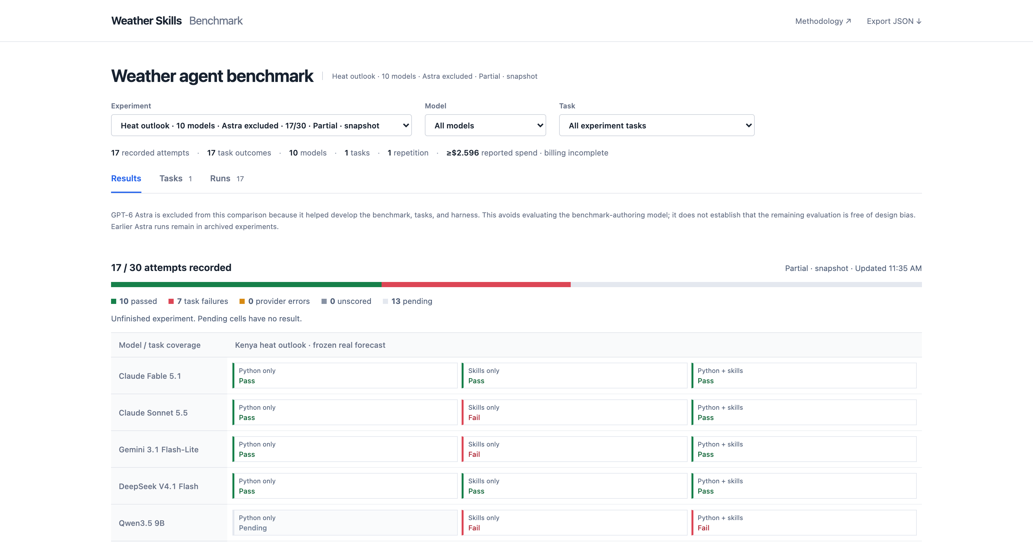
Interim snapshot: 17 of 30 attempts
Landing page of the benchmark dashboard. Select a result to inspect its trace. Not a ranking.
Weather agent benchmark · 1 Oct 2026 · 13
Notes:
Actual unfiltered landing page captured at 2026-09-30T16:35:15.917487+00:00. 17 of 30 attempts recorded. This is a viewport screenshot; the remaining model rows continue below the visible area. The dashboard supports success/time/token/cost charts and drilldowns to code, skill calls, model responses, errors, and grading. Provider errors are separated from task failures. The screenshot is an interface illustration, not a ranking.
Sources:
docs/index.html
presentations/assets/landing-provenance.json

Slide 14
Observed failure modes
Skills bypassed: 0 of 6 Python + skills attempts invoked a skill. The prompt makes skills optional; this condition tests availability, not actual reuse.
Interface friction: wrong action names, XML tool-call wrappers, guide-read requirements, and invalid CLI arguments consumed turns.
Recovery and delivery: Python indexing and unit errors required retries. Sonnet produced a figure but failed the strict artifact-submission contract.
Budget exhaustion: 6 of 7 failures hit the token limit; Qwen's hybrid run hit the time limit. Repeated context and unusable responses contributed.
Initial six-model batch: 18 attempts, 7 failures. One attempt per model and condition.
Weather agent benchmark · 1 Oct 2026 · 14
Notes:
Evidence is frozen to the completed initial six-model batch, not the still-expanding ten-model panel. All six hybrid attempts used Python and no skill invocations; only Ministral read one guide. Four hybrid attempts passed. The prompt begins with the Python agent instructions, presents skills as additional optional actions, and explicitly permits Python custom calculations. This supports an adoption/design diagnosis; it does not reveal a model's internal motivation or establish a causal effect from prompt length. Skills-only Sonnet had 12 successful skill calls and a valid figure but rejected XML-like action wrappers and a literal [7,14] array under the artifact-only numeric submission rule. Its intermediate scientific correctness was not independently established here. Qwen strict-skills had nine protocol errors, including two empty responses ending at the output limit; its clipping and conversion worked. Gemini and Ministral strict-skills also encountered CLI arguments and dimension/precondition mismatches. Qwen hybrid summed six longitude cells without averaging, then timed out. Six failed attempts ended at the cumulative token ceiling, one at the shared task deadline. The follow-up should separately test a skill-discovery/preference policy with Python recovery, fix action transport and submission friction, and repeat paired runs. Existing records and scores remain unchanged.
Sources:
results/initial-panel-failure-modes.json
results/qwen35-heat-failure-analysis.json
weather_bench/runner.py: BASE_PROMPT and SKILL_PROMPT

Slide 15
Earlier proposal: test the libraries and their skill guides directly
Baseline
Libraries
Libraries + skills
General scientific Python; the agent implements the workflow itself.
The same Python environment plus acmadDL and africaS2S, with ordinary API documentation.
The same libraries plus agent guides and progressively disclosed workflow references.
Keep Python available in every condition. Use seasonal tasks covering data acquisition, downscaling, held-out verification, and forecast delivery.
Predeclare tasks and scoring; freeze versions and seeds; repeat across regions, methods, and models.
Weather agent benchmark · 1 Oct 2026 · 15
Notes:
This proposed library ablation has not been run in the current benchmark. Comparing baseline with libraries estimates reusable-code value; comparing libraries with libraries plus skills estimates additional guidance value. All arms retain Python and recovery. No condition should be deprived of basic API usability; ordinary documentation is the middle-arm control. Seasonal tasks should avoid training/verification leakage, use fixed or appropriately nested method selection, common valid masks, and independent references or cross-implementation checks. Agent correctness and meteorological predictive skill are different: held-out forecast verification may use RPSS, reliability, RMSE, or other predeclared metrics. Separate cold acquisition/setup from warm-data solve time. Use repeated tasks and model sampling before drawing claims about generalization.
Sources:
User-provided objective
../../accord/acmadDL/skills/acmaddl/SKILL.md
../../accord/africas2s/skills/africas2s/SKILL.md
STATISTICS.md

Slide 16
Can a coding agent build a seasonal forecast workflow?
September-issued OND rainfall in a Kenyan study box.
Aggregate monthly inputs, fit a calibration, save the fitted model, and produce a new forecast.
Scratch model | Checks passed | Tokens | Cost | Time
Fable 5.1 | 0/12 | 236,218 | $4.38 | 9.6 min
Haiku 4.5 | 6/12 | 473,419 | $0.60 | 4.3 min
Neither scratch model completed its initial attempt. Fable later reached 11/12 checks using saved work; this pilot does not establish a model capability threshold.
Same inputs and attempt limits. One attempt per condition: an illustration, not a general model ranking.
Monthly data was supplied; live data discovery and retrieval were not tested.
ACCORD weather pilot · development smoke · 1 Oct 2026 · 16
Notes:
Source: results/smoke-summary.json and runs/smoke-v3. Models and all raw traces are recorded. Do not infer a universal capability threshold from one small case.

Slide 17
Do skills and domain libraries reduce the work?
Same Fable 5.1 model, task, normalized inputs, resources and limits. Only the available domain tools differ.
Arm | Checks | Tokens | Cost | Time | Test RPS
Python only | 0/12 | 236,218 | $4.38 | 9.6 min | —
Python + Rhiza | 11/12 | 327,196 | $4.28 | 5.7 min | 0.278
Python + ACCORD | 0/12 | 341,771 | $4.51 | 6.0 min | —
Rhiza reached 11/12 checks on the first attempt. ACCORD inspected the libraries but wrote its own calibration and did not complete. No library advantage established.
RPS is lower-is-better; two previously inspected development years, not untouched scientific validation.
Numerical checks, offline replay and an evidence-citing LLM judge assess the outputs.
ACCORD weather pilot · development smoke · 1 Oct 2026 · 17
Notes:
No weighted leaderboard. Initial infrastructure-aborted attempts are excluded and preserved separately. Agent cost excludes judge/setup cost. Check count includes artifacts, provenance, data aggregation, valid probabilities and reproduction.

Slide 18
What survives into the next forecast?
Fresh conversation, same arm’s saved code, fitted model, data and handoff notes. Apply to a different forecast batch.
Arm | Saved state | Follow-up checks | Initial → follow-up cost | Follow-up time
Python only | code only | 11/12 | $4.38 → $3.65 | 5.7 min
Python + Rhiza | model.nc | 11/12 | $4.28 → $4.20 | 3.4 min
Python + ACCORD | code only | 1/12 | $4.51 → $4.00+ | 10.0 min
Rhiza’s frozen predictor ran the next batch in 1.5 s with zero LLM tokens. Conversational cost barely fell ($4.28 → $4.20); scratch recovered, ACCORD stayed incomplete.
All saved code, models, notes, figures and usage are retained. + marks unrecorded usage from a timed-out request.
No fresh-workspace controls; recovery from an incomplete initial attempt is not reuse of a working forecast.
ACCORD weather pilot · development smoke · 1 Oct 2026 · 18
Notes:
Saved state refers to the initial attempt. A follow-up after an incomplete initial attempt measures recovery, not reuse of a working forecast. Direct saved-predictor timing is in results/direct-reuse-timing.json and includes container startup/cleanup. It is distinct from conversational follow-up cost. Do not imply that only ACCORD can save code or that two verification years establish probabilistic calibration.

