Slide 1
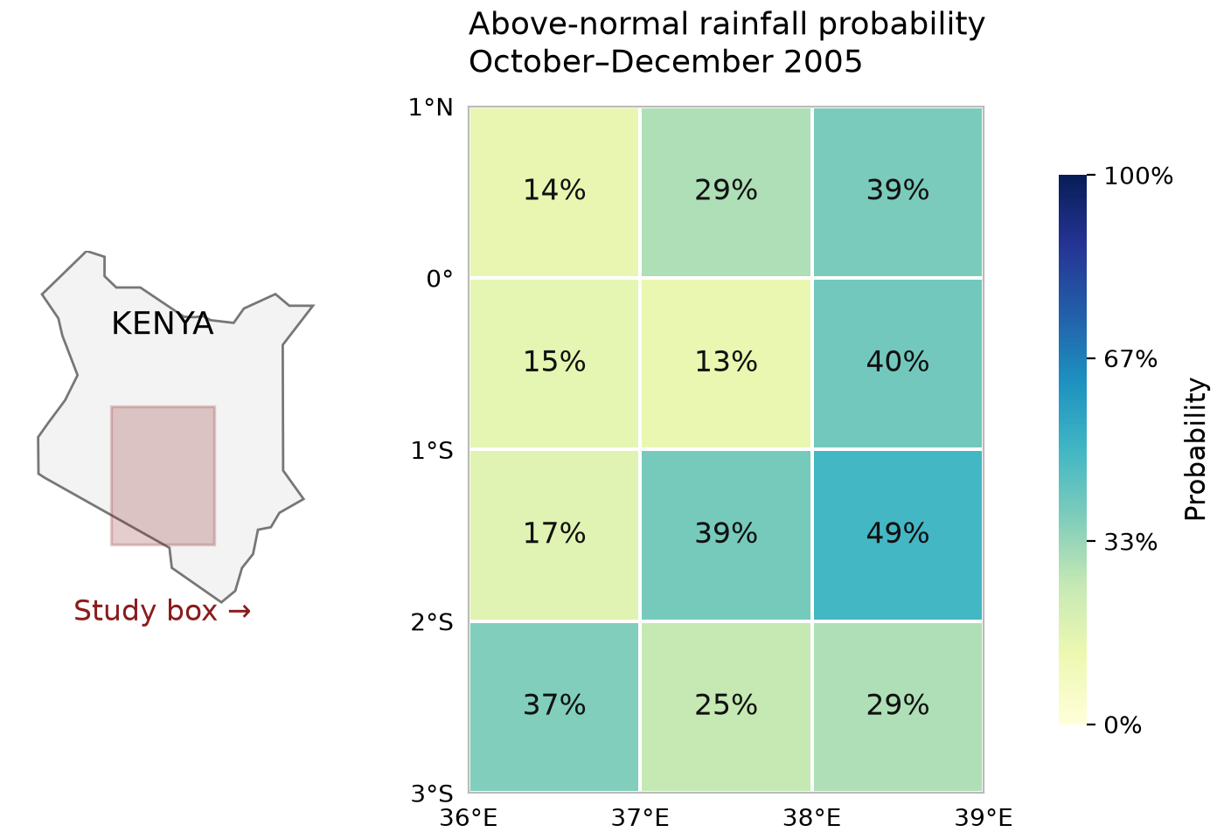
The task: a reusable seasonal rainfall forecast
Same data and budgets; scratch, Rhiza skills, or ACCORD libraries (DeepScale / Rosetta).
Turn September-issued ECMWF forecasts and CHIRPS observations into Oct–Dec rainfall probabilities for a 12-cell Kenyan study box.
Train on 1993–2004; predict 2005–06. Save the code and fitted model, then forecast 2007–08 in a fresh conversation.
Check completion and replay, scientific quality with an LLM judge, forecast error, tokens, time and cost.
Can stronger agents finish? Do tools save effort? Does saved work help next time?
Example: Fable + ACCORD, historical 2005 forecast; 33% is climatology.
ACCORD · 1 October 2026 · 16
Notes:
The Kenya locator places the shaded study box beside its probability grid. Natural Earth generalized boundary, source/hash in slides/assets/kenya-study-area.json. Forecast map source and hash: slides/assets/tercile-example.json. Above-normal rainfall is above the observed 1993–2004 upper-tercile threshold; this is one of three probabilities, not a map of skill. The 12 cells cover south=-3, north=1, west=36, east=39, not a national forecast. Monthly rates are converted to seasonal totals; CHIRPS observations are spatially aggregated with cosine-latitude weights. Leave-one-year-out validation fits both thresholds and calibration within each fold. Forecast-only frozen inference receives no verification observations. Twelve independent artifact, calculation and replay checks plus five LLM-judge criteria; accuracy uses RPS/RMSE separately from completion and cost. These are previously inspected development years, two per batch, so general skill and calibration are not established. Same per-attempt caps: $5.50, 900 seconds, 800k tokens, 60 turns, 16,384 output tokens. Data are supplied; acquisition is not tested.

Slide 2
Model capability and tools
Nine initial attempts: three models × three tool environments, with the same task, data and limits.
Scratch
Rhiza
ACCORD
Model / tools | Checks | Tokens | Minutes | API cost | RPS ↓
Haiku / scratch | 3/12 | 776,678 | 4.54 | $0.92 | —
Haiku / Rhiza | 7/12 | 748,020 | 3.76 | $0.86 | —
Haiku / ACCORD | 5/12 | 764,137 | 4.09 | $0.88 | —
Sonnet / scratch | 9/12 | 86,410 | 1.56 | $0.26 | —
Sonnet / Rhiza | 12/12 | 132,946 | 1.64 | $0.36 | 0.279
Sonnet / ACCORD | 9/12 | 213,754 | 2.57 | $0.55 | —
Fable / scratch | 12/12 | 260,515 | 4.92 | $3.36 | 0.279
Fable / Rhiza | 11/12 | 360,047 | 4.88 | $4.42 | 0.281
Fable / ACCORD | 12/12 | 365,355 | 4.10 | $4.39 | 0.279
Sonnet + Rhiza matched Fable scratch’s 12/12 checks at 89% lower API cost. Haiku stayed incomplete in all arms.
One attempt per condition. Cost bars: $0–$5. Haiku 4.5 / Sonnet 5.5 / Fable 5.1. Rhiza supplied catalog context; scripts were not called.
ACCORD · 1 October 2026 · 17
Notes:
Colors are arm-specific on all comparison charts: scratch gray, Rhiza blue, ACCORD red. Rows are grouped Haiku / Sonnet / Fable, always scratch / Rhiza / ACCORD within each group. Haiku + ACCORD and Sonnet + ACCORD are separately authorized extensions with identical task, model settings, pinned sandbox image, tool guidance and inputs. No retries or alternate prompts. All attempts retained. Sonnet scratch missed three units-metadata checks despite correct array values. Fable Rhiza has a read-only replay defect. Rhiza conditions did not call scripts or read individual SKILL.md files. ACCORD agents use the installed scientific API. Checks and exact RPS/RMSE, model versions, prompts, traces, tokens and USD are in report.html and results/revision-summary.json. Sonnet + Rhiza matched Fable scratch’s 12/12 checks with 49% fewer tokens, 67% less elapsed time and 89% lower agent API cost. This does not mean skills improve every model or that libraries universally improve accuracy.

Slide 3
Follow-up task: forecast the next two years
Produce Oct–Dec rainfall probabilities for 2007–08 in the same Kenyan study area (initial: 2005–06).
Fable, fresh conversation: reuse the saved model without refitting; validate the workflow and record repairs.
Fable arm | Initial → follow-up $ | Follow-up tokens | Minutes | Checks
Scratch | $3.36 → $3.77 | 334,053 | 3.76 | 12/12
Rhiza | $4.42 → $2.39 | 213,139 | 2.52 | 11/12
ACCORD | $4.39 → $1.89 | 165,576 | 2.59 | 12/12
ACCORD’s follow-up: 50% fewer tokens, 50% lower cost and 31% less time than scratch.
Both passed 12/12 checks. Across both attempts, ACCORD cost 12% less.
RPS ↓: scratch 0.396; Rhiza 0.404; ACCORD 0.412. No accuracy advantage established. No fresh-workspace controls or download savings.
ACCORD · 1 October 2026 · 18
Notes:
Extension task: with the same 12 cells and training data, prepare the saved predictor for the September-issued October–December forecasts for 2007 and 2008, instead of the initial 2005 and 2006. Each Fable arm starts a fresh conversation with its own retained files. No refitting; repairs may be documented. Verification observations remain private. The locator on slide 16 marks the same study box for both phases. Follow-up uses 2007–08, two previously inspected development years. All three Fable arms retained unchanged fitted-state hashes and cached inputs. Direct predictors execute in approximately 1–2 seconds without LLM calls. Bars instead measure conversational follow-up including validation and reporting. ACCORD initial + follow-up cost $6.27595 versus scratch $7.13088. No causal reuse estimate without fresh-workspace controls. Sonnet has initial comparisons only; follow-ups remain Fable only.

Slide 4
How good were the forecasts?
Fable in all three arms, evaluated against CHIRPS observations.
Ranked Probability Score (RPS): error in below / near / above probabilities; lower is better.
Forecast | 2005–06 initial | 2007–08 follow-up
Raw ECMWF | 0.369 | 0.439
Simple model-climatology baseline | 0.296 | 0.353
Fable / scratch | 0.279 | 0.396
Fable / Rhiza | 0.281 | 0.404
Fable / ACCORD | 0.279 | 0.412
All three beat raw ECMWF; initial forecast accuracy is similar across arms.
The simple baseline wins on the follow-up. No ACCORD accuracy advantage established.
Two previously inspected years per batch; general skill and calibration remain unproven. Rhiza’s predictor scored, but workflow replay failed.
ACCORD · 1 October 2026 · 19
Notes:
Source: results/revision-summary.json, metrics.RPS for Fable scratch, Rhiza and ACCORD initial and follow-up attempts. All scores come from frozen predictors evaluated against private-to-agent CHIRPS observations on the same 12 cells. Training years 1993–2004; initial 2005–06; follow-up 2007–08. Raw baseline counts ECMWF members in observed-training terciles. The model-climatology baseline counts members against terciles from the model’s own historical ensemble distribution; it accounts for distribution differences without the agent-fitted regression. Lower RPS is better. Initial RPS: raw 0.368546598, model-climatology 0.295942372, scratch 0.279028737, Rhiza 0.281017925, ACCORD 0.279452220. Follow-up: raw 0.439242635, model-climatology 0.353362053, scratch 0.396182983, Rhiza 0.403827736, ACCORD 0.412328401. Rainfall-amount RMSE, initial/follow-up mm: raw 214.898/80.597, scratch 178.094/70.096, Rhiza 178.485/73.325, ACCORD 175.870/69.915. Those amount-error reductions do not establish an ACCORD advantage over scratch. Only two development years per batch; spatial cells are not independent years, and verification years had previously been inspected by the designer. Reliability diagnostics are descriptive, not evidence of generally calibrated probabilities. Rhiza’s frozen predictor produced scoreable outputs even though solve.py failed the separate full-workflow replay gate. No submissions were repaired, no new forecasts run, and no new model calls were made for this slide. The next scientific evaluation should apply saved predictors to more untouched years and compare against the same baselines.

Slide 5
Toward auto-science
Make each experiment leave behind something the next agent can use.
Research → Hypothesis → Experiment → Evaluate
Keep tested code, data, fitted models, findings and failed attempts.
Use that shared record to choose and run the next experiment.
Today: measure completion, cost and reuse. Next: test whether scientific improvements accumulate.
ACCORD · 1 October 2026 · 20
Notes:
Simplified from /Users/ezekielbarnett/Developer/ACCORD/docs/presentations/toward-auto-science.html and assets/slide-autoscience-loop.svg. The source describes retrieve/reason/experiment workers submitting to a shared evaluator, curating findings, dead ends, wiki pages and writeups, and using that record for the next hypothesis. This slide is the intended research direction; the weather pilot does not yet demonstrate recursive improvement, a shared scientific leaderboard, or community-contributed discoveries. No illustrative skill curve is presented as measured evidence.

