Slide 1
Questions for the benchmark
Does reusing vetted code improve accuracy or reduce the cost of a complete forecasting workflow?
Our skills teach agents how to use library APIs from Python. weather-skills primarily exposes parameterized commands.
Working hypothesis: agents need Python to recover from data, parameter, and workflow errors.
Compare task success, tokens, cost, and completion time across model sizes. Do not assume skills will win.
1
Notes:
The audience already knows acmadDL and africaS2S, so library introductions are omitted. Their guides cover API conventions, data shapes, and workflow/statistical discipline; scientific implementations are in the libraries. weather-skills also has documentation, but the current harness exposes its operations through subprocess wrappers. The value of reuse and the need for Python recovery are hypotheses, not established conclusions.
Sources:
User-provided framing
../../accord/acmadDL/skills/acmaddl/SKILL.md
../../accord/africas2s/skills/africas2s/SKILL.md

Slide 2
Current experiment: three execution conditions
Python only: the agent writes, runs, and revises its own code using standard scientific Python packages.
Skills only: the agent reads guides and invokes weather-skills operations; custom Python is disabled.
Python + skills: the agent can combine catalog operations with its own Python. Skill use is measured, not assumed.
Ten models, one task, three conditions: 30 planned attempts. The small-model tier includes 1B, 3B, 7B, 8B, and 9B models.
Astra is excluded because it helped develop the benchmark. Earlier runs remain archived.
2
Notes:
The main comparison is Python only versus Python + skills; Skills only diagnoses the completeness and usability of the command interface. All conditions can receive execution feedback and retry within equal budgets. This is a weather-skills pilot, not yet a direct library evaluation. One repetition per task/model/condition is planned; no broad model ranking follows from it. Llama 1B/3B endpoints lack enforced JSON output; their prompts, parsing, and feedback stay the same while the unsupported response_format field is omitted. The ten models are Claude Fable 5.1, Claude Sonnet 5.5, Gemini 3.1 Flash-Lite, DeepSeek V4.1 Flash, Qwen3.5 9B, Ministral 3B, Llama 3.2 1B/3B, Qwen2.5 7B, and Llama 3.1 8B.
Sources:
configs/refined-heat-panel-v4.json
configs/refined-heat-small-v4.json
METHODOLOGY.md

Slide 3
Current task: a two-week Kenya heat outlook
Use a real, archived ECMWF S2S forecast to calculate the hottest daily regional-mean temperature in each week.
Required order: cosine-latitude spatial mean for each member/day → weekly peak per member → ensemble median, spread, minimum, and maximum.
Pass requires a structured answer matching an independent numeric reference, correct units and source citation, and a valid, nonblank figure.
Every attempt gets the same cached raw data and an empty workspace. Intermediate results stay within that attempt; no outputs or history cross runs.
Equal ceilings: 24 model calls, 40 executions, 200k tokens, 600 seconds.
Download and setup are excluded so solve time measures analysis, not data transfer.
3
Notes:
Task: e2e-kenya-heat-cached-v3, executed under repaired protocol cached-heat-v4. Source issue 2026-09-27; week 1 lead days 1–7 and week 2 days 8–14. Service rectangle 5N/34E/5S/42E, boundary grid centres included; not a country-polygon average. All ensemble members including control receive equal weight. Sample spread uses ddof=1. The quantity is daily 2 m temperature, not a daily-maximum-temperature variable. Numerical absolute tolerance 1e-4, relative 1e-6; exact schema, units, and source. PNG validity, size, and nonblank pixels are checked; semantic visual correctness still needs review. This measures correct analysis of an issued forecast, not predictive skill against observations. Cached inputs are raw and hash-verified, not precomputed skill outputs. Successful unchanged skill calls may reuse their own artifacts within a run. Cold acquisition performance needs a separate test.
Sources:
cases/e2e-kenya-heat-cached-v3.json
scripts/validate_refined.py
weather_bench/refined.py
weather_bench/execution_cache.py

Slide 4
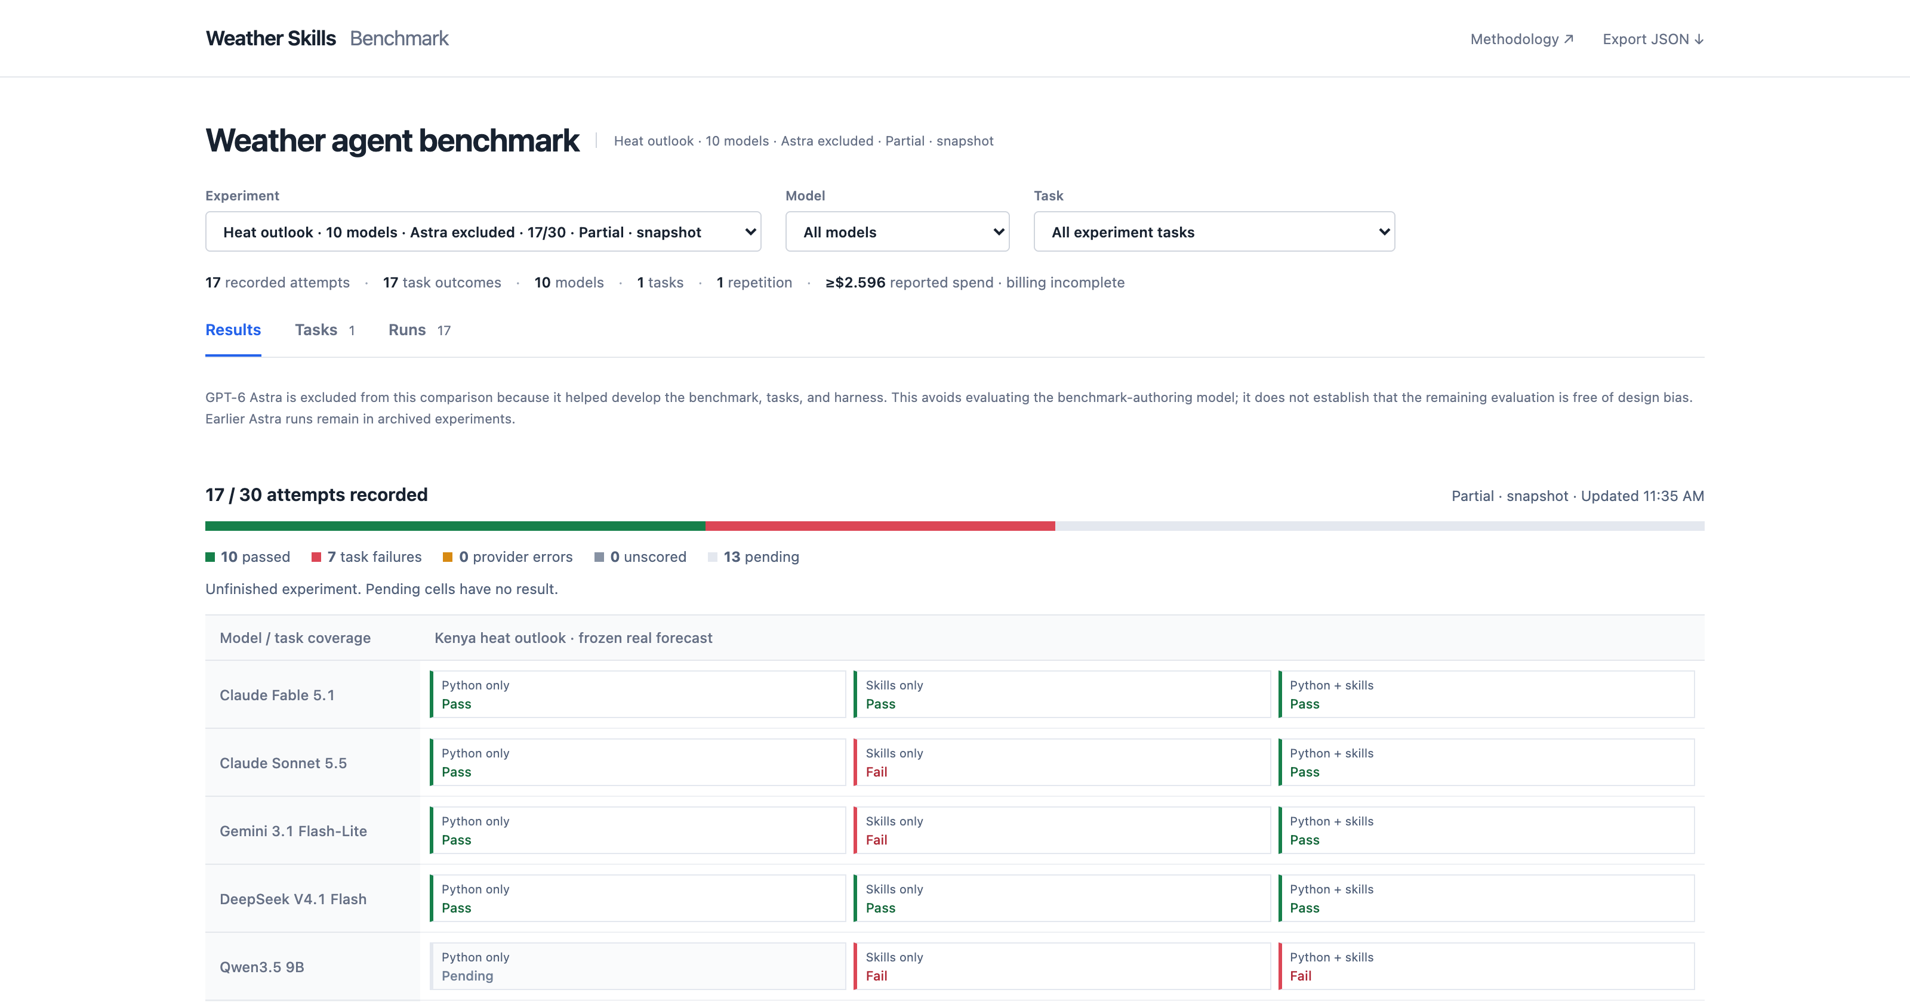
Interim snapshot: 17/30 attempts. Select a result to inspect its trace.
Notes:
Actual unfiltered landing page captured at 2026-09-30T16:35:15.917487+00:00. 17 of 30 attempts recorded. This is a viewport screenshot; the remaining model rows continue below the visible area. The dashboard supports success/time/token/cost charts and drilldowns to code, skill calls, model responses, errors, and grading. Provider errors are separated from task failures. The screenshot is an interface illustration, not a ranking.
Sources:
docs/index.html
presentations/assets/landing-provenance.json

Slide 5
Next: test the libraries and their skill guides directly
Baseline: general scientific Python; the agent implements the workflow itself.
Libraries: the same Python environment plus acmadDL and africaS2S, with ordinary API documentation.
Libraries + skills: the same libraries plus agent guides and progressively disclosed workflow references.
Keep Python available in every condition. Use seasonal tasks covering data acquisition, downscaling, held-out verification, and forecast delivery.
Predeclare tasks and scoring; freeze versions and seeds; repeat across regions, methods, and models.
5
Notes:
This proposed library ablation has not been run in the current benchmark. Comparing baseline with libraries estimates reusable-code value; comparing libraries with libraries plus skills estimates additional guidance value. All arms retain Python and recovery. No condition should be deprived of basic API usability; ordinary documentation is the middle-arm control. Seasonal tasks should avoid training/verification leakage, use fixed or appropriately nested method selection, common valid masks, and independent references or cross-implementation checks. Agent correctness and meteorological predictive skill are different: held-out forecast verification may use RPSS, reliability, RMSE, or other predeclared metrics. Separate cold acquisition/setup from warm-data solve time. Use repeated tasks and model sampling before drawing claims about generalization.
Sources:
User-provided objective
../../accord/acmadDL/skills/acmaddl/SKILL.md
../../accord/africas2s/skills/africas2s/SKILL.md
STATISTICS.md

