Slide 1
WEATHER AGENT BENCHMARK
Benchmarking agents for weather forecasting
Which combination of model, libraries, and agent guidance delivers correct forecasts with the least time, tokens, and cost?
acmadDL
africaS2S
Forecast products
Fetch and normalize weather / climate data.
Return consistent xarray datasets.
Downscale, calibrate, combine, and verify seasonal forecasts.
Fields, probabilities, verification, and briefing figures.
Methods include logistic regression, canonical correlation analysis, quantile mapping, and BCSD.
The benchmark tests the value of reuse against an agent implementing the workflow in Python.
Weather Skills Benchmark / Research design and current pilot
01
Notes:
The aim is an empirical comparison, not a presumption that reusable code always wins. BCSD means bias correction and spatial disaggregation. The user-facing library names are retained here; local documentation also uses Rosetta/deepscale aliases. The current pilot is not yet a direct test of acmadDL or africaS2S.
Sources / audit trail:
User-provided project context
../../accord/acmadDL/skills/acmaddl/SKILL.md
../../accord/africas2s/skills/africas2s/SKILL.md

Slide 2
WEATHER AGENT BENCHMARK
Skills can expose commands or teach library APIs
Both approaches reuse scientific code. They differ in how the agent composes and repairs the workflow.
Command-oriented
weather-skills
Agent
Skill wrapper
Vetted code
Select skill and args
Run a subprocess
Write an artifact
Library-oriented
acmadDL / africaS2S
Skill guide
Python code
Vetted libraries
API rules and
relevant references
Compose library calls;
handle errors
Execute scientific
methods
Hypothesis: progressive disclosure plus Python supports recovery from data, API, and workflow failures.
Weather Skills Benchmark / Research design and current pilot
02
Notes:
The library skills are readme-like guides with deeper references loaded when needed. They teach units, dimensions, API use, and statistical discipline. Numerical implementations are maintained in the libraries; generated Python handles composition and exceptions. weather-skills also has guides: this is a distinction in the execution interface, not a claim that its guidance is absent. The hypothesis that general code execution improves recovery remains to be evaluated quantitatively.
Sources / audit trail:
weather-skills-catalog skill scripts and guides
../../accord/acmadDL/skills/acmaddl/SKILL.md
../../accord/africas2s/skills/africas2s/SKILL.md

Slide 3
WEATHER AGENT BENCHMARK
The current pilot compares three execution conditions
Condition | Write Python | Use weather-skills | Question
Python only | Yes | No | Can the agent implement the task?
Skills only | No | Required | Can catalog operations complete it?
Python + skills | Yes | Available | Does reuse help when code is allowed?
Main comparison: Python only versus Python + skills. Skills only is a diagnostic condition.
10 models × 3 conditions × 1 task × 1 repetition = 30 planned attempts.
The panel spans frontier models and open-weight models from 1B to 9B.
Astra is excluded because it helped develop the benchmark. Earlier runs remain archived.
Weather Skills Benchmark / Research design and current pilot
03
Notes:
Current models: Claude Fable 5.1, Claude Sonnet 5.5, Gemini 3.1 Flash-Lite, DeepSeek V4.1 Flash, Qwen3.5 9B, Ministral 3B, Llama 3.2 1B, Llama 3.2 3B, Qwen2.5 7B, Llama 3.1 8B. DeepSeek is a large open-weight model; the 1B–9B statement describes the smaller tier, not every open model. All arms receive execution feedback and may retry. No one-shot baseline is included. Skills are available, not mandatory, in Python + skills; invocation is measured. Llama 1B/3B endpoints lack API-enforced JSON mode but receive the same action instructions and parsing. Astra exclusion reduces an authoring conflict; it does not eliminate all design bias. Current comparisons concern weather-skills, not the two project libraries.
Sources / audit trail:
configs/refined-heat-panel-v4.json
configs/refined-heat-small-v4.json
METHODOLOGY.md

Slide 4
WEATHER AGENT BENCHMARK
Current task: a two-week heat outlook for Kenya
Use a frozen ECMWF S2S forecast to summarize the hottest daily regional-mean 2 m temperature in each week, including ensemble uncertainty.
1 Select
2 Spatial mean
3 Weekly peak
4 Ensemble
Service rectangle
5°N–5°S, 34°E–42°E
Cosine-latitude weights
Per member and day
Days 1–7 and 8–14
For each member
Median, sample SD,
minimum, maximum
Required order: spatial mean → weekly peak per member → ensemble statistics.
Deliverables
Structured answer, source citation, and a labeled uncertainty figure.
Deterministic checks
Independent numeric reference; exact schema and units; valid, nonblank PNG.
Forecast issue: 2026-09-27. This tests analysis of an issued forecast, not its predictive skill against observations.
Weather Skills Benchmark / Research design and current pilot
04
Notes:
The task uses real, unmodified archived forecast bytes, not synthetic weather observations. Week 1 covers September 28–October 4; week 2 October 5–11. The service rectangle is not a Kenya polygon. All perturbed members and the control receive equal member weights. The quantity is daily 2 m temperature, not a daily-maximum-temperature variable. Numerical tolerance is abs=1e-4, rel=1e-6, with exact schema, dates/lead values, units, and source citation. The oracle uses an independent Python calculation; actual catalog workflows are also validated. A valid nonblank PNG is required, but chart semantics and aesthetics are not fully automatically graded. Workflow conformance is separate from answer correctness.
Sources / audit trail:
cases/e2e-kenya-heat-cached-v3.json
scripts/validate_refined.py
results/refined-reference-v4.json
https://storage.googleapis.com/kenya-forecasting-data/2026-09-27/data/ECMWF_s2s_daily_vars_2026-09-27.zarr

Slide 5
WEATHER AGENT BENCHMARK
Cache the inputs; keep each attempt independent
Raw forecast archive
Python only
Fresh conversation + empty workspace
Real raw forecast bytes
Verified by content hashes
Mounted read-only
Skills only
Fresh conversation + empty workspace
Python + skills
Fresh conversation + empty workspace
Within a run
Reuse unchanged successful skill outputs; retain Python artifacts.
Between runs
Share raw inputs only. No generated outputs, intermediate results, or history.
Equal ceilings: 24 model calls · 40 executions · 200k tokens · 600 seconds
Weather Skills Benchmark / Research design and current pilot
05
Notes:
This is a warm-data benchmark. Download and environment setup are excluded from solve time; this improves repeatability and removes network transfer as a confound. The experiment does not measure live acquisition reliability or cold-start latency. Every run remains isolated. The raw cache does not contain transformed answers. Successful identical skill calls reuse artifacts only within the same run and only if inputs and outputs remain unchanged; cache hits are traced. Python agents can keep their own intermediate files. The repaired v4 catalog pins additional temperature/rolling/median fixes. Task IDs retain v3 naming, but protocol_version is cached-heat-v4. A full live-acquisition benchmark is a separate next-stage measurement.
Sources / audit trail:
weather_bench/refined.py
weather_bench/execution_cache.py
configs/refined-heat-panel-v4.json
results/refined-reference-v4.json

Slide 6
WEATHER AGENT BENCHMARK
Measure correctness, resource use, and failure causes
Task success
Numeric reference + output contract
Where the elapsed time goes
93%
Workflow
Guide reads, calls, dependency order
of recorded solve time was spent
waiting for model / API responses.
Efficiency
Tokens, cost, solve time; cost per success
Diagnostics
API errors, invalid actions, execution errors,
budget exhaustion, wrong results
Model / API
Execution
Other
Interim snapshot: 7/30 attempts.
Timing diagnosis, not a model ranking.
Report service availability separately from task capability.
Weather Skills Benchmark / Research design and current pilot
06
Notes:
The timing chart is native PowerPoint and uses summed run timing, not an unweighted mean of percentages. Snapshot 2026-09-30 16:21 UTC; 7 recorded of 30 planned. Model/API time 837.634s; execution 63.241s; solve 903.161s. Provider queueing, inference, network response time and request failures are not separately identifiable in this aggregate. Default capability charts exclude terminal provider errors; operational results and reported spending retain them. Task timeouts and malformed responses remain task outcomes. Cost per successful task must include the stated attempt population and flag incomplete billing. Total tokens include repeated context and provider-cached input. Exact McNemar comparisons and Wilson intervals are available, but one task and one repetition do not support broad significance or a model ranking. Benchmark sampling and repetitions are still needed.
Sources / audit trail:
presentations/assets/study-snapshot.json
weather_bench/report.py
STATISTICS.md

Slide 7
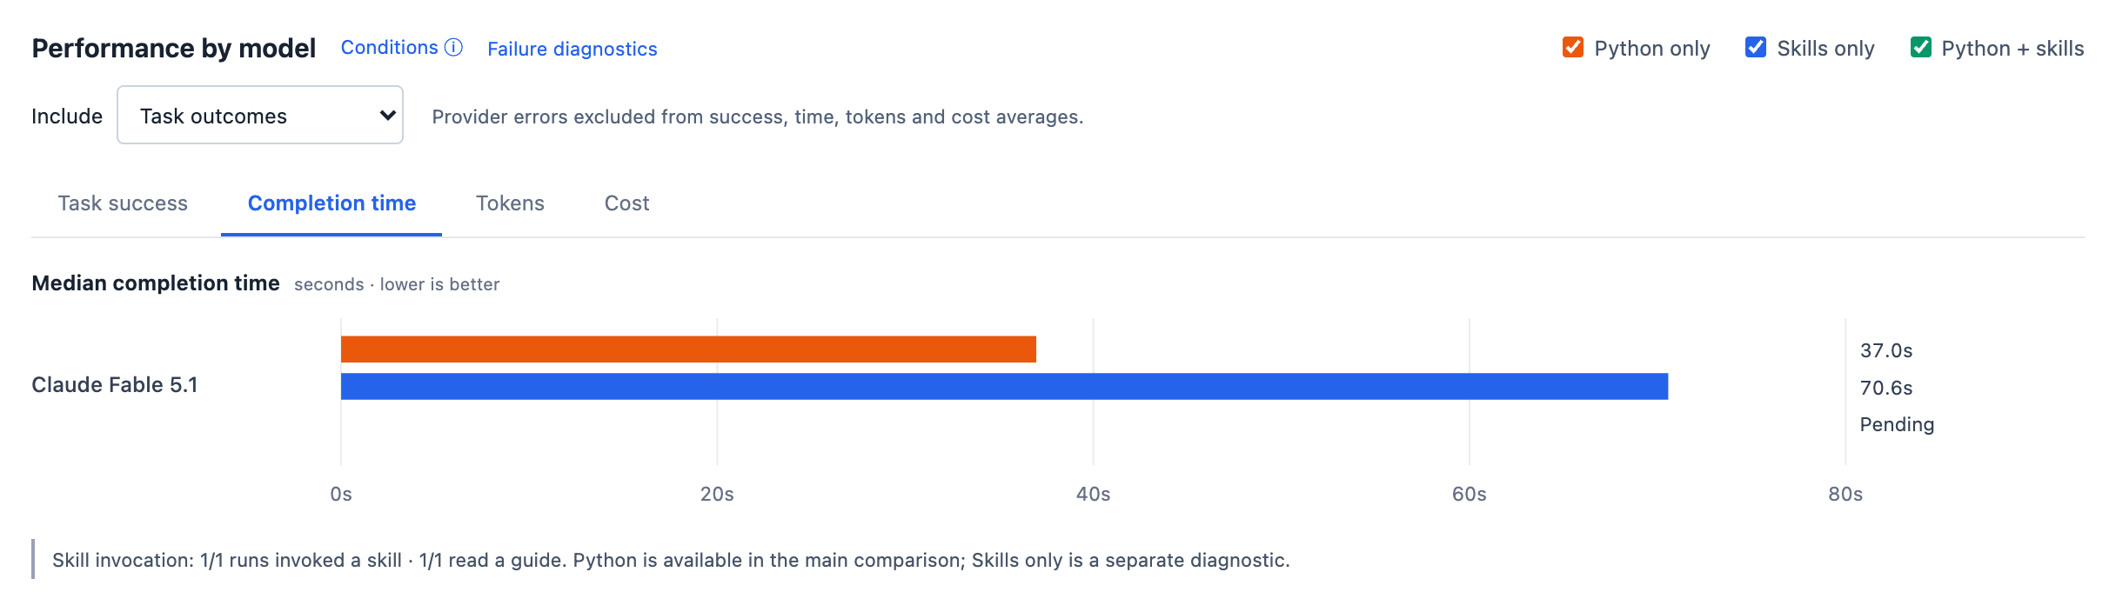
WEATHER AGENT BENCHMARK
Inspect each comparison in the dashboard
Filter by experiment, model, and task; switch between success, time, tokens, and cost.
Select a bar to inspect its attempts. Screenshot shows one model as an interface example.
Weather Skills Benchmark / Research design and current pilot
07
Notes:
Actual dashboard screenshot, frozen at 2026-09-30 16:21 UTC. Selected model is Claude Fable 5.1 and chart metric is completion time. This is an interface demonstration from a partially completed study, not a claim about relative model performance. Missing attempts remain pending. Image captures genuine DOM content and original series colors. All surrounding slide elements are native PowerPoint.
Sources / audit trail:
docs/index.html
presentations/assets/screenshot-provenance.json
presentations/assets/dashboard-comparison.png

Slide 8
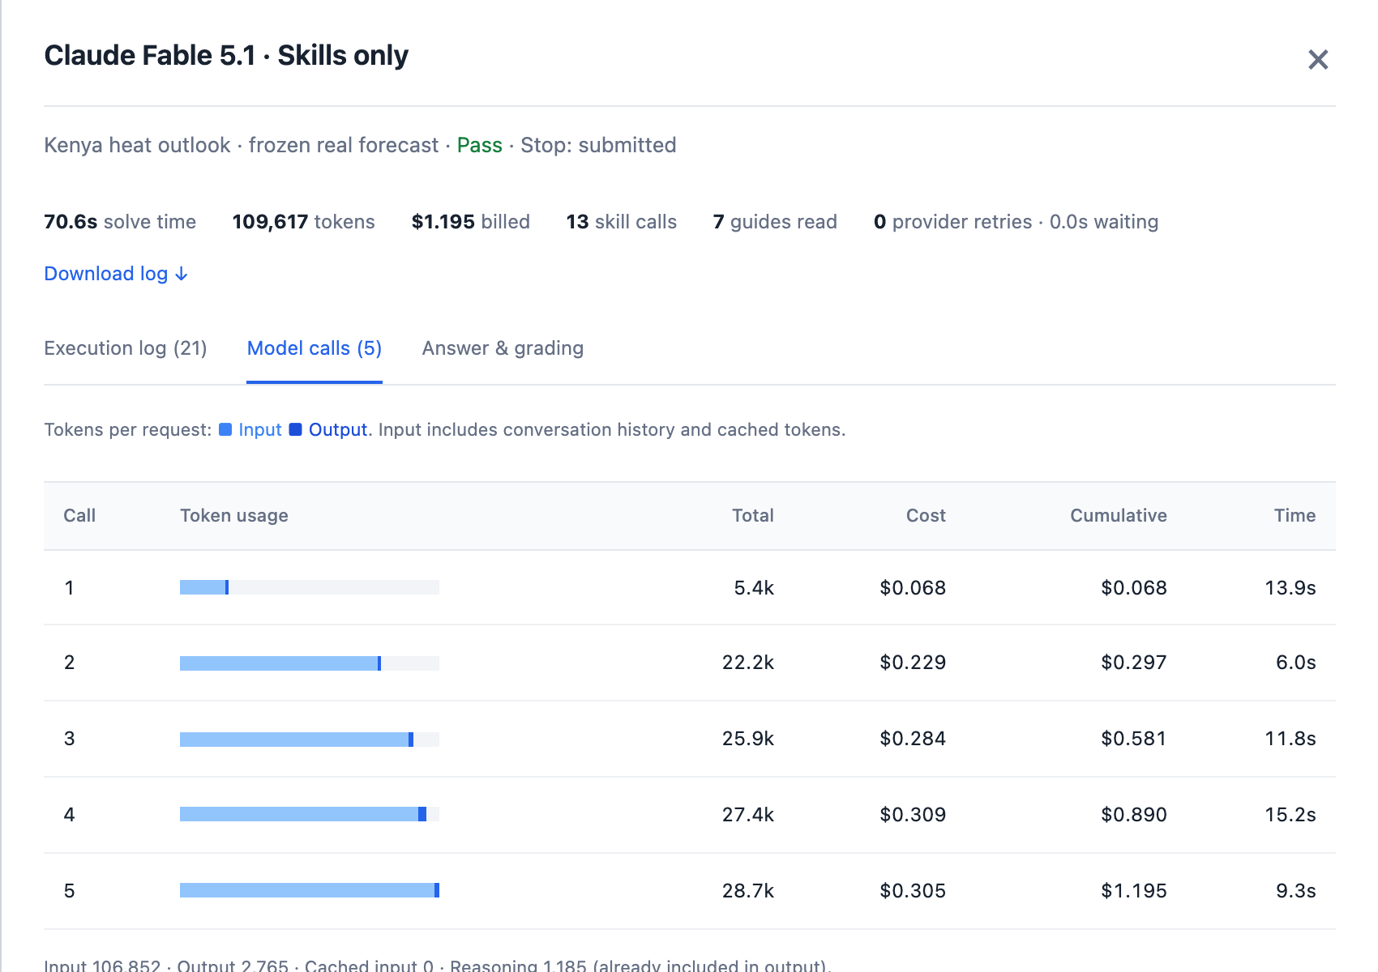
WEATHER AGENT BENCHMARK
Trace a result back to the model and its executions
Each attempt records
Model calls
Visible responses, request time,
tokens, and billed cost.
Execution log
Python or skill arguments,
outputs, errors, and retries.
Answer & grading
Submitted artifacts, reference
values, and failed checks.
Weather Skills Benchmark / Research design and current pilot
08
Notes:
Actual run-detail drawer for run 95fdd288dfc945299b383fb23bf50f48, with Model calls selected. The dashboard also supports execution traces and answer/grade inspection. Logs are sanitized; they exclude credentials and hidden reasoning. Reading a guide and invoking a skill are separately recorded. Correct alternative Python implementations may fail reference-recipe conformance but still pass scientific correctness. The screenshot is an audit example, not a sample chosen for aggregate inference.
Sources / audit trail:
presentations/assets/screenshot-provenance.json
presentations/assets/dashboard-trace.png
weather_bench/report.py: public_audit
docs/app.js: showRun

Slide 9
WEATHER AGENT BENCHMARK
Next: isolate the value of the libraries and their skills
The current pilot tests execution patterns. A direct acmadDL / africaS2S study needs its own tasks.
Proposed condition | What the agent receives | What the comparison estimates
Python baseline | General scientific Python | Reference for custom implementations
Python + libraries | Libraries + ordinary API documentation | Value of reusable implementations
Python + libraries + skills | Same libraries + agent skill guides | Added value of progressive disclosure
Seasonal task: acquire hindcasts + observations → align data → fit / downscale → verify on held-out years → produce forecast probabilities and a briefing.
Predeclare tasks and scoring; freeze versions and seeds; repeat across regions, methods, and models.
Weather Skills Benchmark / Research design and current pilot
09
Notes:
This proposed ablation is not implemented or run in the current study. Keep Python execution and recovery available in all three conditions. For the library-only arm, provide ordinary API documentation rather than withholding basic usability information; the skills arm adds workflow guidance and progressive disclosure. Fix candidate methods and evaluation folds or use properly nested selection to avoid optimistic verification. Reference checks should combine independently computed quantities, cross-implementation agreement, and invariants rather than grade a library exclusively against itself. Separate agent task correctness from meteorological predictive skill. Forecast skill needs held-out years, no calibration/tercile leakage, common masks, and prespecified metrics such as RPSS, reliability, or RMSE as appropriate. Include representative missing data, calendar differences, grids, and recoverable source errors. Report warm-data solve time and cold acquisition/setup separately. The decision is empirical: which configuration meets accuracy requirements at the lowest cost and latency, without assuming skills must win.
Sources / audit trail:
User-provided project objective
../../accord/acmadDL/skills/acmaddl/SKILL.md
../../accord/africas2s/skills/africas2s/SKILL.md
METHODOLOGY.md
STATISTICS.md

