Slide 1
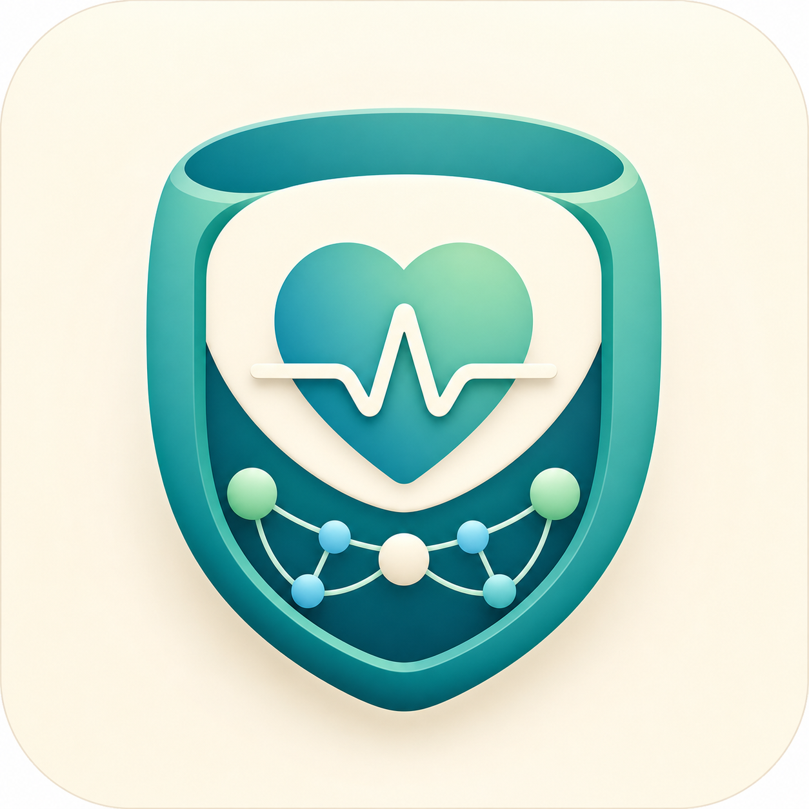
OpenCommons Health PIM
The personal health data layer for an interoperable healthcare economy
A local-first, standards-aligned platform that lets individuals own, organize, and permission health information — without building yet another centralized PHI database.
VC + partner pitch · Version 2
OpenCommons Health PIM · v2 pitch · 01
Notes:
Open with the category: this is not another portal. It is an owner-controlled health data layer around standards, local storage, and permissioned exchange.
[Sources]
- Repository source: docs/APPLICATION_PURPOSE_AND_BENEFITS.md, current MVP provides local/container PIM, local Solid Community Server, 11 owner-controlled domains, standards-coded records, owner-visible Pod activity, HealthKitBridge status, and optional Epic connector foundation.
- Repository source: docs/EXECUTIVE_OVERVIEW.md, executive value proposition, 11-domain surface, privacy posture, standards alignment, and Epic integration direction.

Slide 2
THE TENSION
Healthcare has APIs now. Patients still do not have a trusted control plane.
OpenCommons
$5.3T
18.0%
500+
U.S. health spending in 2024
share of U.S. GDP
person PHI breaches listed by HHS OCR portal
The market has digitized access, but not agency. Data is fragmented across portals, payers, devices, documents, and local notes — while trust in centralized health-data aggregation keeps getting harder to earn.
• Portals remain institution-centered
• Partners need standards without taking custody of everything
• Consumer apps often become another data silo
OpenCommons Health PIM · v2 pitch · 02
Notes:
Use this slide to establish both market size and trust pressure. The claim is not that OpenCommons solves every breach risk; the claim is that local-first architecture changes the default custody pattern.
[Sources]
- CMS National Health Expenditure Data, NHE Fact Sheet / Historical NHE 2024: U.S. health care spending grew 7.2% to $5.3T in 2024 and accounted for 18.0% of GDP. https://www.cms.gov/data-research/statistics-trends-and-reports/national-health-expenditure-data/nhe-fact-sheet
- HHS OCR Breach Portal lists reported breaches of unsecured protected health information affecting 500 or more individuals. https://ocrportal.hhs.gov/ocr/breach/breach_report.jsf
- Repository source: docs/APPLICATION_PURPOSE_AND_BENEFITS.md, current MVP provides local/container PIM, local Solid Community Server, 11 owner-controlled domains, standards-coded records, owner-visible Pod activity, HealthKitBridge status, and optional Epic connector foundation.

Slide 3
WHY NOW
The interoperability rails are here. The missing layer is patient-owned orchestration.
OpenCommons
FHIR APIs
SMART OAuth
Patient access
Local identity
Owner approval
Regulation and standards have shifted the market from closed portals toward API-mediated access. That creates a new opening: applications can compete on trust, workflow, and permissioned data use rather than proprietary capture.
OpenCommons sits above institutional APIs and below partner applications — a neutral owner-controlled layer that can receive, validate, reconcile, and release data by consent.
OpenCommons Health PIM · v2 pitch · 03
Notes:
Frame this as timing, not technology novelty. The standards have matured enough for a patient-owned layer to be practical.
[Sources]
- HL7 SMART App Launch describes OAuth-based authorization/authentication patterns, standalone patient launch, discovery at .well-known/smart-configuration, and patient scopes. https://hl7.org/fhir/smart-app-launch/STU2/
- CMS Patient Access API FAQ: impacted payers must make claims/encounter data and maintained clinical data available through a FHIR-based API. https://www.cms.gov/priorities/burden-reduction/overview/interoperability/frequently-asked-questions/patient-access-api
- Repository source: docs/EPIC_INTEGRATION_ROADMAP.md, Epic data stream, document, workflow, and Annual Medicare Wellness use-case roadmap.

Slide 4
THE PRODUCT
A personal health information manager with the owner’s Solid Pod at the center.
OpenCommons
Owner-controlled core
Integration edge
• Local Solid Community Server + authenticated Pod
• Epic SMART/FHIR connector foundation
• 11 domain APIs for health records, documents, insurance, providers, and workflow
• HealthKitBridge status observability
• FHIR-style coded domains: SNOMED, RxNorm, CVX, LOINC
• RDF/Turtle storage with ShEx validation
• Owner-approved anonymized release boundary
• Preview, reconciliation, and selected apply before Pod writes
OpenCommons Health PIM · v2 pitch · 04
Notes:
This is the product architecture slide. Keep current scope honest: local/container MVP, not production clinical system.
[Sources]
- Repository source: docs/APPLICATION_PURPOSE_AND_BENEFITS.md, current MVP provides local/container PIM, local Solid Community Server, 11 owner-controlled domains, standards-coded records, owner-visible Pod activity, HealthKitBridge status, and optional Epic connector foundation.
- Repository source: docs/EXECUTIVE_OVERVIEW.md, executive value proposition, 11-domain surface, privacy posture, standards alignment, and Epic integration direction.
- Repository source: docs/DEFINITIVE_MVP_DOCUMENTATION_CORPUS.md, current MVP truth and scope boundaries.

Slide 5
WHY IT IS DIFFERENT
The source of authority moves from the vendor cloud to the individual.
OpenCommons
Most health apps
OpenCommons
Aggregate PHI into a service-controlled cloud database, then add consent on top.
Keeps identifiable PHI in the owner’s Pod; apps and partners become clients of owner authority.
Strategic implication: partners can build useful health workflows without requiring OpenCommons to become the central custodian of every user’s identifiable record.
OpenCommons Health PIM · v2 pitch · 05
Notes:
This is the core strategic claim. It is architectural, not regulatory overreach: local-first custody and owner-mediated workflows are the differentiator.
[Sources]
- Repository source: docs/APPLICATION_PURPOSE_AND_BENEFITS.md, current MVP provides local/container PIM, local Solid Community Server, 11 owner-controlled domains, standards-coded records, owner-visible Pod activity, HealthKitBridge status, and optional Epic connector foundation.
- Repository source: docs/EXECUTIVE_OVERVIEW.md, executive value proposition, 11-domain surface, privacy posture, standards alignment, and Epic integration direction.

Slide 6
AI SERVICES
Trusted data unlocks governed AI health services.
OpenCommons
Personal health cockpit
Wellness preparation
Clinical, device, document, and task signals converge under owner control.
AI prepares visits, gaps, and follow-ups without becoming medical advice.
Device context
Partner service layer
HealthKit signals become reviewable context for vitals, sleep, and activity.
Partners deliver navigation, coaching, and research without PHI custody.
OpenCommons Health PIM · v2 pitch · 06
Notes:
This slide adds the services motivation: PIM is the trusted data vault, HealthKit Bridge contributes real-world signal, Epic/FHIR contributes clinical source data, and AI services become useful because deterministic controls keep them scoped to owner-mediated workflows.
[Sources]
- Repository source: docs/APPLICATION_PURPOSE_AND_BENEFITS.md, current MVP provides local/container PIM, Solid Pod authority, HealthKitBridge status, optional Epic connector foundation, and owner-mediated workflows.
- Repository source: docs/EXECUTIVE_OVERVIEW.md, core PIM domains, privacy posture, standards alignment, HealthKitBridge status, and Epic direction.
- Repository source: ../localHealthkitBridge/docs/INGEST_CONTRACT.md, HealthKit Bridge posts authorized normalized samples to Perception Engine endpoints and keeps HealthKit authorization native-side.

Slide 7
AI GOVERNANCE
Deterministic engines make AI usable in health workflows.
OpenCommons
Data authority
The Solid Pod decides what AI can observe, summarize, or release
Consent gates
Owner approval, provenance, and purpose bind every external action
Behavior shaping
Rules and state machines constrain AI into governed workflow
Auditability
Repeatable transitions, diagnostics, and tests make outputs inspectable
OpenCommons Health PIM · v2 pitch · 07
Notes:
Use this slide to make AI credible for healthcare-adjacent workflows. The pitch is not unconstrained diagnosis; it is governed workflow assistance shaped by deterministic engines, Pod authority, consent gates, provenance, diagnostics, and tests.
[Sources]
- Repository source: docs/DEFINITIVE_MVP_DOCUMENTATION_CORPUS.md, current MVP truth, Pod authority, owner-mediated workflows, and HealthKitBridge metadata-only boundary.
- Repository source: ../localHealthkitBridge/docs/INGEST_CONTRACT.md, deterministic cross-engine ingest contract and Perception Engine mapping behavior.
- Repository source: docs/EXECUTIVE_OVERVIEW.md, validation and quality posture for repeatable local deployment and standards-aligned workflows.

Slide 8
BEACHHEAD WORKFLOW
Annual Medicare Wellness is the wedge: high-value, recurring, multi-source, consent-heavy.
OpenCommons
Before visit
During visit
After visit
Ongoing
Owner record
status + gaps
Vitals, meds,
conditions, care plan
Documents,
recommendations,
follow-up tasks
HealthKit +
owner updates
One workflow touches the full value proposition: import, reconcile, store, explain, and selectively release — with the patient in control.
OpenCommons Health PIM · v2 pitch · 08
Notes:
Annual Medicare Wellness is the v1 anchor use case because it naturally spans demographics, medications, conditions, vitals, labs, documents, insurance, and preventive workflow state.
[Sources]
- Repository source: docs/EPIC_INTEGRATION_ROADMAP.md, Epic data stream, document, workflow, and Annual Medicare Wellness use-case roadmap.
- Repository source: docs/EXECUTIVE_OVERVIEW.md, executive value proposition, 11-domain surface, privacy posture, standards alignment, and Epic integration direction.

Slide 9
PARTNER VALUE
Partners can build workflows without owning the patient.
OpenCommons
Health systems
Payers
Lower-friction patient-facing import, review, and longitudinal preparation workflows.
Owner-mediated records and documents that can complement Patient Access API strategy.
Device ecosystems
Research + public good
A privacy-preserving landing zone for authorized local telemetry and summaries.
Anonymized, owner-approved release — not raw PHI resale.
OpenCommons Health PIM · v2 pitch · 09
Notes:
Translate architecture into partner value. The strongest partner promise is controlled collaboration, not data extraction.
[Sources]
- CMS Patient Access API FAQ: impacted payers must make claims/encounter data and maintained clinical data available through a FHIR-based API. https://www.cms.gov/priorities/burden-reduction/overview/interoperability/frequently-asked-questions/patient-access-api
- Repository source: docs/APPLICATION_PURPOSE_AND_BENEFITS.md, current MVP provides local/container PIM, local Solid Community Server, 11 owner-controlled domains, standards-coded records, owner-visible Pod activity, HealthKitBridge status, and optional Epic connector foundation.
- Repository source: docs/EXECUTIVE_OVERVIEW.md, executive value proposition, 11-domain surface, privacy posture, standards alignment, and Epic integration direction.

Slide 10
COMMERCIAL MODEL
The business model rewards trust, not data capture.
OpenCommons
1
2
3
Design-partner pilots
AI + integration services
Personal client tier
Paid pilots with health systems, payer innovation teams, senior-care networks, and device partners.
Governed AI workflows plus connector, mapping, validation, deployment, and support packages.
Premium local/native experiences for individuals and caregivers, with no PHI resale dependency.
VC thesis: governed AI and local-first data custody unlock regulated services without defaulting to centralized PHI capture.
OpenCommons Health PIM · v2 pitch · 10
Notes:
Keep this as a model hypothesis, not an executed revenue claim. V2 clarifies that commercial services include governed AI workflow packages as well as integration, deployment, and support.
[Sources]
- Repository source: docs/APPLICATION_PURPOSE_AND_BENEFITS.md, current MVP provides local/container PIM, local Solid Community Server, 11 owner-controlled domains, standards-coded records, owner-visible Pod activity, HealthKitBridge status, and optional Epic connector foundation.
- Repository source: docs/EXECUTIVE_OVERVIEW.md, executive value proposition, 11-domain surface, privacy posture, standards alignment, and Epic integration direction.
- Repository source: ../localHealthkitBridge/docs/INGEST_CONTRACT.md, HealthKit ingest and deterministic PE interaction contract.

Slide 11
DEFENSIBILITY
The moat compounds across data authority, standards, and governed AI execution.
OpenCommons
Trust posture
Local-first, owner-mediated, anonymized release boundary
Standards graph
FHIR-style domains, SMART/FHIR, Solid, ShEx, OpenAPI, terminology systems
Deterministic engines
Behavior shaping, source diagnostics, repeatable tests, and constrained actions
Workflow memory
Preview, reconciliation, provenance, audit, and domain-specific UX
OpenCommons Health PIM · v2 pitch · 11
Notes:
Defensibility is broadened in v2: trust architecture and standards depth remain central, but governed AI execution and deterministic behavior shaping become a compounding capability rather than a side feature.
[Sources]
- Repository source: docs/EXECUTIVE_OVERVIEW.md, executive value proposition, 11-domain surface, privacy posture, standards alignment, and Epic integration direction.
- Repository source: docs/DEFINITIVE_MVP_DOCUMENTATION_CORPUS.md, current MVP truth and scope boundaries.
- Repository source: ../localHealthkitBridge/docs/INGEST_CONTRACT.md, deterministic cross-engine HealthKit ingest contract.

Slide 12
ROADMAP
The next 12 months should prove live integrations and partner utility.
OpenCommons
Now
Local MVP
11 domains + Pod
Next
Epic sandbox
JWT + preview diagnostics
Pilot
Annual Wellness
partner workflow
Expand
Docs, workflow,
HKB + AI services
Scale
Native + hosted
enterprise options
Milestone discipline: keep localhost stable while pilots prove which AI-assisted workflows create willingness to pay.
Do not jump straight to public hosted PHI custody. Prove the workflow, trust model, and standards integration first.
OpenCommons Health PIM · v2 pitch · 12
Notes:
Use this as a partner/investor roadmap. Current JWT bearer work is still source-level until deployed and validated with Epic dynamic client credentials.
[Sources]
- Repository source: docs/DEFINITIVE_MVP_DOCUMENTATION_CORPUS.md, current MVP truth and scope boundaries.
- Repository source: docs/EPIC_INTEGRATION_ROADMAP.md, Epic data stream, document, workflow, and Annual Medicare Wellness use-case roadmap.

Slide 13
WHY THIS WINS
OpenCommons can become the trusted control plane for personal health AI.
OpenCommons
The wedge is not “another PHR.”
It is a personal health AI operations layer: owner-controlled data, clinical and device context, deterministic behavior shaping, and permissioned outputs that partners can trust because individuals remain in control.
That is the rare overlap VCs and strategic partners care about: large regulated market, standards tailwinds, privacy-first AI, and a wedge into recurring health workflows.
OpenCommons Health PIM · v2 pitch · 13
Notes:
This synthesis slide now names the bigger category: trusted control plane for personal health AI, not merely another patient health record.
[Sources]
- CMS National Health Expenditure Data, NHE Fact Sheet / Historical NHE 2024: U.S. health care spending grew 7.2% to $5.3T in 2024 and accounted for 18.0% of GDP. https://www.cms.gov/data-research/statistics-trends-and-reports/national-health-expenditure-data/nhe-fact-sheet
- HL7 SMART App Launch describes OAuth-based authorization/authentication patterns, standalone patient launch, discovery at .well-known/smart-configuration, and patient scopes. https://hl7.org/fhir/smart-app-launch/STU2/
- Repository source: docs/APPLICATION_PURPOSE_AND_BENEFITS.md, current MVP provides local/container PIM, local Solid Community Server, 11 owner-controlled domains, standards-coded records, owner-visible Pod activity, HealthKitBridge status, and optional Epic connector foundation.

Slide 14
THE ASK
Let’s prove the patient-owned data layer with the right pilots.
OpenCommons
Strategic partners
2–3 design partners around Annual Wellness, document import, or caregiver workflows.
Capital
Seed capital to harden Epic/HealthKit integration, deterministic AI services, security, and pilot operations.
Proof
A measured pilot: connection success, records reconciled, owner-approved writes, AI-assisted workflow value.
OpenCommons Health PIM · personal health, held by you
OpenCommons Health PIM · v2 pitch · 14
Notes:
End with concrete asks. For a VC audience, ask for capital plus design partners. For a strategic audience, ask for a scoped pilot with defined evidence.
[Sources]
- Repository source: docs/DEFINITIVE_MVP_DOCUMENTATION_CORPUS.md, current MVP truth and scope boundaries.
- Repository source: docs/EPIC_INTEGRATION_ROADMAP.md, Epic data stream, document, workflow, and Annual Medicare Wellness use-case roadmap.

