Slide 1

Phishing Awareness
Prepared by: Shweta Sanjay Jathar

Slide 2

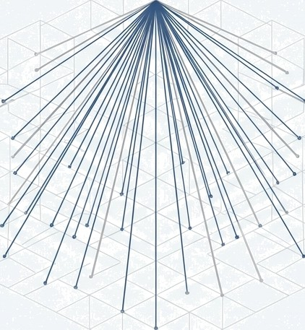
What is Phishing?
Phishing is a type of cyber attack where attackers trick users into revealing sensitive information such as:
Passwords
OTPs
Bank details
Credit/Debit card information
Attackers pretend to be trusted organizations like banks, companies, or government bodies.

Slide 3

















You Are the Target
Modern attackers don't just send random spam. They use sophisticated, targeted attacks called “spear phishing.” They research you on social media and the company website to craft personalized, believable messages designed specifically to fool you.
It doesn't matter what your role is. Whether you have access to financial systems, client data, or just your own login credentials, you are a valuable target. Your access is their entry point.

Slide 4

The Attacker's Primary Weapon: Social Engineering
Social engineering is the art of psychological manipulation. Instead of trying to hack code, attackers ‘hack’ our natural human tendencies to trust, help, or react quickly.
They don't break in. They trick you into letting them in.

Slide 5





The Five Triggers They Exploit
O
URGENCY | FEAR | GREED | HELPFULNESS | CURIOSITY
Creating a false | Threatening | Promising a reward, | Posing as a | Using intriguing or
deadline or | negative | reward, prize, or | colleague or IT | alarming subject
emergency to make | consequences if you | deal that is too | support needing | lines to entice you to
you act before you | don't comply. (e.g., | good to be true. | your help with an | open an attachment
can think. (e.g., | "Suspicious activity | (e.g., "You've won a | "urgent" task. (e.g., | or click a link.
"Your account will be | detected. Log in | new iPhone! Click | ”Can you quickly | (e.g., ”Re: Photos
suspended in 1 hour.") | immediately to secure your account.") | here to claim.") | process this invoice for me? I'm in a meeting.”) | from the party” or "Updated Layoff List.")

Slide 6
How to Identify Fake Websites
Misspelled URLs (e.g., paypa1.com)
No HTTPS (no lock symbol)
Poor website design
Fake login pages
Unrealistic offers and discounts

Slide 7




Spot the Fake: Legitimate vs. Phishing Website
LEGITIMATE PHISHING
The URL is slightly misspelled (e.g., 'Microsofft.com’) or on a completely different domain.
There is no padlock icon, meaning the connection is not cecure (No HTTPS).
Microsoh
The Company logo might be slightly distorted or a low-resolution image.
Sign in
£ mgil, or email address
Sign in
Links to ’Privacy Policy' or 'Contact Us’ might be dead or just refresh the page.

Slide 8


Technology is Shield.
You Are the Guardian.
Our security systems block millions of threats every year. But sophisticated attacks are designed to bypass them by targeting you directly. Your awareness and vigilance are the most critical components of our defense.
This is your playbook.

Slide 9





Your Defence Playbook:
The 5-Second Scan
SOURCE | TONE | LINKS | DETAILS | REQUEST
Do I recognize the | Is it creating a | If I hover over the | Are there unexpected | Is it asking for
sender? Is the email | strong emotion like | links, do they go to a | attachments, | sensitive information
address legitimate? | urgency, fear, or | trusted and | spelling mistakes, or | (passwords, financial
 | excitement? | expected web | generic greetings? | data) or for an
 |  | address? |  | unusual action (like
 |  |  |  | buying gift cards)?

Slide 10

Trust, but Verify: Hover to Discover
Attackers hide malicious links behind legitimate-looking text. Before you click any link, always hover your mouse cursor over it to reveal the true destination address.
Click here to view
our secure document.
http://secure-login-portal.biz/asdIjk123/

Slide 11
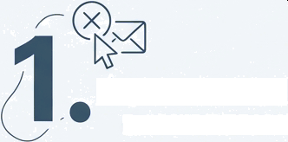
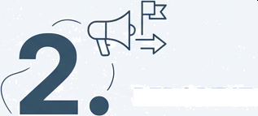
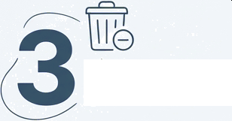

When in Doubt, Follow the 3-Step Protocol
/ DON'T CLICK.
DON'T REPLY.
Never click on suspicious links or attachments, and never reply to the sender. Interacting in any way confirms your email address is active.
REPORT IT.
DELETE IT.
Use the ‘Report Phishing’ button in your email client. If unavailable, forward the email as an attachment to phishing@company.com.
After you have reported the email, delete it from your inbox to prevent accidental clicks later.

Slide 12
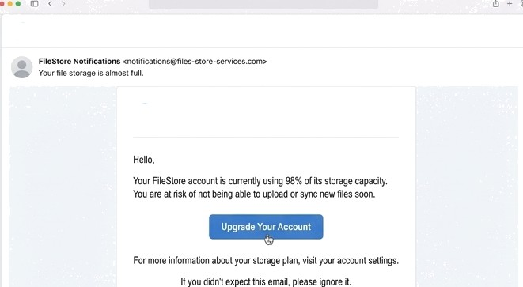

Spot the Phish: Challenge
You receive this email from your file-sharing service. Is it a legitimate notification or a phishing
attempt?
FileStore
FileStore
Real
Fake?

Slide 13


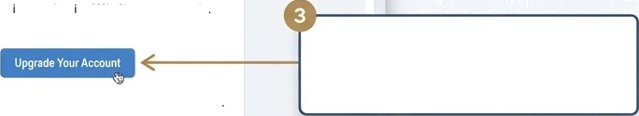
Challenge
: It's a Phish
FileStore
Ff Ie5tore NotI1'ication s <rJotifi ations@files-store-services.com› .“
Ym fiosaogc‹sâmo full
The sender's domain is slightly off (e.g.,
’fileshare-support.com’ instead of'fileshare.com').
FiieStore
"
Hello
The message uses urgency (“Upgrade now to avoid service interruption!") to rush you.
YoiJr FileStore account s currently us ng 98% of ib storage capacity
You are at fish of nd being able to upload oi sync new liles soon.
Hovering over the “Upgrade Your Account" button reveals a URL that is not the official domain of the service.
For more information aboul your slorage plan, visit your account sitings
If}0U didn't expect this emBil, please gnore it
Key Takeaway: Always verify the sender and links, especially when an email asks for urgent action or payment.

Slide 14



Your Key Takeaways
THE THREAT IS REAL & PERSONAL
Cyberattacks start with email, and they are targeted directly at you.
ATTACKERS USE PSYCHOLOGY, NOT JUST CODE
Recognize the triggers of urgency, fear, and curiosity to spot their tactics.
YOU HAVE A SIMPLE, POWERFUL PLAYBOOK
Use the 5-Second Scan and the 3-Step Protocol to defend yourself and the strootium yourself and the company.

Slide 15
Phishing Awareness is the first line of defense against Cyber Attacks.
Educated users can prevent data theft and financial loss.
Stay Alert. Stay Secure.
.

