Slide 1



LabSafe
CB23F35 · LOW-CODE APPLICATION DEVELOPMENT USING ZOHO CREATOR
Laboratory Consumable Inventory & Expiry Management System
End Semester Project Evaluation
Student: Gokulan V · Registration No.: 240701151

Slide 2
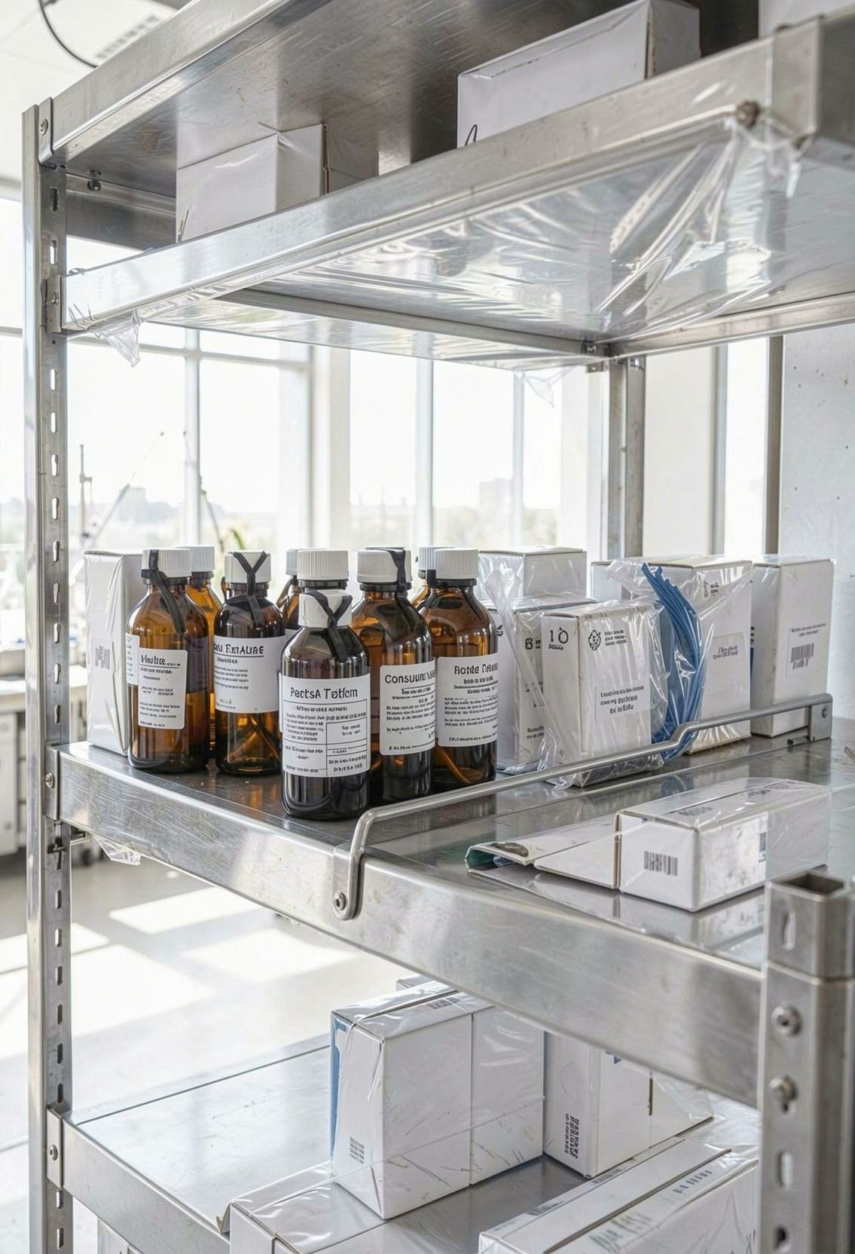
Manual records make laboratory stock hard to trust
THE CONTROL GAP
Disconnected records
Manual records make consumables, suppliers, purchases, stock issues, and expiry information difficult to verify.
Risk stays hidden
Available stock is unclear, expired items may go unnoticed, and low-stock items are difficult to identify.
Verification takes time
Checking the current position of laboratory stock becomes a time-consuming manual exercise.
02

Slide 3
LabSafe turns inventory control into one connected workflow
THE PROPOSED SOLUTION
One source of visibility connects registration, movement, monitoring, and reporting.
01
02
03
04
Register
Maintain consumable and supplier details.
Track
Record purchases, issues, batches, and expiry dates.
Monitor
Identify low-stock and expired consumables.
Report
Centralize dashboards and inventory visibility.
Proposed solution: automated stock tracking, validation, monitoring, and centralized visibility.
03

Slide 4
Zoho Creator provides the application structure
APPLICATION STRUCTURE
Forms hold the operational records; Deluge, reports, and dashboards connect them.
Zoho Creator
Category_Master
Supplier_Master
Consumable_Master
Stock_Purchase
Stock_Issue
Stock_Batch
Purchase_Items_Form
Issue_Items_Form
Deluge scripting
Reports and dashboards
AI/ML stock shortage prediction
under configuration
AI/ML stock shortage prediction remains under configuration until successfully configured and tested.
03

Slide 5
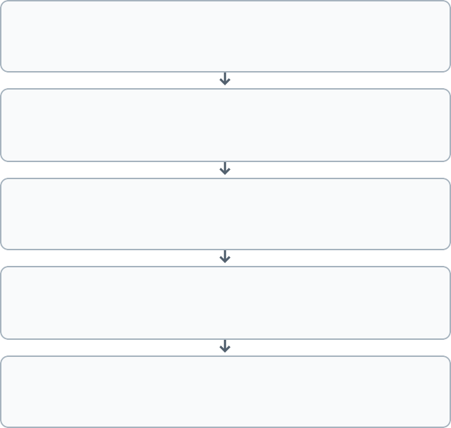
Automation connects every stock movement
AUTOMATION LAYER
User actions create records; Deluge updates quantities and monitoring outputs.
USER ACTIONS
AUTOMATED UPDATES
MONITORING OUTPUTS
Category and Supplier Registration
Automatic Stock Increase
Expiry and Low-Stock Monitoring
Consumable Registration
Validate stock availability
Batch Management
Reports and Dashboard
Prevent issuing more than available stock
Stock Purchase
Email notifications where configured
Stock Issue
Automatic Stock Deduction
Deluge automation updates quantities, validates stock availability, monitors expiry, identifies low stock, and sends email notifications where configured.
03

Slide 6
Reports surface risk early; AI prediction remains under configuration
REPORTING AND AI STATUS
REPORTS
3 named views
Low_stock_report · Expired_Items_Report · Stock Shortage Prediction Results
DASHBOARD
KPI panel
Inventory KPIs, prediction chart, and prediction results table.
AI STATUS
Under configuration
Model training and testing are still required.
DEMAND LOGIC
Next month
Use available quantity, minimum stock level, and usage history.
03

Slide 7

Verified testing, live demo, and next steps
VALIDATION · DEMONSTRATION · NEXT STEPS
Testing checklist: consumable registration · stock purchase · stock quantity update · stock issue · insufficient stock validation · expiry monitoring · low-stock report generation
Live demo: open LabSafe → show forms → demonstrate purchase → demonstrate issue → show expiry and low-stock reports → show dashboard.
GitHub repository: https://github.com/Gokulan00/Low_code
THANK YOU –QUESTIONS & ANSWERS

