Slide 1

WEATHER FORECAST APPLICATION[API]

Slide 2
AGENDA
Introduction
Survey
Modules
Software required
Prototype
Conclusion

Slide 3

INTRODUCTION
A Weather Forecast API (Application Programming Interface) is a tool that allows developers to access and retrieve weather-related information from weather data providers for use in their applications, websites, or services. These APIs provide real-time and forecasted weather data, including temperature, humidity, precipitation, wind speed, and more. Weather Forecast APIs are essential for a wide range of applications, from mobile weather apps to logistics and agriculture.

Slide 4
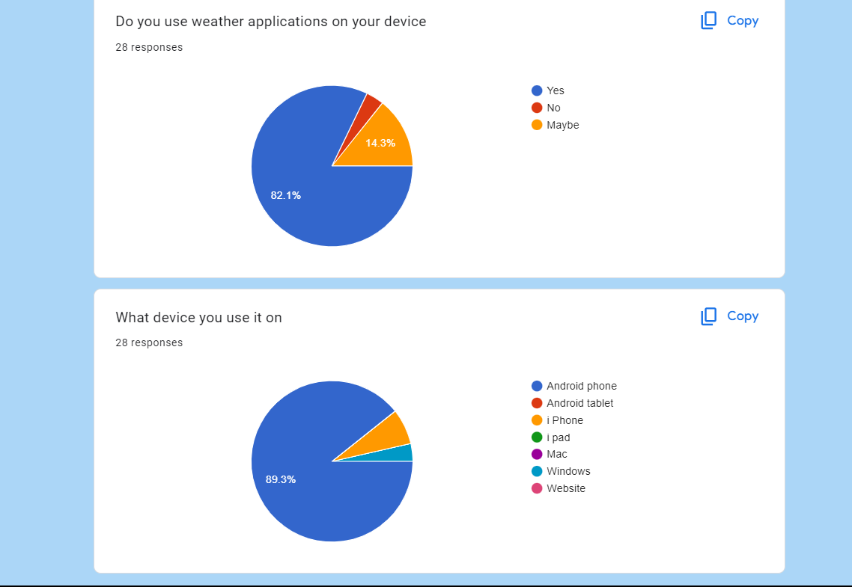
SURVEY
https://docs.google.com/forms/d/e/1FAIpQLSdAkm1KENA5LWFDDvj1TGn1Gd7_g5liKyFV16uKluE3DwDneQ/viewform?usp=sf_link

Slide 5
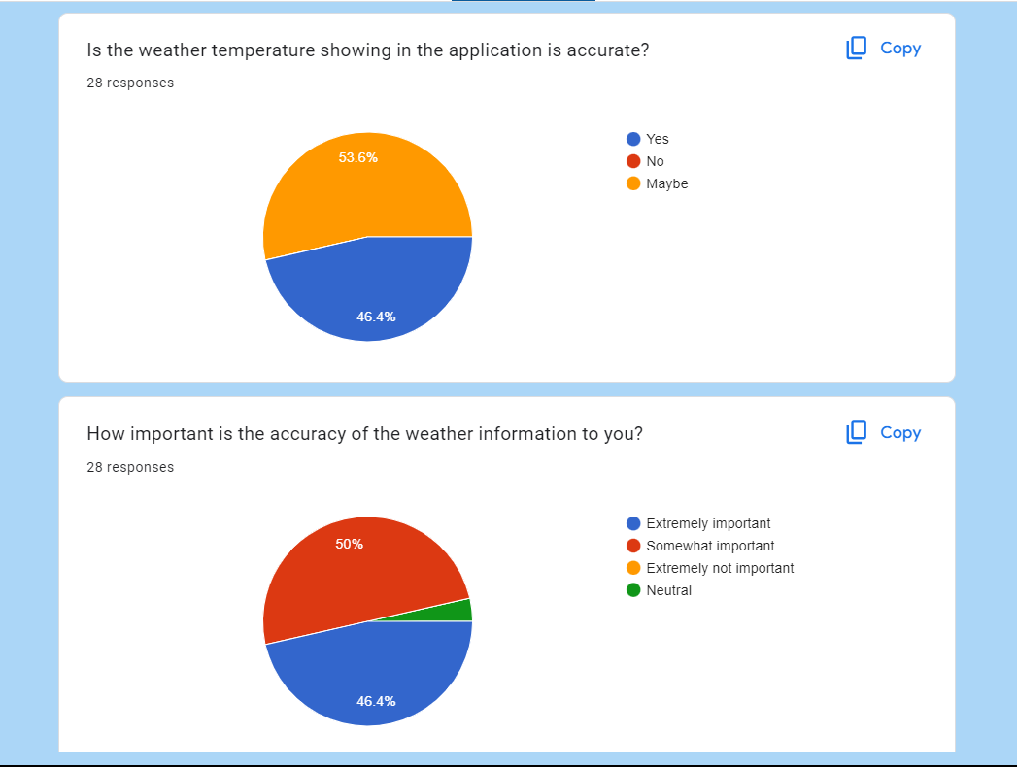
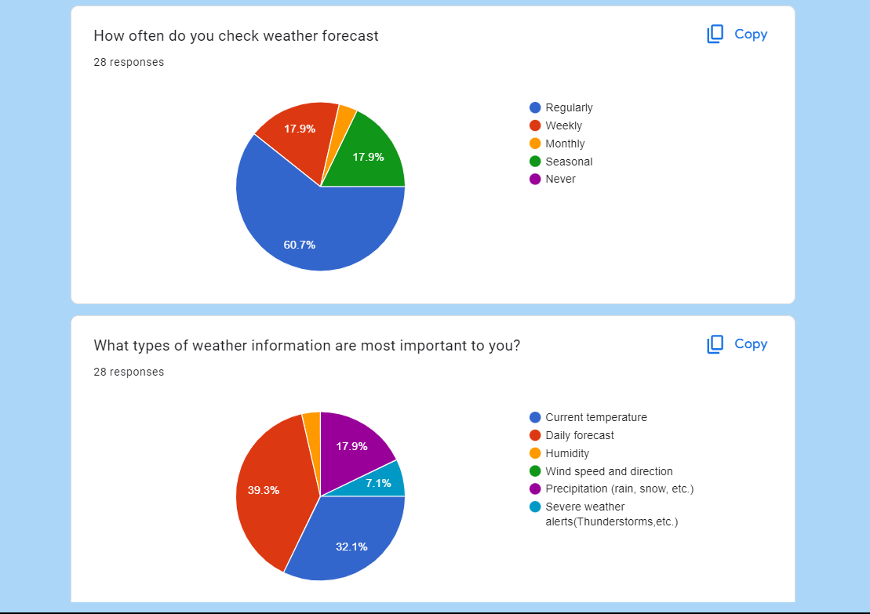
SURVEY

Slide 6
SOFTWARE REQUIRED
pycharm ide
Powerful integrated development environment (IDE) for Python
Django
Disseminate standardized metrics
Html
Websites are built using HTML for structure
Css
CSS for styling of webpages
Web browser
You'll need a web browser to test your website during development.

Slide 7
MODULES
User Interface (UI):
Main Screen:
This is where users input their location or view the current weather conditions.
Data Retrieval Module:
Weather API Integration:
This module interacts with a Weather Forecast API to fetch current weather conditions, hourly forecasts, and daily forecasts based on the user's location.
Current Weather Display:
Temperature:
Display the current temperature in the chosen unit.
Weather Icon:
Show an icon representing the current weather condition (e.g., sunny, rainy, cloudy).
Humidity and Wind:
Display current humidity percentage and wind speed and direction.
Sunrise and Sunset:
Show the times for sunrise and sunset.
Forecast Display:
Hourly Forecast: Display hourly weather forecasts for the next 24 to 48 hours, including temperature, precipitation, and wind information.
Daily Forecast: Provide a summary of the weather forecast for the next 7 to 10 days, including high and low temperatures and precipitation probabilities.
Settings Module:
Unit Preferences: Let users choose between Celsius and Fahrenheit.
Update Frequency: Allow users to set how often the app fetches new weather data (e.g., every hour, every six hours).
Notification Preferences: Give users the option to receive weather-related notifications (e.g., severe weather alerts).
Location Management:
Add Locations: Allow users to add and save multiple locations (e.g., home, work, vacation spots).
Delete Locations: Enable users to remove locations they no longer need.

Slide 8
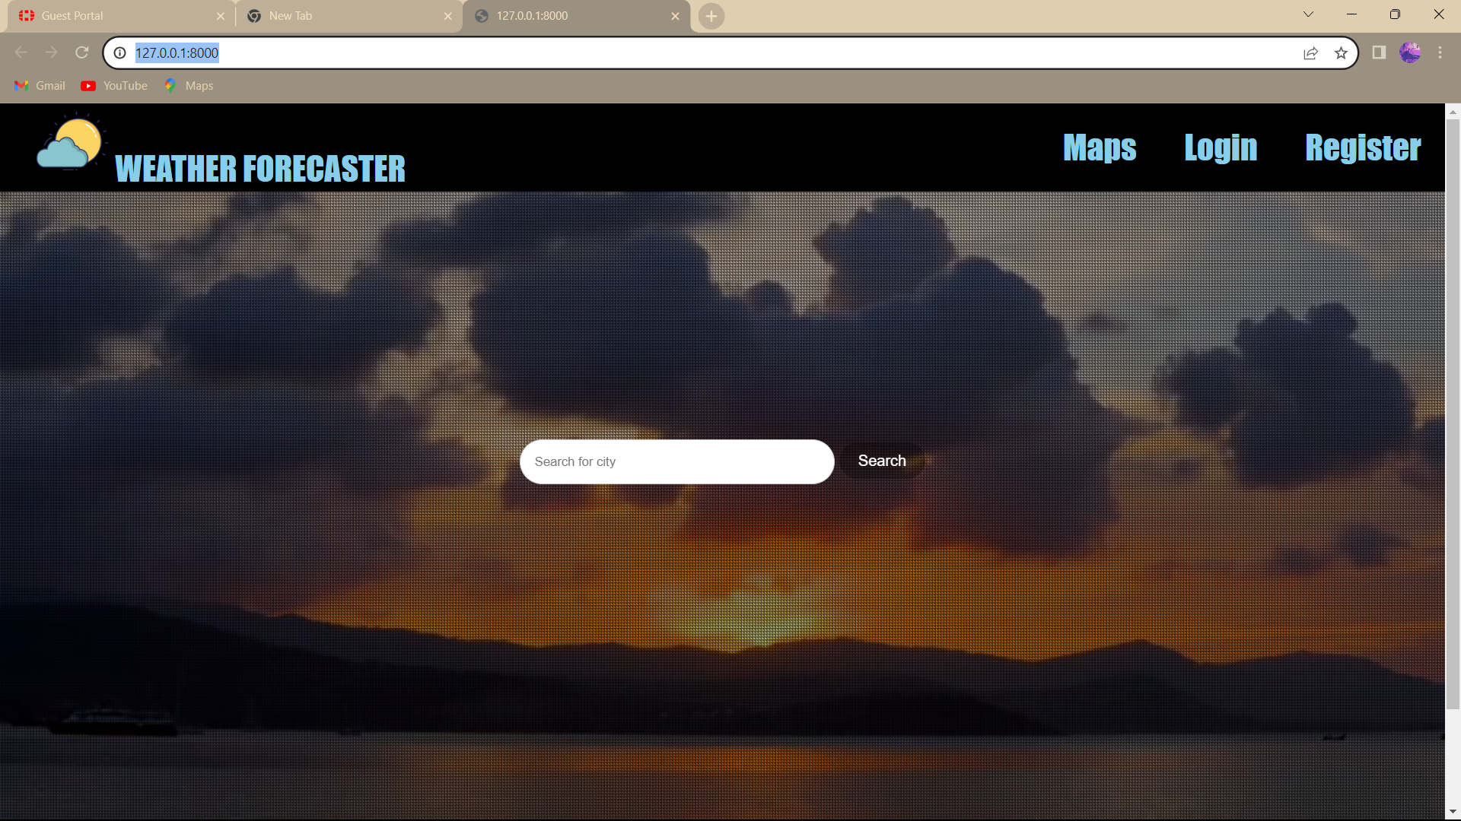
PROTOTYPE

Slide 9

CONCLUSION
weather forecasts are valuable tools that help us prepare for and respond to changing weather conditions. They have become increasingly accurate thanks to advances in technology and our understanding of the atmosphere. However, it's essential to remain aware of the inherent uncertainty in weather predictions and to use forecasts as guidance rather than absolute certainty. Staying informed about the latest forecasts and being prepared for various weather scenarios can help us better navigate the ever-changing conditions of our environment.

