Slide 1
VectorAPI + Valhalla
Oracle Intel F2F April’24
Jatin Bhateja

Slide 2
Agenda
Introduction
Vector API evolution.
Motivation for vector as value types.
New Vector Class Hierarchy.
Multifield Annotation.
Oops model and layout computation.
Special handling for Maxspecies.
Modified fallback implementation.
Compiler Support
Compiler Interface Model.
C2 support.
Problem with Unsafe put operations.
Aliasing behaviour difference with array backing storage
C1 support.
Value object larval state.
De-optimization Support.
lworld+vector current state.

Slide 3
VectorAPI Feature Evolution
Incubation 1: JEP 338
Initial Support added in JDK16 for various lanewise, reduceLane, compare, convert, castShape operations.
Optimized backed support X86 SSE,AVX[1,2,512], and AARCH64 (NEON).
Incubation 2: JEP 414
Enhancements to the API to support operations on characters, such as for UTF-8 character decoding. Specifically, we add methods for copying characters between short vectors and char arrays, and new vector comparison operators for unsigned comparisons with integral vectors.
Enhancements to the API for translating byte vectors to and from boolean arrays.
Intrinsic support for transcendental and trigonometric lanewise operations on x64 using the Intel's Short Vector Math Library (SVML).
General performance enhancements to the Intel x64 and ARM NEON implementations.
Incubation 3: JEP 417
Enhanced masking support for predicated targets AVX512 and ARM SVE.
Incubation 4: JEP 426
Integration of MemorySegments for aligned vector loads and stores.
Various vectorized bit manipulation and query operations (reverse, reversebytes, popcount, bit wise compression).
New APIs for vector compress and expand operations.
Incubation 5, 6, 7: No changes in API surface.
Work in progress: (lworld+fp16, vectorIntrinsics+fp16)
Extend various vector APIs to operate over FP16 reduced precision floating point data types.

Slide 4
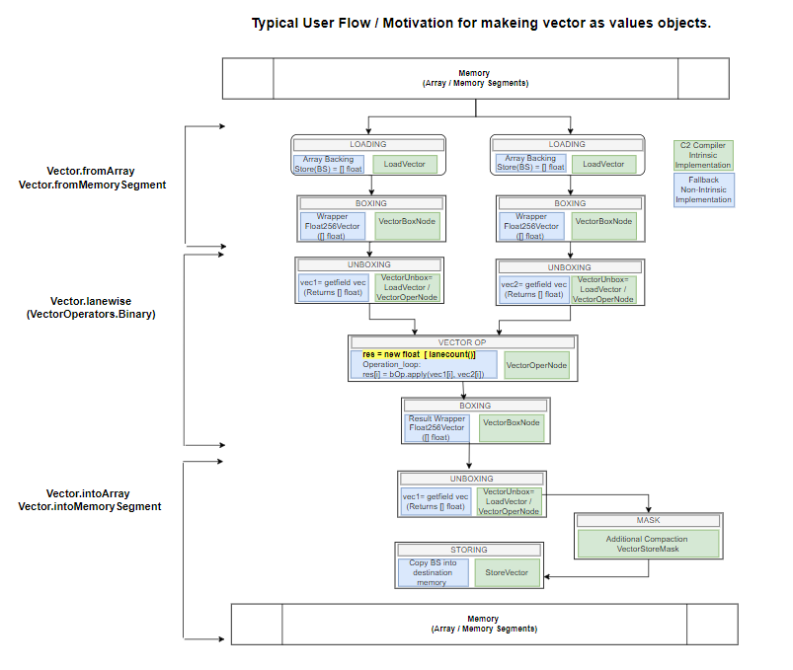
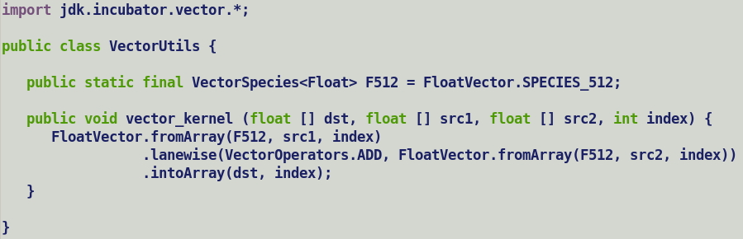

Slide 5
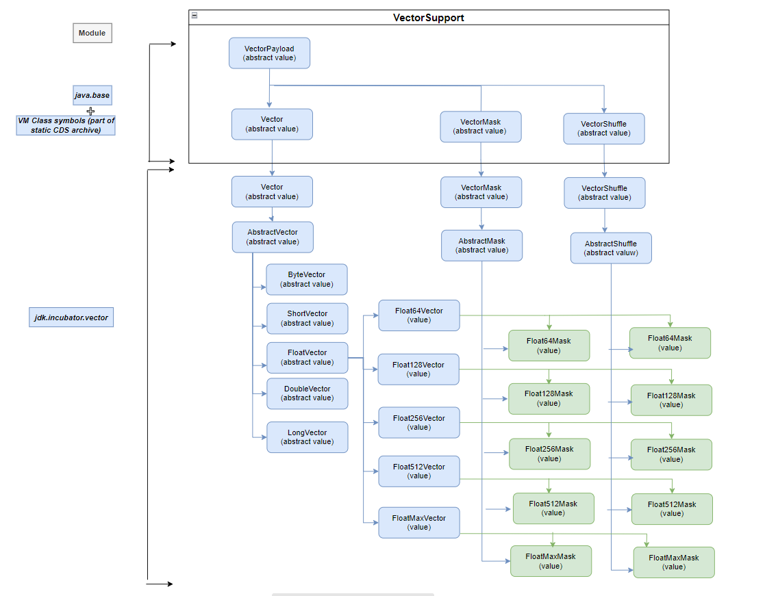
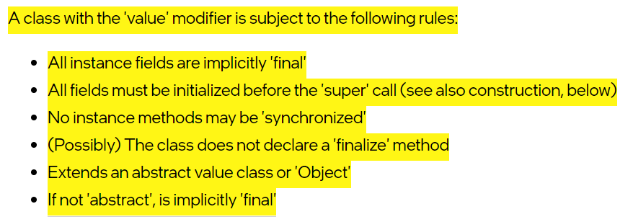
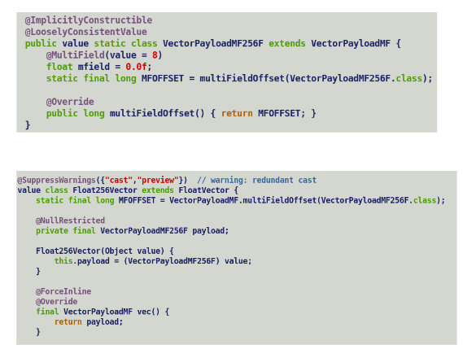
New Vector and Payload Class Hierarchy.

Slide 6
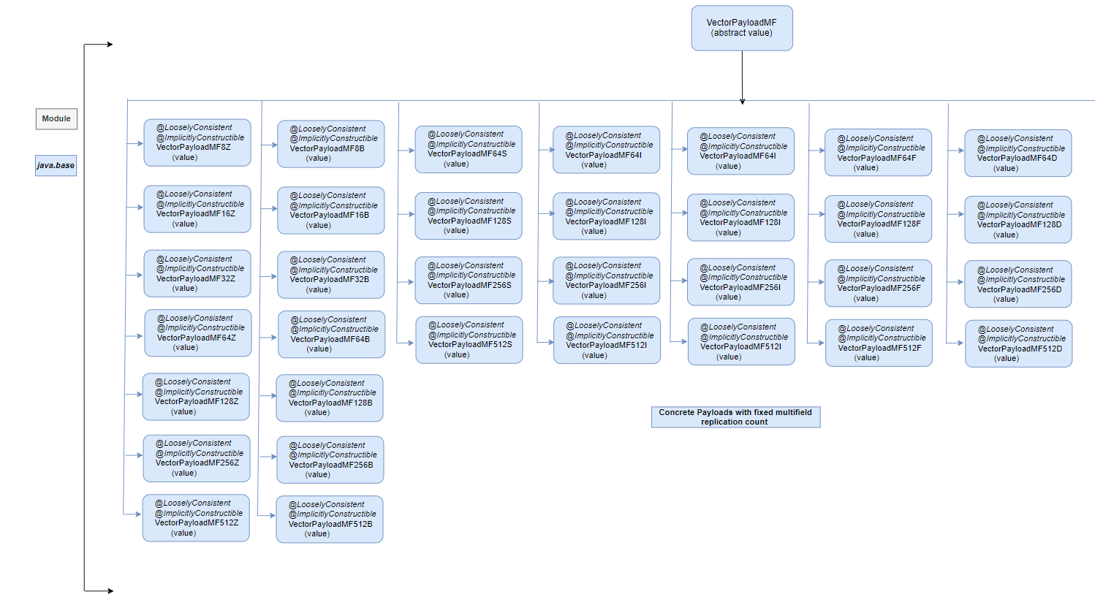
Notes:
VM does not create upfront runtime representations for concrete vector and payload classes.
Only java.base module classes known to VM are VectorPayload, VectorPayloadMF, Vector, VectorShuffle and VectorMask and are used for subclassing checks.
Unlike other classes in java.base module, VectorPayloads are not serialized into Static CDS archive (classes.jsa).

Slide 7
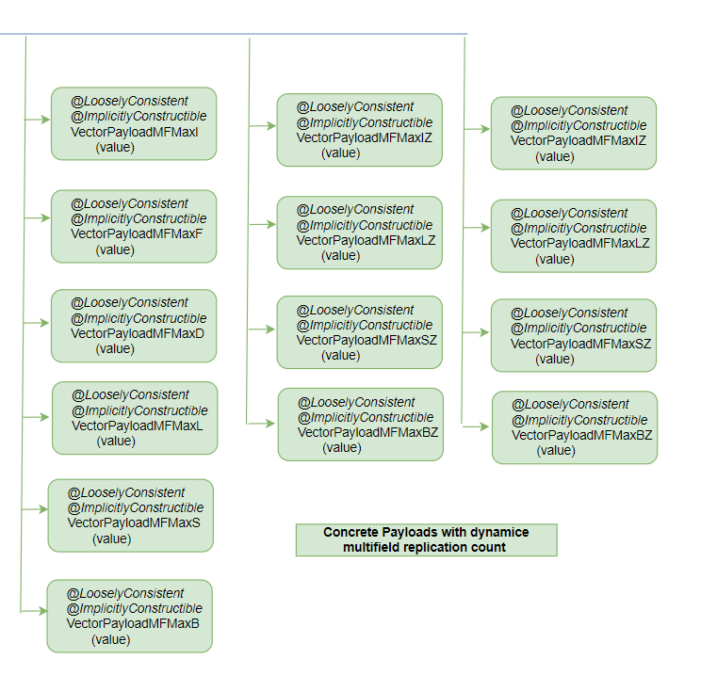
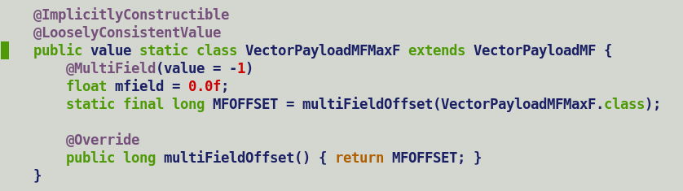
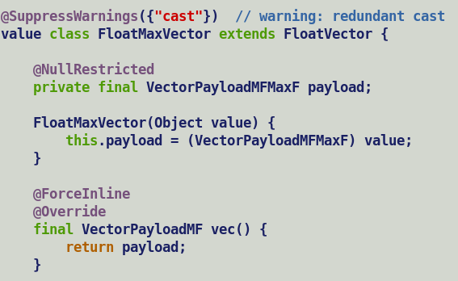

Slide 8
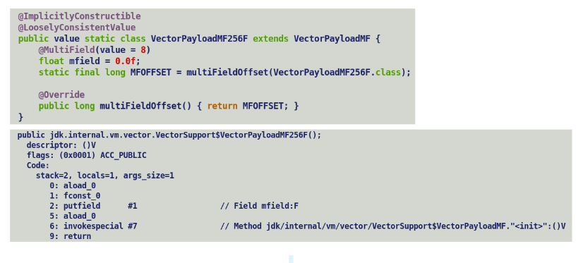
Multifield Annotation
Multi-field feature:
a JVM-internal annotation gives a replication count
extra copies of field injected by class loader (ID1)
extra copies are guaranteed contiguous in memory layout
at most one multi-field per class
the class must be final (no inheritance of multi-fields)
Read/write access to a multifield is performed using Usafe.get/put APIs.
Since existing APIs related to VarHandles do not accept an explicit offset, hence it makes it non-usable to access synthetic multifields.
Q. Who owns the responsibility of initializing synthetic multifields injected by VM ?
Ideally all the primary and synthetic multifield must be initialized in the constructor of the class declaring the multifield annotated field. But language disallows passing uninitialized ‘this’ keyword to an unsafe put API. (ID2)
Additionally, execution engines must disallow a direct access to multifield though getfield/putfield bytecodes.
Currently, both compilers generates additional Stores to initialize all the synthetic multifield with initial values as apart of ‘putfield’ processing during parsing. Interpreter always allocates a new values in heap and all the fields are initialized to their default values.
Ref: https://cr.openjdk.org/~jrose/values/multi-field.html

Slide 9
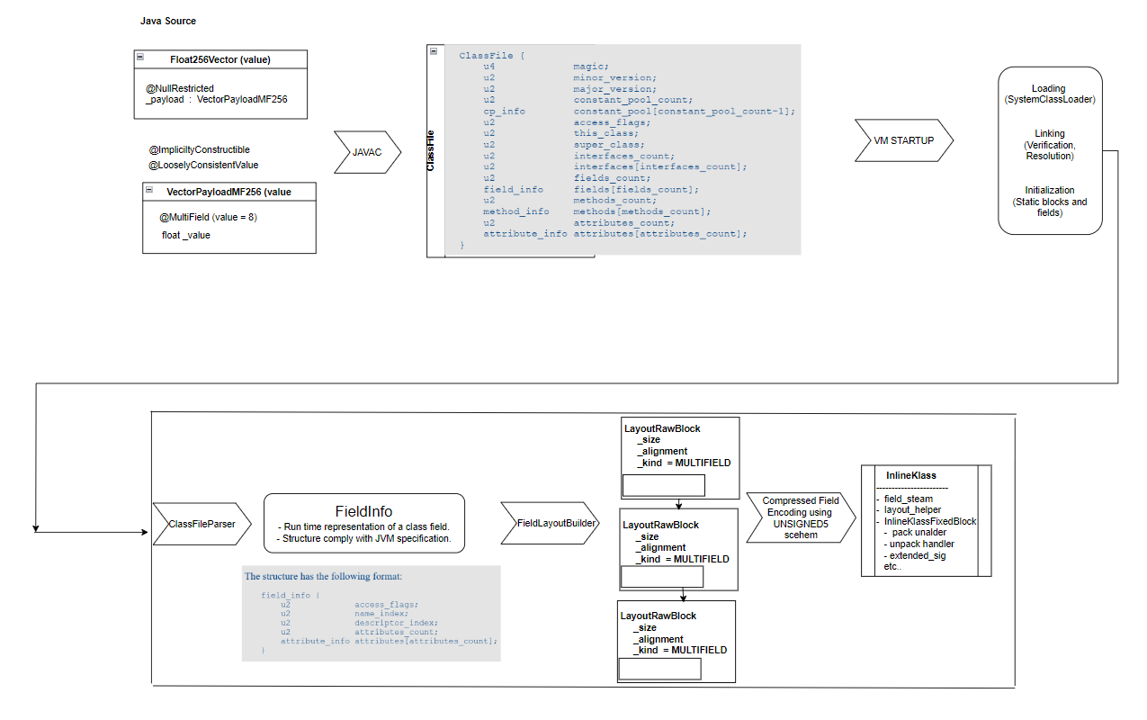
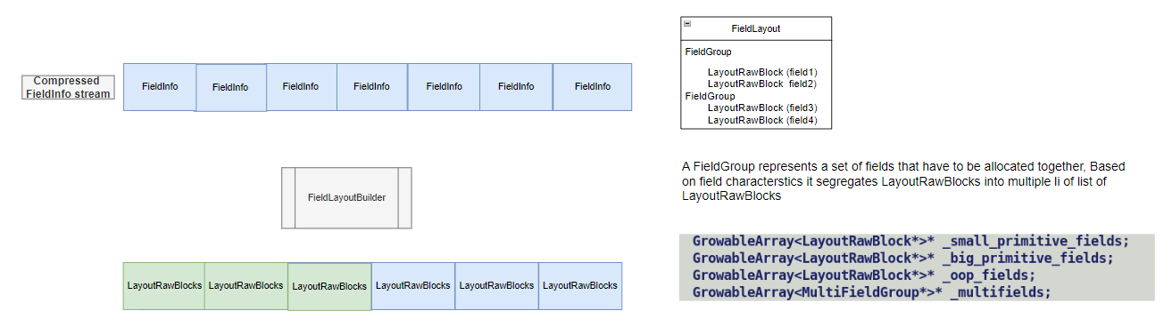
Multifield processing during Parsing.
Role of Field Layout Builder:
Computes the field layout of classes.
Creates a LayoutRawBlock (a fundamental element of a layout) for each FieldInfo to capture its size and alignment. Injects additional LayoutRawBlocks for padding and synthetic fields.
Maintains separate block lists for primitive, big-primitives, oops and multi-fields within FieldGroup.
Sorts and re-orders field for compact layout, build the oopmaps to record oop fields and records the exact layout size in Klass _layout_helper.
Responsible for value type field flattening decisions for null-restricted fields.
Notes:
We created a separate LayoutRawBlock sub-group for multifield rather than treating it as a big-primitive field.
In order to create a run time representation of a class, VM parses associated class file, class is composed of methods, fields , attributes, annotations interfaces etc.

Slide 10
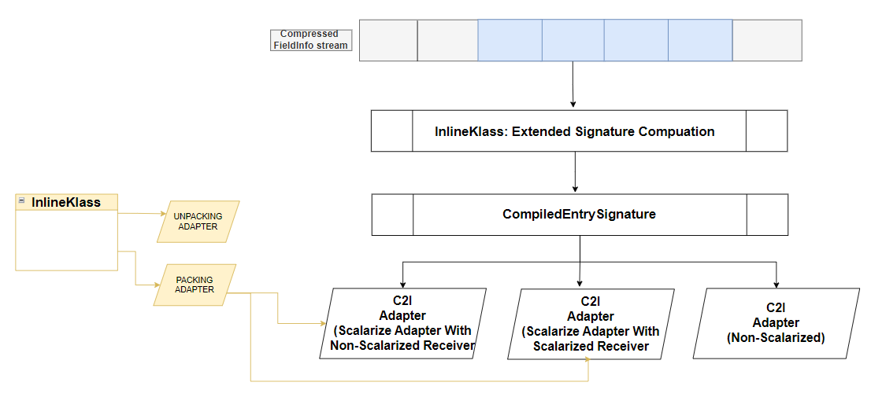

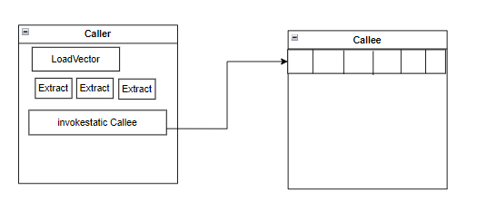
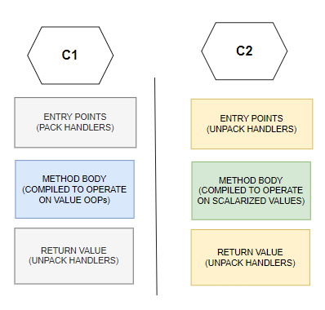
Oops model implications on Calling Conventions
During InlineKlass (a runtime representation of a value class) initialization VM perform following two distinctive actions based on the field infos
Extended signature computation, this is based on the argument signature and is recursive is nature and is computed by iterating on field info stream.
Packing / unpacking handler generation, used by c2i adapter and at compilers (c1/c2) entry points for assembling / dispersing fields of a value type arguments.
For multifield VM creates a separate signature entry for each scalar component of the bundle.
This mean caller will need to disassemble individual fields of a multifield held in a vector by way of vector extraction operation before invoking callee, and callee will re-assembler individual scalar values into Vector in a special entry point . Alternately multifield based value objects must always be boxed and unpacking entry points on callee side to load the multifield into a vector.
Method body is compiled by assuming value type arguments to passed as either oops (c1) OR in scalarized form as individual fields (c2), compiler never attempts to handle both the cases as it may lead to multiversioning. Entry points marshals the arguments based on one of the assumption.
For VectorAPI, all publicly exposed and internal methods have abstract vector / vector payload parameter.
C2 does not support mixed calling convention i.e. passing vector along with GPRs and returning a vector. VectorPayload constructors if not in-lined will return a vector.
For the time being to be safe we have explicitly disabled scalarization of concrete Vectors and Payloads.
Notes:
These problems may not occur if multifield are represented as one big primitive field.
Calling conventions consult argument / return value signatures to select a register (GPR or Floating Point)
In order to assign a vector register vector size needs to be passed explicitly.

Slide 11
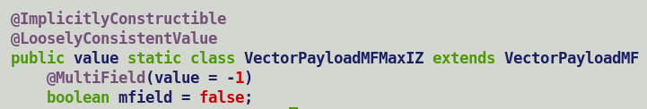
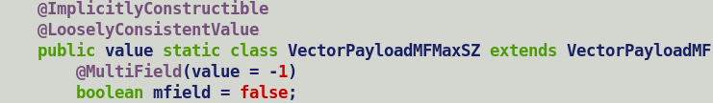
Multifield payloads for MaxSpecies
Multifield only accepts a constant replication count.
For max species, replication count is dependent on max vector size supported by the target and hence is computed dynamically during field parsing.
Field layout computations are sensitive to actual number of non-static fields in a class; hence parser queries VM for max vector size determined during VM initialization to estimate the replication count.
This prevents archiving MaxSpecies VectorPayload* classes in Static CDS archives (classes.jsa), which otherwise serializes all the java.base module classes.
For Shuffles and Masks, replication count is a function of max vector size and the container class type.
e.g. Mask payloads corresponding to IntMaxVector and ShortMaxVector will be based on boolean multifield, but their replication count will vary over AVX-512 targets i.e. 16 for IntMaxMask and 32 for ShortMaxMask.
To handle this, multiple payload class definitions are created for shuffles / masks where both vector type and multifield type encoded in the class name. This enable parser to compute exact replication count by dividing max vector size by a factor which is determined through class name based symbol lookup (ID3)

Slide 12
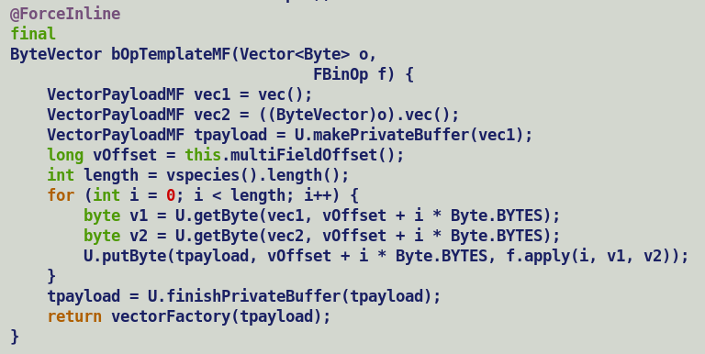
Modified fallback implementation
New fallback implementation using Unsafe payload accesses, applicable to unary, binary and ternary operation kernels.
Kerner first loads the payload of incoming vector operands, which being a flat value field loads entire multifield bundle.
Once the payloads are ready, resultant payload is transitioned into larval state to make it’s a mutable entity.
This is followed by an operation loop which reads the source lanes using Unsafe get API, perform the desired operation and write the result back into mutable result using Unsafe put API.
Individual lane read/write accesses do not translate into Vector Extract / Insert operations, instead vectors contents are dumped into buffer, write addresses are computed and update are performed at corresponding address.
Since each address holds a different offset w.r.t to buffer base, individual stores are allocated different alias indices. (ID4). After updating the specific buffer lane, inline expander re-materialized scalarized IR from modified memory state.
After the update loop, resultant payload is transition out of larval state, wrapped into is corresponding vector box and passed to downstream graph.
Both C1 and C2 compile has intrinsic / native implementation for Unsafe get/put APIs.

Slide 13
Compiler Side Changes.
Compiler interface (ci) model extensions.
C1 specific support.
C2 specific support.

Slide 14
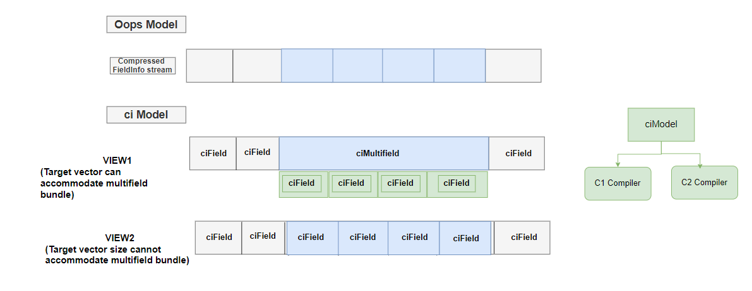
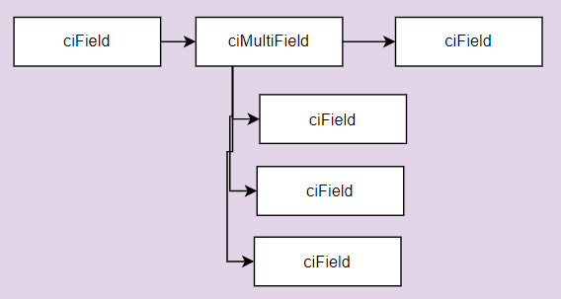
ci Model
Compilers access oops model (klass, instanceKlass, inlineKlass, method, field) through a proxy model called compiler interface.
Ci model is shared between both C1 and C2 compiler.
Based on target vector’s ability to accommodate multifield bundle, it presents multiple field representations to compiler i.e. either as a single ciMultifield OR a sequence of ciFields.
Please Note: ciMultifield is correct by construction i.e. its created only if its certain that multifield can be accommodated in target vector size.
Pros:
Cleaner interface to compiler, scalarization decisions based on target vector size is take upfront. [ID6]
Saves adding special handling in C2 to skip over synthetic multifields when it expect to treat multifield as single bundle.
Cons:
Generalization of Index and offset based field query APIs to preform linear or DFS walks over field stream based on an explicit argument passed by compiler, since c1 does not deal in vectors hence it will always prefer a DFS walks over ciMultifield for field resolution.

Slide 15
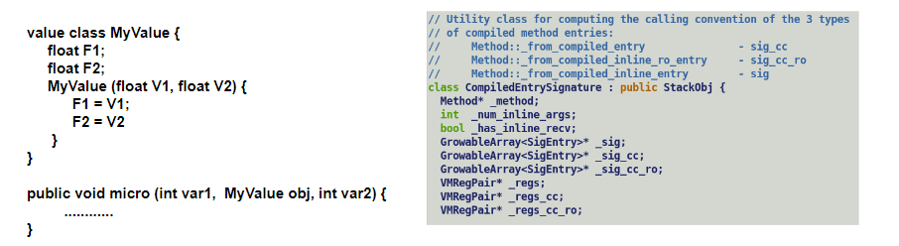
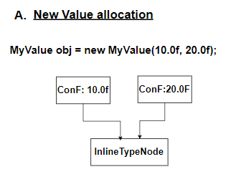
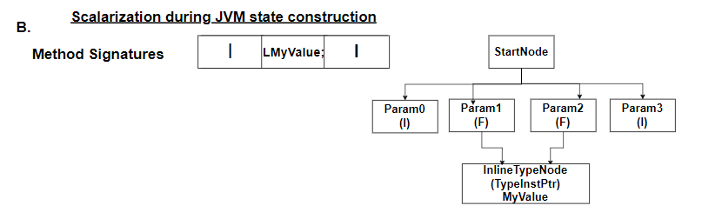
C2 Compiler Support
Compiler represents a value object using InlineTypeNode intermediate representation.
Runtime keeps a track of extended and actual method signatures to support both vanilla and scalarized calling convention.
Following are four intercepts where compiler creates an InlineTypeNode.

Slide 16
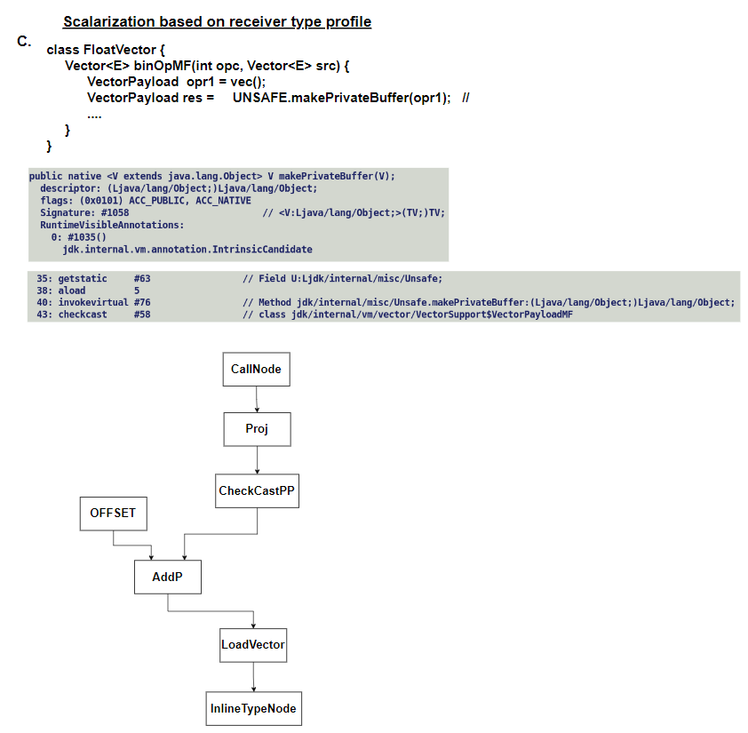
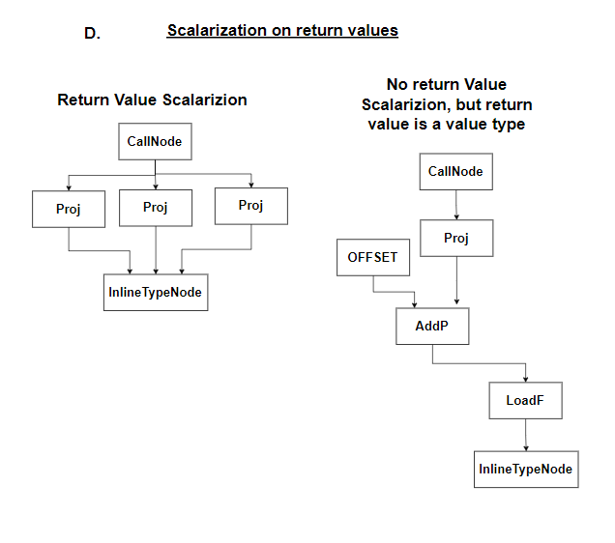
Scalarization Intercepts

Slide 17
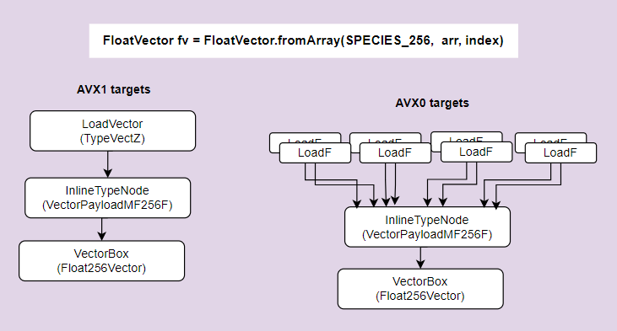
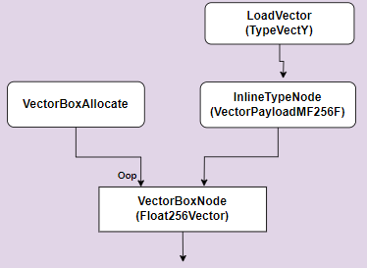
Vector IR representation.
For Vectors compiler generates two different IR shapes depending on the targets ability to load multifield into vector.
VectorBoxes now directly inherit an InlineTypeNode.[ID5]
Q. What is the need to create an explicit VectorBox and not directly use InlineTypeNode for vector box representation ?
VectorBox carry a VectorBoxAllocation node which holds the JVM state (memory / control edges) needed to created Allocation IR. Existing Valhalla infrastructure lacks the support for buffering during optimization passes. Any required buffering is either done during parsing OR during lazy inline expansions.
For Vector API boxes are expanded during one of the passes of PhaseVector.
For eliminated allocations bookkeepings at SafePoints i.e. creation of SafePointScalarObject node to capture the field values needed during object reconstruction we leverage existing Valhalla infrastructure.
An InlineTypeNode is replaced by its oop in downstream optimization passes if it truly has a non-scalarized use.

Slide 18
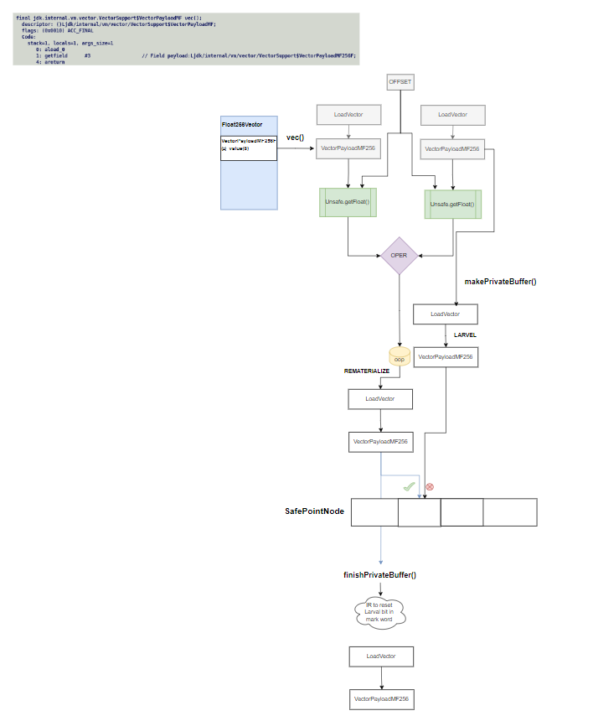
IR corresponding to Binary Kernel
Larval information is captured within the mark word of an oop.
Following actions needs to be performed to transition an InlineTypeNode to larval state:-
Node should be buffered.
Disable field scalarization.
Emission of relevant IR pallet to set the larval specific bit[s] in the mark word of buffer.
Complimentary actions are needed to transition a value out of larval state.

Slide 19
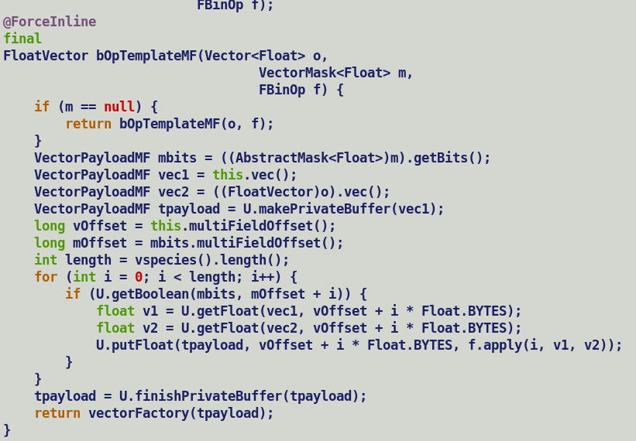
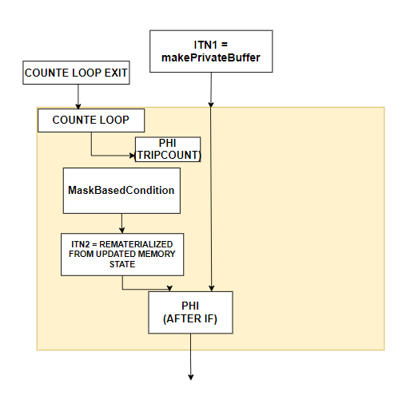
Problem with Unsafe.put
Unsafe put operation returns a void value, thus it only modifies the memory state but do not update any local variable in the block.
C2 parser leverages ciTypeFlow analysis to eagerly inject phi nodes for all induction variable identified by type flow analysis on encountering a loop header.
Because unsafe put never updated any local variable hence ciType could not detect an induction variable in the loop, due to which C2 misses on injecting an inductive phi node for incoming value object and this leads to incorrectness issues for masked vector operations.
Solution: Disable scalarization for mutable values [ID6]
Unsafe.makePrivateBuffer() intrinsic should return larval value oop instead of InlineTypeNode.
Unsafe.put operates over mutable oop and prevent InlineTypeNode re-materialization from modified memory state.
InlineTypeNode creation happened when value oops are transitioned out of larval state though Unsafe.finishPrivateBuffer().
Extend receiver type to capture larval state and disable profile driven InlineTypeNode creation during checkcast processing if profiled indicate a larval state.
Notes:
Suppress scalarization of value between make and finish private buffer calls.

Slide 20
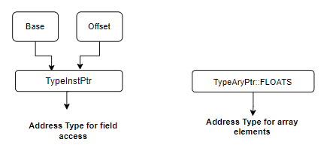
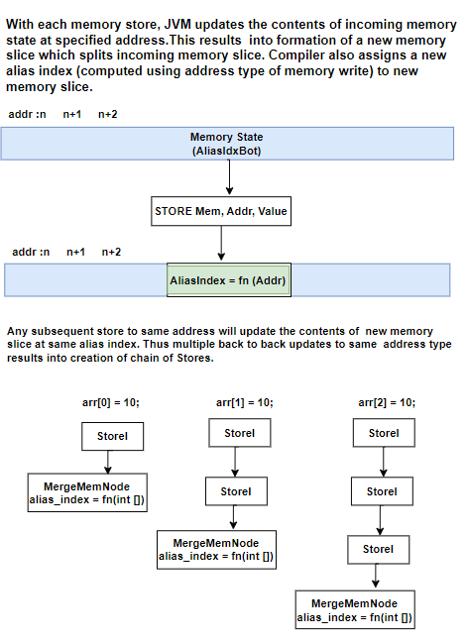
Aliasing behaviour of Vector Payloads
If two memory access are aliases, then compiler can do clever optimizations under strict ordering constraints. e.g., value forwarding from a previous store to subsequent load from same address.
C2 compiler uses Type Based Alias Analysis.
Existing arrays based backing storage assumes all the array elements are aliases and assigns same alias index to stores to different array indices.
This automatically enforces strict program ordering b/w stores to different array elements.
Multifield updates are semantically equivalent to a field update and are performed using Unsafe.put* APIs which accepts the address in (base + offset) form, thus each store is assigned a different alias index.
Unsafe stores follows relaxed memory ordering semantics, due to this compiler do not re-order stores w.r.t other ordered access in program order, thus stores at different multifield offsets follow the program order (ID7)
Q. Do we still need a memory barrier ?
A. Not really, relaxed memory ordering of unsafe operations prevents re-ordering loads and stores which strictly comply with program order.

Slide 21
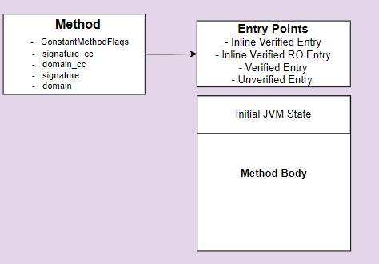
Notes on scalarization.
Methods are marked for argument / return value scalarization during adapter generation.
Decision to scalarize an argument is based on following factors.
Argument Signature, must be an InlineKlass.
Runtime flags (InlineTypePassFieldsAsArgs, InlineTypeReturnedAsFields).
Total number of argument must be withing JLS imposed limit of 255.
Once scalarization decision is taken, its recorded into ConstantMethodFlags (has_scalarized_args)
C2 compiler entry points generation is driven by above decision, compiler always unpacks the incoming value objects if they are passed as oops.
Method body always expects to receive scalarized arguments.

Slide 22
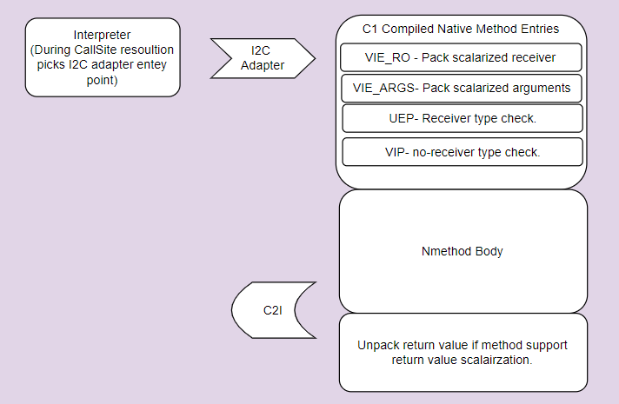
C1 Compiler Support.
With latest Valhalla 401 specification changes, earlier existing value types specific bytecodes aconst_init and withfield have been scrapped off.
Thus, only special handling needed in C1 w.r.t. multifield is during flat field copy operation which must copy all the synthetic fields of multifield bundle.
C1 always operates on value oops and no additional handling needed for multifields in existing unsafe get/put intrinsics apart from passing a DFS walk flag to field query APIs.
Unlike C2, both C1 and interpreter only operates over buffered value arguments. However, while returning a value instance it can dismantle it into multiple fields but as discussed, in absence of vector return calling convention we explicitly disabled return value scalarization for vector and payloads.

Slide 23
Notes on Larval state transition and issue involved.
Q. What is larval state ?
A. A value object is an immutable identity less entity. Any modification to fields of an immutable object results into creation of a new value. There are circumstances where user wants to break this immutability constraint for a while and grant pseudo identity semantics to a value object for freely applying chain of updates to it without creating a new value after each update, for this a value object needs to be transitioned into larval state.
Q. How can a value object be transitioned into and out of larval state ?
A. Using Unsafe.makePrivateBuffer and Unsafe.finishPrivateBufferAPI, these API have both native and optimized intrinsic based implementation.
Q. Do we need to transfer larval information of a value parameter to callee ?
A. A value object transitioned into a larval state in caller must receive back all the updates applied by callee over it. In general, an update to a value object creates a new value but in larval state we relax this constraint to ensure that chain of updates can be applied over same value object by granting temporal mutability.
.

Slide 24
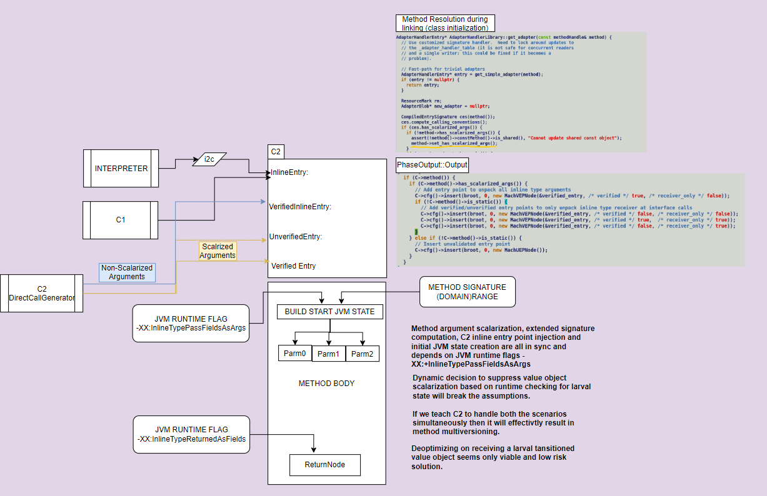
Problem with larvae arguments
Out of all the execution engines, C2 compiler is the only one which enforces value object scalarization.
Currently we do not propagate larval state across method and any updates over mutable value argument received by callee is not propagated back to caller.
Q. What should be done ?
1. Larval argument should be passed as an oop i.e., disable field scalarization.
2. C2 compiler must not attempt to unpack a larval value at inline entry points. This is tricky to address given that unpack handler operates over pre-computed extended signature entries and as discussed, signature computation is agnostic to larval state and is done upfront during adapter generation.
3. C2 compiler should not scalarize values at pre-discussed intercepts.
In a nutshell, larvae argument must be treated as an identity instance by callee.
Q. Does this pose any concerns for Vector API use case ?
A. Given that larvae lifetime is restricted b/w make and finish private buffer and internal / publicly exposed vector APIs operates on abstract values and payloads reduces the problem surface area for vector API use cases.

Slide 25
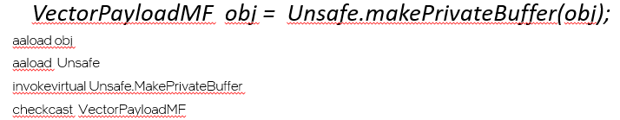
Larval state in context of Vector API
Mutable vectors / value scalarization must be disabled to suppress any un-intentional field value forwarding by compiler.
Generally, larval transitions are performed before a putfield operation but an unintentional getfield over mutable value must load the field contents from value’s oop, instead of returning an existing scalarized field value.
Thus, makePrivateBuffer intrinsic should return a payload oop instead of an InlineTypeNode.
However, native implementation of makePrivateBuffer returns a java.lang.Object which on subsequent checkcasting to a value type (speculative) is converted into a scalarized representation.
Extend receiver profile to record larval state and suppress scalarization of larval values. [ID8]

Slide 26
Generic approaches to handle larvae value object.
Infrastructure related technical debt.
No robust solution insight.
To be discussed.

Slide 27
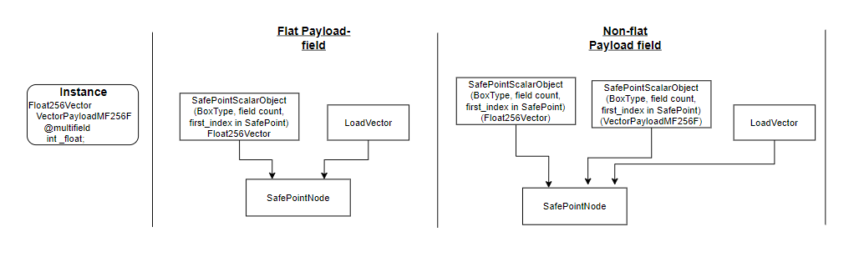
De-optimization Support
Object re-construction related bookkeeping for each scalarized IR at SafePoints.
SafePointScalarObject holds box type, field count and first field value index at SafePoint.
Compiler later transforms them into scope values dumped as part of debug stream for a JIT compiled method.
On method de-optimization, runtime iterates over corresponding debug stream to reconstruct eliminated object and initialize its field value.
Vector API leverage existing Valhalla infrastructure with some special handling for multifield initialization during value re-materialization.

Slide 28
lworld+vector status
Initial performance evaluation over all known opensource use cases of vector API is at par with JDK mainline.
Jvector: https://github.com/jbellis/jvector
JVector is a pure Java embedded vector search engine, used by DataStax Astra DB and Apache Cassandra.
Jlama: https://github.com/tjake/Jlama
Jlama is a pure Java implementation of a LLM inference engine.
Parquet-mr vectorized BytePacker decoder using Java VectorAPI
https://github.com/apache/parquet-mr/pull/1011
JavaFastPFOR: Vectorized integer compression using Vector API
https://github.com/lemire/JavaFastPFOR/pull/51
Simd-json: JSON parser using SIMD instruction
https://github.com/simdjson/simdjson-java/pull/20
Lucene. Accelerating vector search with SIMD instructions | Elastic Blog
All existing Vector API and Valhalla tests are passing with current support.
Next steps..
Align lworld+vector with new code model based on revised JEP 401 specification.
Fix identified gaps in implementation.
Thorough functional validation with various JVM flags.
Performance Benchmarking over Vector API JMH micros.
Request our Oracle friends for a code review.
Acknowledgements: Vladimir Ivanov (Oracle), Paul Sandoz (Oracle), Frederic Parain (Oracle), Tobias Hartmann (Oracle), ), Xiaohong Gong (ARM), Sandhya Viswanathan (Intel)

Slide 29
FP16 Support

Slide 30
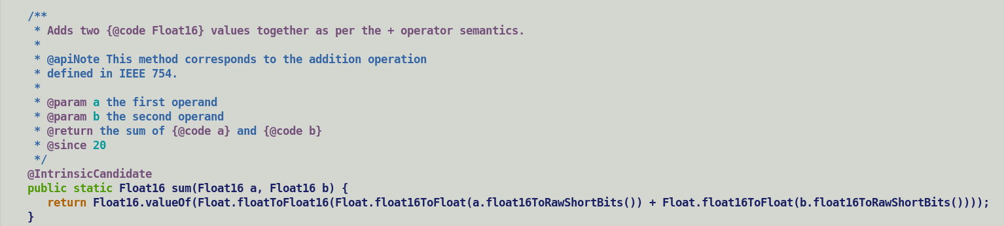
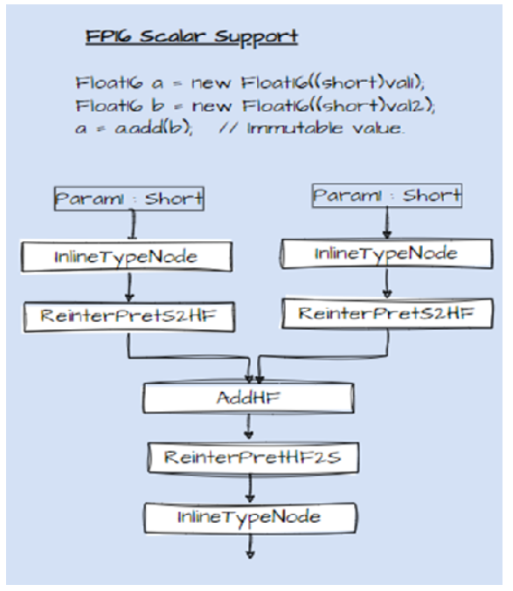
FP16 Status Update
Newly defined Float16 primitive value class encapsulate a short value holding IEEE 754 binary16 encoded value.
Array of primitive value class instances have a compact SIMD friendly flat layout.
Since JEP 401 scrapped primitive classes, so Float16 will become a null-restricted value type.
JVM already has a working support for flat arrays, but its not enabled for null-restricted value types. With minimum effort we can fix this.
In future will be aligned with other enhanced primitive wrapper classes proposed by JEP-402.
Float16 to support all the operations supported by corresponding Float class.
Currently end-to-end support for one operation Float16.sum is in place.
Java implementation of each API will internally perform floating point operation at FP32 granularity.
API which can be directly mapped to an Intel AVX512FP16 instruction will be a candidate for intensification by C2 compiler.
With Valhalla, C2 compiler always creates an InlineType IR node for a value class instance. Total number of inputs of an InlineType node match the number of non-static fields. In this case node will have one input of short type TypeInt::SHORT.
Since all the scalar AVX512FP16 instructions operate on floating point registers and Float16 backing storage is held in a general-purpose register hence we need to introduce appropriate conversion IR which moves a 16-bit value from GPR to a XMM register and vice versa.

Slide 31
Current plan is to introduce a new IR node for each operation which is a subclass of its corresponding single precision IR node. This will allow leveraging idealization routines (Ideal/Identity/Value) of its parent operation.
All the single/double precision IR nodes carry a Type::FLOAT/DOUBLE ideal type. This represents entire FP32/64 value range and is different from integral types which explicitly record lower and upper bounds of value ranges. Value resolution routines operating over integral types calibrates the lattice associated with IR node based on flow function depicting the semantics of the operation.
There are two separate ideal type for floating point constants TypeF and TypeD, these are singleton types and represents a unique single/double precision floating point value
Ideal types are linked to specific register classes and determine the allocation set for register allocator.
Since FP16 value range is a proper subset of FP32 value range hence all the newly created IR nodes will still carry Type::FLOAT type.
To handle constant folding scenarios value routines associated with newly introduced conversion IR nodes convert an FP16 constant to a FP32 constant (TypeF) value using existing runtime helpers. Constant folding is performed by existing idealization routines of parent IR nodes.
Auto-vectorizer scans through packs of scalar IR and considers the container type for new FP16 IR and conversion nodes as a short type.
Above design is generic and should work for any reduced precision types like FP8 values.

Slide 33
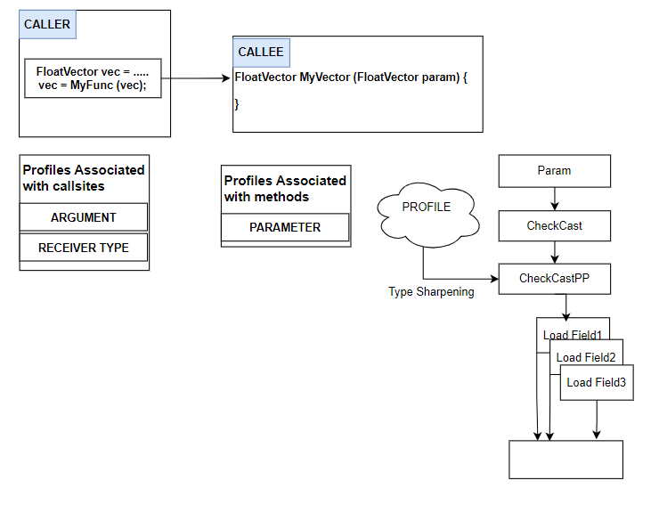
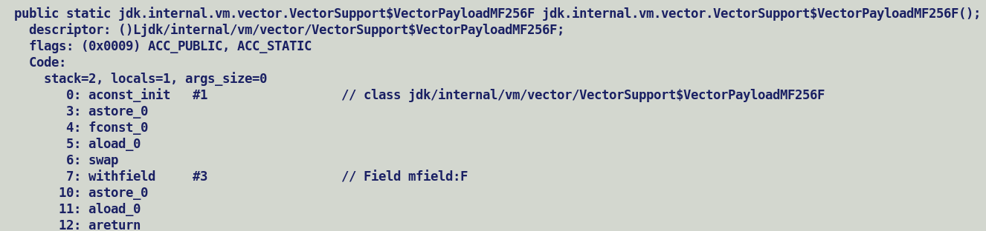
Scalarization in context of vectors..
VectorAPI expose vectors through abstract vector interface.
User defined methods accepting abstract vectors will not be marked with has_scalarize_args flags.
A call accepting vector argument if not in-lined will pass boxed vectors, any profile drive type sharpening will result into explicit scalarization on callee side.
Explicitly scalarized value arguments and return values pass individual component fields based on existing argument and new return calling convention. C2 does not support mixed scalar / vector calling convention.
In absence of mixed argument and vector return calling convention, currently we explicitly disable scalarization of vectors return values. [ID8], applicable to concrete vector payloads factory constructor methods which sometime are non-inlined specially during warm-up phase.

