Slide 1
Generic Vector Operand Support

Slide 2
Background
X86 targets provides SIMD instructions – These instructions perform same operations over multiple data elements and thus significantly improves the runtime performance.
SIMD support came in with MMX target extension and over the years was extended through various extension SSE, SSE2, SSE3, SSE4, AVX, AVX2 and AVX512
SSE instructions operates over 16-byte XMM register, AVX/AVX2 over 32-byte vector register and AVX512 64-byte ZMM registers.

Slide 3
In order to support vector operation JIT compilers were extended.
C2 compiler support vectorization in two ways:-
Implicit - Auto Vectorization : Super-Word extraction from loops, unrolling and packing operation across multiple iterations.
Explicit - Vector API : Java source is written using vector APIs, c2 creates compiler intrinsic for them which are lowered into vector operations.
To support vector operations Instruction selector was significantly enhanced to cover various patterns for different vector instructions.
This was main contributor to increase in JVM binary (libjvm.so) size.

Slide 4
Problem Definition:
There were multiple instruction patterns for various vector operations which meagerly differed in vector lengths of input/output operands i.e. they had same selector predication logic, matching pattern, data flow attribution (effect clause) over operands and same number of operands.
This multiplicity in patterns for same operation meagerly differing in vector operands translated to generation of lots of extra functional and conditional logic which effectivity increases the libjvm.so size.
Collapsing such multiple patterns to one pattern not only helped in size reduction of generated object files but also help in better maintenance and cleanup of AD files.

Slide 5
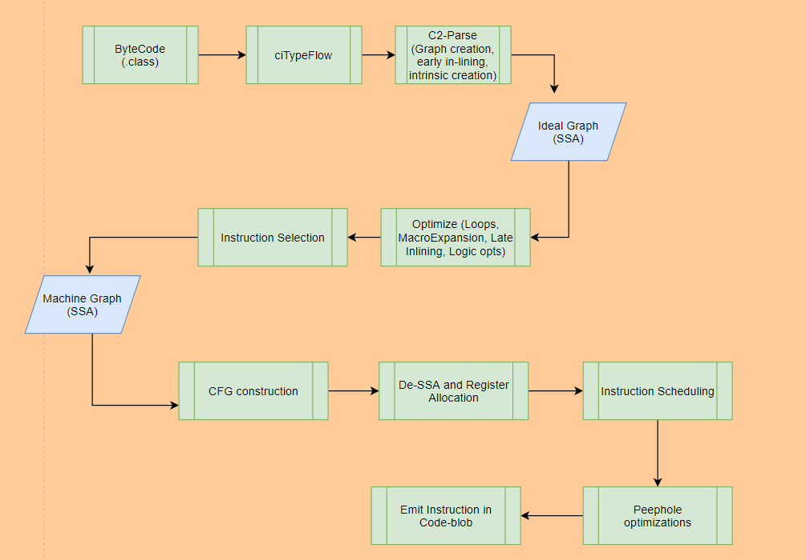
C2- Compilation Flow

Slide 6
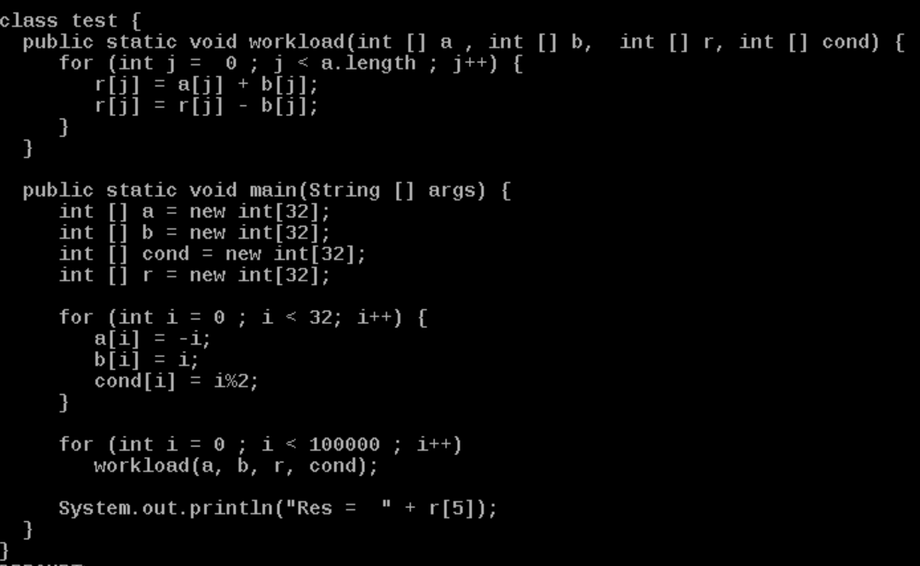
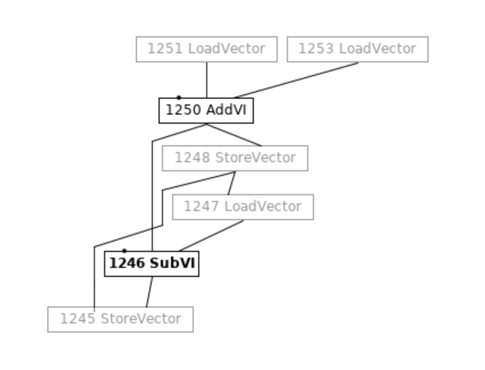
Example - Java Method: micro workload and it’s IDEAL graph.

Slide 7
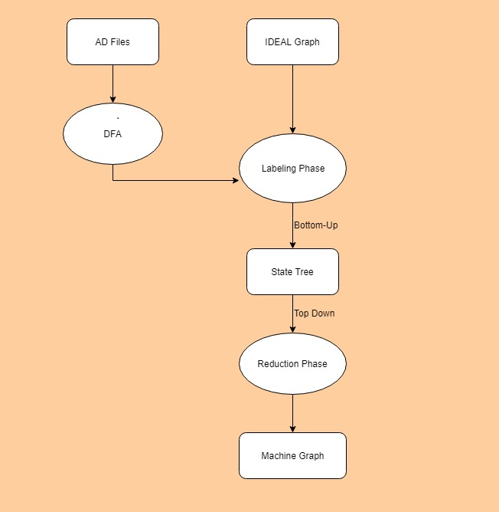
C2 - Instruction Selection
BURS style (bottom-up rewriting system).
Dynamic programming based. Instruction cost as optimizing function.
Two phased
Labelling (bottom-up)
Reduction (top-down).

Slide 8
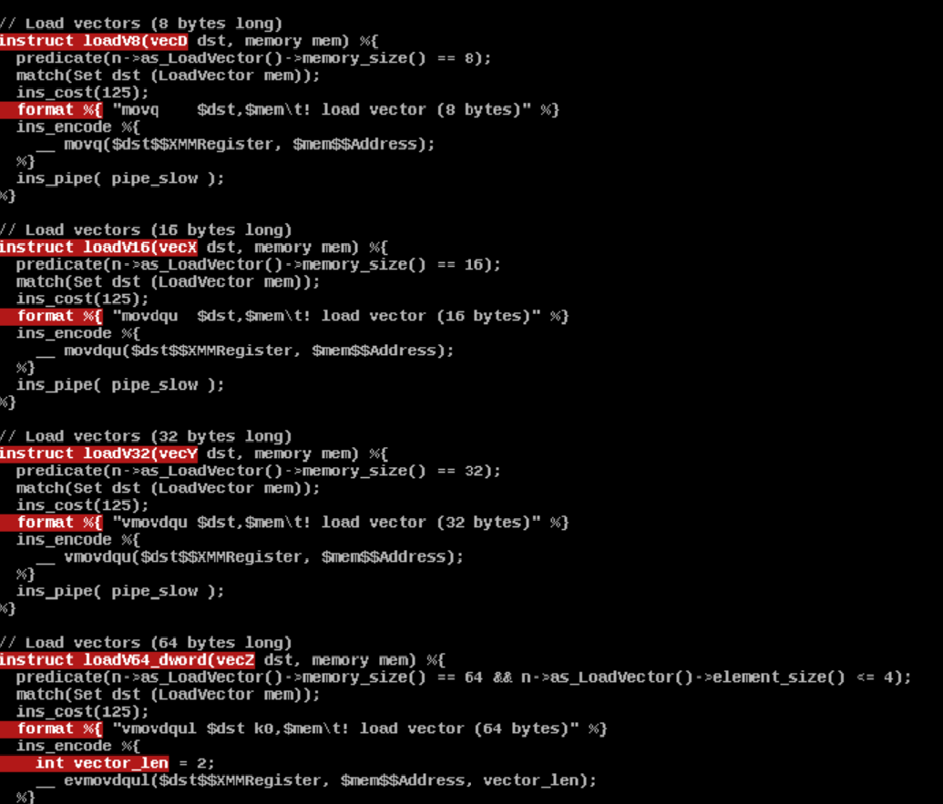
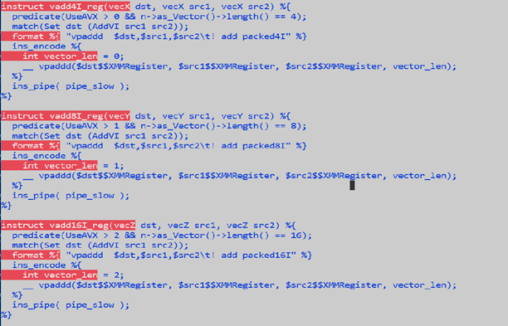
Instruction Patterns for Vector Load and Vector Add operation

Slide 9
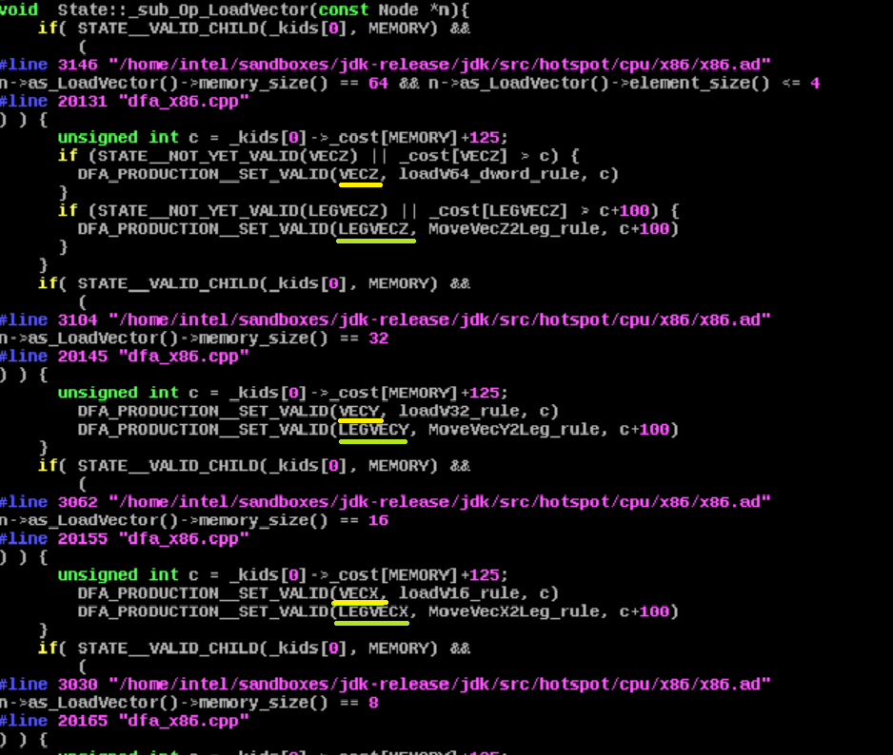
DFA for Load Vector – Current..
Notes:
Each state corresponding to Ideal node is populated with legal transitions (ones which obeys predicate logic) during bottom up labeling phase.

Slide 10
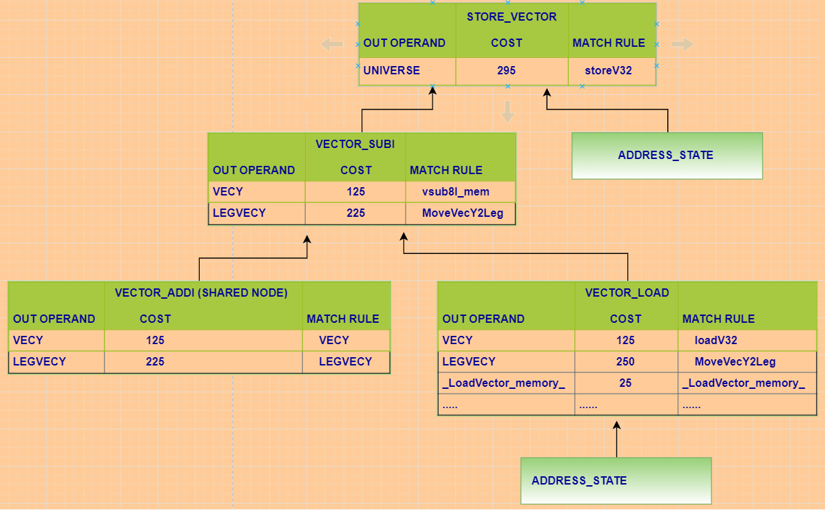
State Tree Construction:
Notes:
State tree is a binary tree which has left and right child nodes.
Each state node encapsulates following
Set of valid transitions i.e. reduction rules and its corresponding output operand.
Cost associated with each rule.
Additional chain rules which transform into a glue node to connect DEF and USE operands having same type but different register class.

Slide 11
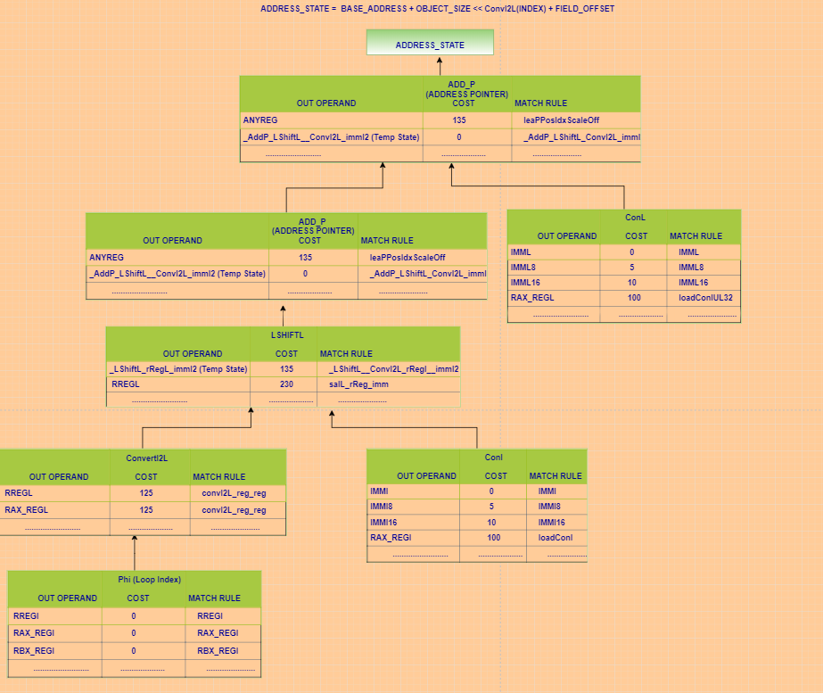

Slide 12
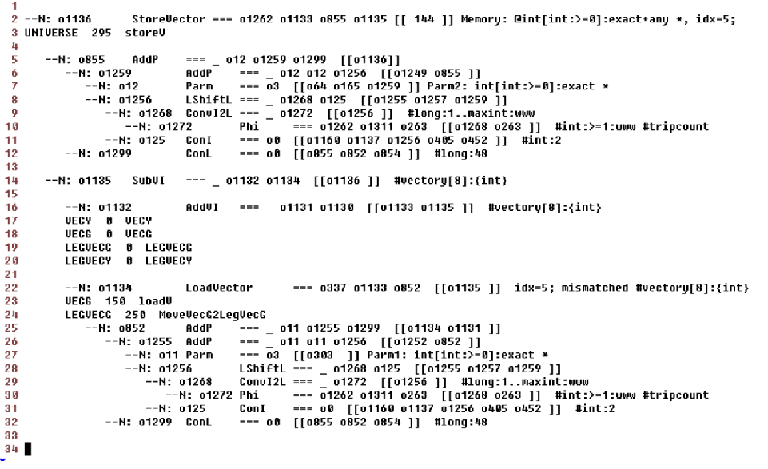







Slide 13
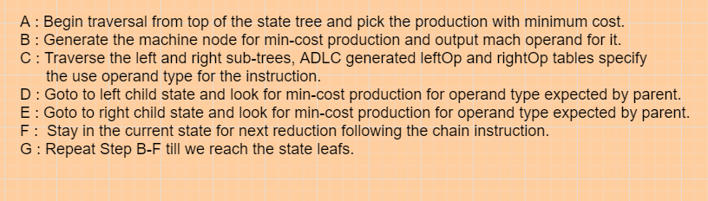
Reduction Algorithm:

Slide 14
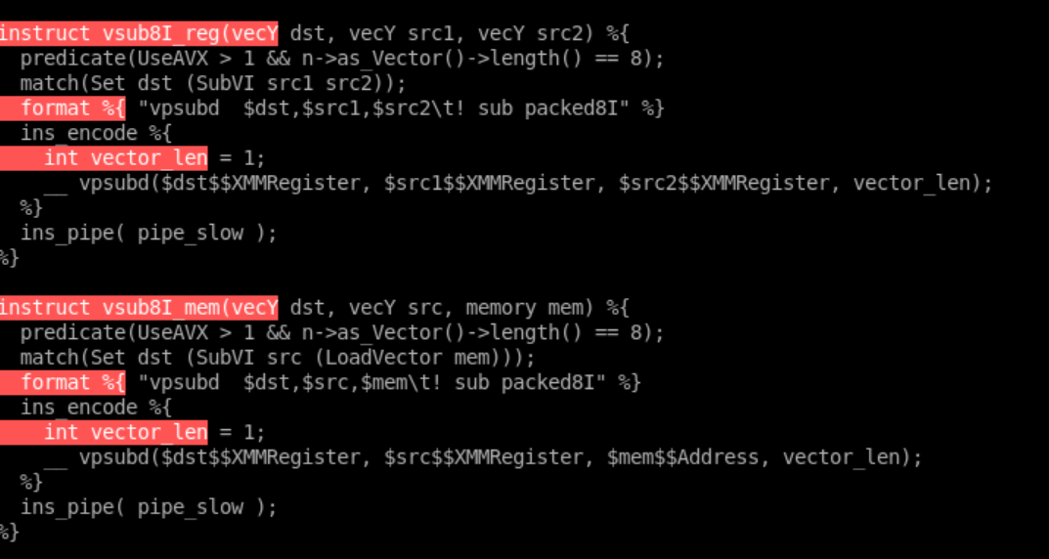
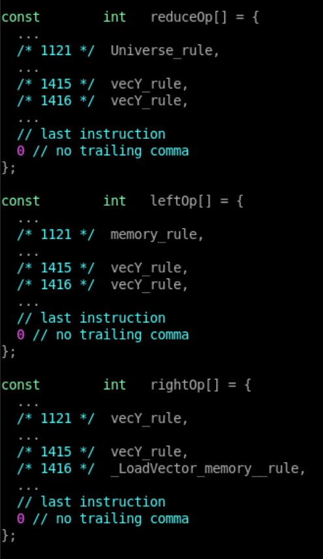
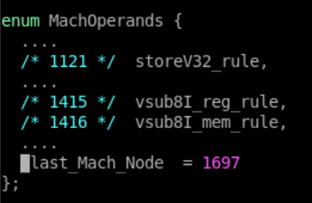

Slide 15
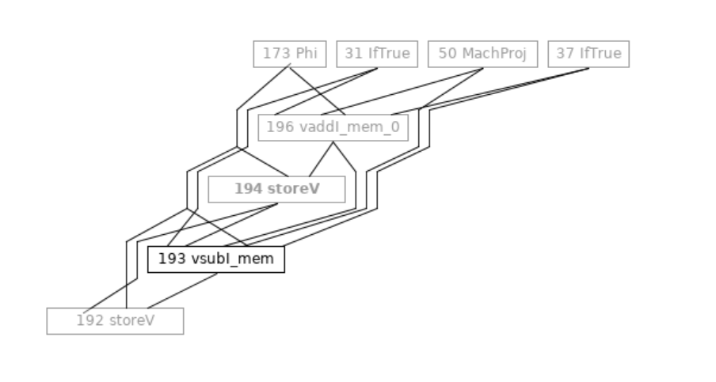
Reduction Example:

Slide 16
Vector Operand:
There were various vector operands like vecS, vecD, vecX, vecY, vecZ and each operand also had its corresponding legacy variant i.e. legVecS, legVecD, legVecX, legVecY and legVecZ.
A non-legacy and its corresponding legacy operand had same ideal type (Type::[VECX , VECY, VECZ] i.e. type and vector length) but differed in register classes associated with them.
Ideal types are propagated from Ideal node to its corresponding machine node.

Slide 17
Register Classes:
A register class is a collection of registers, each of which has the same vector length.
These register classes get translated to register masks which are associated with operands.
Register mask is bit vector where each bit corresponds to a 32-bit double word.
Register mask associated with the operands are used by register allocator to limit the allocation set for a def operand, also it is used to compute the spill slot size in case a definition needs to be spilled to memory on account of greater number of intersecting live ranges than available allocatable register set.
A legacy register class encapsulates registers from lower register bank where as a non-legacy register class encapsulates registers from both higher and lower register bank.
Dynamic register classes associated with vector operands select b/w the non-legacy OR legacy register class based on the CPUID of the target during VM initialization.
There are various instruction patterns where legacy register classes are associated with operands because some of the assembly instructions in the sequence are strictly supported over lower feature target.

Slide 18
Generic Operands:
To facilitate the collapsing of multiple instruction patterns differing meagerly in vector length of their operands two new generic operands have been created vec and legVec.
Dummy register class are associated with generic operands.
To minimize the effect of new generic operands over downstream passes a new post selection stage is added which replaces the generic operands with concrete operands having legal vector lengths and register mask.

Slide 19
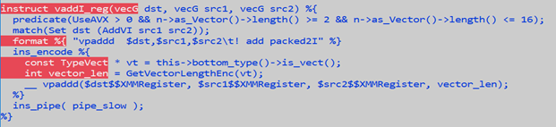
Pattern collapsing using generic operands

Slide 20
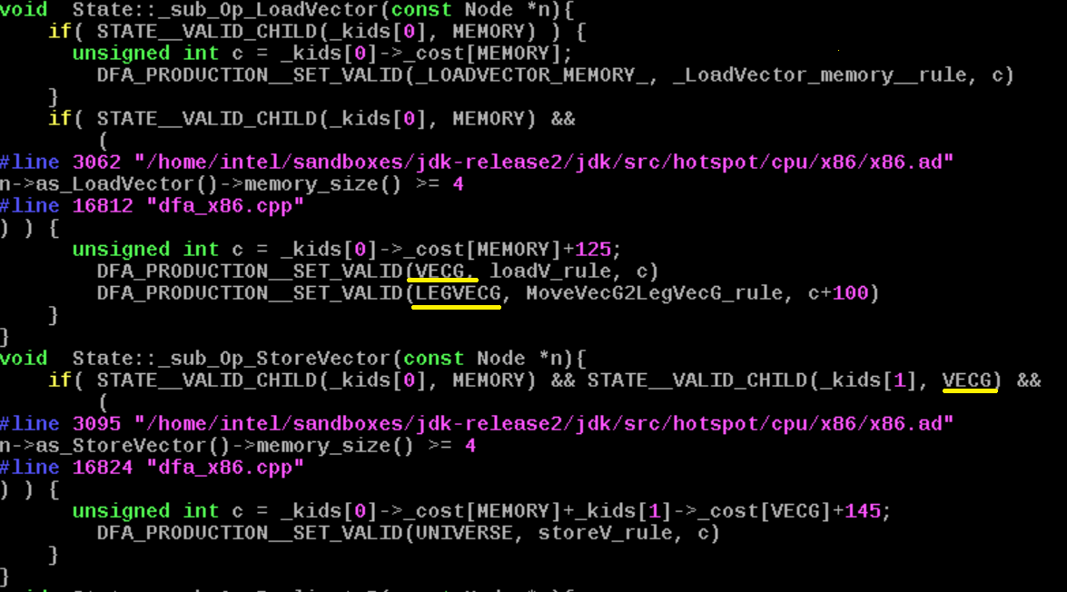
DFA for LoadVector– New..

Slide 21
Post-selection stage
In order to keep the downstream passes transparent to generic operands creation during selection, a new post selection pass has been introduced.
This pass is currently invoked only for X86 target and its primarily responsible for replacement of generic operand with their corresponding concreter vector length operands using the ideal type associated with machine nodes.
Operand resolution is done for a def operand, since graph still maintains SSA nature, hence each use has exactly one definition associated with it, this property is used to propagate the resolved concrete operand from def to its users.

Slide 22
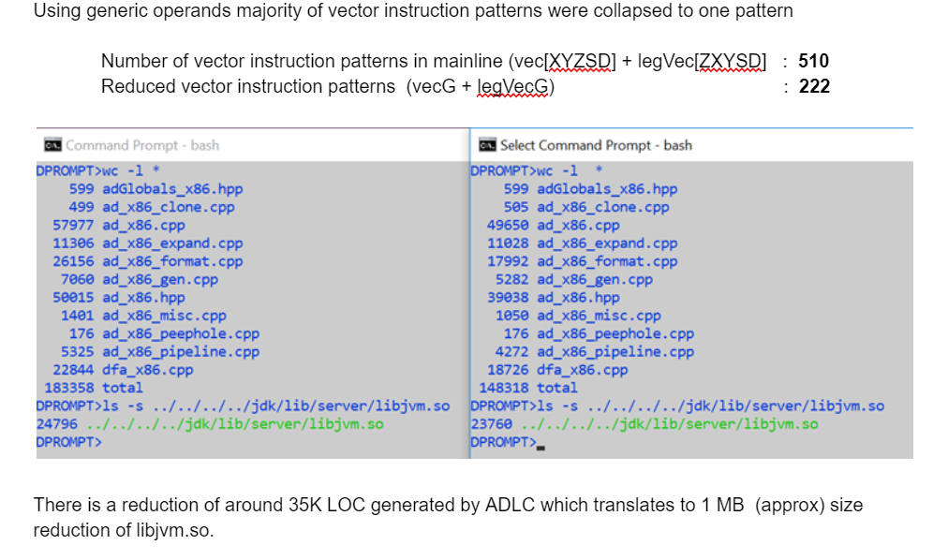
Results (1+MB size reduction in libjvm.so)

Slide 23
OpenJDK – git change lists for generic operands.
979cd452ab3 8234391: C2: Generic vector operands
0de20e8d0d3 8235756: C2: Merge AD instructions for DivV, SqrtV, and FmaV nodes
a05395c6af2 8235719: C2: Merge AD instructions for ShiftV, AbsV, and NegV nodes
9251e91271b 8235688: C2: Merge AD instructions for AddV, SubV, and MulV nodes
df5fba325da 8235405: C2: Merge AD instructions for different vector operations
31e075b019b 8234392: C2: Extend Matcher::match_rule_supported_vector() with element type information
a96089059a2 8234394: C2: Dynamic register class support in ADLC
fb0b8f1d0c3 8234387: C2: Better support of operands with multiple match rules in AD files
a3c0f4c8043 8235825: C2: Merge AD instructions for Replicate nodes
7840d02140e 8235824: C2: Merge AD instructions for AddReductionV and MulReductionV nodes

