Slide 1
lworld+vector

Slide 2
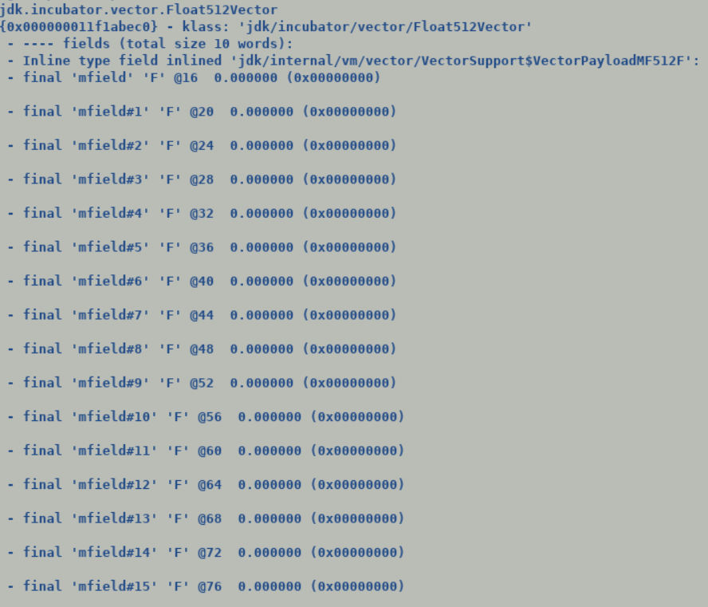
Java Side Changes
Replaced existing backing storage of concrete vectors from current primitive arrays to multi-fields.
Payloads are now primitive class instances; this makes them immutable identity less entities . In future it will be aligned with JEP 401 as a null-restricted value type
Earlier vector payloads were backed by arrays which are mutable data structures, even final array elements can be modified, only @Stable OR frozen arrays (still under draft) ensures complete immutability.
VectorPayloads are immutable value objects, any modification to its field[s] creates a new value object.
Multi-field is a new non-public JDK internal annotation which replicates the scalar field it is attached to e.g.
@multifield (value = <constant>)
byte mfield;
Under default settings payload are flattened into their concrete box containers, this also saves expensive allocation, currently we need to explicitly allocate array payload along with box allocation. InlineFieldMaxFlatSize (default 128 bytes) guides the flatting behavior of value objects.
Vector concrete classes become value class instances holding primitive class payload instances.
Significant re-designing of existing vector class hierarchy.
Top level VectorSupport class holds all the multifield payload class declarations. Thus, these classes are part of java.base module.
Re-wrote existing fallback implementation of all the existing vector APIs routines to access multi-fields-based payload through unsafe accesses.

Slide 3
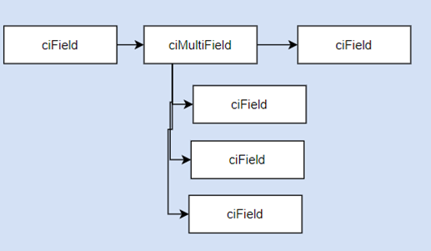
VM and C2 side changes
Merged latest code from lworld to lworld+vector.
https://github.com/openjdk/valhalla/pull/815
There has been significant re-designing around InlineTypeNode which was needed for any further modifications.
JVM needs to be passed -XX:+EnablePrimitiveClasses runtime flag if class hierarchy contains a primitive class.
As all the concrete sub-classes of VectorPayloadMF are now part of Vector Support in java.base module hence it created build issues post merge.
To circumvent this problem special handling has been done to suppress run time errors for JDK internal primitive classes (multi-filed payloads are the only candidates currently).
EnablePrimitiveClasses implicitly with -add-modules=jdk.incubator.vector flag.
Augmented ciField and ciType with additional bits of information (is_multfield_base, is_multifield, secondary_fields_size), this enables C2 to view multi-field as a bundle and create vector IR node, it also simplified identity to value object transitions.
Extended ci mode with a new bookkeeping data structure ciMultiField to capture synthetic multifields. This ensures conformance b/w oop and ci model w.r.t to mutifields. This eases creating scalarized IR if vector size is not supported by a given target.
Vector boxes becomes InlineTypeNodes, relevant changes in Unboxing identity routines.
By making Vector Boxes as InlineTypeNodes we can now leverage Safe point scalarization, de-optimization handling done for inline types.
Suppress buffering after inline expansion for VectorBoxes to facilitate direct extraction of vector payloads during unboxing in subsequent vector API inline expander, currently is a call returns an inline type instance then return value is buffered.
With above changes in place, basic tests which does not need any box expansion is working fine.
Vector objects re-materialization handling for both flattened and non-flattened payloads (this will never be the case unless user explicitly reduces flatting size by tuning InlineFieldMaxFlatSize (default 128 bytes)
Box/unbox expansions for InlineTypeNode.

Slide 4
Value objects access points
Pass value objects as argument :
As a buffered value.
C2 has a special entry point to unpack the object into scalar fields.
Interpreter and C1 do not scalarize value arguments, neither does i2c adapter.
As scalarized fields.
Caller copies individual fields into scalars and then directly jumps at verified (monomorphic calls)/unverified entry points of compile method.
Creation of new value objects : (aconst_init, withfield)
Buffered : Over heap (C1 , Interpreter)
Read Field : (getfield/getstatic) Load field from heap
Write Field : (putfield/putstatic)
Create a clone of old value object.
Store new value into field.
Handle multi-fields during field copy operation.
Unbuffered : Compiler IR (C2)
Read Field : Returns the incoming IR node at field offset.
Write Field: Clone existing IR node and replace the incoming edge corresponding to old field with new value.
On deoptimization runtime reconstructs and reassigns a value object.
Return a value object : (areturn)
Pass back scalarized fields back to caller (c2)
Dismantle value instance IR and connect to Return IR.
Assign appropriate register masks to scalarized fields as per new java return convention.
Create the outgoing projections for each scalarized field and connect them to Call IR. This will allow connecting these projects to appropriate users in caller's context.
Pass back buffered value object.

Slide 5
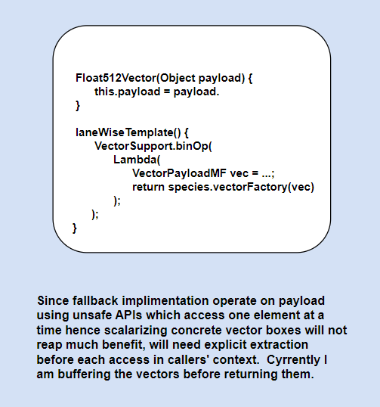
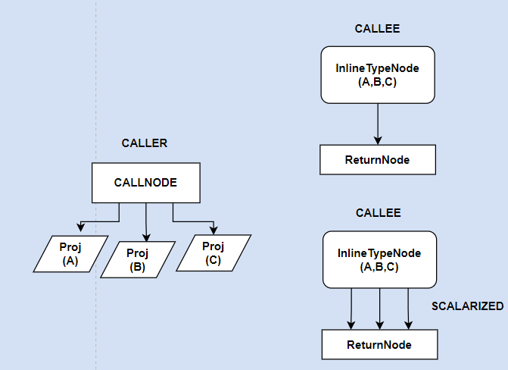
Return vector value scalarization.

Slide 6
TBD items:-
For PoC completion:-
PhaseVector selectively disable object serialization, C2 explicitly handles them in process_inline_types pass.
Crash during VM startup without –add-module=jdk.incubator.vector in exploded builds (non-image build).
Patch stabilization for all vector operations on linux and windows (seeing a crash on Windows). -
Replace explicit vector box expansion with buffering, box expansion can be a lightweight operations which simply returns the oop value contained in InlineTypeIR node.
@ForceInline attribute over leaf level payload allocation routines directly exposes inline type instances to c2 which then creates InlineTypeNode IR using make_from_oop routines before invoking expander for makePrivateBuffer for buffer allocation in larval state, this is succeeded by unsafe access APIs which operate over larval state allocations.
With –XX:-Inline (non-recommended flow) causes assertion in unsafe access expanders. (Tech debt Valhalla Infrastructure JDK-8239003)
Functionality completion:-
Variable value in @multi-field annotation.
Handler Shuffle and Mask operations:-
Java side fallback implementation changes.
Class hierarchy changes in VectorSupport.
Performance Validation:
Inspect the quality of emitted JIT code.
Vector Calling conventions TDB at a later stage.

Slide 7
PoC+ changes:-
Streamline vector / mask / shuffle IR with InlineTypeNode.
Almost all the vector APIs return an abstract vector type (not a value type).
If inline type node does not need buffering, i.e., all its fields are directly forwarded to the user IR.
Currently we create explicit VectorBox (embedding VectorBoxAllocation) and VectorUnbox nodes.
Stock InlineTypeNode favors eager buffering as done for value objects returned by non-inlined calls.
VectorBoxes are indeed inline types but currently represented by a specialized IR.
VectorUnbox is a lite weight operation which tier through the InlineTypeNode (Box) node and return the needed field to the consumer.
Cost of removing VectorUnbox Node and associated idealization routines :-
Mask and Shuffles use byte [] are a backing storage.
A mask load is a two-step process where first raw masks the masks are loaded into vector which is succeeded by VectorLoadMask operation which uncompressed the mask lanes to match upto vector lanes (for legacy targets), AVX-512 / SVE masks are propagated through predicate registers.
Masks casting optimization.
Similar to masks, shuffles load comprises of raw shuffle load followed by VectorLoadShuffle, current implementation perform shuffle load during unboxing idealization.
process_inline_type() automatically replaces any surviving InlineTypeNode with its oop (buffer) towards the end of optimization pass.

Slide 8
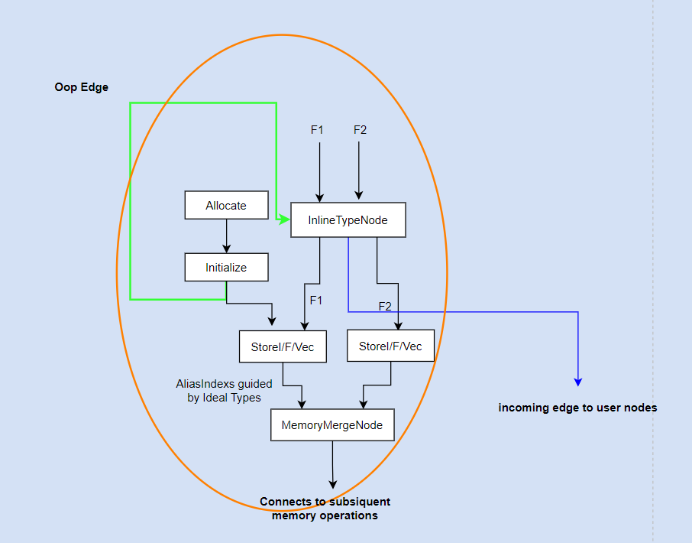
process_inline_type
In case InlineTypeNode become dead, there oops are tied to BlackHole.
But what about field store IR which gets tied to MemoryMergeNode.
This looks like tech debt in existing Valhalla infrastructure. To be investigated.

Slide 9
Valhalla:
Larval state.
Larval state is captured in the allocation nodes. Compiler post allocation expansion generates code to set the specific bits in the mark word of the objects.
GC ensures to re-instantiate the larval state in the destination post scavenging.
Any modifications over non-larval instance using unsafe API result into runtime exception.
C2 creates InlineTypeNode IR for a value/primitive object, but the hash value for the node does not capture the larval information, this may result into incorrect sharing during GVN.
Object Layout:
Computed by FieldLayoutBuilder::build_layout, for value object, size is computed by fully flattening the value fields. GC object movement will be preserved.
Debug Trace options: –XX:+PrintFieldLayout, -XX:+PrintInlineLayout.

Slide 10
Valhalla cont..
Mirror is a klass specific oop which contains both static and instance specific fields. Unlike InstanseKlass, InlineKlass contains two mirror objects, a val_mirror and a ref_mirror.
HeapAccess APIs for Value object copy
static inline void value_copy(void* src, void* dst, InlineKlass* md)
Runtime Support for packing/unpacking
BufferedInlineTypeBlob* SharedRuntime::generate_buffered_inline_type_adapter(const InlineKlass* vk)
Runtime representation of InlineKlass encapsulates specialized packing/unpacking handlers.

Slide 11
Object Model intercepts:-
Oop data model:-
ClassFileParser
|_ _fields [u2*] -> Array of FieldInfo* (includes declared, injected and multifields)
Iterator : FieldsStream
Accessors :
Private: FieldInfo* field()
Public: fieldDescriptor& field_descriptor();
InlineKlass type contains explicit packing/unpacking methods initialized upfront.
These handlers are used by C1,Interpreter currently and GC barriers which need to pack the scalarized fields into a buffer.
A new method skip_value_scalarization enables interpreter to prevent scalarization of returned value objects, since entire scalarization handling is under global InlineTypePassFieldsAsArgs and InlineTypeReturnedAsFields.
ci data model (mainly used by c1 and c2 compiler to query Oop DM)
Both c1 and c2 compiler share the ci model. At construction time ci queries target vector size to either create a ciMultifield if vector can accommodate entire multifield bundle or generates scalarized ciFields.

Slide 12
Object Model Intercepts…
Apart from C2 compiler all the other components which directly access oop fields using AllFieldStream/JavaFieldStream will get exposed to FieldInfo structures for both base and synthetic multi-fields.
As usual, parser always creates a distinct FieldInfo for each scalar field of a multifield bundle.
Compilers do not have direct access to oops model and use compiler interface to query it.

Slide 13
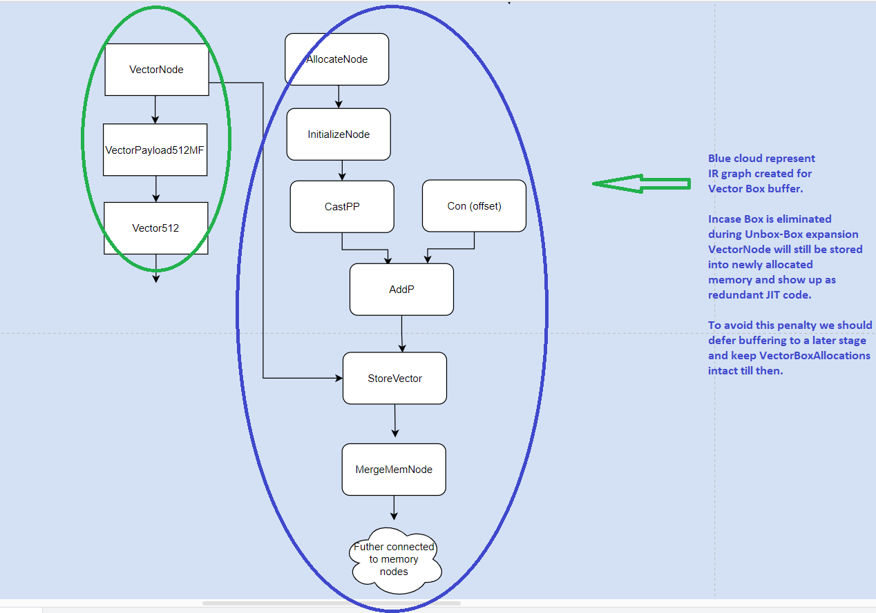
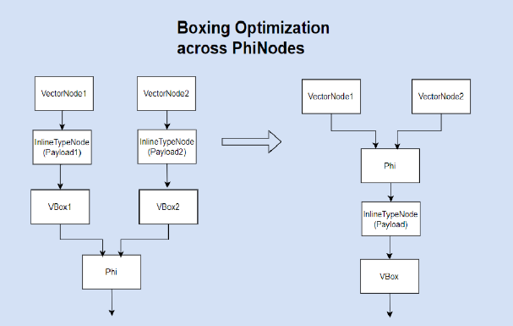
Status Update
Refactoring around boxing – un-bocking expansion.
Attempted early buffering and eliding VectorBoxAllocate node.
Difficulty in removing buffer related IR , allocation , StoreVector etc.
Extended boxing handling around PhiNodes.
Some cleanups and fixes in field access APIs, deoptimization.
Object re-materialization should preserve the larval state of newly allocated vector payload boxes so that subsequent field updates by interpreter do not cause assertion failures. (WIP)
This could be directly patched on lowrld branch.
T1 = ValueObject.makePrivateBuffer(); ← A
Foreach v in Input
Unsafe.put (T1 + offset, func.apply(v1, v2)) <- Could see deoptimizations b/w A and before call for unsafe.put
Object re-materialization does not propagate larval state to interpreter.

Slide 14
Functional Validation
Configurations:-
-Xint
-XX:TieredStopAtLevel=1,2,3
-XX:-TieredCompilation
-XX:MaxVectorSize=8,16,32,64
-XX:+DeoptimizeALot
Vector Only tests are clean for first 2 configuration, with C2 only compilation problem seen in larval state preservation in deoptimization, most other binary/unary/ternary tests are passing.
JIT code sequence matches with stock implementation.

Slide 15
Community engagement
ARM folks (Xiaohong , Eric) showed interest in contributing towards masking support after PoC patch gets integrated.
Jatin will send a mail to Vladimir and others for review and PR integration by early next week after vector only tests are clean.
Will continue TBD items.

Slide 16
Validation Updates:-
Test suite:- Existing JTREG based VectorAPI tests.
Picked one test Float256Vector.java, eventually will regress all the test files.
-Xint and TieredStopAtLevel=1,2,3:-
All green
-XX:-TieredCompilation:- (60% complete)
Most of the tests are passing.
There are failures in IS_FINITE tests.
Root causing in progress, problem occurs during loop building phase a bare SafePointNode gets is queried for type information. Bare SafePoints are type-less nodes.
I can see VectorBoxAllocations substitutes them with SafePoints (??)
Saw failures in LoadStore tests, problem root caused , -XX:+EnablePrimitiveClasses was not getting set.
Need to strengthen it based on klass type in interpreter (like done for suppressing scalization).
On explicitly passing EnablePrimitveClasses tests work fine, there is one incorrectness issues which is not reproducible in stand along run, suspect related to deoptimization.
Handled multifield access in Unsafe.put/get operation
C2 always creates an InlineTypeNode for a value object, (VectorBoxes are also InlineTypeNodes but only created by inline expanders).
Fallback implementation makes use of Unsafe.put operations over payloads (VectorPayloadMF* instances).
Since multifield is loaded into a Vector an Unsafe get operation should either extract an element from Vector OR we buffer the InlineType and then load the filed value from it (this is chosen currently) anyways access APIs are only used in fallback implementation.

Slide 17
Plan
Check-in initial patch and then continue validation.
Commit rights.
This will allow ARM folks to contribute in parallel.

Slide 18
Status Update
Initial patch got checked-in, thanks to Vladimir and Xiaohong for reviews.
ARM has posted an incremental patch to support VectorMask as value types.
Merged lworld into lworld+vector, branch was out of sync since 4+ months. (patch waiting for sponsor)
Validation WIP :-
C2 failures are centered around SafePoint type access, to be root causes.
EnablePrimitiveType not getting when Load/Store tests are invoked through JTREG framework.
Root cause graph shape in PhiNode::Ideal

Slide 19
Root cause following graph shape during PhiNode::Ideal
2970 VectorBox === _ 2967 34 2969 [[ 562 557 ]] #jdk/incubator/vector/Byte256Vector$Byte256Mask:NotNull:exact * Oop:jdk/incubator/vector/Byte256Vector$Byte256Mask:NotNull:exact * !orig=[3040],... !jvms: VectorMask::fromArray @ bci:47 (line 212) Byte256VectorTests::ABSMaskedByte256VectorTests @ bci:63 (line 5256)
561 IfTrue === 559 [[ 2883 562 ]] #1 !jvms: VectorMask::fromArray @ bci:50 (line 212) Byte256VectorTests::ABSMaskedByte256VectorTests @ bci:63 (line 5256)
2883 If === 561 2882 [[ 2884 2885 ]] P=0.000001, C=-1.000000 !orig=[584] !jvms: VectorMask::fromArray @ bci:50 (line 212) Byte256VectorTests::ABSMaskedByte256VectorTests @ bci:63 (line 5256)
1181 LoadVector === 2876 2991 1180 [[ 1179 3038 ]] @jdk/incubator/vector/Byte256Vector$Byte256Mask:exact+16 *, name=mfield, idx=10; mismatched #vectory[32]:{bool} !jvms: Byte256Vector::lanewise @ bci:5 (line 279) Byte256Vector::lanewise @ bci:3 (line 42) Byte256VectorTests::ABSMaskedByte256VectorTests @ bci:107 (line 5261)
51 ConP === 0 [[ 52 60 137 146 252 259 332 340 452 434 557 565 801 788 2286 1058 1066 1081 1179 2286 3018 1808 1823 1907 1915 1969 1956 2279 2969 2994 3030 3031 3034 3036 3036 ]] #NULL
0 Root === 0 64 83 150 166 263 280 344 360 438 456 569 597 620 633 646 684 696 708 792 805 1070 1090 1188 1812 1832 1919 1960 1973 2243 2255 2267 2290 2305 2365 2394 2463 2834 2557 2833 2627 2826 2669 2813 2731 2756 |2152 2172 2504 [[ 0 1 3 2487 23 2435 26 2349 2343 32 34 50 51 59 69 78 2205 107 134 145 2155 2154 601 2821 329 1914 1771 1166 411 413 433 451 478 1099 500 502 1036 935 506 858 641 628 534 554 615 ]]
2876 IfFalse === 2875 [[ 1181 1177 3002 ]] #0 !orig=[1175] !jvms: Byte256Vector::lanewise @ bci:5 (line 279) Byte256Vector::lanewise @ bci:3 (line 42) Byte256VectorTests::ABSMaskedByte256VectorTests @ bci:107 (line 5261)
668 If === 652 667 [[ 669 670 ]] P=0.010156, C=23040.000000 !jvms: Byte256VectorTests::ABSMaskedByte256VectorTests @ bci:86 (line 5259)
2162 If === 2152 2161 [[ 2163 2164 ]] P=0.989844, C=22806.000000 !jvms: Byte256VectorTests::ABSMaskedByte256VectorTests @ bci:86 (line 5259)
562 CastPP === 561 2970 [[ 593 570 587 ]] #jdk/internal/vm/vector/VectorSupport$VectorPayload:NotNull * Oop:jdk/internal/vm/vector/VectorSupport$VectorPayload:NotNull * !jvms: VectorMask::fromArray @ bci:50 (line 212) Byte256VectorTests::ABSMaskedByte256VectorTests @ bci:63 (line 5256)
2884 IfFalse === 2883 [[ 587 611 3041 ]] #0 !orig=[585] !jvms: VectorMask::fromArray @ bci:50 (line 212) Byte256VectorTests::ABSMaskedByte256VectorTests @ bci:63 (line 5256)
1179 InlineType === _ 51 34 1181 [[ 1178 ]] #jdk/internal/vm/vector/VectorSupport$VectorPayloadMF256Z:NotNull:exact * Oop:jdk/internal/vm/vector/VectorSupport$VectorPayloadMF256Z:NotNull:exact * !jvms: Byte256Vector::lanewise @ bci:5 (line 279) Byte256Vector::lanewise @ bci:3 (line 42) Byte256VectorTests::ABSMaskedByte256VectorTests @ bci:107 (line 5261)
34 ConI === 0 [[ 2503 2257 2245 2233 2171 1823 1822 1179 1178 1081 1080 698 609 622 635 674 686 3019 3018 2969 2970 2994 2995 1801 3033 3037 3042 ]] #int:1
1177 CheckCastPP === 2876 587 [[ 1178 1180 1180 3034 ]] #jdk/incubator/vector/Byte256Vector$Byte256Mask:NotNull:exact * Oop:jdk/incubator/vector/Byte256Vector$Byte256Mask:NotNull:exact * !jvms: Byte256Vector::lanewise @ bci:5 (line 279) Byte256Vector::lanewise @ bci:3 (line 42) Byte256VectorTests::ABSMaskedByte256VectorTests @ bci:107 (line 5261)
669 IfTrue === 668 [[ 673 ]] #1 !jvms: Byte256VectorTests::ABSMaskedByte256VectorTests @ bci:86 (line 5259)
2164 IfFalse === 2162 [[ 673 ]] #0 !jvms: Byte256VectorTests::ABSMaskedByte256VectorTests @ bci:86 (line 5259)
587 CheckCastPP === 2884 562 [[ 1828 1808 3002 1184 616 629 642 1177 2170 680 692 704 1169 1169 788 801 2978 1066 1086 1184 ]] #jdk/incubator/vector/VectorMask:NotNull * Oop:jdk/incubator/vector/VectorMask:NotNull * !jvms: VectorMask::fromArray @ bci:50 (line 212) Byte256VectorTests::ABSMaskedByte256VectorTests @ bci:63 (line 5256)
1178 InlineType === _ 1177 34 1179 [[ 2152 2170 3002 1969 1956 ]] #jdk/incubator/vector/Byte256Vector$Byte256Mask:NotNull:exact * Oop:jdk/incubator/vector/Byte256Vector$Byte256Mask:NotNull:exact * !jvms: Byte256Vector::lanewise @ bci:5 (line 279) Byte256Vector::lanewise @ bci:3 (line 42) Byte256VectorTests::ABSMaskedByte256VectorTests @ bci:107 (line 5261)
673 Region === 673 2164 669 [[ 673 2176 2167 2168 2893 2170 2172 3034 3036 3037 3038 ]] !jvms: Byte256VectorTests::ABSMaskedByte256VectorTests @ bci:132 (line 5258)
2170 Phi === 673 1178 587 [[ ]] #jdk/incubator/vector/VectorMask:NotNull * Oop:jdk/incubator/vector/VectorMask:NotNull * !jvms: Byte256VectorTests::ABSMaskedByte256VectorTests @ bci:86 (line 5259)

Slide 20
Status Update:-
Validation Updates:-
Root caused and fixed multiple regressions failures VectorAPI regressions.
Merging InlineTypeNodes with VectorBoxTypes.
Special handling for Long64 and Double64 during deoptimization, there values are passed though non-vector Locations (Location::register).
Currently VectorAPIs skip intrinsic creation for single lane elements and fall-back implementation operates over scalar code.
With Valhalla C2 creates an InlineTypeNode for any value object hence we see InlineTypeNode creation even in fall back implementation.
Boxes come into picture only when an API get intrinsified.
Bug fix around setting –XX:+EnablePrimitiveClass.
With these changes all *VectorTests.java are passing.
Pending bugs :-
Incorrectness issues seen during load/store from memory segment.
Conversion tests runs.
ARM has contributed Shuffle and Masking support.
Reviewed the patch looks good.
Waiting for Vladimir’s sponsorship.

Slide 21
Plan
ARMs patch integration.
Rebase lworld Merge pull request.
There have been significant changes in API interfaces during field parsing.
Max Species support.
Further validation and bug fixing on merged code.
Various AVX levels.
Compilation tiers (0,1,2,3,4).
Large kernel tests and JMHs.
Making vector as a true value type by extending calling convention (mixed calling convention which accepts both GPRs and Vectors), returning vector fields will save expensive allocation costs in non-inlining scenarios (pending on base Valhalla infrastructure to handling speculative Parameter type and extent inline entry points accordingly)

Slide 22
Status Update
Merge lworld into lworld+vector
Recently lworld was rebased with latest mainline
Significant changes in FieldInfo structure, FieldLayoutBuilder and field parsing.
Lots many conflicts needed manual interventions.
All the conflicts have been resolved and I can now do a clean build
Thanks for Xiaohong for resolving Java side conflicts around shuffle overhaul.
Able to run stand alone having few vector operations with -Xshare:off
Facing issues with CDS
All the VectorPayloadsMF* classes are part of java.base modules and are serialized in classes.jsa.
However, during restoration InlineFixedBlock receive garbage value in _exact_size_in_byte.
This causes crashes during Layout computation stage.
We do shallow copy while serializing know java classes in java.base module.

Slide 23
Status Update Valhalla Integration (29/06) :-
Integrate Merge patch (major merge after 4+ months with changes in core oops structures.
TODO items post merge:-
Check multifield handling during acmp parsing. Unlike identity objects values are compared at field level.
Values are buffered and fallback case does field level comparison using ValueObjectMethod::substitutable method.
De-opt incorrectness seen in JTREGs and deopt micros.
Some load store and VectorConversion test are failing.
MaxSpecies handling, extend scope of @multifield.
Re-visit ci field handing and field query APIs based on offset / index.
Add a new ci model API to query multifield scalarization in both C1 and C2.
CDS flow limitations (primaryType / secondaryType restoration)
Create a PR for InlineKlassFixedBlock pointer restoration against lworld branch.
Further validation and bug fixing on merged code.
Various AVX levels.
Compilation tiers (0,1,2,3,4).
Large kernel tests and JMHs.
Stretch items:-
Making vector as a true value type by extending calling convention (mixed calling convention which accepts both GPRs and Vectors).
Remove non-scalarization limitation from Vector / Payloads.
Replace VectorBoxes with InlineTypeNode after calling conventions are extended to support arguments / return values.

Slide 24
Updates (13/07/2023) :-
CDS issues:-
InlineKlassFixedBlock restoration fixed while reading shared archive during restoration of unshared data. [lworld, lworld+vector]
primaryType and secondaryType fields of java.lang.Class are now being explicitly allocated while archive loading. [lworld]
Clean-up of deoptimization pass (ARM)
Removed explicit handling for vector box reconstruction.
Support is not fully aligned with existing Valhalla infrastructure which already handles reallocation and re-assignment of InlineTypes.
Explicit handling for preserving larval state.
Multifield re-assignment.
Since box expansion and de-optiomation now leverage existing Valhalla infrastructure, we may move VectorPayloadMF* classes out of java.base module.
We still need to have create vmClass for top level VectorPaylod/Vector/Shuffle/mask class for subtype checks. Is_vector, is_payload.
Max Species support..
Regressions
Load / Store tests.
Conversion tests.

Slide 25
Other vector API Projects:-
[lworld+fp16]
FP16 scalar PoC support with compiler and runtime side support is in place.
Need to extend the patch to support all the operations supported by FP32.
Scalar intrinsification.
Auto-vectorization.
[vectorIntrinsics+fp16]
Existing support:-
ARM merged latest changes from jdk mainline into fp16 branch.
There are few failures post merge around reduction tests.
Branch contains new HalffloatVector and associated Java side implementation of vector APIs, JTREG and JMH tests.
MVP patch of x86 backend.
Missing pieces:-
C2 inline expander change for handling non-primitive Halffloat element type.
New C2 IR and complete backend support remaining vector operations.
Functional and performance testing.
Deprecate vectorIntrinsic+fp16 and move the code to lworld+fp16.

Slide 26
Status Update:-
Bug fixes:-
[c2] Incorrect binding of inline type node with Allocation IR.
[c2] Unexpected graph shape during boxing expansion.
[c1] Fixed offset computation in scalarized loop for multifield copy.
[oops] Population of static / non-static synthetic multifield.
Validation Status:-
As of now all the conversion and load/store tests and Vector operation tests are passing at UseAVX=3 apart from MaxSpecies related failures.
Pending regressions:-
2-3 failures of similar kind at lower AVX levels (0/1/2) in some tests.
Vector Tests passing at
Load / Store Tests passing at AT ALL AVX LEVELS.
CONVERSION TESTS ARE PASSING AT ALL AVX LEVELS.
Incorrectness issue around finishPriviateBuffer().
ROOT CAUSED
Unexpected graph shape during vector box expansion, extending the scope of assertion to accomodate checkcastPP works, to root cause existence of check cast PP in cyclic graph pattern.

Slide 27
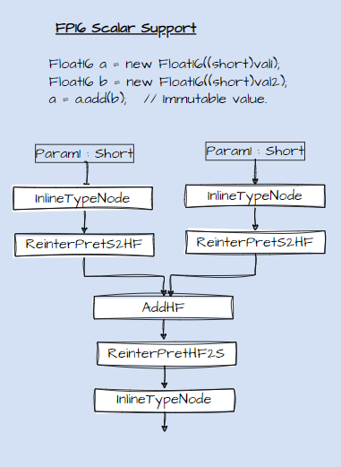
Float16 support:-
Initial MVP implementation to support FP16 operations
New Float16 primitive class encapsulating short storage holding 16-bit FP16 value.
Being a primitive type C2 create an InlineTypeNode for each Float16 object.
Explicit re-interpretation nodes b/w InlineTypeNodes and Half precision IR nodes enable loading short value held in GPR into XMM.
AddHF node still carry Type::FLOAT.
FP16 constant are converted to floating point constants (TypeF) using runtime helpers (hf2f / f2hs) before being constant folded by Value routines of operation IR nodes.
Thus, we can still support all the FP16 scalar operations without introducing a new Type.
PR for MVP implementation created against lworld+fp16 branch.
https://github.com/jatin-bhateja/valhalla/commit/b7b7231ae76f4f2a2510dd904aa407771a70c970
Next step we need different branch (lworld+fp16) for future work.

Slide 28
Vector Box -> InlineTypeNode replacements
Return value objects are guaranteed to scalarize unless InlineTypeReturnFieldsAsArgs is enabled.
Eager buffering instead of VBA creation may pose problems in removing allocation and initialization IR.
Delay buffering before passing Boxes as arguments / return values to non-intrinsified APIs.
Expander will again unbox incoming vector values which will always be InlineTypeNode (LoadVector/ [VectorLoadMask]).
It will also ease out converging Vector Value (InlineTypeNode) in non-IncrementalInlining flow, where VectorBoxes are created at parse-time, otherwise Phi converging nodes may have InlineType and VectorBox inputs.

Slide 29
e.g.
Source:-
FloatVector fv1 = FloatVector.fromArray(SPECIES, ARR1, IDX);
FloatVector fv2 = FloatVector.fromArray(SPECIES, ARR2, IDX);
Fv1.mul(fv2);
Parsing:
v1 = CallStatic VectorSupport.load1 -> checkcastpp -> InlineTypeNode
v2 = CallStatic VectorSupport.load2 -> checkcastpp -> InlineTypeNode
v3 = CallStatic VectorSupport.naryOp v1 , v2 -> checkcastpp -> InlineTypeNode → (A)
Call Non-Intrinsic API v3
Lazy Inline Expansion for naryOp
v1 = LoadVector (make_unsafe_addr(v1.oop))
v2 = LoadVector (make_unsafe_addr(v2.oop))
v3 = MulVF v1 v2
b1 = VectorBox v3 // Call in (A) gets replaced by VectorBox IR. Call was feeding into checkcast PP etc.. Either we allocate a buffer an initialize it with newly create box contents, as done in stock implementation
// But later if VectorBox is removed during Unbox – Box optimization then allocations + initialization IR of associated oop need to removed to. This will be a special handling for Vector API, we can use InlineTypeNode::remove_redundant_allocations in VectorUnboxNode::Identity to remove oop allocations if no more used of VectorBox exists.
Call Non-Intrinsic API b1 // Box Expansion needs JVM states which is captured into VectorBoxAllocation node.
No explicit VectorBox expansaion stage needed and VectorBox and VectorBoxAllocations can be removed,
When a vector box is passed to non-intrinsic API , process_inline_types will replace the box with its initialized oop field.

Slide 30
PhaseVector transforms
Expand_vunbox , light weight [Will still be needed]
Expand_vbox (Uses existing InlineTypeNode::store) [ Can be removed once VectorBoxes are replaced by InlineTypeNode]
Scalarize Vbox nodes
All functionality is moved to process_inline_types
Remaining transform to replace Phi (VBA, VBA) -> new VBA when passed as call argument saves costly VBA expansions to allocate and store IR. [ This is only real benefit of lazy VBA expansion]
This can be removed after calling convention changes when we pass scalarized vector box arguments i.e. directly passing a vector payload vectors.
As of now we buffer the vector value when passed across the calls, thus it’s good to save redundant VBA expansions in incoming phi blocks.
Stock inline objects are always guaranteed to be scalarized when passed as argument, also they do not have a vector fields, java does not have an explicit vector type from language perspective, all the fields of value objects are either of primitive types or reference type or value types. Which is why process_inline_types do not have a special handling in place for passing buffered arguments to calls.
Inline vector re-boxing calls, not used any more, could not find any occurrence of “mayBeRebox” in java code.

Slide 31
ToDO
Enable intrinsification of finishPrivateBuffer.

Slide 32
Status Update (24/08/2023)
Fixed multiple issues spanning across CDS, VM, CI Model , C1 and C2 compiler.
https://github.com/openjdk/valhalla/pull/909
Patch is now checked into lworld+vector
Added a new API ciEnv::is_multifield_scalarized, to create scalarized ciField[s] in case target vector cannot handled multifield bundle size, else it create a hierarchical structure ciMultiField an expose entire multifield bundle as one field to C2 compiler.
This cleans up lots of special handling done in C2 compiler, ci field query APIs and object reconstruction handling at SafePoints.
Patch will be posted for review post validation.
Validation Status with patch.
All VectorAPI Jtreg test points except following known issues are passing on x86 at various AVX levels and compilation levels.
Pending/know issues:-
Failures in some of the mask/shuffle related test points with -XX:+DeoptimizeALot, to be resolved after mainline merge to incorporate major shuffle re-structuring changes in in mainline.
Test point using Max-Species are failing, to be fixed with max species support in subsequent patch.
Assertion failure in cyclic graph check due to unexpected graph shape seen in box expansion.

Slide 33
AIs
Xiaohong to merge latest lworld changes into lworld+vector and aligin shuffle related handling to jdk mainline.
Max Species support specs are ready.
Exclude dumping VectorPayload classes, these hold multifield whose lane count is determined at runtime based on max vector size supported by target platform.
Symbols based multifiled payload size estimation, VM is exposed to payload symbols, parser to estimate bundle size of max species by querying max vector size and class symbol name. Symbols are initialized at VM startup.
All the known VM classes should be part of java.base modules, thus VectorPayload* classes should be defined in java.base/jdk/internal/vm/vector/VectorSupport.java
Payload class name for max species mask to encode bundle type and vector type.
VectorPayloadMFMaxZL -> For LongMaxVector mask.
Shuffles lane size and type match with corresponding vector type.
Gen source template modifications (VectorPayloadMF{species:Max}{bundle_type[0]}{vector_type[0]}

Slide 34
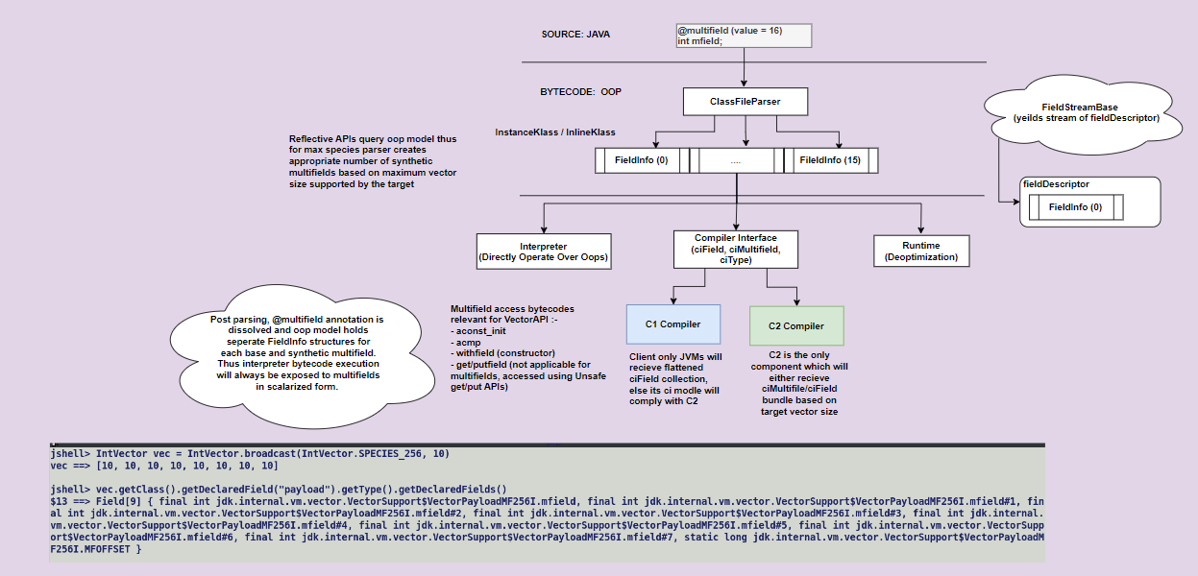
Status Update (7/9/2023)
Adding a new API interface in ciEnv which is implemented by both compiles to decide on scalarizability of multifield.
This will ensure uniformity in field count values returned by ciInstanceKlass::nof_nonstatic_fields and InlineTypeNode::field_count() APIs.
Patch makes an upfront scalarization checks during ciField/ciMultiField creation.
Based on a newly added API to check if target vector can accommodate multifield.
Thus C1 always receives a list of ciFields whereas C2 may either received a hierarchical ciMulfield or a flattened ciField lists.
This cleans up most of the special handling in field query APIs and de-optimization handling on C2 side.
2) Max-species support.
3) Merge with lworld and re-factoring shuffle code to align with jdk mainline.
4) Remaining functional validation and bug fixes.

Slide 35
Other Items
Re-enable intrinsification of finishPrivateBuffer.
https://github.com/openjdk/valhalla/pull/909#:~:text=Disable%20inline%20expansion,updated%20buffer%20argument.
https://github.com/openjdk/valhalla/pull/909#discussion_r1301050523
On slide 28 of following presentation, I have added some notes on replacing VectorBoxNode with InlineTypeNode.
https://cr.openjdk.org/~jbhateja/Valhalla/lworld%2Bvector.pptx
It will be good to know your thoughts on this.
There is a LW5 merge up for review on lworld branch, it will add initial support for null-restricted value types and trigger the changes in Java side VectorPaylod class declerations.
JDK-8228361: [lworld] Further optimize acmp on inline types in C2
Vector comparisons for multifield to be added once PR is integrated.
C1 deoptimization.
Vanilla C1 does not do escape analysis and allocations are never eliminated.
With Valhalla Value objects are scalarized and a new Deoptimize IR node is introduced to handle value reconstruction.

Slide 36
Status Update (21/9)
8314980: [lworld+vector] consider scalarization conditions during ciMultiField creation.
Cleaned up special handling in field query API and compilers.
Now, bundle size > 1 and is_multifield_base flag is only set for ciMultifield objects.
Patch checked into lworld+vector.

Slide 37
Max Species Support:-
Added new Java side max payload definitions vector / shuffle and masks.
Multifield annotation pass a –1 value since exact lane count is target dependent.
Parser based on target supported max vector size and field type estimates the bundle size multifield payload.
Based on this dynamic bundle size it creates a separate FieldInfo structure for each scalar multifield.
C1 model iterates over FieldInfo structure and crease scalar ciField[s] or a ciMultiFiled for specific compiler and target.
Using efficient VM symbol ID based lookup to estimate the bundle size of shuffle and mask payloads, since underlined field type I.e. boolean for mask and byte for shuffle is same for different SPECIES but dynamic bundle size will differ.
WIP: Prevent archiving VectorPayloadMF* classes in CDS archive.

Slide 39
lworld to lworld+vector merge:-
Off late there have been several nomenclature change patches integrated into lworld from lw5.
Code merge is completed.
Removed all the special handlings for multifield from C1 compiler.
All the VALHALLA jtreg tests are passing now at various AVX levels.
FP16 PoC Patch integrated into lworld+fp16.
End to handling for Float16.sum API.

Slide 40
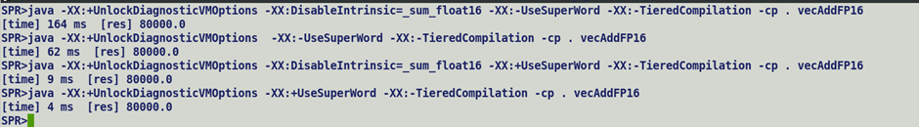
FP16 PoC
End to handling for Float16.sum API. Changes spans across Java code, C2 scalar intrinsic and Auto-vectorizer, IR transformations and optimized x86 backend implementation
IR and functional tests checked in.

Slide 41
Status Update (10/5/2023)
8311675: [lworld+vector] Max Species support.
Patch up for review.
Removed the class symbols for payloads from vmClasses, this automatically prevents archiving these classes in CDS.
Patch adds MaxSpecies support for all types of vectors.
New factory methods and VectorPayload classes for various kinds of vector, shuffle and mask payloads.
Summary of high-level flow :- 1/ Max species payloads encapsulate @multifield annotated field accepting -1 value as bundle size parameter. 2/ For Vector payload bundle size is determined using maximum vector size supported by the target. 3/ For Shuffles and Masks payloads multifield bundle size is a function of maximum vector size and vector lane size. 4/ Based on the dynamic bundle size parser creates a separate FieldInfo structure for each base and synthetic multifield and rest of the flow remains the same.

Slide 42
Function Validation Status
All Valhalla specific JTREG tests under test/hotspot/jtreg/compiler/valhalla/inlinetypes/ are passing at various AVX levels.
All Vector API JTREG tests apart from following are passing at various AVX levels.
jdk/incubator/vector/DoubleMaxVectorLoadStoreTests.java
jdk/incubator/vector/FloatMaxVectorLoadStoreTests.java
jdk/incubator/vector/IntMaxVectorLoadStoreTests.java
jdk/incubator/vector/LongMaxVectorLoadStoreTests.java
jdk/incubator/vector/Vector128ConversionTests.java
jdk/incubator/vector/Vector256ConversionTests.java
jdk/incubator/vector/Vector512ConversionTests.java
jdk/incubator/vector/Vector64ConversionTests.java#id0
jdk/incubator/vector/VectorMaxConversionTests.java#ZGenerational
jdk/incubator/vector/VectorMaxConversionTests.java#ZSinglegen
jdk/incubator/vector/VectorMaxConversionTests.java#id0

Slide 43
Performance Validation:-
Performance data for JMH micros in test/micro/jdk/jdk/incubator/vector matches with existing support.
Need to collect perf data for vector operations micros.

Slide 44
Status Updates 19/10/2023
Max Species Support:-
https://github.com/openjdk/valhalla/pull/931
PR integrated into lworld+vector.
Post merge Validation:-
All stock Valhalla tests under test/hotspot/jtreg/compiler/valhalla/inlinetypes/ are passing at various AVX levels.
All the Vector API Jtreg tests are now passing with defaults settings at various AVX levels.
There are some failures in mask / shuffle tests with –XX:+DeoptimizeALot.
Pending items
C1 deoptimization.
Perf runs results.

Slide 45
Status Update (2/11/2023)
JMH runs with UseAVX=2 and 3 shows perf degradations around shuffle and slice / unslice related micros.
This is mainly because finishPrivateBuffer is not intrinsified and Java implementation of these APIs directly make a call to it.
Started re-evaluating JDK-8317659: Incorrect unsafe put operation over value objects.
Unsafe put operations does modify JVM state along with memory state.
Problem occurs while propagating effect of merged InlineTypeNode in downstream graph.
Some issues seen with –XX:+DeoptimizeALot.
JEP 401 scope is significantly modified, and primitive class and null-restricted value types are out of scope for the first version of Valhalla.

Slide 46
Status Update (16/11/2023) :-
8319972: [lworld+vector] Enable intrinsification of Unsafe.finishPrivateBuffer.
Fixed perf drops.
Enables finishPrivateBuffer intrinsicfication.
Disables scalarization b/w make and finish private buffer.
8319971: [lworld+vector] Fallback implementation cleanups.
Cleaned up fallback implementation in usage of Unsafe APIs.
Integrated into lworld+vector.
Validation Status:-
Functional:-
All VectorAPI JTREG tests are now passing at various AVX levels.
With and wo –XX:+DeoptimizeALot.
All Valhalla JTREG tests are passing are various AVX levels.
Performance:-
Performance mostly at par with JDK mainline.
Detailed runs are underway.

Slide 47
Status Update (30/11/2023)
8319972: [lworld+vector] Enable intrinsification of Unsafe.finishPrivateBuffer.
Patch submitted to lworld+vector.
Validation Updates:-
All Vector API JTREG tests now pass at various levels.
All tests pass with additional JVM option –XX:+DeoptimizeALot.
There are some failures on setting –XX:InlineFieldMaxFlatSize=0
Xiaohong from ARM to explore this further.
Making VectorPayload as value classes
This will prevent payload flattening because of atomicity constraint requirements.
But given that payloads encapsulate multifield which is a packed bundle of scalars, hence will not impact vector loads / stores.
Transformed all existing concrete payload classes to a value classes.
Additional descriptor changes in vmSymbol definitions replace Q descriptors with L descriptors.

Slide 48
Found some issues during de-optimization where payloads refences are always null.
C2 creates InlineTypeNode for both value and primitive type objects.
It buffers an inline type node only when there is actually a need to do so, e.g. assignment to a non-flattened field though withfield bytcode
OR passing a value object to a method which is marked to receive non-scalarized fields.
All bufferend InlineTypeNode are eventually replaced by their oops later in optimization pipeline (process_inline_types).
An InlineTypeNode reaching so far is expected to be buffered, in other words we buffer only those nodes which have non-scalarized usages.
I expected during safe point scalarization handling, C2 should directly tie the oop reference of a value object to a SafePointNode.

Slide 49
e.g. Double512Vector (value class)
|_ VectorPayloadMF512D (value class) -> not flattened.
Compiler creates SafePointScalarObjectNode for each eliminated allocation.
In this case C2 will find both concrete and payload InlineTypeNodes live at the safepoint and will create two SafePointScalarObjectNodes even if payloads are buffered.
If we de-optimize an identity classes instance with a reference field pointing to another identity object, compiler will create only one SafePointScalarObject and directly bookkeep reference over SafePointNode.
Thus during de-optimization, runtime will only re-materialize container object and initialize reference with the corresponding value in RegMap.

Slide 50
Larval State Propagation in Valhalla
Q. What is larval state ?
A value object is an immutable identity less entity. Any modification to fields of an immutable object results into creation of a new value. There are circumstances where user wants to break this immutability constraint for a while and grant identity semantics to a value object and freely apply chain of updates to it without creating a new value after each update, for this a value object needs to be transitioned into larval state.
Q. How can a value object be transitioned into and out of larval state ?
A. Using Unsafe.makePrivateBuffer and Unsafe.finishPrivateBufferAPI.

Slide 51
Q. Are makePrivateBuffer and finishPrivateBuffer intrinsics.
Yes, currently makePrivateBuffer intrinsic accept an InlineTypeNode which is a scalarized IR representation of a value object, it then creates and Allocation IR to buffer its contents, sets AllocateNode::_larval to true and re-materializes an new InlineTypeNode from the buffer. Please note we are not emitting the IR to set the larval bit in mark work.
Finish Private buffer has a complimentary implementation, it accepts an InlineTypeNode corresponding to a larval value i.e. its oop fields must point to Allocation whose _larval flag is set, it then emits IR to re-set larval bit of buffer.

Slide 52
Q. Why do we need to transfer larval information to callee.
A. A value object transitioned into a larval state in caller must receive back all the updates applied by callee over it. In general, an update to a value object creates a new value but in larval state we relax this constraint to ensure that chain of updates can be applied over same value object by granting temporal mutability.

Slide 53
Q. What if makePrivateBuffer / finishtPrivateBuffers are not intrinsified
makePrivateBuffer and finishPrivateBuffer have native implementations. MakePrivateBuffer returns an java.lang.Object.
Consider following example and its corresponding bytecode
VectorPayloadMF obj = Unsafe.makePrivateBuffer(obj);
aaload obj
aaload Unsafe
invokevirtual Unsafe.MakePrivateBuffer
checkcast VectorPayloadMF
A checkcast bytecode ensures that returned value (j.l.o) is a ValuePayloadMF, else throw a ClassCastException.
Interpreter and C1 also bookkeeps the receiver profile for checkcast object. This can be used to infer a speculative receiver type by C2. C2 then casts the object with most granular / sharper type. Any speculative assumption is also recoded as a Dependency by runtime.

Slide 54
Q. Can we avoid applying a checkcast operation after makePrivateBuffer.
Only if the receiver type is a sub-type of the cast type.
Consider following example
class Base {}
class Derived extends Base {}
Derived obj = new Derived();
Base ref = (Base)obj; // checkcasting Derived type which is a sub-type of Base is a no-op.

Slide 55
Q. Is it illegal to cast a value object by some other value class.
A. Yes, definitely because a value cannot be casted to another value. We can write adapters to transform a value to another.

Slide 56
Q. What is the problem associated with Unsafe.put over value objects.
It returns a void and does not modify JVM state. If it appears within a loop then ciTypeFlow will not be able to detect an induction localvariable due to which C2 will not inject an inductive phi for in loop header during parsing. As a result, only the last update is preserved.

Slide 57
Q. Can imbalanced Phi nodes with one inputs as InlineTypeNode and other as value object pose any problems.
Not a problem, a non-scalarized use of a value object is replaced by its oop by process_inline_type. It will only inhabit value object propagation across PhiNode.
Phi InlineTypeNode A, InlineTypeNode B => InlineTypeNode Phi A , B

Slide 58
Q. List the C2 intercepts where InlineTypeNode is created.
a. JVM initial state construction.
Based on parameter descriptor, ff incoming parameter has an inline type. Using make_from_multi (in= true).
Based on parameter profile, using make_from_oop.
b. During checkcast processing, if casted type is a value class.
c. Value returned by a callee, based on return descriptor type.
Based on return value profile, using make_from_oop.
Based on return value descriptor, using make_from_multi(in = false)
A new allocation, aconst_init.
By updating any field value, withfield.

Slide 59
Q. How does C1 and Interpreter pass value object to C2.
C1 and Interprter pass value buffers and enter though inline entry points which unpacks incoming object into GPRs.
However, both interpreter and C1 returns the value in scalarized using unpack handler is InlineTypeReturnedAsFields is true.

Slide 60
Q. Conditions under which parameter and return value scalarization is disabled.
If CompiledEntrySignature called during method linking finds more than 60 stack arguments.
Using JVM flags InlineTypePassFieldsAsArgs and InlineTypeReturnedAsFields.

Slide 61
Q. Why is it a problem to re-materialize a value object from updated oop in Unsafe.put API.
An unsafe put operation can only be performed over mutable value object, which expects all updates to be done in-place instead of creating a new value with each update. By re-materializing a scalarized IR we are updating the JVM state since older value is replaced by a newly re-materialized IR, this is a departure from byte code semantics, an Unsafe.put operation returns a void and does not modify a JVM state. As a side-effect this causes creation of addition InlineType Phi node at state merge points. JVM maintains an running operand stack and a local variable array, there is not additional memory state, any modification to a field is through putfield, however an Unsafe API creates a special scenario where compiler update the memory state but it should not have an effect on JVM state.
By, disabling scalarization we ensure only memory state modification which anyways is converged when block merge.

Slide 62
Vector API alignment with latest JEP 401
Vector API specific use case.
Concrete vectors and payloads are value classes :-
@ImplicitlyConstructible -> default value initialization.
@LooselyConsistent -> Relax strict atomic update constraint.
Value class VectorPayloadMF256I {
@multifield (value = 8)
int value;
}
Value class Int256Vector {
@NullRestricted
VectorPayloadMF256I payload;
}
This shall promote payload flattening in its container, flattening offers compact layout, saves indirection and header size.
API definition expose only abstract vector class to users, IntVector, FloatVector …
Since abstract vectors are not value classes (an abstract class cannot be instantiated and thus no question of materializing an immutable instance for it.) hence vector as passed as regular identity objects.
Parameter type speculation on callee side may scalarize vector, speculation injects type sharpening checkcasts.

Slide 63
Vector API fall back implementation template
ByteVector bOpTemplateMF(Vector<Byte> o, FBinOp f) {
VectorPayloadMF vec1 = vec();
VectorPayloadMF vec2 = ((ByteVector)o).vec();
VectorPayloadMF tpayload = U.makePrivateBuffer(vec1); // [A] Intrinsic OR Unsafe implementation.
long vOffset = this.multiFieldOffset();
int length = vspecies().length();
for (int i = 0; i < length; i++) {
byte v1 = U.getByte(vec1, vOffset + i * Byte.BYTES);
byte v2 = U.getByte(vec2, vOffset + i * Byte.BYTES);
U.putByte(tpayload, vOffset + i * Byte.BYTES, f.apply(i, v1, v2));
}
tpayload = U.finishPrivateBuffer(tpayload); // [B] Intrinsic OR Unsafe implementation.
return vectorFactory(tpayload);
}
[A] If intrinsified, allocates a value buffer initializes it with incoming scalarized IR, sets AllocateNode::_larval flag, but do not emit the IR to set larval bit in mark word. Unsafe implementation returns a java.lang.Object.
[B] If intrinsified, receive a buffer and transition it out of larval state, emits IR to turn off the larval bit and re-materializes an InlineTypeNode.

Slide 64
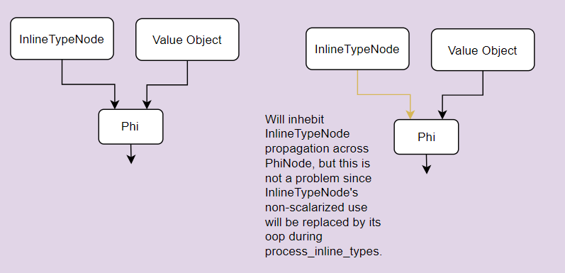
checkcast
Source:-
VectorPayloadMF vec = Unsafe.makePrivateBuffer(vec);
Bytecode:-
invokevirtual Unsafe::makePrivateBuffer
checkcast VectorPayloadMF
Unsafe.makePrivateBuffer is succeeded by checkcast bytecode.
checkcast is a no-op if cast type is a super-class of receiver type.
e.g. class Base {}
class Derived extends Base {}
Derived obj1 = new Derived();
Base obj2 = (Base) obj1;
Which is why when makePrivateBuffer is intrinsified, it returns a buffer of concrete vector type and checkcasting become a no-op.
However, since unsafe implementation returns java.lang.Object, checkcasting based on type profile injects a CheckCastPP node followed by scalarization.
Entry_Block:
CheckCastPP obj, VectorPayloadMF256I
If (!larval(obj)) {
Scalarized_Block:
sobj = Scalarize (InlineTypeNode) // 1) Capture larval in receiver profile and disable speculation based CheckCasting based on it.
// 2)
}
value = Phi Entry_Block: obj , Scalarized_Block: sobj

Slide 65
Currently InlineType nodes are propagated across Phi nodes, this promotes scalarization, otherwise a getfield will not be able to tier through Phi and C2 will have to buffer the Inline node the moment it has a non-scalar user.
Phi (InlineTypeNode A , InlineTypeNode B) => InlineTypeNode (Phi A, B)

Slide 66
Larval state propagation (FAQs)
Q. What is larval state ?
A value object is an immutable identity less entity. Any modification to fields of an immutable object results into creation of a new value. There are circumstances where user wants to break this immutability constraint for a while and grant identity semantics to a value object and freely apply chain of updates to it without creating a new value after each update, for this a value object needs to be transitioned into larval state.
Q. How can a value object be transitioned into and out of larval state ?
A. Using Unsafe.makePrivateBuffer and Unsafe.finishPrivateBufferAPI.

Slide 67
Q. Why do we need to transfer larval information to callee.
A. A value object transitioned into a larval state in caller must receive back all the updates applied by callee over it. In general, an update to a value object creates a new value but in larval state we relax this constraint to ensure that chain of updates can be applied over same value object by granting temporal mutability.

Slide 68
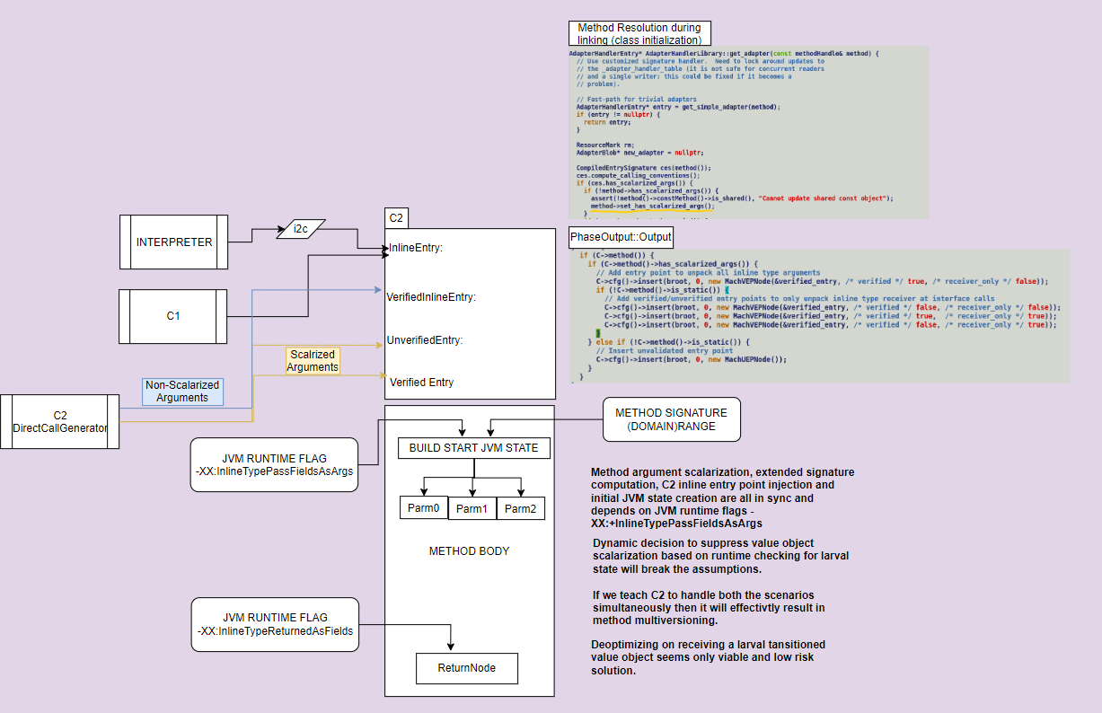
Problem with larval state propagation.
Out of all the execution engines, C2 compile is the only one which enforces value object scalarization and truly respects immutability.
It creates an InlineTypeNode to present a scalarized view of value object.
C1 and Interpreter always deals with value objects in non-scalar fashion, they even pass the values a identity objects.
Only while returning a value object they scalarize them under influence of following runtime flags, InlineTypePassFieldsAsArgs and InlineTypeReturnedAsFields.

Slide 69
C2 intercepts where InlineTypeNode is created
a. JVM initial state construction.
Based on parameter descriptor, if incoming parameter has an inline type. Using make_from_multi (in= true).
Based on parameter profile, using make_from_oop.
b. During checkcast processing, if casted type is a value class.
c. Value returned by a callee, based on return descriptor type.
Based on return value profile, using make_from_oop.
Based on return value descriptor, using make_from_multi(in = false)
A new allocation, aconst_init.
By updating any field value, withfield.

Slide 70
Approaches to handle larvae value object.
Disable scalarization, make private buffer to return a value buffer.
checkcast to deoptimize if receiver is a larvae.
This will result into a back-and-forth transition b/w interpreter and compiler.
Caller to always pass a non-scalarized value object and tap into inline entry point.
We cannot directly de-optimize from an inline entry point in absence of associated ScopeDesc (debug dump JVM states needed to reconstruct activation stack during depot fetch unrolling.)
Scalarize larvae objects before passing them to callee with an explicit larval state argument, we anyways pass init value explicitly.
Entry point protocol will not be disturbed.
C2 create initial JVM state based on larval parameter.
This will again result into formation of PhiNode.
To be optimal C2 can resort to multiversioning.
Follow pass by copy-restore semantics to pass back updates to larval object to caller.

Slide 71
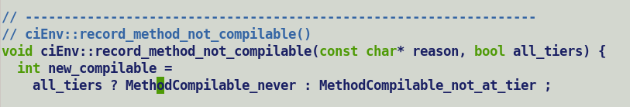
Since entry point generation is completely de-coupled from method body compilation, hence we can make MachVEP as an Ideal node.
VEPNode derivative of SafePointNode and bound to StartNode during initial JVM state creation.
VEP bookkeeps the JVM state, goes through regular compilation flow.
We may still need a clear trick to create a separate PcDesc for each uncommon_trap in entry point, one for each value object.
Instead of de-optimization, bailout callee C2 compilation and allow it to be compiled by a lower tier compiler.

Slide 72
Status Update 2/21/2024
A) JEP 401 alignment:-
Java side change to mark vector payloads classes with ImplicitlyContructible and LooselyConsistentValue annotations and make payload field in concrete class as NullRestricted.
This ensure payload field flattening.
Working on fixing issues seen during JTREG tests
Some non-eliminated InlineTypeNode are not buffered, this is causing assertion failures during oop replacements.
B) Value Type Payload:
WIP on null value payloads, did some more debugging, still figuring out the root cause.
Incorrect graph shape with –XX:-IncrementalInline, this causes eager inline expansion, assertion failure during loop optimization.
C) Profile driven larval Handling for lworld+vector.
Extended ReceiverProfile to encapsulate larval state, interpreter and c1 profile capturing changes in progress.

Slide 73
Status Update 8/5/2024
Valhalla
Vector API

Slide 74
Valhalla
Merged latest changes w.r.t to JEP 401 alignment from lworld.
Post merge issues logged into JDK-8327435
1. | Fix failures in JTREG with -XX:+DeoptimizeALot |  | OPEN | Jatin Bhateja
2. | Initialization of multifield during putifield bytecode processing by interpreter. |  | OPEN | Jatin Bhateja
3. | Initialization of scalarized multifield during putfield processing by compilers. |  | OPEN | Jatin Bhateja
4. | JVM state propagation issue in Shuffle/Mask recursive constructor with new code model |  | OPEN | Jatin Bhateja
5. | InineTypeNode larval out of sync with non-intrinsic makePrivateBuffer |  | OPEN | Jatin Bhateja

Slide 75
Vector API – New Operation Support.
New Operators:-
• VectorOperators.SATURATING_UNSIGNED_ADD
• VectorOperators.SATURATING_UNSIGNED_SUB
• VectorOperators.SATURATING_ADD
• VectorOperators.SATURATING_SUB
Applicable Types for new operators:
Prosed vector operators are applicable to integral types only since their values wraparound in over/underflowing scenarios after setting appropriate status flags.
For floating point types, as per IEEE 754 specs there are multiple schemes to handler underflow, one of them is gradual underflow[2] which transitions the value to subnormal range. Similarly, overflow implicitly saturates the floating-point value to a representable range or an Infinite value.

Slide 76
New API
Vector<E>.selectFrom(Vector<E> v1, Vector<E> v2)
Using index values stored in the lanes of this vector, assemble values stored in first (v1) and second (v2) vector arguments. Thus, first and second vector serves as a table, whose elements are selected by indexes in the current vector. This is a cross-lane operation that rearranges the lane elements of the argument vectors, under the control of this vector, re-arranged vectors are finally blended under the control of third (mask) argument.
API is applicable to all integral and floating-point types. The result of this operation is semantically equivalent to expression Vector.blend(v1.rearrange(this.toShuffle(), v2,rearrange(this.toShuffle), mask).
Will not be able to support ARM 2048-bit byte vectors, since but it’s a known limitation.
Q. Why not use shuffle to passing indices ?
Shuffles hold the indices corresponding to one vector and wraps around / create a –ve index for out-of-range indices, it always expects indices to fit into valid ranges [0: VEC_LENGTH), it will not be able to accommodate indices for combined index range of two vectors [0 : VEC_LENGTH * 2).

