Slide 1
C2J Transcompiler.

Slide 2
Motivation
We often see lots of high-performance code written in system languages like C/C++.
OpenJDK Java JIT compiler have evolved over time, and today generated code quality mostly matches with standard compilers like GCC and LLVM.
C2 Compiler is capable of emitting vectorized code, either through auto-vectorization OR Java Vector API.
By translating existing native SIMD kernels to Java, user will get benefit of runtime language (WORA) and will be able to exploit latest target features.

Slide 3
Current research on Transcompilers
Facebook’s developed a language translation model “TransCoder” in 2020 with a claim that it correctly translates more than 90 percent of Java functions to C++, 74.8 percent of C++ functions to Java.

Slide 4
Model for C++ to Java Translation
Seq2seq model is a Recurrent Neural Network model which accept multiple inputs and generates multiple outputs, but there is no 1:1 mapping b/w inputs and outputs i.e. number of neurons in input layer differ from output layer.
Used for natural language translations, text summarization e.g. English to French, well know use case include google translate.

Slide 5
Development Plan
Stage 1:
- Develop a seq2seq model based on Teacher Forcing technique over a corpus of c++ and java samples.
- It’s a challenge to gather large training with 1:1 correspondence b/w language kernels.
- Due to syntactic similarity b/w c++ and Java, we can initially train the model on just c++ input and output.
- Evaluate the mode on unseen c++ input, output should be similar to input.
Stage 2:
- Once sufficient accuracy is reached, refine the model by adding an Attention Layer to Decoder.
- Unlike vanilla seq2seq models where decoder is fed with the context vector generated by encoder, an attention-based decoder looks at all the hidden states of encoder and computes the alignment of decode ground trough input with respect to each hidden states of all the time steps of the encoder.
- This ensures decoder pays attention to each input of encoder and eventually causes faster training convergence.
Stage 3:
- Collect java and equivalent c++ source from various github repose and use transfer learning technique to tune pre-trained model.
- Hyper parameter tuning for accuracy.
Stage 4:
- Develop a corpus of C++ data parallel kernels and equivalent Java Vector API kernels.
- Use transfer learning technique to tune the mode over new SIMD kernel corpus.

Slide 6
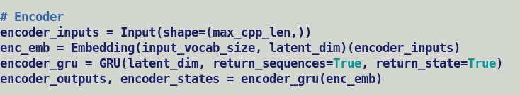
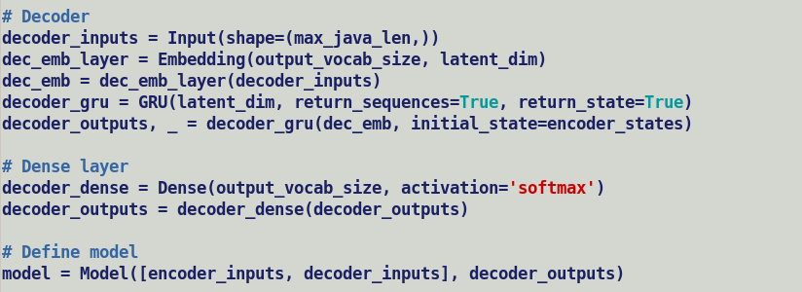
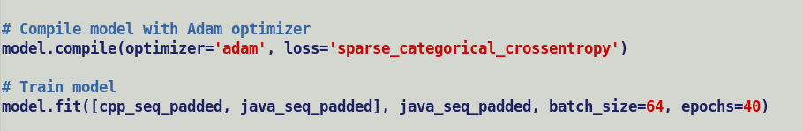
Vanilla seq2seq model topology
Latent Space
(Context / Thought Vector)
ENCODER
DECODER
Input
(Tokenizer)
C++ source
Embedding
GRU
Input (Tokenizer) Java code
Embedding
GRU
DenseLayer (SoftMax)

