Slide 1
AVX-512 differentiating optimizations for OpenJDK
Jatin Bhateja (11846689)
Sandhya Viswanathan (11267150)

Slide 2
Table of Content
Introduction to AVX-512
Introduction to OpenJDK
Aggressive Logic Packing optimization
Performance stats
Fast-efficient Memcopy using masked instructions
Performance stats
Conclusion

Slide 3
What is AVX-512
Over the years Intel processors have been supporting data parallelism through Single Instruction Multiple Data instructions (SIMD).
MMX -> SSE -> SSE2 -> SSE3 -> SSE4 -> AVX -> AVX2-> AVX512.
( Evolution of SIMD instructions over various generations of processors)
SIMD operations provides significant performance boost compared to scalar operation since they simultaneously operate over multiple data elements.
SIMD instruction operates over vector register. MM0-MM7(8 bytes), XMM0-XMM15(16 bytes) , YMM0-YMM15 (32 bytes).
With AVX-512
Operating vector register set increased from 16 to 32 (ZMM0-ZMM31)
Vector size increased to 512 bits (64 bytes).
8 predicate registers (K0-K7) were added to facilitates operations over a part of vector register.
New EVEX encoding to support register addressing for newly added vector register , embedded broadcasting.
Gamut of new instructions and more.
AVX-512 is a key differentiating feature which is not supported by any other X86 ISA compliant processors.

Slide 4
OpenJDK
Java is #1 programming language; JVMs are deployed over more than a billion devices and is the most popular runtime for cloud.
Java language and Virtual machine specifications are maintained and extended by Oracle.
OpenJDK is an implementation of Java platform specification.
Intel works in close collaboration with Oracle and OpenJDK community to optimize Java workloads for IA platforms.
JVM executes bytecode and hence also support other bytecode targeting languages like Kotlin, Scala, Groovy.

Slide 5
Aggressive LOGIC packing OPTIMIZATION

Slide 6
Introduction
This is a code size and latency-oriented optimization.
This optimization targets folding expression trees involving logic operations into macro logic node.
These macro logic nodes are then mapped to powerful AVX-512 VPTERNLOG instruction.
This not only reduces the number of instructions emitted for a given logic expression but also absorbs dependency chains b/w intermediate expressions.
Since VPTERNLOG is a vector instruction it gives significant performance boost for to logic expression appearing with vectorizable loops.

Slide 7
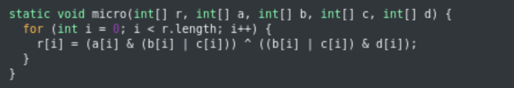
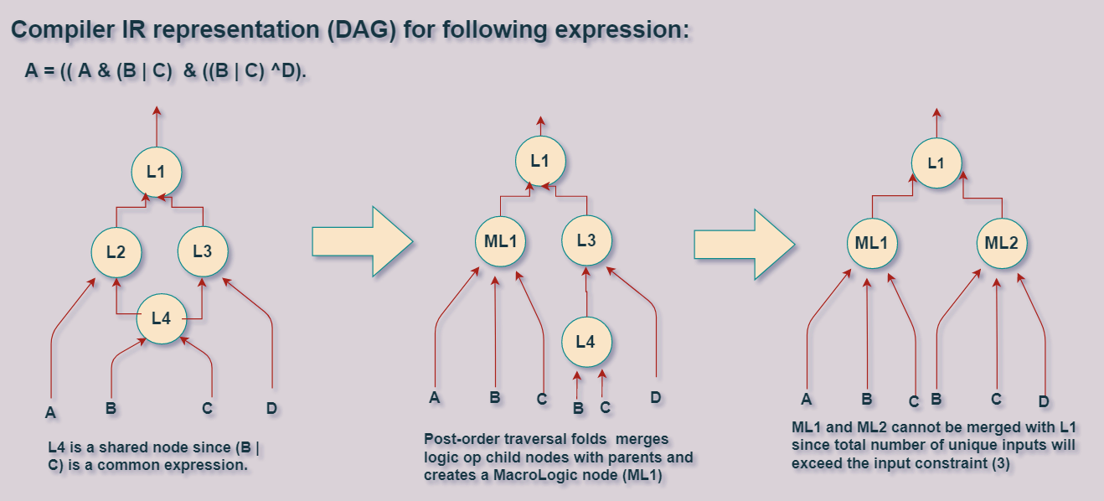
Transformation:
Consider an example micro workload
It comprises of a logic expression with 3 levels.
Each sub-expression is computed by a separate logic instruction and results is fed to the parent expression.
Hotspot C2 Compiler intermediate representation will create a DAG for this expression.
Our aggressive packer traverses through the IR graph and collects logic expression root nodes.
It then does a bottom-up traversal over the expression DAG and creates a MacroLogic node which folds the parent logic node with its children nodes under a constraint on the number of inputs. Input are assigned boolean values and symbolic evaluation is performed as per the logic operation.
A MacroLogic nodes is analogous to a 3-input truth table. Each node emits an AVX-512 VPTERNLOG instruction.

Slide 8
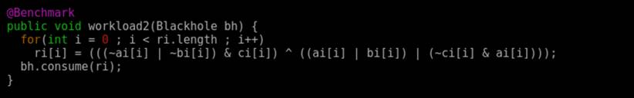
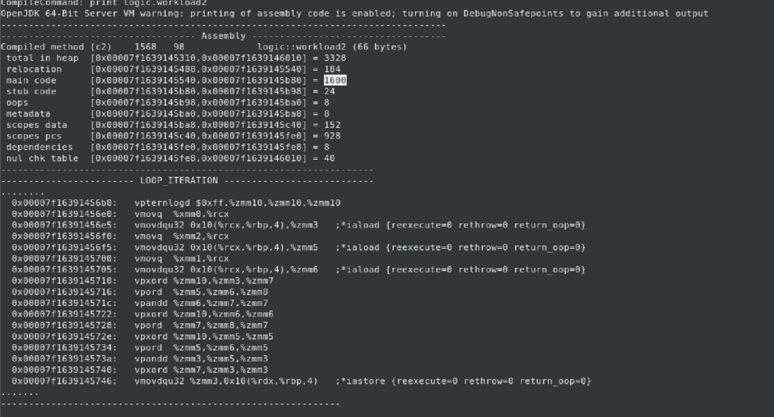
Micro-workload and its JIT output before and after transformation
Original C2 JIT assembly sequence:

Slide 9
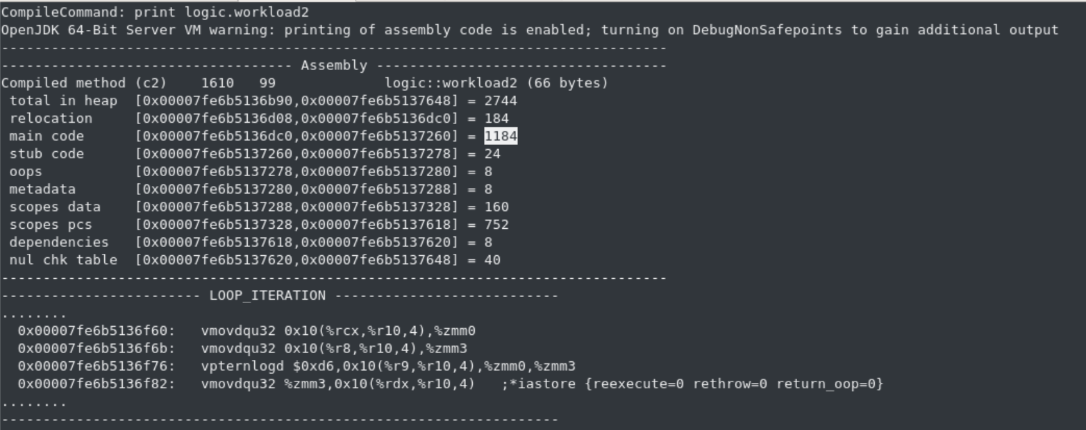
New C2 JIT assembly sequence:

Slide 10
Perf Analysis:
Let’s start by defining proof points (KPIs) to gauge the performance improvements:
Generated Code size: This corresponds to the size of the code stream (instructions) generated for a given expression **. From our earlier example we could see that generated JIT assembly sequence size reduced from 1600 bytes to 1184 bytes.
Instruction execution count/ path length : It has direct impact on the runtime performance since with a path length increase processer’s front-end and back-end has more work to churn.
Throughput: For our micro workload each loop iteration can be considered as an operation, thus number of operation per unit time determines workload throughput. Existence of dependency chains significantly degrades the throughput; macro logic absorbs logic levels.
4. Throughput under constraints: Defining SLA constraints imposes stricter criteria for performance analysis; it increases the sensitivity towards micro-architectural conditions like Cache and TLB misses, front-end bottlenecks (I-cache misses, decoding, micro-op caches, macro and micro-fusions) , branch mispredictions, back-end port congestions etc.
** At times, even if the total number of emitted instructions reduces, the code size may still increase, this generally happens as AVX-512 instructions use 4-byte EVEX encoding, thus have bigger prefixes compared to AVX/AVX2 VEX encoded prefixes (2/3 bytes).

Slide 11
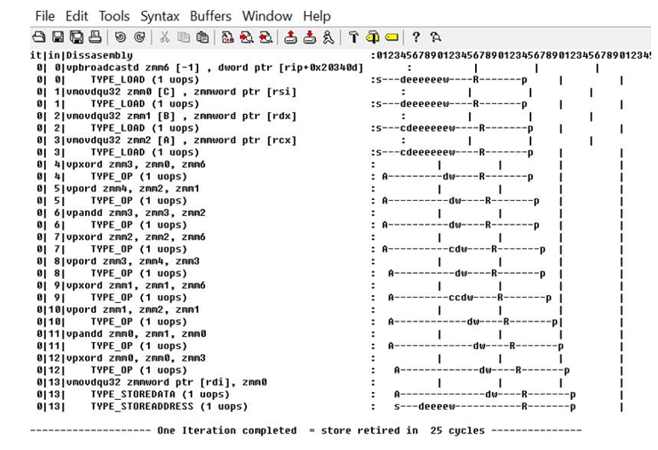
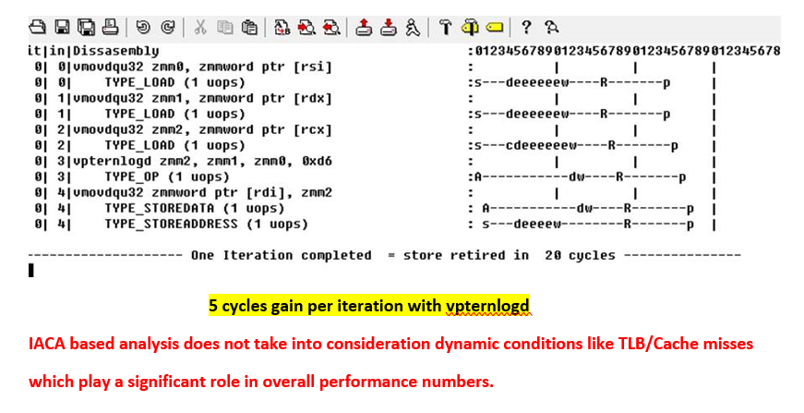
Detailed micro-architectural analysis using IACA
We extracted the JIT assembly snippet and embedded it as an in-lined assembly block in a C-application to run it through IACA.
Results shows 5 cycles gain per iteration since dependency chains were absorbed.

Slide 12
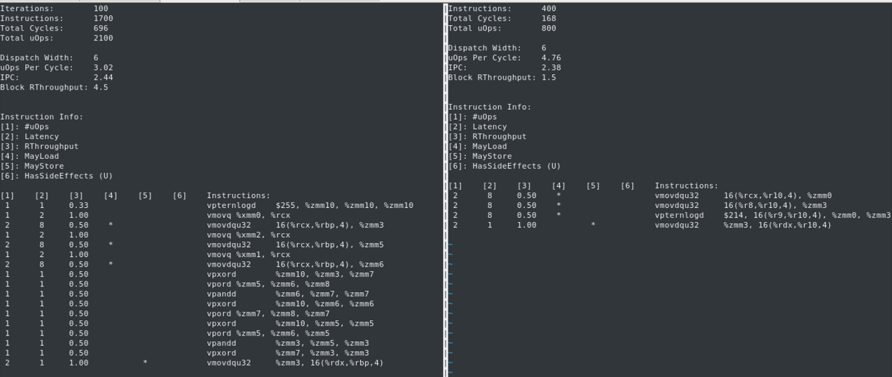
LLVM-MCA output:
Static micro-architectural analysis tool shows significant reduction in number of micro-ops and reduction in reciprocal throughput.

Slide 13
Fast-efficient Memcopy using masked instructions

Slide 14
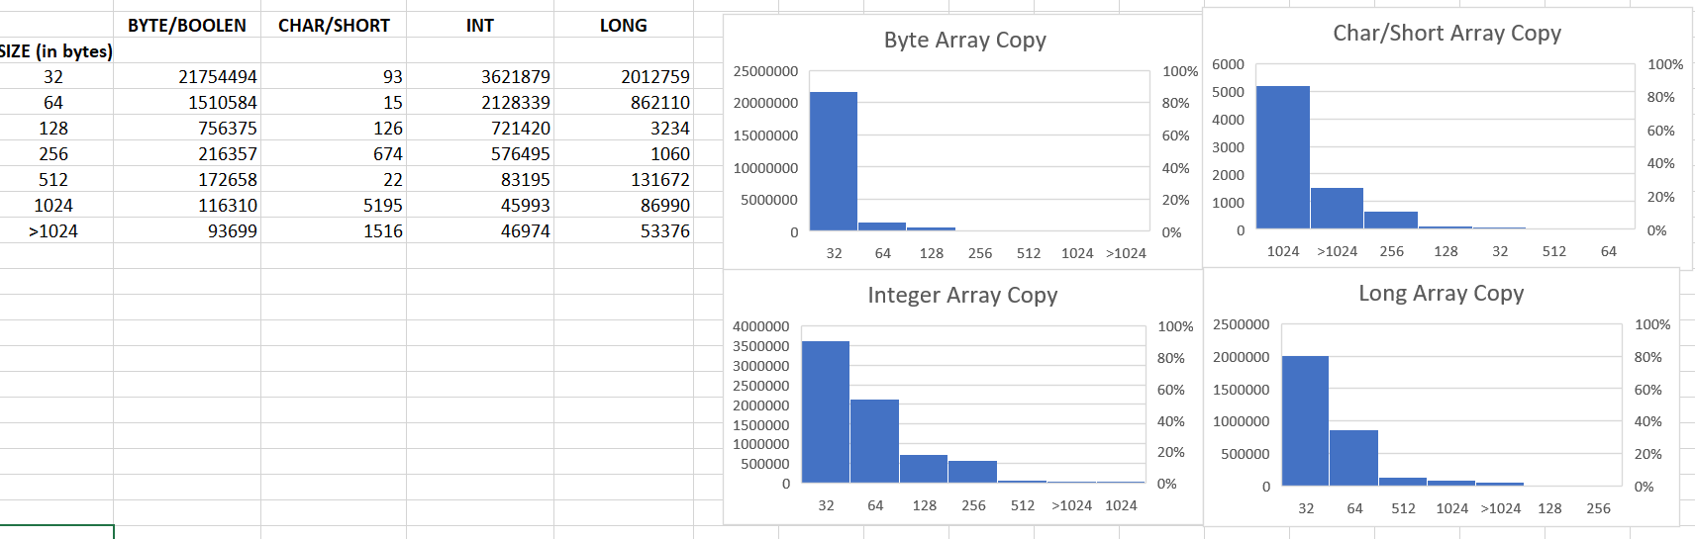
Introduction
Memcopy/arraycopy is a frequently used operation which is routinely called by every Java application thus may have a significant impact on application runtime performance.
Following cases frequently triggers bulk copy operation in JVM:
Explicit use of copy APIs like System.arraycopy.
Object cloning.
GC sweeping and compaction phases.
Doing a copy operation at the higher granularity not only reduces the number of memory operation but also gives significant performance boost.
AVX-512 offers 64 bytes vector registers, thus memory loads and stores can now copy double the data compared to previous generation AVX2.
In addition AVX-512 offers masked / predicated variants of vector move instruction, this improves the performance of tail operation where data less than 64 bytes can be copied using one memory load and store instruction.
Another important addition is vector length extension, this allows operating new AVX-512 instruction over lesser width vector register i.e. XMMs and YMMs.
Following histogram show call frequency profile of various array copy operation in SPECjbb2015

Slide 15
Factors influencing performance of copy operations
Vector Size
Element size for masked operation.
Data alignment
Number of memory operations

Slide 16
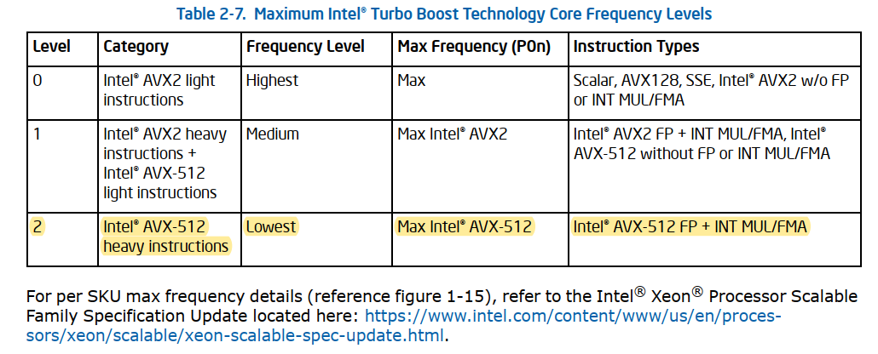
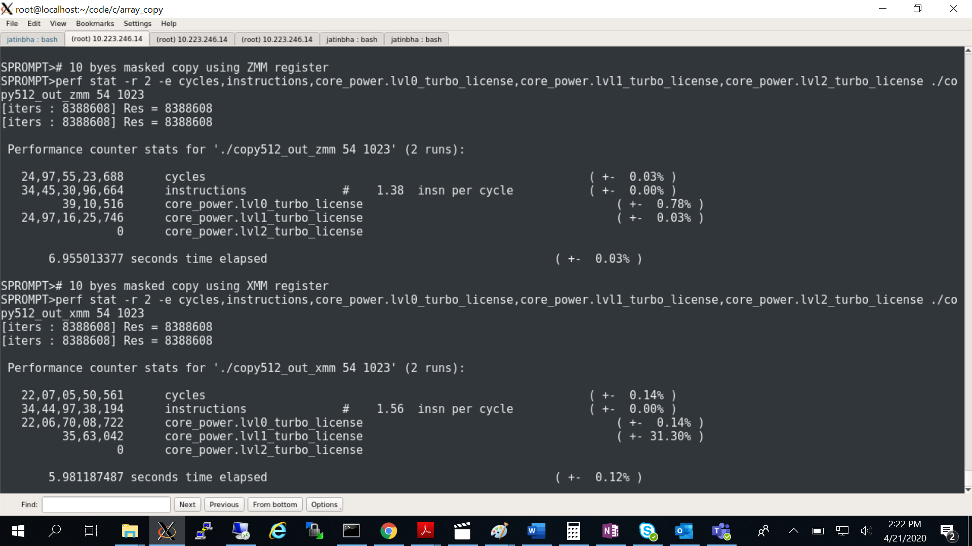
Vector Size (frequency switchover)
Processor operates at multiple frequency levels i.e. P0,P1,P2. P0 being highest frequency.
Higher width ZMM register causes core frequency switchover to a lower frequency level, in addition it effect the port schemes (available backend port for SIMD and FMA dispatch).
Our experiments shows using a small vector register (XMM/YMM) for copy sizes less than 32 bytes using masked instruction gives better performance.
Notes:
C-application : arg1 -> starting offset within source and destination buffers.
arg2 -> mask defining the number of bytes to be copied (1023 -> 11,1111,1111)

Slide 17
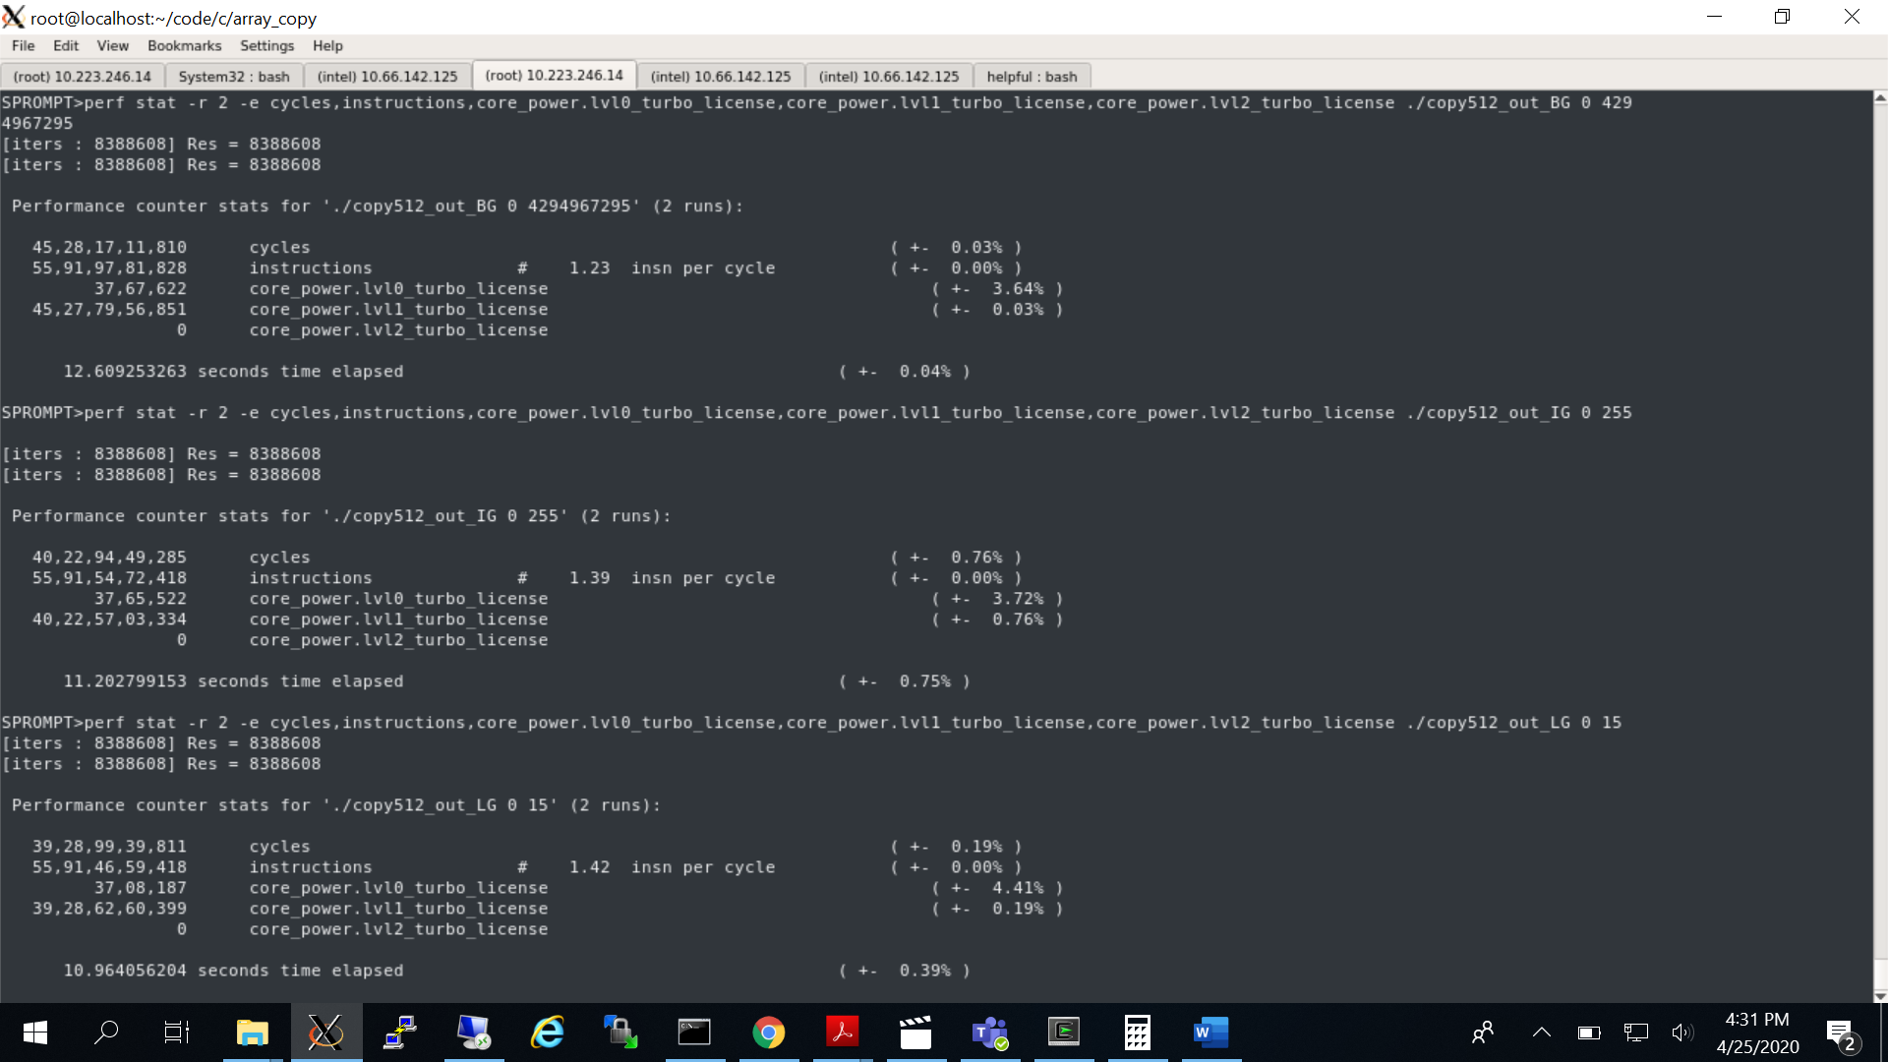
Element Granularity
For masked operation granularity of element size corresponding to a mask bit has direct impact of performance of copy operation.
Lower the granularity (bigger element size) better the performance.
Consider these perf stats for same copy sizes at byte granularity (BG) , integer granularity (IG) and long granularity (LG)
Notes:
C-application coping 32 bytes of data
-> Mask BG [Byte Granularity] -> 2^32 -1 = 4,294,967,295
-> Mask IG [Integer Granularity] -> 2^8 -1 = 255
-> Mask LG [Long Granularity] -> 2^4 -1 = 15

Slide 18
Data alignment (cache line split stores)
Address alignment of data has direct impact on copy operation performance.
For bulk copy operation at the granularity of vector register size (16/32/64); a mis-aligned store may result into a split store operation i.e. stores happening across cache line boundary. This significantly degrades the performance.

Slide 19
Number of memory instructions
At a fundamental level a copy involves loading the data into a register from source address and storing the data from register into destination address.
Using wider registers (ZMMs) number of memory operation reduces by a factor of 2 compared to previous generations (AVX2).
Pumping more memory instruction into the processor stress the processors machinery (AGU , allocation of Load/Store ports, reservation station entries)

Slide 20
Efficient copy algorithm a multi-stage optimization
Keeping in view various factors effecting copy performance we chose a multi-stage approach
Performs partial in-lining for small copy sizes.
Fall back over to optimized hand-crafted assembly sequence (stubs) for bigger copy sizes.

Slide 21
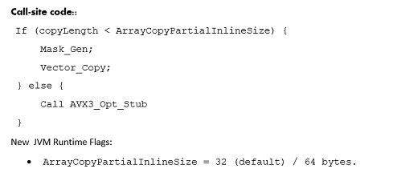
Partial in-lining benefit
Procedure in-lining is well explored compiler optimization, instead of making a call to function, procedure body replaces the call-site.
This offers better optimization opportunities to compiler and saves the call overhead (argument preparation, caller save register spills, jumps, walk over callee’s prolog and epilog instruction sequences).
Aggressive in-lining can also adversely affect the performance since it may increase I-cache and TLB misses.
Our approach of partially in-lining copy operation for small copy sizes (less than vector register size) using AVX-512 masked move instructions gives significant performance boost.

Slide 22
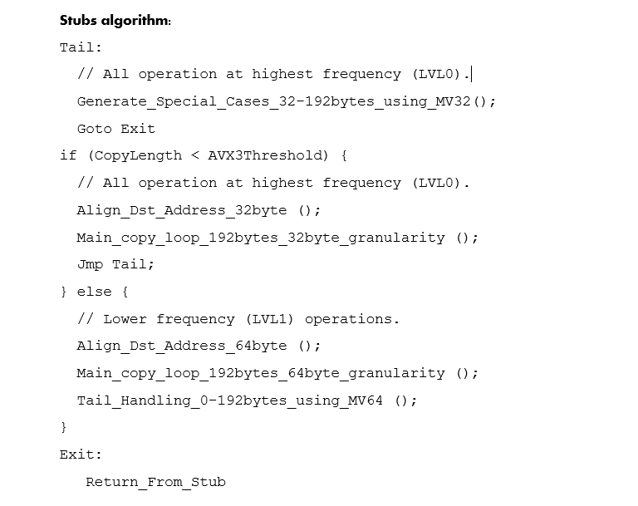
Intelligent stubs
Stubs are hand crafted sequence of assembly instructions.
Our new AVX-512 optimized stubs uses explicit instruction sequence for different copy sizes between 0-192 bytes. It uses masked instructions for fractional sizes (less than 32 bytes).
To prevent any performance degradation due to frequency level switchover instruction sequence uses YMM registers for both masked and non-masked moves (AVX-512 VL feature).
For bigger sized copy operation destination address is aligned to vector size, it prevents split-stores across cache lines, this is followed by a bulk aligned copy loop and tail part which again fall back over optimized blocks for various copy sizes.
Based on the performance analysis over various workloads a threshold value is chosen, any copy size above this threshold offers better performance using ZMM registers despite of lower operating frequency.

Slide 23
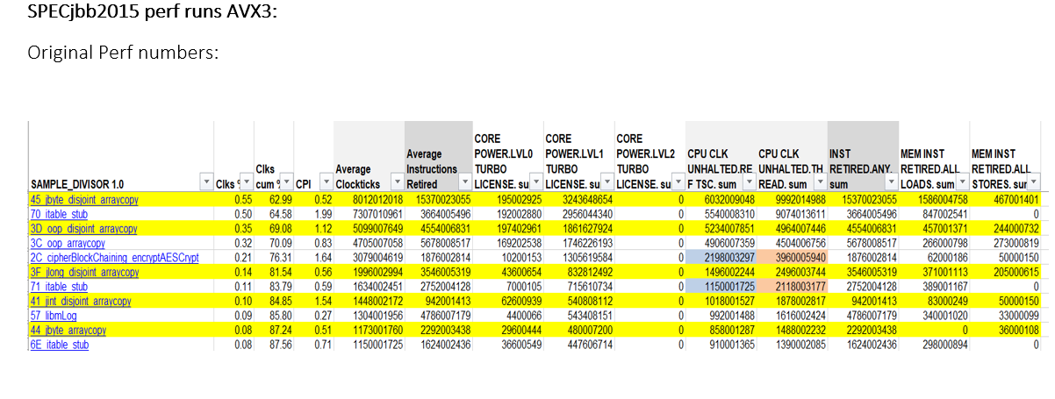
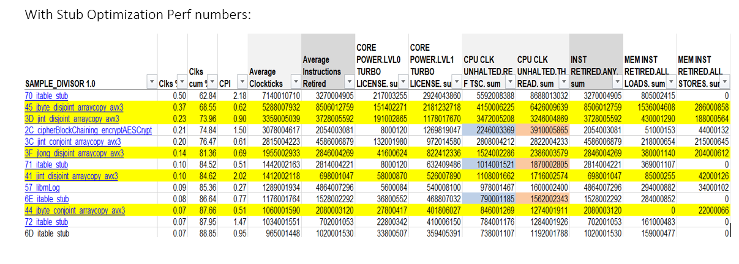
Performance stats
New optimized stubs show significant reduction in instruction execution count, cycles consumed, number of memory load and stores.
Micro-workloads shows around 1.5-2x gains for smaller and bulk copy sizes.

Slide 24
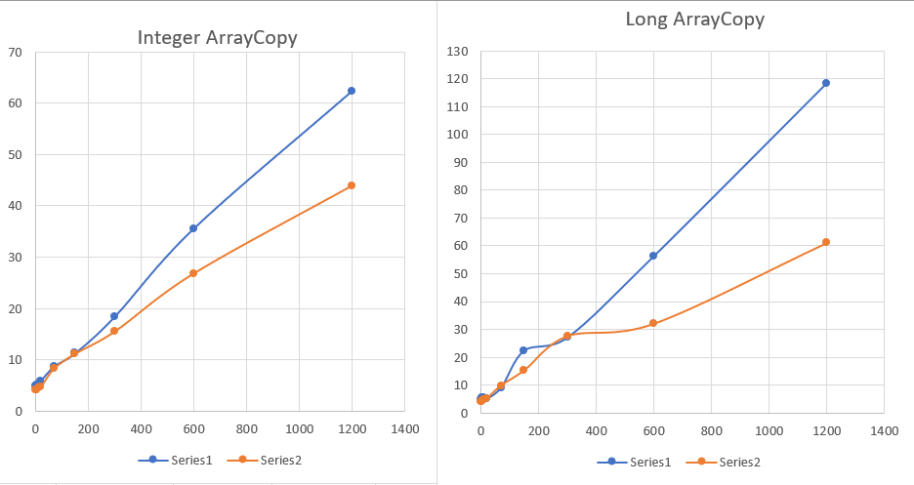
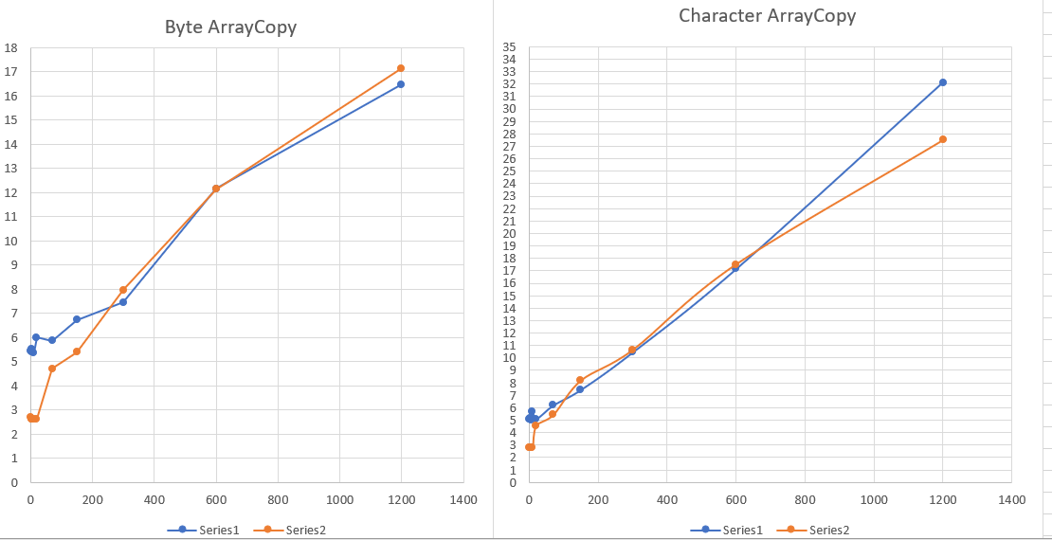
Java Micro workloads performance
Micro work workload measuring reciprocal throughput (ns/op) for various copy sizes varying from 1-1200 bytes for various primitive types.
Partial in-lining is enabled for sub-words type (byte/char) shows better performance for small copy sizes.
Optimized aligned subs shows gains for bigger copy sizes for all primitive types.

Slide 25
Conclusion
AVX-512 is a powerful instruction set and offers significant performance boost compared to previous SIMD generations.
There is a frequency paneity associated with the use of wider vectors ZMM but vector length orthogonality along with predication/masking support allows AVX-512 instruction to operate on narrower vector registers (XMMs/YMMs) without any performance hits.

Slide 26
References:
Various optimizations discussed in the presentation are up-streamed to OpenJDK
[1] JDK-8241040: Support for AVX-512 Ternary Logic Instruction: https://hg.openjdk.java.net/jdk/jdk/rev/29d878d3af35
[2] JDK-8252847: Optimize primitive arraycopy stubs using AVX-512 masked instructions: https://bugs.openjdk.java.net/browse/JDK-8252847
[3] JDK-8252848: Optimize small primitive arraycopy operations through partial in lining using AVX-512 masked instructions: https://bugs.openjdk.java.net/browse/JDK-8252848
[4] Intel Software Developers Manual : https://software.intel.com/content/www/us/en/develop/download/intel-64-and-ia-32-architectures-sdm-combined-volumes-1-2a-2b-2c-2d-3a-3b-3c-3d-and-4.html
[5] Intel Optimization manual: https://software.intel.com/content/www/us/en/develop/download/intel-64-and-ia-32-architectures-optimization-reference-manual.html

Slide 27
Questions?

Slide 28
Session Evaluation
Please follow instructions in the Room

