Slide 1
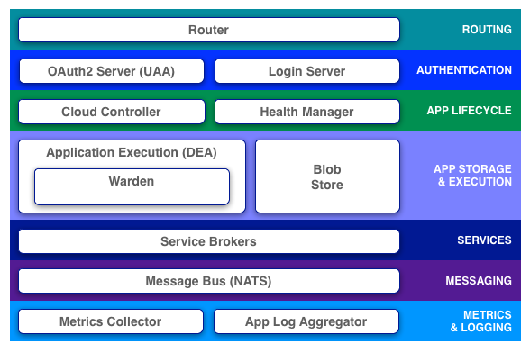
UAA Database

Slide 2
Cloud Controller Database

Slide 3
Blob Store (NFS Server)

Slide 4
UAA Database
Cloud Controller Database
Blob Store (NFS Server)

