Slide 1
Design and Analysis of Algorithms
CS602
Lecture 1
Overview of the course
Motivational Problems
moodle.cse.iitk.ac.in
Login as guest

Slide 2
Aim of the course
To empower each student with the skills to design algorithms
With provable guarantee on correctness.
With provable guarantee on efficiency.

Slide 3



How CSE is making our lives better ?
Important role:
Little role:
Operating System
Algorithms
Computer Networks
Database

Slide 4
The world of Algorithms
Algorithms having
non-trivial design
non-trivial analysis
Efficiency

Slide 5

The world of Algorithms
Algorithms having
Real World Applications
non-trivial design
non-trivial analysis
Efficiency

Slide 6

Impact of an Algorithm
on
Future of thousands of students in India

Slide 7
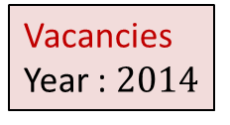


Technical Institutes in India
Entrance Exam
IITs
JEE Advanced
NITs
IIITs
GFTIs
JEE Main
CSAB institutes
DCE
BITS PILANI
ANNA University

Slide 8
A closer look at the problem
Ram
Allocation in
IITs
JEE Advanced
Allocation in
CSAB Institutes
JEE
(Mains)
Mohan
IITK Civil
NIT Warangal CSE
IITM Metallurgy
NIT Surat Mechanical
Notes:
Let us take a close look at the problem. Suppose there are two candidates Ram and Mohan. Both study hard for JEE(Mains) and JEE(Advanced). It turns out that Ram outperforms Mohan in JEE Advanced
Ram prefers NIT Warangal Electrical.
Mohan prefers IITK Civil.
Unfortunately both these seats remain vacant and none of them get their desired programs.

Slide 9
A closer look at the problem
Ram
Allocation in
IITs
JEE Advanced
Allocation in
CSAB Institutes
JEE
(Mains)
Mohan
IITK Civil
NIT Warangal CSE
IITM Metallurgy
NIT Surat Mechanical
Notes:
Shyam gets NIT Warangal Electrical though his rank is inferior to that of Ram.
The reason: On the date of spot round at NIT Warangal, Ram is unable to come physically to NIT Warangal but Shyam does.

Slide 10
A closer look at the problem
Ram
Allocation in
IITs
JEE Advanced
Allocation in
CSAB Institutes
JEE
(Mains)
Mohan
IITK Civil
NIT Warangal CSE
SPOT round
IITM Metallurgy
NIT Surat Mechanical
Shyam
Notes:
Shyam gets NIT Warangal Electrical though his rank is inferior to that of Ram.
The reason: On the date of spot round at NIT Warangal, Ram is unable to come physically to NIT Warangal but Shyam does.

Slide 11
A closer look at the problem
Ram
Allocation in
IITs
JEE Advanced
Allocation in
CSAB Institutes
JEE
(Mains)
Mohan
IITK Civil
NIT Warangal CSE
SPOT round
IITM Metallurgy
NIT Surat Mechanical
Shyam
Notes:
Shyam gets NIT Warangal Electrical though his rank is inferior to that of Ram.
The reason: On the date of spot round at NIT Warangal, Ram is unable to come physically to NIT Warangal but Shyam does.

Slide 12





Multiple Merit Lists
19 IITs
31 NITs
18 IIITs
33989 seats
1304127 candidates
18 OtherGFTIs

Slide 13
Fairness
Choice list of Mohan
p
q
p
Mohan
q
Ram
Merit list
of programme q
Ram
Mohan

Slide 14
Homework
The seat allocation algorithm for the single merit list.?
Can you now tackle the problem of multiple merit lists ?

Slide 15
Problem 1
The Stable Marriage Problem

Slide 16
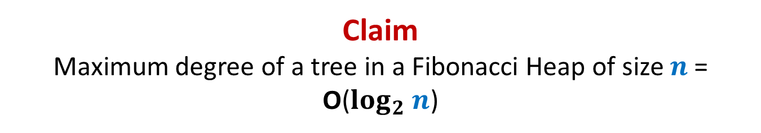












Stable Marriage Problem
Women
Men
$$w_{1}$$
$$m_{1}$$
$$3$$
…
$$w_{2}$$
$$m_{2}$$
$$1$$
…..
$$w_{3}$$
$$m_{3}$$
$$2$$
$$w_{i}$$
$$m_{j}$$
$$w_{n}$$
$$m_{n}$$

Slide 17




Stable Marriage Problem
Women
Men
$$w_{1}$$
$$m_{1}$$
$$3$$
$$w_{2}$$
$$m_{2}$$
…
…
$$1$$
$$w_{3}$$
$$m_{3}$$
…..
$$2$$
$$k$$
$$w_{i}$$
$$m_{j}$$
$$w_{n}$$
$$m_{n}$$

Slide 18
Stable Marriage Problem
Women
Men
Marriage : ?
$$w_{1}$$
$$m_{1}$$
$$w_{2}$$
$$m_{2}$$
$$w_{3}$$
$$m_{3}$$
…
…
$$w_{i}$$
$$m_{j}$$
…
…
$$w_{n}$$
$$m_{n}$$
a bijection between Women and Men

Slide 19




Stable Marriage Problem
Meaning of unstability
$w_{l}$ prefers $m_{j}$ to $m_{k}$
$m_{j}$ prefers $w_{l}$ to $w_{i}$
Definition:
A marriage is said to be stable if there is no unstable pair in the society.
($w_{l}$, $m_{j}$) : an unstable pair
$$w_{l}$$
divorce
$$m_{k}$$
$$w_{i}$$
divorce
$$m_{j}$$

Slide 20

Stable Marriage Problem
$M$ : set of $n$men
$W$ : set of $n$women
For each man $m∈M$,
$L(m)$: a preference list of all women
For each woman $w∈W$,
$L(w)$: a preference list of all men
Aim: To compute a stable marriage.

Slide 21
Problem 2
The Unique-path Problem

Slide 22



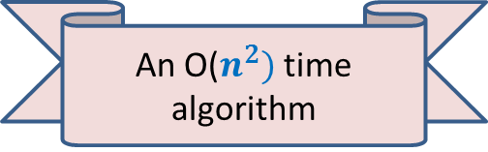
Unique-path graph
Definition: A directed graph $G$=($V$, $E$) is said to be unique-path graph if
For each pair $u$, $v∈V$, there is at most one path from $u$ to $v$.
In other words,
$u⇝v$
Aim: Design an efficient algorithm to determine if $G$ is unique-path graph.
➔ there is only one path from $u$ to $v$
An O($n^{2})$ time algorithm
y
u
v
q
b
d
w
j
r
p
h
c
t
k

Slide 23
Problem 3
The Huffman Coding Problem

Slide 24

Binary coding
alphabet set $A$: {$a_{1}$, $a_{2}$,…, $a_{n}$ }
A text File: a sequence of alphabets
Question: How many bits needed to encode a text file of size $m$ alphabets ?
Answer: $m \left\lceil \log_{2} n\right\rceil$ bits.
once upon a time …………..
…………………………….
……………………………..
…………………
A text file F
Binary coding of F

Slide 25
Fixed length coding
alphabet set $A$: {$a_{1}$, $a_{2}$,…, $a_{n}$ }
Question: What is a binary coding of $A$?
Answer: $γ$: $A$→binary strings
Question: What is a fixed length coding of $A$?
Answer: each alphabet ← a unique binary string of length $\left\lceil \log_{2} n\right\rceil$.
Question: How to decode a fixed length binary coding?
Answer: easy ☺
$$0100101000001011…$$

Slide 26
Fixed length coding
alphabet set $A$: {$a_{1}$, $a_{2}$,…, $a_{n}$ }
Question: Can we use fewer than $\left\lceil \log_{2} n\right\rceil$ bits for each alphabet of $A$ ?
Answer: No.
Question: Can we use fewer than $m \left\lceil \log_{2} n\right\rceil$ bits to store a file of length $m$?
Answer: Yes most likely.

Slide 27
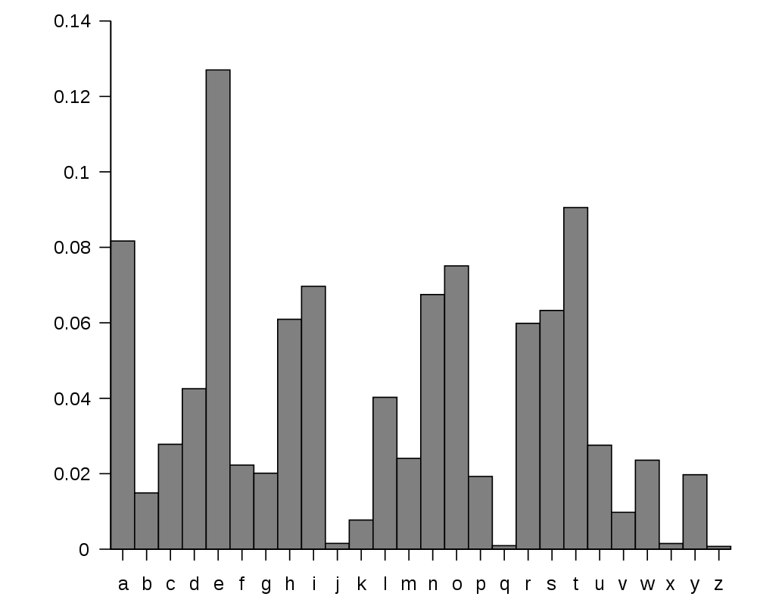
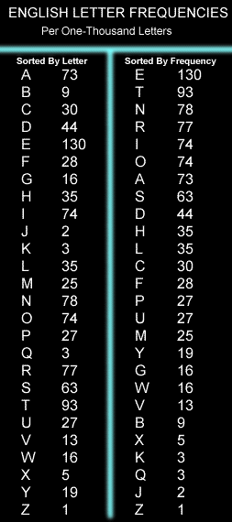
huge variation in the frequency of alphabets in a text.
http://en.wikipedia.org/wiki/Letter_frequency

Slide 28
huge variation in the frequency of alphabets in a text.
Question: How to exploit variation in the frequencies of alphabets ?
Answer:
More frequent alphabets ⬅ coding with shorter bit string
Less frequent alphabets ⬅ coding with longer bit string

Slide 29
Problem 4
A Physics Problem

Slide 30



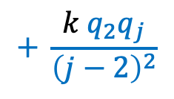
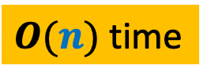



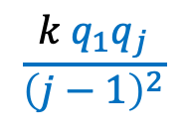
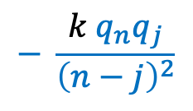

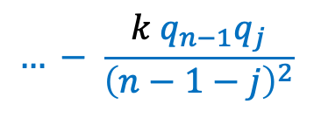
$$1$$
$$1$$
$$1$$
$⊕$ $⊕ ⊕…$ $⊕$ … $⊕$ $⊕$
$$q_{1} q_{2} q_{3} q_{j} q_{n−1} q_{n}$$
$F_{j}$ : Force exerted on $q_{j}$
Aim: Compute $F_{j}$ for each $1≤j≤n$
$$\frac{k{ q}_{1}q_{j}}{{\left(j−1\right)}^{2}}$$
$$+ \frac{k{ q}_{2}q_{j}}{{\left(j−2\right)}^{2}}$$
$$…+ \frac{k{ q}_{j−1}q_{j}}{{\left(1\right)}^{2}}$$
$$F_{j}=$$
$O(n)$time
$$− \frac{k{ q}_{j+1}q_{j}}{{\left(1\right)}^{2}}$$
$$… − \frac{k{ q}_{n−1}q_{j}}{{\left(n−1−j\right)}^{2}}$$
$$− \frac{k{ q}_{n}q_{j}}{{\left(n−j\right)}^{2}}$$
in $O(n log n)$time.

Slide 31
Problem 5
Closest Pair Distance

Slide 32





Distance between 2 points
$$(x_{j},y_{j})$$
O($1$) time
$$(x_{i},y_{i})$$
$$y$$
$$x$$

Slide 33

The Closest Pair Distance Problem
$$δ$$
$$y$$
$$x$$

Slide 34
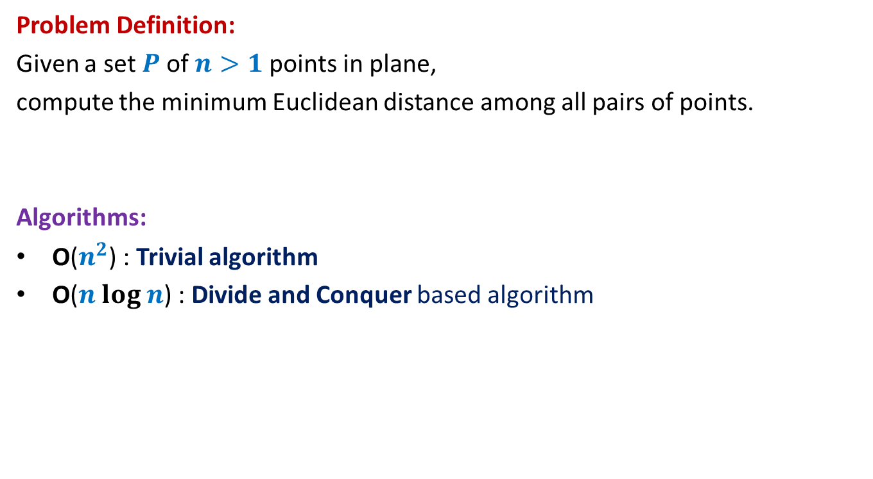
The Closest Pair Distance Problem
Problem Definition:
Given a set $P$of $n>1$points in plane,
compute the minimum Euclidean distance among all pairs of points.
Algorithms:
O($n^{2}$) : Trivial algorithm
O($n log n$) : Divide and Conquer based algorithm

Slide 35
Homework
Ponder over the algorithm.
How will you divide the problem ?
Spend at least 30 minutes pondering over this question
before coming to the next class.

