Slide 1
Survey:
Sentiment Analysis using Transformers
CSE 676 Deep Learning: Prof. Alina Vereshchaka
Date: 3rd May 2024
Team 8:
James Nguyen (khuongng)
Jatin Chhabria (jatinjay)

Slide 2
Introduction
The huge success of ChatGPT triggered a boom of investment and development in large language models (LLM)
There are so many LLMs that are publicly available to solve various NLP tasks
NLP tasks:
Sentiment analysis (our project) , eg: is this a good news, bad, or just neutral
Text summarization: eg: summarize news articles, research papers
Machine translation: eg: Youtube auto-translate feature that can translate to any languages
Question and answering: eg: ChatGPT, Gemini, Claude AI, Meta AI, …

Slide 3
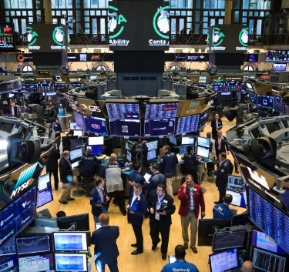

Sentiment Analysis
Main objective:
Given a text of any length, determine a categorized label about that text
This label can be anything: emotion of writer, quality of product, is financial report good or bad, …
Applications:
Amazon analyzes reviews to determine if a particular product good or bad
Twitter (or X) analyzes tweets if this comes from bot or a real person
A financial institution analyzes financial reports from hundreds of companies to invest
Politicians analyze media articles or posts to determine public opinion about election campaigns

Slide 4
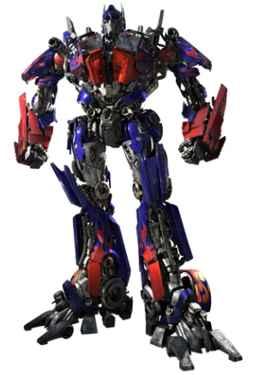


Our project: sentiment analysis using Transformer
Main objective:
Demonstrate effectiveness of transformer
Find the advantages and disadvantages of transformer architecture
Experiments:
Train 3 models: LSTM, Transformer from scratch, and pretrained BERT classifier on 2 datasets: Yelp and Amazon review datasets

Slide 5
Datasets
Amazon polarity
Amazon full reviews
Yelp polarity
Yelp full reviews

Slide 6
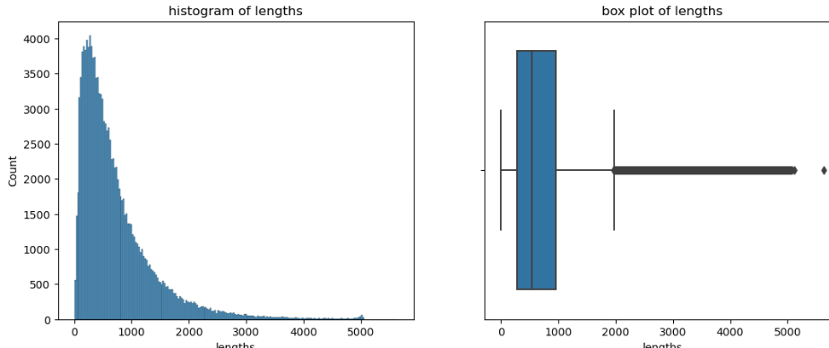
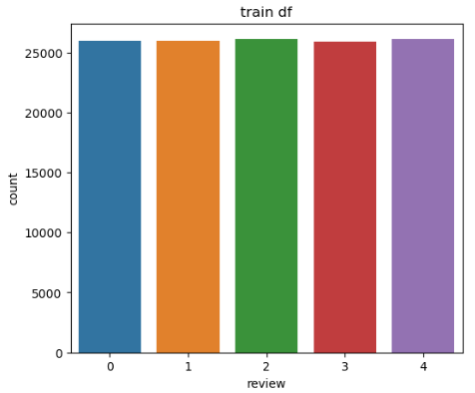
Datasets
Yelp full review dataset - Link
20% of the original train dataset, 130,000 data points
10% of the original test dataset, 5000 data points
Yelp polarity review dataset - Link
20% of the original train dataset, 112,000 data points
10% of the original test dataset, 3800 data points

Slide 7
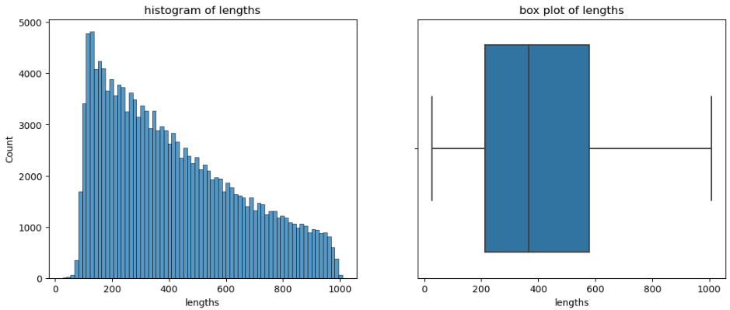
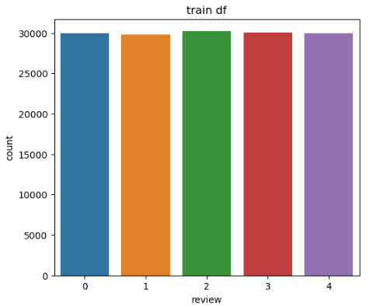
Yelp Datasets
Amazon full review dataset - Link
20% of the original train dataset, 150,000 data points
10% of the original test dataset, 6500 data points
Amazon polarity review dataset - Link
20% of the original train dataset, 180,000 data points
10% of the original test dataset, 4000 data points

Slide 8
BONUS: Real-world deep learning application
Real world datasets: Utilized Amazon and Yelp datasets, which are rich in diverse sentiments and opinions expressed by real users.
Vast Use Cases: Sentiment Analysis has a broad applicability. It is not limited to just one industry or sector but has applications across diverse fields such as marketing, customer service, product development, and even public opinion analysis.
Deep Learning Models: Leveraged deep learning models to address the challenges of sentiment analysis employing state-of-the-art methodologies to tackle real-world problems effectively.
Practical Implications: Helping businesses make data-driven decisions, improving customer experiences, or enhancing product development processes.
Sentiment Analysis using Deep Learning models can lead to meaningful outcomes and drive positive change in various domains.

Slide 9
Data Preprocessing
Natural Language Processing
Label Encoding
Tokenization
Padding

Slide 10
Data process procedure
lower case → remove urls → expand contractions → remove punctuations
map the labels to make it start from 0s. (originally it’s like 1,2,3,4,5, we map back 0,1,2,3,4)
build vocabulary and tokenize words into token ids
pad sequences with the maximum length sequence and use pad_id = 0
mark unknown tokens with unk_id = 1
Note that for steps 3,4,5 are not applied on BERT small training because they have their own pre-trained BertTokenizer and no need to build a vocabulary from scratch
Notes:
lemmatization, stop word removal
tokenization padding

Slide 11
Models
LSTM
Transformer from scratch
Pretrained-BERT small

Slide 12
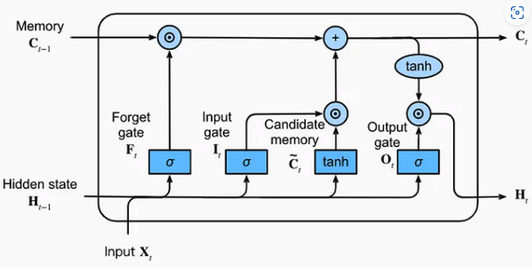
Long Short Term Memory (LSTM)
Introduction: an RNN architecture that attempt to overcome vanishing gradient problem
Our setup:
5 layer of LSTM with 512 hidden dimension
Bidirectional
Embedding uses GloVE with 300 dimension for each token
Linear layer fully-connected layer for prediction
Dropout = 0.2
Adam optimizer with learning rate = 0.0005
Parameters = 38M
Notes:
Introduction:
LSTM, or Long Short-Term Memory, is a type of recurrent neural network architecture designed to address the vanishing gradient problem. LSTMs are capable of selectively remembering and forgetting information from previous states, allowing them to model complex patterns in data like text, speech, or time series.
Architecture details:
Our LSTM model has 5 layers with 512 hidden dimensions in each layer.
It is a bidirectional LSTM, which means it processes the input sequence in both forward and reverse directions, capturing context from both sides.
We use GloVe, a popular word embedding technique, to represent each token in our input with a 300-dimensional vector.
A fully-connected linear layer is used for making predictions based on the LSTM outputs.
Training and hyperparameter details:
To prevent overfitting, we apply a dropout rate of 0.2 during training.
The Adam optimization algorithm is used for training, with a learning rate of 0.0005.
Our model has approximately 38 million trainable parameters, which is a relatively large model size.
Diagram:
The LSTM cell has gates that control the flow of information: the input gate, forget gate, and output gate.
Each gate has a special function and plays an important role.
This gating mechanism allows LSTMs to selectively remember and forget information, enabling them to capture long-term dependencies.

Slide 13
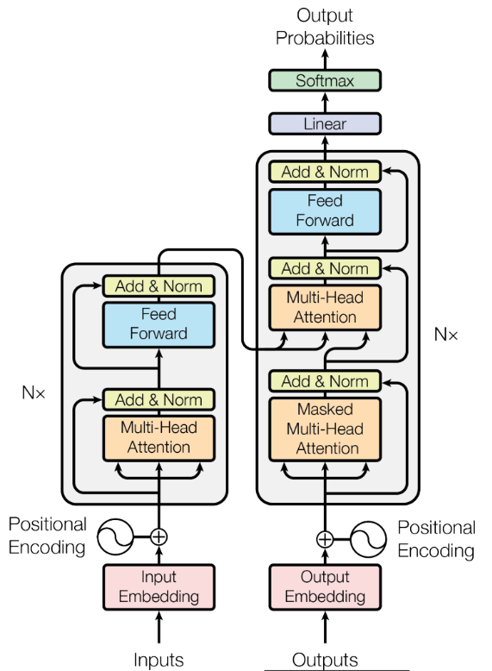
Transformer from scratch
Introduction:
Used transformer architecture from the paper attention is all you need (2017)
Our setup:
Only use transformer encoder for classification, inspired by BERT
Static positional encoding
5 heads for multi-head attention
Embedding uses GloVE with 300 dimension for each token
Linear layer fully-connected layer for prediction
Dropout = 0.4
Adam optimizer with learning rate = 0.0005
Parameters count = 28M
Notes:
The transformer architecture, introduced in the paper "Attention is All You Need" has revolutionized the field of natural language processing and has become a crucial component in many state-of-the-art language models. In this project, we have implemented the transformer encoder from scratch, following the architectural details outlined in the original paper. Architecture:
Our implementation focuses solely on the encoder part of the transformer, which is inspired by the BERT model's approach for classification tasks.
Instead of relying on recurrent or convolutional layers, we utilize static positional encoding to incorporate the order information of the input sequence.
We employ multi-head attention with 5 attention heads, allowing the model to capture different attention patterns simultaneously.
For token embedding, we use GloVe, a popular word embedding technique, with a 300-dimensional vector representation for each token.
A fully-connected linear layer is used for making the final predictions based on the encoded representations.
Training details:
To prevent overfitting and improve generalization, we apply a dropout rate of 0.4 during training.
We use the Adam optimization algorithm for training our model, with a learning rate of 0.0005.
Our transformer encoder model has approximately 28 million trainable parameters, which is a substantial model size but still manageable on modern hardware.
Diagram:
The input sequence is first passed through a positional encoding layer, which adds positional information to the token embeddings.
The encoded sequence is then processed by multiple multi-head attention layers.
The outputs from the multi-head attention layers are combined and passed through a feed-forward neural network.
The final encoded representations from the transformer encoder are then used by the fully-connected linear layer to make predictions for the classification task.

Slide 14
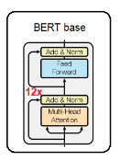
Pretrained BERT small
Introduction:
BERT is a special type of Transformer that only uses the encoder blocks to classify text
pretrained model from hugging face
Our setup:
Layers = 4
Hidden dimensions = 512
Parameters = 29M
Notes:
BERT stands for Bidirectional Encoder Representation form Transformers and was developed in 2018 by Google. This NLP technique utilized pre-trained transformer type neural networks. There are different sizes of the BERT model to meet various use-cases and available computing resources for different applications.

Slide 15
Results

Slide 16
Accuracy on Amazon review datasets
Models | Amazon polarity (2 labels) | Amazon full (5 labels)
LSTM | 52% | 25%
Transformer from scratch | 50% | 20%
BERT mini | 93% | 57%
Observation:
Against our expectations, the LSTM model performs slightly better our Transformer scratch implementation.
BERT mini met our expectations. Its pretrained power out-performed the other 2 methods.

Slide 17
Accuracy on Yelp review datasets
 | Yelp polarity (2 labels) | Yelp full reviews (5 labels)
LSTM | 63% | 24%
Transformer from scratch | 50% | 21%
BERT small | 95% | 63%
Observation:
The same pattern happens in Yelp. LSTM is better than our Transformer scratch implementation by a lot in Yelp polarity.
BERT small again out-performed the other 2 methods

Slide 18
Observations

Slide 19
Pretrained BERT pros and cons:
Pros:
More realistic to use in real-world applications than training from scratch
Very efficient compared to other RNN architectures
Cons:
Very huge in size. Impractical to load and deploy on mobile devices
Longer to train because of its massive amount of parameters
Notes:
BERT is a winner.
BERT Medium 8 layers-42M
BERT Base 12 layers-108M

Slide 20
Future work

Slide 21
If we could, we would:
Optimize our Transformer implementation to see if we can exceed the LSTM results
Use BERT large with 340M parameters to squeeze all the power of BERT on those datasets
Train on more data points to improve test results in full review Amazon and Yelp datasets
Deploy the fine-tuned BERT model on GPU-enabled server to run inferences so that we can build a downstream application to analyze product reviews with URLs

Slide 22
Team contribution
James - 50%
Jatin - 50%

Slide 23
Thank you
Q&A

