Slide 1

Data Structure and algorithm
IT206 PROJECT
Vaccination Management Portal

Slide 2


PROBLEM STATEMENT
The trending COVID-19 vaccination drive appealed and motivated us to think of designing an optimized and effective vaccination system
Organized distribution of booster injections
Solution
Neutral and Impartial vaccine distribution system
Providing choice of booster injections of covaxin and covishield
Providing choice of vaccination center near to their locality

Slide 3



How we approach ?
We started by discussing the basic requirements for a distribution portal
After doing an adequate web search about the problem we gathered productive information
Now, we broke our giant problem into small solvable parts and started working on technical aspect of the problem
We developed a basic version of our proposed solution within few days and demonstrated it to few of our family members
We took their valuable feedback into consideration and developed a better version of it by resolving few limitations of previous version
Eventually, we formatted our structure of code to replicate the COWIN vaccination portal

Slide 4

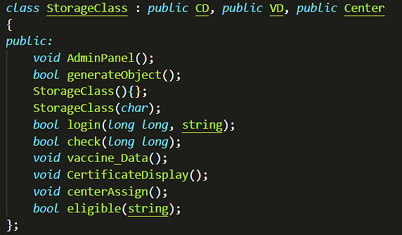
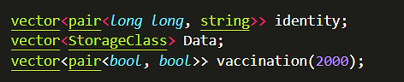
Insights of Code
We have used four classes, in which Storage class is the main Class which inherits other three classes i.e. CustomorData, VaccineData and CenterData.
Vector and Map is used majorly so that we can get random access and dynamic storage.
String is majorly used data-type along with long-long integer.
With the help of file I/0, we wrote a readable Certificate.

Slide 5


Things we learned…
Standard template library (STL)
File handling
Clock and Time module
Object oriented programming
Data Structures and Algorithms
Code reusability using functions
Team Work

Slide 6

Limitations
Before Feedback
User does not have choice of center
The user cannot have any proof or certificate of vaccination
Static Run Time Memory.
No Database for Centers Vaccine Stocks.
After Feedback
Only Readable Certificate(Preview-Type not download)
Static Run Time Memory.

Slide 7

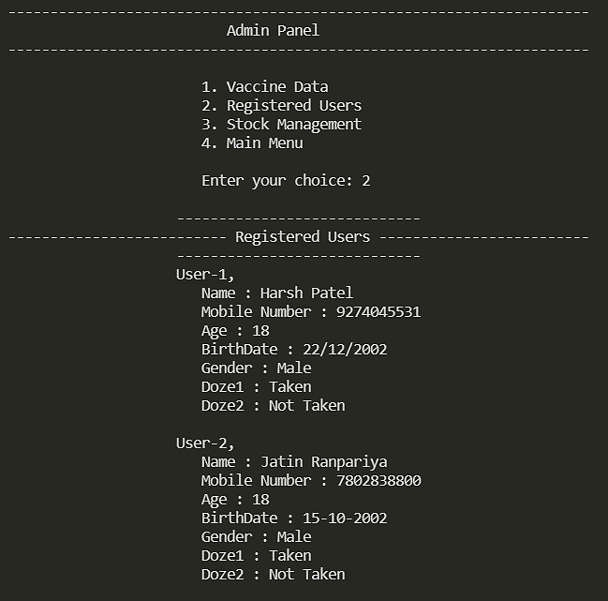
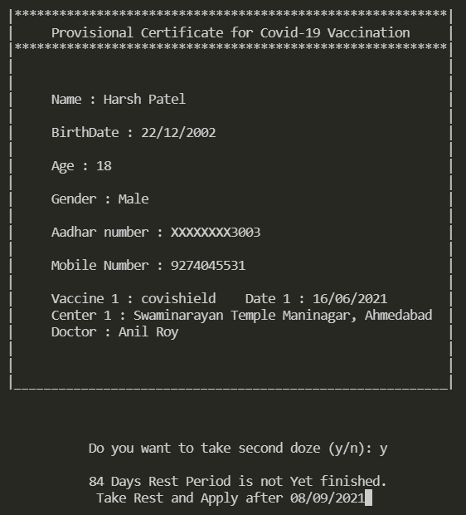
Insights of Portal

Slide 8
References
https://www.geeksforgeeks.org/the-c-standard-template-library-stl/
https://www.cplusplus.com/reference/ctime/
https://www.geeksforgeeks.org/how-to-print-colored-text-in-c/
(we learned library and modules from them and applied it into our code)

Slide 9


Team members
Patel Harsh Umakant 202001173
Ranpariya Jatin Bharatbhai 202001226
Thank you

