Slide 1

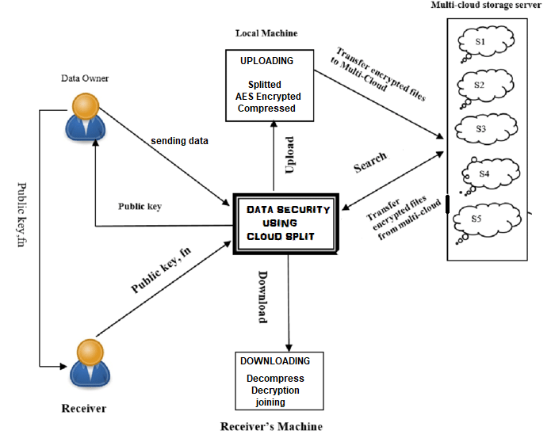
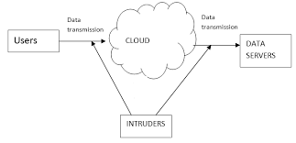
DATA SECURITY USING CLOUDSPLIT
TEAM:- DCEGGNHY
ABSTRACT
WORKING MODULES
Cloud computing transport or carry to a place everything as a service over the web supports demand of user anywhere, for example network, software, storage, hardware. Benefits of cloud storage are easy accessibility of data anyplace and at any time cost efficiency, and high reliability of the data. So every company is transferring its data to the cloud, means it uses the storage service provided by the cloud provider. So it is mandatory to protect that data against hackers. In this paper we propose splitting algorithms adoptable to better security for the cloud.
We focus on the problem of data security in cloud data storage and data transmission, which is essentially a distributed storage system.
In data transmission, data which we are trying to share, will we first splitted in n parts by the user, after splitting of files user will choose to encrypt the file using AES encryption of each part, after encryption technique, Each part has to be compressed by the user, Compression technique is proposed because of file size reduction. The basic plan is to use many clouds at constant time to mitigate the risks of malicious knowledge manipulation, disclosure, and method meddling. This design changed targets the confidentiality of knowledge and process logic. The idea of this design is that the applying logic must be divided into fine-grained components and these components area unit distributed to distinct cloud. In coding technique, the user encrypts the information together with his public key and uploads the cipher texts to the Cloud. The cloud will severally figure on the encrypted knowledge to get AN encrypted result that solely the user will decode. The user (or a little trusty non-public cloud) manages the keys and performs the coding and coding operations, whereas the huge computation on encrypted knowledge is finished by AN untrusted public cloud.
We can view cloud computing as the next-generation architecture of IT Enterprise. In the cloud, the data is shared between the server and the client. Speed is always the issue in networking. Security in the cloud is the current discussion topic in the IT world. In this research paper we propose the securing data without affecting the network and protecting the data from unauthorized access into the server, the data is secured in server based on users’ choice of security method so that data is being secured. In contrast to traditional solutions, where the IT services are under proper physical, logical and personnel controls, Cloud Computing moves the application software and databases to the large data centres, where the management of the data and services may not be fully trustworthy.
Step 1: Registration Module
In registration module users will register themselves by username, email, and password.
In Proposed system, we are splitting the file in different parts with some extension (.part in our case). It then splited and stored in our local system with extension .part.
Step 3: Encryption
In our proposed system, we encrypt each and every splitted file which is of .part extension with public key so that it cannot be easily readable by any unauthorised access or hacker.
Step 4: Compression Module
In our system, splited files get compressed with GZIPSTREAM algorithm so that the size of splited files gets reduced, and it can easily be transferred to cloud server.
Step 5: Upload and download module
We have developed a desktop application to upload files in cloud server in other words splited files get saved to different cloud server. We created a method where an user can share there files to other users also, for that we have designed a page in which user can simply enter the id of person whom to transfer the files and file gets uploaded to cloud server and name of the files get saved to sql server table. The receiver will get a notification that somebody has shared a file with you. If user clicks on the download button all the splitted files get merged and saved to receiver local system. Now the receiver party gets the encrypted and compressed file its time the user has to decrypt and decompressed the received file.
CONCLUSION
CURRENT PROBLEM
Cloud computing is emerging as a new thing and many of the organizations are moving toward the cloud but lacking due to security reasons. So cloud security is must which will break the hindrance the acceptance of the cloud by the organizations. There are a lot of security algorithms which may be implemented to the cloud.
DES, Triple-DES, AES, and Blowfish etc are some symmetric algorithm. DES and AES are mostly used symmetric algorithms. DES is quite simple to implement then AES.
RSA and Diffie-Hellman Key Exchange is the asymmetric algorithms. In cloud computing both RSA and Diffie-Hellman Key Exchange is used to generate encryption keys for symmetric algorithms. But the security algorithms which allow operations (like searching) on decrypted data are required for cloud computing, which will maintain the confidentiality of the data. So we are going to implement Split algorithm so that we can split long file and then after we process the encryption and decryption technique.
Cloud computing is changing the way IT departments buy IT. Businesses have a range of paths to the cloud, including infrastructure, platforms and applications that are available from cloud providers as online services. Many people may be confused by the range of offerings and the terminology used to describe them and will be unsure of the risk and benefits. Security is a major requirement in cloud computing while we talk about data storage. There are number of existing techniques used to implement security in cloud. In this paper, we discussed number of symmetric and asymmetric algorithms. Our future will be considering some problems related to existing security algorithms and implement a better version of Split algorithm.
Future Scope
As discussed there are many security algorithms which are currently used in a cloud computing environment. Apart from this there are still too many areas which require further enhancements like more efficient algorithms can be developed which can increase the security level in the environment. In future we will implement the advanced split algorithm in a cloud environment also we can enhance encryption features of file.
The complete data firstly uploaded over the internet which is completely under the untrustworthy CSP(cloud service providers) eyes
During the data transmission the data travels through a single transmission path all data transmitted which can easily hacked
REFERENCE
[1] AL.Jeeva, Dr.V.Palanisamy And K.Kanagaram “Comparative Analysis Of Performance Efficiency And Security Measures Of Some Encryption Algorithms” International Journal Of Engineering Research And Applications (IJERA) ISSN: 2248-9622 Vol. 2, Issue 3, May-Jun 2012, Pp.3033-3037.
[2] Neha Jain and Gurpreet Kaur ‘Implementing DES Algorithm in Cloud for Data Security” VSRD International Journal of CS & IT Vol. 2 Issue 4, 2012, pp. 316-321.
[3] Simarjeet Kaur “Cryptography and Encryption In Cloud Computing”, VSRD International Journal of CS & IT Vol. 2 Issue 3, 2012, pp. 242-249.
[4] Nelson Gonzalez, Charles Miers, Fernando Redigolo, Marcos Simplicio, Tereza Carvalho, Mats Naslund and Makan Pourzandi “A quantitative analysis of current security concerns and solutions for cloud computing”,Springer Journal of Cloud Computing: Advances, Systems and Applications 2012.
[5] Ronald L. Krutz and Russell Dean Vines, Cloud Security: A Comprehensive Guide to Secure Cloud Computing Wiley Publishing, Inc. Indianapolis, Indiana 2010.
[6] Behrouz A. Forouzan, Cryptography and Network Security, McGraw-Hill Companies, Inc., New York, Special Indian Edition 2007.
[7] Wayne Jansen and Timothy Grance “Guidelines on Security and Privacy in Public Cloud Computing”, National Institute of Standards and Technology, Special Publication 800-144, December 2011, 80 pages
[8] Akhil Behl “Emerging Security Challenges in Cloud Computing ”, IEEE World Congress on Information and Communication Technologies, 2011 pp.217-222.
ACKNOWLEDGEMENT
I would like to thank my research supervisors,Prof VIMMI MALHOTRA Hod Cse AND Prof. MEGHA , ASAS I would like to thank you very much for your support and understanding over the entire time.
My sincere thanks also goes to the management Dronacharya College Of Engineering , Haryana who provided me an opportunity and gave access to the laboratory and research facilities. Without their precious support it would not have been possible to conduct this research.
Developed By:- JATIN SHARMA , DEEPAK BENIWAL , PARVEEN SAINI
PHONE NO:- 9991742244
EMAIL:- JATINSHRAMA328@GMAIL.COM

