Slide 1
Logical Organization Of Computer-2
BCA 2nd Sem
By:
Mrs. Meenu Nangia
HIMT,Rohtak

Slide 2
Addressing Modes
The operation field of an instruction specifies the operation to be performed. This operation will be executed on some data which is stored in computer registers or the main memory. The way any operand is selected during the program execution is dependent on the addressing mode of the instruction.
Purpose:
The purpose of using addressing modes is as follows:
1.To give the programming versatility to the user.
2.To reduce the number of bits in addressing field of instruction.

Slide 3
Types of Addressing Modes
Register Mode
Immediate Mode
Register Indirect Mode
Auto Increment/Decrement Mode
Direct Addressing Mode
Indirect Addressing Mode
Displacement Addressing Mode
Relative Addressing Mode
Base Register Addressing Mode

Slide 4
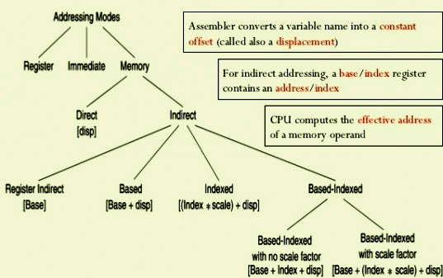
Illustrate By Diagram

Slide 5
Types Explanation
1.Immediate addressing mode
In this Immediate Addressing Mode, the data is provided in the instruction itself. The data is provided immediately after the opcode.
2. Register addressing mode
In the register addressing mode the source or destination data should be present in a register .
3.Direct Addressing Mode
In the Direct Addressing Mode, the source or destination address is specified by using 8-bit data in the instruction. Only the internal data memory can be used in this mode.

Slide 6
4. Register indirect addressing Mode
In this mode, the source or destination address is given in the register. By using register indirect addressing mode, the internal or external addresses can be accessed.
5.Indexed addressing mode
In the indexed addressing mode, the source memory can only be accessed from program memory only. The destination operand is always the register .
6.Implied Addressing Mode
In the implied addressing mode, there will be a single operand. These types of instruction can work on specific registers only. These types of instructions are also known as register specific instruction.

Slide 7
7.Indirect Addressing
Indirect addressing mode uses instructions that include the address of a value that points to the effective address of the operand. The instructions point to either a register or a memory location, and the location would contain the effective address of the operand in memory.
8.Based indexed mode
In this the effective address is sum of base register and index register. The physical memory address is calculated according to the base register. Indexed mode – In this type of addressing mode the effective address is sum of index register and displacement.

Slide 8
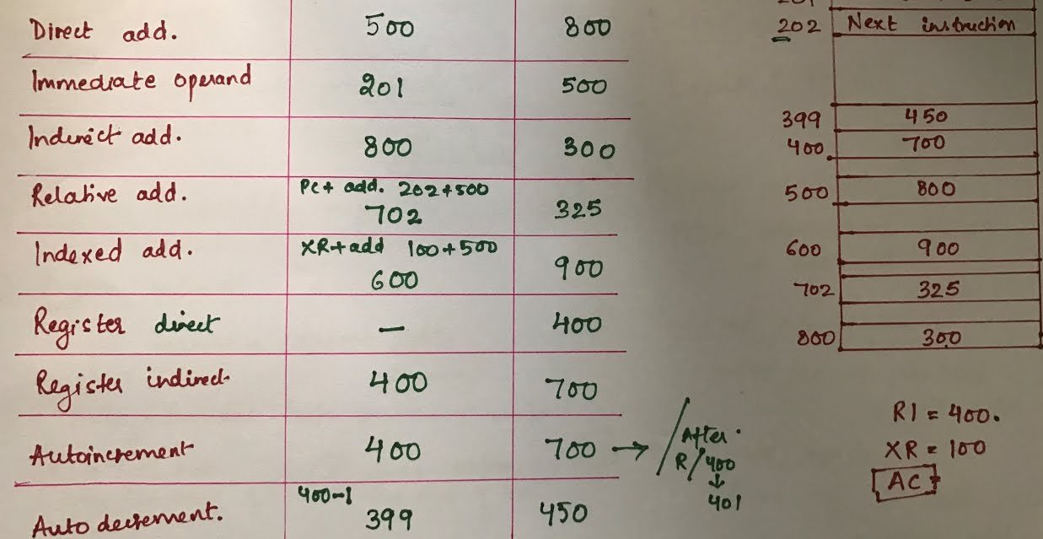
Example of Addressing Modes

Slide 9
Direct Memory Access (DMA)
For the execution of a computer program, it requires the synchronous working of more than one component of a computer. For example, Processors – providing necessary control information, addresses…etc, buses – to transfer information and data to and from memory to I/O devices…etc. The interesting factor of the system would be the way it handles the transfer of information among processor, memory and I/O devices. Usually, processors control all the process of transferring data, right from initiating the transfer to the storage of data at the destination. This adds load on the processor and most of the time it stays in the ideal state, thus decreasing the efficiency of the system. To speed up the transfer of data between I/O devices and memory, DMA controller acts as station master. DMA controller transfers data with minimal intervention of the processor.

Slide 10
DMA Controller
The term DMA stands for direct memory access. The hardware device used for direct memory access is called the DMA controller. DMA controller is a control unit, part of I/O device’s interface circuit, which can transfer blocks of data between I/O devices and main memory with minimal intervention from the processor.
DMA controller provides an interface between the bus and the input-output devices. Although it transfers data without intervention of processor, it is controlled by the processor. The processor initiates the DMA controller by sending the starting address, Number of words in the data block and direction of transfer of data .i.e. from I/O devices to the memory or from main memory to I/O devices. More than one external device can be connected to the DMA controller.

Slide 11
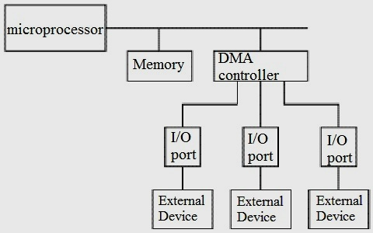

Slide 12
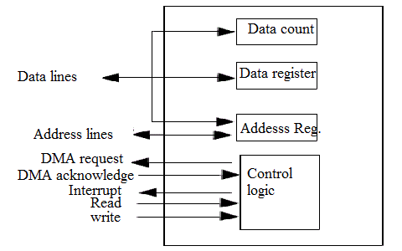
DMA controller contains an address unit, for generating addresses and selecting I/O device for transfer. It also contains the control unit and data count for keeping counts of the number of blocks transferred and indicating the direction of transfer of data. When the transfer is completed, DMA informs the processor by raising an interrupt.

Slide 13
Working of DMA Controller
DMA controller has to share the bus with the processor to make the data transfer. The device that holds the bus at a given time is called bus master. When a transfer from I/O device to the memory or vice verse has to be made, the processor stops the execution of the current program, increments the program counter, moves data over stack then sends a DMA select signal to DMA controller over the address bus.
If the DMA controller is free, it requests the control of bus from the processor by raising the bus request signal. Processor grants the bus to the controller by raising the bus grant signal, now DMA controller is the bus master. The processor initiates the DMA controller by sending the memory addresses, number of blocks of data to be transferred and direction of data transfer. After assigning the data transfer task to the DMA controller, instead of waiting ideally till completion of data transfer, the processor resumes the execution of the program after retrieving instructions from the stack.

Slide 14
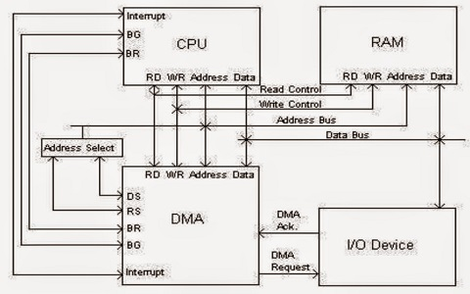
Transfer of Data in Computer By DMA Controller

Slide 15
DMA controller now has the full control of buses and can interact directly with memory and I/O devices independent of CPU. It makes the data transfer according to the control instructions received by the processor. After completion of data transfer, it disables the bus request signal and CPU disables the bus grant signal thereby moving control of buses to the CPU.
When an I/O device wants to initiate the transfer then it sends a DMA request signal to the DMA controller, for which the controller acknowledges if it is free. Then the controller requests the processor for the bus, raising the bus request signal. After receiving the bus grant signal it transfers the data from the device. For n channeled DMA controller n number of external devices can be connected.

Slide 16
Mode of Transfer in DMA
The DMA transfers the data in three modes which include the following.
a) Burst Mode: In this mode DMA handover the buses to CPU only after completion of whole data transfer. Meanwhile, if the CPU requires the bus it has to stay ideal and wait for data transfer.
b) Cycle Stealing Mode: In this mode, DMA gives control of buses to CPU after transfer of every byte. It continuously issues a request for bus control, makes the transfer of one byte and returns the bus. By this CPU doesn’t have to wait for a long time if it needs a bus for higher priority task.
c) Transparent Mode: Here, DMA transfers data only when CPU is executing the instruction which does not require the use of buses.

Slide 17
Thanks……..

