Slide 1

By
Mr. Vikas Vij
Asst Professor Dept Of MBA

Slide 2

Service is an act or performance that one party can offer to another that is essentially intangible and does not result in any ownership of anything. Its production may or may not be tied to physical products.(Philip Kotler)
It is based on relationship and value.
It may be used to market a service or product.

Slide 3

Upward trend in disposable income
Income increasing in the past 20 years: Disposable Personal Income in India increased to 71640930 INR Million in 2011 from 60158160 INR Million in 2010
Developing country
Liberalization
Job Opportunities
Demand increases with disposable income
Increasing Specialization
Technology
Cost effective
Expert and professionals
Development of services, financial, banking

Slide 4
Changing Lifestyle
Development of corporate culture
Jogging, gym centre
Adapting western culture: foreign brands
Increasing Literacy Rate Professionalism in education Information explosion Government Regulations Consumer protection, KYC

Slide 5
In recent times the service sector is increasing at a very fast pace. After the liberalization in the year 1991, the contribution of service sector is continuously increasing in the growth of our economy.
However, agriculture is still dominating the Indian economy. Service sector are growing not only in volume but also in sophistication and complexity. The growth of service industry is the result of combination of several reasons, they are,

Slide 6
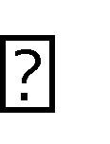
The Services Sector contributes the most to the Indian GDP. The Sector of Services in India has the biggest share in the country's GDP, it accounts for more than 50% contribution
The various sectors under the Services Sector in India are construction, trade, hotels, transport, restaurant, communication and storage, social and personal services, community, insurance, financing, business services, and real estate.

Slide 7
Increasing affluence(wealth)
More leisure(free time) time
Greater life expectancy(hope)
Greater complexity of the product
Higher percentage of working women
Increasing complexity of life
Increasing number of new products

Slide 8
Intangibility
Inseparability
Variability
Perish ability

Slide 9

Services are intangible means it cannot be seen, tasted felt, heard or smelled before purchase.
Evaluation is a challenge
Intangibility is used in marketing to describe the inability to assess the value gained from engaging in an activity using any tangible evidence
It draws inferences about:
Place
People
Equipment
Communication Material
Symbols
Price

Slide 10

Services are produced and consumed simultaneously
Provider-client interactions is a special feature of service marketing.
In inseparability, key quality of services as distinct from goods
A live theatre performance, a makeover

Slide 11

It is otherwise called heterogeneity
Services are highly variable
The state or characteristic of being variable
Eg: service firms
A car servicing varies each time
Mc Donald’s consumables maybe standardized but a weekday or a weekend maybe different.

Slide 12

Perish ability is used in marketing to describe the way in which service capacity cannot be stored for sale in the future
Services cannot be stored
A 100 m race in Olympics(4 years)

Slide 13
Services Marketing Mix:7 Ps for Services:-
Product
Price
Place
Promotion
People
Process
Physical Evidence

Slide 14

Organization size and Structure
Regulatory Bodies
Growth in service Industries
Customer/employer interaction
Service Quality
Specific sectors

Slide 15
Low Value Misconception Low Capital Interest Small Scale View
Cannot Provide Wealth Cost

Slide 16
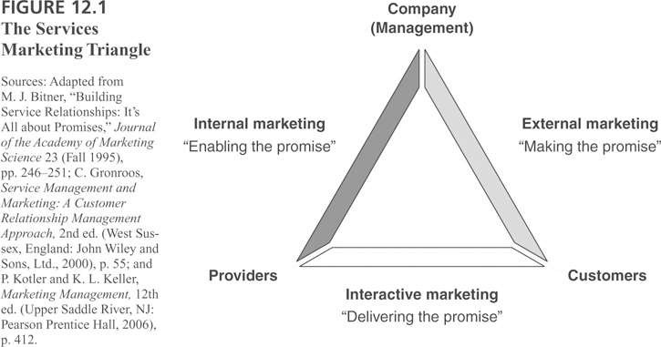

Slide 17

Focus on a service organization. In the context you are focusing on, who occupies each of the three points of the triangle?
How is each type of marketing being carried out currently?
Are the three sides of the triangle well aligned?

Slide 18
Internal Marketing
Internal marketing is the side of the triangle between your organization and your employees
Provide services to customers.
Adequate training on the services to be delivered
Customer satisfaction service techniques.
Involve with your employees
Performance rewards system for employees who deliver the highest level of customer service.

Slide 19

External marketing goes from your business organization out to customers and prospective customers.
Traditional form of business marketing,
How the services provided by your business benefit customers.
External marketing includes advertising, your
website and your company's social media efforts.
Fill the business pipeline with future business.

Slide 20

The side of the triangle between your employees and customers is called interactive marketing.
How your employees deliver the services your company provides.
Goal is to have highly satisfied customers who become long-term, repeat customers.
Effectiveness of the interactive marketing relates back to the internal marketing efforts of your business.
How your employees keep the promises made by your external marketing efforts.

Slide 21

○ Overall Strategic Assessment
How is the service organization doing on all three sides of the triangle?
Where are the weaknesses?
What are the strengths?
Specific Service Implementation
What is being promoted and by whom?
How will it be delivered and by whom?
Are the supporting systems in place to deliver the promised service?

Slide 22
○ The Gaps Model was proposed by A Parasuraman, Valarie Zeithaml and LL Berry in 1985 in the Journal Of Marketing:

Slide 23
Introduce a framework, called the gaps model of service quality.
Demonstrate that the most critical service quality gap to close is the customer gap, the difference between customer expectations and perceptions.
Show that four gaps that occur in companies, which we call provider gaps, are responsible for the customer gap.
Identify the factors responsible for each of the four provider gaps.

Slide 24
Gaps Model of Service Quality Customer Gap: difference between customer expectations and perceptions Provider Gap 1 ( The Knowledge Gap ):
Not knowing what customers expect Provider Gap 2 ( The Service Design & Standards Gap ):
Not having the right service designs and standards Provider Gap 3 ( The Service Performance Gap ):
Not delivering to service standards Provider Gap 4 ( The Communication Gap ):
Not matching performance to promises

Slide 25
○ The difference between customer expectations of service standards & quality and the service provider’s understanding of these expectations

Slide 26
Inadequate marketing research,
Research not focused on service quality
Research findings not used properly
Lack of upward communication from customers & frontline employees,
Too many layers
Lack of market segmentation
Focus on transactions & customer acquisition
Inadequate service recovery

Slide 27

○ The difference between service provider’s understanding of customer expectations and development of customer-driven service design & standards

Slide 28
Poor / vague / undefined service design
Unsystematic service development process,
Failure to match service design to service positioning
Lack of customer defined standards
Lack of focus on customer requirements,
Absence of formal process for setting service quality goals & standards
Lack of attention to physical evidence
The packaging of the service

Slide 29

○ The discrepancy between development of customer-driven service standards and actual service delivery or performance

Slide 30
Deficiencies in HR policies
Wrong recruitment, role ambiguity / conflict, poor employee / technology fit,
Evaluation / compensation schemes,
Empowerment etc
Supply demand gaps
Over reliance on pricing strategies to close gaps
Customers not fulfilling roles (ignorance?)
Intermediaries – conflicts re objectives,
Performance, rewards, empowerment, control etc

Slide 31

○ Provider Gap 4 The difference between service provider’s external (marketing) communications and service delivery

Slide 32
Absence of integrated marketing communications
Lack of interactive marketing in communications plan,
Inadequate internal marketing program
Gaps in horizontal communications between sales, marketing and operations
Ineffective management of customer expectations

Slide 33

The difference between customer expectations from the service and customer perceptions of the delivered service.
Customer perceptions are subjective assessments of service experiences.
Customer expectations are the standards against which service experiences are compared.

Slide 34

Customer expectations – from marketer controlled factors as well as factors outside the control of the marketer or service provider such as personal needs, word of mouth and past experiences
The aim is to reduce Gap 5 by suitable strategic and tactical actions in marketing, sales, operations and communications
Unique characteristics of services – intangibility, heterogeneity, inseparability & perishability contribute to Gap 5

Slide 35
Current thinking: More Gaps An extension of the Gaps Model has been put forward by Dr Arash Shahin. Two more gaps have been proposed. These centre around "Employees’ Perceptions of Customers’ Expectations"
Gap 6:
Gap 6 The discrepancy between customers’ expectations and employees’ perceptions of customers’ expectations
Gap 7:
Gap 7 The discrepancy between employees’ perceptions of customers’ expectations and management (or company)
perceptions of customers’ expectations

Slide 36

The Customer Gap Expected service Perceived service Customer Gap
Key Factors Leading to the Customer Gap:
Key Factors Leading to the Customer Gap Customer Expectations Customer Perceptions Customer Gap
Customer Expectations Company Perceptions of Customer Expectations Key Factors Leading to Provider Gap 1 Gap 1
○
Key Factors Leading to Provider Gap 2:
Customer-Driven Service Designs and Standards Management Perceptions of Customer Expectations Key Factors Leading to Provider Gap 2 Gap 2
○
Key Factors Leading to Provider Gap 3:
Service Delivery Customer-Driven Service Designs an Standards Key Factors
Leading to Provider Gap 3 Gap 3
○
Key Factors Leading to Provider Gap 4:
○ Service Delivery External Communications to Customers Key Factors Leading to Provider Gap 4 Gap 4

Slide 37
○ Perceived Service Expected Service CUSTOMER COMPANY Customer Gap Gap 1 Gap 2 Gap 3 External Communications to Customers Gap 4 Service Delivery Customer- Driven Service Designs and Standards Company Perceptions of Consumer Expectations Gaps Model of Service Quality

Slide 38
Consumer Behaviour is the process and activities people engage in when searching for selecting, purchasing, using, evaluating and disposing of products and services so as to satisfy their needs and services
(Belch and Belch)
Consumer Behavior includes those activities directly involved in obtaining, consuming and disposing of products, services including the decision processes that precede and follow these actions
Engel, Blackwell and Miniard
Who buys products or services
How do they buy produts or services
Where do they buy them
How often do they buy them
How often do they use them
When do they buy them
Why do they buy them

Slide 39

Goods are high on search attributes eg: goods can be seen, touched and felt or evaluate their physical properties
In Services experience is needed before evaluating them. Customers cannot be sure of attributes even after the experience. these are credence attributes

Slide 40
Attributes a consumer can determine before purchase
Physical goods tend to emphasize search attributes
Style, colour, texture, taste, test drive, clothing, furniture, cars electronic equipments are high in search attributes
Tangible attributes help in evaluation

Slide 41
Holidays, live entertainment performances scuba diving different for different consumers
A Trip on a ship
A Carribean experience, trekking

Slide 42
Impossible to evaluate even after purchase and consumption
Forced to think that it has been delivered
Example: An appendicitis operation/ A Root canal treatment

Slide 43

Customer expectations are beliefs about service delivery that serve as standards or reference points against which performance is judged.
Knowing what the customer expects is the first and
possibly most critical step in delivering good quality service
What types of expectation standards do customers
hold about services? What factors most influence the formation of these expectations? What role do
These factors play in changing expectations? How can
a service company meet or exceed customer expectations?

Slide 44
IDEAL EXPECTATIONS
‘Everyone says this restaurant is as good as one in France and I want to go somewhere very special for my anniversary.’
NORMATIVE SHOULD EXPECTATIONS
‘As expensive as this restaurant is, it ought to have excellent food service.’
EXPERIENCE BASED NORMS
‘Most times this restaurant is very good, but when it gets busy the service is slow.’
ACCEPTABLE EXPECTATIONS
‘I expect this restaurant to serve me in an adequate manner.’
MINIMUM TOLERABLE EXPECTATIONS
‘I expect terrible service from this restaurant but come because the price is low.’

Slide 45

1. Desired Service Expectations
It means the level of service customer hopes to receive
Desired service is a blend of what customers can be and should be
They are further classified into two types
1) Ideal Expectations:
This is the highest degree of customer service expectations Customer wants to adjust her expectations
Normative Expectations
This is the second highest degree of expectations and at this level the customer has a pre-decided mindset that the service should be beyond or at par with respect to a particular expected level

Slide 46
2. Adequate Service Expectations
It is the service expectation which has the minimum threshold level which is acceptable to the customer.
According to these expectations the services at this point are acceptable
to customer but not so as desired by customer
They are classified into three Experience based expectations
Acceptable expectations--based on charges
Minimum Tolerable expectations
These are the boundary line of lowest level degree expecting lesser standard of service since price is low

Slide 47
Services are heterogeneous and performance vary across providers
and employees. The extent to which customers recognize and are willing to accept the variation
The gap between the desired and adequate service has been called the zone of tolerance
If service drops below adequate service, the minimum level considered
acceptable customers will be frustrated
Service performance is higher than the top level of zone of tolerance were performance exceeds desired service customers will be pleased/delighted
Service within the zone of tolerance where customers do not notice
the service in particular
Example waiting time in a grocery store
Different customers poses different zones of tolerance Example price increases zone of tolerance is lesser

Slide 48
Need Recognition
Information Search
Evaluation of Alternatives
Purchase Decision
Post purchase Behaviour

Slide 49
The first step of this process requires determining the difference between an ideal state and the physical situation. It can be triggered through marketing.
Example: A mother sees a commercial for milk and realizes she is almost out.

Slide 50
The second stage defines a consumer's options available and the product package - or bundle of benefits the customer perceives the item to be. This includes the price, quality, and access to the product. Two types of information searches exist.
Internal: Most often used in frequent purchases. The potential buyer recalls memories and previous experiences with a product or with the company.
External: Most often used when there is a lack of prior experience with a product. The risk of making a wrong purchase decision is greater.
3 Primary sources of external information are...
-Personal (friends, family, co-workers)
-Public (media reviews, magazines, i.e. Consumer Reports)
-Marketed (commercials, print ads, websites, sales person)

Slide 51
Here the consumer notes product features he or she wants and does not want. Brands play a significant role in this step. A consumer is likely to go with a brand that is trusted, or resume information search. The alternatives will be weighed to seek the best outcome.

Slide 52
○ This is the actual action taken by the consumer.
Does the customer choose an alternative? If not, three possibilities remains...
-Where to buy (choose a person, location, or
company). Past experience with the seller again will affect the decision, along with terms of the sale and policies.
○ -When to buy (immediate transaction or
postpone until later). Time availability, convenience, and sales are considered.
-Don't Buy

Slide 53
○ This is the evaluation of purchase, pleased or displeased. If satisfied, customer loyalty is gained - the right decision was made. If not, negative feedback may occur and lose of loyalty. Warranties, support, future discounts, and surveyors can contribute to post- purchase behaviour.

Slide 54
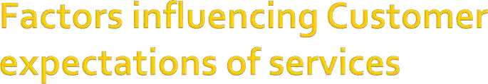
1. Sources of Desired Service expectations
The two largest influences on desired service level are personal needs & enduring service intensifiers
1. Personal Needs:
physical, social, psychological and functional
basic hunger expectations
already had dinner has less expectation
customer with high social dependency

Slide 55
2. Enduring service intensifiers Heightened sensitivity to services
Derived service expectations is based on the dependency of other people's expectations, example planning of a party
Personal service philosophy
customer's underlying generic attitude about the meaning of service Eg: serving food

Slide 56
2. Sources of adequate service expectations level of service the customer finds acceptable they are short term and tend to fluctuate
1.
Transitory service intensifiers:
temporary short term factors that make customer aware of the need of the service personal emergency situation accident/automobile insurance
2. Perceived service alternative
multiple service providers
small town and airline operators customer is more tolerant
customer in bigger cities have less tolerance level
3. Customers self perceived service role
customers influence on the level of service
customers demands on certain parameters might make her more choosy than those who do not

Slide 57
4. Situational factors
tornadoes floods rains lowers level of service expectation
5 predicted service:
predicted patterns during weekends and weekdays

Slide 58
3. Source of both desired and predicted service expectation
information from different sources internal and external experience
explicit service promises personal by salespeople non personal through advertising and media in control of the service provider
implicit service promises tangibles, prices higher price higher quality
word of mouth communication shaping expectations of
service
past experience

Slide 59

○ Perception is the process by which information from the outside environment is selected, received, organized and interpreted to give meaning to the environment

Slide 60
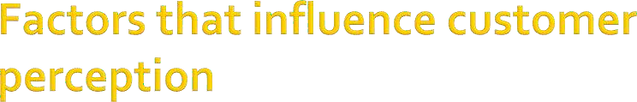
Service Encounters:
every encounter sums up to the customer satisfaction
Service Evidence
People: Employees and Customers
Process: Operational flow of activities steps in process, Technology vs Human
Physical Evidence: Tangible servicescape, guarantee, technology website
Organizational Image
Price

Slide 61
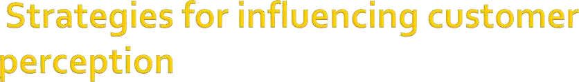
Measure and manage customer satisfaction
Aim for customer quality and satisfaction in every service
Plan for effective recovery
Facilitate adaptability and flexibility
Encourage spontaneity
Help employees cope with problem customers
Manage dimensions of quality at encounter level 8.Evidence of service
Communicate and create realistic image
Enhance customer perception of quality and value through pricing

Slide 62
The interaction between the customer and the service provider represents the company to the customer
The core of service element is the interaction between those providing services and the customer which is known as service encounter also known as the moment of truth
Customer satisfaction is achieved when
appropriate processes are designed to ensure that the service encounters meets customer expectations

Slide 63
During each service encounter the customer goes through a range of mental states
Experiencing the needs
Anxiety about how to fulfill the need or whether or not it will be fulfilled
Sensitivity about whether the right choice has been made or not or whether to accept the way in which service is being provided or not
Dependence or a child like relationship to the product or service
Happiness or unhappiness according to the degree of success of the encounter or transaction
Satisfaction or resentment after the encounter is over according to the outcome

Slide 64
Service encounters are purposeful:
doctor visit even relieving boredom
Service providers are humane
In service encounter prior acquaintance is not necessary:
hairdresser
color consultant wardrobe advisors
Task related information dominates train timings exchange rate
Service encounters are limited in scope with the scope of interchange being restricted by nature and content of the service to be delivered
example: no extra service only the concerned
Temporary suspension of normal social status of participants
doctors and dentists cater to lower levels of society

Slide 65
Shares the customers perception of service received
Implications on visitors satisfaction evaluation
Types of service encounters
Remote encounter
Online
Face to face

Slide 66

Recovery
Adaptability- employee response to customer needs
Spontaneity: unprompted and unsolicited employee actions
Coping-employee response to customer problem
phone encounter

Slide 67
Role theory:
Interactive features of service provider-client interface and a clearer focus on role performance and the interpersonal dimensions of service quality.
Script Theory
Types of Service Encounter:
Remote
Phone
Face to face

Slide 68

Product
Sales activity
After sales
Culture

Slide 69

Products and service feature
Consumer emotions
Attributions for service success or failure
Perceptions of equity or fairness:
The belief is that people value fair treatment which causes them to be motivated to keep the fairness maintained within the relationships of their employees and customers
Other consumer, family, co workers

Slide 70

Customer Expectation is of paramount importance to provide good quality of service
Marketing research plays a major role in
establishing the expectations of a customer
An organization that does not research consumer expectation cannot understand their needs and hence cannot grow
Research helps bring customer expectation
realistically

Slide 71
To identify dissatisfied customer
Discover customer requirements
Monitor and track service performance
Assess overall company performance Vs competition
Gaps between customer expectations and perceptions
Gauge effectiveness of changes in services
Appraise service performance
Monitor changing expectations
Forecast Future Expectations

Slide 72
Complaints
Requirements
Critical Incidence/factors t customer touch points
Trailer calls to track performance
Mystery shopping to monitor quality
Customer panel/forum
Lost customers..why shifting loyalty
Satisfaction survey

Slide 73
STAGE 1: Define Problem
STAGE 2: Develop Measurement strategy STAGE 3 Implement Research Program STAGE 4: Collect and Tabulate Data STAGE 5 Interpret and Analyze findings STAGE 6: Report Findings

Slide 74

Relationship Marketing:
is a philosophy of doing business that focuses on keeping and improving current customers
does not emphasize acquiring new customers
is usually cheaper (for the firm)--to keep a
current customer costs less than to attract anew one
goal = to build and maintain a base of
committed customers who are profitable for the organization
thus, the focus is on the attraction, retention,and enhancement of customer relationships

Slide 75
To the customer To the firm

Slide 76

Enhancing
Retaining Satisfying Getting

Slide 77
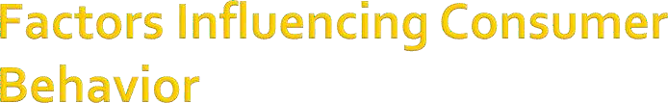
Culture values norms roles and customs dating services in US
Sub-culture- behavior pattern age lifestyle, geography, ethnicity, race and religion
Social Class shopping patterns, owning certain products
Reference Groups; Sahara India uses cricket group
Family

