Slide 1
1.KingCountryHouse(Dashboard)
File created on: 8/26/2023 8:04:43 PM

Slide 2
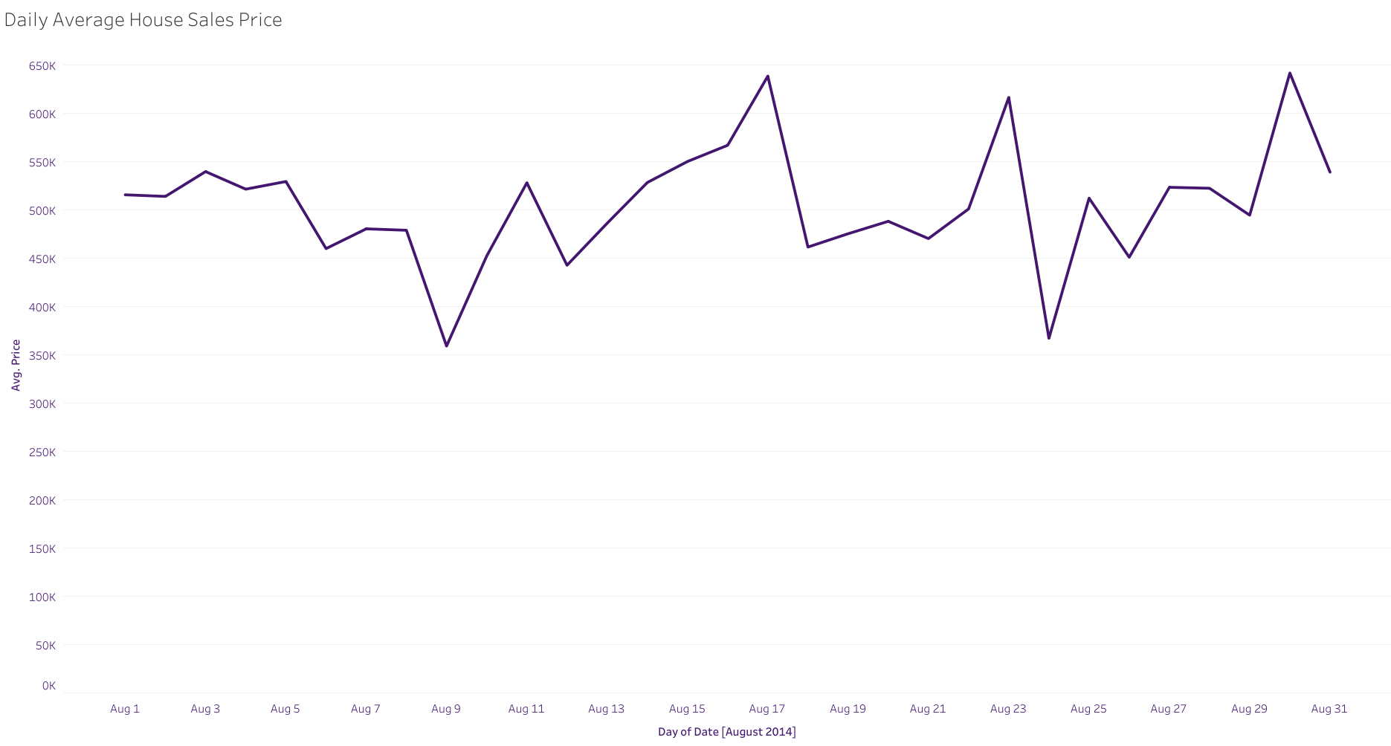

Slide 3
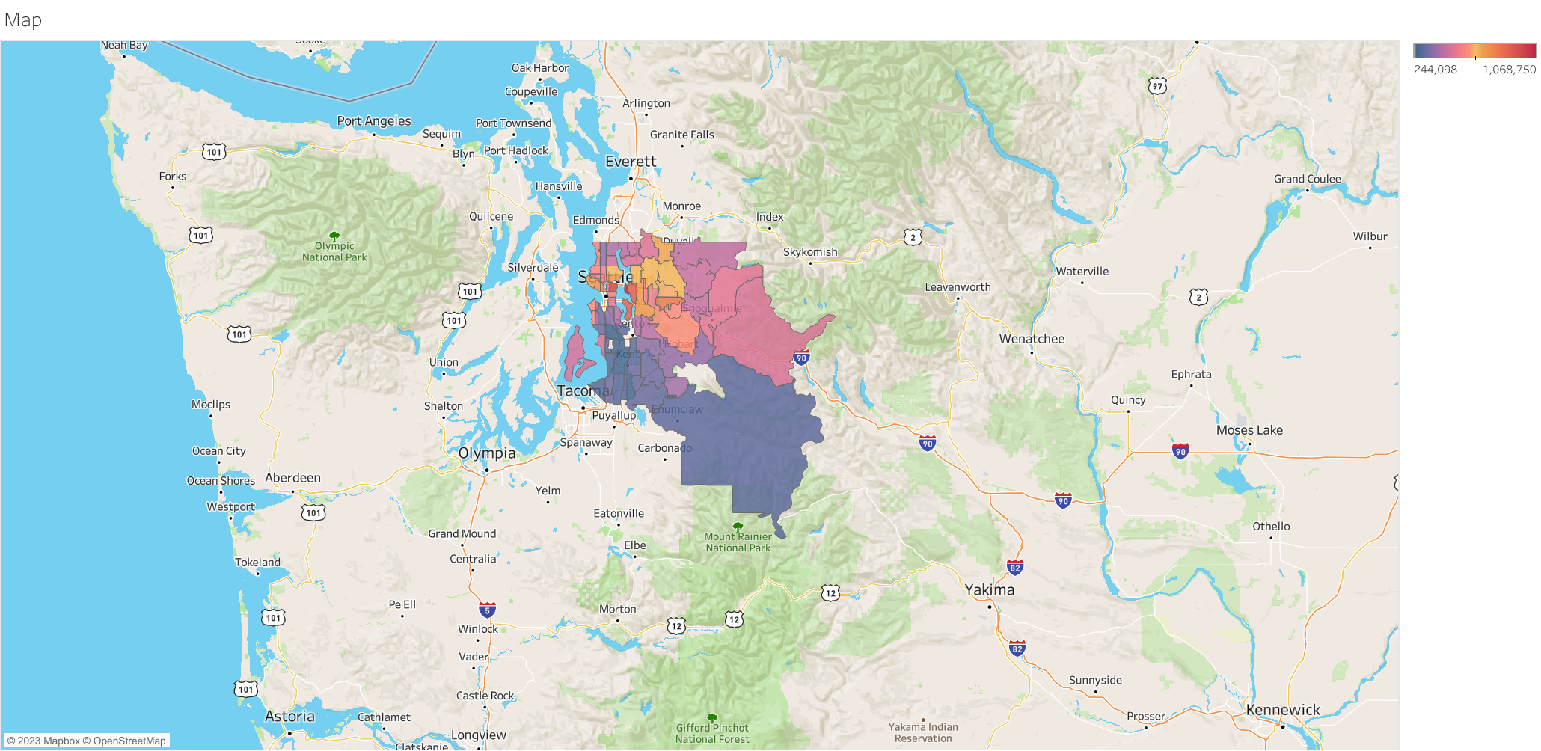

Slide 4
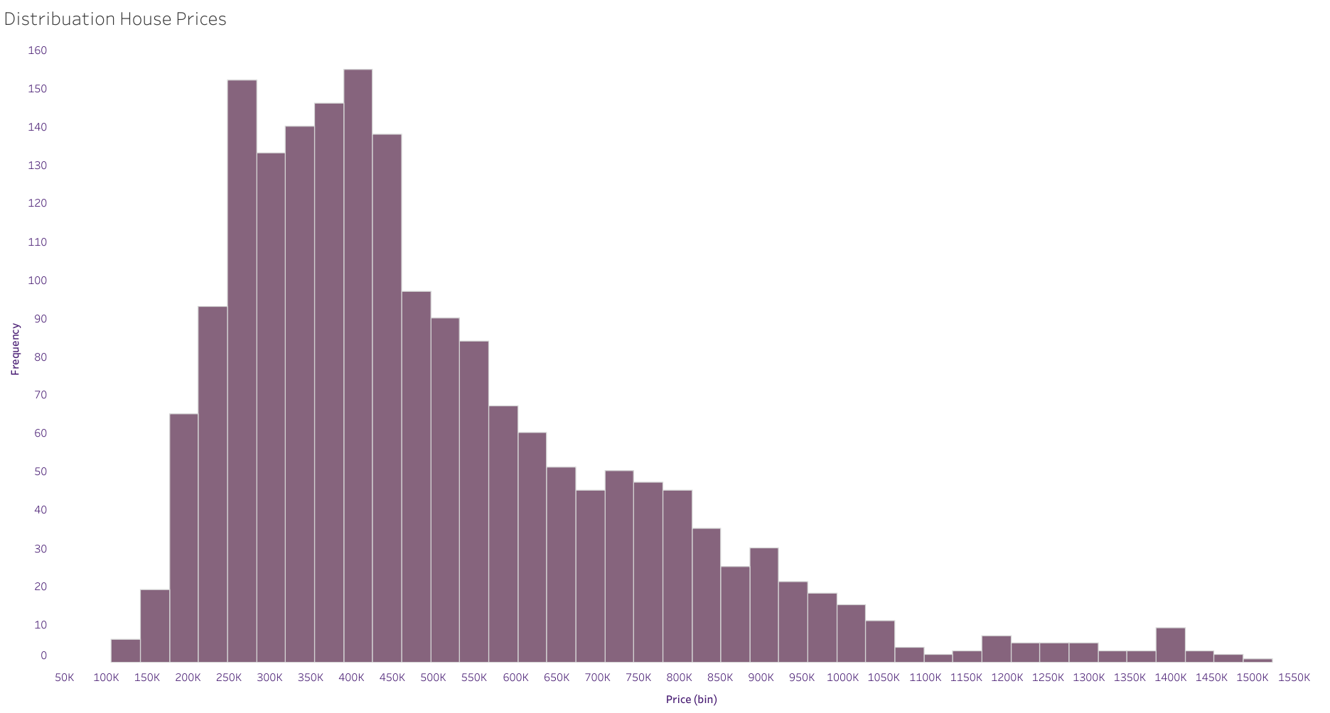

Slide 5
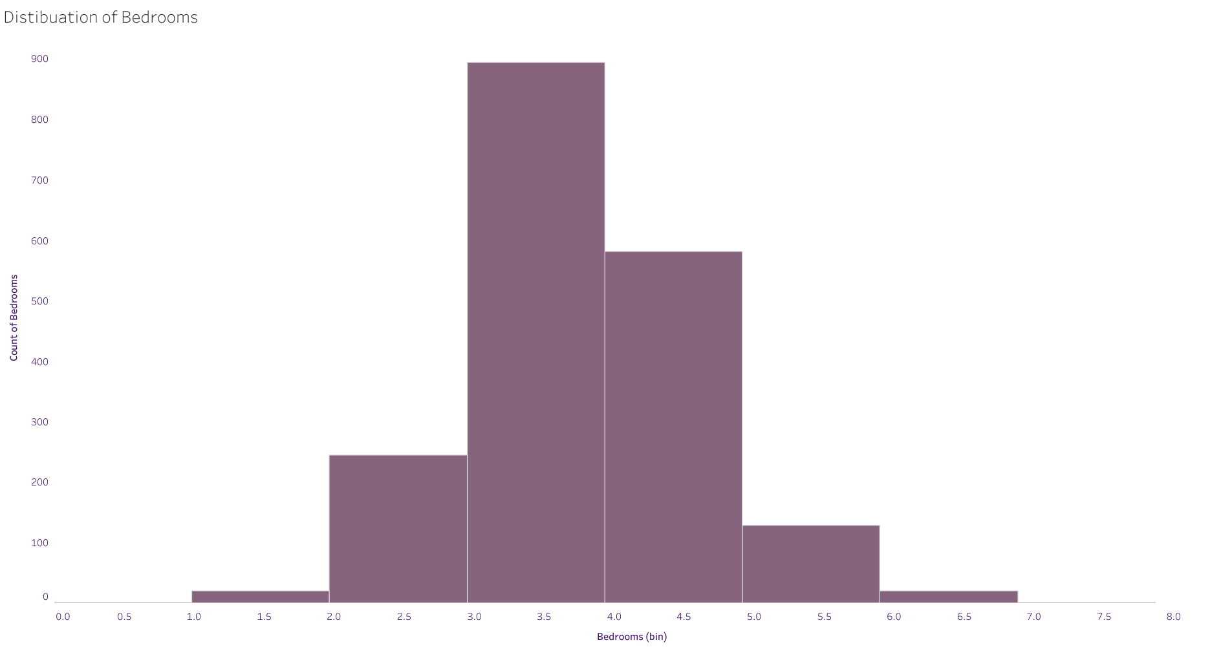

Slide 6
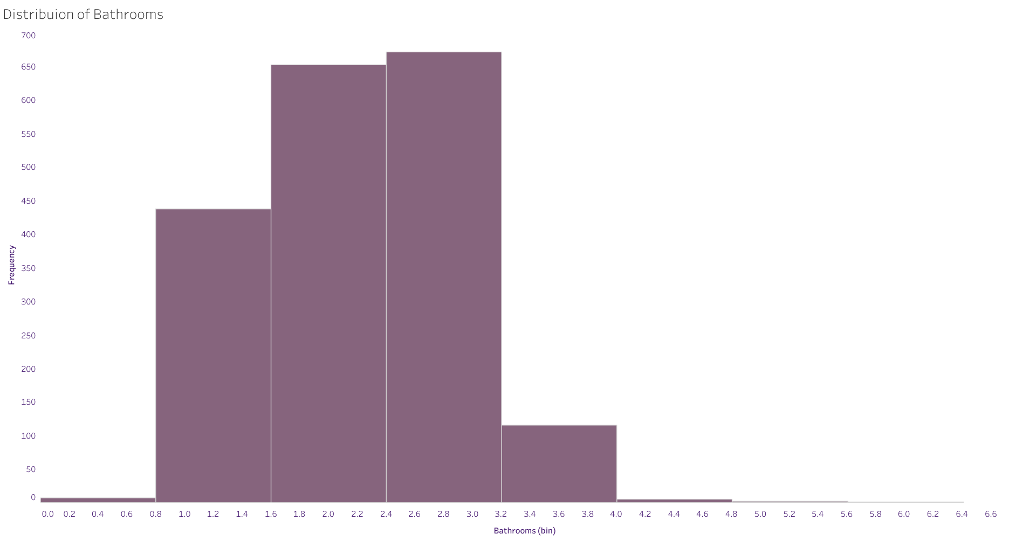

Slide 7
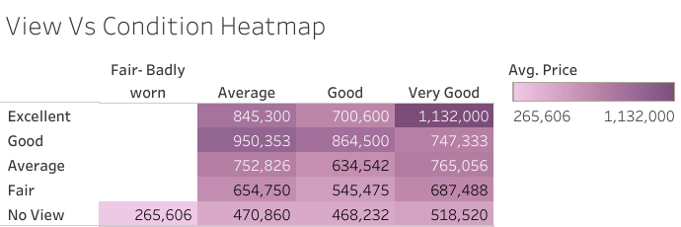

Slide 8


Slide 9
