Slide 1

Predictive Analytics for Optimizing Sanitaryware Retail
Ensuring Product Completeness and Pricing
By Jatin Kumar | xxxxxxxx | IITM BS (BDM Capstone)

Slide 2


PROJECT OVERVIEW
GOAL
Understand business issues and optimize operations
1
2
3
Analyze credit records
Study MRP changes
Identify inventory losses
40
Credit record
217
product’s
MRP details
61
product’s
Broken entries
DATA
OUTCOME
Major debt drivers + pricing misalignment + high-loss products identified

Slide 3





K***** A******* STORE
ABOUT STORE
OPERATIONS
CUSTOMER BASE
Retail sanitaryware store dealing in toilets, taps, showers, and related products.
Mix of cash and credit sales with daily transactions and manual record keeping.
Serves local households, contractors, and builders with repeat credit-based customers.
BUSINESS CHALLENGES
OBJECTIVE
High outstanding credit, Product’s price updates and losses from damaged products
Use data analysis to improve cash flow, pricing decisions, and reduce inventory losses

Slide 4
INVENTORY LOSSES
Identify key customers contributing to outstanding payments
CREDIT
MANAGEMENT
Customer balances, payment patterns
OUR
OBJECTIVE
Analyze impact of MRP changes
Old vs new MRP, pricing gaps
Identify high-loss products and damage patterns
Broken items, loss value
PRICING ANALYSIS

Slide 5


Methodology
DATA PREP
Cleaned raw records, removed duplicates, structured datasets
DATA prep
Explore
Exploratory Analysis
Google Sheet & Power BI – charts, summary tables
DESCRIPTIVE ANALYSIS
Customer summaries, MRP comparison, loss calculations
Insights
Describe
BUSINESS LENS
Focus on key drivers (high-debt customers, pricing gaps, loss-heavy products)

Slide 6
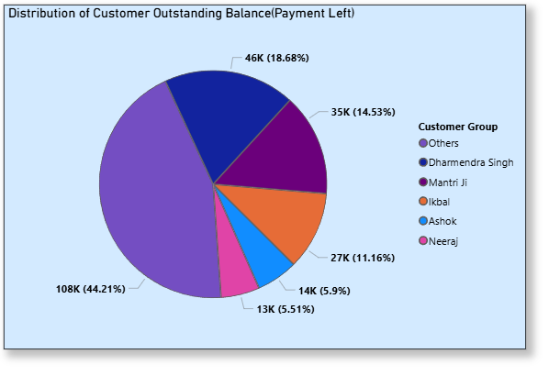
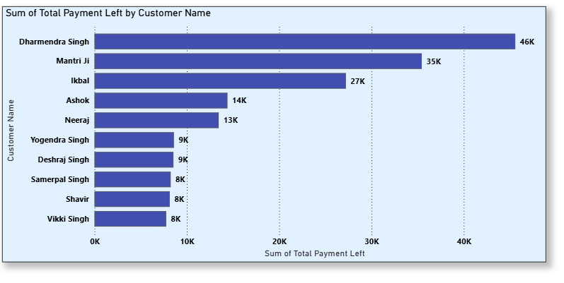
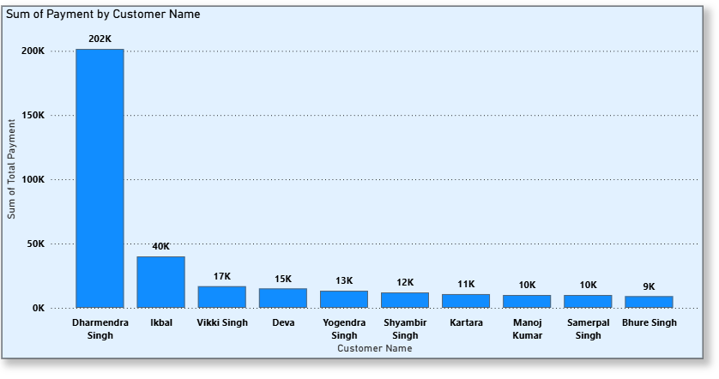
Credit customers analysis
Significant proportion of credit balance is hold by a few key customers
Top 10 customers with highest outstanding balance (dharmendra Singh and Mantri ji are identified as the major contributor to credit balance)
Top 10 customers with highest payment (dharmendra Singh and ikbal are the major contributor to the payment )

Slide 7
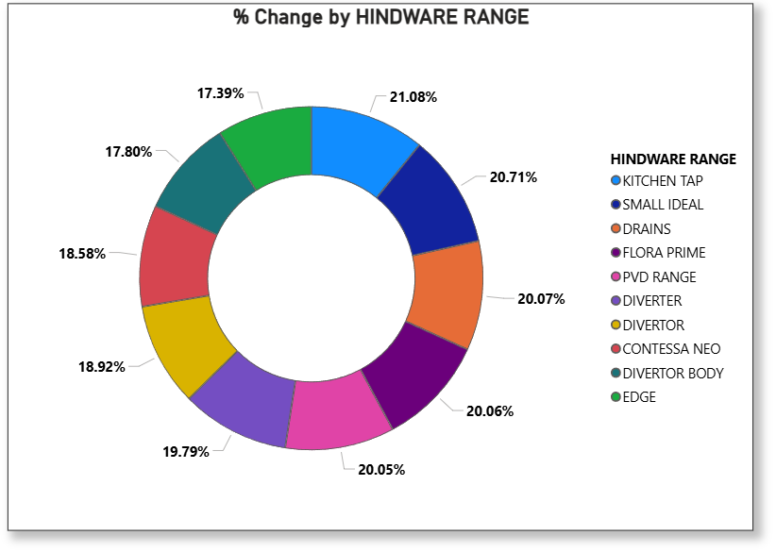
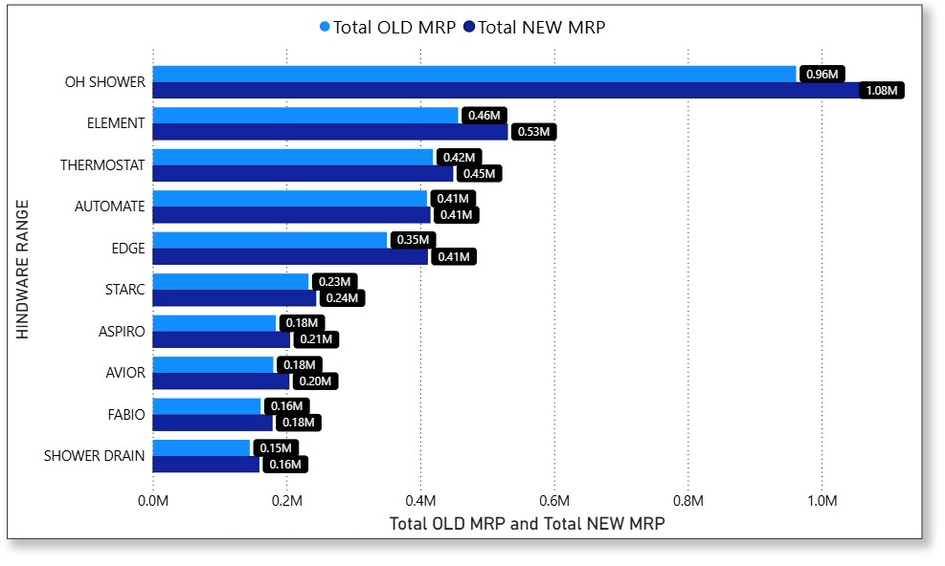
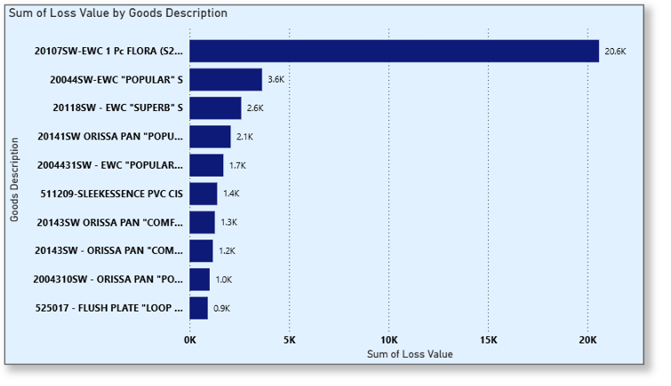
Product’s mrp and broken parts Analysis

Slide 8


Underneath PROBLEMs
SOLUTIONs by APPROACH
~55% debt concentrated in few customers
~9% pricing misaligned due
to MRP delays
~₹20K loss from single
product
Analyzed customer-wise outstanding balances using sorting and aggregation
Compared old vs new MRP to identify pricing gaps
Evaluated loss data to find high-loss products
Used charts (bar, pie, etc) to identify key contributors
Focused on high-impact customers and products for insights

Slide 9
RECOMMENDATIONS
CREDIT MANAGEMENT
PRICING IMPROVEMENT
LOSS REDUCTION
Align selling price with MRP, ensuring fair, competitive increase.
Focus on top regular categories (~21% price rise segments)
Identify affordable alternatives to price-increased products, retain originals, prevent revenue loss.
Prioritize top customers contributing ~55% of total debt
Focus on high defaulters (₹46K, ₹35K, ₹27K outstanding)
Set stricter credit limits for “Others” (44% spread debt)
  Target top loss product (~₹20K loss – FLORA S220)
  Focus on few items causing ~70–80% total losses
  Improve fragile item handling (EWC, Orissa pans) and negotiate insurance for costly breakages.

Slide 10
Conclusion
Align MRP, focus categories, retain alternatives
~55% debt concentrated in few customers
Target losses, improve handling, insure breakages
Data-driven decisions can improve cash flow, pricing efficiency, and reduce inventory losses
Data
Insights
Action
Clear identification of high-debt customers
Price misalignment across key product categories
Loss concentration in few high-risk products

Slide 11
Questions?

